Slide 1

CSCI 466: Networks
IP Addresses, IP Protocol, Subnets, NAT
Reese Pearsall Fall 2024
https://www.cs.montana.edu/pearsall/classes/fall2024/466/main.html
*All images are stolen from the internet
1

Slide 2
Announcements
No lecture on Friday
Wireshark Lab due tonight at 11:59 PM
Quiz 3 on Friday
Pipelining
TCP/UDP
Congestion Control
Network Layer, Routers, Forwarding
IP Addresses
Subnets, NAT

Slide 3

Application Layer
Presentation Layer
*
Application Layer
Session Layer
*
Messages from Network Applications
Transport Layer
Network Layer
Physical Layer
Data Link Layer
Bits being transmitted over a medium
Physical Layer
*In the textbook, they condense it to a 5-layer model,
but 7 layers is what is most used

Slide 4

Application Layer
Presentation Layer
*
Application Layer
Session Layer
*
Messages from Network Applications
Transport Layer
Network Layer
Physical Layer
Data Link Layer
Bits being transmitted over a medium
Physical Layer
*In the textbook, they condense it to a 5-layer model,
but 7 layers is what is most used

Slide 5

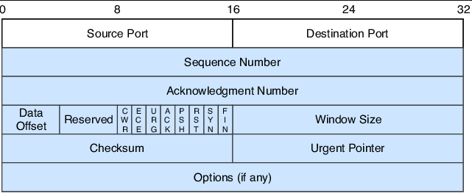
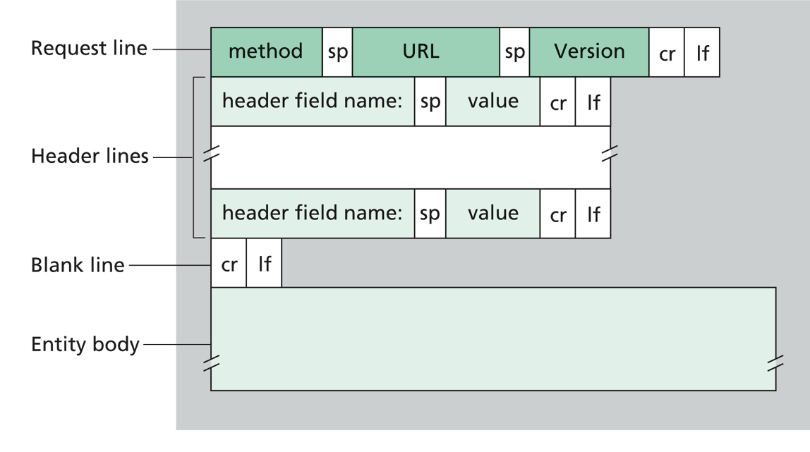
Application Layer
Our packet of information so far…
Transport Layer
“Segment”
Transport Layer Header
Message
Transport Layer Protocol
(ex. TCP)
Application Layer Protocol (ex. HTPP)

Slide 6
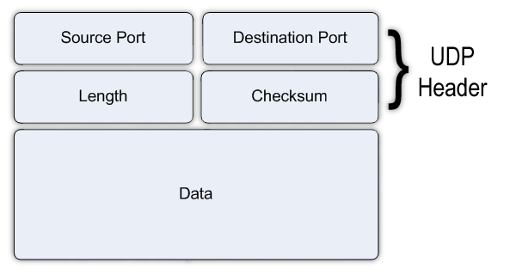
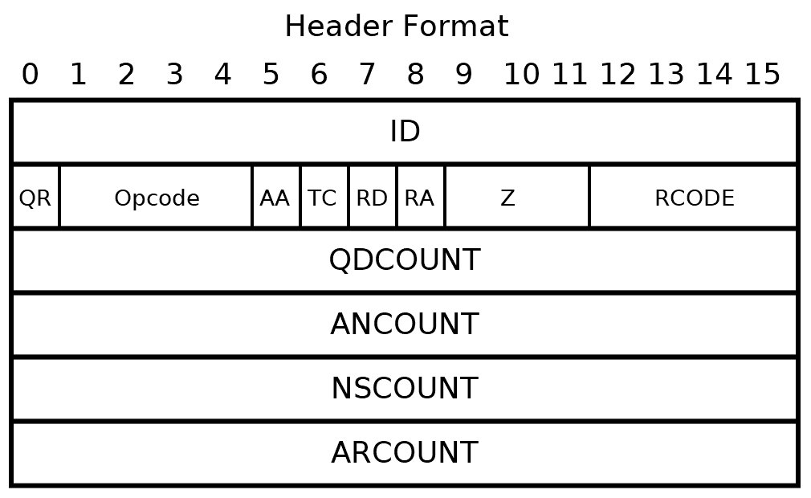
Application Layer
Our packet of information so far…
Transport Layer
“Segment”
Transport Layer Header
Message
Transport Layer Protocol
(ex. UDP)
Application Layer Protocol (ex. DNS)

Slide 7
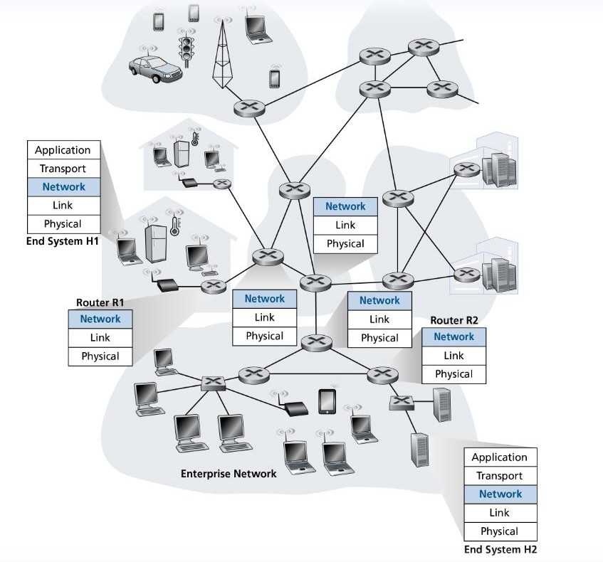
Routers do not have functionality for application & transport layer protocols

Slide 8

We will now shift our focus towards routers, or packet switches
Routing: determine route taken by packets from source to destination
There is likely very many paths from one host to another! Which is the most efficient path?

Slide 9
We will now shift our focus towards routers, or packet switches
?
?
?
Which path should be taken?
Forwarding: move packets from router’s input to appropriate router output

Slide 10






Network Layer
Responsible for the delivery of data through a network
Forwarding
Routing

Slide 11
Forwarding Techniques
Longest prefix matching
Address range | Interface (output link)
11001000 00010111 00010*** ********* | 1
11001000 00010111 00011000 ********* | 2
11001000 00010111 00011*** ******** | 3
otherwise | 4
Lookup, forwarding, queueing
…
…
when looking for forwarding table entry for given destination address, use longest address prefix that matches destination address
examples:
DA: 11001000 00010111 000
10110 10100001
which interface? which interface?
DA: 11001000 00010111 000
11000 10101010

Slide 12

IP addressing, IPv4, and IPv6
https://www.rfc-editor.org/rfc/rfc791

Slide 13
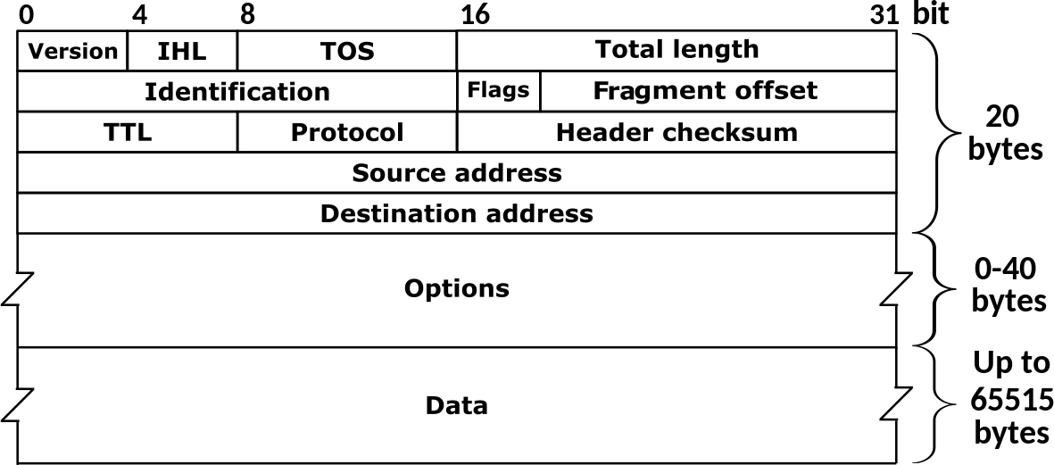
IPv4: 32-bit addresses (decimal)
Packets traversing through the network layer are referred to as a datagram. Each packet gets an IPv4/IPv6 header
192.149.252.76
IPv6: 128-bit addresses (hexademical)
3ffe:1900:fe21:4545::
Transport Layer Header
IP Header
Message
Transport
Layer Header
Message
Why do we need IPv6?
IPv4 Header

Slide 14
Packets traversing through the network layer are referred to as a datagram. Each packet gets an IPv4/IPv6 header
Transport Layer Header
IP Header
Message
Transport
Layer Header
TCP header = 20 bytes IP header = 20 bytes
Message
IPv4 Header

Slide 15
IP Address: Globally unique* 32 bit (4 byte) dotted decimal number assigned to interfaces on hosts and routers
193.32.216.9

Slide 16

IP Address: Globally unique* 32 bit (4 byte) dotted decimal number assigned to interfaces on hosts and routers
(1 byte = 8 bits)
193.32.216.9
1 bytes
1 bytes 1 bytes
1 bytes
128 | 64 | 32 | 16 | 8 | 4 | 2 | 1
1 | 1 | 0 | 0 | 0 | 0 | 0 | 1
128 + 64 + 1 = 193
193 = 11000001 in binary

Slide 17
IP Address: Globally unique* 32 bit (4 byte) dotted decimal number assigned to interfaces on hosts and routers
(1 byte = 8 bits)
193.32.216.9
=
11000001 00100000 11011000 00001001
How many addresses are possible with a 32 bit number? ~4 billion possible IPv4 addresses

Slide 18
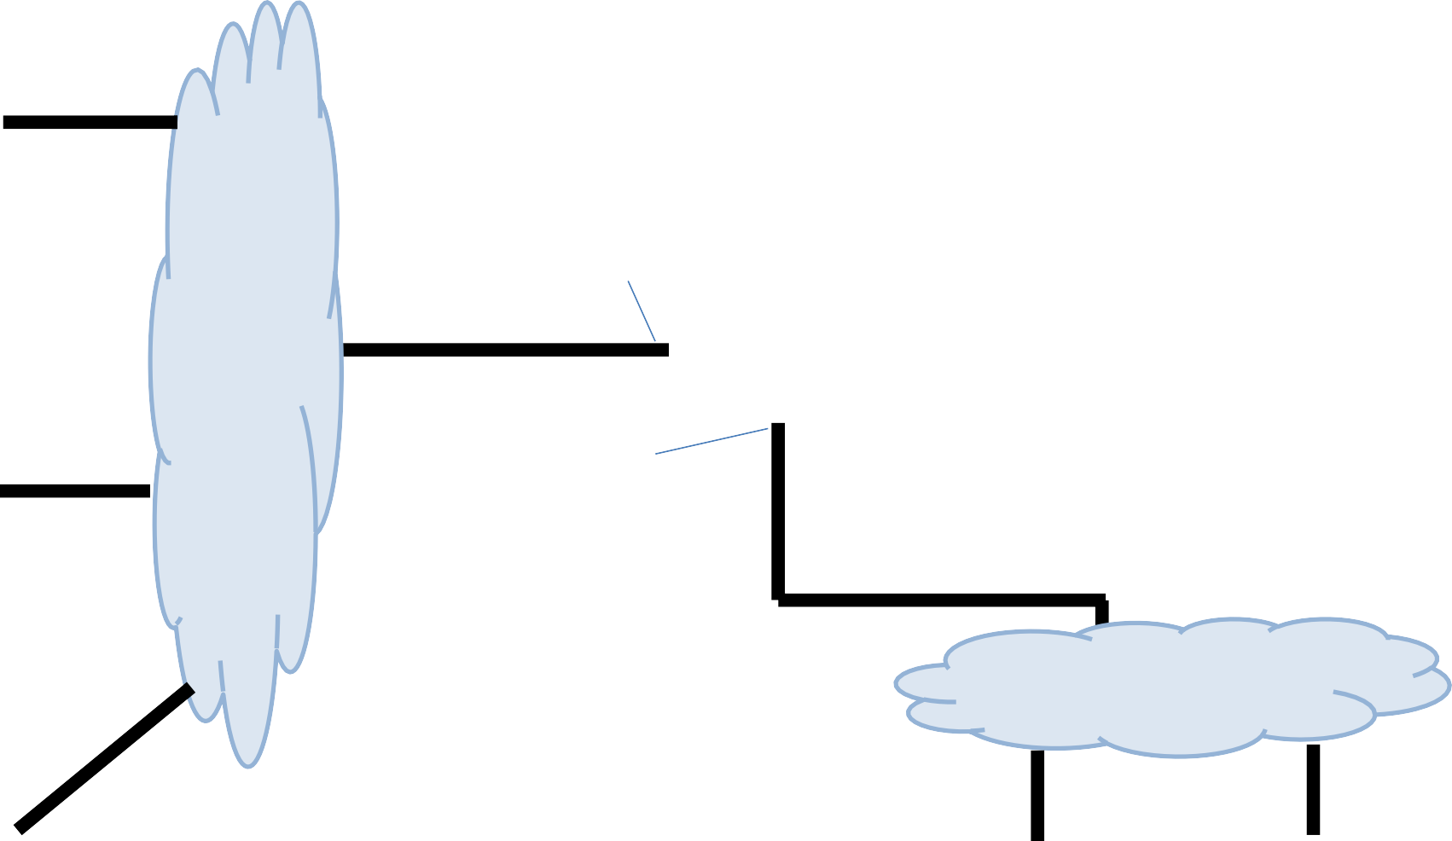
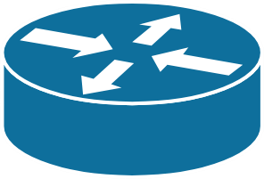
223.1.2.1
Subnet is a logical subdivision of an IP network
223.1.1.1
223.1.1.4
223.1.2.9
223.1.2.2
223.1.3.27
223.1.1.2
223.1.1.3
223.1.3.1
223.1.3.2

Slide 19
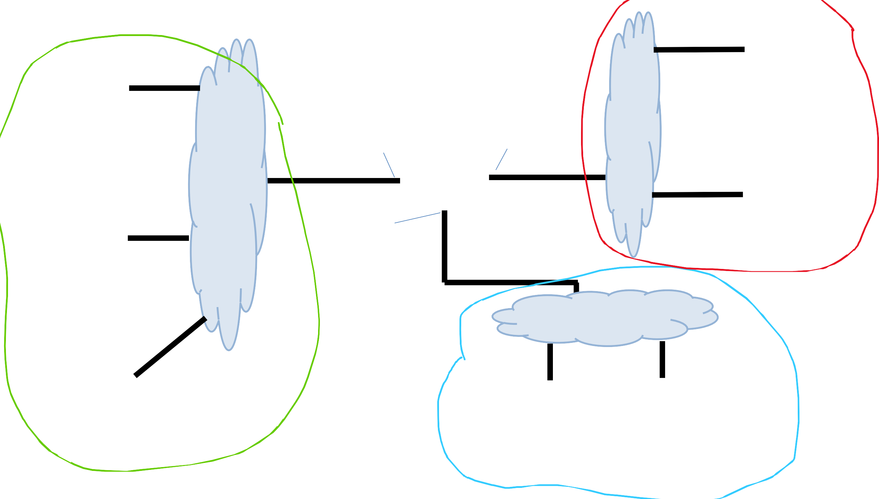
223.1.2.1
Subnet is a logical subdivision of an IP network In this network, we have 3 subnets
223.1.1.1
223.1.1.4
223.1.2.9
223.1.2.2
223.1.3.27
223.1.1.2
223.1.1.3
223.1.3.1
223.1.3.2

Slide 20
Subnet is a logical subdivision of an IP network In this network, we have 3 subnets
Computers usually have 1
interface. Routers have many
223.1.2.1
223.1.1.1
223.1.1.4
223.1.2.9
223.1.2.2
223.1.3.27
223.1.1.2
Devices usually have a private IP address, and a public IP address
IP addresses on the same subnet share a common prefix
Hosts on the same subnet can reach each other without going through a router
223.1.1.3
223.1.3.1
223.1.3.2
38

Slide 21

It is very common to have a range of IP addresses assigned to you (random assignment would be chaos)
Subnet mask
223.1.1.0/24
The leftmost 24 bits represent the prefix of the subnet
11111111 11111111 11111111 XXXXXXXX = 255.255.255.0
223.1.1.1
223.1.1.67
223.2.1.67
223.2.1.255
223.1.1.2
…
193.32.216.9
Network bits
Host bits
223.1.1.253
11000001 00100000 11011000 00001001

Slide 22
Computers usually have 1
interface. Routers have many
Subnet is a logical subdivision of an IP network In this network, we have 3 subnets
223.1.1.0/24 223.1.2.0/24
223.1.3.0/24

Slide 23
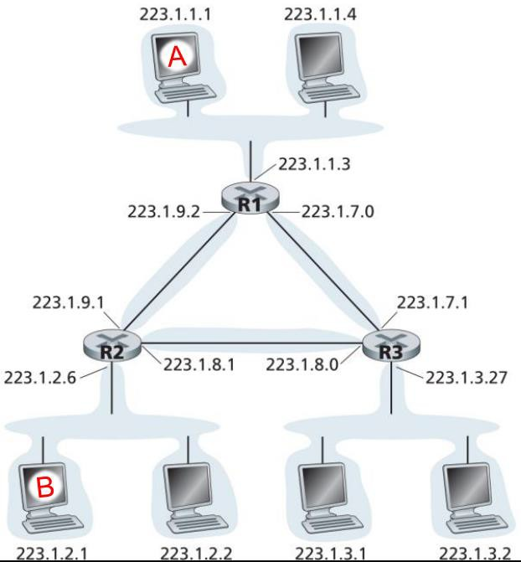





6 subnets
1. 223.1.1.0/24
2. 223.1.7.0/24
3. 223.1.3.0/24
4. 223.1.8.0/24
5. 223.1.2.0/24
6. 223.1.9.0/23

Slide 24
223.1.1.0/24
Managing and Assigning Subnets
The subnet
contains the following addresses
223.1.1.1
223.1.1.2
223.1.1.3
223.1.1.4
223.1.1.5
…
223.1.1.252
223.1.1.253
223.1.1.254
How many addresses does a /24 subnet provide?
0 and 255 are reserved for special services (?)

Slide 25
223.1.1.0/24
Managing and Assigning Subnets
The subnet
contains the following addresses
223.1.1.1
223.1.1.2
223.1.1.3
223.1.1.4
223.1.1.5
…
223.1.1.252
223.1.1.253
223.1.1.254
How many addresses does a /24 subnet provide?
2^8 – 2 = 253
Class C network
0 and 255 are reserved for special services (?)

Slide 26
Managing and Assigning Subnets
Subnet Type | Slash | Subnet Mask | Available Addresses
Class A | /8 | 255.0.0.0 | 2^24 – 2 = 16777216
Class B | /16 | 255.255.0.0 | 2^16 – 2 = 65,634
Class C | /24 | 255.255.255.0 | 2^8 – 2 = 254
Issues with this type of assignment?

Slide 27
Managing and Assigning Subnets
Subnet Type | Slash | Subnet Mask | Available Addresses
Class A | /8 | 255.0.0.0 | 2^24 – 2 = 16777216
Class B | /16 | 255.255.0.0 | 2^16 – 2 = 65,634
Class C | /24 | 255.255.255.0 | 2^8 – 2 = 254
If I have 2000 devices, I will either need 8 class C subnets or 1 class B
subnet (but waste 63,000ish IP addresses)
We need a better way to subnet!

Slide 28
Managing and Assigning Subnets
Our only available subnet masks have been:
255.255.255.0 | 11111111 11111111 11111111 00000000
255.255.0.0 | 11111111 11111111 00000000 00000000
255.0.0.0 | 11111111 00000000 00000000 00000000
/24
/16
/8
CIDR introduces a more flexible way for subnetting We can any number of bits for our mask
Host bits!
200.23.16.0/20 = 11001000.00010111.00010000.00000000
Mask = 11111111.11111111.11110000.00000000

Slide 29
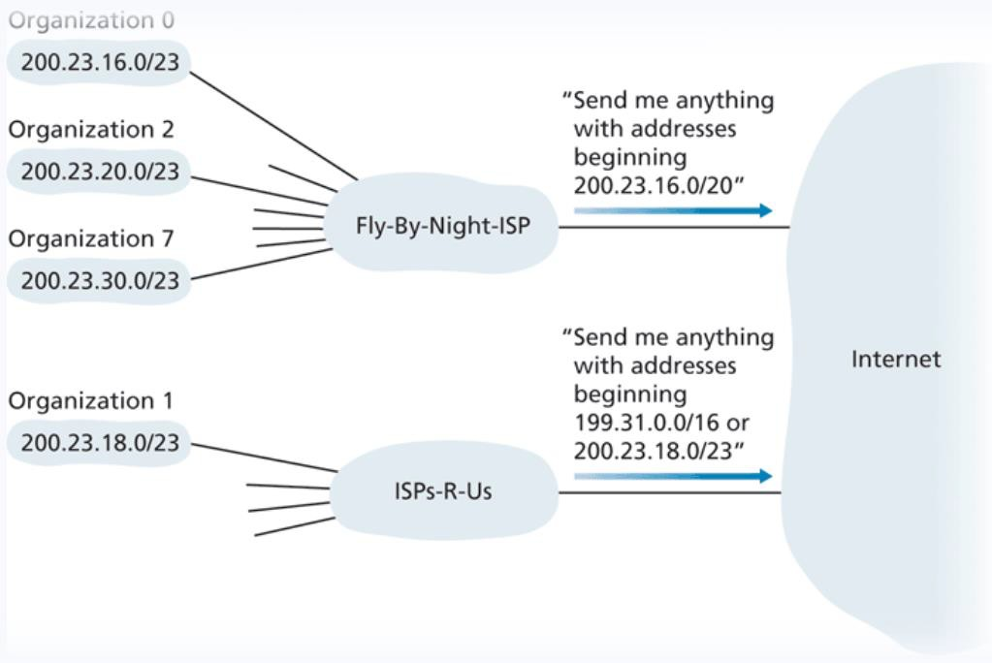
ISPs can now group and advertise organizations by IP blocks
We once again have another hierarchy ☺

Slide 30
One possible way an ISP could organize IP blocks
ISP’s block | 200.23.16.0/20 | 11001000 00010111 00010000 00000000
Organization 0 | 200.23.16.0/23 | 11001000 00010111 00010000 00000000
Organization 1 | 200.23.18.0/23 | 11001000 00010111 00010010 00000000
Organization 2 | 200.23.20.0/23 | 11001000 00010111 00010100 00000000
…
Organization 7 | 200.23.30.0.23 | 11001000 00010111 00011110 00000000

Slide 31
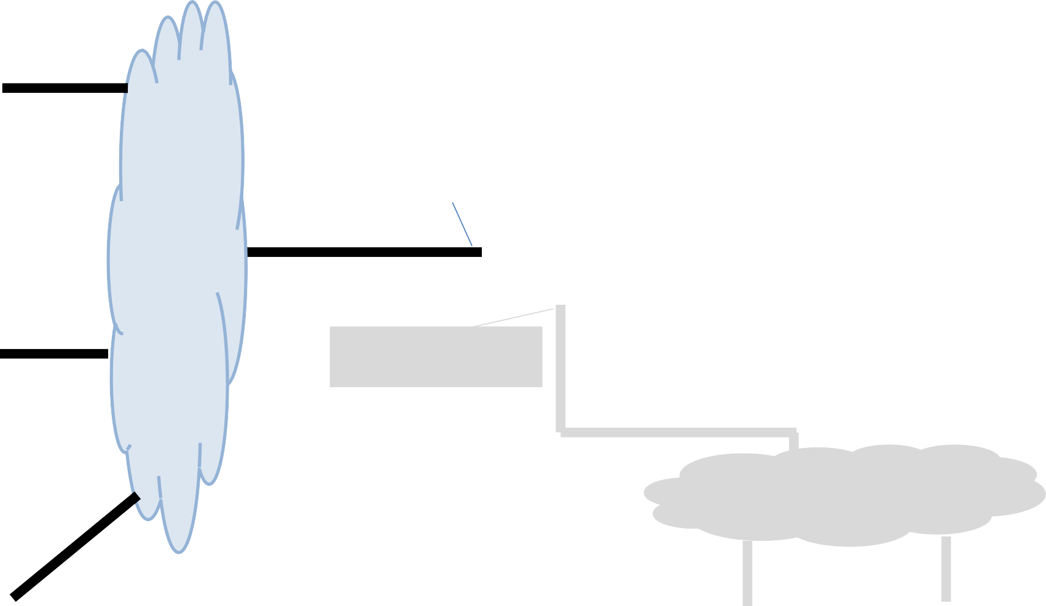
Devices on the same subnet communicate with each other by broadcasting a special message
This special message is when the source IP address of some packet is 255.255.255.255
223.1.1.4
223.1.1.1
223.1.3.27
223.1.1.2
223.1.1.3
223.1.3.1
223.1.3.2

Slide 32
Devices on the same subnet communicate with each other by broadcasting a special message
255.255.255.255
This special message is when the source IP address of some packet is 255.255.255.255
223.1.1.1
223.1.1.4
(This request can sometimes be echoed to
neighboring subnets)
223.1.3.27
223.1.1.2
223.1.1.3
223.1.3.1
223.1.3.2

Slide 33
A subnet mask can be used to reveal which bits are the host bits

Slide 34
A subnet mask can be used to reveal which bits are the host bits
172.16.1.0
10101100.00010000.00000001.00000000
255.255.0.0
11111111.11111111.00000000.00000000

Slide 35
A subnet mask can be used to reveal which bits are the host bits
172.16.1.0
10101100.00010000.00000001.00000000
255.255.0.0
11111111.11111111.00000000.00000000

Slide 36
A subnet mask can be used to reveal which bits are the host bits
172.16.1.0
10101100.00010000.00000001.00000000
255.255.0.0
11111111.11111111.00000000.00000000
The last two octets do not match 1s, so they are the host bits

Slide 37
A subnet mask can be used to reveal which bits are the host bits
172.16.1.0
10101100.00010000.00000001.00000000
255.255.0.0
11111111.11111111.00000000.00000000
The last two octets do not match 1s, so they are the host bits
This IP address would fall under the range of:
172.16.0.0 /16

Slide 38
A subnet mask can be used to reveal which bits are the host bits
172.16.1.0
10101100.00010000.00000001.00000000
255.255.224.0
11111111.11111111.11100000.00000000

Slide 39
A subnet mask can be used to reveal which bits are the host bits
172.16.1.0
10101100.00010000.00000001.00000000
255.255.224.0
11111111.11111111.11100000.00000000
The last 13 bits are the host bits, the first 19 bits are the network bits

Slide 40
A subnet mask can be used to reveal which bits are the host bits
172.16.1.0
10101100.00010000.00000001.00000000
255.255.224.0
11111111.11111111.11100000.00000000
The last 13 bits are the host bits, the first 19 bits are the network bits
This IP address would fall under the range of
172.16.0.0/19
CIDR

Slide 41
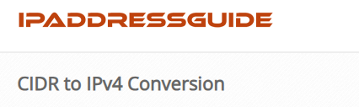
A subnet mask can be used to reveal which bits are the host bits
172.16.1.0
10101100.00010000.00000001.00000000
255.255.224.0
11111111.11111111.11100000.00000000
The last 13 bits are the host bits, the first 19 bits are the network bits
This IP address would fall under the range of
172.16.0.0/19
CIDR

Slide 42
A subnet mask can be used to reveal which bits are the host bits
CIDR
172.0.0.0/9
Subnet Mask?

Slide 43
A subnet mask can be used to reveal which bits are the host bits
CIDR
172.0.0.0/9
Subnet Mask?
11111111.10000000.00000000.00000000

Slide 44
A subnet mask can be used to reveal which bits are the host bits
CIDR
172.0.0.0/9
Subnet Mask?
11111111.10000000.00000000.00000000
255.128.0.0

Slide 45

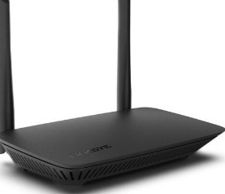


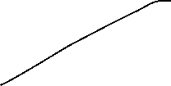




















One Subnet

Slide 46












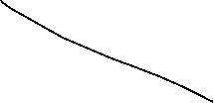
















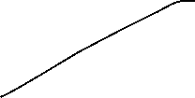




When communicating on a subnet, the message gets broadcasted to every device on the network

Slide 47











If there are many devices on a subnet, then this might cause some problems (congestion, lag, delay)

Slide 48

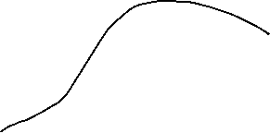



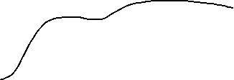



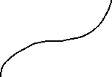










Six Subnets

Slide 49
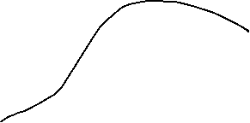






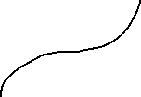















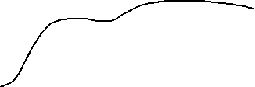

Six Subnets

Slide 50
Suppose that a packet needs to be sent to another subnet

Slide 51









We broadcast to our subnet, but we won’t find our destination

Slide 52
So, the packet will get sent to the default gateway, which is typically the router

Slide 53



And the router will send it the correct subnet

Slide 54
Subnets
Suppose we have a class c network
X.X.X.0/24
Subnet Mask
11111111.11111111.11111111.00000000

Slide 55
Subnets
Suppose we have a class c network
X.X.X.0/24
Subnet Mask
11111111.11111111.11111111.00000000
1 network with 253* hosts
What if we wanted to divide this network into multiple subnets?

Slide 56
Subnets
Suppose we have a class c network
X.X.X.0/24
Subnet Mask
11111111.11111111.11111111.00000000
1 network with 253* hosts
What if we wanted to divide this network into multiple subnets?
We sacrifice one of our host bits, and give it to the network bits

Slide 57
Subnets
Suppose we have a class c network
X.X.X.0/24
Subnet Mask
11111111.11111111.11111111.00000000
1 network with 253* hosts
What if we wanted to divide this network into multiple subnets?
We sacrifice one of our host bits, and give it to the network bits
Subnet 1:
11111111.11111111.11111111.00000000
Subnet 2:
11111111.11111111.11111111.10000000
2 Networks with 126 hosts

Slide 58
Subnets
Suppose we have a class c network
X.X.X.0/24
Subnet Mask
11111111.11111111.11111111.00000000
1 network with 253* hosts
What if we wanted to divide this network into multiple subnets?
We sacrifice one of our host bits, and give it to the network bits
Subnet 1:
11111111.11111111.11111111.00000000
Subnet 2:
11111111.11111111.11111111.10000000
Subnet 3:
11111111.11111111.11111111.01000000
Subnet 4:
11111111.11111111.11111111.11000000
4 Networks with 62 hosts

Slide 59
Subnets
Suppose we have a class c network
X.X.X.0/24
Subnet Mask
11111111.11111111.11111111.00000000
1 network with 253* hosts
What if we wanted to divide this network into four subnets?
We sacrifice one of our host bits, and give it to the network bits
Subnet 1:
11111111.11111111.11111111.00000000
Subnet 2:
11111111.11111111.11111111.10000000
Subnet 3:
11111111.11111111.11111111.01000000
Subnet 4:
11111111.11111111.11111111.11000000
4 Networks with 62 hosts

Slide 60
Subnets
Suppose we have a class c network
X.X.X.0/24
Subnet Mask
11111111.11111111.11111111.00000000
1 network with 253* hosts
What if we wanted to divide this network into four subnets?
We sacrifice one of our host bits, and give it to the network bits
New Subnet Mask
11111111.11111111.11111111.11000000
255.255.255.192

Slide 61
Issue: IPv4 can only support ~4 billion devices
If every device on the internet gets an IP address, we are going to run out of IP addresses to use

Slide 62
Issue: IPv4 can only support ~4 billion devices
If every device on the internet gets an IP address, we are going to run out of IP addresses to use
Solution: IPv6 (This will take awhile to implement and switch to)
Temporary Solution: Public IP addresses, Private IP addresses, NAT

Slide 63




Every device needs an IP address of some kind…
The Internet

Slide 64




Every device needs an IP address of some kind…
We could give every device a public IP address (public registered), but this would be expensive, and a waste of IPv4 addresses
The Internet

Slide 65
Every device needs an IP address of some kind…
We could give every device a public IP address (public registered), but this would be expensive, and a waste of IPv4 addresses
Your ISP will assign your router/modem a public IP address
The Internet
12.234.56.78

Slide 66
Your router will assign private IP addresses to each device via DHCP
Private IP addresses are only used internally, they are not seen by the “outside world”
Private IP addresses typically have a common prefix
192.168.0.1
The Internet
192.168.0.2
12.234.56.78
10.x.x.x
172.x.x.x
192.168.x.x
192.168.0.3

Slide 67
Issue: When receiving a packet with our public IP address, we need to convert to our private IP address to ensure it gets delivered to the correct host
(and vice versa)
192.168.0.1
The Internet
DST: 12.234.56.78
192.168.0.2
12.234.56.78
192.168.0.3

Slide 68
NAT (network address translation) is what translates a set of IP addresses to another set of IP addresses (Public ←→ Private)
192.168.0.1
The Internet
192.168.0.2
12.234.56.78
192.168.0.3

Slide 69


NAT (network address translation) is what translates a set of IP addresses to another set of IP addresses (Public ←→ Private)
DST: 192.168.0.1
192.168.0.1
The Internet
NAT
DST: 12.234.56.78
192.168.0.2
12.234.56.78
192.168.0.3

Slide 70


NAT (network address translation) is what translates a set of IP addresses to another set of IP addresses (Public ←→ Private)
SRC: 192.168.0.1
192.168.0.1
The Internet
NAT
SRC: 12.234.56.78
192.168.0.2
12.234.56.78
192.168.0.3

Slide 71







Because private IP addresses are only used internally within a subnet, devices on the internet can have the same private IP address (which is fine!)
192.168.0.1
The Internet
192.168.0.2
12.234.56.78
192.168.0.3
56.131.23.89
Devices on the same subnet should not have same private IP addresses
192.168.0.6
192.168.0.1
192.168.0.5

Slide 72




The Internet
12.234.56.78
192.168.0.1
192.168.0.2
192.168.0.3
192.168.0.4
192.168.0.5

Slide 73




The Internet
12.234.56.78
192.168.0.1
192.168.0.2
Suppose a host is doing something malicious on some website
192.168.0.3
The website might decide to block their IP address
192.168.0.4
192.168.0.5

Slide 74
The Internet
12.234.56.78
192.168.0.1
192.168.0.2
Suppose a host is doing something malicious on some website
192.168.0.3
The website might decide to block their IP address
However, from their perspective, their IP address is 12.234.56.78
192.168.0.4
192.168.0.5

Slide 75
The Internet
12.234.56.78
192.168.0.1
192.168.0.2
Suppose a host is doing something malicious on some website
192.168.0.3
The website might decide to block their IP address
However, from their perspective, their IP address is 12.234.56.78
So, they block the IP address 12.234.56.78
192.168.0.4
192.168.0.5

Slide 76










The Internet
12.234.56.78
192.168.0.1
192.168.0.2
Suppose a host is doing something malicious on some website
192.168.0.3
The website might decide to block their IP address
However, from their perspective, their IP address is 12.234.56.78
So, they block the IP address 12.234.56.78
Because this public IP address is shared by several hosts, all the other hosts also get blocked
192.168.0.4
192.168.0.5

Slide 77
How do IPs get obtained/assigned?
The Internet Corporation for Assigned Names and Numbers (ICANN) is responsible for managing and allocating IP address space for ISPs and organizations
(they also manage the DNS root servers!)
When an organization gets a range of IP addresses to use, how to we give assign them to devices?
Do we do it manually?
we could….

Slide 78
DHCP
Dynamic Host Configuration Protocol (DHCP) is a plug-and-play, client-server protocol that allows a host to obtain an IP address automatically
When a host is automatically assigned an IP address, it might keep that one forever, or the IP addresses can be temporary
(more common)

Slide 79
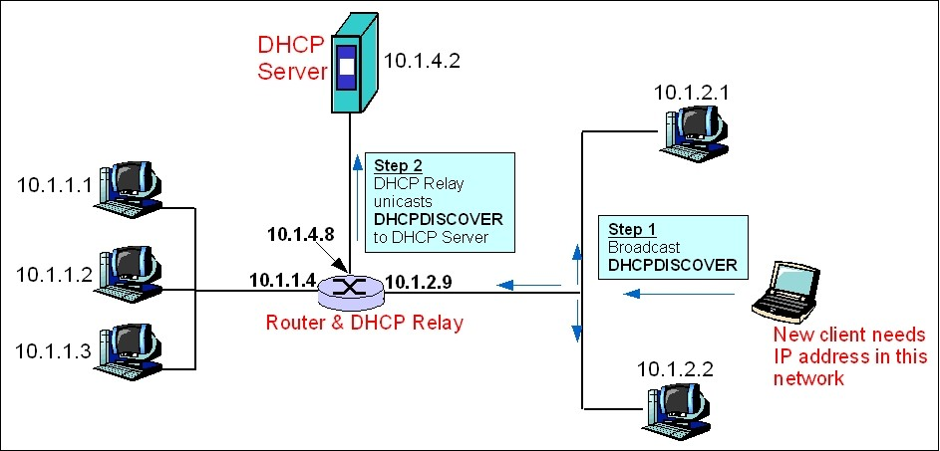

This process is similar to a TCP handshake!
Broadcast gets sent to all devices on the subnet!!
But devices that are not the dhcp server will ignore it

Slide 80
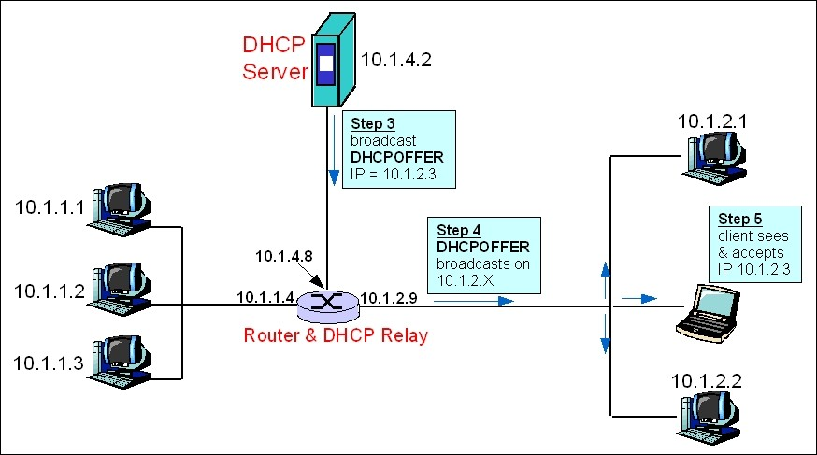
This process is similar to a TCP handshake!

Slide 81
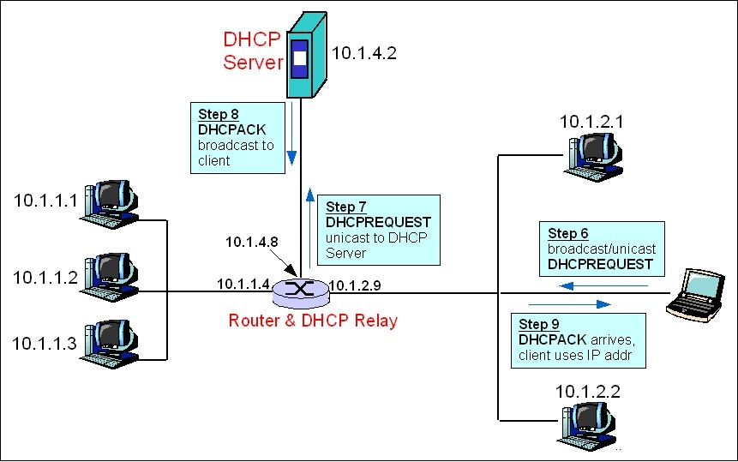
This process is similar to a TCP handshake!

Slide 82
IP/DHCP in Wireshark

