Slide 1

CSCI 476: Computer Security
Set-UID and Environment Variables (Part 2)
Reese Pearsall
Fall 2024
*all images are stolen from the internet
https://www.cs.montana.edu/pearsall/classes/fall2024/476/main.html

Slide 2

Announcements
Lab 1 posted. Due on Sunday September 22nd.
→ After today, you will be able to complete it
-rwx
Cybersecurity CTF club meets Fridays @ 2:00 – 3:00 PM in NAH 331
https://learn2ctf.org/
-rws

Slide 3
Set-UID In a Nutshell
Set-UID allows a user to run a program with the program owner’s privilege
User runs a program w/ temporarily elevated privileges
Created to deal with inflexibilities of UNIX access control
Example: The passwd program

Slide 4
RUID vs EUID
Real User ID (RUID) and Effective User ID (EUID) are values that are tracked by OS for each process. These IDs are used for access control decisions
ex. Should this process be allowed to do _____ ?
RUID refers to the user that created the process
ex. A normal user running ./hello_world, the RUID == seed
EUID refers to the current privilege of the process, and is used for most permission checks
ex. A normal user running ./hello_world, the EUID == seed

Slide 5
RUID vs EUID
RUID refers to the user that created the process
EUID refers to the current privilege of the process, and is used for most permission checks
When running a process, generally RUID and EUID will be the same
However, when the process is a Set UID program, the EUID now becomes the owner of the program, which will typically be root (now RUID != EUID)

Slide 6
RUID vs EUID
RUID refers to the user that created the process
EUID refers to the current privilege of the process, and is used for most permission checks
However, when the process is a Set UID program, the EUID now becomes the owner of the program, which will typically be root (now RUID != EUID)
There are shell countermeasures (/bin/dash) that prevents a process from doing things when it detects that the RUID != EUID, which is why we must disable the countermeasure before starting the lab
sudo ln –sf /bin/zsh /bin/sh

Slide 7
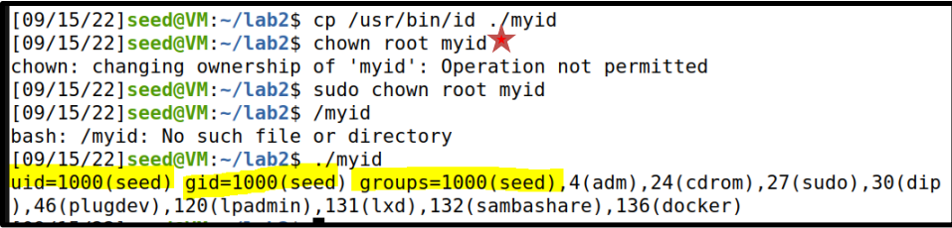
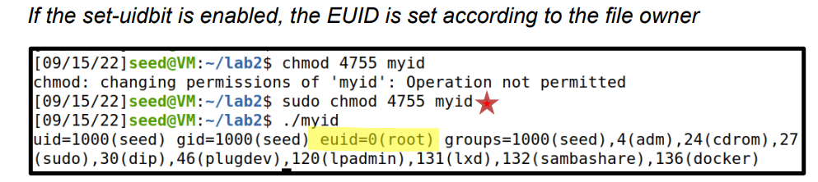
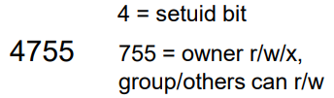
A Set-UID program is just like any other program, except that is has a special bit set
Steps for creating a set-uid program
Change file ownership to root (chown)
2. Enable to Set-uid bit (chmod)
Access control decisions made based on EUID, not RUID !

Slide 8
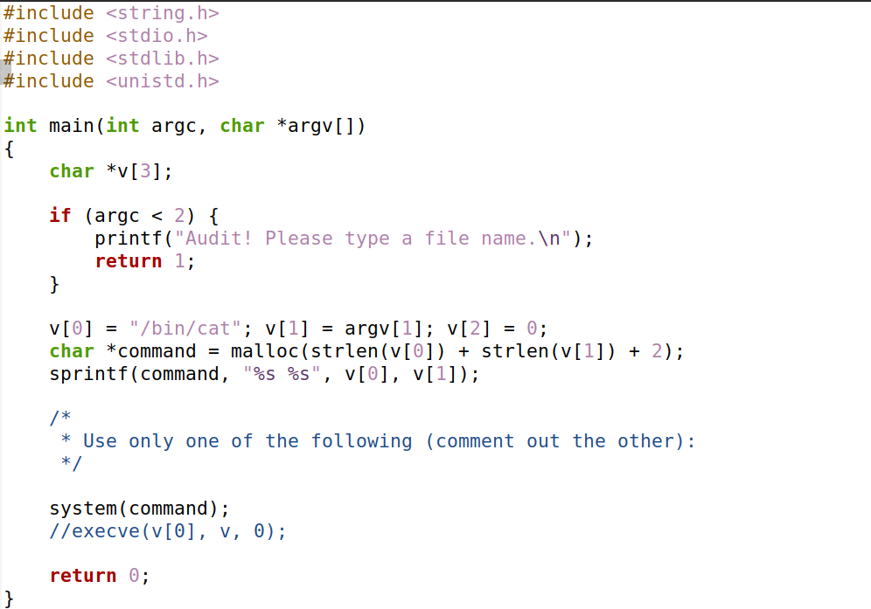
catall.c
The command line argument (file path) is appended to the string “/bin/cat”
Spawns a new process that executes:
/bin/cat [FILE_PATH]
ex. /bin/cat my_file.txt

Slide 9
Suppose you are preparing for an audit. An auditor may need the access to view certain files.
Instead of giving them total access to everything on the system, we will create a privileged program that will the auditor view the content of some file
Set-UID program name
Name of file the auditor will view
./audit company_data.csv
./audit ../lab0/solution.docx
/bin/cat company_data.csv
/bin/cat ../lab0/solution.docx

Slide 10
system() is a very unsafe function
We can exploit this by maliciously constructing the input to this program
Hint: the string passed to system() can include multiple commands

Slide 11
system() is a very unsafe function
We can exploit this by maliciously constructing the input to this program
Hint: the string passed to system() can include multiple commands
./audit “my_info.txt; /bin/sh”

Slide 12
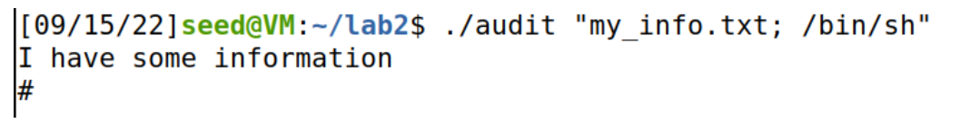
./audit “my_info.txt; /bin/sh”
system(/bin/cat my_info.txt; /bin/sh)
system() interprets this as two separate commands

Slide 13




./audit “my_info.txt; /bin/sh”
system(/bin/cat my_info.txt; /bin/sh)
system() interprets this as two separate commands

Slide 14
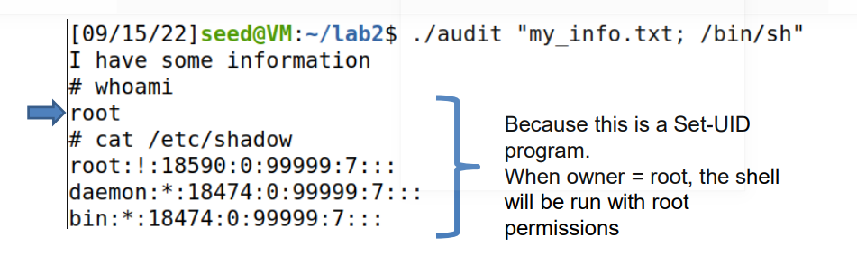

./audit “my_info.txt; /bin/sh”
system(/bin/cat my_info.txt; /bin/sh)

Slide 15
./audit “my_info.txt; /bin/sh”
system(/bin/cat my_info.txt; /bin/sh)
We have gained access into the system

Slide 16

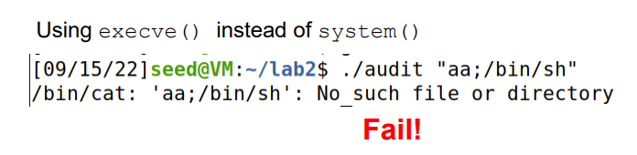
A safer way to invoke programs
int execve(const char *pathname, char *const argv[], char *const envp[]);
execve() executes the program referred to by pathname.
argv[] is the command line arguments for the command

Slide 17
A safer way to invoke programs
int execve(const char *pathname, char *const argv[], char *const envp[]);
execve() executes the program referred to by pathname.
argv[] is the command line arguments for the command
execve(“/bin/cat”,[“aa;/bin/sh”])
/bin/cat “aa;/bin/sh”
Treated as an entire argument to the command
Fail!

Slide 18

The ability (and risks) of invoking external commands is not limited to C
Python has a system call
Perl has open()
PHP has system

Slide 19
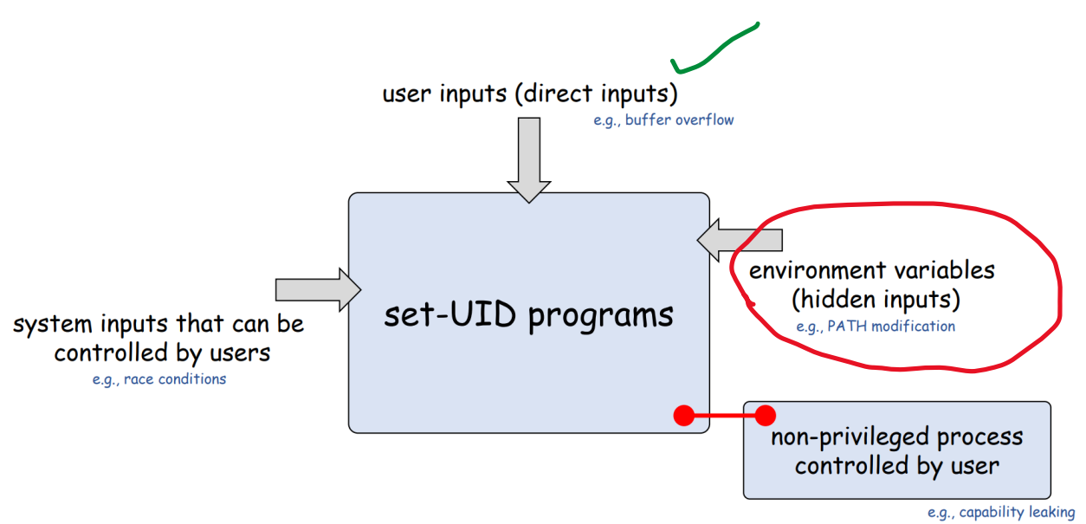

Slide 20
Environment variable are a set of dynamic named values that affect the way a running process will behave (key-value pairs)
Example: The PATH variable
• We use command such as ls and passwd
We could be in any directory.
How does it know to run /bin/ls ?

Slide 21
Environment variable are a set of dynamic named values that affect the way a running process will behave (key-value pairs)
Example: The PATH variable
• We use command such as ls and passwd
We could be in any directory.
How does it know to run /bin/ls ?
If the full path is not provided, the shell process will use the PATH env. variable to search for it!
Tells the OS to look for the ls program in /usr/local/bin

Slide 22
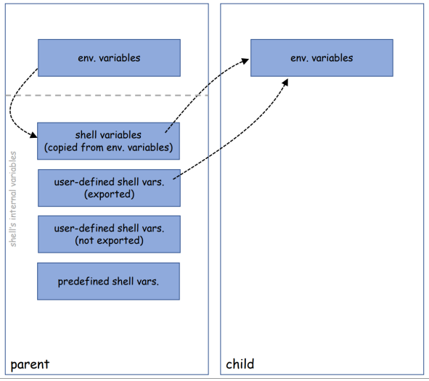
Where do environment variables come from?
Processes can get environment variables in one of two ways:
fork() → the child process inherits its parent process’s environment variables.
exec() → the memory space is overwritten, and all old environment variables are lost.
However, execve()can explicitly pass environment variables from one process to another

Slide 23
Creating our own environment variables
(Task 1 on Lab 1)
We can define our own environment variables using the export command
env var name
value

Slide 24
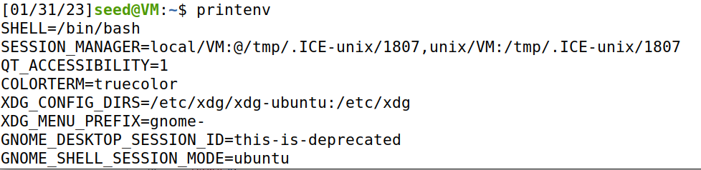
Creating our own environment variables
(Task 1 on Lab 1)
We can define our own environment variables using the export command
We can use printenv to print out all the environment variables on the system

Slide 25
Creating our own environment variables
(Task 1 on Lab 1)
We can define our own environment variables using the export command
We can use printenv to print out all the environment variables on the system
There are a lot of environment variables, so we can combine printenv with the grep command to find out specific environment variables

Slide 26
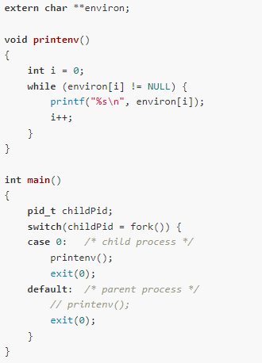
Demo: Seeing environment variables in a parent and child process
Do all environment variables get inherited by the child process?
(Task 2 on Lab 1)
myprintenv.c

Slide 27
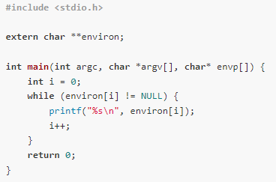
Experiment: Do all environment variables get inherited by SET-UID programs?
PATH ?
LD_LIBRARY_PATH ?
MYVAR ?
myenv_environ.c
(Task 3 on lab 1)

Slide 28
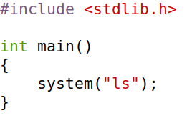
Exploiting a Set-UID program with environment variables
(Task 5 on lab 1)
This program uses the system() command to run the ls program
However, this program does not use the absolute path of the ls program (/bin/ls)

Slide 29
Exploiting a Set-UID program with environment variables
(Task 5 on lab 1)
This program uses the system() command to run the ls program
However, this program does not use the absolute path of the ls program (/bin/ls)
… which means it will use the PATH environment variable to locate the ls program

Slide 30
Exploiting a Set-UID program with environment variables
(Task 5 on lab 1)
This program uses the system() command to run the ls program
However, this program does not use the absolute path of the ls program (/bin/ls)
… which means it will use the PATH environment variable to locate the ls program
Important reminder: We can set the value of the PATH env variable

Slide 31
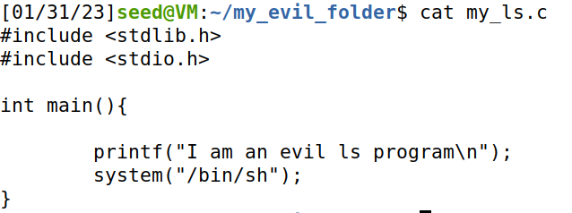
Exploiting a Set-UID program with environment variables
(Task 5 on lab 1)
We first make our own malicious program that creates a shell with system()
Compile it and make the executable is named ls

Slide 32

Exploiting a Set-UID program with environment variables
(Task 5 on lab 1)
This is the program we are going to exploit… and if this is a Set-UID program, things can get scary
Make ls_vuln a Set-UID progam

Slide 33

Exploiting a Set-UID program with environment variables
(Task 5 on lab 1)
Update the PATH environment variable to point to our malicious ls program that’s located in the my_evil_folder directory
When we run ls_vuln, system()will execute OUR ls program instead of the normal one
Root shell!!!

Slide 34
Environment variable are a set of dynamic named values that affect the way a running process will behave (key-value pairs)
Example: The PATH variable
• We use command such as ls and passwd
We could be in any directory.
How does it know to run /bin/ls ?
If the full path is not provided, the shell process will use the PATH env. variable to search for it!
Tells the OS to look for the ls program in /usr/local/bin

Slide 35
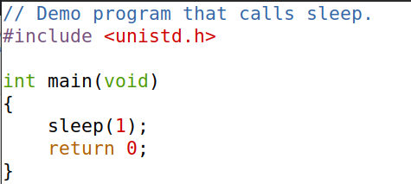
Linking finds the external library code referenced in a program
Static Linking – Linker combines program code/external code into final executable
Dynamic Linking- linker uses env variables to locate external dependencies
This program uses the sleep function. When compiling this program, how does it know where to find the source code for the sleep() function ?

Slide 36
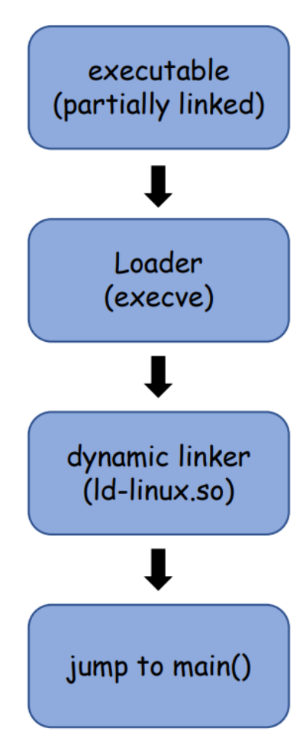
Linking finds the external library code referenced in a program
Static Linking – Linker combines program code/external code into final executable
Dynamic Linking- linker uses env variables to locate external dependencies
This program uses the sleep function. When compiling this program, how does it know where to find the source code for the sleep() function ?
It will use environment variables !

Slide 37
Linking finds the external library code referenced in a program
Static Linking – Linker combines program code/external code into final executable
Dynamic Linking- linker uses env variables to locate external dependencies
This program uses the sleep function. When compiling this program, how does it know where to find the source code for the sleep() function ?
It will use environment variables !
Specifically, it will use the LD_PRELOAD env variable

Slide 38
Dynamic Linking- linker uses env variables to locate external dependencies
LD_PRELOAD contains a list of shared libraries to search through during the linking process
Provides precedent over standard functions calls (malloc, free, etc)
If functions are not found, it will consult the location specified in LD_LIBRARY_PATH
Because these are just environment variables, we can set both of these values (LD_PRELOAD, LD_LIBRARY_PATH)
Any ideas how we could exploit this program?

Slide 39

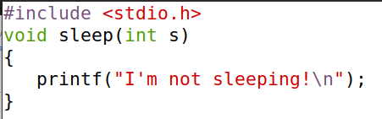
sleep_prog.c
Let’s write our own sleep() function!
We could put any code here (printf is not very malicious…)
mylib.c

Slide 40
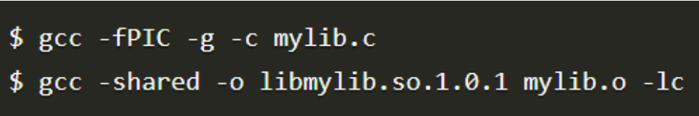
sleep_prog.c
2
Add code to a shared library, libmylib.so.1.0.1
1
Let’s write our own sleep() function!
mylib.c

Slide 41
sleep_prog.c
2
Add code to a shared library, libmylib.so.1.0.1
1
Let’s write our own sleep() function!
3
Set the LD_PRELOAD environment variable, which tells linker to use our malicious library instead of the default one
mylib.c

Slide 42
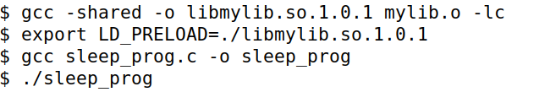
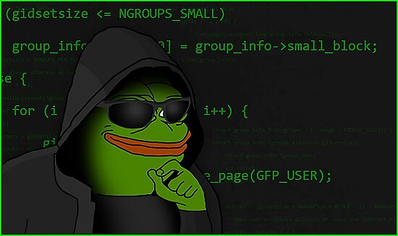
sleep_prog.c
(the program we are exploiting)
Task 6 Lab 1:
What if run this program as a normal user?
1
Let’s write our own sleep() function!
mylib.c
2
Add code to a shared library, libmylib.so.1.0.1
The program uses our sleep function!!
3
Set the LD_PRELOAD environment variable, which tells linker to use our malicious library instead of the default one

Slide 43


sleep_prog.c
(the program we are exploiting)
Task 6 Lab 1:
What if we make the program a Set-UID program and run as a normal user?
1
Let’s write our own sleep() function!
mylib.c
2
Add code to a shared library, libmylib.so.1.0.1
The program sleeps normally (it does not use our sleep function)
3
Set the LD_PRELOAD environment variable, which tells linker to use our malicious library instead of the default one

Slide 44
sleep_prog.c
(the program we are exploiting)
Task 6 Lab 1:
What if we make the program a Set-UID program and run as the root user?
1
Let’s write our own sleep() function!
mylib.c
2
Add code to a shared library, libmylib.so.1.0.1
3
Set the LD_PRELOAD environment variable, which tells linker to use our malicious library instead of the default one
The program uses our sleep function!!

Slide 45


We have mixed results. Sometimes the program used our malicious sleep function, other times it did not
Process Owner Set-UID program? Success?
seed
seed
root
Any ideas what could be causing this?

Slide 46
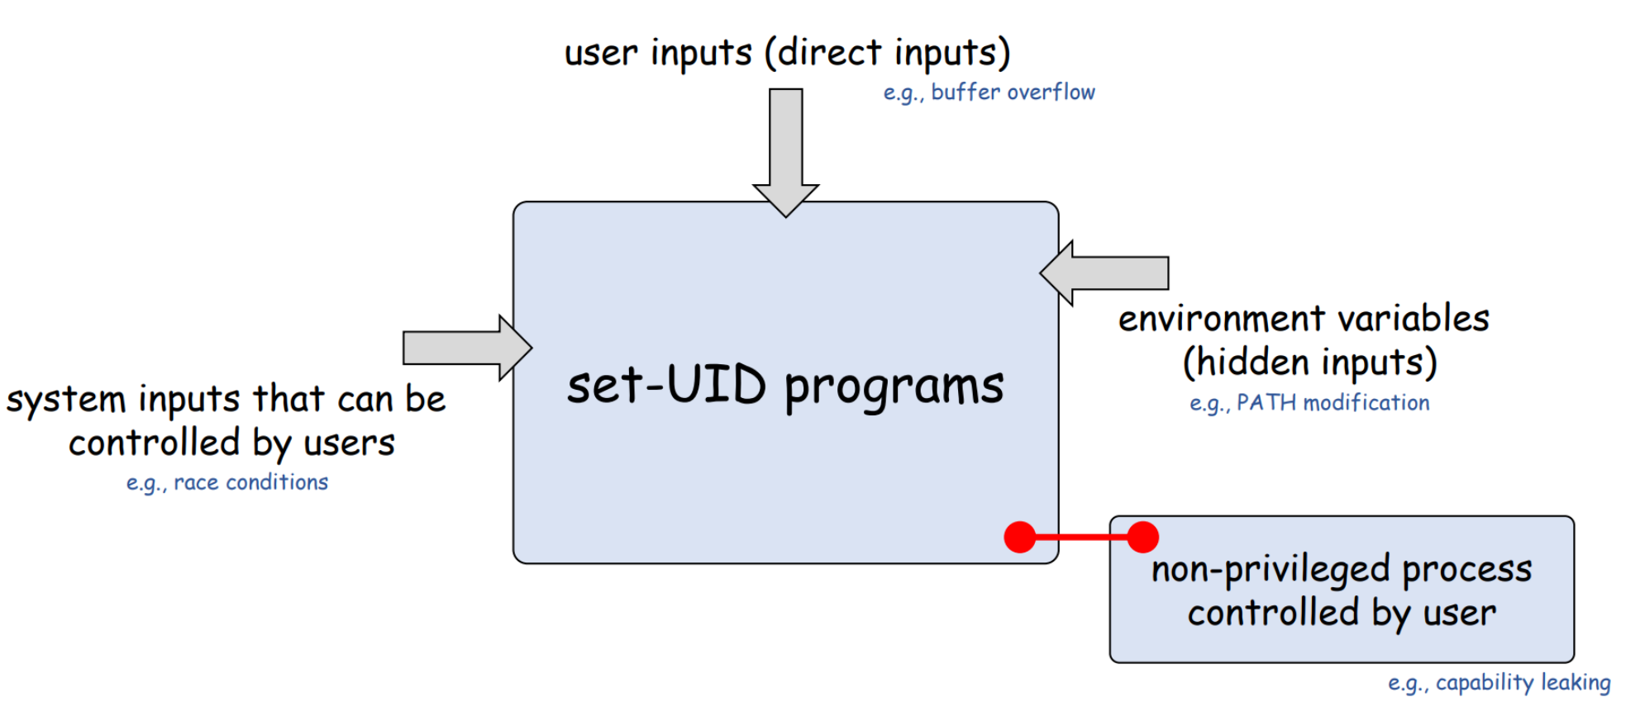

Exploiting Set-UID programs via capability leaking
(This won’t be on the lab ☺ )

Slide 47
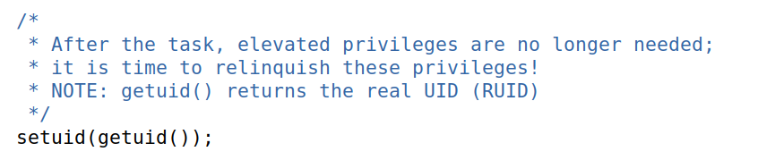
Exploiting Set-UID programs via capability leaking
Often times, a process will downgrade its privileges when it no longer needs them
It can do this by using the setuid()function
Capability leaking can occur when a privilege process does not properly clean up its privileges when downgrading

Slide 48
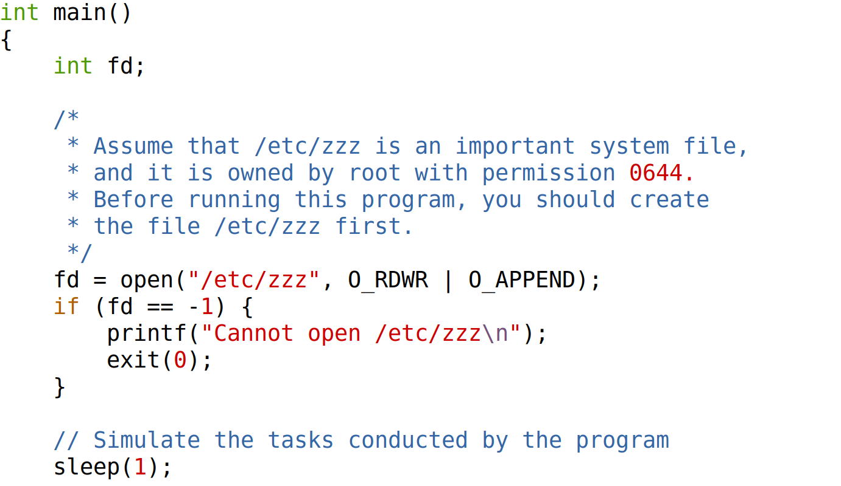
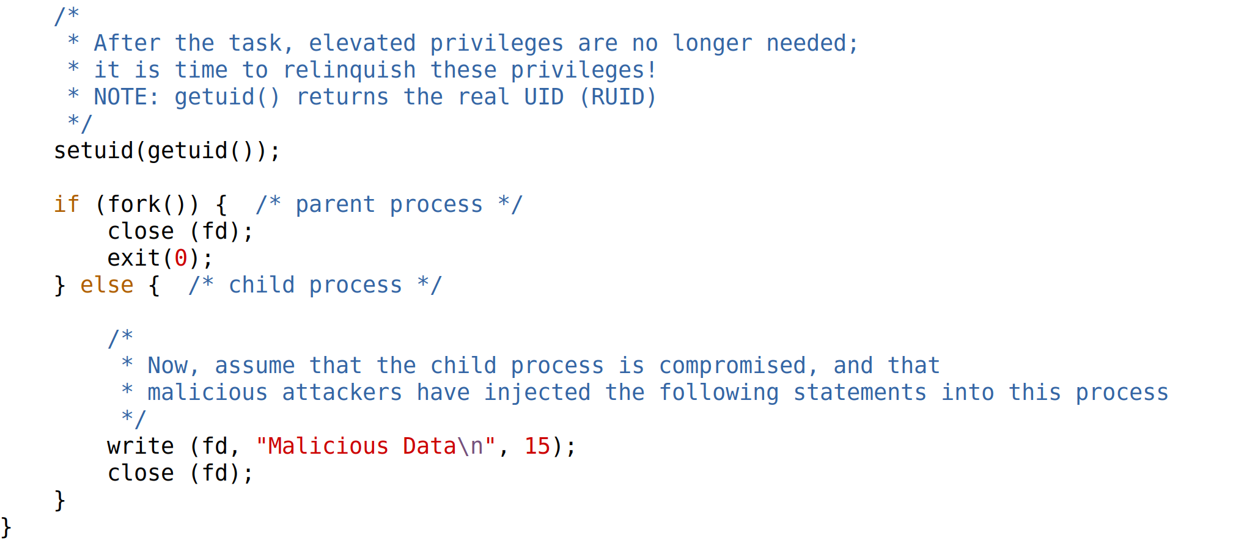



First opens a file descriptor (fd) for “/etc/zzz”, which is only writeable by root
Suppose this program does some stuff with the file before dropping privileges

Slide 49
We then fork() and create a new process
In the parent process, we close the file
However, in the child process, the file descriptor is still open!

Slide 50
If this a Set-UID program, then fd is a root-level file descriptor, and the child process inherits this!
Thus, the child process (which was created after dropping privileges) can write to /etc/zzz (bad!!!!)

Slide 51
Capability leaking can occur when a privilege process does not properly clean up its privileges when downgrading
Always be careful about the privileges you are giving to a process!

Slide 52
That’s it for Set-UID Programs, but we will continue to use Set-UID programs in future sections
Did we learn any valuable lessons?

Slide 53
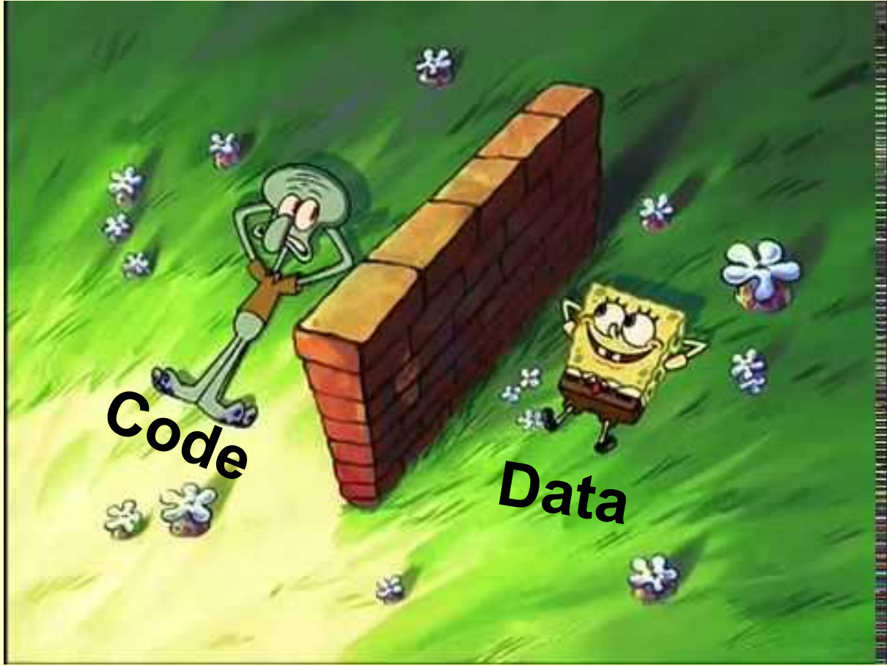
Security Principle #1
Principle of Isolation
There needs to be a clear separation of data and code
If user input is needed as data, it should not be interpreted as code

Slide 54
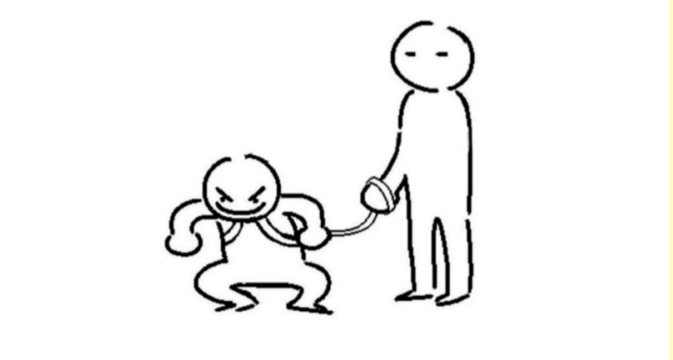
Security Principle #1
Principle of Least Privilege
Subjects and Programs should be given only the privileges needed to complete their task
Disable privileges when they are not needed

