Slide 1

CSCI 132: Basic Data Structures and Algorithms
Intro to Java (Data Types, Variables, Operators)
Reese Pearsall
Spring 2025
https://www.cs.montana.edu/pearsall/classes/spring2025/132/main.html
*All images are stolen from the internet

Slide 2
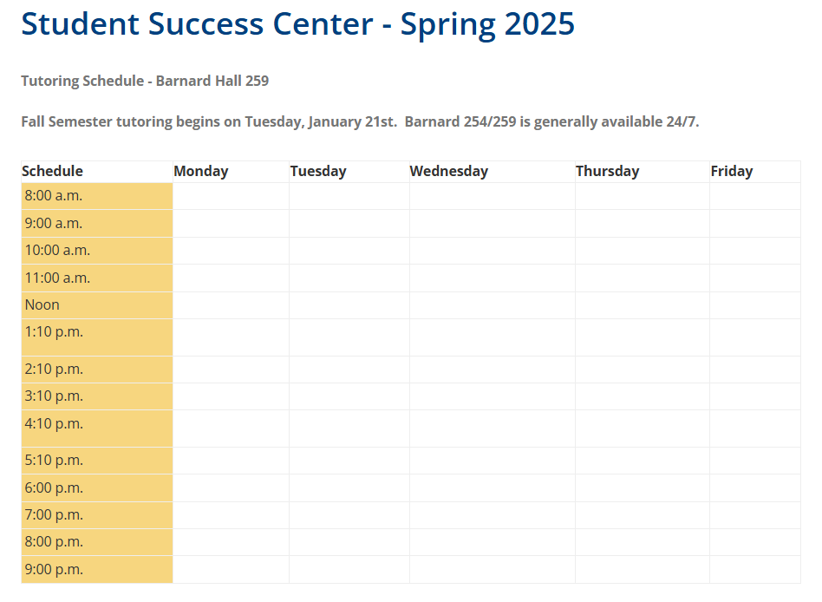
Announcements
Fill out the course questionnaire and join Discord
No class on Monday (MLK Day)
Lab 1 is due on Tuesday @ 11:59 PM
CSCI 132 TAs
They all have office hours in the Computer Science Student Success Center (Barnard Hall 259)
Section 003- Andras Necz
Email: andras.necz@student.montana.edu
Section 004- Andras Necz
Email: andras.necz@student.montana.edu
Section 005- Ahmad Sultan
Email: ahmadjajja86@gmail.com
Section 006- Ahmad Sultan
Email: ahmadjajja86@gmail.com
There will also be junior/senior CS lab assistants present during lab

Slide 3
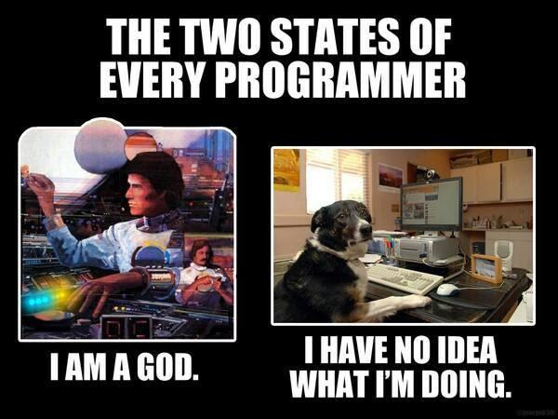

Slide 4
Hello World Program
Java programs always start execution in public static void main(String[] args)
public class HelloWorld {
public static void main(String[] args) {
// This is a comment
System.out.println("Hello World");
}
}
Code needs to go inside of the curley brackets { }
Whitespace does not matter ☺

Slide 5
Declaring Variables
Valid Variable Declaration
int i = 5;
int x;
int num = 125;
char grade = “A”;
boolean flag = true;
Primitive Data Types
int
double
boolean
char
float
When we declare a variable, we must define the datatype as well
Non-Primitive Data Types
String
Invalid Variable Declaration
String s = “Reese”;
String last_name = “Pearsall”;
System.out.println(s + last_name)
i = 5; (data type is not declared)
int 2023year = 2023; (bad variable name)
char final = “F”; (bad variable name)

Slide 6
Using the plus operator (+) between two values that are Strings will result in String concatenation
Operators
+ (Addition)
- (Subtraction)
* (Multiplication)
/ (Division)
% (Modulo)
+ (String concatenation)
++ (Increment)
-- (Decrement)
String x = “hi ”;
String y = “there”;
System.out.println(x + y);
>> hi there
Increment operator (++) will add 1 to a variable
int counter = 0;
System.out.println(counter);
counter++;
System.out.println(counter);
counter++;
System.out.println(counter);
>> 0
1
2
int x, y, answer;
x= 2;
y = 3;
answer = x + y;

Slide 7
User input
We use Java’s Scanner library to get user input
Remember to import the Scanner library!
import java.util.Scanner;
public class ScannerExample {
public static void main(String Args[]) {
Scanner scanner = new Scanner(System.in); //Creates Scanner object
System.out.println("Enter your name:"); //prompt user for name
String input = scanner.next(); // Accepts user input, stores result in input
System.out.println(“Your name is:"+ input);
}
}

Slide 8
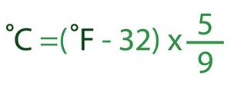
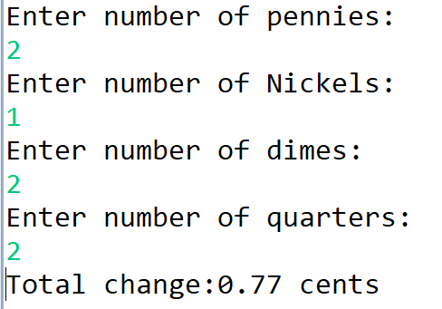
In class exercise
1. Write a program that will take in a temperature in Fahrenheit. The Program should convert the temperature to Celsius, and print it out to the screen
2. Write a program that will ask the user for an amount of pennies, nickels, dimes, and quarters. The program should compute the total change value, and print it to the screen

