Slide 1

CSCI 132: Basic Data Structures and Algorithms
Intro to Java (OOP, Methods, Control Flow)
Reese Pearsall
Spring 2025
https://www.cs.montana.edu/pearsall/classes/spring2025/132/main.html
*All images are stolen from the internet

Slide 2
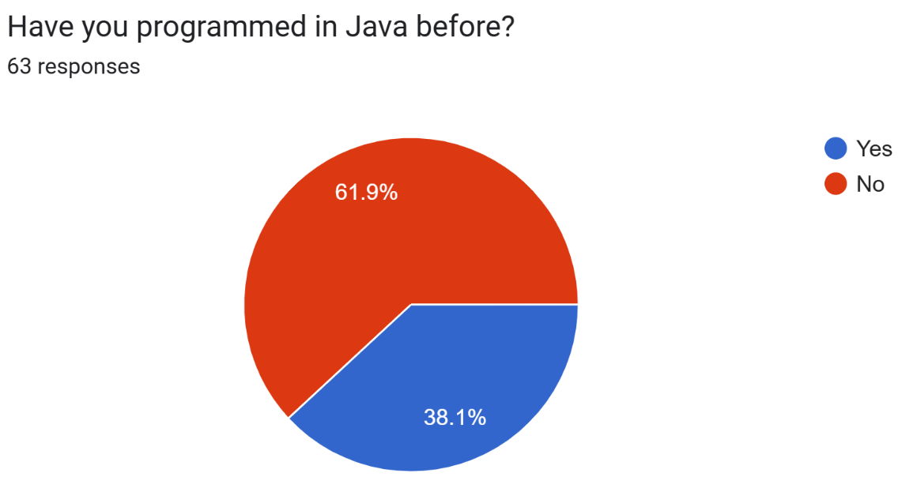


Course Questionnaire
What was the most challenging part of CSCI 127?
Recursion
Object Oriented Programming
Having to wake up early
There are many different majors in this course– not just computer science ☺
I enjoy to procrastinate
I work full-time

Slide 3

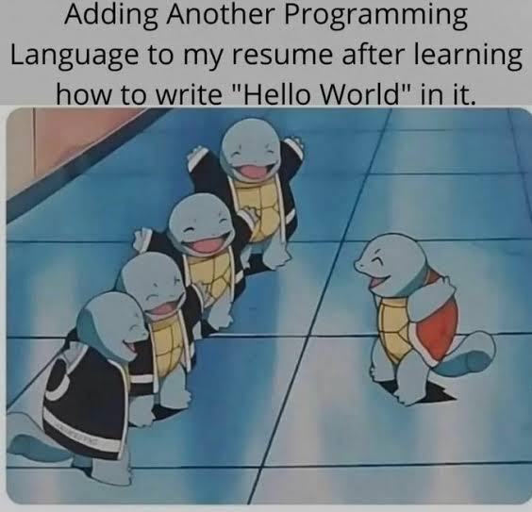
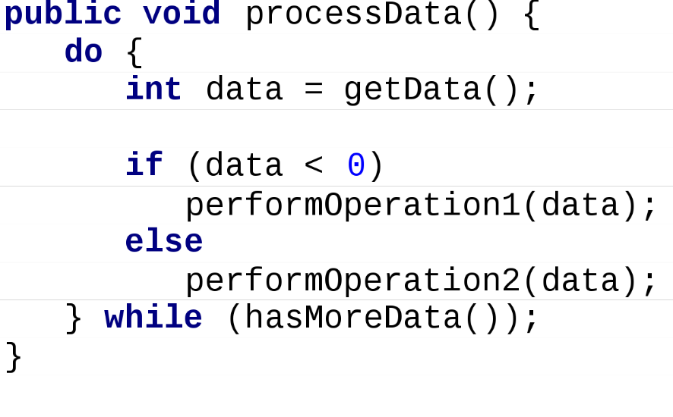
Java
In this class, we will use Java as our programming language
Why do we need more than one programming language?

Slide 4
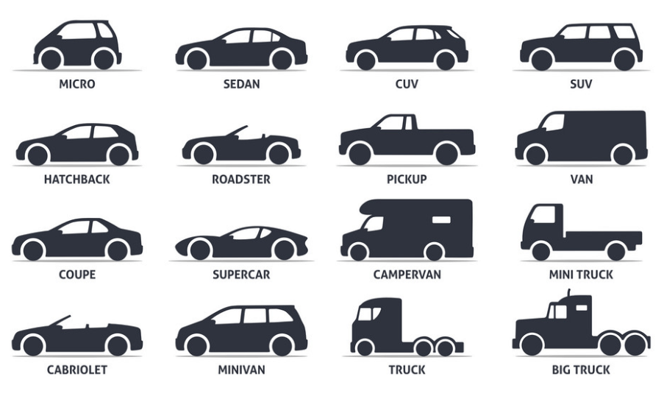
Java
In this class, we will use Java as our programming language
Why do we need more than one programming language?
Different programming languages are better for different things

Slide 5

Java vs Python
Good for developing large, commercial, distributable software
Very flexible. Good for shorter jobs, data analysis, Web development,
Faster than Python
Slower than Java
OOP Language
Functional programming language
Verbose (sigh)
Simple (but requires whitespace)
Static Typed
Dynamic Typed

Slide 6
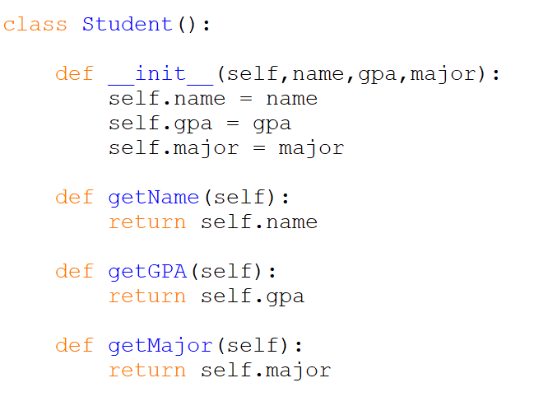
Object Oriented Programming

Slide 7

Object Oriented Programming
We write classes that is a blueprint of something

Slide 8






Object Oriented Programming
We write classes that is a blueprint of something
Classes consist of two important things:
Instance Fields/Attributes
Methods/Behaviors

Slide 9
Object Oriented Programming
We write classes that is a blueprint of something
Classes consist of two important things:
Instance Fields/Attributes
Methods/Behaviors
This program does nothing until we start creating objects

Slide 10

Object Oriented Programming
Object Oriented Programming
student1 and student2 are instances of the Student class.

Slide 11

Object Oriented Programming
1. 2. 3.
student1 and student2 are instances of the Student class.
To create an object, we called the class name, and then pass the necessary parameters/arguments
This triggers the constructor, which will create our objects
1. 2. 3.
1. 2. 3.

Slide 12

Object Oriented Programming
1. 2. 3.
student1 and student2 are instances of the Student class.
An object is an encapsulation of information…
Printing/accessing an object doesn’t do much on its own…
1. 2. 3.
1. 2. 3.

Slide 13
Object Oriented Programming
student1
Methods
Instance Field
name: “Reese”
GPA: 4.0
major: “Computer Science”
getName()
getMajor()
getGPA()

Slide 14
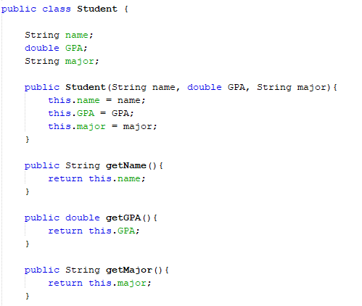

Object Oriented Programming
Java is only OOP,
all our code will be going inside of a class

Slide 15
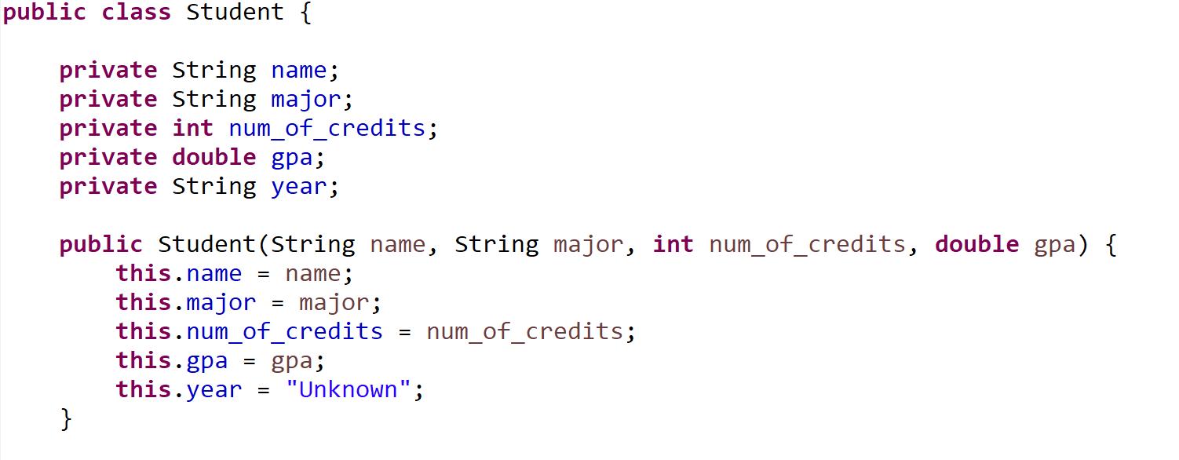
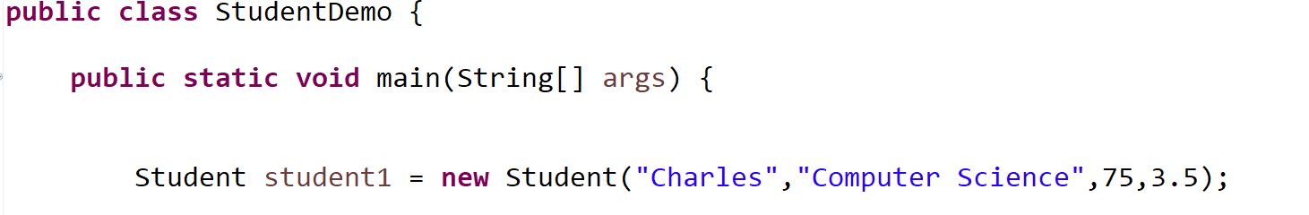
Instance fields of our Student Class
private means they can not be directly accessed outside of the class
Student.Java
StudentDemo.Java

Slide 16

This is the constructor, the special method that creates our objects
Each of our “blueprints” needs a constructor
Student.Java
StudentDemo.Java

Slide 17



Student.Java
When we use the new keyword, it will invoke our constructor
StudentDemo.Java

Slide 18




The constructor has 4 arguments
Name of student
Major of student
Number of credits
Student’s GPA
Student.Java
When we use the new keyword, it will invoke our constructor
StudentDemo.Java

Slide 19







The constructor has 4 arguments
Name of student
Major of student
Number of credits
Student’s GPA
Whenever we create a new Student object with new, we must make sure we pass in these 4 values
Student.Java
When we use the new keyword, it will invoke our constructor
StudentDemo.Java

Slide 20
Student.Java
StudentDemo.Java

Slide 21
Student.Java
StudentDemo.Java

Slide 22

student1
Student.Java
StudentDemo.Java

Slide 23
name
“Charles”
student1
major
num_of_credits
gpa
year
Student.Java
StudentDemo.Java

Slide 24

name
“Charles”
student1
major
“Computer Science”
num_of_credits
gpa
year
Student.Java
StudentDemo.Java

Slide 25
name
“Charles”
student1
major
“Computer Science”
num_of_credits
75
gpa
year
Student.Java
StudentDemo.Java

Slide 26
name
“Charles”
student1
major
“Computer Science”
num_of_credits
75
gpa
3.5
year
Student.Java
StudentDemo.Java

Slide 27
name
“Charles”
student1
major
“Computer Science”
num_of_credits
75
gpa
3.5
year
“Unknown”
Student.Java
StudentDemo.Java

Slide 28
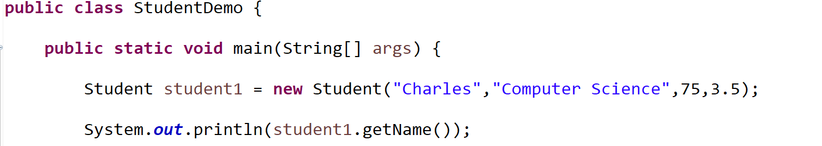
Let’s add a function (a method) that will get a Student’s name
StudentDemo.Java

Slide 29
Let’s add a function (a method) that will get a Student’s name
We called this method on a Student object (student1.getName())
So, our function needs to belong in our Student class (Student.Java)
StudentDemo.Java

Slide 30
Let’s add a function (a method) that will get a Student’s name
We called this method on a Student object (student1.getName())
So, our function needs to belong in our Student class (Student.Java)
What should this function take as input? What should this function output?
Input: a Student object
Output: the name of a student (String)
StudentDemo.Java

Slide 31
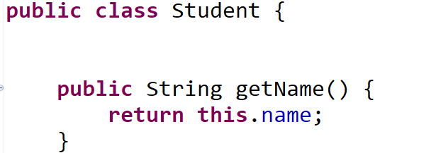
(instance fields and constructor go here)
Student.Java
StudentDemo.Java

Slide 32
Name of method
(instance fields and constructor go here)
Student.Java
StudentDemo.Java

Slide 33
Name of method
(instance fields and constructor go here)
When we define methods in Java, we must declare the data type that the method will return
This method returns a String
Student.Java
StudentDemo.Java

Slide 34
Name of method
(instance fields and constructor go here)
This method returns a String
This method is public (other classes can use it)
(Generally, all methods will be public ☺ )
Student.Java
StudentDemo.Java

Slide 35
Name of method
(instance fields and constructor go here)
This method returns a String
This method is public (other classes can use it)
The this keyword refers to the object that this method was called on (student1)
(return student1’s name attribute)
Student.Java
StudentDemo.Java

Slide 36
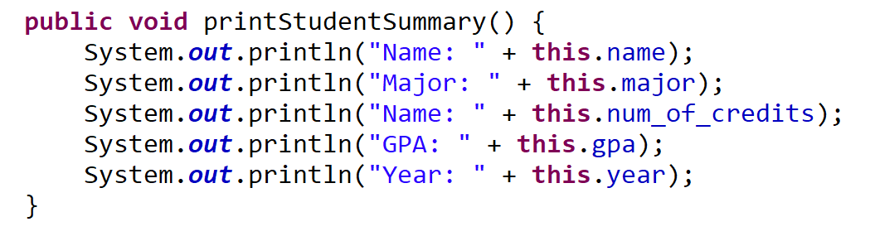
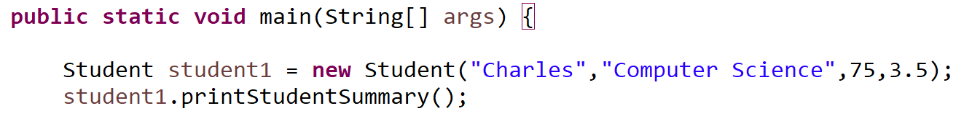
Here is a method that doesn’t return anything
void is used to indicate that a method will not return anything
Student.Java
StudentDemo.Java

Slide 37
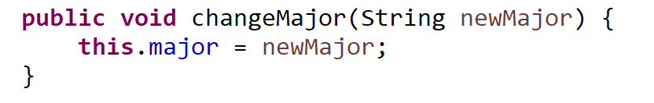
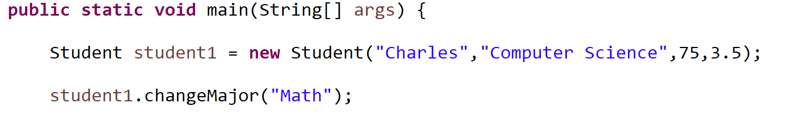
Here is method to change a Student’s major. When we call this method, we pass in the Student’s new major as an argument
So when we define this method, we need to make sure it accepts one argument
Student.Java
StudentDemo.Java

Slide 38
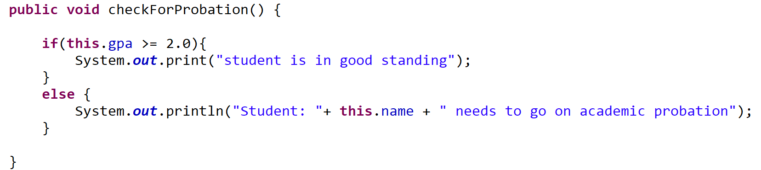
If statements can be used to check a condition.
If the condition is true, execute the code in the body of the if statement
If it is false, proceed to the else statement
Student.Java
StudentDemo.Java

Slide 39
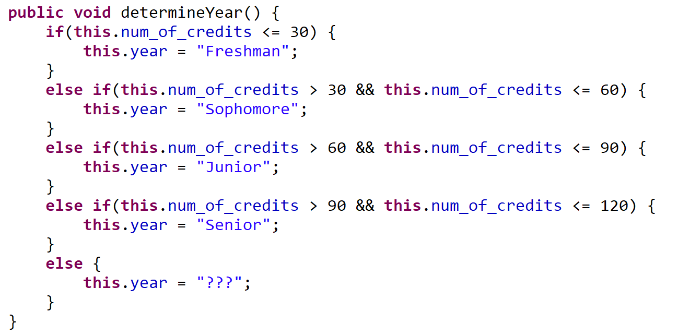

We can check multiple conditions using the and operator (&&)
(we do not have the and keyword in Java)
Student.Java
StudentDemo.Java

Slide 40
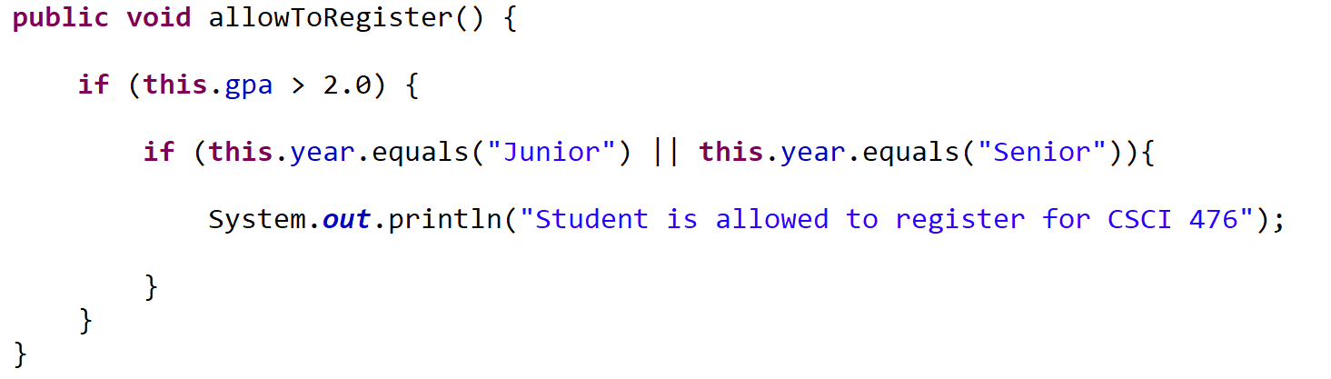
Example: A student is allowed to register for CSCI 476 if they have a GPA greater than 2.0, and if they are a Junior or Senior
// check the first condition (Alternatively, we could use an && here)
We can check one of two conditions is true using the or operator ( || )
(we do not have the or keyword in Java)
Student.Java
StudentDemo.Java

Slide 41
Example: A student is allowed to register for CSCI 476 if they have a GPA greater than 2.0, and if they are a Junior or Senior
// check the first condition (Alternatively, we could use an && here)
Student.Java
Why do this.year.equals("Junior") and not this.year == "Junior“
Checking for string equality in Java is a little bit funky…
Using == does not check for equivalence of values between two strings…

Slide 42
Example: A student is allowed to register for CSCI 476 if they have a GPA greater than 2.0, and if they are a Junior or Senior
// check the first condition (Alternatively, we could use an && here)
Student.Java
Do not use == to compare two strings
Why do this.year.equals("Junior") and not this.year == "Junior“
Checking for string equality in Java is a little bit funky…
Using == does not check for equivalence of values between two strings…
Instead, we need to use the .equals() method between two string

