Slide 1

CSCI 132: Basic Data Structures and Algorithms
Java file I/O
Reese Pearsall
Spring 2025
https://www.cs.montana.edu/pearsall/classes/spring2025/132/main.html

Slide 2
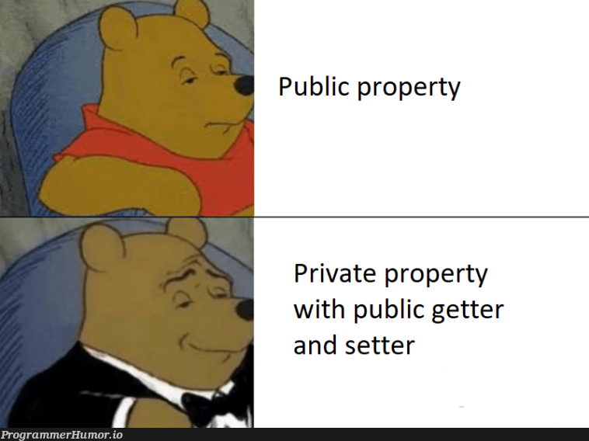
Announcements
On Friday we will be discussing Program 1

Slide 3
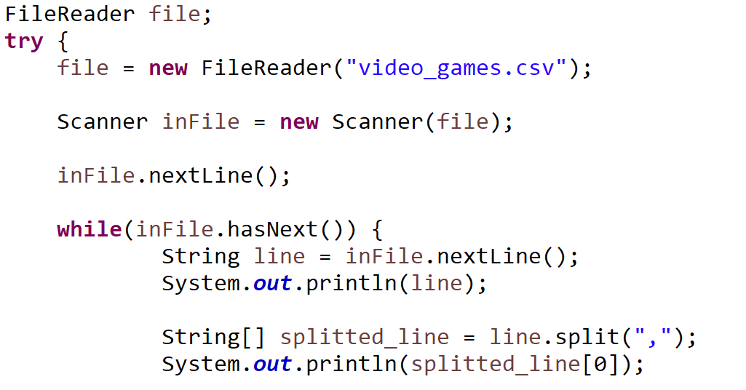
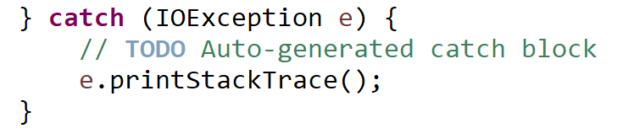
Reading in a file in Java
Opening a reading a file must be done inside of a try/catch statement

Slide 4

Reading in a file in Java
Open a file with the FileReader library

Slide 5
Reading in a file in Java
Open a file with the FileReader library
Read contents of file with Scanner

Slide 6

Reading in a file in Java
Open a file with the FileReader library
Read contents of file with Scanner
Read headers of csv file (discard them)

Slide 7

Reading in a file in Java
Open a file with the FileReader library
Read contents of file with Scanner
Read headers of csv file (discard them)
Iterate through each line of file

Slide 8



Reading in a file in Java
Open a file with the FileReader library
Read contents of file with Scanner
Read headers of csv file (discard them)
Iterate through each line of file
Get each line and print it out

Slide 9
Reading in a file in Java
Open a file with the FileReader library
Read contents of file with Scanner
Read headers of csv file (discard them)
Iterate through each line of file
Get each line and print it out
“Reese,Susan,Spencer”
One long String
To print out the first column of the file, we can split each line, and print out the first column
.split(“,”)
[ “Reese”, “Susan”, “Spencer” ]
Array of Strings

Slide 10
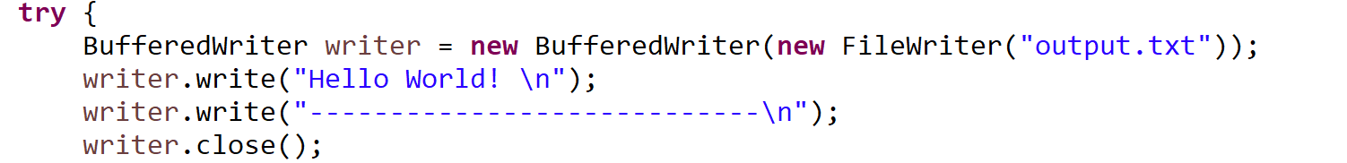
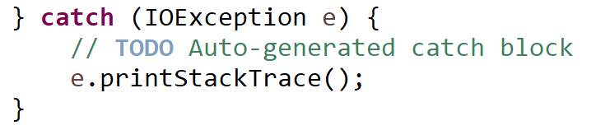
Writing to a file in Java

Slide 11
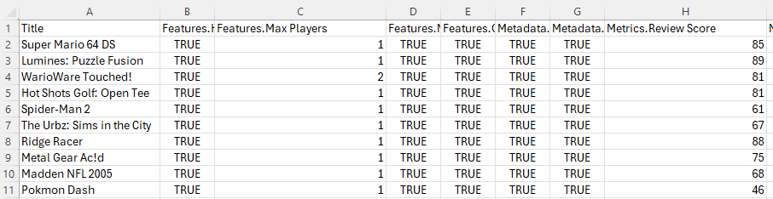







VideoGame Class Blueprint
String name
int num_of_players
int rating
VideoGame[] array
Super Mario 64 DS
1
85
Lumines: Puzzle Fusion
1
89
WarioWare Touched!
2
81
Hot Shots Golf: Open Tee
1
81

Slide 12



Writing to a file in Java
Name of output file

Slide 13

Writing to a file in Java
We write out contents to file using the write() method

Slide 14
Writing to a file in Java
When writing to a file, it is very important to close the file when you are finished

