Slide 1

CSCI 132: Basic Data Structures and Algorithms
2D Arrays, Program 1
Reese Pearsall
Spring 2025
https://www.cs.montana.edu/pearsall/classes/spring2025/132/main.html

Slide 2
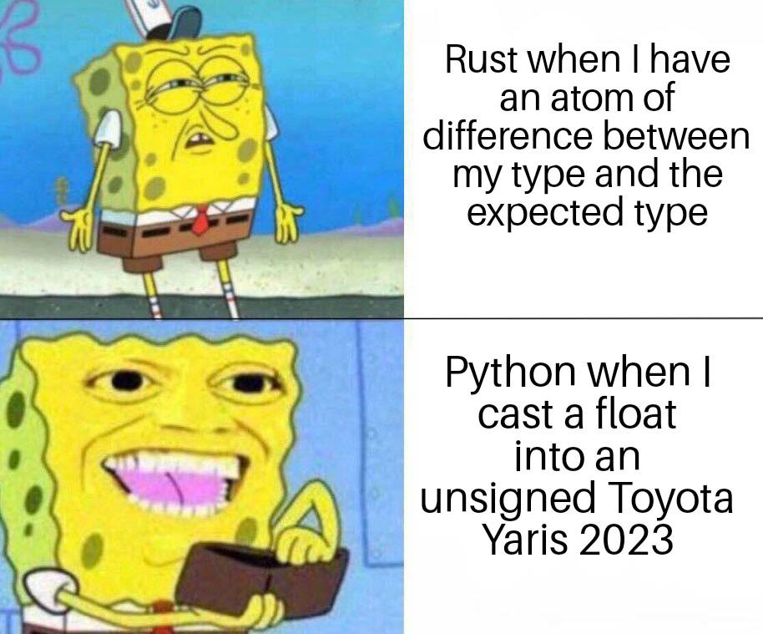
Announcements
java
Program 1 posted
→ Due Wednesday Feb 19
Next lab will be posted sometime soon

Slide 3
2D Arrays
array = [ 0, 1, 2, 3, 4 ]
Here is a one-dimensional array that holds ints (int[])

Slide 4
2D Arrays
array = [ 0, 1, 2, 3, 4 ]
Here is a one-dimensional array that holds ints (int[])
array2 = [ [0, 1, 2, 3, 4],
[5, 6, 7, 8, 9],
[10, 11, 12, 13, 14],
[15, 16, 17, 18, 19],
[20, 21, 22, 23, 24] ]
Here is a two-dimensional array that holds ints (int[][])

Slide 5


2D Arrays
array = [ 0, 1, 2, 3, 4 ]
Here is a one-dimensional array that holds ints (int[])
array2 = [ [0, 1, 2, 3, 4],
[5, 6, 7, 8, 9],
[10, 11, 12, 13, 14],
[15, 16, 17, 18, 19],
[20, 21, 22, 23, 24] ]
array2[3]
Will return a 1D-array
Here is a two-dimensional array that holds ints (int[][])

Slide 6





2D Arrays
array = [ 0, 1, 2, 3, 4 ]
Here is a one-dimensional array that holds ints (int[])
array2 = [ [0, 1, 2, 3, 4],
[5, 6, 7, 8, 9],
[10, 11, 12, 13, 14],
[15, 16, 17, 18, 19],
[20, 21, 22, 23, 24] ]
array2[3][1]
Will return a singular element in that array
Here is a two-dimensional array that holds ints (int[][])

Slide 7

2D Arrays
We can use a single for loop to print out each element of this array
array = [ 0, 1, 2, 3, 4 ]
Here is a one-dimensional array that holds ints (int[])
array2 = [ [0, 1, 2, 3, 4],
[5, 6, 7, 8, 9],
[10, 11, 12, 13, 14],
[15, 16, 17, 18, 19],
[20, 21, 22, 23, 24] ]
Here is a two-dimensional array that holds ints (int[][])

Slide 8
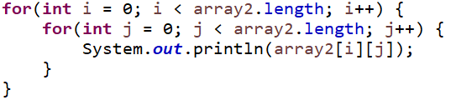
2D Arrays
We can use a single for loop to print out each element of this array
array = [ 0, 1, 2, 3, 4 ]
Here is a one-dimensional array that holds ints (int[])
array2 = [ [0, 1, 2, 3, 4],
[5, 6, 7, 8, 9],
[10, 11, 12, 13, 14],
[15, 16, 17, 18, 19],
[20, 21, 22, 23, 24] ]
We can use a nested for loop to print out each element of this 2D array
Here is a two-dimensional array that holds ints (int[][])

Slide 9
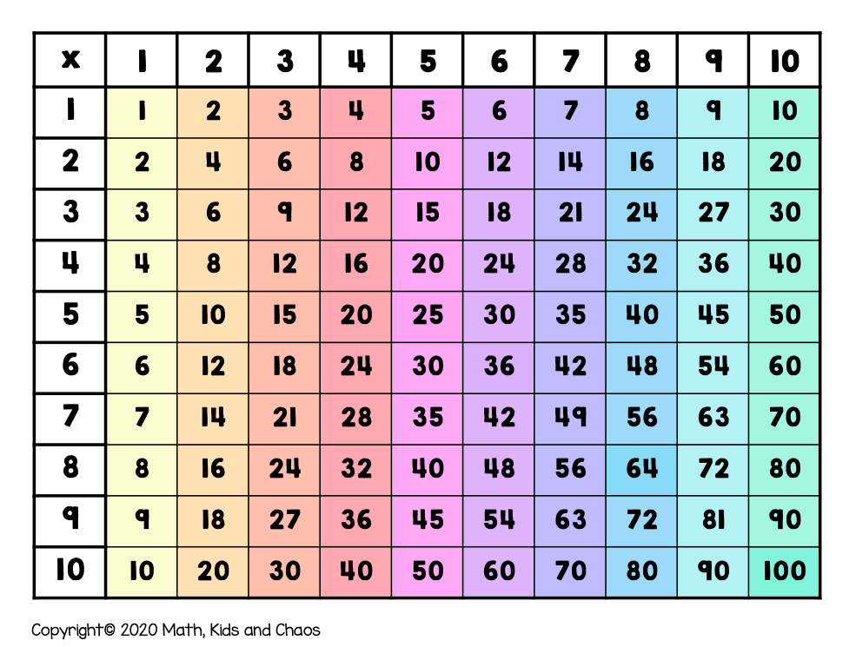
2D Arrays
Let’s build a multiplication table using 2D arrays

Slide 10
2D Arrays
i
for(int i = 0; i < temp.length; i++) {
for(int j = 0; j < temp.length; j++) {
temp[i][j] = (i+1) * (j+1);
}
}

Slide 11
2D Arrays
j
i
for(int i = 0; i < temp.length; i++) {
for(int j = 0; j < temp.length; j++) {
temp[i][j] = (i+1) * (j+1);
}
}

Slide 12
2D Arrays
j
i
1
for(int i = 0; i < temp.length; i++) {
for(int j = 0; j < temp.length; j++) {
temp[i][j] = (i+1) * (j+1);
}
}

Slide 13
2D Arrays
j
i
1
for(int i = 0; i < temp.length; i++) {
for(int j = 0; j < temp.length; j++) {
temp[i][j] = (i+1) * (j+1);
}
}

Slide 14
2D Arrays
j
i
1 | 2
for(int i = 0; i < temp.length; i++) {
for(int j = 0; j < temp.length; j++) {
temp[i][j] = (i+1) * (j+1);
}
}

Slide 15
2D Arrays
j
i
1 | 2
for(int i = 0; i < temp.length; i++) {
for(int j = 0; j < temp.length; j++) {
temp[i][j] = (i+1) * (j+1);
}
}

Slide 16
2D Arrays
j
i
1 | 2 | 3
for(int i = 0; i < temp.length; i++) {
for(int j = 0; j < temp.length; j++) {
temp[i][j] = (i+1) * (j+1);
}
}

Slide 17
2D Arrays
j
i
1 | 2 | 3 | 4 | 5 | 6 | 7 | 8 | 9 | 10
for(int i = 0; i < temp.length; i++) {
for(int j = 0; j < temp.length; j++) {
temp[i][j] = (i+1) * (j+1);
}
}

Slide 18
2D Arrays
j
1 | 2 | 3 | 4 | 5 | 6 | 7 | 8 | 9 | 10
i
for(int i = 0; i < temp.length; i++) {
for(int j = 0; j < temp.length; j++) {
temp[i][j] = (i+1) * (j+1);
}
}

Slide 19
2D Arrays
j
1 | 2 | 3 | 4 | 5 | 6 | 7 | 8 | 9 | 10
i
for(int i = 0; i < temp.length; i++) {
for(int j = 0; j < temp.length; j++) {
temp[i][j] = (i+1) * (j+1);
}
}

Slide 20
2D Arrays
j
1 | 2 | 3 | 4 | 5 | 6 | 7 | 8 | 9 | 10
2
i
for(int i = 0; i < temp.length; i++) {
for(int j = 0; j < temp.length; j++) {
temp[i][j] = (i+1) * (j+1);
}
}

Slide 21
2D Arrays
j
1 | 2 | 3 | 4 | 5 | 6 | 7 | 8 | 9 | 10
2
i
for(int i = 0; i < temp.length; i++) {
for(int j = 0; j < temp.length; j++) {
temp[i][j] = (i+1) * (j+1);
}
}

Slide 22
2D Arrays
j
1 | 2 | 3 | 4 | 5 | 6 | 7 | 8 | 9 | 10
2 | 4
i
for(int i = 0; i < temp.length; i++) {
for(int j = 0; j < temp.length; j++) {
temp[i][j] = (i+1) * (j+1);
}
}

Slide 23
2D Arrays
j
1 | 2 | 3 | 4 | 5 | 6 | 7 | 8 | 9 | 10
2 | 4 | 6 | 8 | 10 | 12 | 14 | 16 | 18 | 20
i
for(int i = 0; i < temp.length; i++) {
for(int j = 0; j < temp.length; j++) {
temp[i][j] = (i+1) * (j+1);
}
}

Slide 24
2D Arrays
j
1 | 2 | 3 | 4 | 5 | 6 | 7 | 8 | 9 | 10
2 | 4 | 6 | 8 | 10 | 12 | 14 | 16 | 18 | 20
3 | 6 | 9 | 12 | 15 | 18 | 21 | 24 | 27 | 30
4 | 8 | 12 | 16 | 20 | 24 | 28 | 32 | 36 | 40
5 | 10 | 15 | 20 | 25 | 30 | 35 | 40 | 45 | 50
6 | 12 | 18 | 24 | 30 | 36 | 42 | 48 | 54 | 60
7 | 14 | 21 | 28 | 35 | 42 | 49 | 56 | 63 | 70
8 | 16 | 24 | 32 | 40 | 48 | 56
9 | 18 | 27 | 36 | 45 | 54 | 63
10 | 20 | 30 | 40 | 50 | 60 | 70
for(int i = 0; i < temp.length; i++) {
for(int j = 0; j < temp.length; j++) {
temp[i][j] = (i+1) * (j+1);
}
}
i

Slide 25

2D Arrays
j
1 | 2 | 3 | 4 | 5 | 6 | 7 | 8 | 9 | 10
2 | 4 | 6 | 8 | 10 | 12 | 14 | 16 | 18 | 20
3 | 6 | 9 | 12 | 15 | 18 | 21 | 24 | 27 | 30
4 | 8 | 12 | 16 | 20 | 24 | 28 | 32 | 36 | 40
5 | 10 | 15 | 20 | 25 | 30 | 35 | 40 | 45 | 50
6 | 12 | 18 | 24 | 30 | 36 | 42 | 48 | 54 | 60
7 | 14 | 21 | 28 | 35 | 42 | 49 | 56 | 63 | 70
8 | 16 | 24 | 32 | 40 | 48 | 56
9 | 18 | 27 | 36 | 45 | 54 | 63
10 | 20 | 30 | 40 | 50 | 60 | 70
for(int i = 0; i < temp.length; i++) {
for(int j = 0; j < temp.length; j++) {
temp[i][j] = (i+1) * (j+1);
}
}
i

Slide 26
2D Arrays
Program 1

