Slide 1

CSCI 132: Basic Data Structures and Algorithms
Interfaces
Reese Pearsall
Spring 2025
https://www.cs.montana.edu/pearsall/classes/spring2025/132/main.html

Slide 2
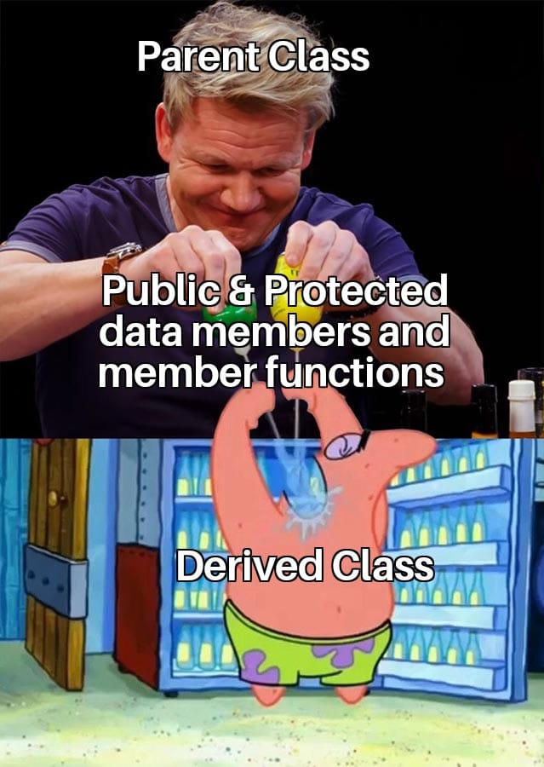

Inheritance is a mechanism that allows a parent class to pass on public and protected instance fields and methods to a child class
Inheritance is great when you have shared behaviors and attributes across classes with the same implementation
Programmer
Professor
Advisor
public String getName() {
return this.name;
}
public String getName() {
return this.name;
}
public String getName() {
return this.name;
}
Same code (same implementation!!!)

Slide 3

Inheritance is a mechanism that allows a parent class to pass on public and protected instance fields and methods to a child class
Inheritance is great when you have shared behaviors and attributes across classes with the same implementation
Programmer
Professor
Advisor
public String getName() {
return this.name;
}
public String getName() {
return this.name;
}
public String getName() {
return this.name;
}
Same code (same implementation!!!)

Slide 4
Interfaces are abstract classes that only contain methods with no body
Accelerate, Slow down, and refuel are all common behavior that all vehicles will have
However, the specifics of how they accelerate, slow down, refuel will be different between vehicles (ie the body of the methods will be slightly different)
public interface Vehicle {
void accelerate(int a);
void slowdown(int a);
void refuel(int a);
}
Interfaces can be used to specify what a class must do, but not how

Slide 5
Interfaces are abstract classes that only contain methods with no body
public interface Vehicle {
void accelerate(int a);
void slowdown(int a);
void refuel(int a);
}
public class Ferrari implements Vehicle {
}
For a Java class to use an interface, it must use the implements keyword
We can implement multiple interfaces (unlike inheritance)

Slide 6



Interfaces are abstract classes that only contain methods with no body
public class Ferrari implements Vehicle {
@Override
public void accelerate(int a) {
…
}
@Override
public void slowdown(int a) {
…
}
@Override
public void refuel(int a) {
}
…
}
public interface Vehicle {
void accelerate(int a);
void slowdown(int a);
void refuel(int a);
}
Now, any Class that also has the behavior of accelerating, slowdown, and refuel can implement our interface, and those classes are forced to write the body of the methods
The code of the method body is omitted, but that is where the programmer can put the specific behavior of:
how a Ferrari will accelerate
how a Ferrari will slow down
how a Ferrari will refuel

Slide 7



Interfaces are abstract classes that only contain methods with no body
public class Ferrari implements Vehicle {
@Override
public void accelerate(int a) {
…
}
@Override
public void slowdown(int a) {
…
}
@Override
public void refuel(int a) {
}
…
}
public interface Vehicle {
void accelerate(int a);
void slowdown(int a);
void refuel(int a);
}
You can not create an instance of an interface
In the interface, the method bodies must be empty
(Remember, the classes that use our interface will have the method bodies)
The code of the method body is omitted, but that is where the programmer can put the specific behavior of:
how a Ferrari will accelerate
how a Ferrari will slow down
how a Ferrari will refuel

Slide 8
Interfaces are abstract classes that only contain methods with no body
Why use interfaces?
Interfaces are great when you shared behavior with different implementations
It forces classes to implement X methods that might not logically belong to them (more control)
It provides abstraction
(ie the details of how things are implemented are not revealed in an interface)

Slide 9
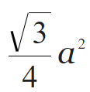

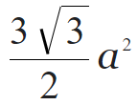
Given a side length a
Shape | Perimeter Formula | Area Formula
Square | a * 4 | a²
Equilateral Triangle | a * 3
Regular Pentagon | a * 5
Regular Hexagon | a * 6

Slide 10
Given a side length a
Shape | Perimeter Formula | Area Formula
Square | a * 4 | a²
Equilateral Triangle | a * 3
Regular Pentagon | a * 5
Regular Hexagon | a * 6
Shared behaviors with different implementations

Slide 11




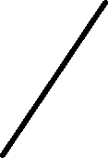




MSU D2L
getCourses()
getGrades()
getTechSupport
NDSU D2L
UW D2L
getCourses()
getGrades()
getTechSupport()
getCourses()
getGrades()
getTechSupport()

Slide 12
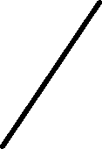




getCourses()
getGrades()
getTechSupport
We could make a parent class, and the classes could inherit to get shared methods
Child classes could override the inherited methods if they want to customize their D2L in a different way
MSU D2L
getCourses()
getGrades()
getTechSupport
NDSU D2L
UW D2L
getCourses()
getGrades()
getTechSupport()
getCourses()
getGrades()
getTechSupport()

Slide 13

getCourses()
getGrades()
getTechSupport
Let’s suppose a small piece of code in the parent class is updated
MSU D2L
getCourses()
getGrades()
getTechSupport
NDSU D2L
UW D2L
getCourses()
getGrades()
getTechSupport()
getCourses()
getGrades()
getTechSupport()

Slide 14
getCourses()
getGrades()
getTechSupport
Let’s suppose a small piece of code in the parent class is updated
All child classes will have to recompile and update as well (not trivial)
MSU D2L
getCourses()
getGrades()
getTechSupport
NDSU D2L
UW D2L
getCourses()
getGrades()
getTechSupport()
getCourses()
getGrades()
getTechSupport()

Slide 15
getCourses()
getGrades()
getTechSupport
Interface
If we use an interface, the child classes will be forced to implement the code for all the shared methods
MSU D2L
getCourses()
getGrades()
getTechSupport
NDSU D2L
UW D2L
getCourses()
getGrades()
getTechSupport()
getCourses()
getGrades()
getTechSupport()

Slide 16
getCourses()
getGrades()
getTechSupport
Interface
If we use an interface, the child classes will be forced to implement the code for all the shared methods
If we update some functionality, we only have to recompile and update the child class
MSU D2L
getCourses()
getGrades()
getTechSupport
NDSU D2L
UW D2L
getCourses()
getGrades()
getTechSupport()
getCourses()
getGrades()
getTechSupport()

