Slide 1

CSCI 132: Basic Data Structures and Algorithms
Arrays
Reese Pearsall
Spring 2025
https://www.cs.montana.edu/pearsall/classes/spring2025/132/main.html

Slide 2
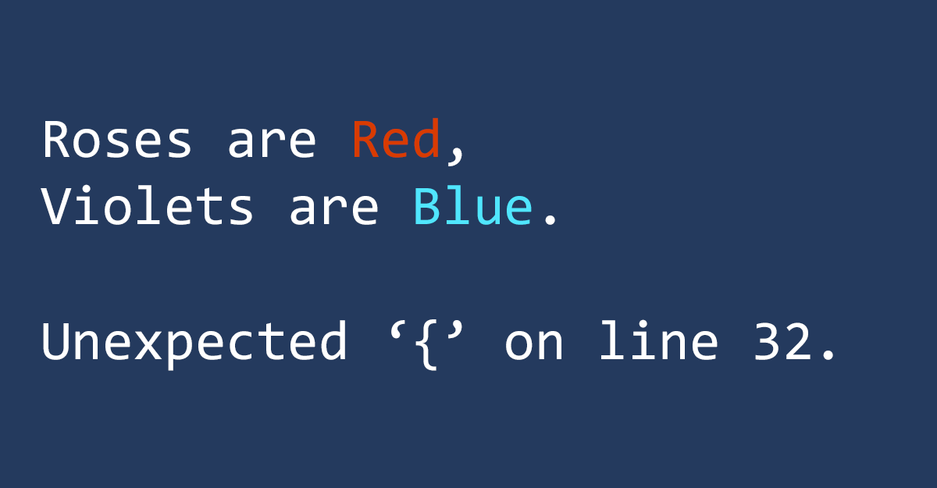
Announcements
Lab 4 due tomorrow at 11:59PM
Program 1 due next Wednesday

Slide 3

What do you need to dig a hole?
Thank you to Sean Yaw (the goat) for the analogy

Slide 4

What do you need to dig a hole?
Thank you to Sean Yaw (the goat) for the analogy

Slide 5
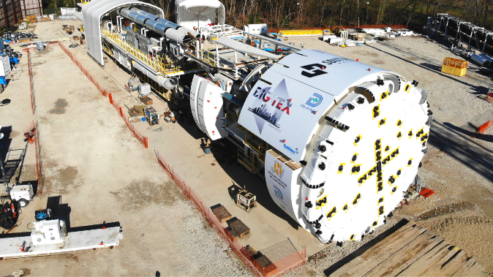
What do you need to dig a hole?
Pros
Cons
Thank you to Sean Yaw (the goat) for the analogy

Slide 6
What do you need to dig a hole?
Pros
Cons
Cheap
Precise
No Training
Availability
Slow
Labor
Thank you to Sean Yaw (the goat) for the analogy

Slide 7
What do you need to dig a hole?
Pros
Cons
Cheap
Precise
No Training
Availability
Slow
Labor
Fast
Labor
Expensive
Training
Thank you to Sean Yaw (the goat) for the analogy

Slide 8
What do you need to dig a hole?
Pros
Cons
Cheap
Precise
No Training
Availability
Slow
Labor
Fast
Labor
Expensive
Training
Really good at digging
Takes up a lot of garage space
Thank you to Sean Yaw (the goat) for the analogy

Slide 9

What do you need to dig a hole?
Pros
Cons
Cheap
Precise
No Training
Availability
Best tool for the job?
Slow
Labor
Burying your pet goldfish
Fast
Labor
Expensive
Training
Really good at digging
Takes up a lot of garage space
Thank you to Sean Yaw (the goat) for the analogy

Slide 10
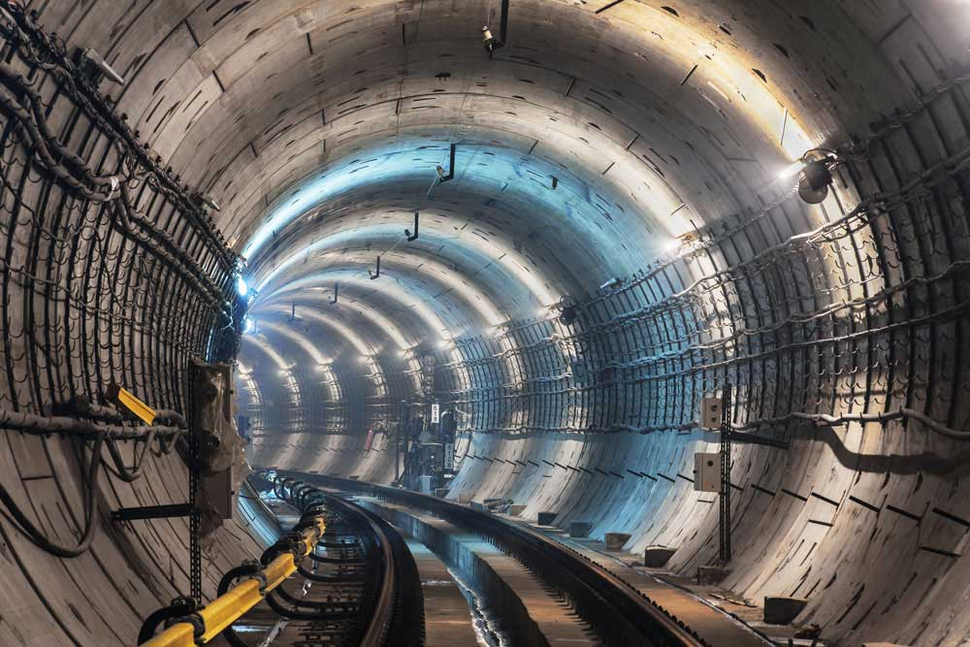
What do you need to dig a hole?
Pros
Cons
Cheap
Precise
No Training
Availability
Best tool for the job?
Slow
Labor
Building Express tunnel to Bridger Bowl
Fast
Labor
Expensive
Training
Really good at digging
Takes up a lot of garage space
Thank you to Sean Yaw (the goat) for the analogy

Slide 11
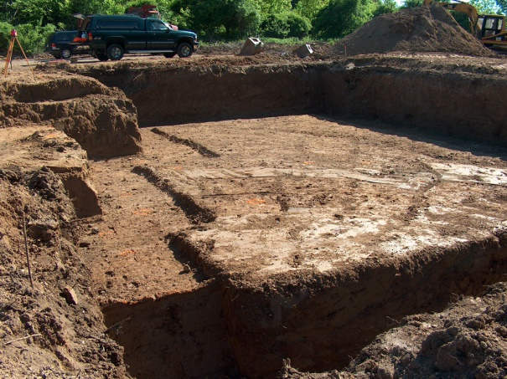
What do you need to dig a hole?
Pros
Cons
Cheap
Precise
No Training
Availability
Best tool for the job?
Slow
Labor
Creating the foundation for a house
Fast
Labor
Expensive
Training
Really good at digging
Takes up a lot of garage space
Thank you to Sean Yaw (the goat) for the analogy

Slide 12
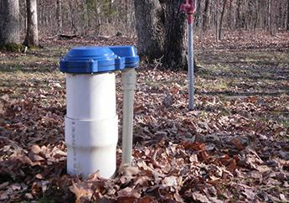
What do you need to dig a hole?
Pros
Cons
Cheap
Precise
No Training
Availability
Best tool for the job?
Slow
Labor
Digging a Well for water
Fast
Labor
Expensive
Training
Really good at digging
Takes up a lot of garage space
Thank you to Sean Yaw (the goat) for the analogy

Slide 13

What do you need to dig a hole?
Pros
Cons
Cheap
Precise
No Training
Availability
Best tool for the job?
Slow
Labor
Digging a Well for water
Fast
Labor
Expensive
Training
Really good at digging
Takes up a lot of garage space
Thank you to Sean Yaw (the goat) for the analogy

Slide 14
What do you need to dig a hole?
Pros
Cons
Cheap
Precise
No Training
Availability
Best tool for the job?
We can’t use the best tool for the job unless we know that tool exists!
Slow
Labor
Digging a Well for water
Fast
Labor
Expensive
Training
Really good at digging
Takes up a lot of garage space
Thank you to Sean Yaw (the goat) for the analogy

Slide 15

What do you need to dig a hole?
Pros
Cons
Cheap
Precise
No Training
Availability
Best tool for the job?
Slow
Labor
Creating the foundation for a house
Fast
Labor
Expensive
Training
Really good at digging
Takes up a lot of garage space
Thank you to Sean Yaw (the goat) for the analogy

Slide 16
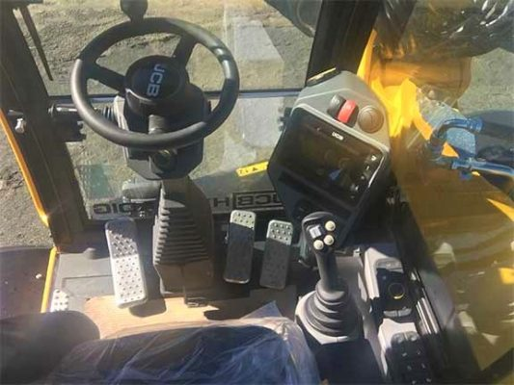

What do you need to dig a hole?
Pros
Cons
Cheap
Precise
No Training
Availability
Best tool for the job?
Slow
Labor
Creating the foundation for a house
Fast
Labor
Expensive
Training
Really good at digging
Takes up a lot of garage space
Thank you to Sean Yaw (the goat) for the analogy

Slide 17
What do you need to dig a hole?
Pros
Cons
Cheap
Precise
No Training
Availability
Best tool for the job?
Slow
Labor
Creating the foundation for a house
We can’t use the best tool for the job unless we know how to use that tool
Fast
Labor
Expensive
Training
Really good at digging
Takes up a lot of garage space
Thank you to Sean Yaw (the goat) for the analogy

Slide 18
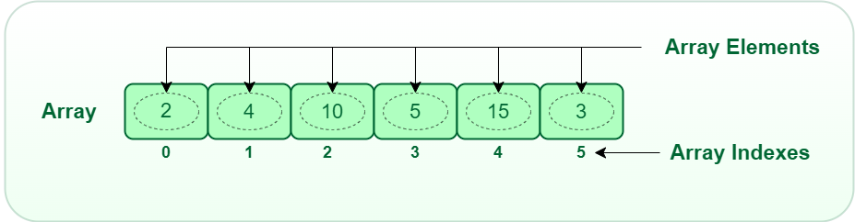
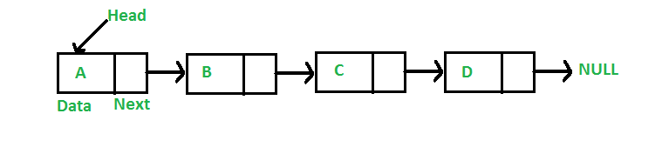
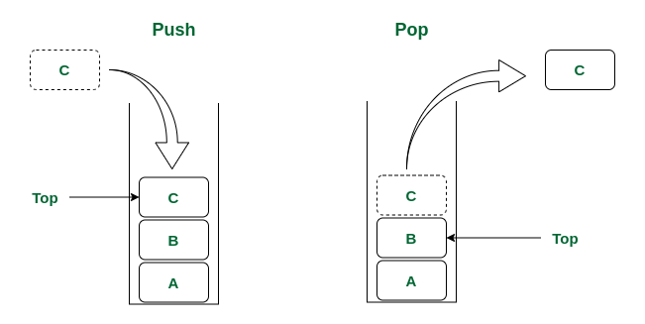
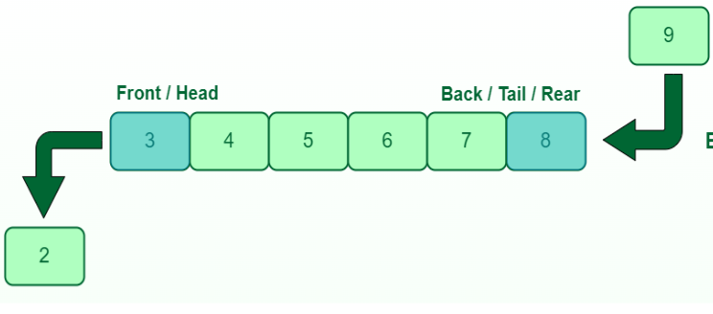
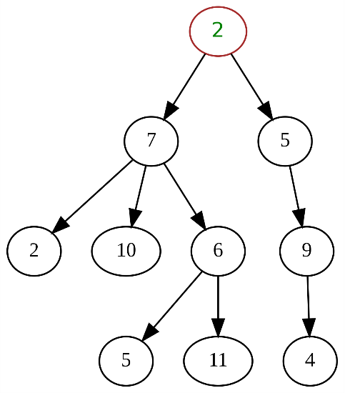
A data structure is a mechanism for storing and organizing data
Linked List
Arrays
Queue
Stack
Trees

Slide 19





A data structure is a mechanism for storing and organizing data
We have structured ways of accessing and managing data
Linked List
Arrays
Queue
There are many types of data structure, and each data structure has its pros and cons
Stack
Trees

Slide 20
An array is a data structure that can hold multiple, similar values
String[] cars = {"Volvo", "BMW", "Ford", "Mazda"};
int[] myNum = {10, 20, 30, 40};
Pros
Holds multiple pieces of information
Information is ordered (by index)
Can easily change what is stored in each slot
Can store duplicate data
Easy to iterate through

Slide 21
An array is a data structure that can hold multiple, similar values
String[] cars = {"Volvo", "BMW", "Ford", "Mazda"};
int[] myNum = {10, 20, 30, 40};
Cons
Can’t change the length
Can only store one data type
Pros
Holds multiple pieces of information
Information is ordered (by index)
Can easily change what is stored in each slot
Can store duplicate data
Easy to iterate through

Slide 22
Array Limitations
Cons
Can’t change the length
Can only store one data type
What can we do about this?
int[] myArray = {1, 2, 3};
System.out.println(Arrays.toString(myArray));
What if we wanted to add 4 to the array?

Slide 23
Array Limitations
Cons
Can’t change the length
Can only store one data type
What can we do about this?
int[] myArray = {1, 2, 3};
System.out.println(Arrays.toString(myArray));
int[] newArray = new int[myArray.length + 1];
for(int i = 0; i < myArray.length; i++) {
newArray[i] = myArray[i];
}
// Create a new array that is one spot bigger
// Fill new array with contents of old array

Slide 24
Array Limitations
Cons
Can’t change the length
Can only store one data type
What can we do about this?
int[] myArray = {1, 2, 3};
System.out.println(Arrays.toString(myArray));
int[] newArray = new int[myArray.length + 1];
for(int i = 0; i < myArray.length; i++) {
newArray[i] = myArray[i];
}
// Create a new array that is one spot bigger
// Fill new array with contents of old array
int new_value = 4;
newArray[myArray.length] = new_value;
myArray = newArray;
// add new value to array
// Update reference variable

Slide 25


Array Limitations
We updated our reference variable (myArray) to point to our new array with the new element
int[] myArray = {1, 2, 3};
System.out.println(Arrays.toString(myArray));
int[] newArray = new int[myArray.length + 1];
for(int i = 0; i < myArray.length; i++) {
newArray[i] = myArray[i];
}
int new_value = 4;
newArray[myArray.length] = new_value;
myArray = newArray;
myArray
newArray
1 | 2 | 3
1 | 2 | 3 | 4

Slide 26


Array Limitations
We updated our reference variable (myArray) to point to our new array with the new element
int[] myArray = {1, 2, 3};
System.out.println(Arrays.toString(myArray));
int[] newArray = new int[myArray.length + 1];
for(int i = 0; i < myArray.length; i++) {
newArray[i] = myArray[i];
}
int new_value = 4;
newArray[myArray.length] = new_value;
myArray = newArray;
myArray
newArray
1 | 2 | 3
1 | 2 | 3 | 4
What happens to this array?
This is an unused object

Slide 27
Array Limitations
We updated our reference variable (myArray) to point to our new array with the new element
int[] myArray = {1, 2, 3};
System.out.println(Arrays.toString(myArray));
int[] newArray = new int[myArray.length + 1];
for(int i = 0; i < myArray.length; i++) {
newArray[i] = myArray[i];
}
Java has a mechanism called Garbage Collection, with deletes unused object to free up memory
int new_value = 4;
newArray[myArray.length] = new_value;
myArray = newArray;
(this runs automatically!)
myArray
newArray
1 | 2 | 3
1 | 2 | 3 | 4
What happens to this array?
This is an unused object

Slide 28
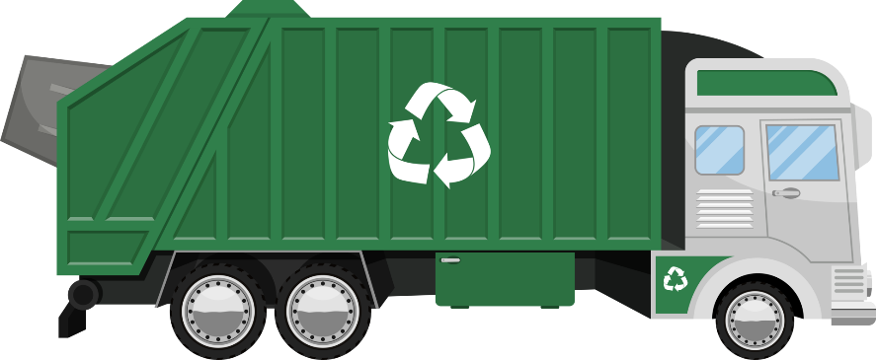
Array Limitations
We updated our reference variable (myArray) to point to our new array with the new element
int[] myArray = {1, 2, 3};
System.out.println(Arrays.toString(myArray));
int[] newArray = new int[myArray.length + 1];
for(int i = 0; i < myArray.length; i++) {
newArray[i] = myArray[i];
}
Java has a mechanism called Garbage Collection, with deletes unused object to free up memory
int new_value = 4;
newArray[myArray.length] = new_value;
myArray = newArray;
(this runs automatically!)
myArray
1 | 2 | 3
newArray
1 | 2 | 3 | 4
Java sees that we have an used/unreferenced object, so it will delete it!

Slide 29
Array Limitations
Cons
Can’t change the length
Can only store one data type
int[] myArray = {1, 2, 3};
System.out.println(Arrays.toString(myArray));
Solution
Create new array, copy everything over
int[] newArray = new int[myArray.length + 1];
for(int i = 0; i < myArray.length; i++) {
newArray[i] = myArray[i];
}
(this can be expensive ☹ )
int new_value = 4;
newArray[myArray.length] = new_value;
myArray = newArray;
Solution
Store an object, use two separate arrays, use a different data structure

Slide 30
We are going to write our own dynamic array data structure
Users should be able to:
Print the array
Add a new element to the array
Get an element at a particular index
Find the index of a particular element
Remove an element

Slide 31
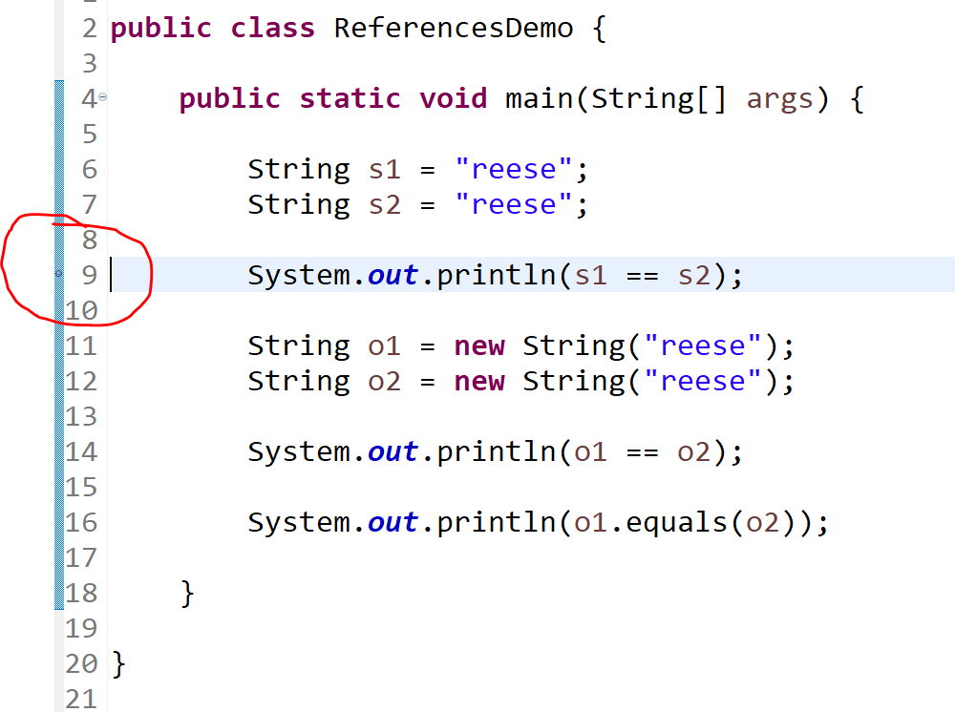
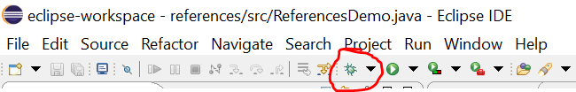
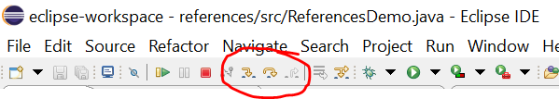
Debugging Code
Our IDE has a super nifty debugger, which allows us to pause our code, and then step through each line in the control flow.
The first thing to do is to place a breakpoint, which is where execution will pause at, and debugging will begin
Usually you try to place the breakpoint where you think things are going wrong
Then, press the little green bug icon next to the play button, which will run the debugger and stop at your breakpoint
Use the “step into” and “step over” buttons to start walking through your code

Slide 32
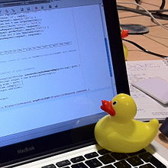
Debugging Code
Our IDE has a super slick debugger built in to it. I highly recommend learning how to use the debugger tool (see lecture)
Rubber Duck Debugging
Many programmers have had the experience of explaining a problem to someone else, possibly even to someone who knows nothing about programming, and then hitting upon the solution in the process of explaining the problem. In describing what the code is supposed to do and observing what it actually does, any incongruity between these two becomes apparent.^{[2]} More generally, teaching a subject forces its evaluation from different perspectives and can provide a deeper understanding.^{[3]} By using an inanimate object, the programmer can try to accomplish this without having to interrupt anyone else, and with better results than have been observed from merely thinking aloud without an audience.
(From Wikipedia)

