Slide 1

CSCI 132: Basic Data Structures and Algorithms
Linked Lists
Reese Pearsall
Spring 2025
https://www.cs.montana.edu/pearsall/classes/spring2025/132/main.html

Slide 2

Announcements
Program 1 is due Wednesday at 11:59 PM
No class on Monday (President’s day)
There will still be a lab due on Tuesday.
Wednesday may be a recorded lecture (no in-person lecture)

Slide 3
The List ADT
A List is a linear, ordered collection of elements
Can dynamically grow and shrink in size

Slide 4
The List ADT
A List is a linear, ordered collection of elements
Can dynamically grow and shrink in size
Very vague description. We can achieve this functionality in several different ways in java

Slide 5
The List ADT
A List is a linear, ordered collection of elements
Can dynamically grow and shrink in size
Very vague description. We can achieve this functionality in several different ways in java
Any list should be able to:
Get(index)
Add(Element)
Add(Element, index)
Remove(Element)
Remove(Index)
Size()
isEmpty()

Slide 6
The List ADT
A List is a linear, ordered collection of elements
Can dynamically grow and shrink in size
Very vague description. We can achieve this functionality in several different ways in java
Any list should be able to:
Get(index)
Add(Element)
Add(Element, index)
Remove(Element)
Remove(Index)
Size()
isEmpty()
A List Abstract Data Type (ADT) describes what a list needs to do, rather than how to implement it

Slide 7





The Pizza ADT
a dish of Italian origin consisting of a flat, round base of dough baked with a topping of tomato sauce and cheese, typically with added meat or vegetables.

Slide 8
The List ADT
A List is a linear, ordered collection of elements
Can dynamically grow and shrink in size
Very vague description. We can achieve this functionality in several different ways in java
Any list should be able to:
Get(index)
Add(Element)
Add(Element, index)
Remove(Element)
Remove(Index)
Size()
isEmpty()
A List Abstract Data Type (ADT) describes what a list needs to do, rather than how to implement it
Implementations of a List:
ArrayLists
Linked Lists

Slide 9


Linked Lists
A Linked List is a data structure that consists of a collection of connected nodes
Susan
Reese
Cosmo
Nodes consists of data (String, int, array, etc) and a pointer to the next node

Slide 10

Linked Lists
A Linked List is a data structure that consists of a collection of connected nodes
head
Susan
Reese
Cosmo
Nodes consists of data (String, int, array, etc) and a pointer to the next node
A Linked List also has a pointer to the start of the Linked List (head)

Slide 11
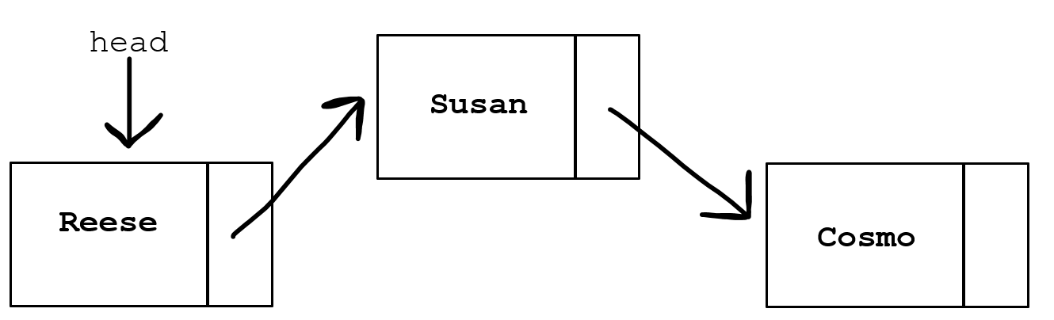
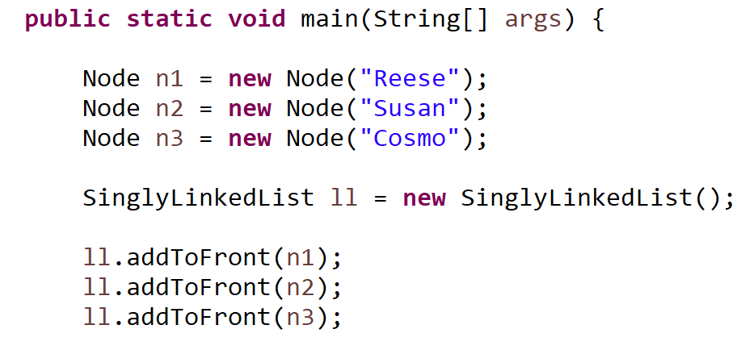

Node.java
LinkedList.java
LinkedListDemo.java
Reese
Collection of nodes connected by pointers.
head pointer
size of linked list
Methods for adding, removing, searching for nodes
Blueprint for a single node in our data structure. Nodes have data, and a pointer to the next node
Creates the LinkedList
Calls methods to manipulate Linked List

Slide 12
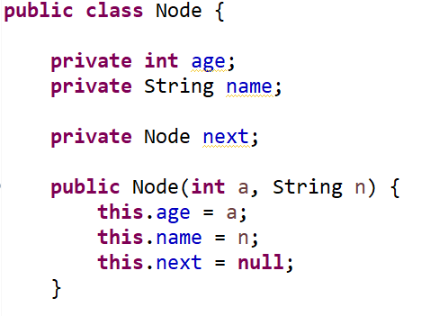
A Linked List will hold Node objects
Reese
Data
Pointer to next Node
Susan
Cosmo

Slide 13
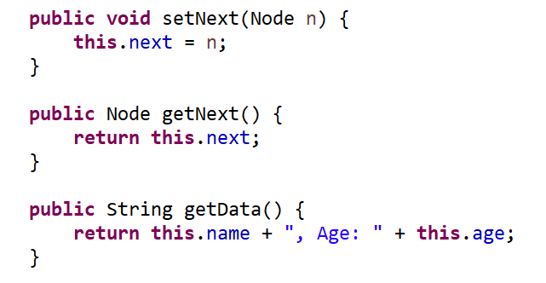

A Linked List will hold Node objects
System.out.println(reese.getNext().getData())
???
Reese
Cosmo

Slide 14

A Linked List will hold Node objects
System.out.println(reese.getNext().getData())
This would print out the Cosmo node’s data
next
Reese
Cosmo

Slide 15

A Linked List will hold Node objects
reese.setNext(susan)
???
Susan
next
Reese
Cosmo

Slide 16

A Linked List will hold Node objects
reese.setNext(susan)
Set’s the Reese’s node next value to point to Susan
Susan
next
Reese
The Cosmo node also got removed from the linked list (!!!)
Cosmo

Slide 17
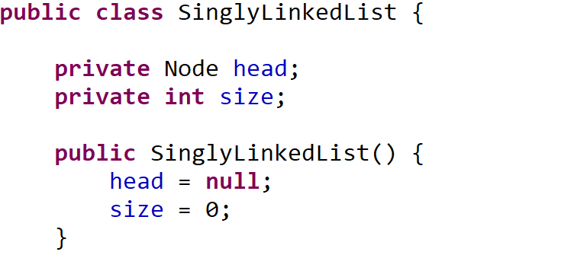


Linked List Creation
head
Susan
Reese
Cosmo
null

Slide 18

Linked List Methods
addToFront() - adds new node to beginning of LL
addToBack() – adds new node to end of LL
removeFirst() – removes first node of LL
removeLast() – removes last node of LL
printLinkedList() – prints nodes and their data
head
Susan
Reese
Cosmo
null

Slide 19
Linked List Methods
addToFront() - adds new node to beginning of LL
What if the Linked List is empty?

Slide 20


Linked List Methods
addToFront() - adds new node to beginning of LL
What if the Linked List is empty?
Set head equal to the new node
head
Reese
null

Slide 21

Linked List Methods
addToFront() - adds new node to beginning of LL
What if the Linked List is not empty?
head
Reese
null

Slide 22

Linked List Methods
addToFront() - adds new node to beginning of LL
What if the Linked List is not empty?
1. Set the new node’s next value to head
head
Susan
Reese
null

Slide 23


Linked List Methods
addToFront() - adds new node to beginning of LL
What if the Linked List is not empty?
Set the new node’s next value to head
Update head to point to new node
head
Susan
Reese
null

Slide 24
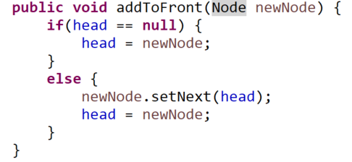

Linked List Methods
addToFront() - adds new node to beginning of LL
What if the Linked List is not empty?
Set the new node’s next value to head
Update head to point to new node
head
Susan
Reese
null

Slide 25
Linked List Methods
addToBack() – adds new node to end of LL
We need to find the end of the Linked List, but we don’t know how many Nodes there may be…
We need to find the last node!
But how do we know if a node is the last node ???
head
Susan
Reese
null

Slide 26
Linked List Methods
addToBack() – adds new node to end of LL
We need to find the end of the Linked List, but we don’t know how many Nodes there may be…
We need to find the last node!
But how do we know if a node is the last node? If a node’s next value is null
head
Susan
Reese
null

Slide 27
Linked List Methods
addToBack() – adds new node to end of LL
We need to find the end of the Linked List, but we don’t know how many Nodes there may be…
We need to find the last node!
But how do we know if a node is the last node? If a node’s next value is null
1. Traverse through the linked list until we find the last node
We will use a while loop to iterate through a Linked List
head
Start at the head node
Keep following pointers until we reach null
Susan
Reese
null

Slide 28
Linked List Methods
addToBack() – adds new node to end of LL
We need to find the end of the Linked List, but we don’t know how many Nodes there may be…
We need to find the last node!
But how do we know if a node is the last node? If a node’s next value is null
Traverse through the linked list until we find the last node
Set the last node’s next value equal to the new node
head
Susan
Reese
Cosmo
null

Slide 29
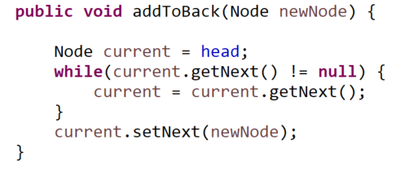
Linked List Methods
addToBack() – adds new node to end of LL
Traverse through the linked list until we find the last node
Set the last node’s next value equal to the new node
head
Susan
Reese
Cosmo
null

Slide 30

Linked List Methods
addToBack() – adds new node to end of LL
Traverse through the linked list until we find the last node
Set the last node’s next value equal to the new node
This method will fail if the LL is empty
head
Susan
Reese
Cosmo
null

Slide 31
Linked List Methods
printLinkedList() – prints nodes and their data
Iterate through each Node in the LL, and print the data in that node

Slide 32
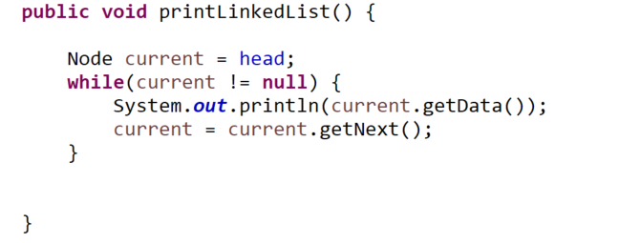
Linked List Methods
printLinkedList() – prints nodes and their data
Iterate through each Node in the LL, and print the data in that node

Slide 33



Linked List Methods
printLinkedList() – prints nodes and their data
Iterate through each Node in the LL, and print the data in that node
Always start at the head node
“Keep on looping until we reach the end of the LL”
This line updates the current node we are at
ie. “move to the next node”

Slide 34
Linked List Methods
removeFirst() – removes first node of LL
head
Susan
Reese
null

Slide 35
Linked List Methods
removeFirst() – removes first node of LL
1. Update head to be the next node
head
Susan
Reese
null

Slide 36

Linked List Methods
removeFirst() – removes first node of LL
Update head to be the next node
Update the old head’s next value to be null
head
Susan
Reese
null
null

Slide 37
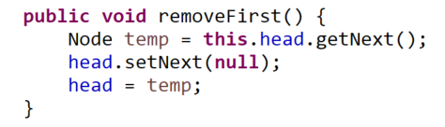


Linked List Methods
removeFirst() – removes first node of LL
Update head to be the next node
Update the old head’s next value to be null
Create a new temporary variable to save 2nd node value
head
Susan
Reese
null
null

Slide 38
Linked List Methods
removeFirst() – removes first node of LL
Update head to be the next node
Update the old head’s next value to be null
There's an easier way to do this
head
Susan
Reese
null
null

Slide 39

Linked List Methods
removeFirst() – removes first node of LL
Update head to be the next node
Update the old head’s next value to be null
We don’t need to remove the pointer.
Remember, whenever we iterate or add something to a list, we always start from the head node
If a node is not reachable from the head, it is essentially removed from the LL !!
There's an easier way to do this
head
Susan
Reese
null

Slide 40
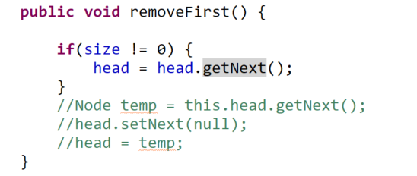

Linked List Methods
removeFirst() – removes first node of LL
Update head to be the next node
Update the old head’s next value to be null
We don’t need to remove the pointer.
Remember, whenever we iterate or add something to a list, we always start from the head node
If a node is not reachable from the head, it is essentially removed from the LL !!
There's an easier way to do this
head
(we need to also check that there is something to be removed, otherwise we get an error)
Susan
Reese
null

Slide 41

Linked List Methods
removeLast() – removes last node of LL
???
Susan
Reese
Cosmo
null

Slide 42

Linked List Methods
removeLast() – removes last node of LL
Find the second to last node
Set that node’s next value to null
head
Cosmo
null
Susan
Reese
null

Slide 43
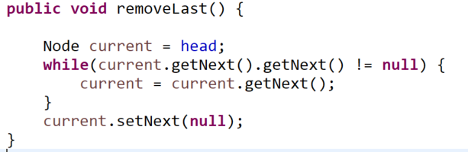


Linked List Methods
removeLast() – removes last node of LL
Find the second to last node
Set that node’s next value to null
head
Cosmo
null
Susan
Reese
null

Slide 44


Linked List Methods
removeLast() – removes last node of LL
Find the second to last node
Set that node’s next value to null
head
Will this always work?
Cosmo
null
Susan
Reese
null

Slide 45


Linked List Methods
removeLast() – removes last node of LL
Find the second to last node
Set that node’s next value to null
head
If the LL is empty, or of size 1, this will result in a NullPointerException
Cosmo
null
Susan
Reese
null

