Slide 1

CSCI 132: Basic Data Structures and Algorithms
Circular Linked Lists, Program 2
Reese Pearsall
Spring 2025
https://www.cs.montana.edu/pearsall/classes/spring2025/132/main.html

Slide 2
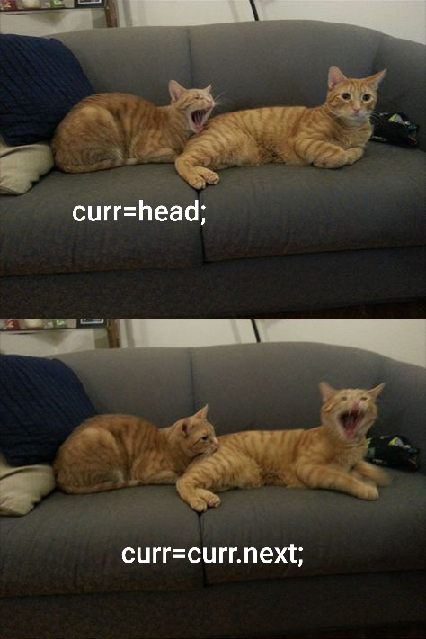

Announcements
Program 2 Posted
Due ~two weeks from now
I will be gone on Monday 2/24 and Wednesday 2/26
Ahmad (TA) is giving the lecture on Monday
Andras (TA) is giving the lecture on Wednesday
I wont have office hours those days

Slide 3
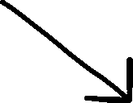
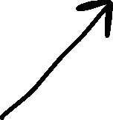
Linked Lists
A Linked List is a data structure that consists of a collection of connected nodes
Susan
Reese
Sarah
Nodes consists of data (String, int, array, etc) and a pointer to the next node

Slide 4








Linked Lists
A Doubly Linked List keeps track of the next node and the previous node
head
tail
Susan
Reese
prev
next
null
null
Spencer
prev
next
prev
next
next
prev

Slide 5






A Circular Linked List is a linked list where the first and last node are connected, which creates a circle
BZN
Bozeman
ORD
Chicago
SEA
Seattle
LAX
Los Angeles
BOS
Boston
head
tail

Slide 6


A Circular Linked List is a linked list where the first and last node are connected, which creates a circle
BZN
Bozeman
head.setPrev(tail);
tail.setNext(head);
ORD
Chicago
SEA
Seattle
LAX
Los Angeles
BOS
Boston
head
tail

Slide 7
Traversing a Circular Linked List
public void printList() {
Node current = this.head;
while(current != null) {
current.printNode();
current = current.getNext();
}
}
BZN
Bozeman
This was our previous code for traversing and printing out nodes in a linked list
ORD
Chicago
SEA
Seattle
This will no longer work because…
LAX
Los Angeles
BOS
Boston
head
tail

Slide 8
Traversing a Circular Linked List
public void printList() {
Node current = this.head;
while(current != null) {
current.printNode();
current = current.getNext();
}
}
BZN
Bozeman
This was our previous code for traversing and printing out nodes in a linked list
ORD
Chicago
SEA
Seattle
This will no longer work because…
LAX
Los Angeles
BOS
Boston
We will never reach null
head
tail

Slide 9
Traversing a Circular Linked List
Suppose our goal is to print out each node only once
BZN
Bozeman
ORD
Chicago
SEA
Seattle
LAX
Los Angeles
BOS
Boston
head
tail

Slide 10
Traversing a Circular Linked List
Suppose our goal is to print out each node only once
BZN
Bozeman
ORD
Chicago
SEA
Seattle
How do we know that we’ve reached the “end” of the CLL ?
LAX
Los Angeles
BOS
Boston
head
tail

Slide 11
Traversing a Circular Linked List
Suppose our goal is to print out each node only once
BZN
Bozeman
ORD
Chicago
SEA
Seattle
How do we know that we’ve reached the “end” of the CLL ?
LAX
Los Angeles
BOS
Boston
head
tail
If we start from the head, we should stop looping once we reach the head again

Slide 12






Traversing a Circular Linked List
If we start from the head, we should stop looping once we reach the head again
BZN
Bozeman
ORD
Chicago
SEA
Seattle
public void printLinkedList() {
Node current = this.head.getNext();
while(current != this.head) {
current.printNode();
current = current.getNext();
}
}
LAX
Los Angeles
BOS
Boston
head
tail

Slide 13






Traversing a Circular Linked List
If we start from the head, we should stop looping once we reach the head again
BZN
Bozeman
ORD
Chicago
SEA
Seattle
public void printLinkedList() {
Node current = this.head.getNext();
while(current != this.head) {
current.printNode();
current = current.getNext();
}
}
LAX
Los Angeles
BOS
Boston
head
tail
This won’t work because…

Slide 14
Traversing a Circular Linked List
If we start from the head, we should stop looping once we reach the head again
BZN
Bozeman
ORD
Chicago
SEA
Seattle
public void printLinkedList() {
Node current = this.head.getNext();
while(current != this.head) {
current.printNode();
current = current.getNext();
}
}
LAX
Los Angeles
BOS
Boston
head
tail
This won’t work because…
The head node will never be printed out

Slide 15
Traversing a Circular Linked List
If we start from the head, we should stop looping once we reach the head again
BZN
Bozeman
ORD
Chicago
SEA
Seattle
public void printLinkedList() {
Node current = this.head;
do {
current.printNode();
current = current.getNext();
}
while(current != this.head);
}
LAX
Los Angeles
BOS
Boston
head
tail
A do/while loop executed the body of the loop, and then checks the looping condition

Slide 16
Program 2

