Slide 1

CSCI 132: Basic Data Structures and Algorithms
Stacks (Linked List implementation)
Reese Pearsall
Spring 2024
https://www.cs.montana.edu/pearsall/classes/spring2024/132/main.html
*All images are stolen from the internet

Slide 2
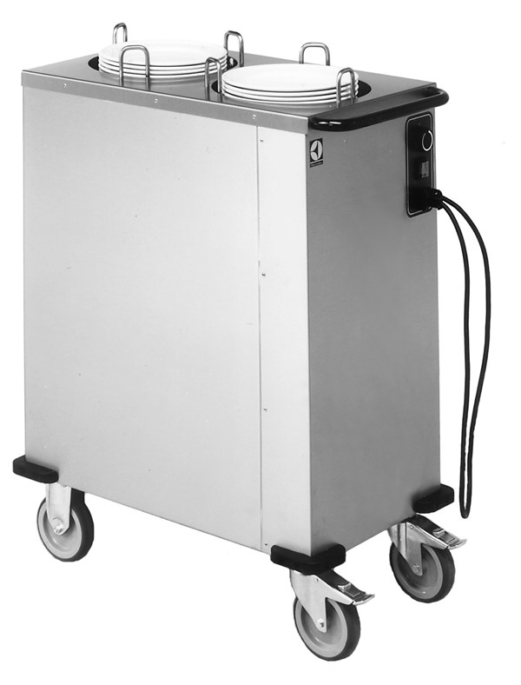
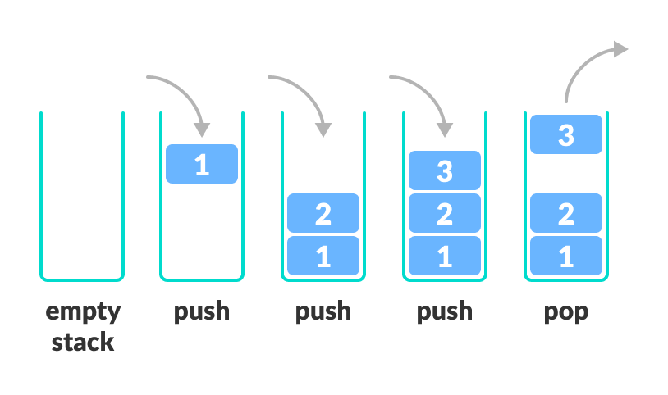
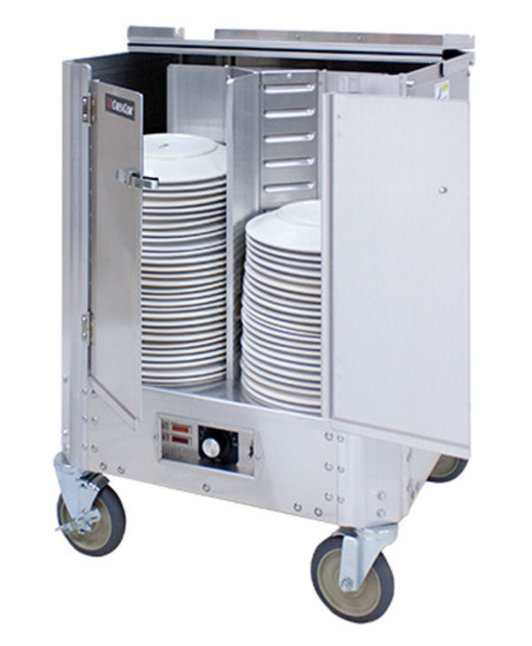
A stack is a data structure that can hold data, and follows the last in first out (LIFO) principle
We can:
Add an element to the top of the stack (push)
Remove the top element (pop)
We can implement a Stack using an Array, or a linked List

Slide 3
Stack Implementation (Linked List)
To Do List:
Push()
Pop()
Peek()
IsEmpty()
We will import the Linked List Library (we will not write our own linked list class)
Head
Spencer
If we don’t know how big out stack needs to be ahead of time, then using a linked list will be a better choice than an array/arraylist
Susan
Cosmo
Reese
The top of the stack will be the head of the linked list

Slide 4
Stack Implementation (Linked List)
To Do List:
Push()
Pop()
Peek()
IsEmpty()
We will import the Linked List Library (we will not write our own linked list class)
Head
Jeff
stack.push(“Jeff”)
Spencer
Whenever we add something to the stack, we add the element to the front of the linked list
Susan
Cosmo
Reese
The top of the stack will be the head of the linked list

Slide 5
Stack Implementation (Linked List)
To Do List:
Push()
Pop()
Peek()
IsEmpty()
We will import the Linked List Library (we will not write our own linked list class)
stack.pop()
Head
Spencer
Whenever we remove an element from the stack ( pop() ), we always remove the head node of the linked list
Susan
Cosmo
Reese
The top of the stack will be the head of the linked list

Slide 6
Stack Implementation (Linked List)
To Do List:
Push()
Pop()
Peek()
IsEmpty()
We will import the Linked List Library (we will not write our own linked list class)
public void push(newElement){
}
Head
addToFront(newElement);
size++
Spencer
Susan
When we use a linked list, we are no longer restricted by a fixed size
Cosmo
Reese

Slide 7
Stack Implementation (Linked List)
To Do List:
Push()
Pop()
Peek()
IsEmpty()
We will import the Linked List Library (we will not write our own linked list class)
public void push(newElement){
}
Head
addToFront(newElement);
size++
top_of_stack = head
Spencer
Susan
When we use a linked list, we are no longer restricted by a fixed size
public void pop(){
}
Cosmo
If size == 0:
return
Else:
removeFront()
size--
top_of_stack = head
Reese

