Slide 1

CSCI 132: Basic Data Structures and Algorithms
References, Static Methods, Exceptions
Reese Pearsall
Spring 2025
https://www.cs.montana.edu/pearsall/classes/spring2025/132/main.html

Slide 2
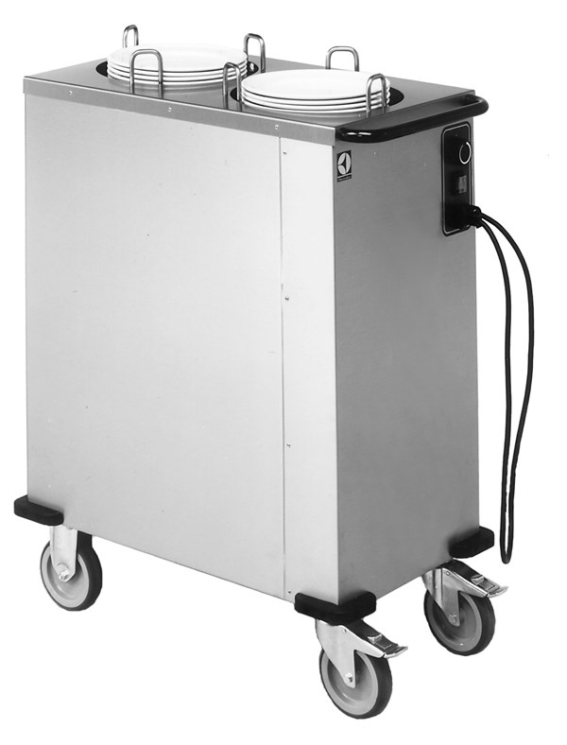
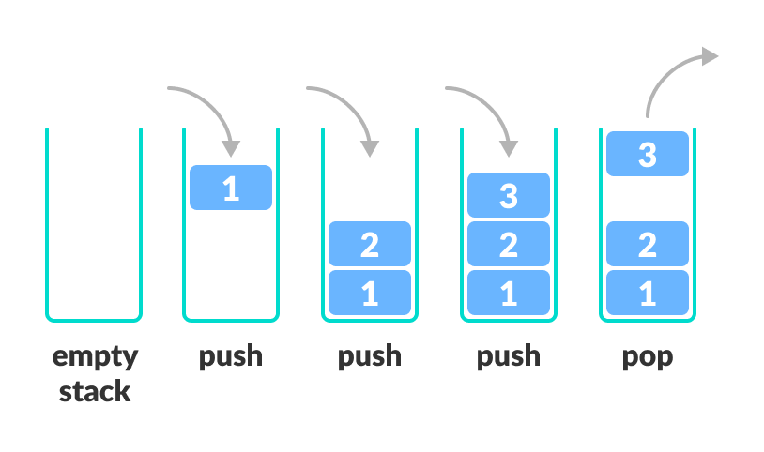
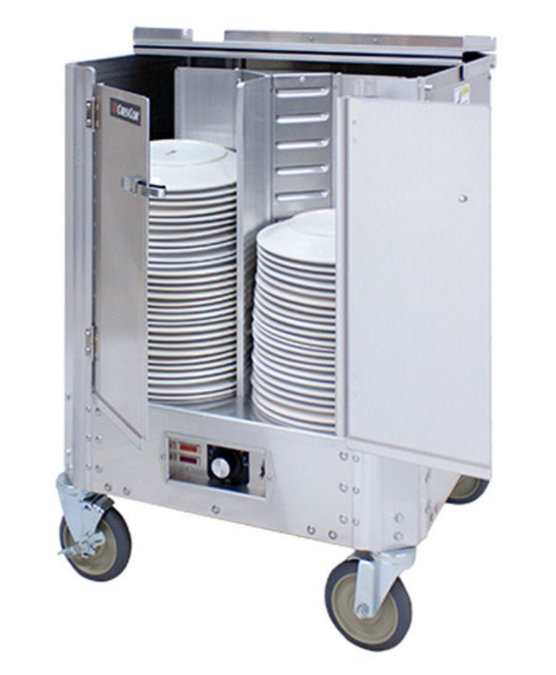
A stack is a data structure that can hold data, and follows the last in first out (LIFO) principle
We can:
Add an element to the top of the stack (push)
Remove the top element (pop)
Any Stack (Stack ADT) must be able to:
Push()
Pop()
Peek()
isEmpty()
We can implement a Stack using an Array, or a linked list

Slide 3
public class ReferencesDemo {
public static void main(String[] args) {
Person person1 = new Person("Jim Bob", 44);
Person person2 = new Person("Sally", 28);
}
}
person1 and person2 are references to a Person object
person1
name: “Jim Bob”
age: 44
name: “Sally”
age: 28
person2

Slide 4
public class ReferencesDemo {
public static void main(String[] args) {
Person person1 = new Person("Jim Bob", 44);
Person person2 = new Person("Sally", 28);
person1.changeName("Jack");
}
}
person1 and person2 are references to a Person object
person1
name: “Jim Bob”
age: 44
name: “Sally”
age: 28
person2

Slide 5

public class ReferencesDemo {
public static void main(String[] args) {
Person person1 = new Person("Jim Bob", 44);
Person person2 = new Person("Sally", 28);
person1.changeName("Jack");
}
}
person1 and person2 are references to a Person object
person1
name: “Jack”
age: 44
name: “Sally”
age: 28
person2
In this method call, this is referencing the person1 object

Slide 6
public class ReferencesDemo {
public static void main(String[] args) {
Person person1 = new Person("Jim Bob", 44);
Person person2 = new Person("Sally", 28);
Person person3 = person1;
}
}
Suppose we create a new reference variable and link it to an existing object
person1
name: “Jack”
age: 44
name: “Sally”
age: 28
person2
In this method call, this is referencing the person1 object

Slide 7
public class ReferencesDemo {
public static void main(String[] args) {
Person person1 = new Person("Jim Bob", 44);
Person person2 = new Person("Sally", 28);
Person person3 = person1;
}
}
Suppose we create a new reference variable and link it to an existing object
person3 is now pointing to same object and person1
person1
name: “Jack”
age: 44
person3
name: “Sally”
age: 28
person2
In this method call, this is referencing the person1 object

Slide 8
public class ReferencesDemo {
public static void main(String[] args) {
Person person1 = new Person("Jim Bob", 44);
Person person2 = new Person("Sally", 28);
Person person3 = person1;
person1.changeName("test");
}
}
Suppose we create a new reference variable and link it to an existing object
person3 is now pointing to same object and person1
person1
name: “test”
age: 44
person3
Any changes to person1 will also update person3 (and vice versa)
System.out.println(person1.getName()) → “test”
System.out.println(person3.getName()) → “test”

Slide 9

Static methods are methods in Java that can be called without creating an object of a class
public class StaticDemo {
public static void fun1(String arg1) {
System.out.println(arg1);
}
public static void main(String[] args) {
fun1("Hello");
}
}
I do not need to create a StaticDemo object in order to call the fun1() method

Slide 10


Static methods are methods in Java that can be called without creating an object of a class
public class StaticDemo {
public static void main(String[] args) {
AnotherClass.funMethod("Hello");
}
}
public class AnotherClass {
public static void funMethod(String arg)
{
System.out.println(arg);
}
}
StaticDemo.java
AnotherClass.java
If the static method is in another class, we can access it by giving the class name (AnotherClass)
Once again, I do not need to create an AnotherClass object to call this static method
However, now objects are no longer an implicit argument to this method (cant use this anymore)

Slide 11
Static methods are methods in Java that can be called without creating an object of a class
Error: static method cannot be referenced from a non static context
funMethod("Hello");
This is a very common error to see in Java.
You can turn the method static by adding the static keyword in the method definition
Or you use OOP and call the method on an instance of the class
(Easy and quick fix)
AnotherClass obj = new AnotherClass()
obj.funMethod(“Hello”)
(Usually this is the better solution 80% of the time)

Slide 12
try/catch and exceptions are a way to run a piece of code (“try”), and then deal (“catch”) with errors
It will execute the body of try, and if a certain error/exceptions arises, then it will run the body of the catch statement
You can catch any error, or a specific error (FileNotFound, ArrayIndexOutOfBounds, NullPointerException)

Slide 13
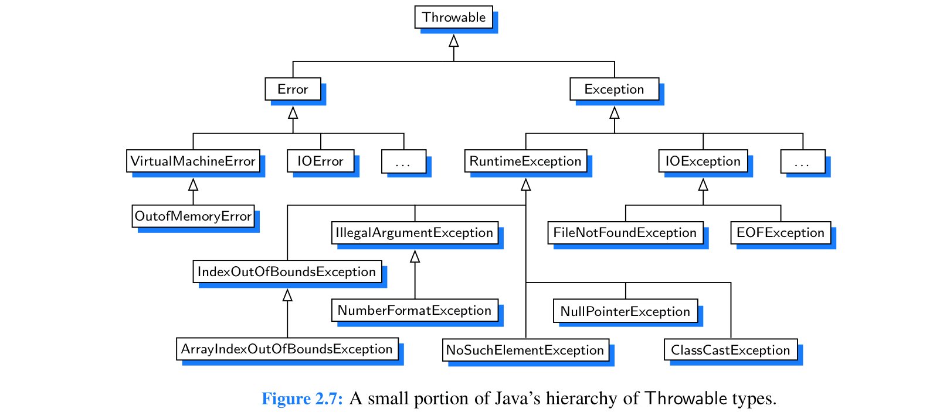

Slide 14
while(userChoice != 3) {
try {
Scanner scanner = new Scanner(System.in);
userChoice = scanner.nextInt();
if(userChoice == 1) {
System.out.println("Hello");
}
else if(userChoice == 2) {
System.out.println("Hey");
}
else if(userChoice == 3) {
System.out.println("Goodbye");
}
else {
System.out.println("Enter a valid integer");
}
}
catch(Exception e) {
System.out.println(e);
System.out.println("Invalid input detected. Please try again");
}
printOptions();
Java will try to execute this block of code

Slide 15


while(userChoice != 3) {
try {
Scanner scanner = new Scanner(System.in);
userChoice = scanner.nextInt();
if(userChoice == 1) {
System.out.println("Hello");
}
else if(userChoice == 2) {
System.out.println("Hey");
}
else if(userChoice == 3) {
System.out.println("Goodbye");
}
else {
System.out.println("Enter a valid integer");
}
}
catch(Exception e) {
System.out.println(e);
System.out.println("Invalid input detected. Please try again");
}
printOptions();
Java will try to execute this block of code
If any error happens, instead of crashing, it will execute the body of the catch

