Slide 1

CSCI 132: Basic Data Structures and Algorithms
Time Complexity, Big-O
Reese Pearsall
Spring 2025
https://www.cs.montana.edu/pearsall/classes/spring2025/132/main.html

Slide 2
Announcements
No Lab next week
Midterm Exam is a week from today
Review/Study Guide has been posted

Slide 3
Suppose you are moving across the country. You’ve contracted a builder to build you a brand-new house. You are trying to plan which date you should put all your belongings in the truck and move to the new house across the country. You ask the builder the following question:
How long will it take to finish building the house?

Slide 4
Suppose you are moving across the country. You’ve contracted a builder to build you a brand-new house. You are trying to plan which date you should put all your belongings in the truck and move to the new house across the country. You ask the builder the following question:
How long will it take to finish building the house?
The builder is unsure exactly when he will be done, but he offers the following answers in an enclosed envelope. You can only pick one.

Slide 5
Suppose you are moving across the country. You’ve contracted a builder to build you a brand-new house. You are trying to plan which date you should put all your belongings in the truck and move to the new house across the country. You ask the builder the following question:
How long will it take to finish building the house?
The builder is unsure exactly when he will be done, but he offers the following answers in an enclosed envelope. You can only pick one.
The fastest time he has completed a house in the past

Slide 6
Suppose you are moving across the country. You’ve contracted a builder to build you a brand-new house. You are trying to plan which date you should put all your belongings in the truck and move to the new house across the country. You ask the builder the following question:
How long will it take to finish building the house?
The builder is unsure exactly when he will be done, but he offers the following answers in an enclosed envelope. You can only pick one.
The fastest time he has completed a house in the past
The slowest time he has completed a house in the past

Slide 7
Suppose you are moving across the country. You’ve contracted a builder to build you a brand-new house. You are trying to plan which date you should put all your belongings in the truck and move to the new house across the country. You ask the builder the following question:
How long will it take to finish building the house?
The builder is unsure exactly when he will be done, but he offers the following answers in an enclosed envelope. You can only pick one.
The fastest time he has completed a house in the past
The slowest time he has completed a house in the past
The average time it takes him to complete a house

Slide 8
Suppose you are moving across the country. You’ve contracted a builder to build you a brand-new house. You are trying to plan which date you should put all your belongings in the truck and move to the new house across the country. You ask the builder the following question:
How long will it take to finish building the house?
The builder is unsure exactly when he will be done, but he offers the following answers in an enclosed envelope. You can only pick one.
(We will also assume they won’t break any records for fastest/slowest time)
The fastest time he has completed a house in the past
The slowest time he has completed a house in the past
The average time it takes him to complete a house
“Best case scenario”
“Worst case scenario”
Average

Slide 9
Suppose you are moving across the country. You’ve contracted a builder to build you a brand-new house. You are trying to plan which date you should put all your belongings in the truck and move to the new house across the country. You ask the builder the following question:
How long will it take to finish building the house?
The builder is unsure exactly when he will be done, but he offers the following answers in an enclosed envelope. You can only pick one.
The slowest time he has completed a house in the past
If we select this option, we are guaranteed a date that the house will be finished by
(The house might be empty for a few days, but that’s much better than having to stay in a hotel until the house is ready)
“Worst case scenario”

Slide 10
The running time of an algorithm is the time it takes for an algorithm to completely run from start to finish
There are a few ways we can measure running time:

Slide 11
The running time of an algorithm is the time it takes for an algorithm to completely run from start to finish
There are a few ways we can measure running time:
Time (seconds, nanoseconds, minutes, days, etc)

Slide 12
The running time of an algorithm is the time it takes for an algorithm to completely run from start to finish
There are a few ways we can measure running time:
Time (seconds, nanoseconds, minutes, days, etc)
Practical, but the hardware of the computer greatly affects the time needed
We need a way to measure running time that is independent from the hardware the computer has

Slide 13
The running time of an algorithm is the time it takes for an algorithm to completely run from start to finish
There are a few ways we can measure running time:
Time (seconds, nanoseconds, minutes, days, etc)
2. Number of operations required to complete algorithm.

Slide 14
The running time of an algorithm is the time it takes for an algorithm to completely run from start to finish
There are a few ways we can measure running time:
Time (seconds, nanoseconds, minutes, days, etc)
2. Number of operations required to complete algorithm.
To measure the running time of an algorithm, we will count the number of operations the algorithm performs, and look at how these operations scale as the input increases

Slide 15
The running time of an algorithm is the time it takes for an algorithm to completely run from start to finish
There are a few ways we can measure running time:
Time (seconds, nanoseconds, minutes, days, etc)
2. Number of operations required to complete algorithm.
To measure the running time of an algorithm, we will count the number of operations the algorithm performs, and look at how these operations scale as the input increases
When we describe the running time of an algorithm, we will represent it using Big-O Notation

Slide 16
A primitive operation is an operation that has a constant execution time

Slide 17
A primitive operation is an operation that has a constant execution time
Assigning a value to a variable
int N = 3;

Slide 18
A primitive operation is an operation that has a constant execution time
Assigning a value to a variable
Performing an arithmetic operation
int N = 3;
a = a + 3 * 12

Slide 19
A primitive operation is an operation that has a constant execution time
int N = 3;
a = a + 3 * 12
if(n >= i)
Assigning a value to a variable
Performing an arithmetic operation
Comparing two numbers/values

Slide 20
A primitive operation is an operation that has a constant execution time
int N = 3;
a = a + 3 * 12
if(n >= i)
i = arr[3]
Assigning a value to a variable
Performing an arithmetic operation
Comparing two numbers/values
Accessing an element in an array (by index)

Slide 21
A primitive operation is an operation that has a constant execution time
int N = 3;
a = a + 3 * 12
if(n >= i)
i = arr[3]
Assigning a value to a variable
Performing an arithmetic operation
Comparing two numbers/values
Accessing an element in an array (by index)

Slide 22
A primitive operation is an operation that has a constant execution time
int N = 3;
a = a + 3 * 12
if(n >= i)
i = arr[3]
return
Assigning a value to a variable
Performing an arithmetic operation
Comparing two numbers/values
Accessing an element in an array (by index)
Returning from a method

Slide 23
A primitive operation is an operation that has a constant execution time
int N = 3;
a = a + 3 * 12
if(n >= i)
i = arr[3]
return
System.out.println(“Hi”)
Assigning a value to a variable
Performing an arithmetic operation
Comparing two numbers/values
Accessing an element in an array (by index)
Returning from a method
Printing out a value

Slide 24
public int find_element_in_array(int[] array, int s) {
for(int i = 0; i < array.length; i++) {
if(array[i] == s) {
return i;
}
}
return -1;
}
This algorithm finds the location (index) of an integer S in an array of size N

Slide 25
public int find_element_in_array(int[] array, int s) {
for(int i = 0; i < array.length; i++) {
if(array[i] == s) {
return i;
}
}
return -1;
}
This algorithm finds the location (index) of an integer S in an array of size N
The number of operations this algorithm executes varies because…

Slide 26
public int find_element_in_array(int[] array, int s) {
for(int i = 0; i < array.length; i++) {
if(array[i] == s) {
return i;
}
}
return -1;
}
This algorithm finds the location (index) of an integer S in an array of size N
The number of operations this algorithm executes varies S will be at different locations

Slide 27

public int find_element_in_array(int[] array, int s) {
for(int i = 0; i < array.length; i++) {
if(array[i] == s) {
return i;
}
}
return -1;
}
This algorithm finds the location (index) of an integer S in an array of size N
This is a primitive operation, lets count how many times this operation is executed given some input

Slide 28
public int find_element_in_array(int[] array, int s) {
for(int i = 0; i < array.length; i++) {
if(array[i] == s) {
return i;
}
}
return -1;
}
This algorithm finds the location (index) of an integer S in an array of size N
S = 5
4 | 6 | 3 | 5 | 1 | 8 | 2 | 9 | 7 | 10

Slide 29
public int find_element_in_array(int[] array, int s) {
for(int i = 0; i < array.length; i++) {
if(array[i] == s) {
return i;
}
}
return -1;
}
This algorithm finds the location (index) of an integer S in an array of size N
S = 5
4 | 6 | 3 | 5 | 1 | 8 | 2 | 9 | 7 | 10

Slide 30
public int find_element_in_array(int[] array, int s) {
for(int i = 0; i < array.length; i++) {
if(array[i] == s) {
return i;
}
}
return -1;
}
This algorithm finds the location (index) of an integer S in an array of size N
S = 5
4 | 6 | 3 | 5 | 1 | 8 | 2 | 9 | 7 | 10

Slide 31
public int find_element_in_array(int[] array, int s) {
for(int i = 0; i < array.length; i++) {
if(array[i] == s) {
return i;
}
}
return -1;
}
This algorithm finds the location (index) of an integer S in an array of size N
S = 5
4 | 6 | 3 | 5 | 1 | 8 | 2 | 9 | 7 | 10

Slide 32
public int find_element_in_array(int[] array, int s) {
for(int i = 0; i < array.length; i++) {
if(array[i] == s) {
return i;
}
}
return -1;
}
This algorithm finds the location (index) of an integer S in an array of size N
S = 5
4 | 6 | 3 | 5 | 1 | 8 | 2 | 9 | 7 | 10

Slide 33
public int find_element_in_array(int[] array, int s) {
for(int i = 0; i < array.length; i++) {
if(array[i] == s) {
return i;
}
}
return -1;
}
This algorithm finds the location (index) of an integer S in an array of size N
S = 5
4 | 6 | 3 | 5 | 1 | 8 | 2 | 9 | 7 | 10

Slide 34
public int find_element_in_array(int[] array, int s) {
for(int i = 0; i < array.length; i++) {
if(array[i] == s) {
return i;
}
}
return -1;
}
This algorithm finds the location (index) of an integer S in an array of size N
S = 5
4 | 6 | 3 | 5 | 1 | 8 | 2 | 9 | 7 | 10
4 operations (5 operations including the return)

Slide 35
public int find_element_in_array(int[] array, int s) {
for(int i = 0; i < array.length; i++) {
if(array[i] == s) {
return i;
}
}
return -1;
}
This algorithm finds the location (index) of an integer S in an array of size N
S = ???
4 | 6 | 3 | 5 | 1 | 8 | 2 | 9 | 7 | 10
What is the best-case scenario for this algorithm (when would this have the shortest running time) ?

Slide 36
public int find_element_in_array(int[] array, int s) {
for(int i = 0; i < array.length; i++) {
if(array[i] == s) {
return i;
}
}
return -1;
}
This algorithm finds the location (index) of an integer S in an array of size N
S = 4
4 | 6 | 3 | 5 | 1 | 8 | 2 | 9 | 7 | 10
What is the best-case scenario for this algorithm (when would this have the shortest running time) ?

Slide 37
public int find_element_in_array(int[] array, int s) {
for(int i = 0; i < array.length; i++) {
if(array[i] == s) {
return i;
}
}
return -1;
}
This algorithm finds the location (index) of an integer S in an array of size N
S = ?
4 | 6 | 3 | 5 | 1 | 8 | 2 | 9 | 7 | 10
What is the worst-case scenario for this algorithm (when would this have the longest running time) ?

Slide 38
public int find_element_in_array(int[] array, int s) {
for(int i = 0; i < array.length; i++) {
if(array[i] == s) {
return i;
}
}
return -1;
}
This algorithm finds the location (index) of an integer S in an array of size N
S = 1 1
4 | 6 | 3 | 5 | 1 | 8 | 2 | 9 | 7 | 10
What is the worst-case scenario for this algorithm (when would this have the longest running time) ?

Slide 39
Running Time
Input Instance

Slide 40
Best Case Scenario
Worst Case scenario
Running Time
Input Instance

Slide 41
Best Case Scenario
Worst Case scenario
Running Time
Average
Input Instance

Slide 42
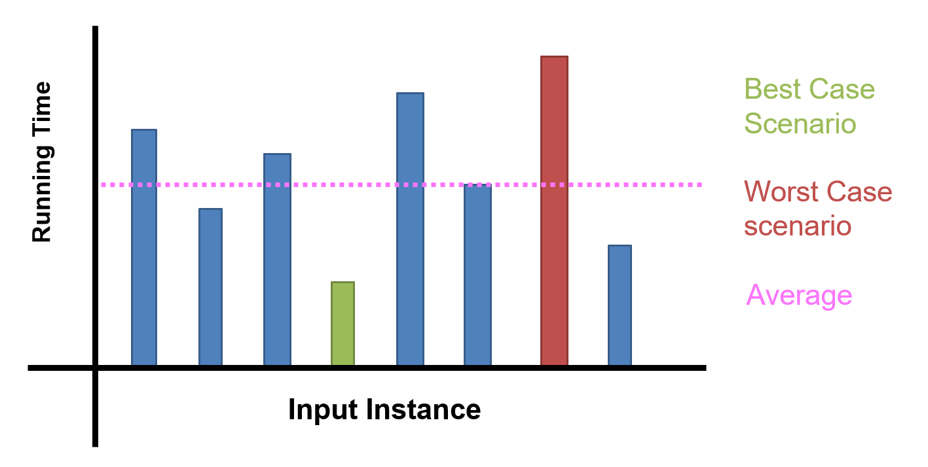
In computer science (and this class in particular), we will be focusing on stating running time in terms of worst-case scenario

Slide 43
public int find_element_in_array(int[] array, int s) {
for(int i = 0; i < array.length; i++) {
if(array[i] == s) {
return i;
}
}
return -1;
}
To compute the running time of this algorithm, we will go line-by-line and state the running time of each operation (worst-case scenario)
At the end, add everything up to get the total running time

Slide 44
public int find_element_in_array(int[] array, int s) {
for(int i = 0; i < array.length; i++) {
if(array[i] == s) {
return i;
}
}
return -1;
}

Slide 45
public int find_element_in_array(int[] array, int s) {
for(int i = 0; i < array.length; i++) {
if(array[i] == s) {
return i;
}
}
return -1;
}
N
Worse case scenario, this for loop will run N times (N = size of the array)

Slide 46
public int find_element_in_array(int[] array, int s) {
for(int i = 0; i < array.length; i++) {
if(array[i] == s) {
return i;
}
}
return -1;
}
N

Slide 47
public int find_element_in_array(int[] array, int s) {
for(int i = 0; i < array.length; i++) {
if(array[i] == s) {
return i;
}
}
return -1;
}
N
1
This is a primitive operation, so it will always run in constant time

Slide 48
public int find_element_in_array(int[] array, int s) {
for(int i = 0; i < array.length; i++) {
if(array[i] == s) {
return i;
}
}
return -1;
}
N
1

Slide 49
public int find_element_in_array(int[] array, int s) {
for(int i = 0; i < array.length; i++) {
if(array[i] == s) {
return i;
}
}
return -1;
}
N
1
1

Slide 50
public int find_element_in_array(int[] array, int s) {
for(int i = 0; i < array.length; i++) {
if(array[i] == s) {
return i;
}
}
return -1;
}
N
1
1
1

Slide 51
public int find_element_in_array(int[] array, int s) {
for(int i = 0; i < array.length; i++) {
if(array[i] == s) {
return i;
}
}
return -1;
}
N
1
1
This whole block consists of only primitive operation, so we will group everything together and call it one single primitive operation
1

Slide 52
public int find_element_in_array(int[] array, int s) {
for(int i = 0; i < array.length; i++) {
if(array[i] == s) {
return i;
}
}
return -1;
}
N
1
1
Total Running Time =

Slide 53
public int find_element_in_array(int[] array, int s) {
for(int i = 0; i < array.length; i++) {
if(array[i] == s) {
return i;
}
}
return -1;
}
N
1
1
Total Running Time = N * 1 + 1
The if statement is inside the for loop, so we must multiply it by N (number of time the for loop runs)

Slide 54
public int find_element_in_array(int[] array, int s) {
for(int i = 0; i < array.length; i++) {
if(array[i] == s) {
return i;
}
}
return -1;
}
N
1
1
Total Running Time = N + 1

Slide 55


public int find_element_in_array(int[] array, int s) {
for(int i = 0; i < array.length; i++) {
if(array[i] == s) {
return i;
}
}
return -1;
}
N
1
1
Total Running Time = N + 1
O(N + 1 )
Big-O = Running Time in terms of worst-case scenario
“Big-Oh”

Slide 56


public int find_element_in_array(int[] array, int s) {
for(int i = 0; i < array.length; i++) {
if(array[i] == s) {
return i;
}
}
return -1;
}
N
1
1
Total Running Time = N + 1
O(N + 1 ) where N = Size of Array
“Big-Oh”

Slide 58
Big O Formal Definition
Let ƒ(n) and g(n) be functions mapping positive integers to positive real numbers
ƒ(n) is O(g(n)) if there is a real constant c > 0 and an integer constant n₀ ≥ 1 such that
ƒ(n) ≤ c · g(n), for all n ≥ n₀

Slide 59
Big O Formal Definition
Let ƒ(n) and g(n) be functions mapping positive integers to positive real numbers
ƒ(n) is O(g(n)) if there is a real constant c > 0 and an integer constant n₀ ≥ 1 such that
ƒ(n) ≤ c · g(n), for all n ≥ n₀
Past a certain spot, g(n) dominates f(n) within a multiplicative constant

Slide 60
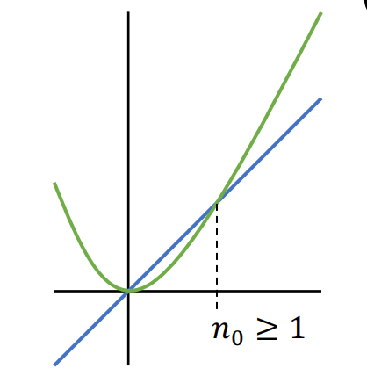
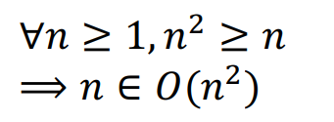
Big O Formal Definition
Let ƒ(n) and g(n) be functions mapping positive integers to positive real numbers
ƒ(n) is O(g(n)) if there is a real constant c > 0 and an integer constant n₀ ≥ 1 such that
ƒ(n) ≤ c · g(n), for all n ≥ n₀
Past a certain spot, g(n) dominates f(n) within a multiplicative constant
g(n)
f(n)
O -notation provides an upper bound on some function ƒ(n)

Slide 61
Big-O
Notation used to describe the running time of an algorithm in terms of worse case scenario
Traits of Big-O-Notation:
In Big-O, we can drop non-dominant factors

Slide 62
Big-O
Notation used to describe the running time of an algorithm in terms of worse case scenario
Traits of Big-O-Notation:
In Big-O, we can drop non-dominant factors
x² + x + 10

Slide 63
Big-O
Notation used to describe the running time of an algorithm in terms of worse case scenario
Traits of Big-O-Notation:
In Big-O, we can drop non-dominant factors
x² + x + 10
When X is really really big, these factors don’t contribute very much at all

Slide 64
Big-O
Notation used to describe the running time of an algorithm in terms of worse case scenario
Traits of Big-O-Notation:
In Big-O, we can drop non-dominant factors
x² + x + 10
∈ O(x² )
When X is really really big, these factors don’t contribute very much at all
x² is the dominating factor, so we can drop everything else

Slide 65



Big-O
Notation used to describe the running time of an algorithm in terms of worse case scenario
Traits of Big-O-Notation:
In Big-O, we can drop non-dominant factors
x² + x + 10
∈ O(x² )
x² + x + 10
= O(x² )
Quick warning on notation
When X is really really big, these factors don’t contribute very much at all
=
∈

Slide 66
Big-O
Notation used to describe the running time of an algorithm in terms of worse case scenario
Traits of Big-O-Notation:
In Big-O, we can drop non-dominant factors
????

Slide 67

public int find_element_in_array(int[] array, int s) {
for(int i = 0; i < array.length; i++) {
if(array[i] == s) {
return i;
}
}
return -1;
}
N
1
1
Total Running Time = N + 1
O(N + 1 ) where N = Size of Array
O(N) where N = Size of Array

Slide 68



Slide 69
Algorithm Analysis: Adding value to an Array/ArrayList
int[] newArray = new int[myArray.length + 1];
for(int i = 0; i < myArray.length; i++) {
newArray[i] = myArray[i];
}
int new_value = 4;
newArray[myArray.length] = new_value;
myArray = newArray;
Create a new array that is one spot larger
Fill new array with contents of old array
Add new value to array and update reference variable
What is the running time of this algorithm?

Slide 70
Algorithm Analysis: Adding value to an Array/ArrayList
int[] newArray = new int[myArray.length + 1];
for(int i = 0; i < myArray.length; i++) {
newArray[i] = myArray[i];
}
int new_value = 4;
newArray[myArray.length] = new_value;
myArray = newArray;
Create a new array that is one spot larger
Fill new array with contents of old array
Add new value to array and update reference variable
What is the running time of this algorithm?
We will find the time complexity for each operation!

Slide 71
Algorithm Analysis: Adding value to an Array/ArrayList
int[] newArray = new int[myArray.length + 1];
for(int i = 0; i < myArray.length; i++) {
newArray[i] = myArray[i];
}
int new_value = 4;
newArray[myArray.length] = new_value;
myArray = newArray;
???
Total Running Time =

Slide 72
Algorithm Analysis: Adding value to an Array/ArrayList
int[] newArray = new int[myArray.length + 1];
for(int i = 0; i < myArray.length; i++) {
newArray[i] = myArray[i];
}
int new_value = 4;
newArray[myArray.length] = new_value;
myArray = newArray;
O(n)
Total Running Time = n

Slide 73
Algorithm Analysis: Adding value to an Array/ArrayList
int[] newArray = new int[myArray.length + 1];
for(int i = 0; i < myArray.length; i++) {
newArray[i] = myArray[i];
}
int new_value = 4;
newArray[myArray.length] = new_value;
myArray = newArray;
O(n)
Total Running Time = n

Slide 74
Algorithm Analysis: Adding value to an Array/ArrayList
int[] newArray = new int[myArray.length + 1];
for(int i = 0; i < myArray.length; i++) {
newArray[i] = myArray[i];
}
int new_value = 4;
newArray[myArray.length] = new_value;
myArray = newArray;
O(n)
O(n)
Total Running Time = n + n

Slide 75
Algorithm Analysis: Adding value to an Array/ArrayList
int[] newArray = new int[myArray.length + 1];
for(int i = 0; i < myArray.length; i++) {
newArray[i] = myArray[i];
}
int new_value = 4;
newArray[myArray.length] = new_value;
myArray = newArray;
O(n)
O(n)
O(1)
Total Running Time = n + n * 1

Slide 76
Algorithm Analysis: Adding value to an Array/ArrayList
int[] newArray = new int[myArray.length + 1];
for(int i = 0; i < myArray.length; i++) {
newArray[i] = myArray[i];
}
int new_value = 4;
newArray[myArray.length] = new_value;
myArray = newArray;
O(n)
O(n)
O(1)
When do we add? When do multiply?
Total Running Time = n + n * 1
Sequential Operations = Add
Nested Operations (in a loop) = Multiply

Slide 77
Algorithm Analysis: Adding value to an Array/ArrayList
int[] newArray = new int[myArray.length + 1];
for(int i = 0; i < myArray.length; i++) {
newArray[i] = myArray[i];
}
int new_value = 4;
newArray[myArray.length] = new_value;
myArray = newArray;
O(n)
O(n)
O(1)
Total Running Time = n + n * 1

Slide 78
Algorithm Analysis: Adding value to an Array/ArrayList
int[] newArray = new int[myArray.length + 1];
for(int i = 0; i < myArray.length; i++) {
newArray[i] = myArray[i];
}
int new_value = 4;
newArray[myArray.length] = new_value;
myArray = newArray;
O(n)
O(n)
O(1)
O(1)
Total Running Time = n + n * 1 + 1

Slide 79
Algorithm Analysis: Adding value to an Array/ArrayList
int[] newArray = new int[myArray.length + 1];
for(int i = 0; i < myArray.length; i++) {
newArray[i] = myArray[i];
}
int new_value = 4;
newArray[myArray.length] = new_value;
myArray = newArray;
O(n)
O(n)
O(1)
O(1)
O(1)
Total Running Time = n + n * 1 + 1 + 1

Slide 80
Algorithm Analysis: Adding value to an Array/ArrayList
int[] newArray = new int[myArray.length + 1];
for(int i = 0; i < myArray.length; i++) {
newArray[i] = myArray[i];
}
int new_value = 4;
newArray[myArray.length] = new_value;
myArray = newArray;
O(n)
O(n)
O(1)
O(1)
O(1)
O(1)
Total Running Time = n + n * 1 + 1 + 1 + 1

Slide 81
Algorithm Analysis: Adding value to an Array/ArrayList
int[] newArray = new int[myArray.length + 1];
for(int i = 0; i < myArray.length; i++) {
newArray[i] = myArray[i];
}
int new_value = 4;
newArray[myArray.length] = new_value;
myArray = newArray;
O(n)
O(n)
O(1)
O(1)
O(1)
O(1)
Total Running Time = n + n * 1 + 1 + 1 + 1
= 2n + 3

Slide 82
Algorithm Analysis: Adding value to an Array/ArrayList
int[] newArray = new int[myArray.length + 1];
for(int i = 0; i < myArray.length; i++) {
newArray[i] = myArray[i];
}
int new_value = 4;
newArray[myArray.length] = new_value;
myArray = newArray;
O(n)
O(n)
O(1)
O(1)
O(1)
O(1)
Total Running Time = n + n * 1 + 1 + 1 + 1
= 2n + 3
O(2n) where n is the size of the array

Slide 83
Big-O
Notation used to describe the running time of an algorithm in terms of worse case scenario
Traits of Big-O-Notation:
In Big-O, we can drop non-dominant factors
In Big-O, we can drop multiplicative constants

Slide 84


Algorithm Analysis: Adding value to an Array/ArrayList
int[] newArray = new int[myArray.length + 1];
for(int i = 0; i < myArray.length; i++) {
newArray[i] = myArray[i];
}
int new_value = 4;
newArray[myArray.length] = new_value;
myArray = newArray;
O(n)
O(n)
O(1)
When we write algorithms, we should still be aware of these coefficients
O(1)
O(1)
O(1)
Total Running Time = n + n * 1 + 1 + 1 + 1
= 2n + 3
O(2n) where n is the size of the array →
O(n) where n is the size of the array

Slide 85
Algorithm Analysis: Adding Node to end of Singly Linked List (no tail pointer)
public void addToBack(Node newNode) {
if(head == null) {
head = newNode;
}
else {
Node current = head;
while(current.getNext() != null) {
current = current.getNext();
}
current.setNext(newNode);
}
}
What is the running time of this algorithm?

Slide 86
Algorithm Analysis: Adding Node to end of Singly Linked List (no tail pointer)
public void addToBack(Node newNode) {
if(head == null) {
head = newNode;
}
else {
Node current = head;
while(current.getNext() != null) {
current = current.getNext();
}
current.setNext(newNode);
}
}
Total Running Time =

Slide 87
Algorithm Analysis: Adding Node to end of Singly Linked List (no tail pointer)
public void addToBack(Node newNode) {
if(head == null) {
head = newNode;
}
else {
Node current = head;
while(current.getNext() != null) {
current = current.getNext();
}
current.setNext(newNode);
}
}
O(1)
Total Running Time = 1 +

Slide 88
Algorithm Analysis: Adding Node to end of Singly Linked List (no tail pointer)
public void addToBack(Node newNode) {
if(head == null) {
head = newNode;
}
else {
Node current = head;
while(current.getNext() != null) {
current = current.getNext();
}
current.setNext(newNode);
}
}
O(1)
O(1)
Total Running Time = 1 + 1

Slide 89
Algorithm Analysis: Adding Node to end of Singly Linked List (no tail pointer)
public void addToBack(Node newNode) {
if(head == null) {
head = newNode;
}
else {
Node current = head;
while(current.getNext() != null) {
current = current.getNext();
}
current.setNext(newNode);
}
}
O(1)
O(1)
O(n)
Total Running Time = 1 + 1 + n

Slide 90
Algorithm Analysis: Adding Node to end of Singly Linked List (no tail pointer)
public void addToBack(Node newNode) {
if(head == null) {
head = newNode;
}
else {
Node current = head;
while(current.getNext() != null) {
current = current.getNext();
}
current.setNext(newNode);
}
}
O(1)
O(1)
O(n)
O(1)
Total Running Time = 1 + 1 + n * 1

Slide 91
Algorithm Analysis: Adding Node to end of Singly Linked List (no tail pointer)
public void addToBack(Node newNode) {
if(head == null) {
head = newNode;
}
else {
Node current = head;
while(current.getNext() != null) {
current = current.getNext();
}
current.setNext(newNode);
}
}
O(1)
O(1)
O(n)
O(1)
O(1)
Total Running Time = 1 + 1 + n * 1 + 1

Slide 92
Algorithm Analysis: Adding Node to end of Singly Linked List (no tail pointer)
public void addToBack(Node newNode) {
if(head == null) {
head = newNode;
}
else {
Node current = head;
while(current.getNext() != null) {
current = current.getNext();
}
current.setNext(newNode);
}
}
O(1)
O(1)
O(n)
O(1)
O(1)
Total Running Time = 1 + 1 + n * 1 + 1
= n + 3

Slide 93
Algorithm Analysis: Adding Node to end of Singly Linked List (no tail pointer)
public void addToBack(Node newNode) {
if(head == null) {
head = newNode;
}
else {
Node current = head;
while(current.getNext() != null) {
current = current.getNext();
}
current.setNext(newNode);
}
}
O(1)
O(1)
O(n)
O(1)
O(1)
Total Running Time = 1 + 1 + n * 1 + 1
= n + 3
O(n) where n is ????
∈

Slide 94
Algorithm Analysis: Adding Node to end of Singly Linked List (no tail pointer)
public void addToBack(Node newNode) {
if(head == null) {
head = newNode;
}
else {
Node current = head;
while(current.getNext() != null) {
current = current.getNext();
}
current.setNext(newNode);
}
}
O(1)
O(1)
O(n)
O(1)
O(1)
Total Running Time = 1 + 1 + n * 1 + 1
= n + 3
O(n) where n is the number of nodes in the LL
∈

Slide 95
Algorithm Analysis: Adding Node to end of Singly Linked List (no tail pointer)
public void addToBack(Node newNode) {
if(head == null) {
head = newNode;
}
else {
Node current = head;
while(current.getNext() != null) {
current = current.getNext();
}
current.setNext(newNode);
}
}
O(1)
O(1)
O(n)
O(1)
O(1)
Total Running Time = 1 + 1 + n * 1 + 1
= n + 3
“Worst case scenario, we have to go through all the nodes in the LL to add something at the end”
O(n) where n is the number of nodes in the LL
∈

Slide 96
Algorithm Analysis: Adding Node to end of Singly Linked List (tail pointer)
public void addToBack(Node newNode) {
if(head == null && tail == null) {
head = newNode;
tail = newNode;
}
else {
tail.setNext(newNode);
tail = newNode;
}
}
What is the running time of this algorithm?

Slide 97
Algorithm Analysis: Adding Node to end of Singly Linked List (tail pointer)
public void addToBack(Node newNode) {
if(head == null && tail == null) {
head = newNode;
tail = newNode;
}
else {
tail.setNext(newNode);
tail = newNode;
}
}
O(1)
Total Running Time =

Slide 98
Algorithm Analysis: Adding Node to end of Singly Linked List (tail pointer)
public void addToBack(Node newNode) {
if(head == null && tail == null) {
head = newNode;
tail = newNode;
}
else {
tail.setNext(newNode);
tail = newNode;
}
}
O(1)
O(1)
Total Running Time =

Slide 99
Algorithm Analysis: Adding Node to end of Singly Linked List (tail pointer)
public void addToBack(Node newNode) {
if(head == null && tail == null) {
head = newNode;
tail = newNode;
}
else {
tail.setNext(newNode);
tail = newNode;
}
}
O(1)
O(1)
O(1)
Total Running Time = 1 + 1 + 1

Slide 100
Algorithm Analysis: Adding Node to end of Singly Linked List (tail pointer)
public void addToBack(Node newNode) {
if(head == null && tail == null) {
head = newNode;
tail = newNode;
}
else {
tail.setNext(newNode);
tail = newNode;
}
}
O(1)
O(1)
O(1)
“The number of operations required for this algorithm is the same no matter the input”
Total Running Time = 1 + 1 + 1
O(1)
∈

Slide 101
Algorithm Analysis: Adding Node to end of Singly Linked List (tail pointer)
public void addToBack(Node newNode) {
if(head == null && tail == null) {
head = newNode;
tail = newNode;
}
else {
tail.setNext(newNode);
tail = newNode;
}
}
O(1)
O(1)
O(1)
“The number of operations required for this algorithm is the same no matter the input”
Total Running Time = 1 + 1 + 1
O(1)
3,000,000 Nodes = 3 operations, 10 Nodes = 3 operations
∈

Slide 102
Algorithm Analysis: Finding pairs that add up to a target sum
public static List<int[]> findPairs(int[] arr, int target) {
List<int[]> pairs = new LinkedList<>();
for (int i = 0; i < arr.length; i++) {
for (int j = i + 1; j < arr.length; j++) {
if (arr[i] + arr[j] == target) {
pairs.add(new int[]{arr[i], arr[j]});
}
}
}
return pairs;
}

Slide 103
Algorithm Analysis: Finding pairs that add up to a target sum
public static List<int[]> findPairs(int[] arr, int target) {
List<int[]> pairs = new LinkedList<>();
for (int i = 0; i < arr.length; i++) {
for (int j = i + 1; j < arr.length; j++) {
if (arr[i] + arr[j] == target) {
pairs.add(new int[]{arr[i], arr[j]});
}
}
}
return pairs;
}
int[] arr = {1, 2, 3, 4, 5, 6, 7};
int target = 8;
pairs = { [1,7], [2,6], [3,5], [4,4], [5,3], [6,2], [7,1] }

Slide 104
Algorithm Analysis: Finding pairs that add up to a target sum
public static List<int[]> findPairs(int[] arr, int target) {
List<int[]> pairs = new LinkedList<>();
for (int i = 0; i < arr.length; i++) {
for (int j = i + 1; j < arr.length; j++) {
if (arr[i] + arr[j] == target) {
pairs.add(new int[]{arr[i], arr[j]});
}
}
}
return pairs;
}
Running time?
int[] arr = {1, 2, 3, 4, 5, 6, 7};
int target = 8;
pairs = { [1,7], [2,6], [3,5], [4,4], [5,3], [6,2], [7,1] }

Slide 105
Algorithm Analysis: Finding pairs that add up to a target sum
public static List<int[]> findPairs(int[] arr, int target) {
List<int[]> pairs = new LinkedList<>();
for (int i = 0; i < arr.length; i++) {
for (int j = i + 1; j < arr.length; j++) {
if (arr[i] + arr[j] == target) {
pairs.add(new int[]{arr[i], arr[j]});
}
}
}
return pairs;
}
O(1)
Running time?
int[] arr = {1, 2, 3, 4, 5, 6, 7};
int target = 8;
pairs = { [1,7], [2,6], [3,5], [4,4], [5,3], [6,2], [7,1] }

Slide 106
Algorithm Analysis: Finding pairs that add up to a target sum
n= length of array
public static List<int[]> findPairs(int[] arr, int target) {
List<int[]> pairs = new LinkedList<>();
for (int i = 0; i < arr.length; i++) {
for (int j = i + 1; j < arr.length; j++) {
if (arr[i] + arr[j] == target) {
pairs.add(new int[]{arr[i], arr[j]});
}
}
}
return pairs;
}
O(1)
O(n)
Running time?
int[] arr = {1, 2, 3, 4, 5, 6, 7};
int target = 8;
pairs = { [1,7], [2,6], [3,5], [4,4], [5,3], [6,2], [7,1] }

Slide 107
Algorithm Analysis: Finding pairs that add up to a target sum
n= length of array
public static List<int[]> findPairs(int[] arr, int target) {
List<int[]> pairs = new LinkedList<>();
for (int i = 0; i < arr.length; i++) {
for (int j = i + 1; j < arr.length; j++) {
if (arr[i] + arr[j] == target) {
pairs.add(new int[]{arr[i], arr[j]});
}
}
}
return pairs;
}
O(1)
O(n)
O(n)
Running time?
int[] arr = {1, 2, 3, 4, 5, 6, 7};
int target = 8;
pairs = { [1,7], [2,6], [3,5], [4,4], [5,3], [6,2], [7,1] }

Slide 108
Algorithm Analysis: Finding pairs that add up to a target sum
n= length of array
public static List<int[]> findPairs(int[] arr, int target) {
List<int[]> pairs = new LinkedList<>();
for (int i = 0; i < arr.length; i++) {
for (int j = i + 1; j < arr.length; j++) {
if (arr[i] + arr[j] == target) {
pairs.add(new int[]{arr[i], arr[j]});
}
}
}
return pairs;
}
O(1)
O(n)
O(n)
O(1)
Running time?
int[] arr = {1, 2, 3, 4, 5, 6, 7};
int target = 8;
pairs = { [1,7], [2,6], [3,5], [4,4], [5,3], [6,2], [7,1] }

Slide 109
Algorithm Analysis: Finding pairs that add up to a target sum
n= length of array
public static List<int[]> findPairs(int[] arr, int target) {
List<int[]> pairs = new LinkedList<>();
for (int i = 0; i < arr.length; i++) {
for (int j = i + 1; j < arr.length; j++) {
if (arr[i] + arr[j] == target) {
pairs.add(new int[]{arr[i], arr[j]});
}
}
}
return pairs;
}
O(1)
O(n)
O(n)
O(1)
O(1)
O(1)
Running time?
int[] arr = {1, 2, 3, 4, 5, 6, 7};
int target = 8;
pairs = { [1,7], [2,6], [3,5], [4,4], [5,3], [6,2], [7,1] }

Slide 110
Algorithm Analysis: Finding pairs that add up to a target sum
n= length of array
public static List<int[]> findPairs(int[] arr, int target) {
List<int[]> pairs = new LinkedList<>();
for (int i = 0; i < arr.length; i++) {
for (int j = i + 1; j < arr.length; j++) {
if (arr[i] + arr[j] == target) {
pairs.add(new int[]{arr[i], arr[j]});
}
}
}
return pairs;
}
O(1)
O(n)
O(n)
O(1)
O(1)
O(1)
Running time?
int[] arr = {1, 2, 3, 4, 5, 6, 7};
int target = 8;
pairs = { [1,7], [2,6], [3,5], [4,4], [5,3], [6,2], [7,1] }

Slide 111


Algorithm Analysis: Finding pairs that add up to a target sum
n= length of array
public static List<int[]> findPairs(int[] arr, int target) {
List<int[]> pairs = new LinkedList<>();
for (int i = 0; i < arr.length; i++) {
for (int j = i + 1; j < arr.length; j++) {
if (arr[i] + arr[j] == target) {
pairs.add(new int[]{arr[i], arr[j]});
}
}
}
return pairs;
}
O(1)
O(n)
O(n)
O(1)
O(1)
O(1)
Running time?
int[] arr = {1, 2, 3, 4, 5, 6, 7};
int target = 8;
O(n²) where n = length of array
pairs = { [1,7], [2,6], [3,5], [4,4], [5,3], [6,2], [7,1] }

Slide 112
public int find_element_in_array(int[] array, int s) {
for(int i = 0; i < array.length; i++) {
System.out.println(array[i]);
System.out.println(array[i]);
System.out.println(array[i]);
System.out.println(array[i]);
System.out.println(array[i]);
}
return -1;
}

Slide 113
public int find_element_in_array(int[] array, int s) {
for(int i = 0; i < array.length; i++) {
System.out.println(array[i]);
System.out.println(array[i]);
System.out.println(array[i]);
System.out.println(array[i]);
System.out.println(array[i]);
}
return -1;
}
O(n)
O(1)
O(1)
O(1)
O(1)
O(1)
O(1)

Slide 114
public int find_element_in_array(int[] array, int s) {
for(int i = 0; i < array.length; i++) {
System.out.println(array[i]);
System.out.println(array[i]);
System.out.println(array[i]);
System.out.println(array[i]);
System.out.println(array[i]);
}
return -1;
}
O(n)
O(1)
O(1)
O(1)
O(1)
O(1)
O(1)
Total Running Time: n * 5
O(5n)
n = | length of array |

Slide 115
public int find_element_in_array(int[] array, int s) {
for(int i = 0; i < array.length; i++) {
System.out.println(array[i]);
System.out.println(array[i]);
System.out.println(array[i]);
System.out.println(array[i]);
System.out.println(array[i]);
}
return -1;
}
O(n)
O(1)
O(1)
O(1)
O(1)
O(1)
O(1)
Total Running Time: n * 5
To find an element in an array, we traverse the length of the array five times ?
O(5n)
n = | length of array |

Slide 116
public int find_element_in_array(int[] array, int s) {
for(int i = 0; i < array.length; i++) {
System.out.println(array[i]);
System.out.println(array[i]);
System.out.println(array[i]);
System.out.println(array[i]);
System.out.println(array[i]);
}
return -1;
}
O(n)
O(1)
O(1)
O(1)
O(1)
O(1)
O(1)
Total Running Time: n * 5
To find an element in an array, we traverse the length of the array five times ?
O(5n)
n = | length of array |
no

Slide 117

public int find_element_in_array(int[] array, int s) {
for(int i = 0; i < array.length; i++) {
System.out.println(array[i]);
System.out.println(array[i]);
System.out.println(array[i]);
System.out.println(array[i]);
System.out.println(array[i]);
}
return -1;
}
O(n)
O(1)
O(1)
Total Running Time: n
To find an element in an array, we traverse the length of the array once
O(n)
n = | length of array |
When calculating the asymptotic running time/big O notation/time complexity/running time the thing we need to pay attention to is the amount of looping

Slide 118
public int print_array(int[] array) {
for(int i = 0; i < array.length; i++) {
System.out.println(array[i]);
}
}
public int print_array(int[] array) {
for(int i = 0; i < array.length; i++) {
System.out.println(array[i]);
}
for(int i = 0; i < array.length; i++) {
System.out.println(array[i]);
}
for(int i = 0; i < array.length; i++) {
System.out.println(array[i]);
}
…
for(int i = 0; i < array.length; i++) {
System.out.println(array[i]);
}
for(int i = 0; i < array.length; i++) {
System.out.println(array[i]);
}
for(int i = 0; i < array.length; i++) {
System.out.println(array[i]);
}
}

Slide 119

public int print_array(int[] array) {
for(int i = 0; i < array.length; i++) {
System.out.println(array[i]);
}
}
public int print_array(int[] array) {
for(int i = 0; i < array.length; i++) {
System.out.println(array[i]);
}
for(int i = 0; i < array.length; i++) {
System.out.println(array[i]);
}
for(int i = 0; i < array.length; i++) {
System.out.println(array[i]);
}
…
for(int i = 0; i < array.length; i++) {
System.out.println(array[i]);
}
for(int i = 0; i < array.length; i++) {
System.out.println(array[i]);
}
for(int i = 0; i < array.length; i++) {
System.out.println(array[i]);
}
}
O(n)
O(n + n + n + … + n + n + n)

Slide 120

public int print_array(int[] array) {
for(int i = 0; i < array.length; i++) {
System.out.println(array[i]);
}
}
public int print_array(int[] array) {
for(int i = 0; i < array.length; i++) {
System.out.println(array[i]);
}
for(int i = 0; i < array.length; i++) {
System.out.println(array[i]);
}
for(int i = 0; i < array.length; i++) {
System.out.println(array[i]);
}
…
for(int i = 0; i < array.length; i++) {
System.out.println(array[i]);
}
for(int i = 0; i < array.length; i++) {
System.out.println(array[i]);
}
for(int i = 0; i < array.length; i++) {
System.out.println(array[i]);
}
}
O(n)
O(500n)

Slide 121
public int print_array(int[] array) {
for(int i = 0; i < array.length; i++) {
System.out.println(array[i]);
}
}
public int print_array(int[] array) {
for(int i = 0; i < array.length; i++) {
System.out.println(array[i]);
}
for(int i = 0; i < array.length; i++) {
System.out.println(array[i]);
}
for(int i = 0; i < array.length; i++) {
System.out.println(array[i]);
}
…
for(int i = 0; i < array.length; i++) {
System.out.println(array[i]);
}
for(int i = 0; i < array.length; i++) {
System.out.println(array[i]);
}
for(int i = 0; i < array.length; i++) {
System.out.println(array[i]);
}
}
O(n)
O(n)

Slide 122
public int print_array(int[] array) {
for(int i = 0; i < array.length; i++) {
System.out.println(array[i]);
}
}
public int print_array(int[] array) {
for(int i = 0; i < array.length; i++) {
System.out.println(array[i]);
}
for(int i = 0; i < array.length; i++) {
System.out.println(array[i]);
}
for(int i = 0; i < array.length; i++) {
System.out.println(array[i]);
}
…
for(int i = 0; i < array.length; i++) {
System.out.println(array[i]);
}
for(int i = 0; i < array.length; i++) {
System.out.println(array[i]);
}
for(int i = 0; i < array.length; i++) {
System.out.println(array[i]);
}
}
O(n)
Even though one algorithm does much more work than another, they still have the same asymptotic running time
O(n)

Slide 123

public int print_array(int[] array) {
for(int i = 0; i < array.length; i++) {
System.out.println(array[i]);
}
}
O(n)

Slide 124

public int print_array(int[] array) {
for(int i = 0; i < array.length; i++) {
System.out.println(array[i]);
}
}
public int print_array(int[] array) {
for(int i = 0; i < array.length; i++) {
System.out.println(array[i]);
}
}
O(n)
???

Slide 125
public int print_array(int[] array) {
for(int i = 0; i < array.length; i++) {
System.out.println(array[i]);
}
}
public int print_array(int[] array) {
for(int i = 0; i < array.length; i++) {
System.out.println(array[i]);
}
}
O(n)
O(n)

Slide 126
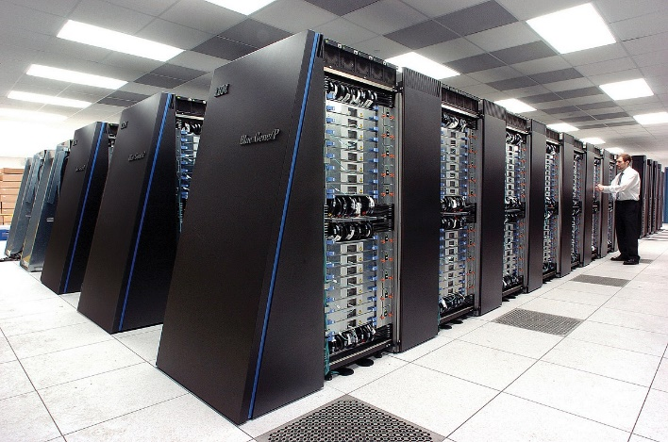
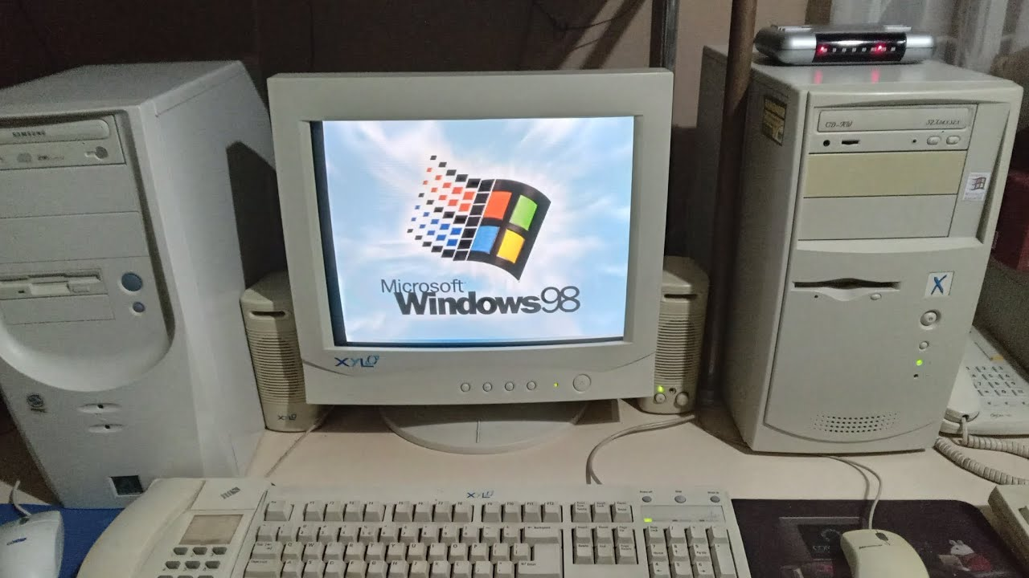
public int print_array(int[] array) {
for(int i = 0; i < array.length; i++) {
System.out.println(array[i]);
}
}
public int print_array(int[] array) {
for(int i = 0; i < array.length; i++) {
System.out.println(array[i]);
}
}
O(n)
O(n)
public int print_array(int[] array) {
for(int i = 0; i < array.length; i++) {
System.out.println(array[i]);
}
}
public int print_array(int[] array) {
for(int i = 0; i < array.length; i++) {
System.out.println(array[i]);
}
}
???
???

Slide 127
public int print_array(int[] array) {
for(int i = 0; i < array.length; i++) {
System.out.println(array[i]);
}
}
public int print_array(int[] array) {
for(int i = 0; i < array.length; i++) {
System.out.println(array[i]);
}
}
The same algorithm will have the same asymptotic running time no matter what the computer’s hardware is
O(n)
O(n)
public int print_array(int[] array) {
for(int i = 0; i < array.length; i++) {
System.out.println(array[i]);
}
}
public int print_array(int[] array) {
for(int i = 0; i < array.length; i++) {
System.out.println(array[i]);
}
}
O(n)
O(n)

Slide 128
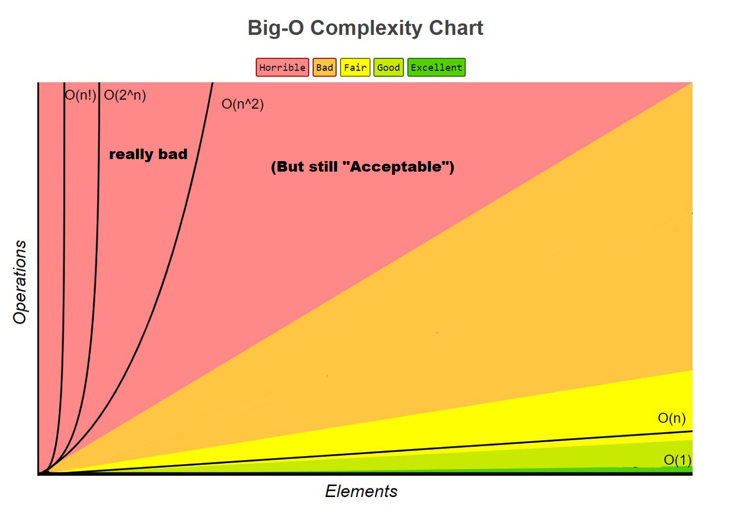

Slide 129

“Polynomial Time”

