Slide 1

CSCI 132: Basic Data Structures and Algorithms
More Big-O
Reese Pearsall
Spring 2025
https://www.cs.montana.edu/pearsall/classes/spring2025/132/main.html

Slide 2
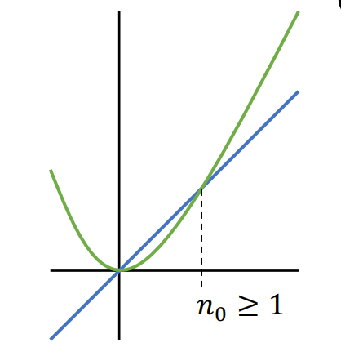
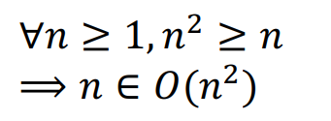
Big O Formal Definition
Let ƒ(n) and g(n) be functions mapping positive integers to positive real numbers
ƒ(n) is O(g(n)) if there is a real constant c > 0 and an integer constant n₀ ≥ 1 such that
ƒ(n) ≤ c · g(n), for all n ≥ n₀
Past a certain spot, g(n) dominates f(n) within a multiplicative constant
g(n)
f(n)
O -notation provides an upper bound on some function ƒ(n)

Slide 3

Big O
Goal: describe the number of operations an algorithm executes in regard to some input n when the input n grows under the worst-case scenario
How many iterations are done?
Are they sequential or nested operations?
Growth Rates
1
n
n²
x^{n}
We want an upper bound
“The algorithm cant do worse than ___ amount of operations”
We can drop multiplicative constants.
We can drop non-dominant factors
Not 100% precise
Real-world limitations

Slide 4
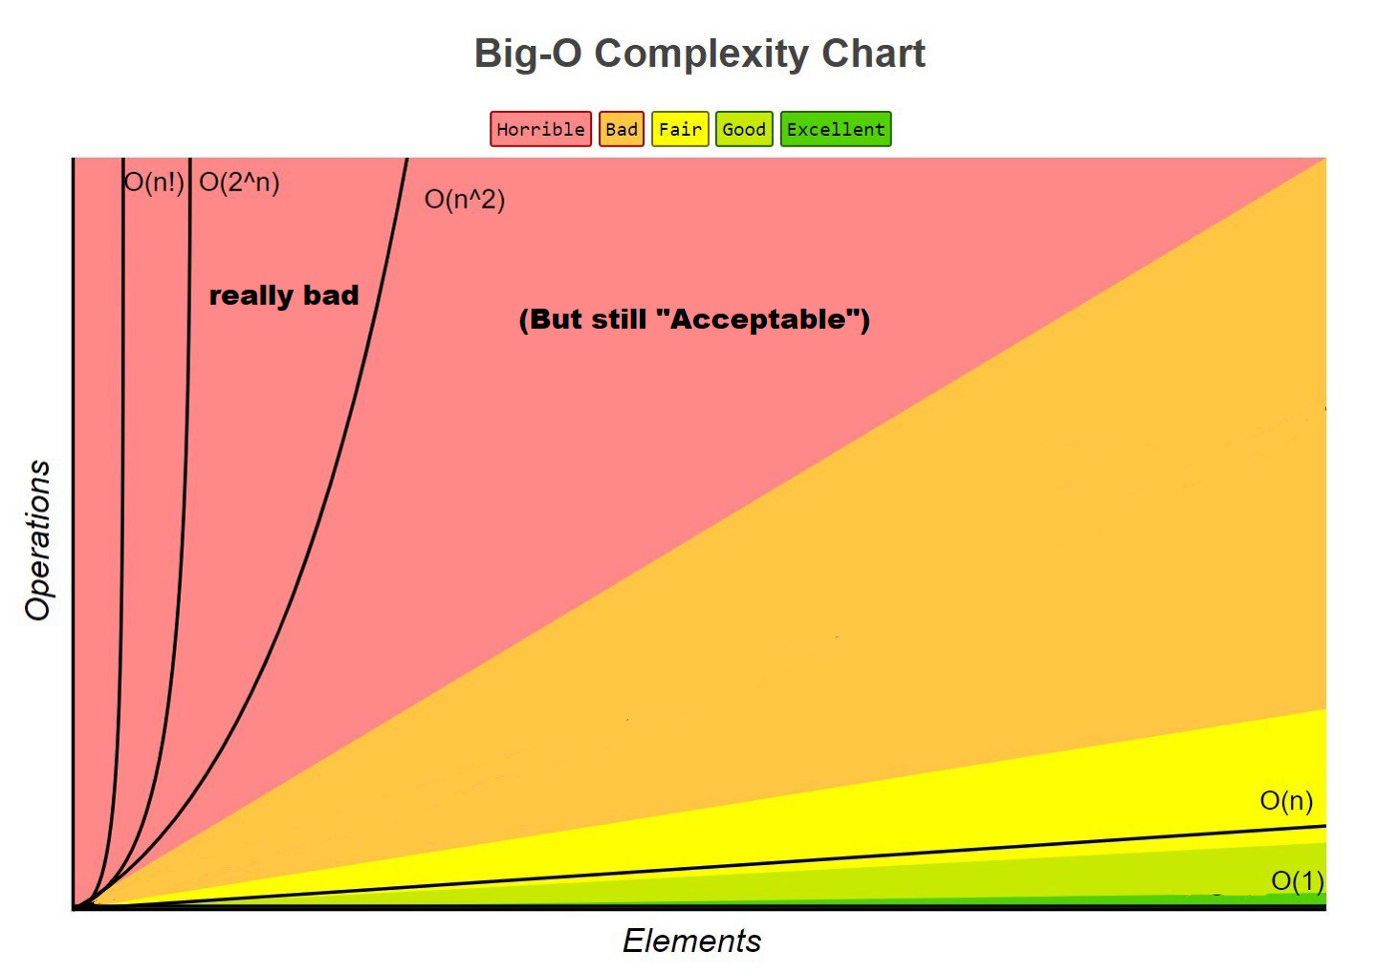

“Polynomial Time”

Slide 5
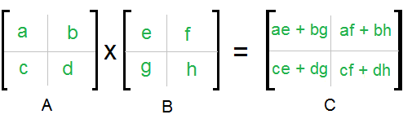
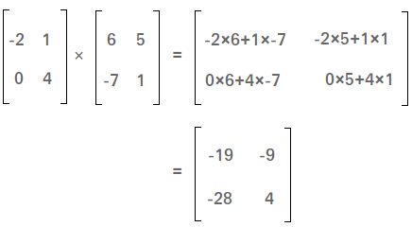
Algorithm Analysis: Matrix Multiplication
Example:

Slide 6
Algorithm Analysis: n*n Matrix Multiplication
void matrixMultiply(int[][] A, int[][] B, int[][] C, int n) {
for (int i = 0; i < n; i++) {
for (int j = 0; j < n; j++) {
C[i][j] = 0;
for (int k = 0; k < n; k++) {
C[i][j] += A[i][k] * B[k][j];
}
}
}
}

Slide 7
Algorithm Analysis: n*n Matrix Multiplication
void matrixMultiply(int[][] A, int[][] B, int[][] C, int n) {
for (int i = 0; i < n; i++) {
for (int j = 0; j < n; j++) {
C[i][j] = 0;
for (int k = 0; k < n; k++) {
C[i][j] += A[i][k] * B[k][j];
}
}
}
}
Running time?

Slide 8
Algorithm Analysis: n*n Matrix Multiplication
void matrixMultiply(int[][] A, int[][] B, int[][] C, int n) {
for (int i = 0; i < n; i++) {
for (int j = 0; j < n; j++) {
C[i][j] = 0;
for (int k = 0; k < n; k++) {
C[i][j] += A[i][k] * B[k][j];
}
}
}
}
O(n)
Running time?

Slide 9
Algorithm Analysis: n*n Matrix Multiplication
void matrixMultiply(int[][] A, int[][] B, int[][] C, int n) {
for (int i = 0; i < n; i++) {
for (int j = 0; j < n; j++) {
C[i][j] = 0;
for (int k = 0; k < n; k++) {
C[i][j] += A[i][k] * B[k][j];
}
}
}
}
O(n)
O(n)
Running time?

Slide 10
Algorithm Analysis: n*n Matrix Multiplication
void matrixMultiply(int[][] A, int[][] B, int[][] C, int n) {
for (int i = 0; i < n; i++) {
for (int j = 0; j < n; j++) {
C[i][j] = 0;
for (int k = 0; k < n; k++) {
C[i][j] += A[i][k] * B[k][j];
}
}
}
}
O(n)
O(n)
O(1)
Running time?

Slide 11
Algorithm Analysis: n*n Matrix Multiplication
void matrixMultiply(int[][] A, int[][] B, int[][] C, int n) {
for (int i = 0; i < n; i++) {
for (int j = 0; j < n; j++) {
C[i][j] = 0;
for (int k = 0; k < n; k++) {
C[i][j] += A[i][k] * B[k][j];
}
}
}
}
O(n)
O(n)
O(1)
O(n)
Running time?

Slide 12
Algorithm Analysis: n*n Matrix Multiplication
void matrixMultiply(int[][] A, int[][] B, int[][] C, int n) {
for (int i = 0; i < n; i++) {
for (int j = 0; j < n; j++) {
C[i][j] = 0;
for (int k = 0; k < n; k++) {
C[i][j] += A[i][k] * B[k][j];
}
}
}
}
O(n)
O(n)
O(1)
O(n)
O(1)
Running time?

Slide 13
Algorithm Analysis: n*n Matrix Multiplication
void matrixMultiply(int[][] A, int[][] B, int[][] C, int n) {
for (int i = 0; i < n; i++) {
for (int j = 0; j < n; j++) {
C[i][j] = 0;
for (int k = 0; k < n; k++) {
C[i][j] += A[i][k] * B[k][j];
}
}
}
}
O(n)
O(n)
O(1)
O(n)
O(1)
These O(1)’s won’t impact the running time. We need to focus on loops
Running time?

Slide 14
Algorithm Analysis: n*n Matrix Multiplication
void matrixMultiply(int[][] A, int[][] B, int[][] C, int n) {
for (int i = 0; i < n; i++) {
for (int j = 0; j < n; j++) {
C[i][j] = 0;
for (int k = 0; k < n; k++) {
C[i][j] += A[i][k] * B[k][j];
}
}
}
}
O(n)
O(n)
O(1)
O(n)
O(1)
These O(1)’s won’t impact the running time. We need to focus on loops
Nested for loops = multiply
Running time? O(n) * O(n) * O(n) → O(n³) where n is size of matrices
Cubic running time!

Slide 15
Algorithm Analysis: n*n Matrix Multiplication
void matrixMultiply(int[][] A, int[][] B, int[][] C, int n) {
for (int i = 0; i < n; i++) {
for (int j = 0; j < n; j++) {
C[i][j] = 0;
for (int k = 0; k < n; k++) {
C[i][j] += A[i][k] * B[k][j];
}
}
}
}
O(n)
O(n)
O(1)
O(n)
O(1)
These O(1)’s won’t impact the running time. We need to focus on loops
Nested for loops = multiply
Running time? O(n) * O(n) * O(n) → O(n³) where n is size of matrices
Cubic running time!
Most efficient Matrix Multiplication (currently known): O(n^{2.37})
https://en.wikipedia.org/wiki/Computational_complexity_of_matrix_multiplication#:~:text=The%20optimal%20number%20of%20field,is%20O(n2.371339).

Slide 16
Algorithm Analysis: Intersection size between two sets
public static int calculate_matches(int[] array1, int[] array2) {
int matches= 0;
for(int i = 0; i < array1.length; i++) {
for(int j = 0; j < array2.length; j++) {
if(array1[i] == array2[j]) {
System.out.println("Match Found:" + array1[i] + " " + array2[j]);
matches++;
}
}
return matches;
}
array 1: [1, 7, 5, 3, 2]
array 2: [0, 1, 6, 7, 2]
| A ∩ B |
Value returned: 3
Running time?

Slide 17
Algorithm Analysis: Intersection size between two sets
public static int calculate_matches(int[] array1, int[] array2) {
int matches= 0;
for(int i = 0; i < array1.length; i++) {
for(int j = 0; j < array2.length; j++) {
if(array1[i] == array2[j]) {
System.out.println("Match Found:" + array1[i] + " " + array2[j]);
matches++;
}
}
return matches;
}
O(1)
O(n)
O(n)
array 1: [1, 7, 5, 3, 2]
array 2: [0, 1, 6, 7, 2]
| A ∩ B |
Value returned: 3
Running time?

Slide 18
Algorithm Analysis: Intersection size between two sets
public static int calculate_matches(int[] array1, int[] array2) {
int matches= 0;
for(int i = 0; i < array1.length; i++) {
for(int j = 0; j < array2.length; j++) {
if(array1[i] == array2[j]) {
System.out.println("Match Found:" + array1[i] + " " + array2[j]);
matches++;
}
}
return matches;
}
O(1)
O(n)
O(n)
O(1)
O(1)
O(1)
O(1)
array 1: [1, 7, 5, 3, 2]
array 2: [0, 1, 6, 7, 2]
| A ∩ B |
Value returned: 3
Running time?

Slide 19
Algorithm Analysis: Intersection size between two sets
public static int calculate_matches(int[] array1, int[] array2) {
int matches= 0;
for(int i = 0; i < array1.length; i++) {
for(int j = 0; j < array2.length; j++) {
if(array1[i] == array2[j]) {
System.out.println("Match Found:" + array1[i] + " " + array2[j]);
matches++;
}
}
return matches;
}
O(1)
O(n)
O(n)
O(1)
O(1)
O(1)
O(1)
array 1: [1, 7, 5, 3, 2]
array 2: [0, 1, 6, 7, 2]
| A ∩ B |
Value returned: 3
Running time?
O(n²) where n = # of elements in the array

Slide 20
Algorithm Analysis: Intersection size between two sets
public static int calculate_matches(int[] array1, int[] array2) {
int matches= 0;
for(int i = 0; i < array1.length; i++) {
for(int j = 0; j < array2.length; j++) {
if(array1[i] == array2[j]) {
System.out.println("Match Found:" + array1[i] + " " + array2[j]);
matches++;
}
}
return matches;
}
O(1)
O(n)
O(n)
O(1)
O(1)
O(1)
O(1)
array 1: [1, 7, 5, 3, 2]
array 2: [0, 1, 6, 7, 2]
| A ∩ B |
Value returned: 3
O(n²) where n = # of elements in the array
Running time?
Are array1 and array2 always the same size?

Slide 21
Algorithm Analysis: Intersection size between two sets
public static int calculate_matches(int[] array1, int[] array2) {
int matches= 0;
for(int i = 0; i < array1.length; i++) {
for(int j = 0; j < array2.length; j++) {
if(array1[i] == array2[j]) {
System.out.println("Match Found:" + array1[i] + " " + array2[j]);
matches++;
}
}
return matches;
}
O(1)
O(n)
O(n)
O(1)
O(1)
O(1)
O(1)
array 1: [1, 7, 5, 3, 2]
array 2: [0, 1, 6]
| A ∩ B |
Value returned: 1
O(n²) where n = # of elements in the array
Running time?
Are array1 and array2 always the same size?

Slide 22
Algorithm Analysis: Intersection size between two sets
public static int calculate_matches(int[] array1, int[] array2) {
int matches= 0;
for(int i = 0; i < array1.length; i++) {
for(int j = 0; j < array2.length; j++) {
if(array1[i] == array2[j]) {
System.out.println("Match Found:" + array1[i] + " " + array2[j]);
matches++;
}
}
return matches;
}
O(1)
O(n)
O(m)
O(1)
O(1)
O(1)
O(1)
array 1: [1, 7, 5, 3, 2]
array 2: [0, 1, 6]
| A ∩ B |
Value returned: 1
O(n * m) where n = # of elements in array1
and m = # of elements in array2
Running time?

Slide 23
Algorithm Analysis: Escaping Jail
public static void escape_jail() {
}

Slide 24
Algorithm Analysis: Escaping Jail in Monopoly
public static void escape_jail() {
Random rand = new Random();
int roll1, roll2;
do {
roll1 = rand.nextInt(6) + 1;
roll2 = rand.nextInt(6) + 1;
} while (roll1 != roll2); // Keep rolling until doubles
System.out.println("doubles rolled! you have escaped jail");
}
This program loops until doubles are rolled

Slide 25
Algorithm Analysis: Escaping Jail in Monopoly
public static void escape_jail() {
Random rand = new Random();
int roll1, roll2;
do {
roll1 = rand.nextInt(6) + 1;
roll2 = rand.nextInt(6) + 1;
} while (roll1 != roll2); // Keep rolling until doubles
System.out.println("doubles rolled! you have escaped jail");
}
This program loops until doubles are rolled

Slide 26
Algorithm Analysis: Escaping Jail in Monopoly
public static void escape_jail() {
Random rand = new Random();
int roll1, roll2;
do {
roll1 = rand.nextInt(6) + 1;
roll2 = rand.nextInt(6) + 1;
} while (roll1 != roll2); // Keep rolling until doubles
System.out.println("doubles rolled! you have escaped jail");
}
O(1)*
This program loops until doubles are rolled

Slide 27
Algorithm Analysis: Escaping Jail in Monopoly
public static void escape_jail() {
Random rand = new Random();
int roll1, roll2;
do {
roll1 = rand.nextInt(6) + 1;
roll2 = rand.nextInt(6) + 1;
} while (roll1 != roll2); // Keep rolling until doubles
System.out.println("doubles rolled! you have escaped jail");
}
O(1)*
O(1)
O(1)
O(1)
This program loops until doubles are rolled

Slide 28
Algorithm Analysis: Escaping Jail in Monopoly
public static void escape_jail() {
Random rand = new Random();
int roll1, roll2;
do {
roll1 = rand.nextInt(6) + 1;
roll2 = rand.nextInt(6) + 1;
} while (roll1 != roll2); // Keep rolling until doubles
System.out.println("doubles rolled! you have escaped jail");
}
O(1)*
O(1)
O(1)
How many times does the while loop repeat?
O(1)
O(???)
This program loops until doubles are rolled

Slide 29
Algorithm Analysis: Escaping Jail in Monopoly
public static void escape_jail() {
Random rand = new Random();
int roll1, roll2;
do {
roll1 = rand.nextInt(6) + 1;
roll2 = rand.nextInt(6) + 1;
} while (roll1 != roll2); // Keep rolling until doubles
System.out.println("doubles rolled! you have escaped jail");
}
O(1)*
O(1)
Worst case scenario: they get really unlucky and never roll doubles → Infinite loop!
O(1)
O(1)
O(???)
This program loops until doubles are rolled

Slide 30
Algorithm Analysis: Escaping Jail in Monopoly
public static void escape_jail() {
Random rand = new Random();
int roll1, roll2;
do {
roll1 = rand.nextInt(6) + 1;
roll2 = rand.nextInt(6) + 1;
} while (roll1 != roll2); // Keep rolling until doubles
System.out.println("doubles rolled! you have escaped jail");
}
O(1)*
O(1)
Worst case scenario: they get really unlucky and never roll doubles → Infinite loop!
O(1)
O(1)
O(???)
This program loops until doubles are rolled
When analyzing an algorithm with Big O notation, there is an assumption that the program will eventually terminate for any input
The Big O for worst case is unbounded
(infinite rolls is possible, but extremely extremely unlikely

Slide 31
Algorithm Analysis: Escaping Jail in Monopoly
public static void escape_jail() {
Random rand = new Random();
int roll1, roll2;
do {
roll1 = rand.nextInt(6) + 1;
roll2 = rand.nextInt(6) + 1;
} while (roll1 != roll2); // Keep rolling until doubles
System.out.println("doubles rolled! you have escaped jail");
}
O(1)*
O(1)
Worst case scenario: they get really unlucky and never roll doubles → Infinite loop!
O(1)
O(1)
O(???)
This program loops until doubles are rolled
When analyzing an algorithm with Big O notation, there is an assumption that the program will eventually terminate for any input
The Big O for worst case is unbounded
(infinite rolls is possible, but extremely extremely unlikely
For a program that uses randomness, it is more helpful to look at expected number of iterations or average case analysis
(there is about 1/6 chance to roll doubles → 6 iterations)

Slide 32
Algorithm Analysis: Escaping Jail in Monopoly
public static void escape_jail() {
Random rand = new Random();
int roll1, roll2;
do {
roll1 = rand.nextInt(6) + 1;
roll2 = rand.nextInt(6) + 1;
} while (roll1 != roll2); // Keep rolling until doubles
System.out.println("doubles rolled! you have escaped jail");
}
This program loops until doubles are rolled
Running time for worst case: unbound
Average case: O(6) ∈ O(1)
There are many algorithms that use randomness, but are guaranteed to have a fixed amount of iterations

Slide 33
Algorithm Analysis: Generating Anagrams
String message = “abcde”

Slide 34
Algorithm Analysis: Generating Anagrams
String message = “abcde”
Anagrams of message:
abcde, abced, abdce, abdec, abecd, abedc,
bacde, baced, badce, badec, baecd, baedc,
cabde, cabed, cadbe, cadeb, caebd, caedb,
dabce, dabec, dacbe, daceb, daebc, daecb,
eabcd, eabdc, eacbd, eacdb, eadbc, eadcb,
bacde, baced, badce, badec, baecd, baedc,
bcade, bcaed, bcdae, bcdea, bcead, bceda,
bdace, bdaec, bdcae, bdcea, bdeac, bdeca,
beacd, beadc, becad, becda, bedac, bedca,
cabde, cabed, cadbe, cadeb, caebd, caedb,
cbade, cbaed, cbdae, cbdea, cbead, cbeda,
cdabe, cdaeb, cdbae, cdbea, cdeab, cdeba,
ceabd, ceadb, cebad, cebda, cedab, cedba,
dabce, dabec, dacbe, daceb, daebc, daecb,
dbace, dbaec, dbcae, dbcea, dbeac, dbeca,
dcabe, dcaeb, dcbae, dcbea, dceab, dceba,
deabc, deacb, debac, debca, decab, decba,
eabcd, eabdc, eacbd, eacdb, eadbc, eadcb,
ebacd, ebadc, ebcad, ebcda, ebdac, ebdca,
ecabd, ecadb, ecbad, ecbda, ecdab, ecdba,
edabc, edacb, edbac, edbca, edcab, edcba

Slide 35
Algorithm Analysis: Generating Anagrams
An algorithm will generate all permutations of a string
String message = “abcde”
Anagrams of message:
Permutations: order matters
Combination: order does not matter
abcde, abced, abdce, abdec, abecd, abedc,
bacde, baced, badce, badec, baecd, baedc,
cabde, cabed, cadbe, cadeb, caebd, caedb,
dabce, dabec, dacbe, daceb, daebc, daecb,
eabcd, eabdc, eacbd, eacdb, eadbc, eadcb,
bacde, baced, badce, badec, baecd, baedc,
bcade, bcaed, bcdae, bcdea, bcead, bceda,
bdace, bdaec, bdcae, bdcea, bdeac, bdeca,
beacd, beadc, becad, becda, bedac, bedca,
cabde, cabed, cadbe, cadeb, caebd, caedb,
cbade, cbaed, cbdae, cbdea, cbead, cbeda,
cdabe, cdaeb, cdbae, cdbea, cdeab, cdeba,
ceabd, ceadb, cebad, cebda, cedab, cedba,
dabce, dabec, dacbe, daceb, daebc, daecb,
dbace, dbaec, dbcae, dbcea, dbeac, dbeca,
dcabe, dcaeb, dcbae, dcbea, dceab, dceba,
deabc, deacb, debac, debca, decab, decba,
eabcd, eabdc, eacbd, eacdb, eadbc, eadcb,
ebacd, ebadc, ebcad, ebcda, ebdac, ebdca,
ecabd, ecadb, ecbad, ecbda, ecdab, ecdba,
edabc, edacb, edbac, edbca, edcab, edcba
Combination:
A pizza with [Pepperoni, Sausage, Cheese] is the same pizza with [Sausage, Cheese, Pepperoni]
Permutation:
The lock code 8124 is a totally different code than 1824
Given a set of elements, there will always be more permutations that combinations

Slide 36
Algorithm Analysis: Generating Anagrams
String message = “abcde”
Anagrams of message:
How many possible anagrams (permutations) are there?
abcde, abced, abdce, abdec, abecd, abedc,
bacde, baced, badce, badec, baecd, baedc,
cabde, cabed, cadbe, cadeb, caebd, caedb,
dabce, dabec, dacbe, daceb, daebc, daecb,
eabcd, eabdc, eacbd, eacdb, eadbc, eadcb,
bacde, baced, badce, badec, baecd, baedc,
bcade, bcaed, bcdae, bcdea, bcead, bceda,
bdace, bdaec, bdcae, bdcea, bdeac, bdeca,
beacd, beadc, becad, becda, bedac, bedca,
cabde, cabed, cadbe, cadeb, caebd, caedb,
cbade, cbaed, cbdae, cbdea, cbead, cbeda,
cdabe, cdaeb, cdbae, cdbea, cdeab, cdeba,
ceabd, ceadb, cebad, cebda, cedab, cedba,
dabce, dabec, dacbe, daceb, daebc, daecb,
dbace, dbaec, dbcae, dbcea, dbeac, dbeca,
dcabe, dcaeb, dcbae, dcbea, dceab, dceba,
deabc, deacb, debac, debca, decab, decba,
eabcd, eabdc, eacbd, eacdb, eadbc, eadcb,
ebacd, ebadc, ebcad, ebcda, ebdac, ebdca,
ecabd, ecadb, ecbad, ecbda, ecdab, ecdba,
edabc, edacb, edbac, edbca, edcab, edcba

Slide 37
Algorithm Analysis: Generating Anagrams
String message = “abcde”
Anagrams of message:
How many possible anagrams (permutations) are there?
abcde, abced, abdce, abdec, abecd, abedc,
bacde, baced, badce, badec, baecd, baedc,
cabde, cabed, cadbe, cadeb, caebd, caedb,
dabce, dabec, dacbe, daceb, daebc, daecb,
eabcd, eabdc, eacbd, eacdb, eadbc, eadcb,
bacde, baced, badce, badec, baecd, baedc,
bcade, bcaed, bcdae, bcdea, bcead, bceda,
bdace, bdaec, bdcae, bdcea, bdeac, bdeca,
beacd, beadc, becad, becda, bedac, bedca,
cabde, cabed, cadbe, cadeb, caebd, caedb,
cbade, cbaed, cbdae, cbdea, cbead, cbeda,
cdabe, cdaeb, cdbae, cdbea, cdeab, cdeba,
ceabd, ceadb, cebad, cebda, cedab, cedba,
dabce, dabec, dacbe, daceb, daebc, daecb,
dbace, dbaec, dbcae, dbcea, dbeac, dbeca,
dcabe, dcaeb, dcbae, dcbea, dceab, dceba,
deabc, deacb, debac, debca, decab, decba,
eabcd, eabdc, eacbd, eacdb, eadbc, eadcb,
ebacd, ebadc, ebcad, ebcda, ebdac, ebdca,
ecabd, ecadb, ecbad, ecbda, ecdab, ecdba,
edabc, edacb, edbac, edbca, edcab, edcba
5
4
3
2
1
= 120 permutations
5!
“five factorial”

Slide 38


Algorithm Analysis: Generating Anagrams
String message = “abcdef”
Anagrams of message:
abcdef, abcedf, abcfde, abcfed, abdcfe, abdecf, abdfce, abdfec, abecdf, abecfd, abedcf, abedfc,
abefcd, abefdc, acbdef, acbdfe, acbedf, acbefd, acdbef, acdbfe, acdebf, acdefb, acebdf, acebfd,
acedbf, acedfb, acefbd, acefdb, adbcef, adbcfe, adbecf, adbefc, adcbef, adcbfe, adcdeb, adcdef,
adcebf, adcefb, adcfbe, adcfeb, adebcf, adebfc, adecbf, adecfb, adefbc, adefcb, aebcdf, aebcfd,
aebdcf, aebdfc, aebfcd, aebfdc, aecbdf, aecbfd, aecdbf, aecdfb, aecfbd, aecfdb, aedbcf, aedbfc,
aedcbf, aedcfb, aedfbc, aedfcb, aefbcd, aefbdc, aefcbd, aefcdb, aefdbc, aefdcb, bacdef, bacdfe,
bacedf, bacefd, bacfde, bacfed, badcef, badcfe, badecf, badefc, badfce, badfec, baecdf, baecfd,
baedcf, baedfc, baefcd, baefdc, bcadef, bcadfe, bcaedf, bcaefd, bcafde, bcafed, bcdaef, bcdafe,
bcdeaf, bcdefa, bcdfea, bcdfae, bceadf, bceafd, bcedaf, bcedfa, bcefad, bcefda, bdacef, bdacfe,
bdaecf, bdaefc, bdafce, bdafec, bdcaef, bdcafe, bdceaf, bdcefa, bdcfea, bdcfae, bdeacf, bdeafc,
bdecaf, bdecfa, bdefac, bdefca, bdface, bdfaec, bdfcae, bdfcea, bdfeac, bdfeca, beacdf, beacfd,
beadcf, beadfc, beafcd, beafdc, becadf, becafd, becdaf, becdfa, becfad, becfda, bedacf, bedafc,
bedcaf, bedcfa, bedfac, bedfca, befacd, befadc, befcad, befcda, befdac, befdca, cabdef, cabdfe,
cabedf, cabefd, cabfde, cabfed, cadbef, cadbfe, cadebf, cadefb, cadfbe, cadfeb, caebdf, caebfd,
caedbf, caedfb, caefbd, caefdb, cbadef, cbadfe, cbaedf, cbaefd, cbafde, cbafed, cbdaef, cbdafe,
cbdeaf, cbdefa, cdbfea, cdbfae, cbeadf, cbeafd, cbedaf, cbedfa, cbefad, cbefda, cdabef, cdabfe,
cdaebf, cdaefb, cdafbe, cdafeb, cdbaef, cdbafe, cdbeaf, cddefa, cdfeab, cdfeba, cdebaf, cdeafb,
cdefba, cefbad, cdefba, cfabde, cfabed, cfadbe, cfadeb, cfaebd, cfaedb, cfbade, cfbaed, cfbdae,
cfbdea, cfbead, cfbeda, cfdabe, cfdaeb, cfdbae, cfdbea, cfdeab, cfdeba, dabcde, dabced, dabdce,
dabdec, dabecd, dabedc, dacbde, dacbed, dacdbe, dacdeb, dacebd, dcaedb, dbaecd, dbaedc, dbaecr,
dbcade, dbcaed, dbcade, dbcdea, dceadb, dcebad, dceabd, dceadb, dcebad, dceabf, deabcd, deabdc,
deacbd, deacdb, deadbc, deadcb, debacd, debadc, debcad, debcda, debdac, debdca, decabd, decadb,
decbad, decbda, decdab, decdba, defabc, defacb, defbac, defbca, defcab, defcba, eabcdf, eabcfb,
eabdcf, eabdfc, eabfcd, eabfdc, eacbdf, eacbfd, eacdbf, eacdfb, eacfbd, eacfdb, eadbcf, eadbfc,
eadcbf, eadcfb, eadfbc, eadfcb, eafbcd, eafbdc, eafcbd, eafcdb, eafdbc, eafdcb, ebacdf, ebacfd,
ebadcf, ebadfc, ebafcd, ebafdc, ebcadf, ebcafd, ebcdaf, ebcdfa, ebcfad, ebcfda, ebdacf, ebadfc,
ebdcaf, ebdcfa, ebdfac, ebdfca, efbcad, efbacd, efcdbd, efcdba, efcdab, efcbda, efacdb, efadbc,
efadcb, efabcd, efabdc, efabcd, efadbc, efadc, efdbca, efdbc, efdbac, efdcba, efacbd, efacdb,
efcbd, efcdba, efacdb, efabdc, efabdc, efadcb, efacdb, efcbad, efcbda, efcadb, efcabd, efcbd, efcbad
Anagrams of length 6?
6! = 720

Slide 39
Algorithm Analysis: Generating Anagrams
public static List<String> generateAnagrams(String str) {
List<String> anagrams = new ArrayList<>();
anagrams.add(String.valueOf(str.charAt(0)));
for (int i = 1; i < str.length(); i++) {
char currentChar = str.charAt(i);
List<String> newAnagrams = new ArrayList<>();
for (String anagram : anagrams) {
for (int j = 0; j <= anagram.length(); j++) {
String newAnagram = anagram.substring(0, j) + currentChar + anagram.substring(j);
newAnagrams.add(newAnagram);
}
}
anagrams = newAnagrams;
}
return anagrams;
}
Running time?

Slide 40
Algorithm Analysis: Generating Anagrams
public static List<String> generateAnagrams(String str) {
List<String> anagrams = new ArrayList<>();
anagrams.add(String.valueOf(str.charAt(0)));
for (int i = 1; i < str.length(); i++) {
char currentChar = str.charAt(i);
List<String> newAnagrams = new ArrayList<>();
for (String anagram : anagrams) {
for (int j = 0; j <= anagram.length(); j++) {
String newAnagram = anagram.substring(0, j) + currentChar + anagram.substring(j);
newAnagrams.add(newAnagram);
}
}
anagrams = newAnagrams;
}
return anagrams;
}
Running time?
Theres a lot of loops and weird stuff happening… let’s focus on how much output is created!

Slide 41
Algorithm Analysis: Generating Anagrams
public static List<String> generateAnagrams(String str) {
List<String> anagrams = new ArrayList<>();
anagrams.add(String.valueOf(str.charAt(0)));
for (int i = 1; i < str.length(); i++) {
char currentChar = str.charAt(i);
List<String> newAnagrams = new ArrayList<>();
for (String anagram : anagrams) {
for (int j = 0; j <= anagram.length(); j++) {
String newAnagram = anagram.substring(0, j) + currentChar + anagram.substring(j);
newAnagrams.add(newAnagram);
}
}
anagrams = newAnagrams;
}
return anagrams;
}
Running time?
Theres a lot of loops and weird stuff happening… let’s focus on how much output is created!
str length
# of string made
1 | 1
2 | 2
3 | 6
5 | 24
6 | 720
7 | 5040
This is not exponential growth… this is far worse

Slide 42
Algorithm Analysis: Generating Anagrams
public static List<String> generateAnagrams(String str) {
List<String> anagrams = new ArrayList<>();
anagrams.add(String.valueOf(str.charAt(0)));
for (int i = 1; i < str.length(); i++) {
char currentChar = str.charAt(i);
List<String> newAnagrams = new ArrayList<>();
for (String anagram : anagrams) {
for (int j = 0; j <= anagram.length(); j++) {
String newAnagram = anagram.substring(0, j) + currentChar + anagram.substring(j);
newAnagrams.add(newAnagram);
}
}
anagrams = newAnagrams;
}
return anagrams;
}
Running time?
Theres a lot of loops and weird stuff happening… let’s focus on how much output is created!
str length
# of string made
1 | 1
2 | 2
3 | 6
5 | 24
6 | 720
7 | 5040
This is not exponential growth… this is far worse
For a string length n, this algorithm does O(n!) amount of work

Slide 43
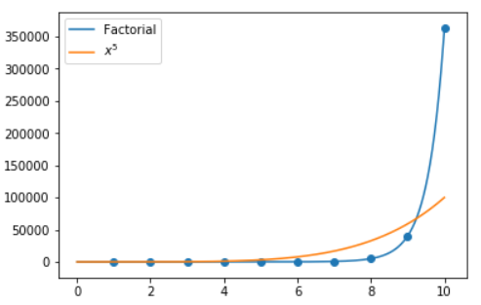
Algorithm Analysis: Generating Anagrams
For a string length n, this algorithm does O(n!) amount of work
x⁵
Algorithms with O(n!) running time are terrible and infeasible
Sometimes they might be the only option available…

Slide 44
Given input n
O(1)
(There are a few other running times we will see later this semester)
“Best”
No loops
Constant amount of work
O(n)
Single loop or sequential for loops
O(n²)
Nested for loops
Quadratic growth
O(n³)
Triple nested for loops
Cubic growth
O(x^{n})
Brute Forcing combinations
Exponential growth
O(n!)
Brute Forcing permutations
Factorial growth
“Worst”

Slide 45

Given input n
O(1)
(There are a few other running times we will see later this semester)
“Best”
No loops
Constant amount of work
O(n)
Single loop or sequential for loops
Polynomial time
“Acceptable”
O(n²)
Nested for loops
Quadratic growth
O(n³)
Triple nested for loops
Cubic growth
O(x^{n})
Brute Forcing combinations
Exponential growth
“Unacceptable”
You are bad at coding (maybe)
O(n!)
Brute Forcing permutations
Factorial growth
“Worst”

Slide 46
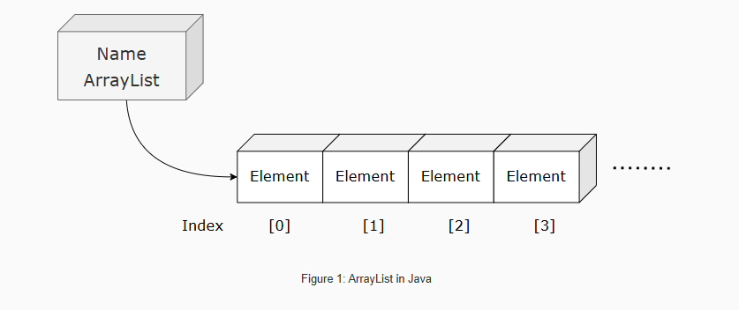
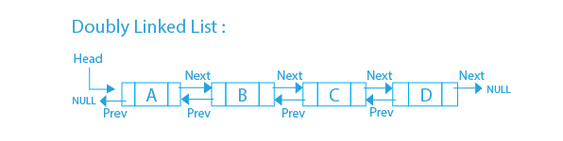
List Running Times
Operation | Running Time
Creation | O(1)
Adding an element | O(1)
Removing head or tail | O(1)
Searching / Contains | O(n) must check every node
Operation | Running Time
Creation of empty list | O(1)
Adding an element | O(n) must grow array and copy
Removing first or last | O(n) must shrink array and copy
Searching / Contains | O(n) must check every node
Where n = # of nodes in Linked List
Where n = # of nodes in arraylist
Adding to a linked list is more efficient than adding to a filled array

Slide 47
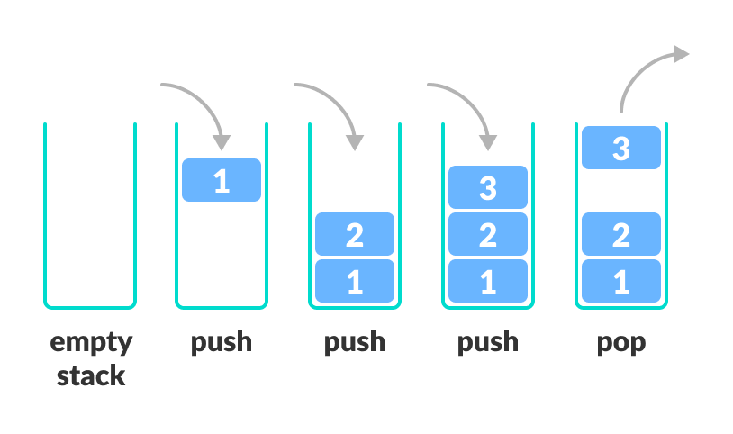
Stack running time analysis
(Array Implementation)
public StackArray() {
data = new Element[8];
top_of_stack = -1;
size = 0;
}
(Linked List Implementation)
Algorithm | w/ Array | w/ Linked List
Creation
Push()
Pop()
peek()
Print()
public StackLinkedList() {
data = new LinkedList<Element>();
this.size = 0;
}

Slide 48
Stack running time analysis
(Array Implementation)
public StackArray() {
data = new Element[8];
top_of_stack = -1;
size = 0;
}
O(n)
O(1)
O(1)
Total Running time: O(n)
n = | array |
(Linked List Implementation)
Algorithm | w/ Array | w/ Linked List
Creation | O(n) | O(1)
Push()
Pop()
peek()
Print()
public StackLinkedList() {
data = new LinkedList<Element>();
this.size = 0;
}
O(1)
O(1)
Total Running time: O(1)

Slide 49
Stack running time analysis
(Array Implementation)
public void push(Element newElement) {
if(this.size == this.data.length) {
return;
}
else {
this.top_of_stack++;
data[this.top_of_stack] = newElement;
this.size++;
}
}
Algorithm | w/ Array | w/ Linked List
Creation | O(n) | O(1)
Push()
Pop()
peek()
Print()

Slide 50
Stack running time analysis
(Array Implementation)
public void push(Element newElement) {
if(this.size == this.data.length) {
return;
}
else {
this.top_of_stack++;
data[this.top_of_stack] = newElement;
this.size++;
}
}
O(1)
O(1)
Algorithm | w/ Array | w/ Linked List
Creation | O(n) | O(1)
Push() | O(1)
Pop()
peek()
Print()
O(1)
O(1)
O(1)
Total Running Time: O(1)

Slide 51
Stack running time analysis
(Linked List Implementation)
public void push(Element newElement) {
data.addFirst(newElement);
this.size++;
}
Algorithm | w/ Array | w/ Linked List
Creation | O(n) | O(1)
Push() | O(1)
Pop()
peek()
Print()

Slide 52
Stack running time analysis
(Linked List Implementation)
public void push(Element newElement) {
data.addFirst(newElement);
this.size++;
}
O(1)
O(1)
Algorithm | w/ Array | w/ Linked List
Creation | O(n) | O(1)
Push() | O(1) | O(1)
Pop()
peek()
Print()
Total Running Time: O(1)

Slide 53
Stack running time analysis
(Array)
public void pop() {
if(this.size == 0) {
return;
}
else {
this.data[this.top_of_stack] = null;
this.top_of_stack--;
this.size--;
}
}
Algorithm | w/ Array | w/ Linked List
Creation | O(n) | O(1)
Push() | O(1) | O(1)
Pop()
peek()
Print()
public void pop() {
if(this.size == 0) {
return;
}
else {
this.data.removeFirst();
this.size--;
}
}
(Linked List)

Slide 54
Stack running time analysis
(Array)
public void pop() {
if(this.size == 0) {
return;
}
else {
this.data[this.top_of_stack] = null;
this.top_of_stack--;
this.size--;
}
}
O(1)
O(1)
O(1)
O(1)
Algorithm | w/ Array | w/ Linked List
Creation | O(n) | O(1)
Push() | O(1) | O(1)
Pop() | O(1) | O(1)
peek()
Print()
public void pop() {
if(this.size == 0) {
return;
}
else {
this.data.removeFirst();
this.size--;
}
}
(Linked List)
O(1)
O(1)
O(1)

Slide 55
Stack running time analysis
(Array)
public Element peek() {
if(this.size != 0) {
return this.data[this.top_of_stack];
}
else {
return null;
}
}
Algorithm | w/ Array | w/ Linked List
Creation | O(n) | O(1)
Push() | O(1) | O(1)
Pop() | O(1) | O(1)
peek()
Print()
(Linked List)
public Element peek() {
if(this.size != 0) {
return this.top_of_stack;
}
else {
return null;
}
}

Slide 56
Stack running time analysis
(Array)
public Element peek() {
if(this.size != 0) {
return this.data[this.top_of_stack];
}
else {
return null;
}
}
O(1)
Algorithm | w/ Array | w/ Linked List
Creation | O(n) | O(1)
Push() | O(1) | O(1)
Pop() | O(1) | O(1)
peek() | O(1) | O(1)
Print()
(Linked List)
public Element peek() {
if(this.size != 0) {
return this.top_of_stack;
}
else {
return null;
}
}
O(1)

Slide 57
Stack running time analysis
(Array)
public void printStack() {
for(int i = this.size-1; i >= 0; i--) {
this.data[i].printElement();
}
}
Algorithm | w/ Array | w/ Linked List
Creation | O(n) | O(1)
Push() | O(1) | O(1)
Pop() | O(1) | O(1)
peek() | O(1) | O(1)
Print()
(Linked List)
public void printStack() {
for(Element each : this.data) {
each.printElement();
}
}

Slide 58
Stack running time analysis
(Array)
public void printStack() {
for(int i = this.size-1; i >= 0; i--) {
this.data[i].printElement();
}
}
O(n)
Algorithm | w/ Array | w/ Linked List
Creation | O(n) | O(1)
Push() | O(1) | O(1)
Pop() | O(1) | O(1)
peek() | O(1) | O(1)
Print()
(Linked List)
public void printStack() {
for(Element each : this.data) {
each.printElement();
}
}
O(n)

Slide 59
Stack running time analysis
(Array)
public void printStack() {
for(int i = this.size-1; i >= 0; i--) {
this.data[i].printElement();
}
}
O(n)
Algorithm | w/ Array | w/ Linked List
Creation | O(n) | O(1)
Push() | O(1) | O(1)
Pop() | O(1) | O(1)
peek() | O(1) | O(1)
Print() | O(n) | O(n)
(Linked List)
public void printStack() {
for(Element each : this.data) {
each.printElement();
}
}
O(n)
Where n = # of elements in the stack

Slide 60
Stack running time analysis
Algorithm | w/ Array | w/ Linked List
Creation | O(n) | O(1)
Push() | O(1) | O(1)
Pop() | O(1) | O(1)
peek() | O(1) | O(1)
Print() | O(n) | O(n)
Where n = # of elements in the stack
Adding and removing elements from a stack runs in O(1) no matter if array or linked list is used
An array will be fixed-sized, linked list will be dynamic

Slide 61
Linked List
Dynamic Array / ArrayList
Operation | Running Time
Creation | O(1)
Adding an element | O(1)
Removing head or tail | O(1)
Searching / Contains | O(n) must check every node
Operation | Running Time
Creation of empty list | O(1)
Adding an element | O(n) must grow array and copy
Removing first or last | O(n) must shrink array and copy
Searching / Contains | O(n) must check every node
Where n = # of nodes in Linked List
Where n = # of nodes in arraylist
Stack
Algorithm | w/ Array | w/ Linked List
Creation | O(n) | O(1)
Push() | O(1) | O(1)
Pop() | O(1) | O(1)
peek() | O(1) | O(1)
Print() | O(n) | O(n)
I don’t force your to memorize things, but you should memorize running times for basic operations of fundamental data structures
Where n = # of elements in the stack

