Slide 1

CSCI 132: Basic Data Structures and Algorithms
Midterm Review
Reese Pearsall
Spring 2025
https://www.cs.montana.edu/pearsall/classes/spring2025/132/main.html

Slide 2
Announcements
No lab tomorrow
Midterm Exam Wednesday
Program 2 due Friday @ 11:59 PM

Slide 3
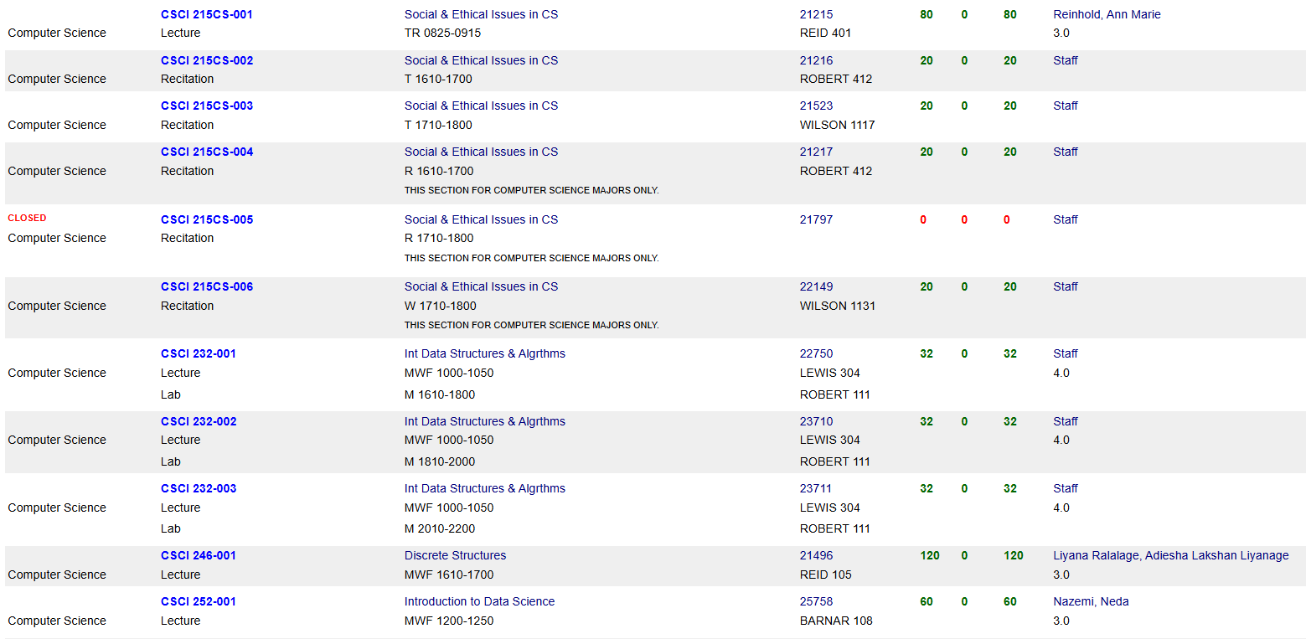
Class Registration
Next class you will need to take is CSCI 232- Data Structures and Algorithms (offered in Fall and Summer)
Other classes that may be of interest to you:
CSCI 204- Multimedia Development Methods (Unity Game Design)
CSCI 215CS- Social and Ethical Issues in CS
CSCI 246- Discrete Structures
CSCI 252- Intro to Data Science
CSCI 112- Programming in C
MART 145RA- Web Design (Formerly CS 145)
Once you pass CSCI 232, you can take most upper-division classes

Slide 4
Logistics
In-class on Wednesday (please show up)
Time: 60 minutes
D2L Quiz (You will be taking exam on laptop), Auto graded
Open note. You can use any notes, assignments, lecture recordings, textbook, your IDE
You cannot use external resources (stack overflow, chat bots, etc)
Make sure you attempt every question, and pace yourself to finish on time
Types of Questions
Multiple Choice
True/False
Matching

Slide 5
Declaring Variables
Valid Variable Declaration
int i = 5;
int x;
int num = 125;
char grade = “A”;
boolean flag = true;
Primitive Data Types
int
double
boolean
char
float
When we declare a variable, we must define the datatype as well
Non-Primitive Data Types
String
Invalid Variable Declaration
String s = “Reese”;
String last_name = “Pearsall”;
System.out.println(s + last_name)

Slide 6
Using the plus operator (+) between two values that are Strings will result in String concatenation
Operators
+ (Addition)
- (Subtraction)
* (Multiplication)
/ (Division)
% (Modulo)
+ (String concatenation)
++ (Increment)
-- (Decrement)
String x = “hi ”;
String y = “there”;
System.out.println(x + y);
>> hi there
Increment operator (++) will add 1 to a variable
int counter = 0;
System.out.println(counter);
counter++;
System.out.println(counter);
counter++;
System.out.println(counter);
>> 0
1
2
int x, y, answer;
x= 2;
y = 3;
answer = x + y;

Slide 7
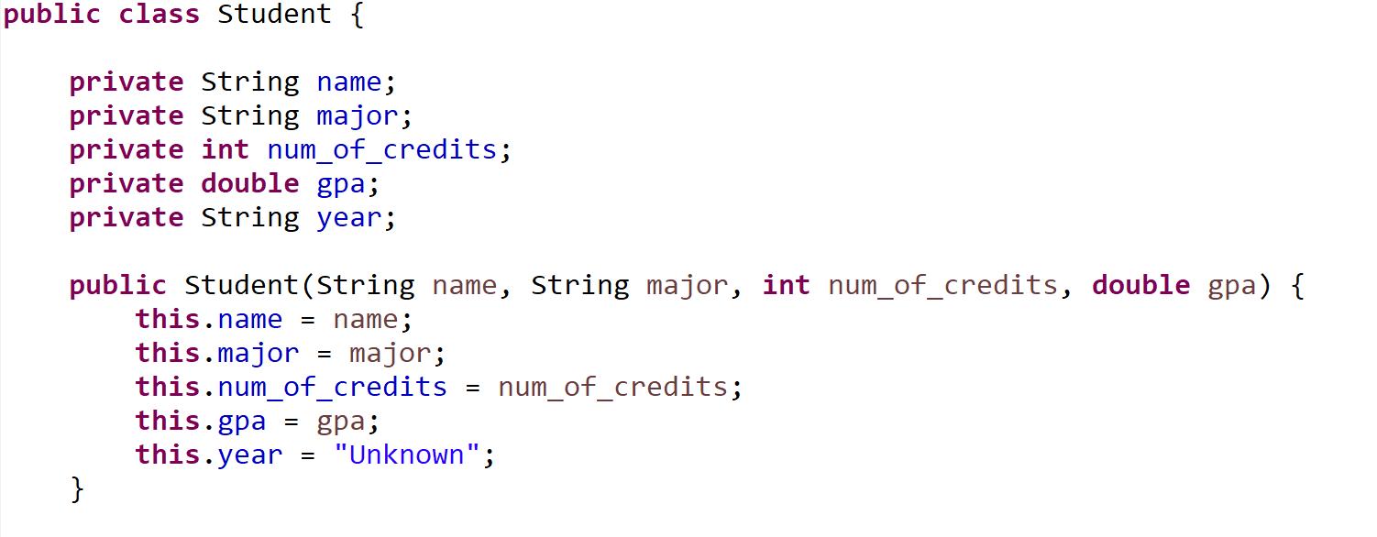
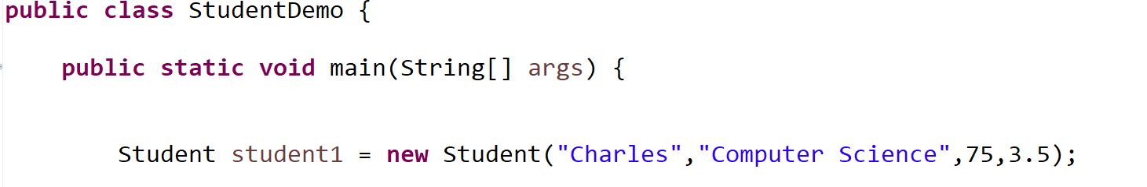
Instance fields of our Student Class
private means they can not be directly accessed outside of the class
Student.Java
StudentDemo.Java

Slide 8

This is the constructor, the special method that creates our objects
Each of our “blueprints” needs a constructor
Student.Java
StudentDemo.Java

Slide 9


Student.Java
When we use the new keyword, it will invoke our constructor
StudentDemo.Java

Slide 10

name
“Charles”
student1
major
“Computer Science”
num_of_credits
75
gpa
3.5
year
“Unknown”
Student.Java
StudentDemo.Java

Slide 11
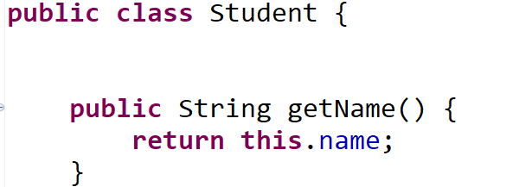
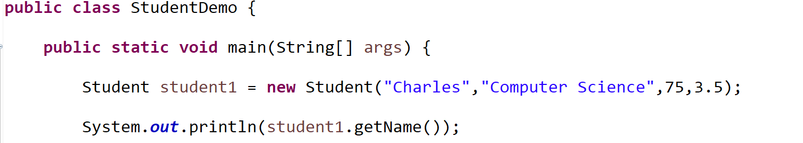
Name of method
(instance fields and constructor go here)
This method returns a String
This method is public (other classes can use it)
The this keyword refers to the object that this method was called on (student1)
(return student1’s name attribute)
Student.Java
StudentDemo.Java

Slide 12
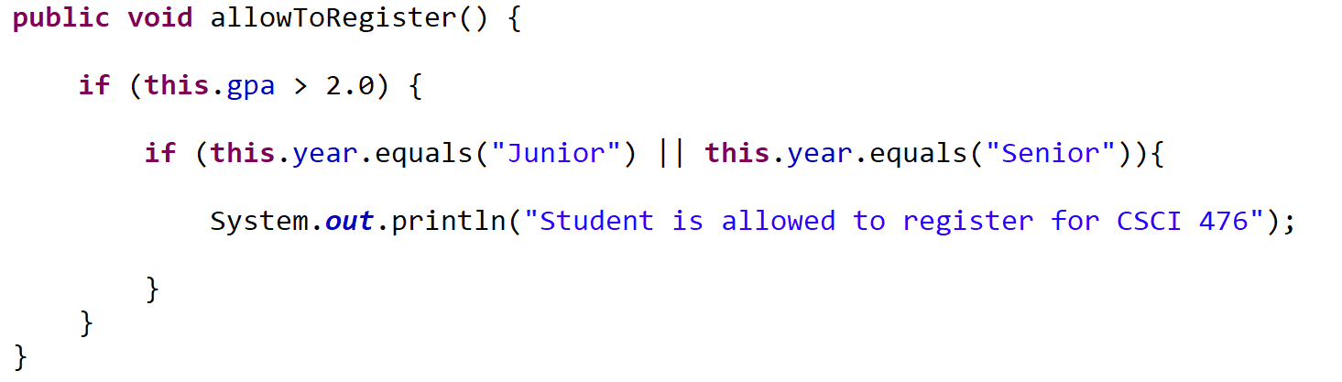

Example: A student is allowed to register for CSCI 476 if they have a GPA greater than 2.0, and if they are a Junior or Senior
// check the first condition (Alternatively, we could use an && here)
We can check one of two conditions is true using the or operator ( || )
(we do not have the or keyword in Java)
Student.Java
allowToRegister
StudentDemo.Java

Slide 13
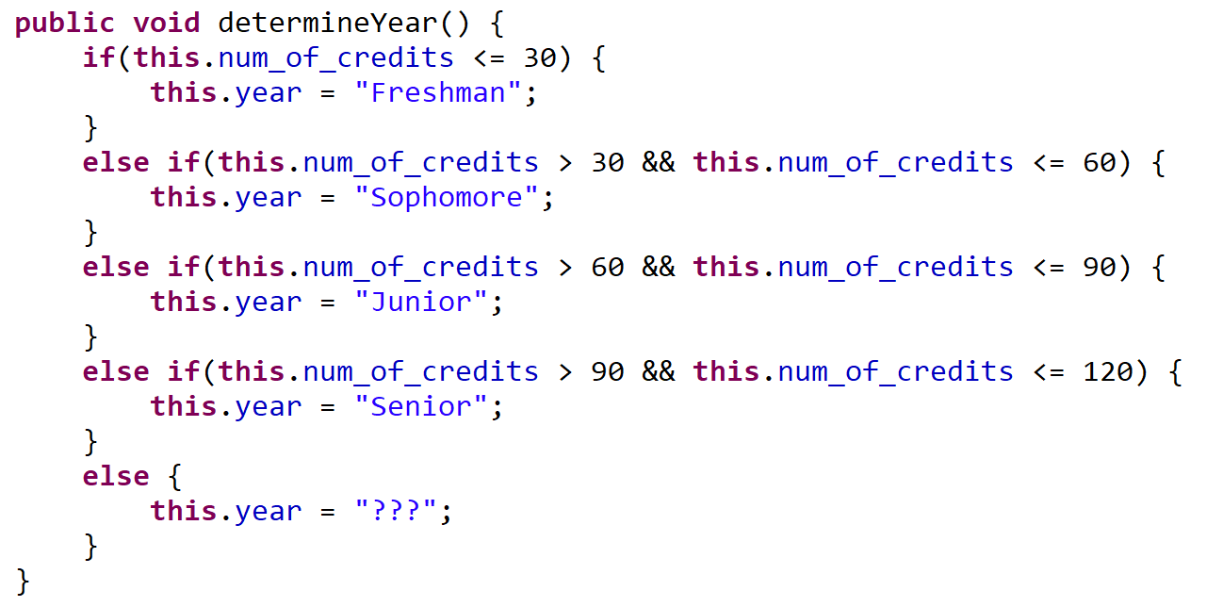
We can check multiple conditions using the and operator (&&)
(we do not have the and keyword in Java)
Student.Java
StudentDemo.Java

Slide 14
Arrays are a collection of data
Once initialized, are fixed in size
Can only hold one data type
>> 65
Declaring an array and giving it a value
int[] test_scores = {99, 81, 65, 46};
Declaring an array allocating 5 empty spots (we need to fill them later)
String[] names = new String[5];
test_scores
99 | 81 | 65 | 46
names
null | null | null | null | null

Slide 15
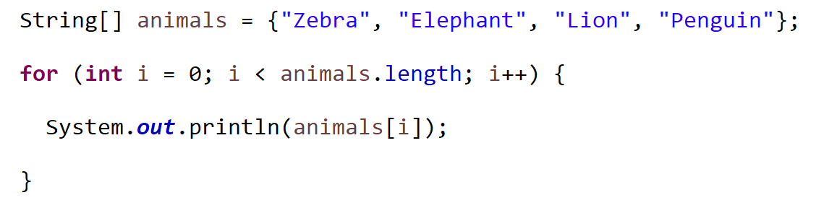
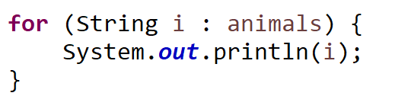
For loops can be used to iterate across an array.
Two ways:
1. Iterate by index
2. Iterate by element
Both will give you the exact same output…

Slide 16
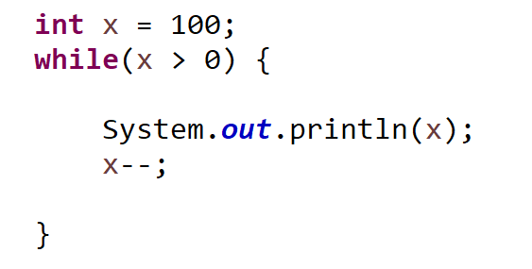
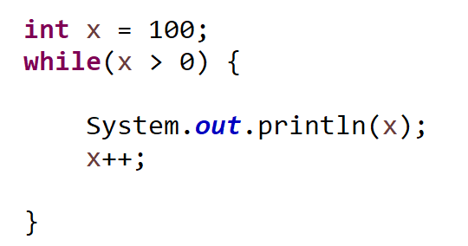
While loops can be used to iterate if a condition is true.
Check Condition
If condition is true, execute body of loop
Repeat
You do have to worry about the possibility of infinite loops….

Slide 17
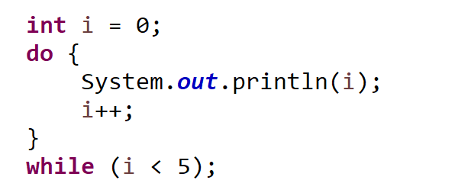
The do/while loop will always execute the body of the loop once, and then check the condition
New
Execute body of loop
Check condition
Repeat
!!! You are guaranteed at least one execution of the loop body

Slide 18

public class ReferencesDemo {
public static void main(String[] args) {
Person person1 = new Person("Jim Bob", 44);
Person person2 = new Person("Sally", 28);
Person person3 = person1;
}
}
Suppose we create a new reference variable and link it to an existing object
person3 is now pointing to same object and person1
person1
name: “Jack”
age: 44
person3
name: “Sally”
age: 28
person2
In this method call, this is referencing the person1 object

Slide 19
public class ReferencesDemo {
public static void main(String[] args) {
Person person1 = new Person("Jim Bob", 44);
Person person2 = new Person("Sally", 28);
Person person3 = person1;
person1.changeName("test");
}
}
Suppose we create a new reference variable and link it to an existing object
person3 is now pointing to same object and person1
person1
name: “test”
age: 44
person3
Any changes to person1 will also update person3 (and vice versa)
System.out.println(person1.getName()) → “test”
System.out.println(person3.getName()) → “test”

Slide 20
Inheritance is a mechanism in Java that allows for a class to acquire instance fields and methods from another class
In Java, we use the extends keyword to indicate that a class is inheriting from another
public class Programmer extends Employee {
}
The Programmer class inherits from the Employee class

Slide 21
public class Programmer extends Employee {
private String programming_language;
public Programmer(String name, int id, int salary, String lan) {
super(name,id,salary);
this.programming_language = lan;
}
public String getLanguage() {
return this.programming_language;
}
}
public class Employee {
private String name;
private int emp_id;
private int salary;
public Employee(String name, int id, int salary) {
this.name = name;
this.emp_id = id;
this.salary = salary;
}
public String getName() {
return this.name;
}
Inherited!
Programmer.java
Employee.java
Programmer reese = new Programmer("Reese Pearsall", 1234, 90000, "Python");
System.out.println(reese.getName());
getName() is not defined in the Programmer class, but because the Programmer class inherits from the Employee class, the reese object has access to the getName() method

Slide 22

public class Programmer extends Employee {
private String programming_language;
public Programmer(String name, int id, int salary, String lan) {
super(name,id,salary);
this.programming_language = lan;
}
public String getLanguage() {
return this.programming_language;
}
}
public class Employee {
private String name;
private int emp_id;
private int salary;
public Employee(String name, int id, int salary) {
this.name = name;
this.emp_id = id;
this.salary = salary;
}
public String getName() {
return this.name;
}
Programmer.java
Employee.java
private instance fields and methods are not inherited
Instead, we can use the protected keyword

Slide 23

Java Inheritance Hierarchy Example
name (String)
emp_id (int)
salary (int)
getName()
getID()
getSalary()
Salesperson
Accountant
Programmer
commission (int)
cpa_grade (char)
language (String)
getCommission()
getCpaGrade()
getLanguage()
name
emp_id
salary
language
school
getName()
getID()
geSalary()
getLanguage()
getSchool()
ProgrammerIntern
A ProgrammerIntern object has access to the following instance fields and methods:
school (String)
getSchool()

Slide 24


Static methods are methods in Java that can be called without creating an object of a class
public class StaticDemo {
public static void main(String[] args) {
AnotherClass.funMethod("Hello");
}
}
public class AnotherClass {
public static void funMethod(String arg)
{
System.out.println(arg);
}
}
StaticDemo.java
AnotherClass.java
If the static method is in another class, we can access it by giving the class name (AnotherClass)
Once again, I do not need to create an AnotherClass object to call this static method
However, now objects are no longer an implicit argument to this method (cant use this anymore)

Slide 25

Abstract Classes are restricted classes that cannot be used to create objects. To access it, it must be inherited from another class.
public abstract class Employee {
…
}
Employee e = new Employee("Sally", 4444, 123456);
You cannot create instances of an abstract class.
Accountant kevin = new Accountant("Kevin Malone", 4444, 42000, 'C');
Instead, we use objects from another class that inherits from the abstract class

Slide 26



Interfaces are abstract classes that only contain methods with no body
public class Ferrari implements Vehicle {
@Override
public void accelerate(int a) {
…
}
@Override
public void slowdown(int a) {
…
}
@Override
public void refuel(int a) {
}
…
}
public interface Vehicle {
void accelerate(int a);
void slowdown(int a);
void refuel(int a);
}
Now, any Class that also has the behavior of accelerating, slowdown, and refuel can implement our interface, and those classes are forced to write the body of the methods
The code of the method body is omitted, but that is where the programmer can put the specific behavior of:
how a Ferrari will accelerate
how a Ferrari will slow down
how a Ferrari will refuel

Slide 27
Interfaces are abstract classes that only contain methods with no body
Why use interfaces?
Interfaces are great when you need multiple implementations of the same behavior
It forces classes to implement X methods that might not logically belong to them (more control)
It provides abstraction
(ie the details of how things are implemented are not revealed in an interface)

Slide 28
Inheriting from a class
Implementing an Interface
Class inherits instance fields and methods
Class inherits methods with no bodies
Can only inherit from one class
Can implement multiple interfaces
Sub class is not required to override methods
Sub class is required to override methods

Slide 29
Array Limitations
Cons
Can’t change the length
Can only store one data type
What can we do about this?
int[] myArray = {1, 2, 3};
System.out.println(Arrays.toString(myArray));
int[] newArray = new int[myArray.length + 1];
for(int i = 0; i < myArray.length; i++) {
newArray[i] = myArray[i];
}
// Create a new array that is one spot bigger
// Fill new array with contents of old array
int new_value = 4;
newArray[myArray.length] = new_value;
myArray = newArray;
// add new value to array
// Update reference variable

Slide 30
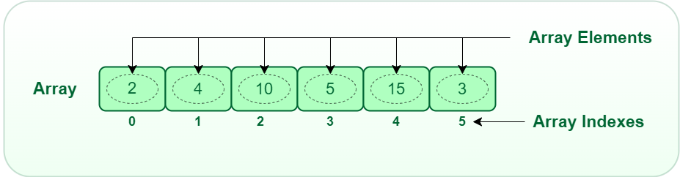
An ArrayList is a data structure that can hold multiple, similar values (just like an array), BUT
Dynamic, can easily resize
Can easily add new elements and remove elements
Like a Python list ☺
Somebody took arrays, and made them better
Still have indices
Still can only store one data type

Slide 31
Java ArrayLists
We first need to remember to import it ☺
import java.util.ArrayList;
Creating a new ArrayList
ArrayList<String> mylist = new ArrayList<String>();
We can add stuff to the ArrayList using the .add() method (built in method!)
mylist.add("Jack");
To access elements in the array, we use the .get() method (we cannot use the square bracket index [ ] )
System.out.println(mylist.get(2));
// this will print the String at index 2
We can remove stuff by index, or by searching for a specific element
mylist.remove("Eli");
mylist.remove(0);

Slide 32



Linked Lists
A Linked List is a data structure that consists of a collection of connected nodes
head
Susan
Reese
Spencer
Nodes consists of data (String, int, array, etc) and a pointer to the next node
A Linked List also has a pointer to the start of the Linked List (head)

Slide 33







Linked Lists
A Doubly Linked List keeps track of the next node and the previous node
head
tail
Susan
Reese
prev
next
null
null
Spencer
prev
next
prev
next
next
prev

Slide 34





A Circular Linked List is a linked list where the first and last node are connected, which creates a circle
BZN
Bozeman
ORD
Chicago
SEA
Seattle
LAX
Los Angeles
BOS
Boston
head
tail

Slide 35
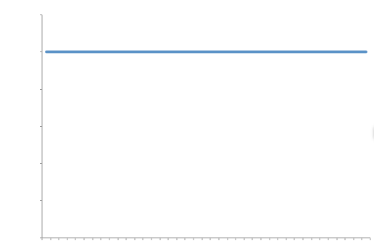

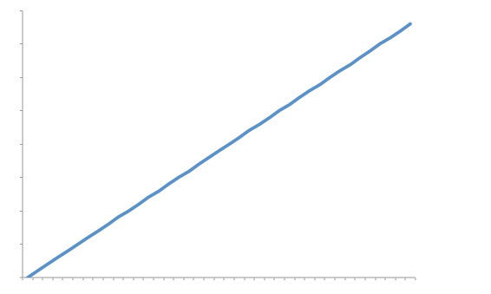
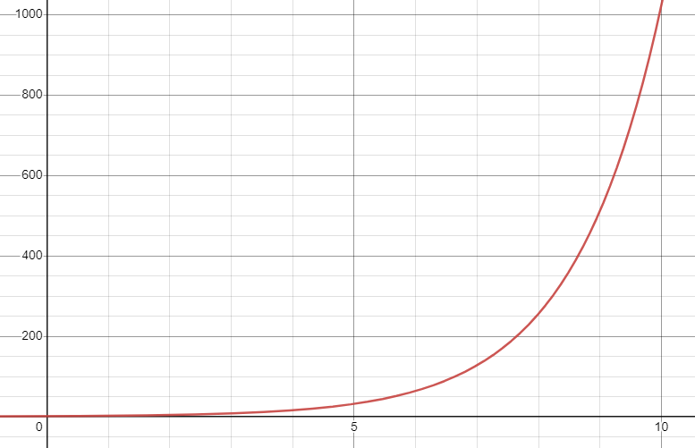
Growth Rates
Constant
Quadratic
Printing out a 2D array
Adding to front of linked list
Linear
Exponential
Generating all possible binary strings of length N
Searching an array for a certain element

Slide 36
The running time of an algorithm is the time it takes for an algorithm to completely run from start to finish
There are a few ways we can measure running time:
Time (seconds, nanoseconds, minutes, days, etc)
2. Number of operations required to complete algorithm.
To measure the running time of an algorithm, we will count the number of operations the algorithm performs, and look at how these operations scale as the input increases
When we describe the running time of an algorithm, we will represent it using Big-O Notation

Slide 37
A primitive operation is an operation that has a constant execution time
int N = 3;
a = a + 3 * 12
if(n >= i)
i = arr[3]
e.print2Darray(array);
return
System.out.println(“Hi”)
Assigning a value to a variable
Performing an arithmetic operation
Comparing two numbers/values
Accessing an element in an array (by index)
Calling a method
Returning from a method
Printing out a value

Slide 38
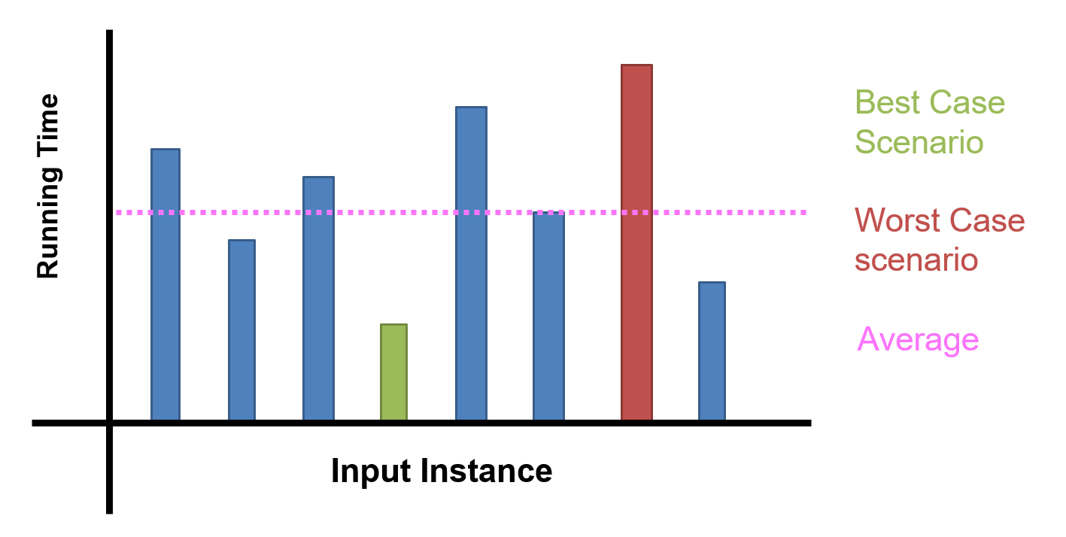
In computer science (and this class in particular), we will be focusing on stating running time in terms of worst-case scenario

Slide 39
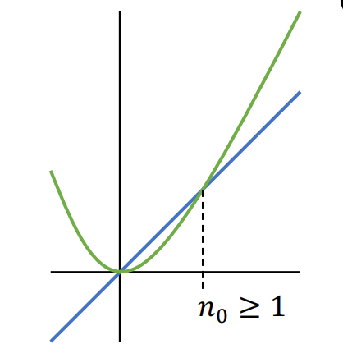
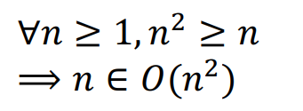
Big O Formal Definition
Let ƒ(n) and g(n) be functions mapping positive integers to positive real numbers
ƒ(n) is O(g(n)) if there is a real constant c > 0 and an integer constant n₀ ≥ 1 such that
ƒ(n) ≤ c · g(n), for all n ≥ n₀
Past a certain spot, g(n) dominates f(n) within a multiplicative constant
g(n)
f(n)
O -notation provides an upper bound on some function ƒ(n)

Slide 40
Big-O
Notation used to describe the running time of an algorithm in terms of worse case scenario
Traits of Big-O-Notation:
In Big-O, we can drop non-dominant factors
In Big-O, we can drop multiplicative constants

Slide 41


Algorithm Analysis: Adding value to an Array/ArrayList
int[] newArray = new int[myArray.length + 1];
for(int i = 0; i < myArray.length; i++) {
newArray[i] = myArray[i];
}
int new_value = 4;
newArray[myArray.length] = new_value;
myArray = newArray;
O(n)
O(n)
O(1)
When we write algorithms, we should still be aware of these coefficients
O(1)
O(1)
O(1)
Total Running Time = n + n * 1 + 1 + 1 + 1
= 2n + 3
O(2n) where n is the size of the array →
O(n) where n is the size of the array

Slide 42

public int find_element_in_array(int[] array, int s) {
for(int i = 0; i < array.length; i++) {
if(array[i] == s) {
return i;
}
}
return -1;
}
N
1
1
Total Running Time = N + 1
O(N + 1 ) where N = Size of Array
O(N) where N = Size of Array

Slide 43
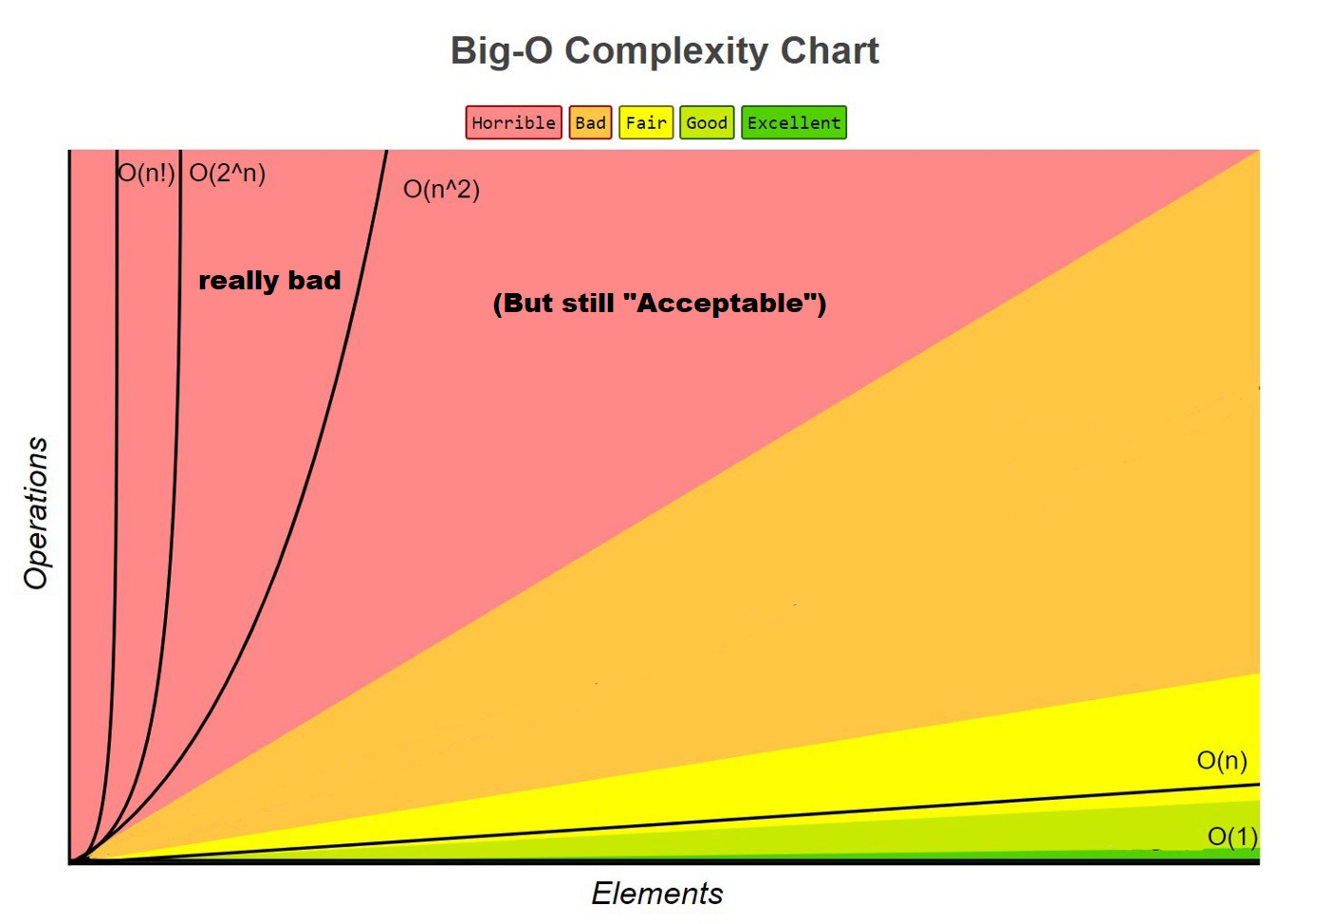

Slide 44
Given input n
O(1)
(There are a few other running times we will see later this semester)
“Best”
No loops
Constant amount of work
O(n)
Single loop or sequential for loops
O(n²)
Nested for loops
Quadratic growth
O(n³)
Triple nested for loops
Cubic growth
O(x^{n})
Brute Forcing combinations
Exponential growth
O(n!)
Brute Forcing permutations
Factorial growth
“Worst”

Slide 45
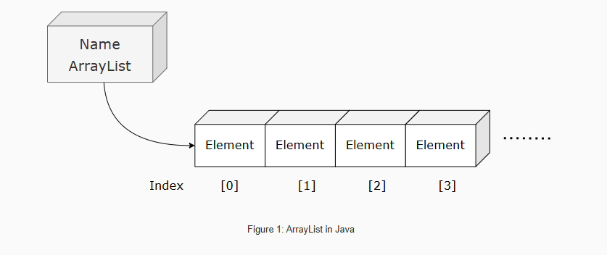
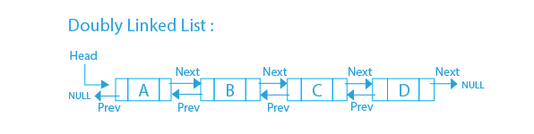
List Running Times
Operation | Running Time
Creation | O(1)
Adding an element | O(1)
Removing head or tail | O(1)
Searching / Contains | O(n) must check every node
Operation | Running Time
Creation of empty list | O(1)
Adding an element | O(n) must grow array and copy
Removing first or last | O(n) must shrink array and copy
Searching / Contains | O(n) must check every node
Where n = # of nodes in Linked List
Where n = # of nodes in arraylist
Adding to a linked list is more efficient than adding to a filled array

Slide 46
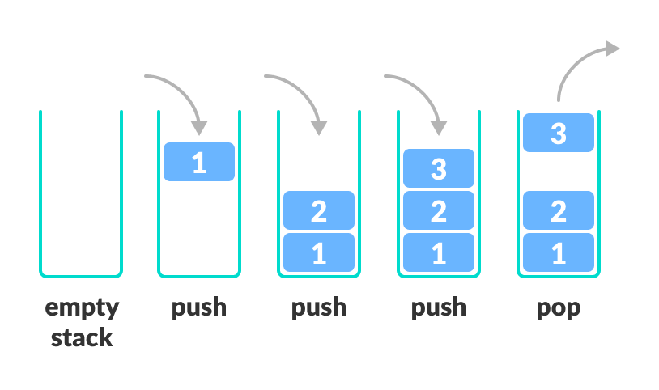
Stacks
Last-in-first-out (LIFO)
Stack
Algorithm | w/ Array | w/ Linked List
Creation | O(n) | O(1)
Push() | O(1) | O(1)
Pop() | O(1) | O(1)
peek() | O(1) | O(1)
Print() | O(n) | O(n)
Where n = # of elements in the stack

