Slide 1

CSCI 132: Basic Data Structures and Algorithms
Stacks and Queues Conclusion, Priority Queue
Reese Pearsall
Spring 2025
https://www.cs.montana.edu/pearsall/classes/spring2025/132/main.html

Slide 2
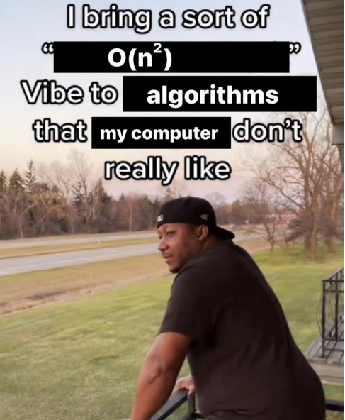
Announcements
O(n!)
Program 3 due next Friday at 11:59 PM
Next Friday will be an optional Program 3 help session (no lecture)

Slide 3
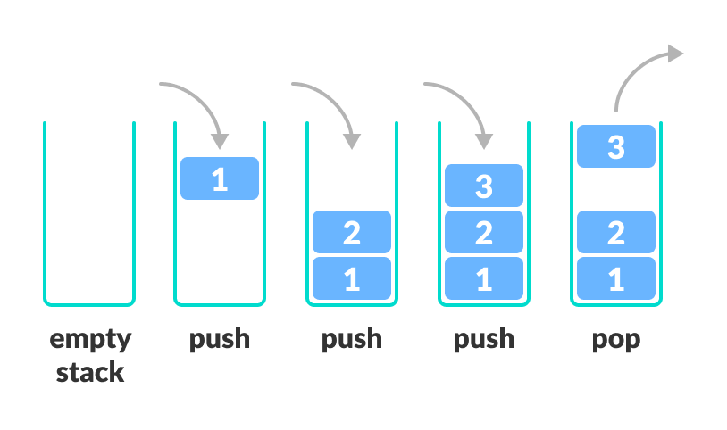
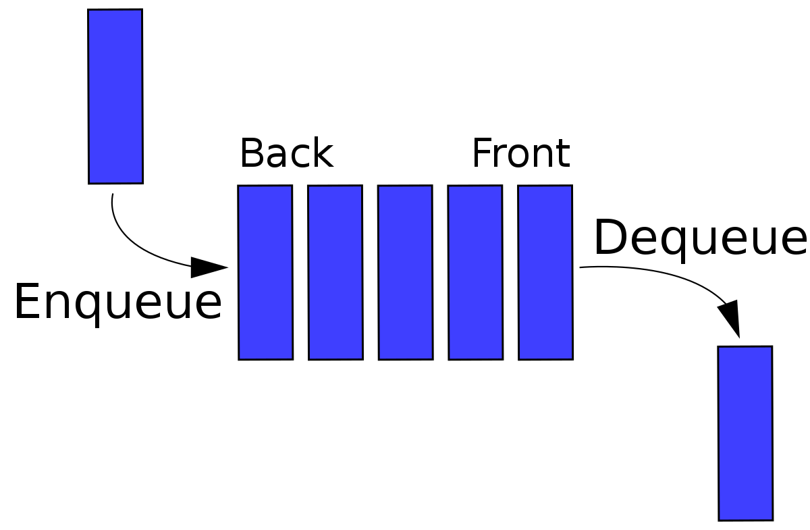
A Queue is a data structure that holds data, but operates in a First-in First-out (FIFO) fashion
A stack is a data structure that can hold data, and follows the last in first out (LIFO) principle
enqueue(), dequeue()
push(), pop()
We implemented both data structures using an Array or a Linked List

Slide 4

Queue Runtime Analysis
 | Linked List | Array
Creation | O(1) | O(n)
Enqueue | O(1) | O(1)
Dequeue | O(1) | O(1)
Peek | O(1) | O(1)
Print Queue | O(n) | O(n)
Takeaway: Adding and removing elements from a queue runs in constant time ( O(1) )
(FIFO)
Stack Runtime Analysis
 | w/ Array | w/ Linked List
Creation | O(n) | O(1)
Push() | O(1) | O(1)
Pop() | O(1) | O(1)
peek() | O(1) | O(1)
Print() | O(n) | O(n)
Takeaway: Adding and removing elements from a stack runs in constant time ( O(1) )
(LIFO)

Slide 5
Queue Runtime Analysis
Which data structure should you use?
 | Linked List | Array
Creation | O(1) | O(n)
Enqueue | O(1) | O(1)
Dequeue | O(1) | O(1)
Peek | O(1) | O(1)
Print Queue | O(n) | O(n)
it depends
Data structures always have tradeoffs.
With stacks and queues, the important thing to consider is the order of how you want your data to be read
Stack Runtime Analysis
 | w/ Array | w/ Linked List
Creation | O(n) | O(1)
Push() | O(1) | O(1)
Pop() | O(1) | O(1)
peek() | O(1) | O(1)
Print() | O(n) | O(n)
Stacks → LIFO
Queues → FIFO*

Slide 6
Queue Runtime Analysis
Applications of Queue Data Structures
Online waiting rooms
Operating System task scheduling
Web Server Request Handlers
Network Communication
CSCI 232 Algorithms
 | Linked List | Array
Creation | O(1) | O(n)
Enqueue | O(1) | O(1)
Dequeue | O(1) | O(1)
Peek | O(1) | O(1)
Print Queue | O(n) | O(n)
Stack Runtime Analysis
Applications of Stack Data Structures
Tracking function calls in programming
Web browser history
Undo/Redo buttons
Recursion/Backtracking
CSCI 232 Algorithms
 | w/ Array | w/ Linked List
Creation | O(n) | O(1)
Push() | O(1) | O(1)
Pop() | O(1) | O(1)
peek() | O(1) | O(1)
Print() | O(n) | O(n)

Slide 7
In the real world, when you want to use a Queue, Stack, Deque, or a Priority Queue, you will likely import this data structure
import.java.util.Stack
import.java.util.Queue
java.util.Queue is an interface. We cannot create a Queue object.
Instead, we create an instance of an object that implements this interface
Some of the Classes that implement the Queue interface:
PriorityQueue (java.util.PriorityQueue)
Linked List (java.util.LinkedList)
(If you need a FIFO queue, Linked List is the way to go…)

Slide 8
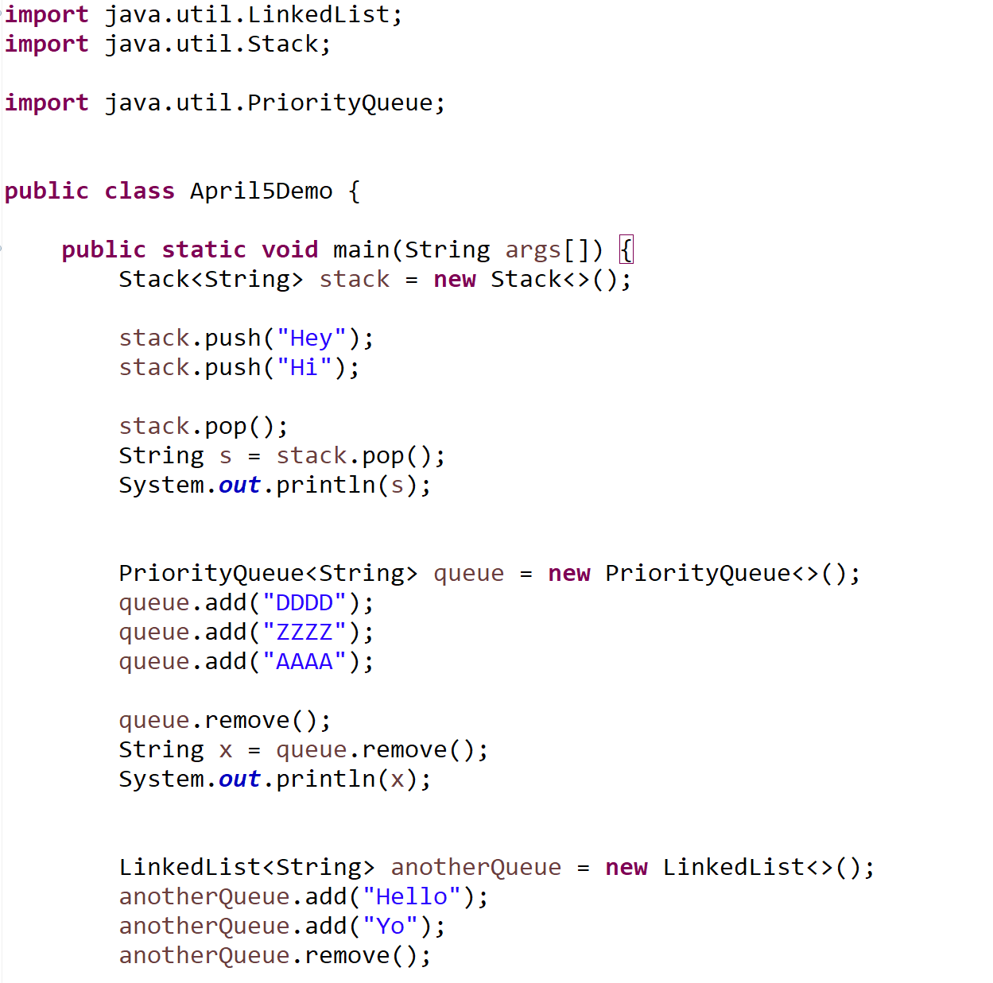

Slide 9
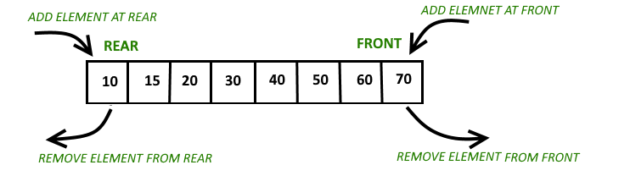
A double-ended queue, or a deque (deck) is a type of queue in which insertion and removal of elements can either be performed from the front or the rear

Slide 10
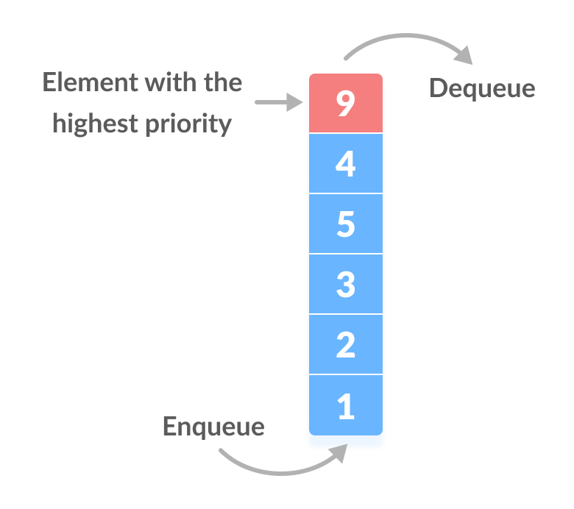
Most of the time, queues will operate in a FIFO fashion, however there may be times we want to dequeue the item with the highest priority
Priority queue in a data structure is an extension of a linear queue that possesses the following properties: Every element has a certain priority assigned to it
When we enqueue something, we might need to “shuffle” that item into the correct spot of the priority queue

