Slide 1

CSCI 132: Basic Data Structures and Algorithms
Recursion (Part 1)
Reese Pearsall
Spring 2025
https://www.cs.montana.edu/pearsall/classes/spring2025/132/main.html

Slide 2

Announcements
Program 3 due Friday
Friday will be a help session for program 3

Slide 3
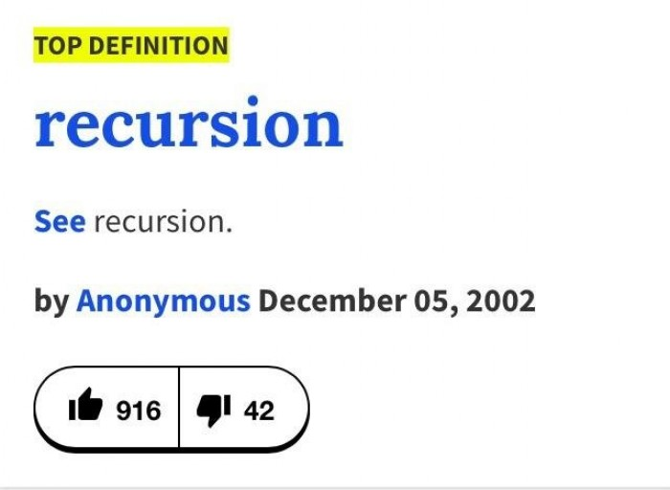
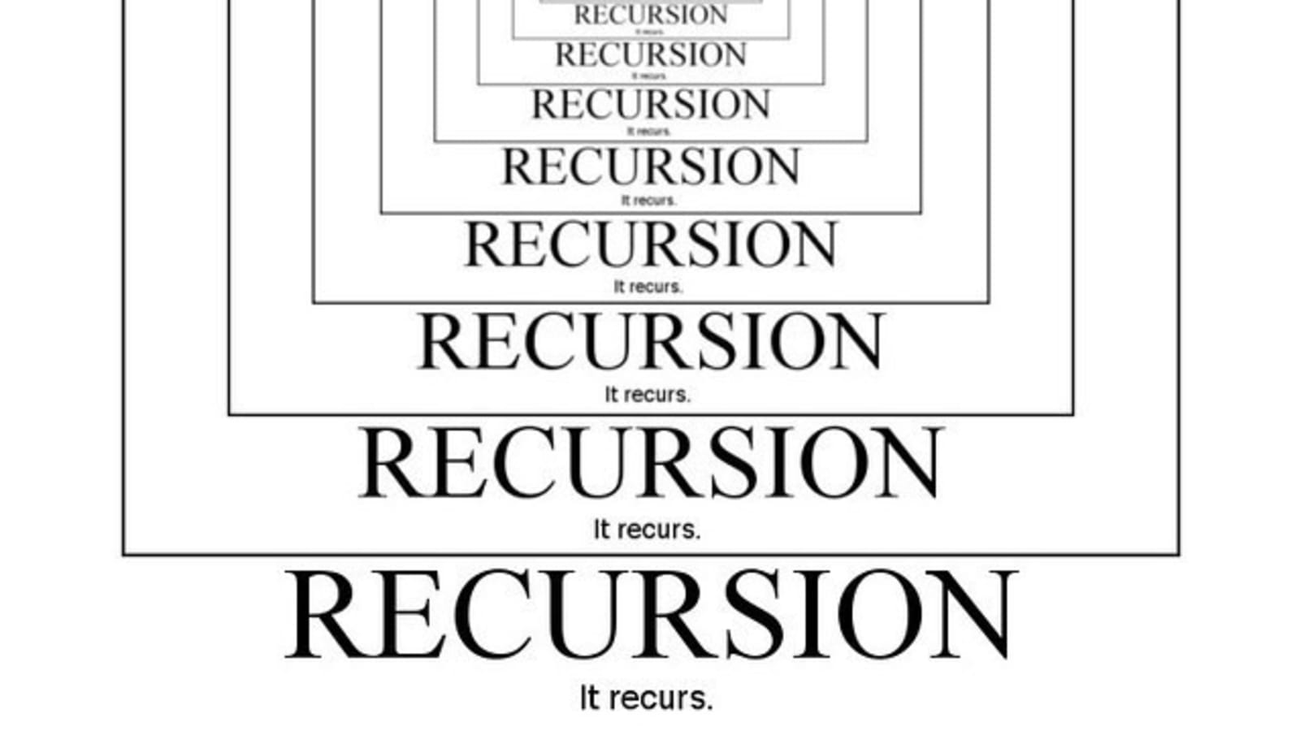
Recursion is a problem-solving technique that involves a method calling itself to solve some smaller problem
static int factorial(int n)
{
if (n == 0)
return 1;
return n * factorial(n - 1);
}

Slide 4
public static int countX(String str) {
if(str.length() == 0){
return 0;
}
if(str.charAt(0) == 'x’){
return 1 + countX(str.substring(1));
}
else{
return 0 + countX(str.substring(1));
}
}
countX(“oxxo”)

Slide 5
public static int countX(String str) {
if(str.length() == 0){
return 0;
}
if(str.charAt(0) == 'x’){
return 1 + countX(str.substring(1));
}
else{
return 0 + countX(str.substring(1));
}
}
countX(“oxxo”)
0 + countX(“xxo”)

Slide 6
public static int countX(String str) {
if(str.length() == 0){
return 0;
}
if(str.charAt(0) == 'x’){
return 1 + countX(str.substring(1));
}
else{
return 0 + countX(str.substring(1));
}
}
countX(“oxxo”)
0 + countX(“xxo”)
1 + countX(“xo”)

Slide 7
public static int countX(String str) {
if(str.length() == 0){
return 0;
}
if(str.charAt(0) == 'x’){
return 1 + countX(str.substring(1));
}
else{
return 0 + countX(str.substring(1));
}
}
countX(“oxxo”)
0 + countX(“xxo”)
1 + countX(“xo”)
1 + countX(“o”)

Slide 8
public static int countX(String str) {
if(str.length() == 0){
return 0;
}
if(str.charAt(0) == 'x’){
return 1 + countX(str.substring(1));
}
else{
return 0 + countX(str.substring(1));
}
}
countX(“oxxo”)
0 + countX(“xxo”)
1 + countX(“xo”)
1 + countX(“o”)
0 + countX(“”)

Slide 9
public static int countX(String str) {
if(str.length() == 0){
return 0;
}
if(str.charAt(0) == 'x’){
return 1 + countX(str.substring(1));
}
else{
return 0 + countX(str.substring(1));
}
}
countX(“oxxo”)
0 + countX(“xxo”)
1 + countX(“xo”)
1 + countX(“o”)
0 + countX(“”)
0

Slide 10
public static int countX(String str) {
if(str.length() == 0){
return 0;
}
if(str.charAt(0) == 'x’){
return 1 + countX(str.substring(1));
}
else{
return 0 + countX(str.substring(1));
}
}
countX(“oxxo”)
0 + countX(“xxo”)
1 + countX(“xo”)
1 + countX(“o”)
0 + 0

Slide 11
public static int countX(String str) {
if(str.length() == 0){
return 0;
}
if(str.charAt(0) == 'x’){
return 1 + countX(str.substring(1));
}
else{
return 0 + countX(str.substring(1));
}
}
countX(“oxxo”)
0 + countX(“xxo”)
1 + countX(“xo”)
1 + 0

Slide 12
public static int countX(String str) {
if(str.length() == 0){
return 0;
}
if(str.charAt(0) == 'x’){
return 1 + countX(str.substring(1));
}
else{
return 0 + countX(str.substring(1));
}
}
countX(“oxxo”)
0 + countX(“xxo”)
1 + countX(“xo”)
1 + 0

Slide 13
public static int countX(String str) {
if(str.length() == 0){
return 0;
}
if(str.charAt(0) == 'x’){
return 1 + countX(str.substring(1));
}
else{
return 0 + countX(str.substring(1));
}
}
countX(“oxxo”)
0 + countX(“xxo”)
1 + 1

Slide 14
public static int countX(String str) {
if(str.length() == 0){
return 0;
}
if(str.charAt(0) == 'x’){
return 1 + countX(str.substring(1));
}
else{
return 0 + countX(str.substring(1));
}
}
countX(“oxxo”)
0 + 2

Slide 15
public static int countX(String str) {
if(str.length() == 0){
return 0;
}
if(str.charAt(0) == 'x’){
return 1 + countX(str.substring(1));
}
else{
return 0 + countX(str.substring(1));
}
}
Final answer = 2

Slide 16
Limitations of recursion?

Slide 17
Example #3: Printing a Linked List in Reverse
first
second
third
fourth
Goal: Print contents of linked list in reverse order using recursion
Expected Output
fourth
third
second
first
Base Case?
Recursive Case?
If the size of the LL is 1, print out the only node
Remove a node (but don’t print it yet), call the recursive method and pass it the new LL. When method returns, print out the node we saved

Slide 18
public static void print_LL_reverse(LinkedList<String> ll) {
if(ll.size() == 1) {
System.out.println(ll.getFirst());
return;
}
else {
String removed = ll.removeFirst();
print_LL_reverse(ll);
System.out.println(removed);
return;
}
String removed = ll.removeFirst();
print_LL_reverse(ll);
System.out.println(removed);
return;
first
second
third
fourth
value saved: “first”

Slide 19

public static void print_LL_reverse(LinkedList<String> ll) {
if(ll.size() == 1) {
System.out.println(ll.getFirst());
return;
}
else {
String removed = ll.removeFirst();
print_LL_reverse(ll);
System.out.println(removed);
return;
}
String removed = ll.removeFirst();
print_LL_reverse(ll);
System.out.println(removed);
return;
first
second
third
fourth
value saved: “first”
String removed = ll.removeFirst();
print_LL_reverse(ll);
System.out.println(removed);
return;
second
third
fourth
value saved: “second”

Slide 20

public static void print_LL_reverse(LinkedList<String> ll) {
if(ll.size() == 1) {
System.out.println(ll.getFirst());
return;
}
else {
String removed = ll.removeFirst();
print_LL_reverse(ll);
System.out.println(removed);
return;
}
String removed = ll.removeFirst();
print_LL_reverse(ll);
System.out.println(removed);
return;
first
second
third
fourth
value saved: “first”
String removed = ll.removeFirst();
print_LL_reverse(ll);
System.out.println(removed);
return;
second
third
fourth
value saved: “second”
String removed = ll.removeFirst();
print_LL_reverse(ll);
System.out.println(removed);
return;
third
fourth
value saved: “third”

Slide 21
public static void print_LL_reverse(LinkedList<String> ll) {
if(ll.size() == 1) {
System.out.println(ll.getFirst());
return;
}
else {
String removed = ll.removeFirst();
print_LL_reverse(ll);
System.out.println(removed);
return;
}
String removed = ll.removeFirst();
print_LL_reverse(ll);
System.out.println(removed);
return;
first
second
third
fourth
value saved: “first”
String removed = ll.removeFirst();
print_LL_reverse(ll);
System.out.println(removed);
return;
second
third
fourth
value saved: “second”
String removed = ll.removeFirst();
print_LL_reverse(ll);
System.out.println(removed);
return;
third
fourth
value saved: “third”

Slide 22
public static void print_LL_reverse(LinkedList<String> ll) {
if(ll.size() == 1) {
System.out.println(ll.getFirst());
return;
}
else {
String removed = ll.removeFirst();
print_LL_reverse(ll);
System.out.println(removed);
return;
}
String removed = ll.removeFirst();
print_LL_reverse(ll);
System.out.println(removed);
return;
first
second
third
fourth
value saved: “first”
String removed = ll.removeFirst();
print_LL_reverse(ll);
System.out.println(removed);
return;
second
third
fourth
value saved: “second”
String removed = ll.removeFirst();
print_LL_reverse(ll);
System.out.println(removed);
return;
third
fourth
value saved: “third”
System.out.println(ll.getFirst());
return;
fourth

Slide 23
public static void print_LL_reverse(LinkedList<String> ll) {
if(ll.size() == 1) {
System.out.println(ll.getFirst());
return;
}
else {
String removed = ll.removeFirst();
print_LL_reverse(ll);
System.out.println(removed);
return;
}
Output
fourth
String removed = ll.removeFirst();
print_LL_reverse(ll);
System.out.println(removed);
return;
first
second
third
fourth
value saved: “first”
String removed = ll.removeFirst();
print_LL_reverse(ll);
System.out.println(removed);
return;
second
third
fourth
value saved: “second”
String removed = ll.removeFirst();
print_LL_reverse(ll);
System.out.println(removed);
return;
third
fourth
value saved: “third”
System.out.println(ll.getFirst());
return;
fourth

Slide 24
public static void print_LL_reverse(LinkedList<String> ll) {
if(ll.size() == 1) {
System.out.println(ll.getFirst());
return;
}
else {
String removed = ll.removeFirst();
print_LL_reverse(ll);
System.out.println(removed);
return;
}
Output
fourth
String removed = ll.removeFirst();
print_LL_reverse(ll);
System.out.println(removed);
return;
first
second
third
fourth
value saved: “first”
String removed = ll.removeFirst();
print_LL_reverse(ll);
System.out.println(removed);
return;
second
third
fourth
value saved: “second”
String removed = ll.removeFirst();
print_LL_reverse(ll);
System.out.println(removed);
return;
third
fourth
value saved: “third”
System.out.println(ll.getFirst());
return;
fourth

Slide 25
public static void print_LL_reverse(LinkedList<String> ll) {
if(ll.size() == 1) {
System.out.println(ll.getFirst());
return;
}
else {
String removed = ll.removeFirst();
print_LL_reverse(ll);
System.out.println(removed);
return;
}
Output
fourth
String removed = ll.removeFirst();
print_LL_reverse(ll);
System.out.println(removed);
return;
first
second
third
fourth
value saved: “first”
String removed = ll.removeFirst();
print_LL_reverse(ll);
System.out.println(removed);
return;
second
third
fourth
value saved: “second”
String removed = ll.removeFirst();
print_LL_reverse(ll);
System.out.println(removed);
return;
third
fourth
value saved: “third”

Slide 26
public static void print_LL_reverse(LinkedList<String> ll) {
if(ll.size() == 1) {
System.out.println(ll.getFirst());
return;
}
else {
String removed = ll.removeFirst();
print_LL_reverse(ll);
System.out.println(removed);
return;
}
Output
fourth
String removed = ll.removeFirst();
print_LL_reverse(ll);
System.out.println(removed);
return;
first
second
third
fourth
value saved: “first”
String removed = ll.removeFirst();
print_LL_reverse(ll);
System.out.println(removed);
return;
second
third
fourth
value saved: “second”
String removed = ll.removeFirst();
print_LL_reverse(ll);
System.out.println(removed);
return;
third
fourth
value saved: “third”

Slide 27
public static void print_LL_reverse(LinkedList<String> ll) {
if(ll.size() == 1) {
System.out.println(ll.getFirst());
return;
}
else {
String removed = ll.removeFirst();
print_LL_reverse(ll);
System.out.println(removed);
return;
}
Output
fourth
third
String removed = ll.removeFirst();
print_LL_reverse(ll);
System.out.println(removed);
return;
first
second
third
fourth
value saved: “first”
String removed = ll.removeFirst();
print_LL_reverse(ll);
System.out.println(removed);
return;
second
third
fourth
value saved: “second”
String removed = ll.removeFirst();
print_LL_reverse(ll);
System.out.println(removed);
return;
third
fourth
value saved: “third”

Slide 28
public static void print_LL_reverse(LinkedList<String> ll) {
if(ll.size() == 1) {
System.out.println(ll.getFirst());
return;
}
else {
String removed = ll.removeFirst();
print_LL_reverse(ll);
System.out.println(removed);
return;
}
Output
fourth
third
String removed = ll.removeFirst();
print_LL_reverse(ll);
System.out.println(removed);
return;
first
second
third
fourth
value saved: “first”
String removed = ll.removeFirst();
print_LL_reverse(ll);
System.out.println(removed);
return;
second
third
fourth
value saved: “second”

Slide 29
public static void print_LL_reverse(LinkedList<String> ll) {
if(ll.size() == 1) {
System.out.println(ll.getFirst());
return;
}
else {
String removed = ll.removeFirst();
print_LL_reverse(ll);
System.out.println(removed);
return;
}
Output
fourth
third
second
String removed = ll.removeFirst();
print_LL_reverse(ll);
System.out.println(removed);
return;
first
second
third
fourth
value saved: “first”
String removed = ll.removeFirst();
print_LL_reverse(ll);
System.out.println(removed);
return;
second
third
fourth
value saved: “second”

Slide 30
public static void print_LL_reverse(LinkedList<String> ll) {
if(ll.size() == 1) {
System.out.println(ll.getFirst());
return;
}
else {
String removed = ll.removeFirst();
print_LL_reverse(ll);
System.out.println(removed);
return;
}
Output
fourth
third
second
String removed = ll.removeFirst();
print_LL_reverse(ll);
System.out.println(removed);
return;
first
second
third
fourth
value saved: “first”

Slide 31
public static void print_LL_reverse(LinkedList<String> ll) {
if(ll.size() == 1) {
System.out.println(ll.getFirst());
return;
}
else {
String removed = ll.removeFirst();
print_LL_reverse(ll);
System.out.println(removed);
return;
}
Output
fourth
third
second
first
String removed = ll.removeFirst();
print_LL_reverse(ll);
System.out.println(removed);
return;
first
second
third
fourth
value saved: “first”

Slide 32

public static void print_LL_reverse(LinkedList<String> ll) {
if(ll.size() == 1) {
System.out.println(ll.getFirst());
return;
}
else {
String removed = ll.removeFirst();
print_LL_reverse(ll);
System.out.println(removed);
return;
}
Output
fourth
third
second
first

Slide 33
Linear Search
“Reese” | “Steve” | “Nando” | “Sally” | “Bob” | “Jill”
public static int linear_search(String[] names, String target, int current){
}

Slide 34
Linear Search
“Reese” | “Steve” | “Nando” | “Sally” | “Bob” | “Jill”
public static int linear_search(String[] names, String target, int current){
//base case
//recursive case
}

Slide 35
Linear Search
“Reese” | “Steve” | “Nando” | “Sally” | “Bob” | “Jill”
public static int linear_search(String[] names, String target, int current){
//base case
if(current >= names.length){
return -1;
}
if(target.equals(names[current])){
return current;
}
//recursive case
return linear_search(names, target, current+1);
}

Slide 36
Linear Search
linear_search( )
“Reese” | “Steve” | “Nando” | “Sally” | “Bob” | “Jill”
linear_search( )
“Reese” | “Steve” | “Nando” | “Sally” | “Bob” | “Jill”
linear_search( )
“Reese” | “Steve” | “Nando” | “Sally” | “Bob” | “Jill”
linear_search( )
“Reese” | “Steve” | “Nando” | “Sally” | “Bob” | “Jill”
linear_search( )
“Reese” | “Steve” | “Nando” | “Sally” | “Bob” | “Jill”
linear_search( )
“Reese” | “Steve” | “Nando” | “Sally” | “Bob” | “Jill”

Slide 37
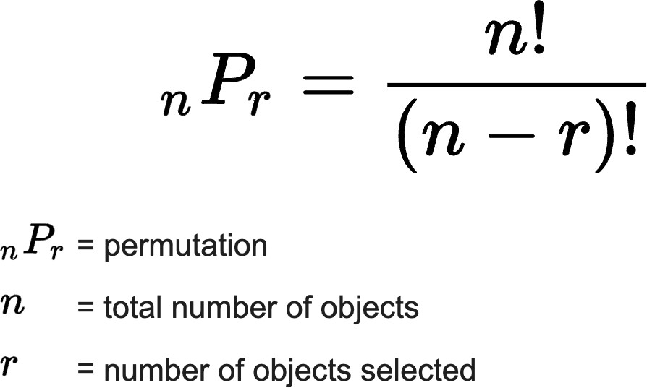
Permutations
Calculation of the number of ways a particular set can be arranged

Slide 38
Permutations
Calculation of the number of ways a particular set can be arranged
Set: a collection of distinct unordered items

Slide 39
Permutations
Calculation of the number of ways a particular set can be arranged
Set: a collection of distinct unordered items Ex:
{1, 2, 3, 4}
{‘H’, ‘I’}
{A, B, C, D}
{“I”, “L”, “A”, “N”}
{1.4, 3.6, 9.5}
{“R”, “E”, “S”}

Slide 40
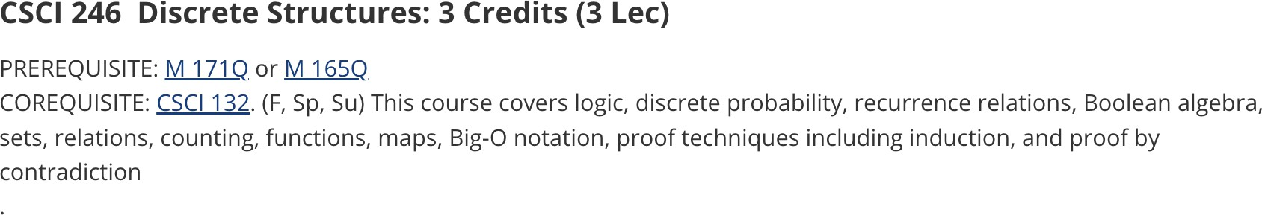
Permutations
Calculation of the number of ways a particular set can be arranged
Set: a collection of distinct unordered items Ex:
{1, 2, 3, 4}
{‘H’, ‘I’}
{A, B, C, D}
{“I”, “L”, “A”, “N”}
{1.4, 3.6, 9.5}
{“R”, “E”, “S”}

Slide 41
Permutations
Calculation of the number of ways a particular set can be arranged
Ex: “ABC”

Slide 42
Permutations
Calculation of the number of ways a particular set can be arranged
Ex: “ABC”
A B C
A C B
B A C
B C A
C A B
C B A

Slide 43
Permutations
Calculation of the number of ways a particular set can be arranged
Ex: “ABC”
1
A B C
2
A C B
3
B A C
4
B C A
5
C A B
6
C B A

Slide 44
Permutations
Calculation of the number of ways a particular set can be arranged
Ex: “ABC”
1
A B C
A C B
3! = 3 * 2 * 1 = 6
2
3
B A C
4
B C A
5
C A B
6
C B A

Slide 45
Permutations
What if we add one more letter?
Calculation of the number of ways a particular set can be arranged
Ex: “ABC” → “ABCD”

Slide 46
Permutations
What if we add one more letter?
Calculation of the number of ways a particular set can be arranged
Ex: “ABC” → “ABCD”
ABCD
BACD
CABD
DABC
ABDC
BADC
CADB
DACB
ACBD
BCAD
CBAD
DBAC
ACDB
BCDA
CBDA
DBCA
ADBC
BDAC
CDAB
DCAB
ADCB
BDCA
CDBA
DCBA

Slide 47
Permutations
What if we add one more letter?
Calculation of the number of ways a particular set can be arranged
Ex: “ABC” → “ABCD”
1 | ABCD | 7 | BACD | 13 | CABD
2 | ABDC | 8 | BADC | 14 | CADB
3 | ACBD | 9 | BCAD | 15 | CBAD
4 | ACDB | 10 | BCDA | 16 | CBDA
19
DABC
20
DACB
21
DBAC
22
DBCA
5
ADBC
11
BDAC
17
CDAB
23
DCAB
6
ADCB
12
BDCA
18
CDBA
24
DCBA

Slide 48
Permutations
What if we add one more letter?
Calculation of the number of ways a particular set can be arranged
Ex: “ABC” → “ABCD”
1 | ABCD | 7 | BACD | 13 | CABD
2 | ABDC | 8 | BADC | 14 | CADB
3 | ACBD | 9 | BCAD | 15 | CBAD
4 | ACDB | 10 | BCDA | 16 | CBDA
19
DABC
20
DACB
DBAC
4! = 4 * 3 * 2 * 1 = 24
21
22
DBCA
5
ADBC
11
BDAC
17
CDAB
23
DCAB
6
ADCB
12
BDCA
18
CDBA
24
DCBA

Slide 49

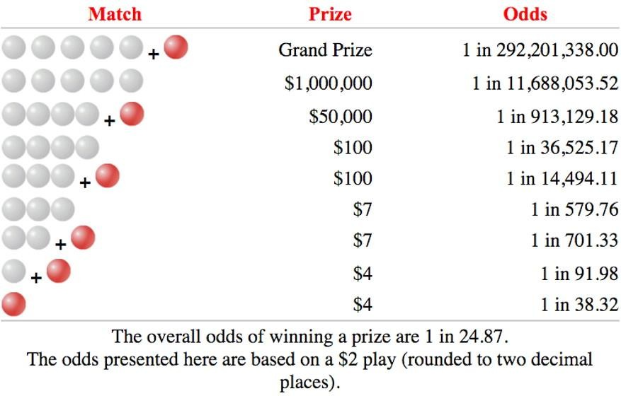
Powerball (Real)
Rules:
select five numbers between 1 and 69 for the white balls select one number between 1 and 26 for the red Powerball

Slide 50

Powerball (CSCI 132 Version)
Rules:
select 6 numbers between 1 and 6
no repeats, numbers must appear in the correct order

Slide 51
Powerball (CSCI 132 Version)
Rules:
select 6 numbers between 1 and 6
no repeats, numbers must appear in the correct order
Potential winning numbers ex:
1 2 3 4 5 6
5 2 4 1 3 6
6 5 4 3 2 1
2 4 6 1 3 5

Slide 52
Powerball (CSCI 132 Version)
Rules:
select 6 numbers between 1 and 6
no repeats, numbers must appear in the correct order
Base case?
Recursive case?

Slide 53
Powerball (CSCI 132 Version)
Rules:
select 6 numbers between 1 and 6
no repeats, numbers must appear in the correct order
Base case?
Check if the length of the current permutation matches the length of the input characters (6)
Recursive case?
Iterate through each value in our values array [1-6].
If the character is not already in the current permutation, append it and makes a recursive call to continue building the permutation

Slide 54
Base case:
Ex: calculating permutations of “123”
len(“”) == len(“123”)
Recursive case:
for chars:
if char not in perm: genPerms()

Slide 55
Ex: calculating permutations of “123”
Base case:
len(“”) == len(“123”)
””
Recursive case:
for chars:
if char not in perm: genPerms()

Slide 56


Ex: calculating permutations of “123”
Base case:
len(“”) == len(“123”)
””
Recursive case:
for chars:
if char not in perm: genPerms()
”1”
”2”
”3”

Slide 57






Ex: calculating permutations of “123”
Base case:
len(“”) == len(“123”)
””
Recursive case:
for chars:
if char not in perm: genPerms()
”1”
”2”
”3”
”12”
”13”
”21”
”23”
”31”
”32”

Slide 58
Ex: calculating permutations of “123”
Base case:
len(“”) == len(“123”)
””
Recursive case:
for chars:
if char not in perm: genPerms()
”1”
”2”
”3”
”12”
”13”
”21”
”23”
”31”
”32”
”123”
”132”
”213”
”231”
”312”
”321”

