Slide 1

CSCI 132: Basic Data Structures and Algorithms
Program 5 Discussion
Reese Pearsall
Spring 2025
https://www.cs.montana.edu/pearsall/classes/spring2025/132/main.html

Slide 2
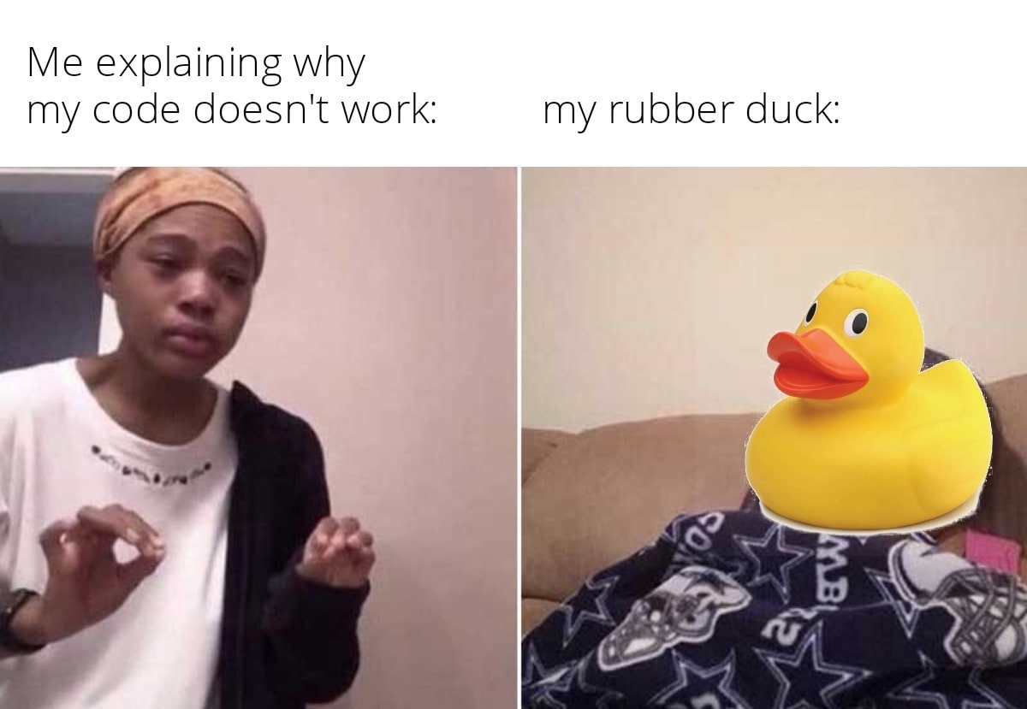
Announcements
Program 5 posted, Sunday due 5/4
Rubber duck extra credit posted. Due next Friday

Slide 3
char[][] maze
[ [ #, #, #, # ,#],
[ #, . , . , . , #],
[ . , . ,# , . , #],
[ #, #, #, . , #],
[ #, . , . , . , . ],
]

Slide 4
char[][] maze
[ [ #, #, #, # ,#],
[ #, . , . , . , #],
[ . , . ,# , . , #],
[ #, #, #, . , #],
[ #, . , . , . , . ],
]
maze[0]

Slide 5
char[][] maze
[ [ #, #, #, # ,#],
[ #, . , . , . , #],
[ . , . ,# , . , #],
[ #, #, #, . , #],
[ #, . , . , . , . ],
]
maze[1]

Slide 6
char[][] maze
[ [ #, #, #, # ,#],
[ #, . , . , . , #],
[ . , . ,# , . , #],
[ #, #, #, . , #],
[ #, . , . , . , . ],
]
maze[1][0]

Slide 7
char[][] maze
[ [ #, #, #, # ,#],
[ #, . , . , . , #],
[ . , . ,# , . , #],
[ #, #, #, . , #],
[ #, . , . , . , . ],
]
maze[1][2]

Slide 8
char[][] maze
[ [ #, #, #, # ,#],
[ #, . , . , . , #],
[ . , . ,# , . , #],
[ #, #, #, . , #],
[ #, . , . , . , . ],
]
maze[y][x]

Slide 9
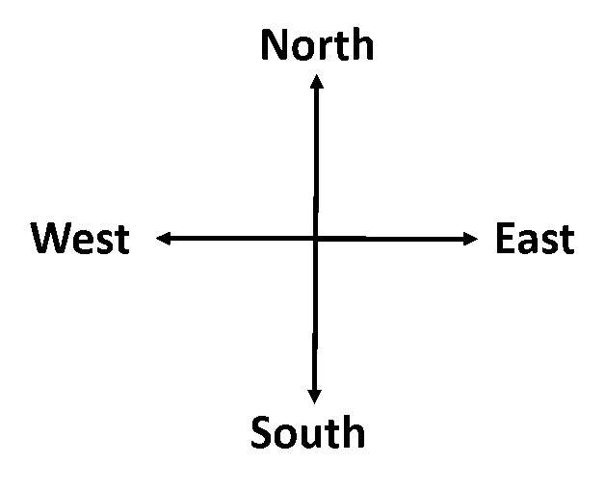




char[][] maze
[ [ #, #, #, # ,#],
[ #, . , . , . , #],
[ . , . ,# , . , #],
[ #, #, #, . , #],
[ #, . , . , . , . ],
]
(2, 1)
(2, 2)
Goal: Move forward one spot
We need to know which direction we are facing first!
maze[y][x]
How do we know direction we are facing?

Slide 10


char[][] maze
[ [ #, #, #, # ,#],
[ #, . , . , . , #],
[ . , . ,# , . , #],
[ #, #, #, . , #],
[ #, . , . , . , . ],
]
(2, 1)
(2, 2)
Goal: Move forward one spot
We need to know which direction we are facing first!
maze[y][x]
Our character Y value and our hand’s Y value is the same,
And our character’s X value is less than our hands’ X value

Slide 11
char[][] maze
[ [ #, #, #, # ,#],
[ #, . , . , . , #],
[ . , . ,# , . , #],
[ #, #, #, . , #],
[ #, . , . , . , . ],
]
(2, 1)
(2, 2)
if(y == hand_y && hand_x > x)
direction = "North";
}
maze[y][x]

Slide 12
char[][] maze
[ [ #, #, #, # ,#],
[ #, . , . , . , #],
[ . , . ,# , . , #],
[ #, #, #, . , #],
[ #, . , . , . , . ],
]
if(y == hand_y && hand_x > x)
direction = "North";
}
…
(2, 1)
(2, 2)
How do we detect if we can move forward?
maze[y][x]

Slide 13
char[][] maze
[ [ #, #, #, # ,#],
[ #, . , . , . , #],
[ . , . ,# , . , #],
[ #, #, #, . , #],
[ #, . , . , . , . ],
]
if(y == hand_y && hand_x > x)
direction = "North";
}
…
(2, 1)
(2, 2)
if(maze[hand_y][hand_x] == '#' && maze[y-1][x] == ‘.’){
}
maze[y][x]

Slide 14
char[][] maze
[ [ #, #, #, # ,#],
[ #, . , . , . , #],
[ . , . ,# , . , #],
[ #, #, #, . , #],
[ #, . , . , . , . ],
]
if(y == hand_y && hand_x > x)
direction = "North";
}
…
(2, 1)
(2, 2)
if(maze[hand_y][hand_x] == '#' && maze[y-1][x] == ‘.’){
}
Make one move by recursively calling the method with the new values
maze[y][x]
makeMove(x, y, hand_x, hand_y)

Slide 15
char[][] maze
[ [ #, #, #, # ,#],
[ #, . , . , . , #],
[ . , . ,# , . , #],
[ #, #, #, . , #],
[ #, . , . , . , . ],
]
if(y == hand_y && hand_x > x)
direction = "North";
}
…
(2, 1)
(2, 2)
if(maze[hand_y][hand_x] == '#' && maze[y-1][x] == ‘.’){
}
Make one move by recursively calling the method with the new values
maze[y][x]
makeMove(x, y, hand_x, hand_y)

Slide 16
char[][] maze
[ [ #, #, #, # ,#],
[ #, . , . , . , #],
[ . , . ,# , . , #],
[ #, #, #, . , #],
[ #, . , . , . , . ],
]
if(y == hand_y && hand_x > x)
direction = "North";
}
…
(1, 1)
(1, 2)
(2, 1)
(2, 2)
if(maze[hand_y][hand_x] == '#' && maze[y-1][x] == ‘.’){
}
makeMove(x, y-1, hand_x, hand_y-1);
maze[y][x]
makeMove(x, y, hand_x, hand_y)

Slide 17
char[][] maze
[ [ #, #, #, # ,#],
[ #, . , . , . , #],
[ . , . ,# , . , #],
[ #, #, #, . , #],
[ #, . , . , . , . ],
]
if(y == hand_y && hand_x > x)
direction = "North";
}
…
if(direction.equals("North")) {
(1, 1)
(1, 2)
(2, 1)
(2, 2)
if(maze[hand_y][hand_x] == '#' && maze[y-1][x] == ‘.’){
}
makeMove(x, y-1, hand_x, hand_y-1);
maze[y][x]
makeMove(x, y, hand_x, hand_y)

Slide 18
char[][] maze
[ [ #, #, #, # ,#],
[ #, . , . , . , #],
[ . , . ,# , . , #],
[ #, #, #, . , #],
[ #, . , . , . , . ],
]
if(y == hand_y && hand_x > x)
direction = "North";
}
…
if(direction.equals("North")) {
(1, 1)
(1, 2)
(2, 1)
(2, 2)
if(maze[hand_y][hand_x] == '#' && maze[y-1][x] == ‘.’){
}
makeMove(x, y-1, hand_x, hand_y-1);
maze[y][x]
Turn right and move forward one spot?
makeMove(x, y, hand_x, hand_y)

Slide 19
char[][] maze
[ [ #, #, #, # ,#],
[ #, . , . , . , #],
[ . , . ,# , . , #],
[ #, #, #, . , #],
[ #, . , . , . , . ],
]
if(y == hand_y && hand_x > x)
direction = "North";
}
…
if(direction.equals("North")) {
(1, 1)
(1, 2)
(2, 1)
(2, 2)
if(maze[hand_y][hand_x] == '#' && maze[y-1][x] == ‘.’){
}
if(maze[hand_y][hand_x] == ‘.’){
}
makeMove(x, y-1, hand_x, hand_y-1);
maze[y][x]
makeMove(x, y, hand_x, hand_y)

Slide 20


char[][] maze
[ [ #, #, #, # ,#],
[ #, . , . , . , #],
[ . , . ,# , . , #],
[ #, #, #, . , #],
[ #, . , . , . , . ],
]
if(y == hand_y && hand_x > x)
direction = "North";
}
…
if(direction.equals("North")) {
(1, 1)
(1, 2)
(2, 1)
(2, 2)
if(maze[hand_y][hand_x] == '#' && maze[y-1][x] == ‘.’){
}
if(maze[hand_y][hand_x] == ‘.’){
}
makeMove(x, y-1, hand_x, hand_y-1);
maze[y][x]
makeMove(??, ??, ??, ??);
makeMove(x, y, hand_x, hand_y)

Slide 21


char[][] maze
[ [ #, #, #, # ,#],
[ #, . , . , . , #],
[ . , . ,# , . , #],
[ #, #, #, . , #],
[ #, . , . , . , . ],
]
if(y == hand_y && hand_x > x)
direction = "North";
}
…
if(direction.equals("North")) {
(1, 1)
(1, 2)
(2, 1)
(2, 2)
if(maze[hand_y][hand_x] == '#' && maze[y-1][x] == ‘.’){
}
if(maze[hand_y][hand_x] == ‘.’){
}
makeMove(x, y-1, hand_x, hand_y-1);
maze[y][x]
makeMove(x+1, y, hand_x, hand_y+1);
makeMove(x, y, hand_x, hand_y)

Slide 22


char[][] maze
[ [ #, #, #, # ,#],
[ #, . , . , . , #],
[ . , . ,# , . , #],
[ #, #, #, . , #],
[ #, . , . , . , . ],
]
if(y == hand_y && hand_x > x)
direction = "North";
}
…
if(direction.equals("North")) {
(1, 1)
(1, 2)
(2, 1)
(2, 2)
if(maze[hand_y][hand_x] == '#' && maze[y-1][x] == ‘.’){
}
if(maze[hand_y][hand_x] == ‘.’){
}
makeMove(x, y-1, hand_x, hand_y-1);
maze[y][x]
makeMove(x+1, y, hand_x, hand_y+1);
makeMove(x, y, hand_x, hand_y)

Slide 23
char[][] maze
[ [ #, #, #, # ,#],
[ #, . , . , . , #],
[ . , . ,# , . , #],
[ #, #, #, . , #],
[ #, . , . , . , . ],
]
if(y == hand_y && hand_x > x)
direction = "North";
}
…
if(direction.equals("North")) {
(1, 1)
(1, 2)
(2, 1)
(2, 2)
if(maze[hand_y][hand_x] == '#' && maze[y-1][x] == ‘.’){
}
if(maze[hand_y][hand_x] == ‘.’){
}
makeMove(x, y-1, hand_x, hand_y-1);
maze[y][x]
makeMove(x+1, y, hand_x, hand_y+1);
makeMove(x, y, hand_x, hand_y)

Slide 24
char[][] maze
maze[y][x]
[ [ #, #, #, # ,#],
[ #, . , . , . , #],
[ . , . ,# , . , #],
[ #, #, #, . , #],
[ #, . , . , . , . ],
]
if(y == hand_y && hand_x > x)
direction = "North";
}
…
if(direction.equals("North")) {
(1, 1)
(1, 2)
(2, 1)
(2, 2)
if(maze[hand_y][hand_x] == '#' && maze[y-1][x] == ‘.’){
}
if(maze[hand_y][hand_x] == ‘.’){
}
makeMove(x, y-1, hand_x, hand_y-1);
makeMove(x+1, y, hand_x, hand_y+1);
Turn right
Go forward
Turn left
makeMove(x, y, hand_x, hand_y)

Slide 25
char[][] maze
maze[y][x]
[ [ #, #, #, # ,#],
[ #, . , . , . , #],
[ . , . ,# , . , #],
[ #, #, #, . , #],
[ #, . , . , . , . ],
]
if(y == hand_y && hand_x > x)
direction = "North";
}
…
if(direction.equals("North")) {
(1, 1)
(1, 2)
(2, 1)
(2, 2)
if(maze[hand_y][hand_x] == ‘.’){
}
if(maze[hand_y][hand_x] == '#' && maze[y-1][x] == ‘.’){
}
Right
makeMove(x+1, y, hand_x, hand_y+1);
Forward
Turn right
Go forward
Turn left
makeMove(x, y-1, hand_x, hand_y-1);
Left
// Turn left

Slide 26
char[][] maze
maze[y][x]
[ [ #, #, #, # ,#],
[ #, . , . , . , #],
[ . , . ,# , . , #],
[ #, #, #, . , #],
[ #, . , . , . , . ],
]
if(y == hand_y && hand_x > x)
direction = "North";
}
…
if(direction.equals("North")) {
(1, 1)
(1, 2)
(2, 1)
(2, 2)
if(maze[hand_y][hand_x] == ‘.’ && maze[y-1][x]=='#’){
}
if(maze[hand_y][hand_x] == '#' && maze[y-1][x] == ‘.’){
}
Right
makeMove(x+1, y, hand_x, hand_y+1);
Forward
makeMove(x, y-1, hand_x, hand_y-1);
You will have need if statements for North, East, South, and West
Lots of if statements ☺
Left
// Turn left

Slide 27
char[][] maze
maze[y][x]
[ [ #, #, #, # ,#],
[ #, . , . , . , #],
[ . , . ,# , . , #],
[ #, #, #, . , #],
[ #, . , . , . , . ],
]
if(y == hand_y && hand_x > x)
direction = "North";
}
…
if(direction.equals("North")) {
(1, 1)
(1, 2)
(2, 1)
(2, 2)
if(maze[hand_y][hand_x] == ‘.’ && maze[y-1][x]=='#’){
}
if(maze[hand_y][hand_x] == '#' && maze[y-1][x] == ‘.’){
}
This code is technically not complete, you will need to add some more code here (backtracking)
Right
makeMove(x+1, y, hand_x, hand_y+1);
Forward
makeMove(x, y-1, hand_x, hand_y-1);
You will have need if statements for North, East, South, and West
Lots of if statements ☺
Left
// Turn left

Slide 28
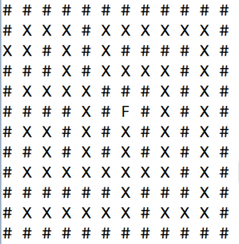
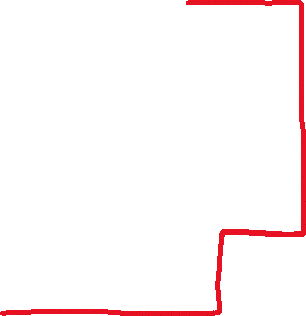
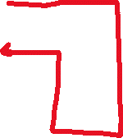

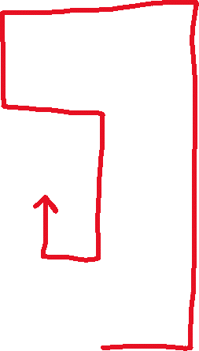


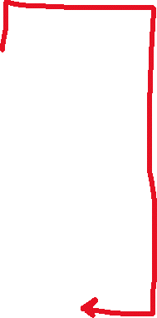

= Backtracking path

