Slide 1

CSCI 132: Basic Data Structures and Algorithms
More Java Constructs, Java Generics, Software Testing
Reese Pearsall
Spring 2025
https://www.cs.montana.edu/pearsall/classes/spring2025/132/main.html

Slide 2
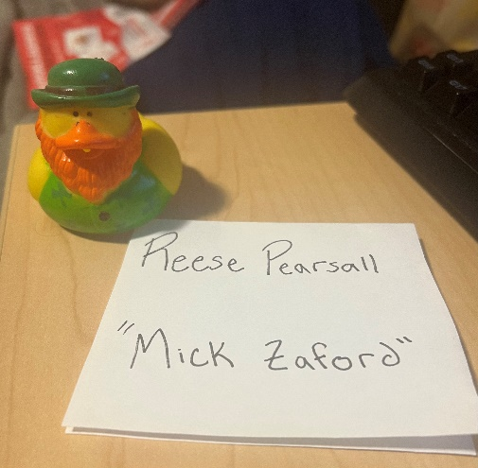
Announcements
Rubber Duck Extra credit screenshot due by Friday
Lab 13 due tomorrow @ 11:59 pm
Course Evaluation
Wednesday will be a help session for Program 5
No lecture
Final Exam- Monday May 5th
2:00 PM – 3:50 PM (Same Classroom)
Same format as midterm exam
Program 5 due Sunday May 4th
Please look at the gradebook this week and let someone know if you are missing a grade

Slide 3
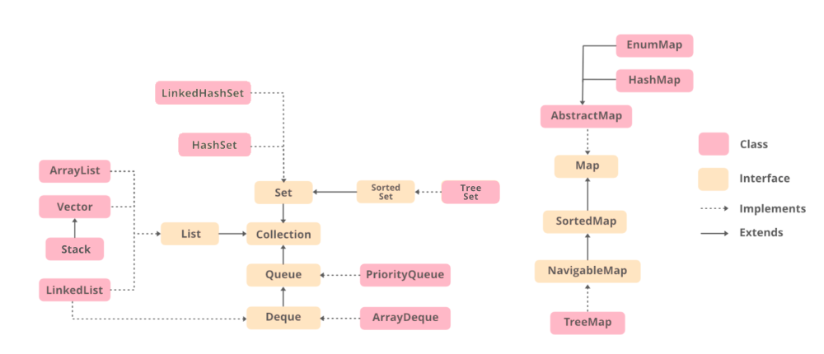
Data Structure Class Hierarchy in Java

Slide 4
Instead of writing many if/else statements, you can use the switch statement
The switch statement selects one of many code blocks to be executed
int day = 4;
switch (day) {
case 1:
System.out.println("Monday");
break;
case 2:
System.out.println("Tuesday");
break;
case 3:
System.out.println("Wednesday");
break;
default:
System.out.println(“???");
These can be efficient when working with many possible conditions. They serve the same purpose as if statements, but are slightly more efficient

Slide 5

Wrapper Classes
Every primitive data type in Java has a Wrapper Class
A Wrapper Class is a way to represent a primitive data type as a Java Object
Primitive Type | Wrapper Class
int | Integer
double | Double
char | Character
Wrapper classes also provide lots of helpful built-in methods
Integer.compareTo(…)
Integer.ParseInt(…)
Integer.toString(..)
Integer num = 5;
int num = 5;
int num = null;
Integer num = null;
num
Integer
value | 5
num | 5

Slide 6
Let’s go back to when we were writing our own Linked List and Node class
For example, this Linked List could only hold Strings
public class Node {
private String name;
private Node next;
public Node(String c) {
this.name = c;
this.next = null
}
…
}

Slide 7
Let’s go back to when we were writing our own Linked List and Node class
If we wanted to have Linked List hold Doubles, we would need to modify parts of the Node and LinkedList class
For example, this Linked List could only hold Strings
public class Node {
private String name;
private Node next;
public Node(String c) {
this.name = c;
this.next = null
}
…
}
public class Node {
private double value;
private Node next;
public Node(double c) {
this.value = c;
this.next = null
}
…
}

Slide 8
Let’s go back to when we were writing our own Linked List and Node class
If we wanted to have Linked List hold Doubles, we would need to modify parts of the Node and LinkedList class
For example, this Linked List could only hold Strings
public class Node {
private String name;
private Node next;
public Node(String c) {
this.name = c;
this.next = null
}
…
}
public class Node {
private double value;
private Node next;
public Node(double c) {
this.value = c;
this.next = null
}
…
}
It would be nice if we could allow our Linked List to hold any type of data without needing to modify the source code of our classes

Slide 9
Let’s go back to when we were writing our own Linked List and Node class
If we wanted to have Linked List hold Doubles, we would need to modify parts of the Node and LinkedList class
For example, this Linked List could only hold Strings
public class Node {
private String name;
private Node next;
public Node(String c) {
this.name = c;
this.next = null
}
…
}
public class Node {
private double value;
private Node next;
public Node(String c) {
this.name = c;
this.next = null
}
…
}
It would be nice if we could allow our Linked List to hold any type of data without needing to modify the source code of our classes→ We can achieve this using Java generics

Slide 10
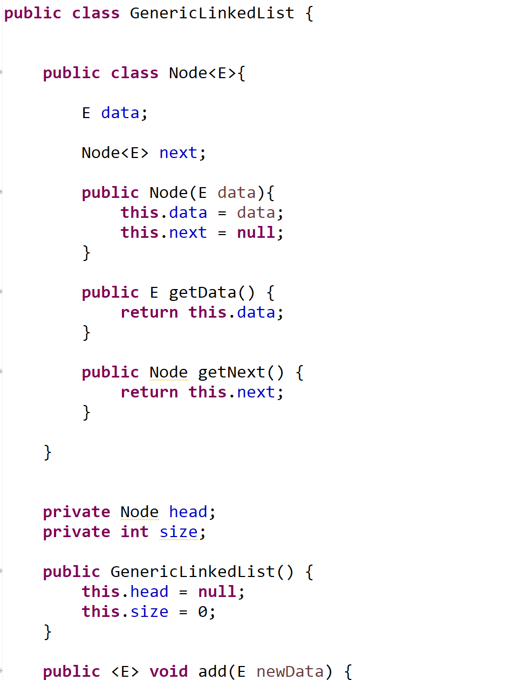







We can embed a class within another class (although I don’t recommend doing this unless the class is very small and/or the classes are strongly related to each other)
The data can be any object
When we create a Node object, we will give it some data type
<E> is used to indicate that this Node class will hold a Generic object. It can be any object
getData() will now return some generic object E
This is very helpful for cases when we might not know what data type we will be working with
Start of Linked List class
<T> is also a value used to indicate a generic object

Slide 11
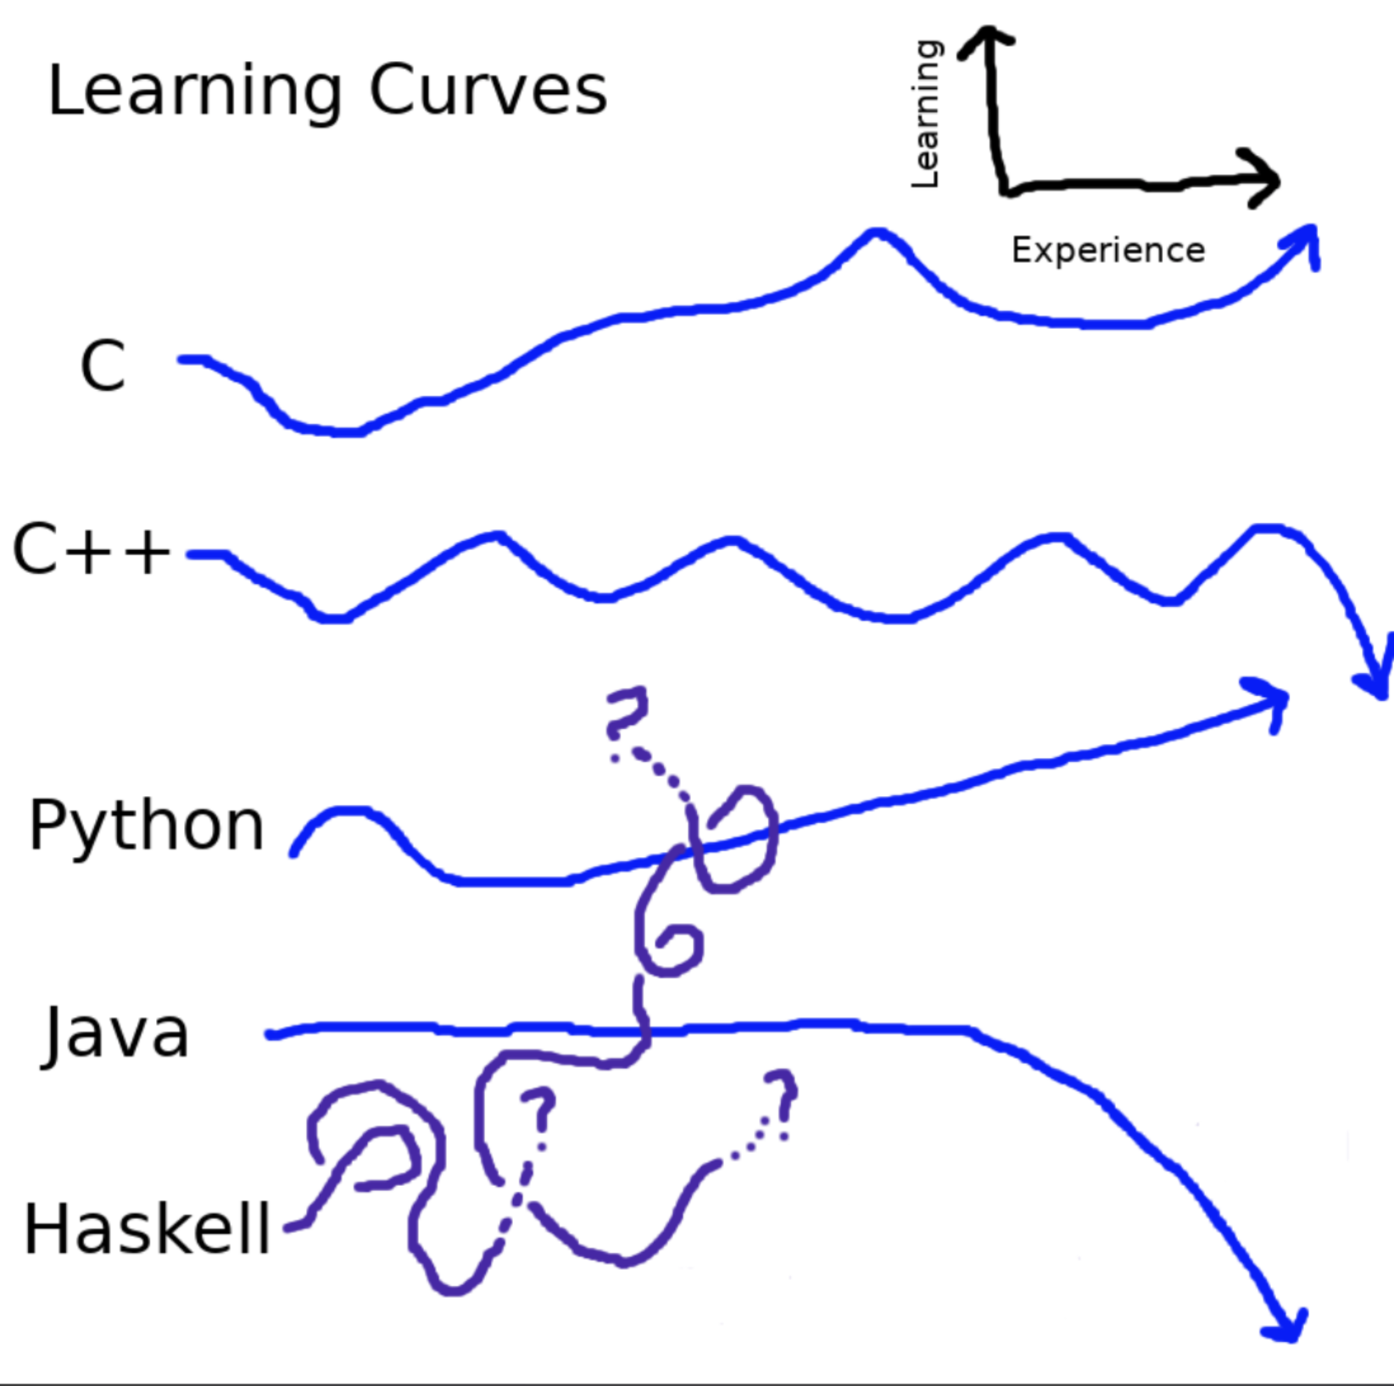

Slide 12
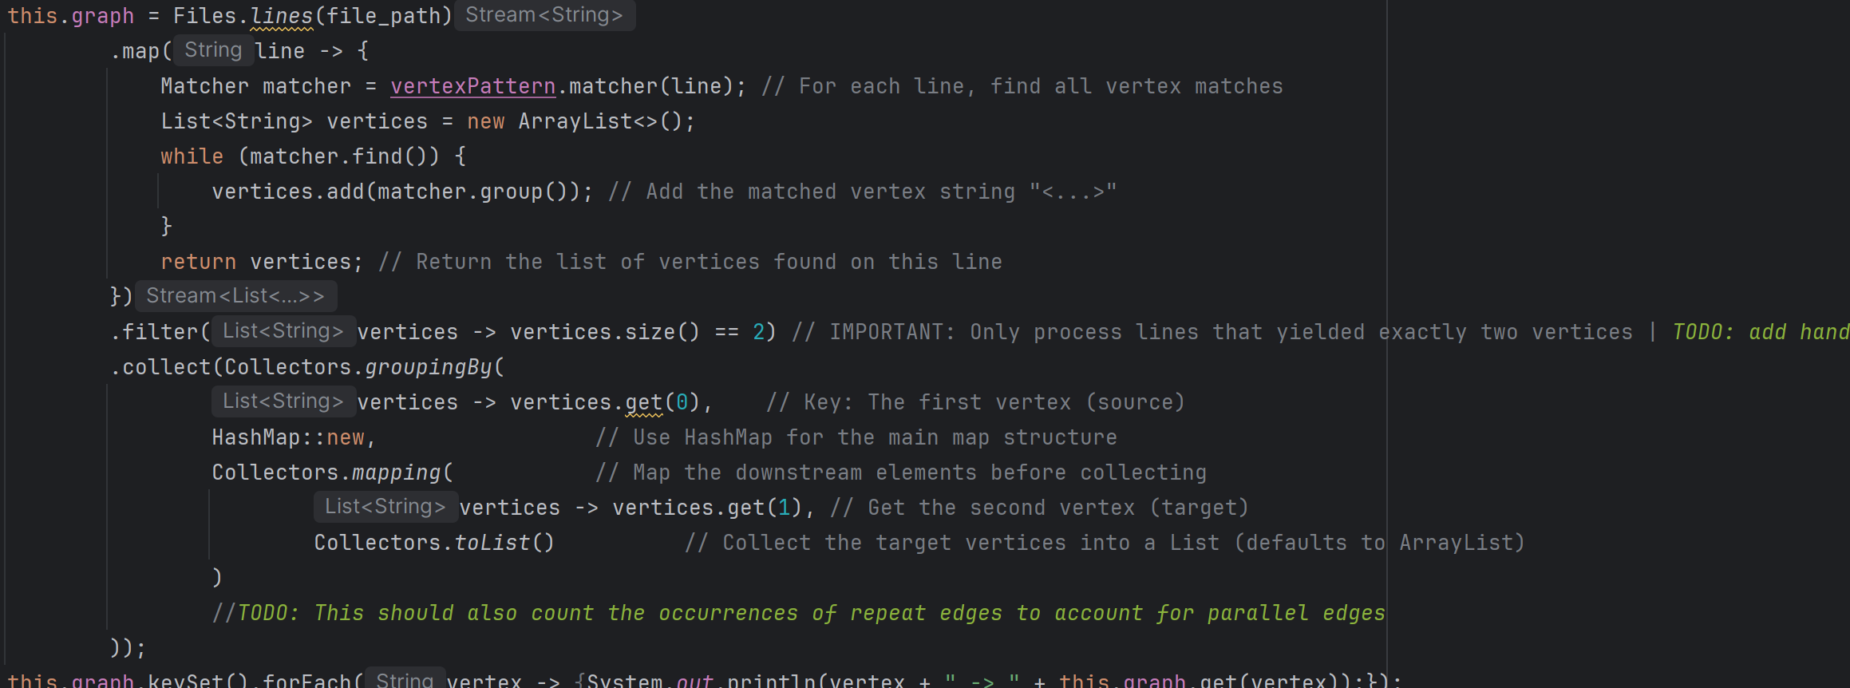

Slide 13

Software testing involves verifying and validating that a software application is free of bugs/errors and that it meets the technical requirements.
Today we will be covering unit testing
Unit testing is preformed by developers during coding
This method tests individual components of an application to identify bugs early
We will be using JUnit, a testing framework built into eclipse
13

Slide 14
Test Driven Development (TDD)
Might see it on job listings
Very popular software development approach where you write tests for a feature before writing the actual code that implements the feature
Main idea is to write automated tests first, then write the code to pass those tests to produce code with fewer bugs
14

Slide 15
Unit Testing
Unit testing focuses on testing individual components or "units" of code (usually functions) independently from the rest of the program
Focused tests that check if a function returns the correct output given a specific input
Allows you to check for strange behavior or confirm your program does what it should when it encounters edge cases
15

Slide 16
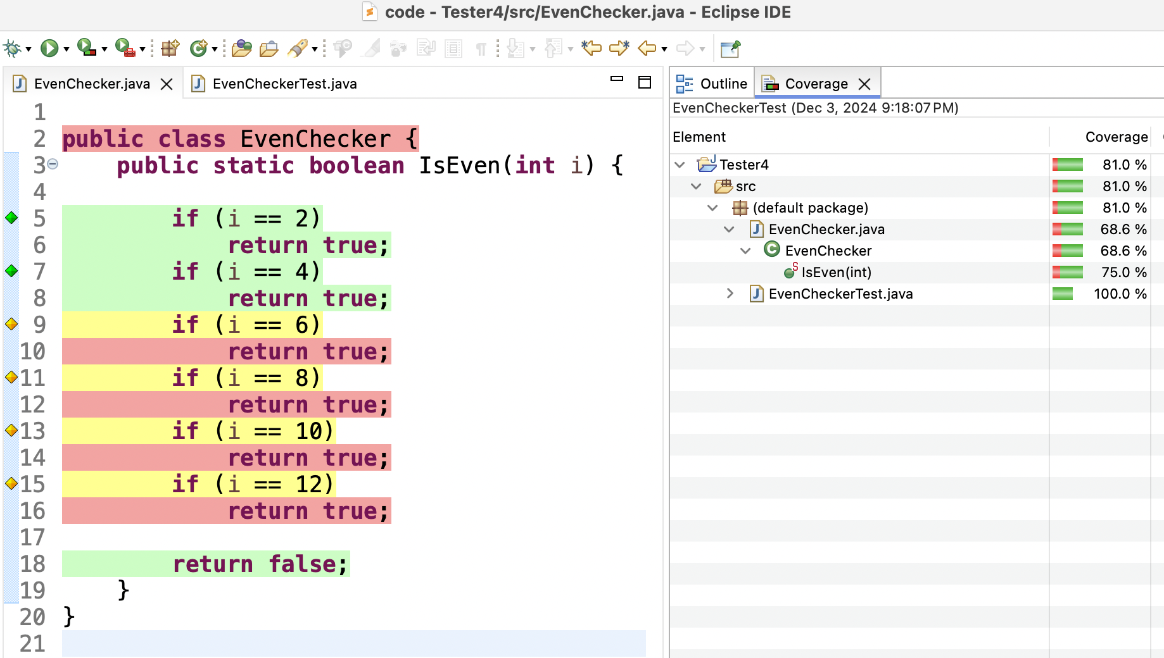

Code Coverage
Code coverage is a metric used in software testing to measure the percentage of your code that is executed when you run your test suite
A percentage value reflects how much of your code is tested within your unit tests
Green → tested
Yellow → partially tested
Red → not tested
16

Slide 17
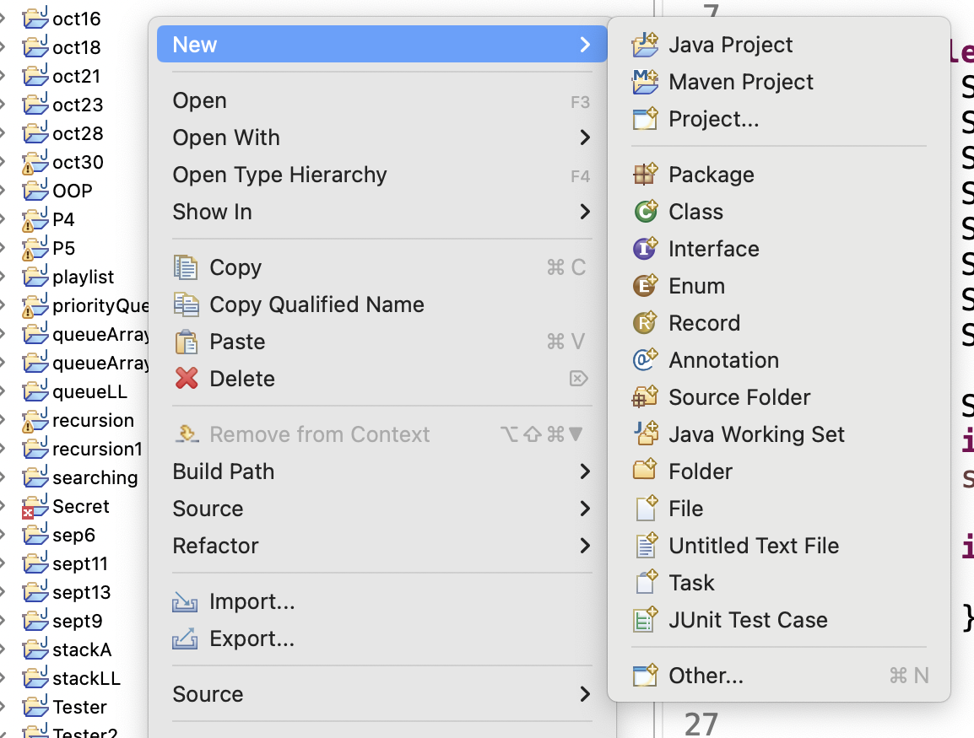

Add new JUnit test case
17

Slide 18
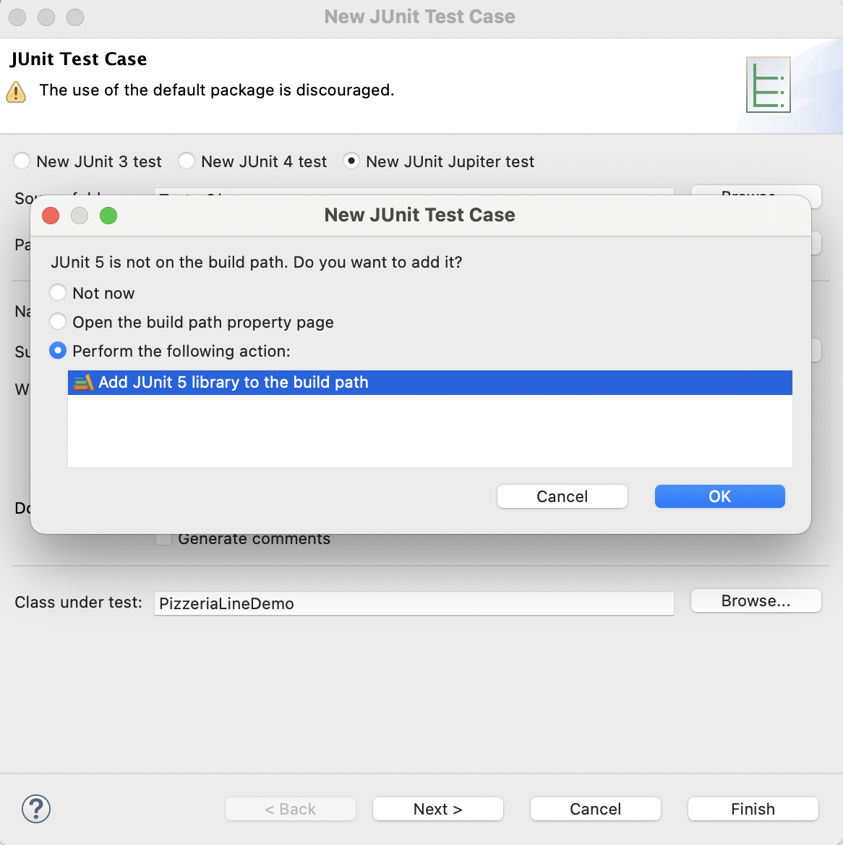

Add the JUnit library to the project path
18

Slide 19
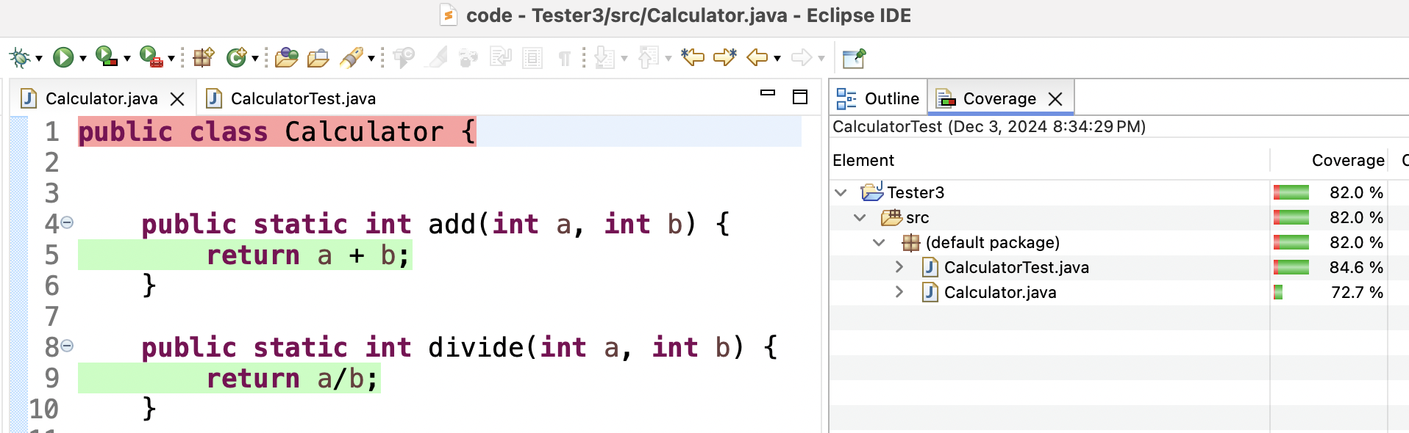
Code Coverage Requirements
You may encounter situations where you're required to meet a minimum level of test coverage (ex. 70%) before you can release your code Reaching a certain level of coverage is often a key part of maintaining code quality and meeting standards when working in industry
Calculator.java has 72.7% test coverage
(since we never instantiated a calculator object)
19

