Slide 1

CSCI 132: Basic Data Structures and Algorithms
Final Exam Review, Course Conclusion
Reese Pearsall
Spring 2025
https://www.cs.montana.edu/pearsall/classes/spring2025/132/main.html

Slide 2
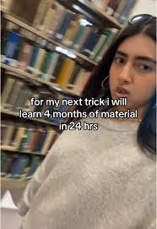


Announcements
Program 5 due Sunday
Final Exam on Monday (5/5) at
2:00 PM – 3:50 PM in our normal classroom
Rubber duck screenshot due tonight
Meatball wishes you good luck on your final exams
Duke

Slide 3
The Four Pillars of Object-Oriented Programming (OOP) are the fundamental principles to building modular, re-usable, and maintainable software
Polymorphism
Abstraction
Encapsulation
Inheritance

Slide 4
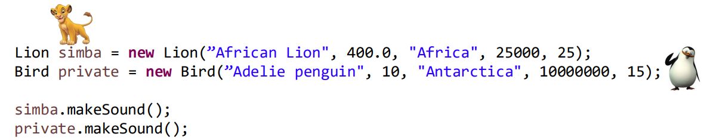
Polymorphism is the ability of a class to provide different implementations of a method, depending on the type of object
It’s all about being able to reference an object with different types to achieve shared behaviors
“The ability for an object to take many forms”
The makeSound() method does something different for each object

Slide 5
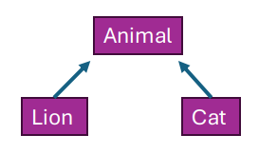
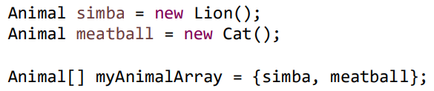
Polymorphism is the ability of a class to provide different implementations of a method, depending on the type of object
It’s all about being able to reference an object with different types to achieve shared behaviors
“The ability for an object to take many forms”
We can also treat the simba reference variable as an Animal, since Lion inherits from Animal

Slide 6
Polymorphism is the ability of a class to provide different implementations of a method, depending on the type of object
It’s all about being able to reference an object with different types to achieve shared behaviors
“The ability for an object to take many forms”
LinkedList<String> mylist = new LinkedList<String>();
List<String> mylist = new LinkedList<String>();
We can reference mylist as just a List

Slide 7

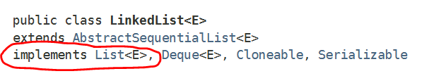
Polymorphism is the ability of a class to provide different implementations of a method, depending on the type of object
It’s all about being able to reference an object with different types to achieve shared behaviors
“The ability for an object to take many forms”
LinkedList<String> mylist = new LinkedList<String>();
JAVA DOCKEY
List<String> mylist = new LinkedList<String>();
We can reference mylist as just a List

Slide 8
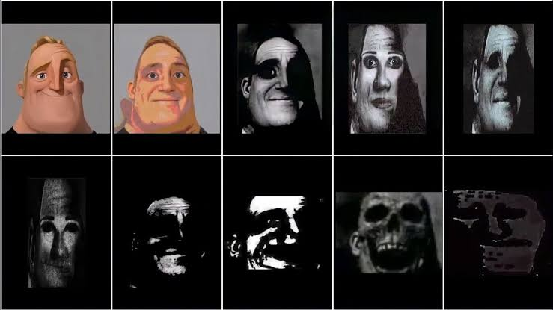

Slide 17
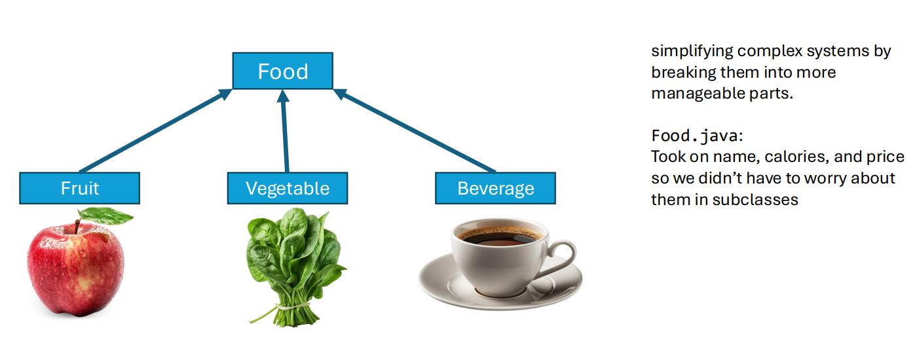
Abstraction is the process of hiding certain details and showing only essential information to the user
Abstraction can be achieved with abstract classes and interfaces
Users don’t care about the implementation details of the Queue, so we hide it (“abstract it”) behind a class

Slide 18
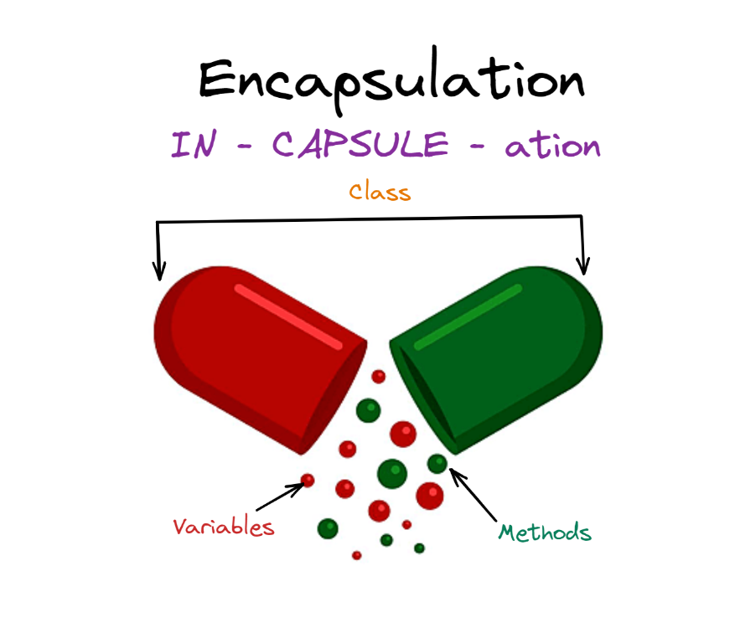

Encapsulation is the process of wrapping and data together into a single unit
Bundling of data and methods that operates on the data within a single unit, which is called a class
Helpful for code organization
Where does it make sense to keep things together, and where are responsibilities separate?

Slide 19
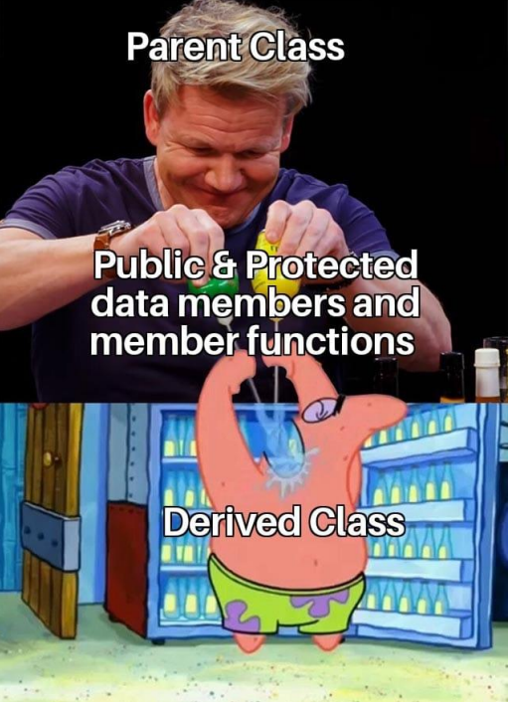
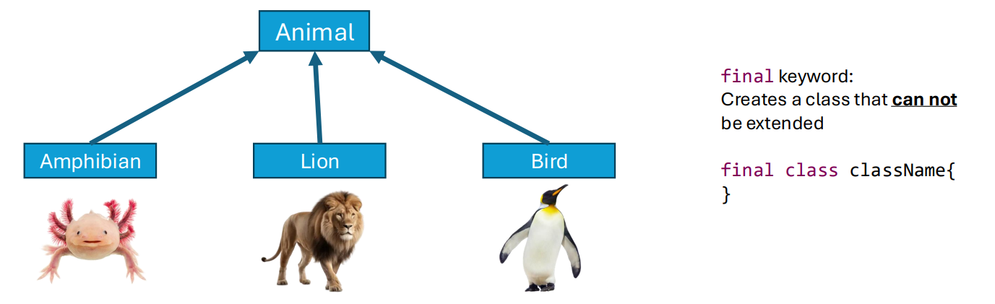
Inheritance is the process of one class inheriting properties and methods from another class
In Java, we have the extends keyword
Useful for code reusability
Reused attributes and methods can be moved to a parent class to reduce redundancy

Slide 20
Final Exam Logistics
In-person
This exam will focus on stuff from the second half of the semester, but some stuff from the first half may appear (cumulative)
Same format/rules as the midterm exam
You can use notes, your IDE, lecture recordings, previous assignments, java documentation. No external resources
It will be a D2L quiz
Bring your laptop
A little bit longer than the Midterm, but you have 2 hours this time ☺
Types of questions
Multiple Choice
True/False
Matching
You won’t have to write code, but you will need to look at code given to you

Slide 21
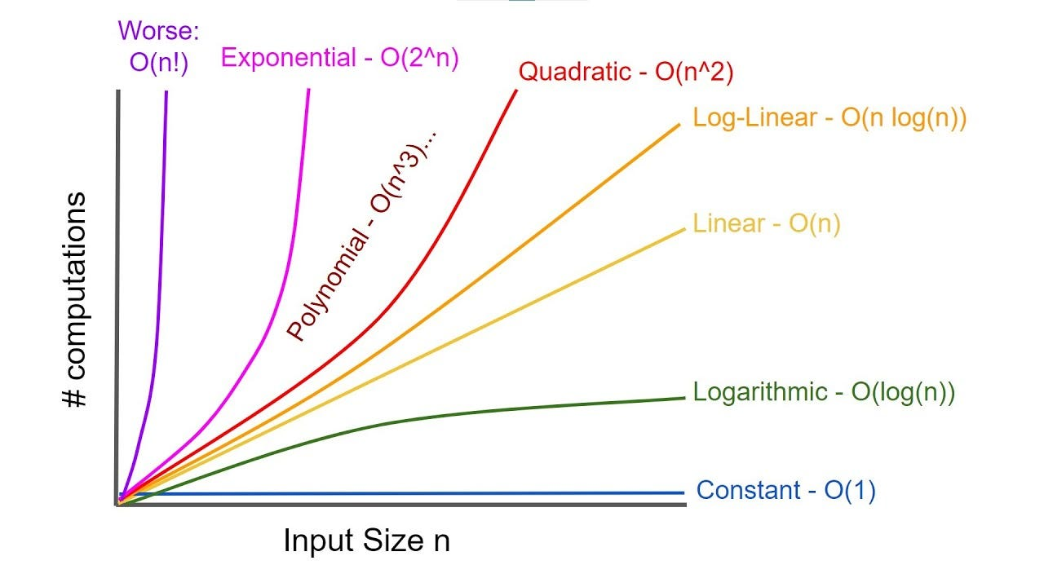
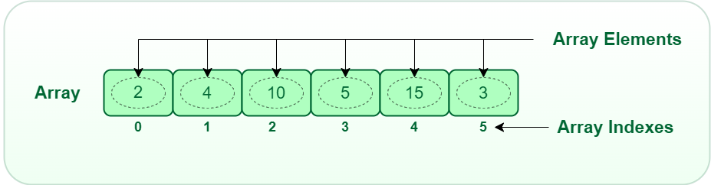
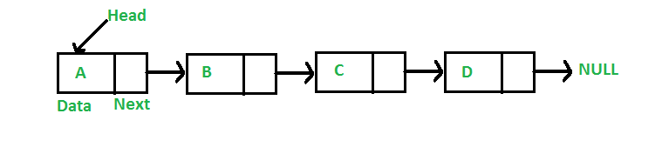
Things from the first half of the semester
Arrays, Array Lists
Linked Lists
Running time analysis, Big-O notation
Basic Java class structure

Slide 22
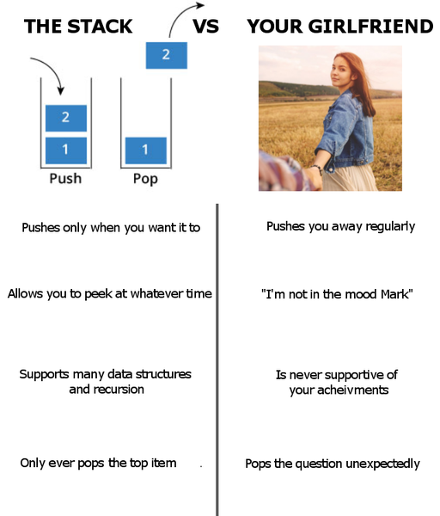
Stacks
Significant other
Be able to understand basic stack methods (push pop peek)
Given code that utilizes a stack, be able to visualize and illustrate the contents of a stack
Know the running time of stack operations

Slide 23
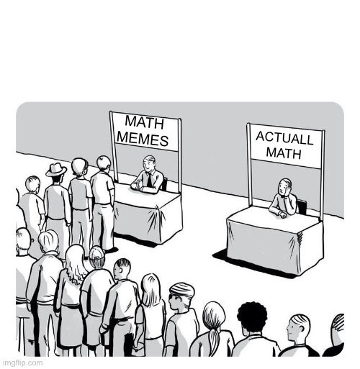

Queues
Be able to understand basic queue methods (enqueue dequeue peek)
Given code that utilizes a queue, be able to visualize and illustrate the contents of a stack
Know the running time of queue operations
Know what a Priority Queue is
Queue
(Linked List)
Queue
(Array)

Slide 24
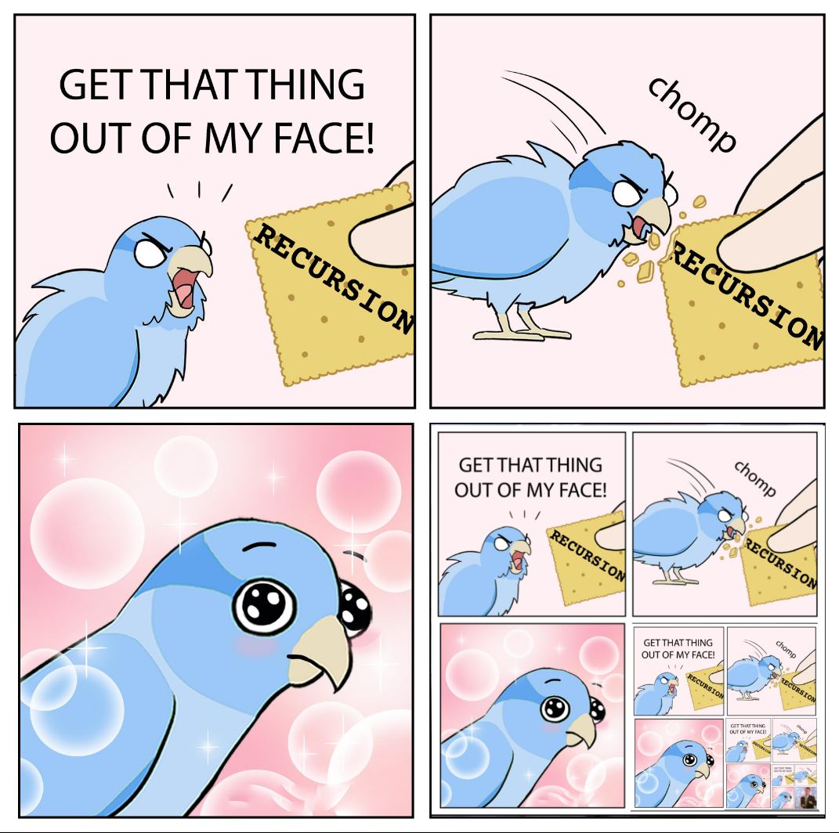
Recursion
Given a basic recursion function, derive the output and number of recursive calls made
Understand how to calculate the running time of a recursive algorithm
Understand limitations/benefits of recursion

Slide 25
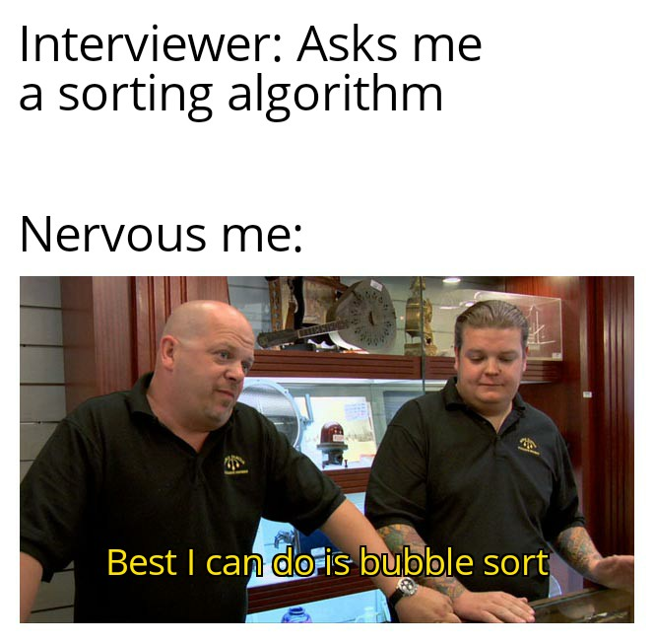
Sorting
Bubble sort, selection sort, merge sort, quick sort
Be able to describe/illustrate the steps of these sorting algorithms
Know the running time for each sorting algorithm
Know which ones are efficient/not efficient
I may ask you a question about some of the obscure sorting algorithms we discussed

Slide 26
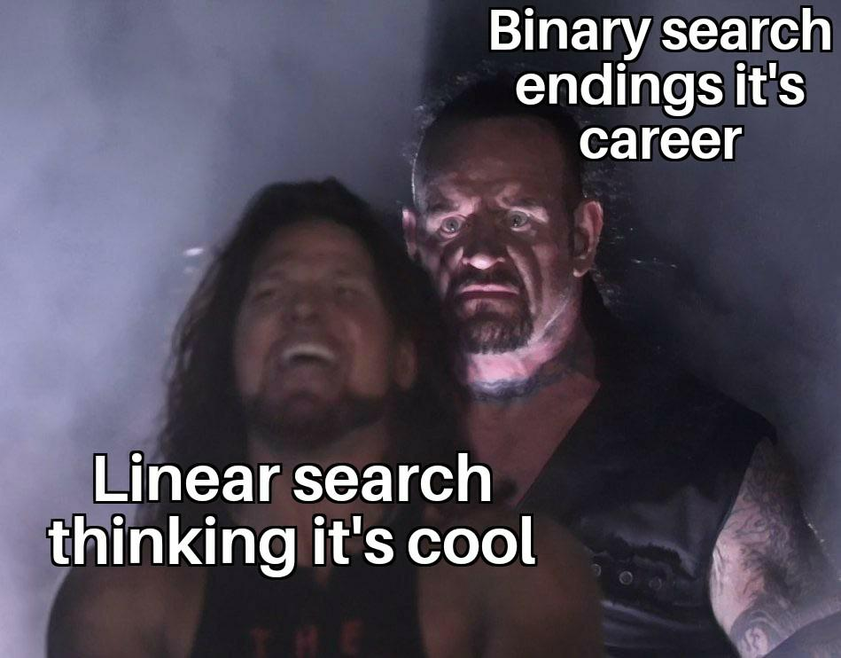
Searching
Understand the differences between linear search and binary search
Understand the running times of those algorithms
Be able to look at code for linear search and binary search and understand what is happening

Slide 27
Special Topics
Java Generics
Software Testing
OOP Principles

Slide 28
Final Exam Study Guide

Slide 29

Course Goals
Design and Implement programs of simple and moderate complexity in Java
Explain the concept of an ADT
Understand and implement basic data structures: Linked lists, stacks, and queues
Given a simple algorithm, determine the time complexity using Big-O notation
Understand basic searching and sorting algorithms and their runtime
Understand how recursion works, be able to analyze recursion runtime, and be able to implement recursion in a program
Be able to debug programs and become an independent problem solver

Slide 30


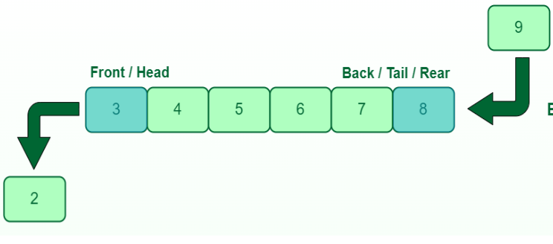
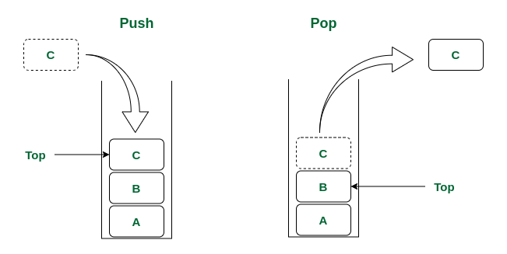
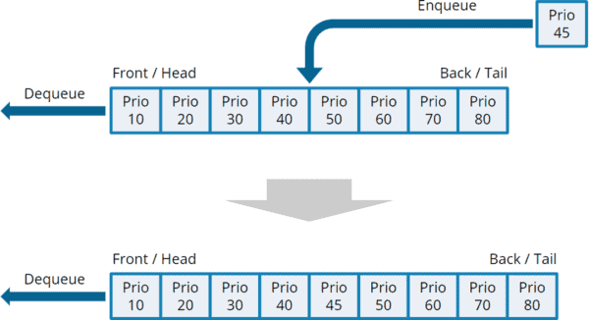



Takeaways
We have different data structures that handle data differently.
There are tradeoffs between using these data structures
Linked List
Arrays
Priority Queue
Queue
Given a problem, you should be able to identify a good candidate for a data structure and provide a justification
Stack

Slide 31

Takeaways
There be many different types of algorithms. Every algorithm has a running time, which is important to be aware of
The algorithm you select is important. It can be the difference between your program finishing in 1 second, or you program never finishing at all
The data structure you select is important. When deciding which data structure to use, you should have a reason to back it up
We have methods for measuring the efficiency of some algorithm (big-O notation), but they are not perfect.
When you write an algorithm, you should be able to broadly describe the effectiveness and efficiency of it
Sorting is a very valuable operation to do on a dataset

Slide 32
My Goals for you
Get you comfortable with writing basic Java programs
Give you a good toolset that can help you solve a variety of problems (Data Structures)
Give you techniques and methods for solving a variety of problems (Algorithms)
Give you the skills to analyze the algorithms that you write (Big-O notation)
Learn how to sort things (shoutout to bogo sort)

Slide 33

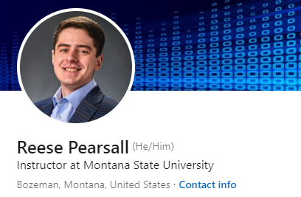

Thank You!
This class has been fun to teach for us to teach. I understand that there were certain parts that were not very exciting, but I appreciate you being in this class and participating
I hope you enjoyed this class, and I hope the stuff you learned will be helpful in your career/future classes
If I can be of assistance to you for anything in the future (reference, advising, support), please let me know!
I will see most of you again next semester ☺
CSCI 232 next semester
Connect with me on LinkedIn!
3 months of no java coding
CSCI 132 students

