Slide 1

CSCI 232: Data Structures and Algorithms
Java Review
Reese Pearsall
Spring 2025
https://www.cs.montana.edu/pearsall/classes/spring2025/232/main.html

Slide 2
Announcements
No lab tomorrow
Quizzes- You must attend the lab that you are registered for
→ If you can’t make it to your lab section, talk to reese beforehand
Fill out the course questionnaire

Slide 3

We are going to write a program where a user can keep track of their online shopping cart.
Users can add items, remove items, search for items, get the total price of cart, and apply coupons to items

Slide 4
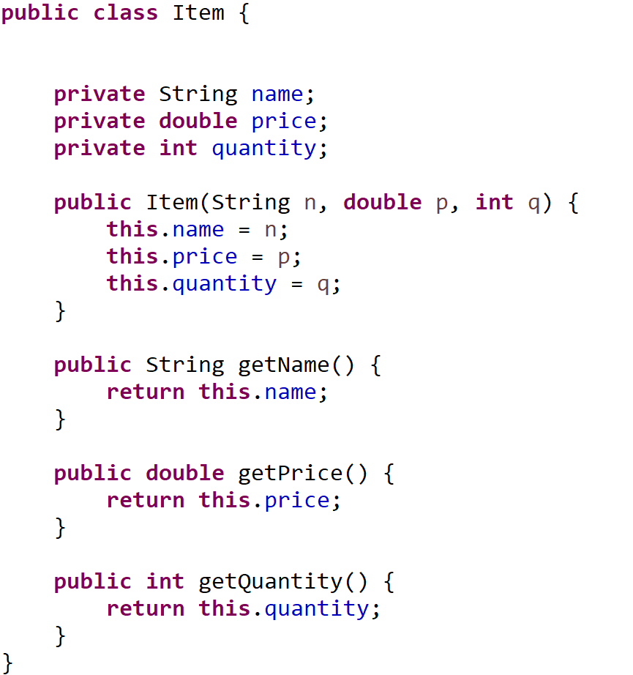
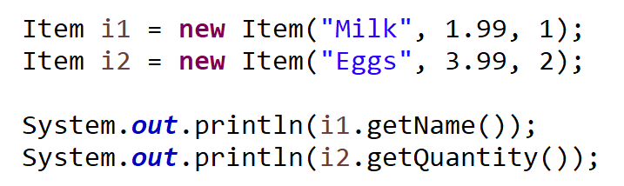
name | “Milk”
price | 1.99
quantity | 1
i1
getName()
getQuantity()
getPrice()
Java Class: Blueprint for an object (i.e. a “thing”)
Java Objects: Instances of classes. Program entities
Instance Field/Attributes
Methods

Slide 5
public void addItem(String name, double price, int quantity) {
Item item = new Item(name, price, quantity);
Item[] tempArray = new Item[this.shoppingCart.length + 1];
for(int i = 0; i < this.shoppingCart.length; i++) {
tempArray[i] = shoppingCart[i];
}
tempArray[shoppingCart.length] = item;
shoppingCart = tempArray;
this.num_of_items++;
}
shoppingCart
Item
Item
Item

Slide 6
public void addItem(String name, double price, int quantity) {
Item item = new Item(name, price, quantity);
Item[] tempArray = new Item[this.shoppingCart.length + 1];
for(int i = 0; i < this.shoppingCart.length; i++) {
tempArray[i] = shoppingCart[i];
}
tempArray[shoppingCart.length] = item;
shoppingCart = tempArray;
this.num_of_items++;
}
shoppingCart
Item
item
Item
Item
Item

Slide 7
public void addItem(String name, double price, int quantity) {
Item item = new Item(name, price, quantity);
Item[] tempArray = new Item[this.shoppingCart.length + 1];
for(int i = 0; i < this.shoppingCart.length; i++) {
tempArray[i] = shoppingCart[i];
}
tempArray[shoppingCart.length] = item;
shoppingCart = tempArray;
this.num_of_items++;
}
shoppingCart
tempArray
Item
item
Item
Item
Item

Slide 8
public void addItem(String name, double price, int quantity) {
Item item = new Item(name, price, quantity);
Item[] tempArray = new Item[this.shoppingCart.length + 1];
for(int i = 0; i < this.shoppingCart.length; i++) {
tempArray[i] = shoppingCart[i];
}
tempArray[shoppingCart.length] = item;
shoppingCart = tempArray;
this.num_of_items++;
}
shoppingCart
Item
tempArray
Item
Item
item
Item
Item
Item
Item

Slide 9
public void addItem(String name, double price, int quantity) {
Item item = new Item(name, price, quantity);
Item[] tempArray = new Item[this.shoppingCart.length + 1];
for(int i = 0; i < this.shoppingCart.length; i++) {
tempArray[i] = shoppingCart[i];
}
tempArray[shoppingCart.length] = item;
shoppingCart = tempArray;
this.num_of_items++;
}
shoppingCart
Item
tempArray
Item
Item
Item
Item
Item
Item

Slide 10
public void addItem(String name, double price, int quantity) {
Item item = new Item(name, price, quantity);
Item[] tempArray = new Item[this.shoppingCart.length + 1];
for(int i = 0; i < this.shoppingCart.length; i++) {
tempArray[i] = shoppingCart[i];
}
tempArray[shoppingCart.length] = item;
shoppingCart = tempArray;
this.num_of_items++;
}
shoppingCart
Item
tempArray
Item
Item
Item
Item
Item
Item

Slide 11
public void addItem(String name, double price, int quantity) {
Item item = new Item(name, price, quantity);
Item[] tempArray = new Item[this.shoppingCart.length + 1];
for(int i = 0; i < this.shoppingCart.length; i++) {
tempArray[i] = shoppingCart[i];
}
tempArray[shoppingCart.length] = item;
shoppingCart = tempArray;
this.num_of_items++;
}
Running time?

Slide 12
public void addItem(String name, double price, int quantity) {
Item item = new Item(name, price, quantity);
Item[] tempArray = new Item[this.shoppingCart.length + 1];
for(int i = 0; i < this.shoppingCart.length; i++) {
tempArray[i] = shoppingCart[i];
}
tempArray[shoppingCart.length] = item;
shoppingCart = tempArray;
this.num_of_items++;
}
Running time: Number of operations required to complete algorithm

Slide 13
public void addItem(String name, double price, int quantity) {
Item item = new Item(name, price, quantity);
Item[] tempArray = new Item[this.shoppingCart.length + 1];
for(int i = 0; i < this.shoppingCart.length; i++) {
tempArray[i] = shoppingCart[i];
}
tempArray[shoppingCart.length] = item;
shoppingCart = tempArray;
this.num_of_items++;
}
Running time: Number of operations required to complete algorithm
Big O Notation: Upper bound on asymptotic growth. I.e. Worst case upper bound of a function

Slide 14
public void addItem(String name, double price, int quantity) {
Item item = new Item(name, price, quantity);
Item[] tempArray = new Item[this.shoppingCart.length + 1];
for(int i = 0; i < this.shoppingCart.length; i++) {
tempArray[i] = shoppingCart[i];
}
tempArray[shoppingCart.length] = item;
shoppingCart = tempArray;
this.num_of_items++;
}
Running time: Number of operations required to complete algorithm
Big O Notation: Upper bound on asymptotic growth. I.e. Worst case upper bound of a function
Big O Notation measures the number of steps needed to complete an algorithm under the worst-case scenario

Slide 15
public void addItem(String name, double price, int quantity) {
Item item = new Item(name, price, quantity);
Item[] tempArray = new Item[this.shoppingCart.length + 1];
for(int i = 0; i < this.shoppingCart.length; i++) {
tempArray[i] = shoppingCart[i];
}
tempArray[shoppingCart.length] = item;
shoppingCart = tempArray;
this.num_of_items++;
}
public int linearSearch(int[] array, int target) {
for(int i = 0; i < array.length; i++) {
if(array[i] == target){
return i;
}
}
return -1;
}
To calculate the running time, we add up the running time of each operation

Slide 16
public void addItem(String name, double price, int quantity) {
Item item = new Item(name, price, quantity);
Item[] tempArray = new Item[this.shoppingCart.length + 1];
for(int i = 0; i < this.shoppingCart.length; i++) {
tempArray[i] = shoppingCart[i];
}
tempArray[shoppingCart.length] = item;
shoppingCart = tempArray;
this.num_of_items++;
}
public int linearSearch(int[] array, int target) {
for(int i = 0; i < array.length; i++) {
if(array[i] == target){
return i;
}
}
return -1;
}
??? →
To calculate the running time, we add up the running time of each operation
Worst case scenario, this for loop will need run n times
O(n) Let n = array.length

Slide 17
public void addItem(String name, double price, int quantity) {
Item item = new Item(name, price, quantity);
Item[] tempArray = new Item[this.shoppingCart.length + 1];
for(int i = 0; i < this.shoppingCart.length; i++) {
tempArray[i] = shoppingCart[i];
}
tempArray[shoppingCart.length] = item;
shoppingCart = tempArray;
this.num_of_items++;
}
public int linearSearch(int[] array, int target) {
for(int i = 0; i < array.length; i++) {
if(array[i] == target){
return i;
}
}
return -1;
}
O(n) →
O(???) →
To calculate the running time, we add up the running time of each operation

Slide 18
public void addItem(String name, double price, int quantity) {
Item item = new Item(name, price, quantity);
Item[] tempArray = new Item[this.shoppingCart.length + 1];
for(int i = 0; i < this.shoppingCart.length; i++) {
tempArray[i] = shoppingCart[i];
}
tempArray[shoppingCart.length] = item;
shoppingCart = tempArray;
this.num_of_items++;
}
public int linearSearch(int[] array, int target) {
for(int i = 0; i < array.length; i++) {
if(array[i] == target){
return i;
}
}
return -1;
}
O(n) →
O(???) →
To calculate the running time, we add up the running time of each operation
Primitive operation – operation that takes constant time (independent of size of the input)

Slide 19
public void addItem(String name, double price, int quantity) {
Item item = new Item(name, price, quantity);
Item[] tempArray = new Item[this.shoppingCart.length + 1];
for(int i = 0; i < this.shoppingCart.length; i++) {
tempArray[i] = shoppingCart[i];
}
tempArray[shoppingCart.length] = item;
shoppingCart = tempArray;
this.num_of_items++;
}
public int linearSearch(int[] array, int target) {
for(int i = 0; i < array.length; i++) {
if(array[i] == target){
return i;
}
}
return -1;
}
O(n) →
O(1) →
To calculate the running time, we add up the running time of each operation
Primitive operation – operation that takes constant time (independent of size of the input)

Slide 20
public void addItem(String name, double price, int quantity) {
Item item = new Item(name, price, quantity);
Item[] tempArray = new Item[this.shoppingCart.length + 1];
for(int i = 0; i < this.shoppingCart.length; i++) {
tempArray[i] = shoppingCart[i];
}
tempArray[shoppingCart.length] = item;
shoppingCart = tempArray;
this.num_of_items++;
}
public int linearSearch(int[] array, int target) {
for(int i = 0; i < array.length; i++) {
if(array[i] == target){
return i;
}
}
return -1;
}
O(n) →
O(1) →
O(1) →
O(1) →
To calculate the running time, we add up the running time of each operation
Primitive operation – operation that takes constant time (independent of size of the input)

Slide 21
public void addItem(String name, double price, int quantity) {
Item item = new Item(name, price, quantity);
Item[] tempArray = new Item[this.shoppingCart.length + 1];
for(int i = 0; i < this.shoppingCart.length; i++) {
tempArray[i] = shoppingCart[i];
}
tempArray[shoppingCart.length] = item;
shoppingCart = tempArray;
this.num_of_items++;
}
public int linearSearch(int[] array, int target) {
for(int i = 0; i < array.length; i++) {
if(array[i] == target){
return i;
}
}
return -1;
}
O(n) →
O(1) →
O(1) →
O(1) →
To calculate the running time, we add up the running time of each operation
Primitive operation – operation that takes constant time (independent of size of the input)
Total running time: O(n * 1 + 1)

Slide 22
public void addItem(String name, double price, int quantity) {
Item item = new Item(name, price, quantity);
Item[] tempArray = new Item[this.shoppingCart.length + 1];
for(int i = 0; i < this.shoppingCart.length; i++) {
tempArray[i] = shoppingCart[i];
}
tempArray[shoppingCart.length] = item;
shoppingCart = tempArray;
this.num_of_items++;
}
public int linearSearch(int[] array, int target) {
for(int i = 0; i < array.length; i++) {
if(array[i] == target){
return i;
}
}
return -1;
}
O(n) →
O(1) →
O(1) →
O(1) →
To calculate the running time, we add up the running time of each operation
Primitive operation – operation that takes constant time (independent of size of the input)
Total running time: O(n * 1 + 1)
In Big O notation:
We can drop non dominant factors
We can drop multiplicative constants (coefficients)

Slide 23
public void addItem(String name, double price, int quantity) {
Item item = new Item(name, price, quantity);
Item[] tempArray = new Item[this.shoppingCart.length + 1];
for(int i = 0; i < this.shoppingCart.length; i++) {
tempArray[i] = shoppingCart[i];
}
tempArray[shoppingCart.length] = item;
shoppingCart = tempArray;
this.num_of_items++;
}
public int linearSearch(int[] array, int target) {
for(int i = 0; i < array.length; i++) {
if(array[i] == target){
return i;
}
}
return -1;
}
O(n) →
O(1) →
O(1) →
O(1) →
To calculate the running time, we add up the running time of each operation
Primitive operation – operation that takes constant time (independent of size of the input)
Total running time: O(n) where n = | array |
In Big O notation:
We can drop non dominant factors
We can drop multiplicative constants (coefficients)

Slide 24
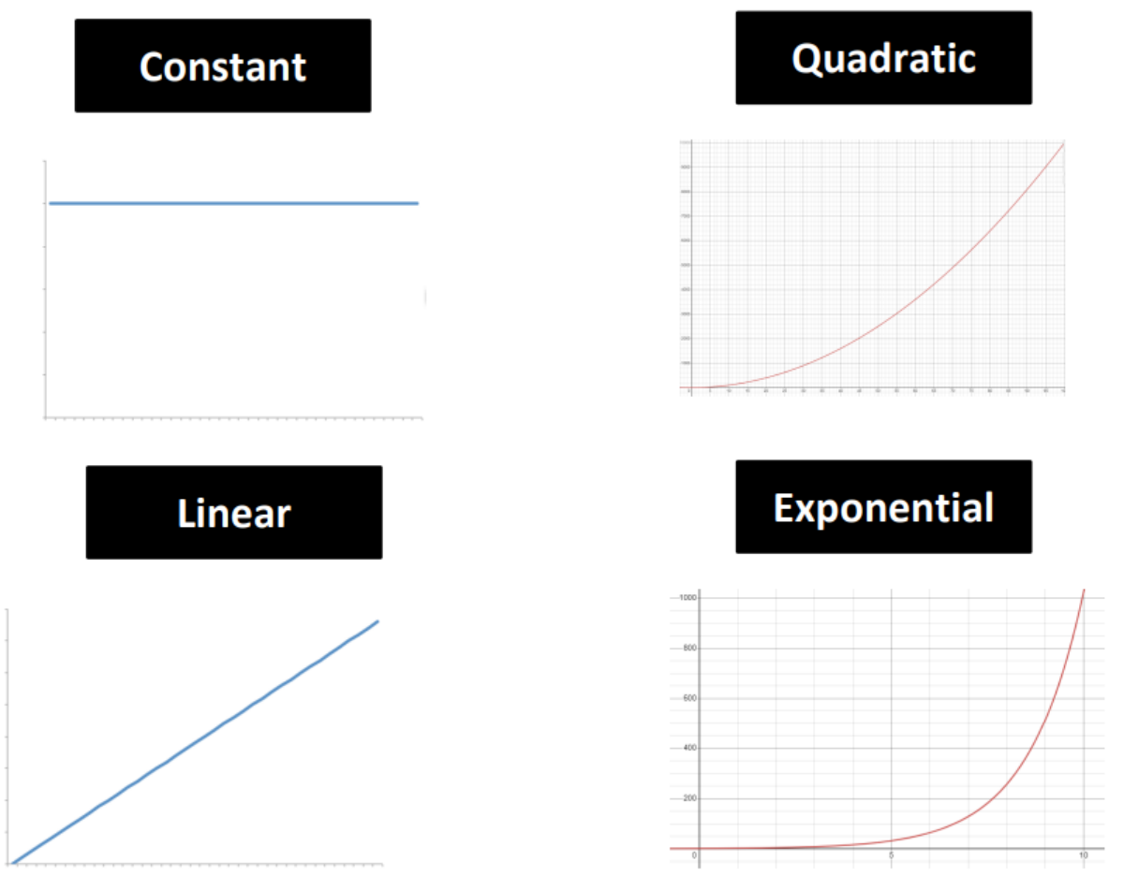
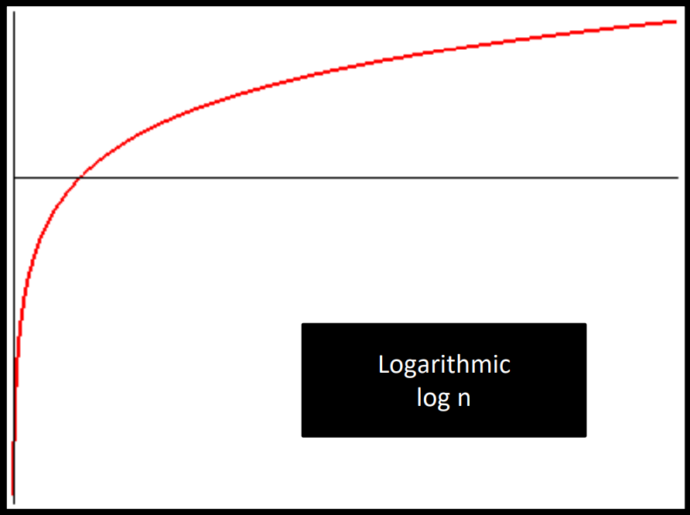
public void addItem(String name, double price, int quantity) {
Item item = new Item(name, price, quantity);
Item[] tempArray = new Item[this.shoppingCart.length + 1];
for(int i = 0; i < this.shoppingCart.length; i++) {
tempArray[i] = shoppingCart[i];
}
tempArray[shoppingCart.length] = item;
shoppingCart = tempArray;
this.num_of_items++;
}

Slide 25
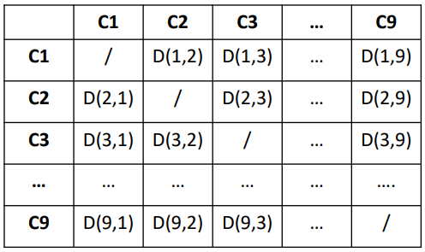
function computeDistanceBetweenCaves():
for each cave in all_caves i;
for each cave in all_caves j;
compute_distance(i, j)

Slide 26
function computeDistanceBetweenCaves():
for each cave in all_caves i;
for each cave in all_caves j;
compute_distance(i, j)
O(n)
O(n-1)
O(1)

Slide 27
function computeDistanceBetweenCaves():
for each cave in all_caves i;
for each cave in all_caves j;
compute_distance(i, j)
O(n)
O(n)
O(1)

Slide 28
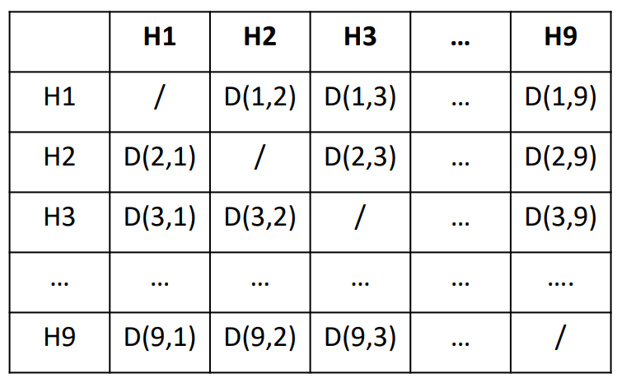
function computeDistanceBetweenCaves():
for each cave in all_caves i;
for each cave in all_caves j;
compute_distance(i, j)
O(n)
O(n)
O(1)
Total running time = O(n) * ( O(n) * O(1) )

Slide 29
function computeDistanceBetweenCaves():
for each cave in all_caves i;
for each cave in all_caves j;
compute_distance(i, j)
O(n)
O(n)
O(1)
Total running time = O(n) * ( O(n) * O(1) )
O(n^2)
Where n = # of caves

Slide 30
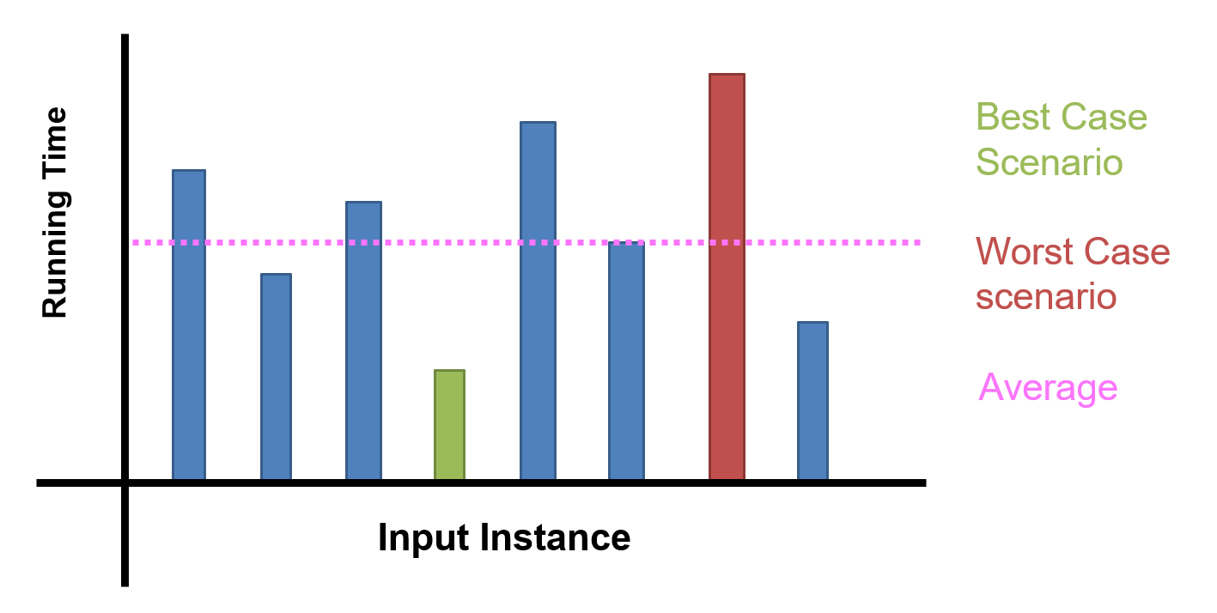



In computer science (and this class in particular), we will be focusing on stating running time in terms of worst-case scenario

Slide 31
Big O Formal Definition
Let ƒ(n) and g(n) be functions mapping positive integers to positive real numbers
ƒ(n) is O(g(n)) if there is a real constant c > 0 and an integer constant n₀ ≥ 1 such that
ƒ(n) ≤ c · g(n), for all n ≥ n₀

Slide 32
Big O Formal Definition
Let ƒ(n) and g(n) be functions mapping positive integers to positive real numbers
ƒ(n) is O(g(n)) if there is a real constant c > 0 and an integer constant n₀ ≥ 1 such that
ƒ(n) ≤ c · g(n), for all n ≥ n₀
Past a certain spot, g(n) dominates f(n) within a multiplicative constant

Slide 33
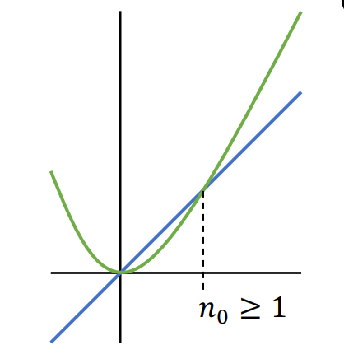
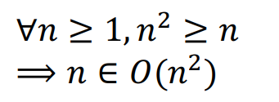
Big O Formal Definition
Let ƒ(n) and g(n) be functions mapping positive integers to positive real numbers
ƒ(n) is O(g(n)) if there is a real constant c > 0 and an integer constant n₀ ≥ 1 such that
ƒ(n) ≤ c · g(n), for all n ≥ n₀
Past a certain spot, g(n) dominates f(n) within a multiplicative constant
g(n)
f(n)
O -notation provides an upper bound on some function ƒ(n)

Slide 34
Which would you rather have?
Given a problem of size n
Algorithm A runs in O(n²) time.
Algorithm B runs in O(n) time.

Slide 35
Which would you rather have?
Given a problem of size n
Algorithm A runs in n² ∈ O(n²) time.
Algorithm B runs in
n + 10²⁵ ∈ O(n) time.

Slide 36


Which would you rather have?
Given a problem of size n
Algorithm A runs in n² ∈ O(n²) time.
Algorithm B runs in
n + 10²⁵ ∈ O(n) time.

Slide 37
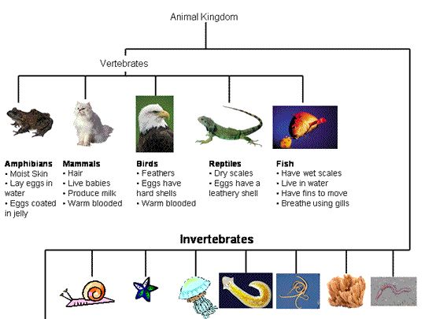
Which would you rather have?
Given a problem of size n
Algorithm A runs in n² ∈ O(n²) time.
Algorithm B runs in
n + 10²⁵ ∈ O(n) time.
Big-O is a helpful way to broadly describe the running time of different programs, but it isn’t perfect

Slide 38
public void addItem(String name, double price, int quantity) {
Item item = new Item(name, price, quantity);
Item[] tempArray = new Item[this.shoppingCart.length + 1];
for(int i = 0; i < this.shoppingCart.length; i++) {
tempArray[i] = shoppingCart[i];
}
tempArray[shoppingCart.length] = item;
shoppingCart = tempArray;
this.num_of_items++;
}

Slide 39
public void addItem(String name, double price, int quantity) {
Item item = new Item(name, price, quantity);
Item[] tempArray = new Item[this.shoppingCart.length + 1];
for(int i = 0; i < this.shoppingCart.length; i++) {
tempArray[i] = shoppingCart[i];
}
tempArray[shoppingCart.length] = item;
shoppingCart = tempArray;
this.num_of_items++;
}
O(1) →

Slide 40
public void addItem(String name, double price, int quantity) {
Item item = new Item(name, price, quantity);
Item[] tempArray = new Item[this.shoppingCart.length + 1];
for(int i = 0; i < this.shoppingCart.length; i++) {
tempArray[i] = shoppingCart[i];
}
tempArray[shoppingCart.length] = item;
shoppingCart = tempArray;
this.num_of_items++;
}
O(1) →
O(n+1) →

Slide 41
public void addItem(String name, double price, int quantity) {
Item item = new Item(name, price, quantity);
Item[] tempArray = new Item[this.shoppingCart.length + 1];
for(int i = 0; i < this.shoppingCart.length; i++) {
tempArray[i] = shoppingCart[i];
}
tempArray[shoppingCart.length] = item;
shoppingCart = tempArray;
this.num_of_items++;
}
O(1) →
O(n+1) →
O(n) →

Slide 42
public void addItem(String name, double price, int quantity) {
Item item = new Item(name, price, quantity);
Item[] tempArray = new Item[this.shoppingCart.length + 1];
for(int i = 0; i < this.shoppingCart.length; i++) {
tempArray[i] = shoppingCart[i];
}
tempArray[shoppingCart.length] = item;
shoppingCart = tempArray;
this.num_of_items++;
}
O(1) →
O(n+1) →
O(n) →
O(1) →

Slide 43
public void addItem(String name, double price, int quantity) {
Item item = new Item(name, price, quantity);
Item[] tempArray = new Item[this.shoppingCart.length + 1];
for(int i = 0; i < this.shoppingCart.length; i++) {
tempArray[i] = shoppingCart[i];
}
tempArray[shoppingCart.length] = item;
shoppingCart = tempArray;
this.num_of_items++;
}
O(1) →
O(n+1) →
O(n) →
O(1) →
O(1) →
O(1) →
O(1) →

Slide 44
public void addItem(String name, double price, int quantity) {
Item item = new Item(name, price, quantity);
Item[] tempArray = new Item[this.shoppingCart.length + 1];
for(int i = 0; i < this.shoppingCart.length; i++) {
tempArray[i] = shoppingCart[i];
}
tempArray[shoppingCart.length] = item;
shoppingCart = tempArray;
this.num_of_items++;
}
O(1) →
O(n+1) →
O(n) →
O(1) →
O(1) →
O(1) →
O(1) →

Slide 45
public void addItem(String name, double price, int quantity) {
Item item = new Item(name, price, quantity);
Item[] tempArray = new Item[this.shoppingCart.length + 1];
for(int i = 0; i < this.shoppingCart.length; i++) {
tempArray[i] = shoppingCart[i];
}
tempArray[shoppingCart.length] = item;
shoppingCart = tempArray;
this.num_of_items++;
}
O(1) →
O(n) →
O(n) →
O(1) →
O(1) →
O(1) →
O(1) →
Total running time: O(n) + O(n)
O(2n)
O(n) where n = shoppingCart.length

Slide 46
public void addItem(String name, double price, int quantity) {
Item item = new Item(name, price, quantity);
Item[] tempArray = new Item[this.shoppingCart.length + 1];
for(int i = 0; i < this.shoppingCart.length; i++) {
tempArray[i] = shoppingCart[i];
}
tempArray[shoppingCart.length] = item;
shoppingCart = tempArray;
this.num_of_items++;
}
O(1) →
O(n) →
O(n) →
O(1) →
O(1) →
O(1) →
O(1) →
Total running time: O(n) + O(n)
O(2n)
O(n) where n = shoppingCart.length
Takeaway: Adding to a full array takes O(n) time

