Slide 1

CSCI 232: Data Structures and Algorithms
Linked Lists, Stacks, Queues
Reese Pearsall
Spring 2025
https://www.cs.montana.edu/pearsall/classes/spring2025/232/main.html

Slide 2

Announcements
TA Office Hours are in Barnard Hall 259
Our TAs for CSCI 232
Section 003 (Friday 10-12)
Shahnaj Mou
shahnajmou@gmail.com
Office Hours: Mondays 3:10 PM – 4:10 PM
5:10 PM - 6:00 PM
Section 004 (Friday 12-2)
Oscar Oropeza
ooropeza2000@gmail.com
Office Hours: Wednesday 12PM – 1PM
Section 005 (Friday 2-4)
Shahnaj Mou
shahnajmou@gmail.com
Office Hours: Mondays 3:10 PM – 4:10 PM
5:10 PM - 6:00 PM
First lab is posted and due on Friday!
Reese’s Office hours are in Roberts Hall 111 today

Slide 3
An array is a fixed-sized, linear collection of elements
A list is a dynamic, linear collection of elements
ArrayList<E>
You can use the built-in Java array
LinkedList<E>

Slide 4
A linked list is a dynamic linear data structure that is a collection of data (nodes)
head
Mark
19
Chemistry
Reese
31
Computer Science
Susan
25
Math

Slide 5
A linked list is a dynamic linear data structure that is a collection of data (nodes)
head
Mark
19
Chemistry
Reese
31
Computer Science
Susan
25
Math
Nodes consists of two parts:
1. Payload

Slide 6
A linked list is a dynamic linear data structure that is a collection of data (nodes)
head
Mark
19
Chemistry
Reese
31
Computer Science
null
Susan
25
Math
Nodes consists of two parts:
Payload
Pointer to next node

Slide 7
A linked list is a dynamic linear data structure that is a collection of data (nodes)
head
Mark
19
Chemistry
Reese
31
Computer Science
null
“Node”
Susan
25
Math
Nodes consists of two parts:
Payload
Pointer to next node

Slide 8
A linked list is a dynamic linear data structure that is a collection of data (nodes)
head
Item
Item
next
null
next
Item
Item
name
Price
quantity
next
node
next

Slide 9
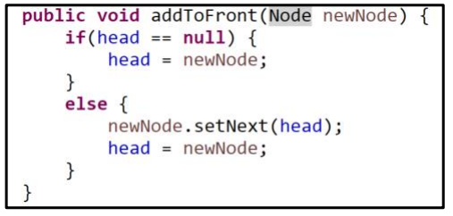
A linked list is a dynamic linear data structure that is a collection of data (nodes)
head
Item
Item
next
null
next
Item
next

Slide 10
A linked list is a dynamic linear data structure that is a collection of data (nodes)
head
Item
Item
next
null
next
Item
public void setNext(Node n) {
this.next = n;
}
Running time?
next
O(1)
O(1)
O(1)
O(1)

Slide 11
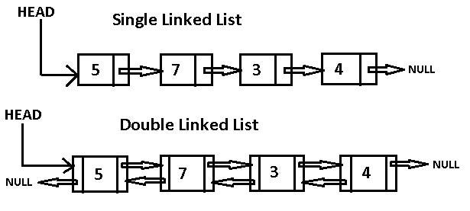
A linked list is a dynamic linear data structure that is a collection of data (nodes)
TAIL

Slide 12
A linked list is a dynamic linear data structure that is a collection of data (nodes)
TAIL
Operation | Time Complexity
Delete / Add first node | O(1)
Delete / Add tail node | O(1)
General Add/Delete node | O(n)
Linear Search | O(n)
Forward Traversal | O(n)

Slide 13
A linked list is a dynamic linear data structure that is a collection of data (nodes)
Linked Lists
Do not have indices
Less memory efficient compared to arrays
TAIL
Takeaway: Adding/Deleting to LL is O(1) work
(if adding to front or back)
Operation | Time Complexity
Delete / Add first node | O(1)
Delete / Add tail node | O(1)
General Add/Delete node | O(n)
Linear Search | O(n)
Forward Traversal | O(n)

Slide 14
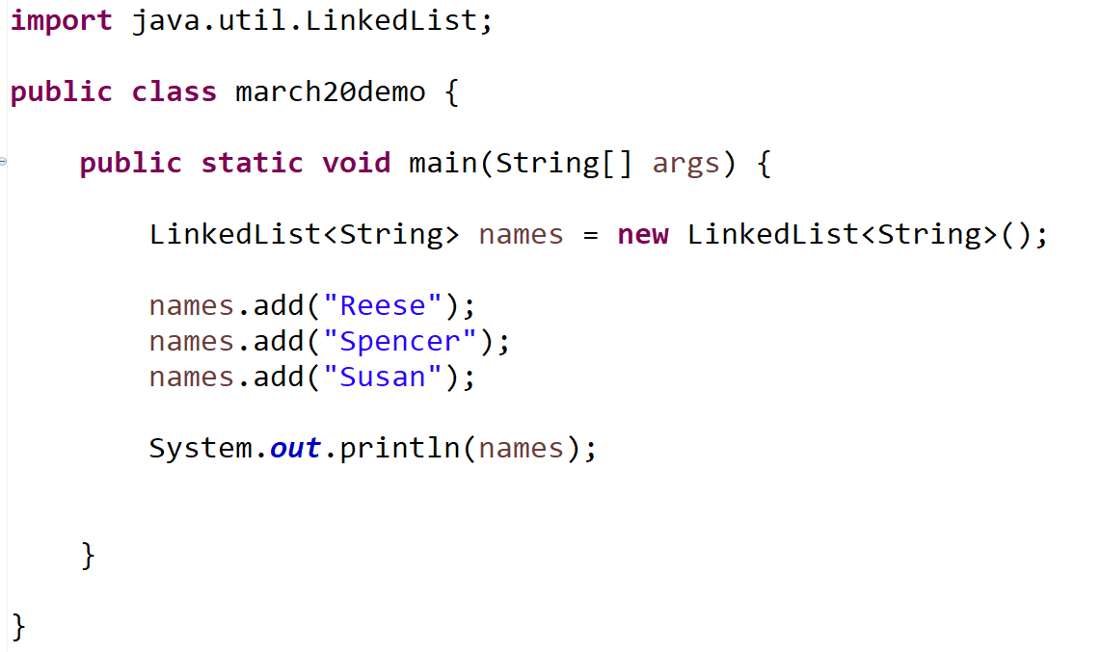
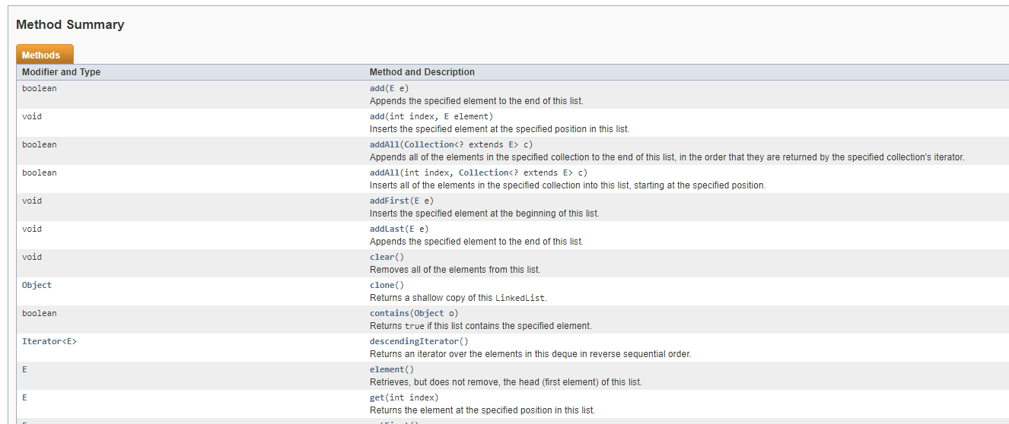
A linked list is a dynamic linear data structure that is a collection of data (nodes)
We will never write our own Linked List class, instead we will always import the Linked List Java Library!
import java.util.LinkedList;

Slide 15
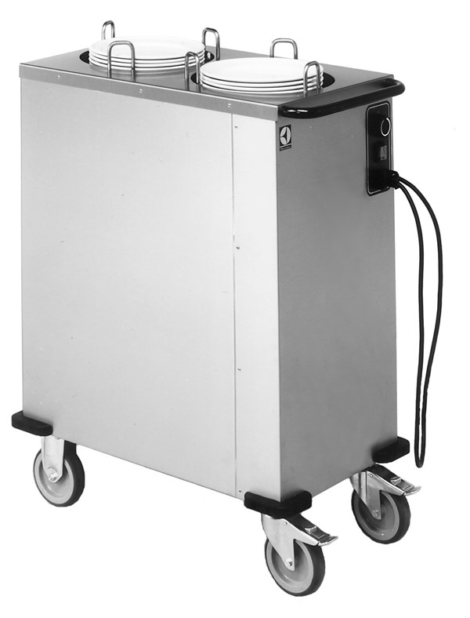
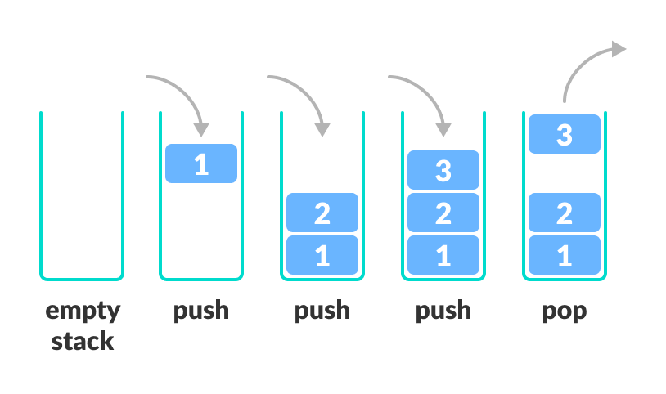
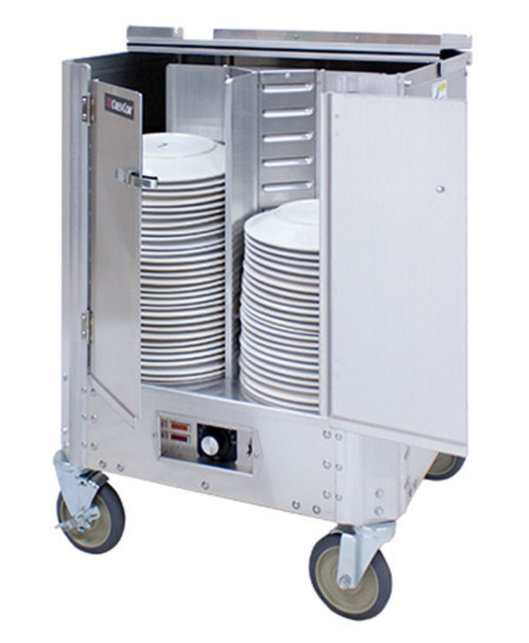
A stack is a data structure that can hold data, and follows the last in first out (LIFO) principle
We can:
Add an element to the top of the stack (push)
Remove the top element (pop)

Slide 16
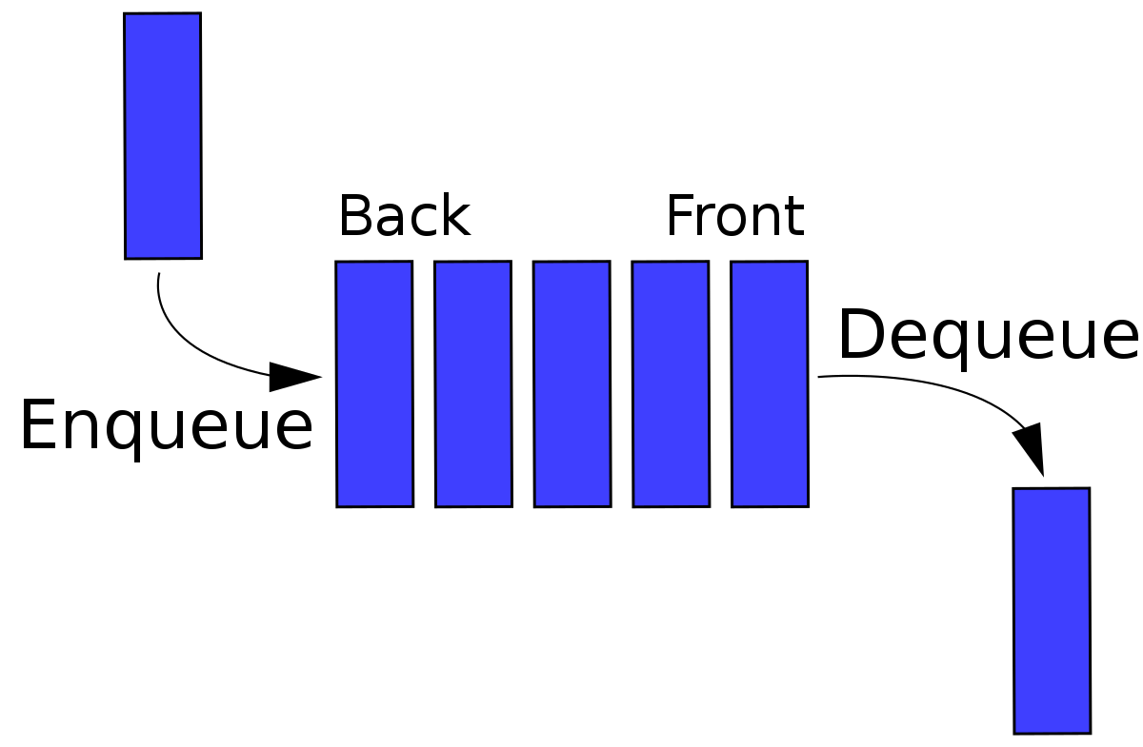
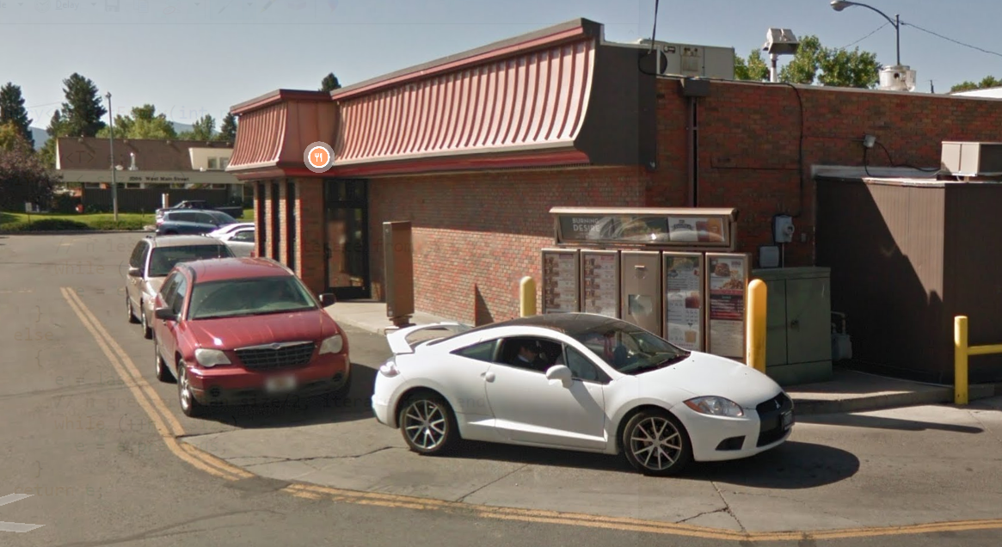

A Queue is a data structure that holds data, but operates in a First-in First-out (FIFO) fashion
Elements get added to the Back of the Queue.
Elements get removed from the Front of the queue

Slide 17
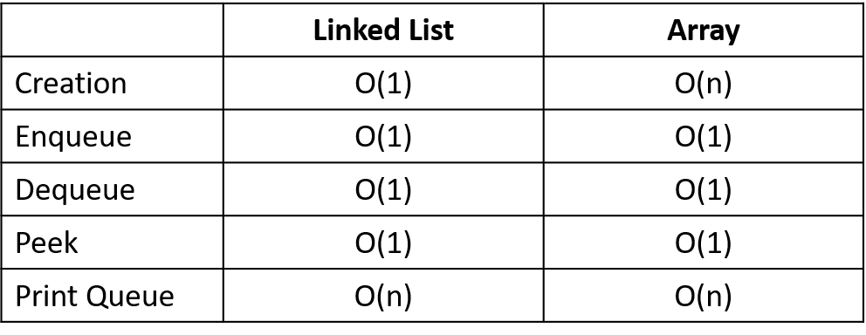
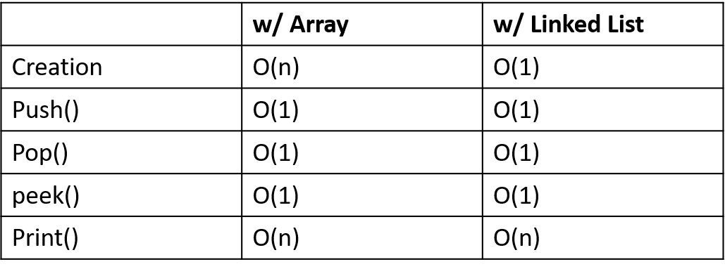
Queue Runtime Analysis
Applications of Queue Data Structures
Online waiting rooms
Operating System task scheduling
Web Server Request Handlers
Network Communication
CSCI 232 Algorithms
Takeaway: Adding to stack or queue is O(1) work
Stack Runtime Analysis
Applications of Stack Data Structures
Tracking function calls in programming
Web browser history
Undo/Redo buttons
Recursion/Backtracking
CSCI 232 Algorithms

Slide 18
In CSCI 232, if we ever need to use a stack or queue, we will import the Java library!
import.java.util.Stack
java.util.Queue is an interface. We cannot create a Queue object.
Instead, we create an instance of an object that implements this interface
import.java.util.Queue
Some of the Classes that implement the Queue interface:
PriorityQueue (java.util.PriorityQueue)
Linked List (java.util.LinkedList)
(If you need a FIFO queue, Linked List is the way to go…)

Slide 19
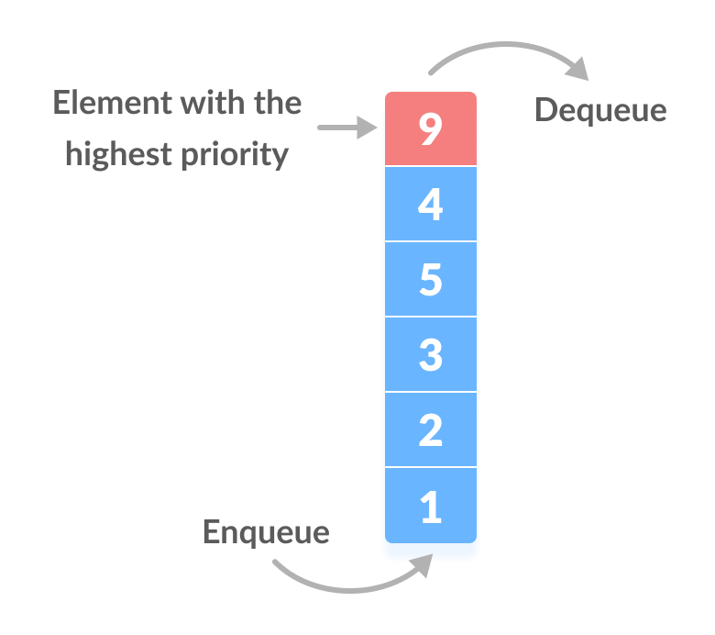
Most of the time, queues will operate in a FIFO fashion, however there may be times we want to dequeue the item with the highest priority
Priority queue in a data structure is an extension of a linear queue that possesses the following properties: Every element has a certain priority assigned to it
When we enqueue something, we might need to “shuffle” that item into the correct spot of the priority queue

Slide 20
Sorting
Bubble Sort | O(n^2)
Selection Sort | O(n^2)
Merge Sort | O(nlogn)
Quick Sort | O(nlogn) (on average)
Takeaway: the fastest sorting algorithm known (currently) is O(nlogn)
(Why don’t you think there are any O(1) or O(logn) sorting algorithms?)

Slide 21
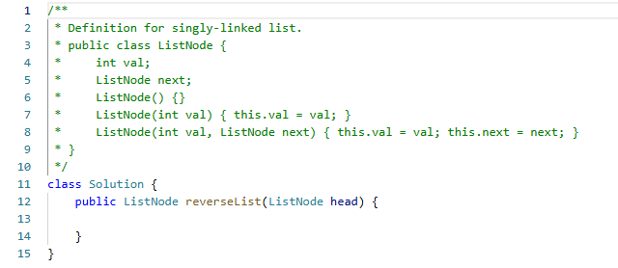
LeetCode #206 Reverse a (singly) Linked List
A
B
C
D
E
input
E
D
C
B
A
output

Slide 22
LeetCode #206 Reverse a (singly) Linked List
A
B
C
D
E
input
public ListNode reverseList(ListNode head){
ListNode prev = null;
while(head != null){
}
return ???;
}

Slide 23
LeetCode #206 Reverse a (singly) Linked List
A
B
C
D
E
prev
null
head
public ListNode reverseList(ListNode head){
ListNode prev = null;
while(head != null){
}
return ???;
}

Slide 24
LeetCode #206 Reverse a (singly) Linked List
A
B
C
D
E
prev
null
head
temp
public ListNode reverseList(ListNode head){
ListNode prev = null;
while(head != null){
ListNode temp = head.next;
}
return ???;
}

Slide 25
LeetCode #206 Reverse a (singly) Linked List
null
A
B
C
D
E
prev
head
temp
public ListNode reverseList(ListNode head){
ListNode prev = null;
while(head != null){
ListNode temp = head.next;
head.next = prev;
}
return ???;
}

Slide 26

LeetCode #206 Reverse a (singly) Linked List
null
A
B
C
D
E
prev
head
temp
public ListNode reverseList(ListNode head){
ListNode prev = null;
while(head != null){
ListNode temp = head.next;
head.next = prev;
prev = head;
}
return ???;
}

Slide 27


LeetCode #206 Reverse a (singly) Linked List
null
A
B
C
D
E
prev
temp
head
public ListNode reverseList(ListNode head){
ListNode prev = null;
while(head != null){
ListNode temp = head.next;
head.next = prev;
prev = head;
head = temp;
}
return ???;
}

Slide 28
LeetCode #206 Reverse a (singly) Linked List
null
A
B
C
D
E
prev
head
temp
public ListNode reverseList(ListNode head){
ListNode prev = null;
while(head != null){
ListNode temp = head.next;
head.next = prev;
prev = head;
head = temp;
}
return ???;
}

Slide 29
LeetCode #206 Reverse a (singly) Linked List
null
A
B
C
D
E
prev
head
temp
public ListNode reverseList(ListNode head){
ListNode prev = null;
while(head != null){
ListNode temp = head.next;
head.next = prev;
prev = head;
head = temp;
}
return ???;
}

Slide 30
LeetCode #206 Reverse a (singly) Linked List
null
A
B
C
D
E
prev
head
temp
public ListNode reverseList(ListNode head){
ListNode prev = null;
while(head != null){
ListNode temp = head.next;
head.next = prev;
prev = head;
head = temp;
}
return ???;
}

Slide 31

LeetCode #206 Reverse a (singly) Linked List
null
A
B
C
D
E
prev
temp
head
public ListNode reverseList(ListNode head){
ListNode prev = null;
while(head != null){
ListNode temp = head.next;
head.next = prev;
prev = head;
head = temp;
}
return ???;
}

Slide 32
LeetCode #206 Reverse a (singly) Linked List
null
A
B
C
D
E
prev
head
temp
public ListNode reverseList(ListNode head){
ListNode prev = null;
while(head != null){
ListNode temp = head.next;
head.next = prev;
prev = head;
head = temp;
}
return ???;
}

Slide 33
LeetCode #206 Reverse a (singly) Linked List
null
A
B
C
D
E
prev
head
temp
public ListNode reverseList(ListNode head){
ListNode prev = null;
while(head != null){
ListNode temp = head.next;
head.next = prev;
prev = head;
head = temp;
}
return ???;
}

Slide 34
LeetCode #206 Reverse a (singly) Linked List
null
A
B
C
D
E
prev
head
temp
public ListNode reverseList(ListNode head){
ListNode prev = null;
while(head != null){
ListNode temp = head.next;
head.next = prev;
prev = head;
head = temp;
}
return ???;
}

Slide 35


LeetCode #206 Reverse a (singly) Linked List
null
A
B
C
D
E
prev
temp
head
public ListNode reverseList(ListNode head){
ListNode prev = null;
while(head != null){
ListNode temp = head.next;
head.next = prev;
prev = head;
head = temp;
}
return ???;
}

Slide 36


LeetCode #206 Reverse a (singly) Linked List
null
A
B
C
D
E
null
prev
temp
head
public ListNode reverseList(ListNode head){
ListNode prev = null;
while(head != null){
ListNode temp = head.next;
head.next = prev;
prev = head;
head = temp;
}
return ???;
}

Slide 37
LeetCode #206 Reverse a (singly) Linked List
null
A
B
C
D
E
null
prev
temp
head
public ListNode reverseList(ListNode head){
ListNode prev = null;
while(head != null){
ListNode temp = head.next;
head.next = prev;
prev = head;
head = temp;
}
return prev;
}

Slide 38

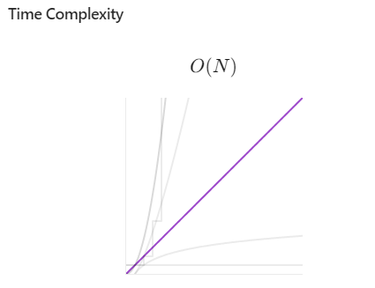

LeetCode #206 Reverse a (singly) Linked List
null
A
B
C
D
E
null
prev
temp
head
public ListNode reverseList(ListNode head){
ListNode prev = null;
while(head != null){
ListNode temp = head.next;
head.next = prev;
prev = head;
head = temp;
}
return prev;
}

Slide 39

Lab 1

