Slide 1

CSCI 232: Data Structures and Algorithms
Trees (Part 1)
Reese Pearsall
Spring 2025
https://www.cs.montana.edu/pearsall/classes/spring2025/232/main.html

Slide 2
Announcements

Slide 3

Trees
Desktop
School
Pictures
Work
Documents
CSCI476
CSCI232
Pets
Memes
Paystubs
Programs
Labs
Meatball
Tater
2023
2024
Trees are data structures used to store elements hierarchically
(not linear like arrays and linked lists)

Slide 4
Trees
Desktop
School
Pictures
Work
Documents
CSCI476
CSCI232
Pets
Memes
Paystubs
Programs
Labs
Meatball
Tater
2023
2024
Nodes: The entities that make up the tree.

Slide 5
Trees
Desktop
School
Pictures
Work
Documents
CSCI476
CSCI232
Pets
Memes
Paystubs
Programs
Labs
Meatball
Tater
2023
2024
Root: The node at the top of the hierarchy

Slide 6
Trees
Desktop
School
Pictures
Work
Documents
CSCI476
CSCI232
Pets
Memes
Paystubs
Programs
Labs
Meatball
Tater
2023
2024
Parent: For a given node, its parent is the node that directly precedes it in the hierarchy

Slide 7
Trees
Desktop
School
Pictures
Work
Documents
CSCI476
CSCI232
Pets
Memes
Paystubs
Programs
Labs
Meatball
Tater
2023
2024
Parent: For a given node, its parent is the node that directly precedes it in the hierarchy

Slide 8
Trees
Desktop
School
Pictures
Work
Documents
CSCI476
CSCI232
Pets
Memes
Paystubs
Programs
Labs
Meatball
Tater
2023
2024
Parent: For a given node, its parent is the node that directly precedes it in the hierarchy. Every node has a parent except the root

Slide 9


Trees
Desktop
School
Pictures
Work
Documents
CSCI476
CSCI232
Pets
Memes
Paystubs
Nodes may not have multiple parents
Programs
Labs
Meatball
Tater
2023
2024
Parent: For a given node, its parent is the node that directly precedes it in the hierarchy. Every node has a parent except the root

Slide 10
Trees
Desktop
School
Pictures
Work
Documents
CSCI476
CSCI232
Pets
Memes
Paystubs
Programs
Labs
Meatball
Tater
2023
2024
Child: For a given node, its children are the node(s) that directly follow it in the hierarchy

Slide 11
Trees
Desktop
School
Pictures
Work
Documents
CSCI476
CSCI232
Pets
Memes
Paystubs
Every node is an internal node or a leaf node
Programs
Labs
Meatball
Tater
2023
2024
Internal node: A node with at least one child (aka the parent nodes)
Leaf node: A node without children

Slide 12
Trees
Desktop
School
Pictures
Work
Documents
CSCI476
CSCI232
Pets
Memes
Paystubs
Programs
Labs
Meatball
Tater
2023
2024
Edge: a pair of nodes such that one is the parent of the other.
There is no edge between nodes that are not directly parent-child related

Slide 13
Trees
Desktop
School
Pictures
Work
Documents
CSCI476
CSCI232
Pets
Memes
Paystubs
Programs
Labs
Meatball
Tater
2023
2024
Path: A sequence of edge-connected nodes

Slide 14
Trees
Desktop
School
Pictures
Work
Documents
CSCI476
CSCI232
Pets
Memes
Paystubs
Programs
Labs
Meatball
Tater
2023
2024
Path: A sequence of edge-connected nodes
Desktop/Pictures/Pets/Meatball/2024

Slide 15
Trees
Desktop
School
Pictures
Work
Documents
CSCI476
CSCI232
Pets
Memes
Paystubs
Programs
Labs
Meatball
Tater
2023
2024
Subtree: a given node and all its descendants

Slide 16
Trees
Desktop
School
Pictures
Work
Documents
CSCI476
CSCI232
Pets
Memes
Paystubs
Programs
Labs
Meatball
Tater
Depth = 3
2023
2024
Depth: For a given node, its depth is the number of edges in the unique path back to root

Slide 17
Trees
Desktop
School
Pictures
Work
Documents
CSCI476
CSCI232
Pets
Memes
Paystubs
Depth = 2
Programs
Labs
Meatball
Tater
2023
2024
Depth: For a given node, its depth is the number of edges in the unique path back to root

Slide 18
Trees
Desktop
Depth = 0
School
Pictures
Work
Documents
CSCI476
CSCI232
Pets
Memes
Paystubs
Programs
Labs
Meatball
Tater
2023
2024
Depth: For a given node, its depth is the number of edges in the unique path back to root

Slide 19
Trees
Desktop
School
Pictures
Work
Documents
CSCI476
CSCI232
Pets
Memes
Paystubs
Height = 4
Programs
Labs
Meatball
Tater
2023
2024
Height: The height of a tree is the maximum depth of any of its nodes

Slide 20
Trees
Desktop
School
Pictures
Work
Documents
CSCI476
CSCI232
Pets
Memes
Paystubs
Programs
Labs
Meatball
Tater
2023
2024
What operations might we need to do on a tree?

Slide 21
Trees
Desktop
School
Pictures
Work
Documents
CSCI476
CSCI232
Pets
Memes
Paystubs
Thesis
Programs
Labs
Meatball
Tater
2023
2024
Insert a node

Slide 22

Trees
Desktop
School
Pictures
Work
Documents
CSCI476
CSCI232
Pets
Memes
Paystubs
Programs
Labs
Meatball
Tater
2023
2024
Remove a node

Slide 23
Trees
Desktop
School
Pictures
Work
Documents
CSCI476
CSCI232
Pets
Memes
Paystubs
Programs
Labs
Meatball
Tater
2023
2024
Get the children of a node

Slide 24
Trees
Desktop
School
Pictures
Work
Documents
CSCI476
CSCI232
Pets
Memes
Paystubs
Programs
Labs
Meatball
Tater
2023
2024
Get the parent of a node

Slide 25
Trees
Desktop
School
Pictures
Work
Documents
CSCI476
CSCI232
Pets
Memes
Paystubs
Programs
Labs
Meatball
Tater
2023
2024
Tree traversal / Printing / Searching
searchForNode(“CSCI232”)

Slide 26


Trees
Desktop
School
Pictures
Work
Documents
CSCI476
CSCI232
Pets
Memes
Paystubs
Programs
Labs
Meatball
Tater
2023
2024
Get Depth of Tree

Slide 27
Trees - Operations
Insert a node
Remove a node
Get children of node
Get parent of node
Traversal/Search/Print
Get depth/height
Some of these operations don’t depend on the purpose of the tree

Slide 28
Trees - Operations
Insert a node
Remove a node
Get children of node
Get parent of node
Traversal/Search/Print
Get depth/height
Some of these operations have implementation details that depend on what the tree is suppose to do

Slide 29
Trees
MSU
Sociology
Engineering
Administration
Cody Warner
Suzie McElrath
Computer Science
Electrical Engineering
Waded Cruzado
Reese Pearsall
John Paxton
Hunter Lloyd
Brad Whitaker
Trees are data structures used to store elements hierarchically
(not linear like arrays and linked lists)

Slide 30
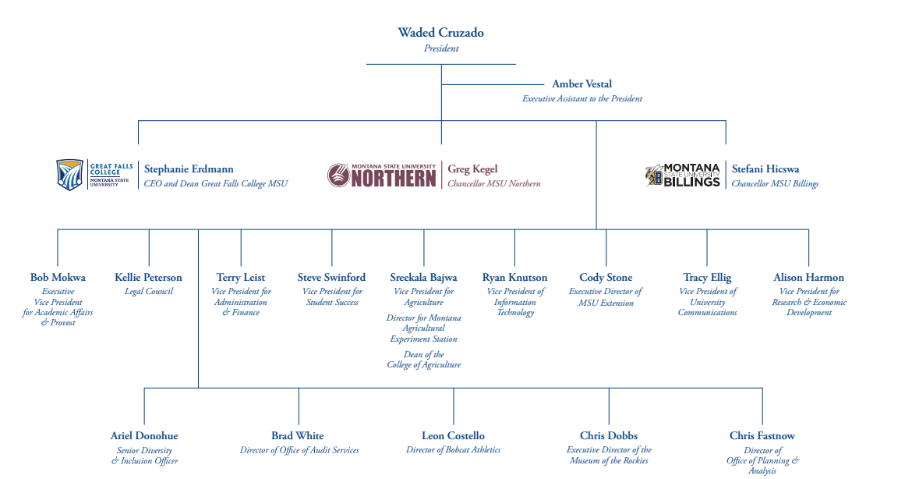
Trees

Slide 31
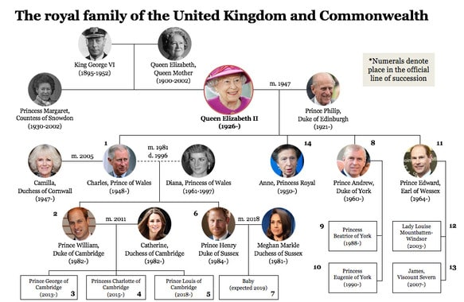
Trees

Slide 32
Trees
Grade
Labs
Programs
Exams
Lab 1
Program 1
Program 4
Midterm
Final Exam
Lab 6
Lab 2
Lab 5
Program 2
Program 3
Lab 3
Lab 4
Trees are data structures used to store elements hierarchically
(not linear like arrays and linked lists)

Slide 33
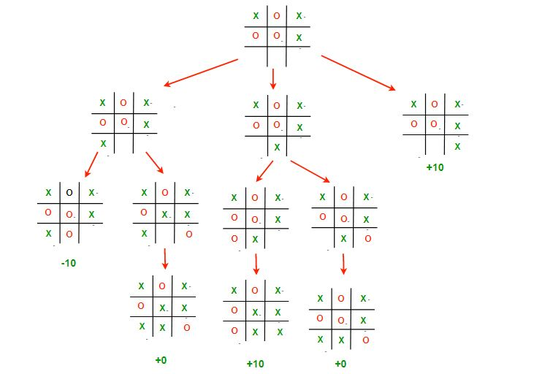
Trees
Decision Tree

Slide 34
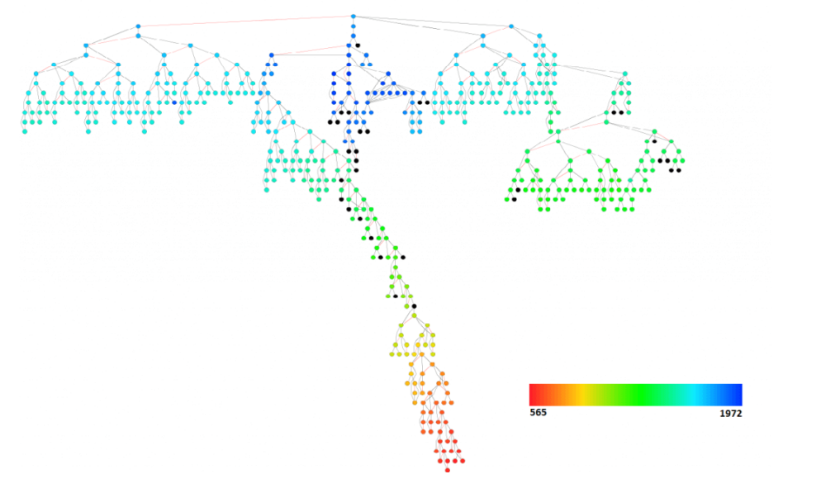
Trees

Slide 35
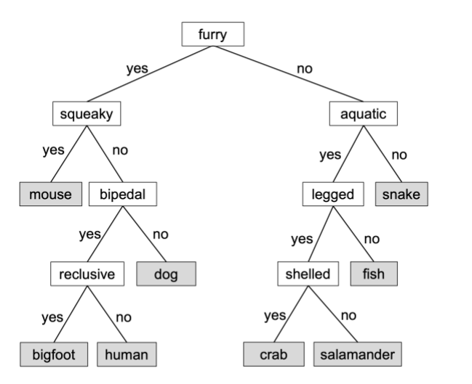
Trees

Slide 36
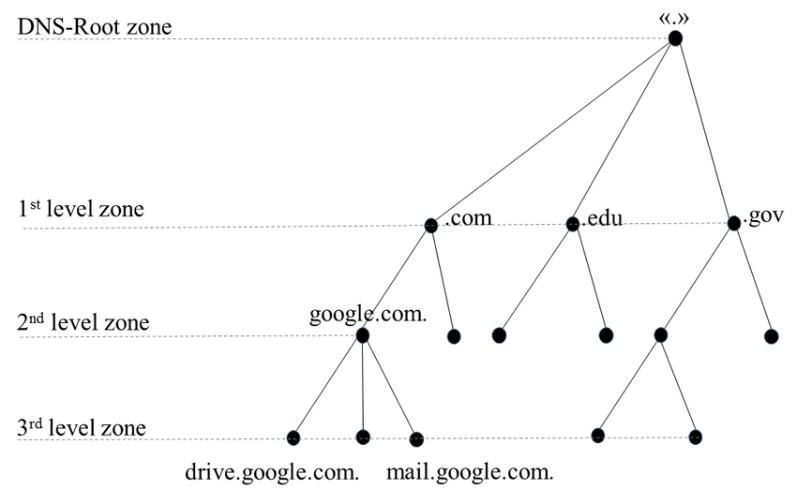
Trees

Slide 37
Desktop
public class Node {
School
Pictures
CSCI476
CSCI232
Pets
Memes
Programs
Labs
Meatball
Tater
2023
2024
How do we represent a tree in code?

Slide 38
Desktop
public class Node {
Instance variables?
School
Pictures
CSCI476
CSCI232
Pets
Memes
Programs
Labs
Meatball
Tater
2023
2024
How do we represent a tree in code?

Slide 39
Desktop
public class Node {
private ??? parent;
School
Pictures
CSCI476
CSCI232
Pets
Memes
Programs
Labs
Meatball
Tater
2023
2024
How do we represent a tree in code?

Slide 40
Desktop
public class Node {
private Node parent;
School
Pictures
CSCI476
CSCI232
Pets
Memes
Programs
Labs
Meatball
Tater
2023
2024
How do we represent a tree in code?

Slide 41
Desktop
public class Node {
private Node parent;
private ?????????????? children;
School
Pictures
CSCI476
CSCI232
Pets
Memes
Programs
Labs
Meatball
Tater
2023
2024
How do we represent a tree in code?

Slide 42
Desktop
public class Node {
private Node parent;
private LinkedList<???> children;
School
Pictures
CSCI476
CSCI232
Pets
Memes
Programs
Labs
Meatball
Tater
2023
2024
How do we represent a tree in code?

Slide 43
Desktop
public class Node {
private Node parent;
private LinkedList<Node> children;
School
Pictures
CSCI476
CSCI232
Pets
Memes
Programs
Labs
Meatball
Tater
2023
2024
How do we represent a tree in code?

Slide 44
Desktop
public class Node {
private Node parent;
private LinkedList<Node> children;
Private String name;
School
Pictures
CSCI476
CSCI232
Pets
Memes
Programs
Labs
Meatball
Tater
2023
2024
How do we represent a tree in code?

Slide 45
Desktop
public class Node {
private Node parent;
private LinkedList<Node> children;
private String name;
public Node(????? ???) {
}
School
Pictures
CSCI476
CSCI232
Pets
Memes
Programs
Labs
Meatball
Tater
2023
2024
How do we represent a tree in code?

Slide 46
Desktop
public class Node {
private Node parent;
private LinkedList<Node> children;
private String name;
public Node(String n) {
}
School
Pictures
CSCI476
CSCI232
Pets
Memes
Programs
Labs
Meatball
Tater
2023
2024
How do we represent a tree in code?

Slide 47
Desktop
public class Node {
private Node parent;
private LinkedList<Node> children;
private String name;
public Node(String n) {
this.name = n;
}
School
Pictures
CSCI476
CSCI232
Pets
Memes
Programs
Labs
Meatball
Tater
2023
2024
How do we represent a tree in code?

Slide 48
Desktop
public class Node {
private Node parent;
private LinkedList<Node> children;
private String name;
public Node(String n) {
this.name = name;
children = new LinkedList<>();
}
School
Pictures
CSCI476
CSCI232
Pets
Memes
Programs
Labs
Meatball
Tater
2023
2024
How do we represent a tree in code?

Slide 49
Desktop
public class Node {
private Node parent;
private LinkedList<Node> children;
private String name;
public Node(String n) {
this.name = name;
children = new LinkedList<>();
}
// getName()
// getParent()
// getChildren()
// setParent()
School
Pictures
CSCI476
CSCI232
Pets
Memes
Programs
Labs
Meatball
Tater
2023
2024
How do we represent a tree in code?

Slide 50
Desktop
public class Node {
private Node parent;
private LinkedList<Node> children;
private String name;
public Node(String n) {
this.name = name;
children = new LinkedList<>();
}
// getName()
// getParent()
// getChildren()
// setParent()
public ??? addChild(??? ????) {
}
School
Pictures
CSCI476
CSCI232
Pets
Memes
Programs
Labs
Meatball
Tater
2023
2024
How do we represent a tree in code?

Slide 51
Desktop
public class Node {
private Node parent;
private LinkedList<Node> children;
private String name;
public Node(String n) {
this.name = name;
children = new LinkedList<>();
}
// getName()
// getParent()
// getChildren()
// setParent()
public ??? addChild(Node child) {
}
School
Pictures
CSCI476
CSCI232
Pets
Memes
Programs
Labs
Meatball
Tater
2023
2024
How do we represent a tree in code?

Slide 52
Desktop
public class Node {
private Node parent;
private LinkedList<Node> children;
private String name;
public Node(String n) {
this.name = name;
children = new LinkedList<>();
}
// getName()
// getParent()
// getChildren()
// setParent()
public void addChild(Node child) {
}
School
Pictures
CSCI476
CSCI232
Pets
Memes
Programs
Labs
Meatball
Tater
2023
2024
How do we represent a tree in code?

Slide 53
Desktop
public class Node {
private Node parent;
private LinkedList<Node> children;
private String name;
public Node(String n) {
this.name = name;
children = new LinkedList<>();
}
// getName()
// getParent()
// getChildren()
// setParent()
public void addChild(Node child) {
children.add(child);
}
School
Pictures
CSCI476
CSCI232
Pets
Memes
Programs
Labs
Meatball
Tater
2023
2024
How do we represent a tree in code?

Slide 54
Desktop
public class Node {
private Node parent;
private LinkedList<Node> children;
private String name;
public Node(String n) {
this.name = name;
children = new LinkedList<>();
}
// getName()
// getParent()
// getChildren()
// setParent()
public void addChild(Node child) {
children.add(child);
}
School
Pictures
CSCI476
CSCI232
Pets
Memes
Programs
Labs
Meatball
Tater
2023
2024
How do we represent a tree in code?

Slide 55
Desktop
Shell
School
Pictures
CSCI476
CSCI232
Pets
Memes
Programs
Labs
Meatball
Tater
2023
2024
How do we represent a tree in code?

Slide 56
Desktop
public class Node {
…
}
Represent Individual data elements and their local relationships
School
Pictures
CSCI476
CSCI232
Pets
Memes
Represent the collection of data elements. Insertion, deletion, navigation
public class Tree {
…
}
Programs
Labs
Meatball
Tater
public class TreeManager {
…
}
Interface between user commands and tree object operations
2023
2024

