Slide 1

CSCI 232: Data Structures and Algorithms
Hashing (Part 2)
Reese Pearsall
Spring 2025
https://www.cs.montana.edu/pearsall/classes/spring2025/232/main.html

Slide 2
Announcements
Lab 4 due tomorrow at 11:59 PM
Program 1 due one week from today (2/20) at 11:59 PM
Not feeling well. Next Tuesday's lecture may be a lecture recording

Slide 3


Slide 4
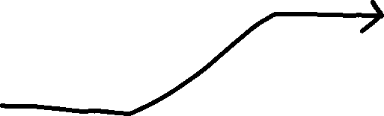

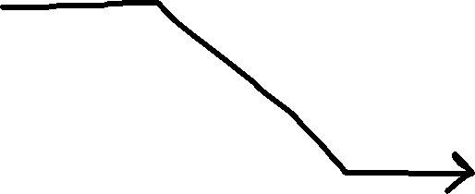
Hash Tables
Student[] Array
Hash Function
0 | null
1 | null
… | null
… | null
12
… | null
… | null
… | null
56
… | null
… | null
… | null
72
… | null
99 | null
Student ID
ID % 100
123456
Sam, Political Science, 2.5
Student Object
121212
Sally, Mathematics, 3.0
Student Object
456672
John, Computer Science, 4.0
Student Object

Slide 5
Hash Tables
Student[] Array
n = 100
Hash Function
0 | null
1 | null
… | null
… | null
12
… | null
… | null
… | null
56
… | null
… | null
… | null
72
… | null
99 | null
Student ID
ID % 100
Lookup time?
O(1) if you have the key
Sam, Political Science, 2.5
Student Object
Sally, Mathematics, 3.0
Student Object
John, Computer Science, 4.0
Student Object

Slide 6
Hash Tables
Student[] Array
n = 100
Hash Function
0 | null
1 | null
… | null
… | null
12
… | null
… | null
… | null
56
… | null
… | null
… | null
72
… | null
99 | null
Student ID
ID % 100
Lookup time?
O(1) if you have the key
O(n) if you don’t have the key
Sam, Political Science, 2.5
Student Object
Sally, Mathematics, 3.0
Student Object
John, Computer Science, 4.0
Student Object

Slide 7
Hash Tables
Student[] Array
n = 100
Hash Function
0 | null
1 | null
… | null
… | null
12
… | null
… | null
… | null
56
… | null
… | null
… | null
72
… | null
99 | null
Student ID
ID % 100
Lookup time?
O(1) if you have the key
O(n) if you don’t have the key
O(k) if you don’t have the key
Sam, Political Science, 2.5
Student Object
Sally, Mathematics, 3.0
Student Object
John, Computer Science, 4.0
Student Object
k = | keyspace |

Slide 8
Hash Tables
Student[] Array
n = 100
Hash Function
0 | null
1 | null
… | null
… | null
12
… | null
… | null
… | null
56
… | null
… | null
… | null
72
… | null
99 | null
Student ID
ID % 100
Lookup time?
O(1) if you have the key*
Array – O(logn)**
BST – O(logn)***
Linked List – O(n)
Sam, Political Science, 2.5
Student Object
Sally, Mathematics, 3.0
Student Object
n = # of elements in data structure
John, Computer Science, 4.0
Student Object
* If we can avoid collisions
**if the array is sorted
***if the tree is balanced

Slide 9
Hash Tables
Student[] Array
n = 100
Hash Function
0 | null
1 | null
… | null
… | null
12
… | null
… | null
… | null
56
… | null
… | null
… | null
72
… | null
99 | null
Student ID
ID % 100
Insertion time?
O(1) *
Array – O(n)
BST – O(logn)**
Linked List – O(1)
Sam, Political Science, 2.5
Student Object
Sally, Mathematics, 3.0
Student Object
n = # of elements in data structure
John, Computer Science, 4.0
Student Object
* If we can avoid collisions
**if the tree is balanced

Slide 10
Hash Tables
Student[] Array
n = 100
Hash Function
0 | null
1 | null
… | null
… | null
12
… | null
… | null
… | null
56
… | null
… | null
… | null
72
… | null
99 | null
Student ID
ID % 100
Removal time?
O(1) *
Array – O(n)
BST – O(logn)**
Linked List – O(1) / O(n)
Sam, Political Science, 2.5
Student Object
Sally, Mathematics, 3.0
Student Object
n = # of elements in data structure
John, Computer Science, 4.0
Student Object
* If we can avoid collisions
**if the tree is balanced

Slide 11
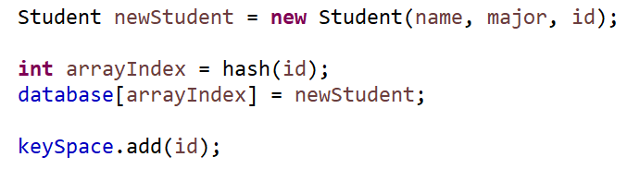
Hash Tables
Student[] Array
n = 100
Hash Function
0 | null
1 | null
… | null
… | null
12
… | null
… | null
… | null
56
… | null
… | null
… | null
72
… | null
99 | null
Student ID
ID % 100
Insertion
Sam, Political Science, 2.5
Student Object
Sally, Mathematics, 3.0
Student Object
John, Computer Science, 4.0
Student Object

Slide 12

Hash Tables
Student[] Array
n = 100
Hash Function
0 | null
1 | null
… | null
… | null
12
… | null
… | null
… | null
56
… | null
… | null
… | null
72
… | null
99 | null
Student ID
ID % 100
Lookup (get)
Sam, Political Science, 2.5
Student Object
O(1)
Sally, Mathematics, 3.0
Student Object
John, Computer Science, 4.0
Student Object

Slide 13
Hash Tables
Student[] Array
n = 100
Hash Function
0 | null
1 | null
… | null
… | null
12
… | null
… | null
… | null
56
… | null
… | null
… | null
72
… | null
99 | null
Student ID
ID % 100
Sam, Political Science, 2.5
Student Object
Remove Method
Sally, Mathematics, 3.0
Student Object
John, Computer Science, 4.0
Student Object

Slide 14
Hash Tables in Java
Typically, we will never have to create our own HashTable class, instead we will import the one that Java provides
import java.util.HashMap;
import java.util.HashSet;

Slide 15
Hash Maps
Hash Maps are a collection of key-values pairs (Map) that uses hashing when inserting, removing, lookup, etc
HashMap<String, String> capitalCities = new HashMap<String, String>();
This is a HashMap that maps Strings (keys) to Strings (values)
Adding a new Key-Value pair
Removing a Value
capitalCities.put("England", "London");
capitalCities.put("Germany", "Berlin");
capitalCities.put("Norway", "Oslo");
capitalCities.put("USA", "Washington DC");
capitalCities.remove("England");
Other Helpful Methods
• keySet() → returns set of keys
• values() → returns set of values
• containsKey()
• containsValue()
• replace()
• size()
Retrieving a Value
capitalCities.get("England");

Slide 16



Hash Sets
Hash Sets is an implementation of the Set interface that uses a Hash Map under the hood
A set is a collection of elements with no duplicate elements
You can think of this as a List, but without the ability to use indices
HashSet<String> candy = new HashSet<String>;
false
true
false
false
true
false
true
…
false
HashSet<String>
Hash Set that stores Strings
“Twix”
“Skittles”
“Snickers”
candy.add(“Twix”);
candy.add(“Skittles”);
candy.add(“Snickers”);
candy.contains(“Skittles”);
candy.remove(“Twix”);

Slide 17



Hash Sets
Hash Sets is an implementation of the Set interface that uses a Hash Map under the hood
A set is a collection of elements with no duplicate elements
You can think of this as a List, but without the ability to use indices
The order in the HashSet may not be the same order you added with
( “Twix” , “Snickers” , “Skittles” )
false
true
false
false
true
false
true
…
false
Insertion: O(1)
Lookup: O(1)
HashSet<String>
“Twix”
“Skittles”
“Snickers”
When to use HashSet?
For fast lookups and insertions
When order doesn’t matter
Only need unique elements

Slide 18
Today’s Mandatory Fun
Updating our Student Database Class
Replace Array with HashMap
Replace ArrayList with HashSet
Write a method that will compute the number of CS majors, Math Majors, History majors, etc
Add method that will compute which student(s) have a 4.0, 3.0, 3.1, etc
Write a program that will convert an English sentence to sentence in Pirate
“Hello” → “Ahoy”
“Friends” → “Mateys”

Slide 19


HashMap Inner-workings
Every object has a HashCode in Java
Every object has one HashCode and two objects usually don’t have the same hash code
// 99644
// 3089079

Slide 20
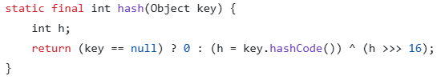

HashMap Inner-workings
Every object has a HashCode in Java
Every object has one HashCode and two objects usually don’t have the same hash code
// 99644
// 3089079
Value is run through the HashMap hash() method
Bucket is determined by:
Bit-level XOR operator
Shift bits right by 16 places
index = hash & (n – 1)
(& = bit-level AND operator, n = table size)

Slide 21
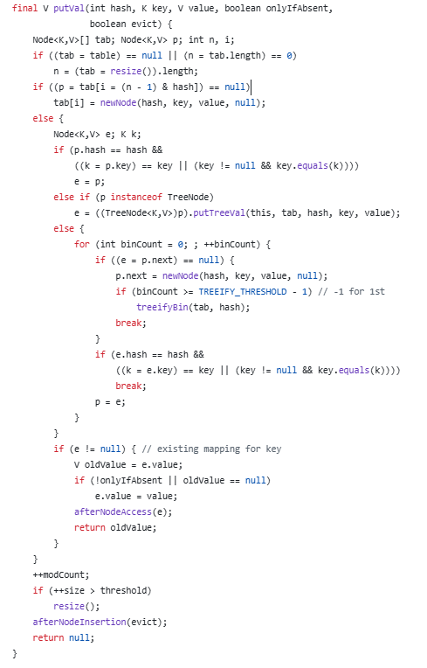
HashMap Inner-workings
Every object has a HashCode in Java
Every object has one HashCode and two objects usually don’t have the same hash code
// 99644
// 3089079
putVal() is called to place it in array
Value is run through the HashMap hash() method

Slide 22
HashMap Inner-workings
Every object has a HashCode in Java
Every object has one HashCode and two objects usually don’t have the same hash code
// 99644
// 3089079
Value is run through the HashMap hash() method
Bucket is determined by:
put() calls a putVal() method that inserts into the array and deals with collisions
index = hash & (n – 1)

Slide 23
HashMap Inner-workings
A new HashMap can fit 16 values

Slide 24
HashMap Inner-workings
A new HashMap can fit 16 values
If it ever reaches 75% capacity, it will double the array size (16 → 32 → 64 → 128)

Slide 25
HashMap Inner-workings
A new HashMap can fit 16 values
If it ever reaches 75% capacity, it will double the array size (16 → 32 → 64 → 128)
When the arrays doubles, we have to re-hash all our Key-Value pairs

Slide 26
HashMap Inner-workings
A new HashMap can fit 16 values
If it ever reaches 75% capacity, it will double the array size (16 → 32 → 64 → 128)
When the arrays doubles, we have to re-hash all our Key-Value pairs
→ This most likely will require O(k) moves

Slide 27

HashMap Inner-workings
A new HashMap can fit 16 values
If it ever reaches 75% capacity, it will double the array size (16 → 32 → 64 → 128)
When the arrays doubles, we have to re-hash all our Key-Value pairs
→ This most likely will require O(k) moves
Why is this not taken into consideration for running time?

Slide 28

HashMap Inner-workings
A new HashMap can fit 16 values
If it ever reaches 75% capacity, it will double the array size (16 → 32 → 64 → 128)
When the arrays doubles, we have to re-hash all our Key-Value pairs
→ This most likely will require O(k) moves
Why is this not taken into consideration for running time?
(Amortized analysis)
On average, expansion happens very rarely compared to put() method calls when N is really big.
“Since doubling happens exponentially, the total cost of resizing is spread out across many operations, making amortized time per operation O(1).”

