Slide 1

CSCI 232: Data Structures and Algorithms
Heaps
Reese Pearsall
Spring 2025
https://www.cs.montana.edu/pearsall/classes/spring2025/232/main.html

Slide 2
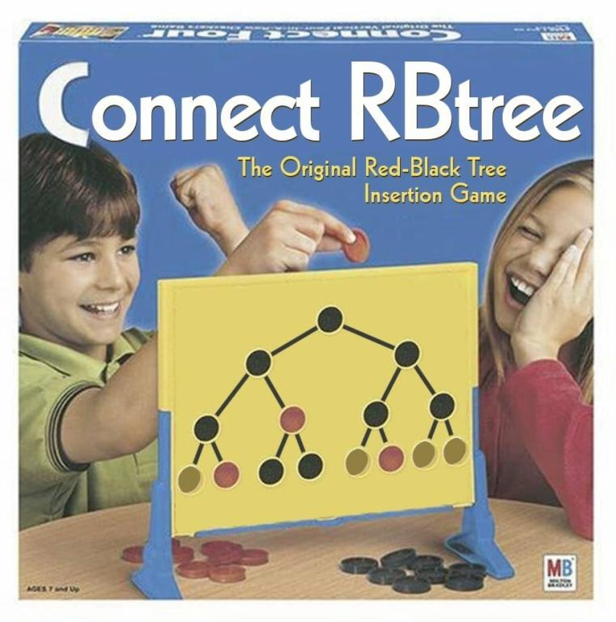
Announcements
Lab 6 due Friday at 11:59 PM
Program 2 due Sunday at 11:59 PM
There will be a lab next week, but I will try to make it easy
Tweaked a few dates on the schedule
10 labs → 11 labs
* I will now drop your lowest lab grade
Quiz 2 moved back a week, Quiz 3 will take place in this classroom during finals week
the game that you play in nightmares ^

Slide 3
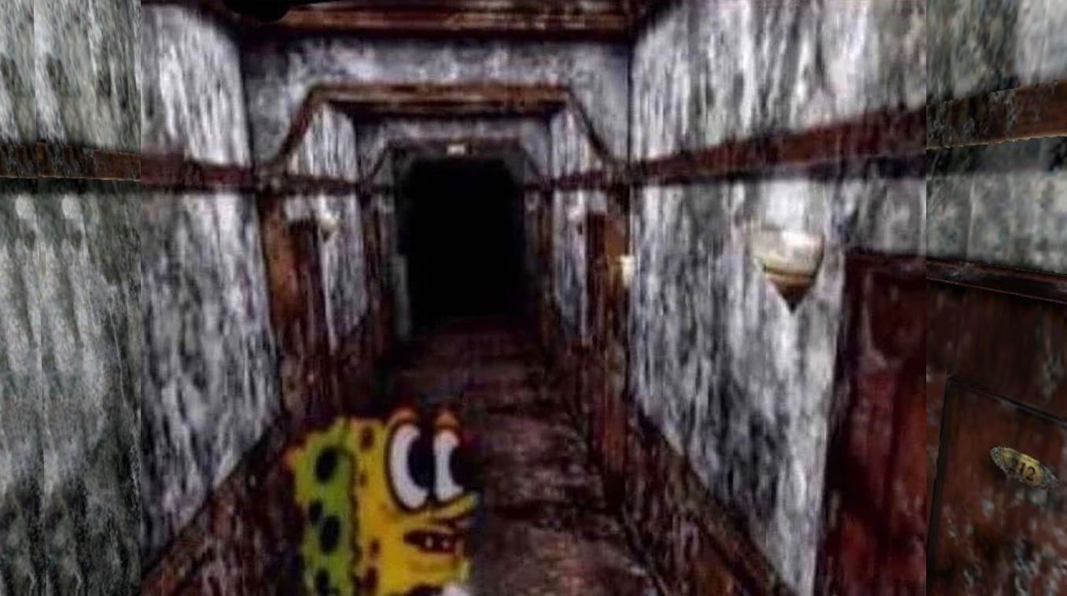
Quiz 1

Slide 4
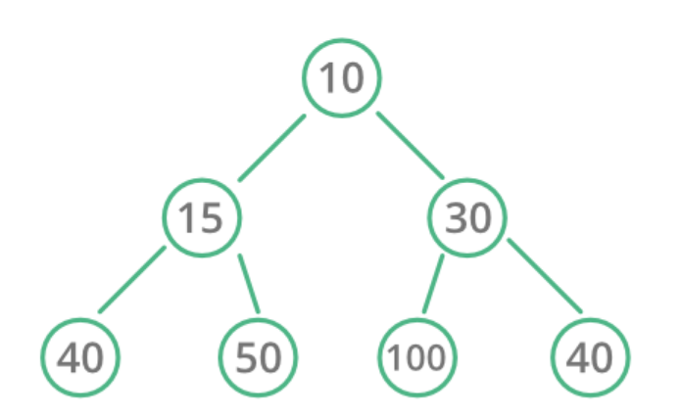
The Heap data structure is complete binary tree that follows the heap property

Slide 5
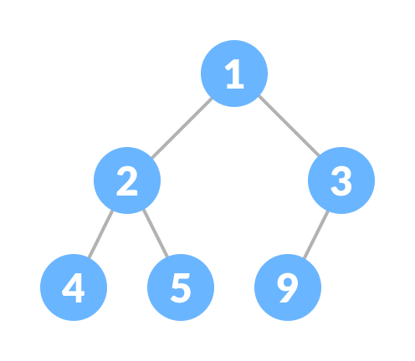
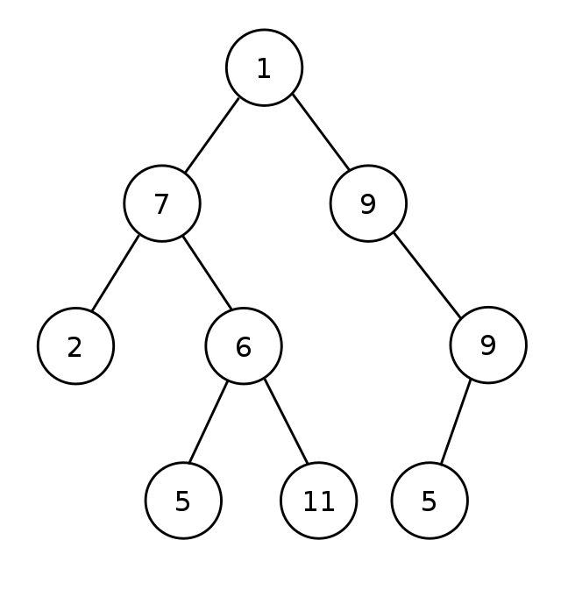
The Heap data structure is complete binary tree that follows the heap property
Complete tree - Every level, except possibly the last, is completely filled, and all nodes in the last level are as far left as possible
complete
complete
Not complete

Slide 6
The Heap data structure is complete binary tree that follows the heap property
Binary – cannot have more than two children

Slide 7
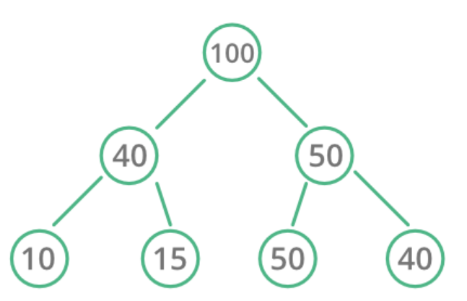
The Heap data structure is complete binary tree that follows the heap property
Two types of heaps
Max Heap – Parent nodes are greater than both of its children
Min Heap – Parent nodes are less than both of its children
maximum value
minimum value

Slide 8
Heap Operations - Insert
6
Min Heap – Parent nodes are less than both of its children
add(7);
10
15
12
16
21
33
25
23

Slide 9
Heap Operations - Insert
6
Min Heap – Parent nodes are less than both of its children
add(7);
10
15
Because this is a complete binary tree, this is the only place a new node can go
12
16
21
33
25
23
7

Slide 10

Heap Operations - Insert
6
Min Heap – Parent nodes are less than both of its children
add(7);
10
15
Because this is a complete binary tree, this is the only place a new node can go
12
16
21
33
However, we are now violating the heap property
25
23
7

Slide 11
Heap Operations - Insert
6
Min Heap – Parent nodes are less than both of its children
add(7);
10
15
Because this is a complete binary tree, this is the only place a new node can go
12
16
21
33
However, we are now violating the heap property
When new nodes are added, we may need to move it up in the tree
25
23
7

Slide 12
Heap Operations - Insert
6
Min Heap – Parent nodes are less than both of its children
add(7);
10
15
Because this is a complete binary tree, this is the only place a new node can go
12
16
21
33
However, we are now violating the heap property
When new nodes are added, we may need to move it up in the tree
25
23
7

Slide 13
Heap Operations - Insert
6
Min Heap – Parent nodes are less than both of its children
add(7);
10
15
Because this is a complete binary tree, this is the only place a new node can go
12
7
21
33
However, we are now violating the heap property
When new nodes are added, we may need to move it up in the tree
25
23
16

Slide 14

Heap Operations - Insert
6
Min Heap – Parent nodes are less than both of its children
add(7);
10
15
Because this is a complete binary tree, this is the only place a new node can go
12
7
21
33
However, we are now violating the heap property
When new nodes are added, we may need to move it up in the tree
25
23
16

Slide 15
Heap Operations - Insert
6
Min Heap – Parent nodes are less than both of its children
add(7);
10
15
Because this is a complete binary tree, this is the only place a new node can go
12
7
21
33
However, we are now violating the heap property
When new nodes are added, we may need to move it up in the tree
25
23
16

Slide 16

Heap Operations - Insert
6
Min Heap – Parent nodes are less than both of its children
add(7);
7
15
Because this is a complete binary tree, this is the only place a new node can go
12
10
21
33
However, we are now violating the heap property
When new nodes are added, we may need to move it up in the tree
25
23
16

Slide 17
Heap Operations - Insert
6
Min Heap – Parent nodes are less than both of its children
This process is called Heapify (up)
add(7);
7
15
Because this is a complete binary tree, this is the only place a new node can go
12
10
21
33
However, we are now violating the heap property
When new nodes are added, we may need to move it up in the tree
25
23
16

Slide 18
Heap Operations - Insert
6
Min Heap – Parent nodes are less than both of its children
This process is called Heapify (up)
add(7);
7
15
add(14);
12
10
21
33
25
23
16

Slide 19
Heap Operations - Insert
6
Min Heap – Parent nodes are less than both of its children
This process is called Heapify (up)
add(7);
7
15
add(14);
12
10
21
33
25
23
16
14

Slide 20
Heap Operations - Insert
6
Min Heap – Parent nodes are less than both of its children
This process is called Heapify (up)
add(7);
7
15
add(14);
add(19);
12
10
21
33
25
23
16
14
19

Slide 21
Heap Operations - Insert
6
Min Heap – Parent nodes are less than both of its children
This process is called Heapify (up)
add(7);
7
15
add(14);
add(19);
12
10
19
33
25
23
16
14
21

Slide 22
Heap Operations - Insert
6
Min Heap – Parent nodes are less than both of its children
This process is called Heapify (up)
add(7);
7
15
add(14);
add(19);
12
10
19
33
Running time?
Finding where to place new node: O(1) (this will make sense later)
Insertion – O(1)
Heapify Up – O(logn)
Total Running Time: O(logn)
25
23
16
14
21

Slide 23
Heap Operations – Removal ( poll() )
6
Min Heap – Parent nodes are less than both of its children
When using a Heap, we only remove the root node, which will be either the maximum value or minimum value
7
15
12
10
19
33
25
23
16
14
21

Slide 24
Heap Operations – Removal ( poll() )
Min Heap – Parent nodes are less than both of its children
When using a Heap, we only remove the root node, which will be either the maximum value or minimum value
7
15
When the root is removed, we replace it with the last node that was added to the heap
12
10
19
33
25
23
16
14
21

Slide 25
Heap Operations – Removal ( poll() )
21
Min Heap – Parent nodes are less than both of its children
When using a Heap, we only remove the root node, which will be either the maximum value or minimum value
7
15
When the root is removed, we replace it with the last node that was added to the heap
12
10
19
33
25
23
16
14

Slide 26


Heap Operations – Removal ( poll() )
21
Min Heap – Parent nodes are less than both of its children
When using a Heap, we only remove the root node, which will be either the maximum value or minimum value
7
15
When the root is removed, we replace it with the last node that was added to the heap
12
10
19
33
25
23
16
14

Slide 27
Heap Operations – Removal ( poll() )
21
Min Heap – Parent nodes are less than both of its children
When using a Heap, we only remove the root node, which will be either the maximum value or minimum value
7
15
When the root is removed, we replace it with the last node that was added to the heap
12
10
19
33
When the root is replaced, it may need to be moved down in the tree
25
23
16
14

Slide 28
Heap Operations – Removal ( poll() )
7
Min Heap – Parent nodes are less than both of its children
When using a Heap, we only remove the root node, which will be either the maximum value or minimum value
21
15
When the root is removed, we replace it with the last node that was added to the heap
12
10
19
33
When the root is replaced, it may need to be moved down in the tree
25
23
16
14

Slide 29
Heap Operations – Removal ( poll() )
7
Min Heap – Parent nodes are less than both of its children
When using a Heap, we only remove the root node, which will be either the maximum value or minimum value
21
15
When swapping down, we want to swap it with the smaller child
When the root is removed, we replace it with the last node that was added to the heap
12
10
19
33
When the root is replaced, it may need to be moved down in the tree
25
23
16
14

Slide 30
Heap Operations – Removal ( poll() )
7
Min Heap – Parent nodes are less than both of its children
When using a Heap, we only remove the root node, which will be either the maximum value or minimum value
10
15
When the root is removed, we replace it with the last node that was added to the heap
12
21
19
33
When the root is replaced, it may need to be moved down in the tree
25
23
16
14

Slide 31
Heap Operations – Removal ( poll() )
7
Min Heap – Parent nodes are less than both of its children
When using a Heap, we only remove the root node, which will be either the maximum value or minimum value
10
15
When the root is removed, we replace it with the last node that was added to the heap
12
21
19
33
When the root is replaced, it may need to be moved down in the tree
25
23
16
14

Slide 32
Heap Operations – Removal ( poll() )
7
Min Heap – Parent nodes are less than both of its children
When using a Heap, we only remove the root node, which will be either the maximum value or minimum value
10
15
When the root is removed, we replace it with the last node that was added to the heap
12
14
19
33
When the root is replaced, it may need to be moved down in the tree
25
23
16
21

Slide 33
Heap Operations – Removal ( poll() )
7
Min Heap – Parent nodes are less than both of its children
When using a Heap, we only remove the root node, which will be either the maximum value or minimum value
10
15
When the root is removed, we replace it with the last node that was added to the heap
12
14
19
33
When the root is replaced, it may need to be moved down in the tree
25
23
16
21

Slide 34
Heap Operations – Removal ( poll() )
7
Min Heap – Parent nodes are less than both of its children
This process is called Heapify (down)
When using a Heap, we only remove the root node, which will be either the maximum value or minimum value
10
15
When the root is removed, we replace it with the last node that was added to the heap
12
14
19
33
When the root is replaced, it may need to be moved down in the tree
25
23
16
21

Slide 35
Heap Operations – Removal ( poll() )
7
Min Heap – Parent nodes are less than both of its children
This process is called Heapify (down)
10
15
Running time?
- Removing root: O(1)
- Replacing root: O(1) (this will make sense later)
- Heapify down: O(logn)
Total running time: O(logn)
12
14
19
33
25
23
16
21

Slide 36
Heap Operations – Removal ( poll() )
7
Min Heap – Parent nodes are less than both of its children
Heapify (up)
10
15
Moving the new leaf node up in the tree
12
14
19
33
Heapify (down)
Moving the new root node down in the tree
25
23
16
21

Slide 37
Heap Representation
7
Min Heap – Parent nodes are less than both of its children
How to represent a heap?
10
15
public class HeapNode{
Node leftChild;
Node rightChild;
Node parent;
(…)
}
12
14
19
33
25
23
16
21

Slide 38
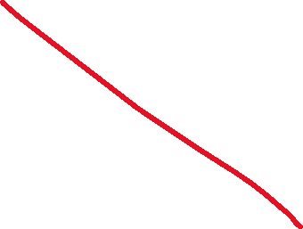

Heap Representation
7
Min Heap – Parent nodes are less than both of its children
How to represent a heap?
10
15
public class HeapNode{
Node leftChild;
Node rightChild;
Node parent;
(…)
}
12
14
19
33
25
23
16
21

Slide 39
Heap Representation
1
7
Min Heap – Parent nodes are less than both of its children
2
3
10
15
4
6
7
12
5
14
19
33
8
9
10
11
25
23
16
21

Slide 40
Heap Representation
1
7
Min Heap – Parent nodes are less than both of its children
Array
2
3
10
15
7 | 10 | 15 | 12 | 14 | 19 | 33 | 25 | 23 | 16 | 21
0 | 1 | 2 | 3 | 4 | 5 | 6 | 7 | 8 | 9 | 10
4
6
7
12
5
14
19
33
8
9
10
11
25
23
16
21

Slide 41
Heap Representation
1
7
Min Heap – Parent nodes are less than both of its children
Array
2
3
10
15
7 | 10 | 15 | 12 | 14 | 19 | 33 | 25 | 23 | 16 | 21
0 | 1 | 2 | 3 | 4 | 5 | 6 | 7 | 8 | 9 | 10
Given a spot in the array, how can we find its children?
4
6
7
12
5
14
19
33
8
9
10
11
25
23
16
21

Slide 42


Heap Representation
1
7
Min Heap – Parent nodes are less than both of its children
Array
2
3
10
15
7 | 10 | 15 | 12 | 14 | 19 | 33 | 25 | 23 | 16 | 21
0 | 1 | 2 | 3 | 4 | 5 | 6 | 7 | 8 | 9 | 10
Given a spot in the array, how can we find its children?
4
6
7
12
5
14
19
33
8
9
10
11
25
23
16
21

Slide 43
Heap Representation
1
7
Min Heap – Parent nodes are less than both of its children
Array
2
3
10
15
7 | 10 | 15 | 12 | 14 | 19 | 33 | 25 | 23 | 16 | 21
0 | 1 | 2 | 3 | 4 | 5 | 6 | 7 | 8 | 9 | 10
Given a spot in the array, how can we find its children?
4
6
7
12
5
14
19
33
Because this is a complete binary tree, there is a pretty nifty formula for this
8
9
10
11
25
23
16
21

Slide 44
Heap Representation
1
7
Min Heap – Parent nodes are less than both of its children
Array
2
3
10
15
7 | 10 | 15 | 12 | 14 | 19 | 33 | 25 | 23 | 16 | 21
0 | 1 | 2 | 3 | 4 | 5 | 6 | 7 | 8 | 9 | 10
Given a spot in the array, how can we find its children?
4
6
7
12
5
14
19
33
Because this is a complete binary tree, there is a pretty nifty formula for this
For a given element at index i
Its left child will be located at index:
2 * i + 1
Its right child will be located at index:
2 * i + 2
8
9
10
11
25
23
16
21

Slide 45
Heap Representation
1
7
Min Heap – Parent nodes are less than both of its children
Left Child = 2 * 4 + 1 = index 9 !
Array
2
3
10
15
7 | 10 | 15 | 12 | 14 | 19 | 33 | 25 | 23 | 16 | 21
0 | 1 | 2 | 3 | 4 | 5 | 6 | 7 | 8 | 9 | 10
Given a spot in the array, how can we find its children?
4
6
7
12
5
14
19
33
Because this is a complete binary tree, there is a pretty nifty formula for this
For a given element at index i
Its left child will be located at index:
2 * i + 1
Its right child will be located at index:
2 * i + 2
8
9
10
11
25
23
16
21

Slide 46
Heap Representation
1
7
Min Heap – Parent nodes are less than both of its children
Left Child = 2 * 4 + 1 = index 9 !
Right Child = 2 * 4 + 2 = index 10 !
Array
2
3
10
15
7 | 10 | 15 | 12 | 14 | 19 | 33 | 25 | 23 | 16 | 21
0 | 1 | 2 | 3 | 4 | 5 | 6 | 7 | 8 | 9 | 10
Given a spot in the array, how can we find its children?
4
6
7
12
5
14
19
33
Because this is a complete binary tree, there is a pretty nifty formula for this
For a given element at index i
Its left child will be located at index:
2 * i + 1
Its right child will be located at index:
2 * i + 2
8
9
10
11
25
23
16
21

Slide 47
Heap Representation
1
7
Min Heap – Parent nodes are less than both of its children
Left Child = 2 * 0 + 1 = index 1 !
Right Child = 2 * 0 + 2 = index 2 !
Array
2
3
10
15
7 | 10 | 15 | 12 | 14 | 19 | 33 | 25 | 23 | 16 | 21
0 | 1 | 2 | 3 | 4 | 5 | 6 | 7 | 8 | 9 | 10
Given a spot in the array, how can we find its children?
4
6
7
12
5
14
19
33
Because this is a complete binary tree, there is a pretty nifty formula for this
For a given element at index i
Its left child will be located at index:
2 * i + 1
Its right child will be located at index:
2 * i + 2
8
9
10
11
25
23
16
21

Slide 48
Heap Representation
1
7
Min Heap – Parent nodes are less than both of its children
Array
2
3
10
15
7 | 10 | 15 | 12 | 14 | 19 | 33 | 25 | 23 | 16 | 21
0 | 1 | 2 | 3 | 4 | 5 | 6 | 7 | 8 | 9 | 10
Given a spot in the array, how can we find its parent?
4
6
7
12
5
14
19
33
8
9
10
11
25
23
16
21

Slide 49
Heap Representation
1
7
Min Heap – Parent nodes are less than both of its children
Array
2
3
10
15
7 | 10 | 15 | 12 | 14 | 19 | 33 | 25 | 23 | 16 | 21
0 | 1 | 2 | 3 | 4 | 5 | 6 | 7 | 8 | 9 | 10
Given a spot in the array, how can we find its parent?
4
6
7
12
5
14
19
33
Because this is a complete binary tree, there is a pretty nifty formula for this
Given an index i
Its parent will be located at index:
(i - 1) / 2
8
9
10
11
(remember that the / operator will floor the answer)
25
23
16
21

Slide 50
Heap Representation
7
Min Heap – Parent nodes are less than both of its children
Parent = (6 - 1) / 2 = Index 2
Array
10
15
7 | 10 | 15 | 12 | 14 | 19 | 33 | 25 | 23 | 16 | 21
0 | 1 | 2 | 3 | 4 | 5 | 6 | 7 | 8 | 9 | 10
Given a spot in the array, how can we find its parent?
Because this is a complete binary tree, there is a pretty nifty formula for this
12
14
19
33
Given an index i
Its parent will be located at index:
(i - 1) / 2
(remember that the / operator will floor the answer)
25
23
16
21

Slide 51
Heap Representation
7
Min Heap – Parent nodes are less than both of its children
Parent = (3 - 1) / 2 = Index 1
Array
10
15
7 | 10 | 15 | 12 | 14 | 19 | 33 | 25 | 23 | 16 | 21
0 | 1 | 2 | 3 | 4 | 5 | 6 | 7 | 8 | 9 | 10
Given a spot in the array, how can we find its parent?
Because this is a complete binary tree, there is a pretty nifty formula for this
12
14
19
33
Given an index i
Its parent will be located at index:
(i - 1) / 2
(remember that the / operator will floor the answer)
25
23
16
21

Slide 52
Heap Representation
7
Min Heap – Parent nodes are less than both of its children
Array
10
15
7 | 10 | 15 | 12 | 14 | 19 | 33 | 25 | 23 | 16 | 21
0 | 1 | 2 | 3 | 4 | 5 | 6 | 7 | 8 | 9 | 10
We can represent our tree with an array! We have formulas to find the left child, right child, and parent for a given node
12
14
19
33
2 * i + 1
Left Child
Right Child
Parent
2 * i + 2
25
23
16
21
(i - 1) / 2

Slide 53
Heap Representation
7
Min Heap – Parent nodes are less than both of its children
Array
10
15
7 | 10 | 15 | 12 | 14 | 19 | 33 | 25 | 23 | 16 | 21
0 | 1 | 2 | 3 | 4 | 5 | 6 | 7 | 8 | 9 | 10
insert(11);
12
14
19
33
25
23
16
21

Slide 54
Heap Representation
7
Min Heap – Parent nodes are less than both of its children
O(1) time
(assuming we had space in the array)
Array
10
15
7 | 10 | 15 | 12 | 14 | 19 | 33 | 25 | 23 | 16 | 21 | 11
0 | 1 | 2 | 3 | 4 | 5 | 6 | 7 | 8 | 9 | 10 | 11
insert(11);
12
14
19
33
25
23
16
21
11

Slide 55
Heap Representation
7
Min Heap – Parent nodes are less than both of its children
Array
10
15
7 | 10 | 15 | 12 | 14 | 19 | 33 | 25 | 23 | 16 | 21 | 11
0 | 1 | 2 | 3 | 4 | 5 | 6 | 7 | 8 | 9 | 10 | 11
insert(11);
Time to Heapify Up!
12
14
19
33
25
23
16
21
11

Slide 56
2 * i + 1
Min Heap – Parent nodes are less than both of its children
Heap Representation
Left Child
Right Child
Parent
7
2 * i + 2
(i - 1) / 2
Array
10
15
7 | 10 | 15 | 12 | 14 | 19 | 33 | 25 | 23 | 16 | 21 | 11
0 | 1 | 2 | 3 | 4 | 5 | 6 | 7 | 8 | 9 | 10 | 11
insert(11);
Time to Heapify Up!
12
14
19
33
11’s parent is located at (11 – 1) / 2 = 5
25
23
16
21
11

Slide 57
2 * i + 1
Min Heap – Parent nodes are less than both of its children
Heap Representation
Left Child
Right Child
Parent
7
2 * i + 2
(i - 1) / 2
Array
10
15
7 | 10 | 15 | 12 | 14 | 11 | 33 | 25 | 23 | 16 | 21 | 19
0 | 1 | 2 | 3 | 4 | 5 | 6 | 7 | 8 | 9 | 10 | 11
insert(11);
Time to Heapify Up!
12
14
11
33
25
23
16
21
19

Slide 58
2 * i + 1
Min Heap – Parent nodes are less than both of its children
Heap Representation
Left Child
Right Child
Parent
7
2 * i + 2
(i - 1) / 2
Array
10
15
7 | 10 | 15 | 12 | 14 | 11 | 33 | 25 | 23 | 16 | 21 | 19
0 | 1 | 2 | 3 | 4 | 5 | 6 | 7 | 8 | 9 | 10 | 11
insert(11);
Time to Heapify Up!
12
14
11
33
11’s parent is located at (5 – 1) / 2 = 2
25
23
16
21
19

Slide 59
2 * i + 1
Min Heap – Parent nodes are less than both of its children
Heap Representation
Left Child
Right Child
Parent
7
2 * i + 2
(i - 1) / 2
Array
10
11
7 | 10 | 11 | 12 | 14 | 15 | 33 | 25 | 23 | 16 | 21 | 19
0 | 1 | 2 | 3 | 4 | 5 | 6 | 7 | 8 | 9 | 10 | 11
insert(11);
Time to Heapify Up!
12
14
15
33
11’s parent is located at (5 – 1) / 2 = 2
25
23
16
21
19

Slide 60
2 * i + 1
Min Heap – Parent nodes are less than both of its children
Heap Representation
Left Child
Right Child
Parent
7
2 * i + 2
(i - 1) / 2
Array
10
11
7 | 10 | 11 | 12 | 14 | 15 | 33 | 25 | 23 | 16 | 21 | 19
0 | 1 | 2 | 3 | 4 | 5 | 6 | 7 | 8 | 9 | 10 | 11
insert(11);
Time to Heapify Up!
12
14
15
33
25
23
16
21
19

Slide 61
2 * i + 1
Min Heap – Parent nodes are less than both of its children
Heap Representation
Left Child
Right Child
Parent
7
2 * i + 2
(i - 1) / 2
Array
10
11
7 | 10 | 11 | 12 | 14 | 15 | 33 | 25 | 23 | 16 | 21 | 19
0 | 1 | 2 | 3 | 4 | 5 | 6 | 7 | 8 | 9 | 10 | 11
poll();
12
14
15
33
25
23
16
21
19

Slide 62
2 * i + 1
Min Heap – Parent nodes are less than both of its children
Heap Representation
Left Child
Right Child
Parent
19
2 * i + 2
(i - 1) / 2
Array
O(1) time
10
11
19 | 10 | 11 | 12 | 14 | 15 | 33 | 25 | 23 | 16 | 21
0 | 1 | 2 | 3 | 4 | 5 | 6 | 7 | 8 | 9 | 10
poll();
12
14
15
33
25
23
16
21

Slide 63
2 * i + 1
Min Heap – Parent nodes are less than both of its children
Heap Representation
Left Child
Right Child
Parent
19
2 * i + 2
(i - 1) / 2
Array
10
11
19 | 10 | 11 | 12 | 14 | 15 | 33 | 25 | 23 | 16 | 21
0 | 1 | 2 | 3 | 4 | 5 | 6 | 7 | 8 | 9 | 10
poll();
Time to Heapify down!
12
14
15
33
25
23
16
21

Slide 64
2 * i + 1
Min Heap – Parent nodes are less than both of its children
Heap Representation
Left Child
Right Child
Parent
19
2 * i + 2
(i - 1) / 2
Array
10
11
19 | 10 | 11 | 12 | 14 | 15 | 33 | 25 | 23 | 16 | 21
0 | 1 | 2 | 3 | 4 | 5 | 6 | 7 | 8 | 9 | 10
poll();
Time to Heapify down!
12
14
15
33
19’s left child is located at 2 * 0 + 1 = 1
19’s left child is located at 2 * 0 + 2 = 2
(We want to swap it with the lower value)
25
23
16
21

Slide 65
2 * i + 1
Min Heap – Parent nodes are less than both of its children
Heap Representation
Left Child
Right Child
Parent
19
2 * i + 2
(i - 1) / 2
Array
10
11
19 | 10 | 11 | 12 | 14 | 15 | 33 | 25 | 23 | 16 | 21
0 | 1 | 2 | 3 | 4 | 5 | 6 | 7 | 8 | 9 | 10
poll();
Time to Heapify down!
12
14
15
33
25
23
16
21

Slide 66
2 * i + 1
Min Heap – Parent nodes are less than both of its children
Heap Representation
Left Child
Right Child
Parent
10
2 * i + 2
(i - 1) / 2
Array
19
11
10 | 19 | 11 | 12 | 14 | 15 | 33 | 25 | 23 | 16 | 21
0 | 1 | 2 | 3 | 4 | 5 | 6 | 7 | 8 | 9 | 10
poll();
Time to Heapify down!
12
14
15
33
25
23
16
21

Slide 67
2 * i + 1
Min Heap – Parent nodes are less than both of its children
Heap Representation
Left Child
Right Child
Parent
10
2 * i + 2
(i - 1) / 2
Array
19
11
10 | 19 | 11 | 12 | 14 | 15 | 33 | 25 | 23 | 16 | 21
0 | 1 | 2 | 3 | 4 | 5 | 6 | 7 | 8 | 9 | 10
poll();
Time to Heapify down!
12
14
15
33
19’s left child is located at 2 * 1 + 1 = 3
19’s left child is located at 2 * 1 + 2 = 4
(We want to swap it with the lower value)
25
23
16
21

Slide 68
2 * i + 1
Min Heap – Parent nodes are less than both of its children
Heap Representation
Left Child
Right Child
Parent
10
2 * i + 2
(i - 1) / 2
Array
19
11
10 | 19 | 11 | 12 | 14 | 15 | 33 | 25 | 23 | 16 | 21
0 | 1 | 2 | 3 | 4 | 5 | 6 | 7 | 8 | 9 | 10
poll();
Time to Heapify down!
12
14
15
33
25
23
16
21

Slide 69
2 * i + 1
Min Heap – Parent nodes are less than both of its children
Heap Representation
Left Child
Right Child
Parent
10
2 * i + 2
(i - 1) / 2
Array
12
11
10 | 12 | 11 | 19 | 14 | 15 | 33 | 25 | 23 | 16 | 21
0 | 1 | 2 | 3 | 4 | 5 | 6 | 7 | 8 | 9 | 10
poll();
Time to Heapify down!
19
14
15
33
25
23
16
21

Slide 70
2 * i + 1
Min Heap – Parent nodes are less than both of its children
Heap Representation
Left Child
Right Child
Parent
10
2 * i + 2
(i - 1) / 2
Array
12
11
10 | 12 | 11 | 19 | 14 | 15 | 33 | 25 | 23 | 16 | 21
0 | 1 | 2 | 3 | 4 | 5 | 6 | 7 | 8 | 9 | 10
poll();
Time to Heapify down!
19
14
15
33
25
23
16
21

Slide 71

2 * i + 1
Min Heap – Parent nodes are less than both of its children
Heap Representation
Left Child
Right Child
Parent
10
2 * i + 2
(i - 1) / 2
Array
12
11
10 | 12 | 11 | 19 | 14 | 15 | 33 | 25 | 23 | 16 | 21
0 | 1 | 2 | 3 | 4 | 5 | 6 | 7 | 8 | 9 | 10
19
14
15
33
Let’s code this!!!
25
23
16
21

Slide 72
7
Min Heap – Parent nodes are less than both of its children
Array
10
15
7 | 10 | 15 | 12 | 14 | 19 | 33 | 25 | 23 | 16 | 21
0 | 1 | 2 | 3 | 4 | 5 | 6 | 7 | 8 | 9 | 10
12
14
19
33
25
23
16
21

Slide 73
What can a Heap do well that other data structures cannot as well?

Slide 74
What can a Heap do well that other data structures cannot as well?
Finding the largest/smallest element happens in O(1) time
Because we use an array, it might be more memory efficient than a standard tree

Slide 75
Does a Heap remind you of any other data structures?

Slide 76
Does a Heap remind you of any other data structures?
Priority Queue

Slide 77
Does a Heap remind you of any other data structures?
Priority Queue
Whenever we remove an element, we always remove the smallest/largest value (poll())
Whenever we add an element, it initially gets added to the back of the array, and then swaps itself within the array

Slide 78
Takeaways
A Heap is a priority queue
Whenever we remove an element, we always remove the smallest/largest value (poll())
Whenever we add an element, it initially gets added to the back of the array, and then swaps itself within the array
Getting the maximum/minimum value happens in O(1) time
There is a section of memory in your computer called “The Heap”, which is something totally unrelated to this data structure

Slide 79
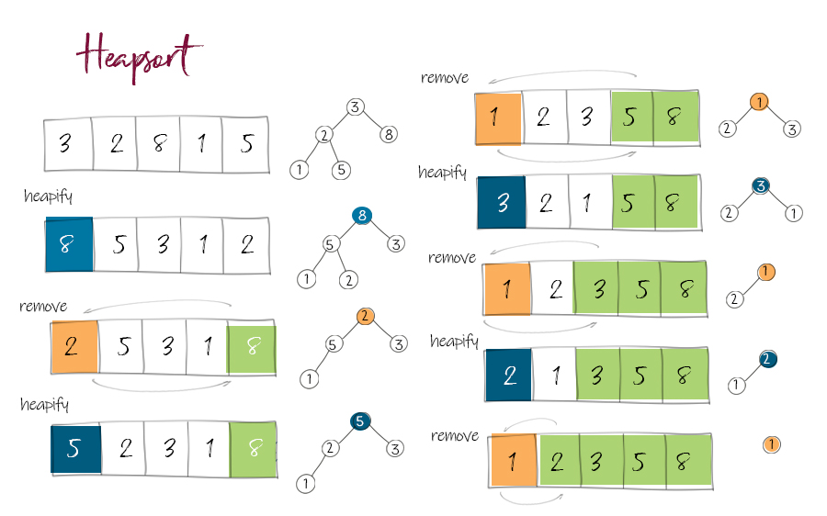
Applications
Heapsort- Sorting algorithm that converts an unsorted array to a Heap, and then repeatedly remove the root node

Slide 80
Heap Sort
int[] data = {23, 7, 45, 12, 89, 34, 56, 78, 90, 11, 67, 3}
23
1. Build a Max Heap from the unsorted array
Work through the array backwards, and swap a node with a child if its larger
7
45
12
89
34
56
78
90
11
67
3

Slide 81
Heap Sort
int[] data = {23, 7, 45, 12, 89, 34, 56, 78, 90, 11, 67, 3}
23
1. Build a Max Heap from the unsorted array
Work through the array backwards, and swap a node with a child if its larger
7
45
12
89
34
56
78
90
11
67
3

Slide 82
Heap Sort
int[] data = {23, 7, 45, 12, 89, 34, 56, 78, 90, 11, 67, 3}
23
1. Build a Max Heap from the unsorted array
Work through the array backwards, and swap a node with a child if its larger
7
45
12
89
34
56
78
90
11
67
3

Slide 83
Heap Sort
int[] data = {23, 7, 45, 12, 89, 34, 56, 78, 90, 11, 67, 3}
23
1. Build a Max Heap from the unsorted array
Work through the array backwards, and swap a node with a child if its larger
7
45
12
89
34
56
78
90
11
67
3

Slide 84
Heap Sort
int[] data = {23, 7, 45, 12, 89, 34, 56, 78, 90, 11, 67, 3}
23
1. Build a Max Heap from the unsorted array
Work through the array backwards, and swap a node with a child if its larger
7
45
12
89
34
56
78
90
11
67
3

Slide 85
Heap Sort
int[] data = {23, 7, 45, 12, 89, 34, 56, 78, 90, 11, 67, 3}
23
1. Build a Max Heap from the unsorted array
Work through the array backwards, and swap a node with a child if its larger
7
45
12
89
34
56
78
90
11
67
3

Slide 86
Heap Sort
int[] data = {23, 7, 45, 12, 89, 34, 56, 78, 90, 11, 67, 3}
23
1. Build a Max Heap from the unsorted array
Work through the array backwards, and swap a node with a child if its larger
7
45
12
89
34
56
78
90
11
67
3
3 is not larger than 34, so we are fine

Slide 87
Heap Sort
int[] data = {23, 7, 45, 12, 89, 34, 56, 78, 90, 11, 67, 3}
23
1. Build a Max Heap from the unsorted array
Work through the array backwards, and swap a node with a child if its larger
7
45
12
89
34
56
78
90
11
67
3
11 and 67 are not larger than 89, so continue

Slide 88
Heap Sort
int[] data = {23, 7, 45, 90, 89, 34, 56, 78, 12, 11, 67, 3}
23
1. Build a Max Heap from the unsorted array
Work through the array backwards, and swap a node with a child if its larger
7
45
90
89
34
56
78
12
11
67
3
90 is the larger child, so swap

Slide 89
Heap Sort
int[] data = {23, 7, 45, 90, 89, 34, 56, 78, 12, 11, 67, 3}
23
1. Build a Max Heap from the unsorted array
Work through the array backwards, and swap a node with a child if its larger
7
45
90
89
34
56
78
12
11
67
3
90 is the larger child, so swap
90 is larger than 78 and 12 so continue

Slide 90
Heap Sort
int[] data = {23, 7, 45, 90, 89, 34, 56, 78, 12, 11, 67, 3}
23
1. Build a Max Heap from the unsorted array
Work through the array backwards, and swap a node with a child if its larger
7
45
90
89
34
56
78
12
11
67
3

Slide 91
Heap Sort
int[] data = {23, 7, 45, 90, 89, 34, 56, 78, 12, 11, 67, 3}
23
1. Build a Max Heap from the unsorted array
Work through the array backwards, and swap a node with a child if its larger
7
45
90
89
34
56
78
12
11
67
3

Slide 92
Heap Sort
int[] data = {23, 7, 56, 90, 89, 34, 45, 78, 12, 11, 67, 3}
23
1. Build a Max Heap from the unsorted array
Work through the array backwards, and swap a node with a child if its larger
7
56
90
89
34
45
78
12
11
67
3

Slide 93
Heap Sort
int[] data = {23, 7, 56, 90, 89, 34, 45, 78, 12, 11, 67, 3}
23
1. Build a Max Heap from the unsorted array
Work through the array backwards, and swap a node with a child if its larger
7
56
90
89
34
45
78
12
11
67
3

Slide 94
Heap Sort
int[] data = {23, 90, 56, 7, 89, 34, 45, 78, 12, 11, 67, 3}
23
1. Build a Max Heap from the unsorted array
Work through the array backwards, and swap a node with a child if its larger
90
56
7
89
34
45
78
12
11
67
3
Heapify Down 7 !

Slide 95
Heap Sort
int[] data = {23, 90, 56, 7, 89, 34, 45, 78, 12, 11, 67, 3}
23
1. Build a Max Heap from the unsorted array
Work through the array backwards, and swap a node with a child if its larger
90
56
7
89
34
45
78
12
11
67
3
Heapify Down 7 !

Slide 96
Heap Sort
int[] data = {23, 90, 56, 78, 89, 34, 45, 7, 12, 11, 67, 3}
23
1. Build a Max Heap from the unsorted array
Work through the array backwards, and swap a node with a child if its larger
90
56
78
89
34
45
7
12
11
67
3
Heapify Down 7 !

Slide 97
Heap Sort
int[] data = {23, 90, 56, 78, 89, 34, 45, 7, 12, 11, 67, 3}
23
1. Build a Max Heap from the unsorted array
Work through the array backwards, and swap a node with a child if its larger
90
56
78
89
34
45
7
12
11
67
3
Heapify down 23 !

Slide 98
Heap Sort
int[] data = {23, 90, 56, 78, 89, 34, 45, 7, 12, 11, 67, 3}
23
1. Build a Max Heap from the unsorted array
Work through the array backwards, and swap a node with a child if its larger
90
56
78
89
34
45
7
12
11
67
3
Heapify down 23 !

Slide 99
Heap Sort
int[] data = {23, 90, 56, 78, 89, 34, 45, 7, 12, 11, 67, 3}
90
1. Build a Max Heap from the unsorted array
Work through the array backwards, and swap a node with a child if its larger
23
56
78
89
34
45
7
12
11
67
3
Heapify down 23 !

Slide 100
Heap Sort
int[] data = {90, 23, 56, 78, 89, 34, 45, 7, 12, 11, 67, 3}
90
1. Build a Max Heap from the unsorted array
Work through the array backwards, and swap a node with a child if its larger
23
56
78
89
34
45
7
12
11
67
3
Heapify down 23 !

Slide 101
Heap Sort
int[] data = {90, 23, 56, 78, 89, 34, 45, 7, 12, 11, 67, 3}
90
1. Build a Max Heap from the unsorted array
Work through the array backwards, and swap a node with a child if its larger
89
56
78
23
34
45
7
12
11
67
3
Heapify down 23 !

Slide 102
Heap Sort
int[] data = {90, 89, 56, 78, 23, 34, 45, 7, 12, 11, 67, 3}
90
1. Build a Max Heap from the unsorted array
Work through the array backwards, and swap a node with a child if its larger
89
56
78
23
34
45
7
12
11
67
3
Heapify down 23 !

Slide 103
Heap Sort
int[] data = {90, 89, 56, 78, 67, 34, 45, 7, 12, 11, 23, 3}
90
1. Build a Max Heap from the unsorted array
Work through the array backwards, and swap a node with a child if its larger
89
56
78
67
34
45
for index i data.size to 0 :
heapifyDown(data.size, i)
O(n)
O(logn)
7
12
11
23
3
Total for building heap: O(nlogn)
We now have a max heap

Slide 104
Heap Sort
int[] data = {90, 89, 56, 78, 67, 34, 45, 7, 12, 11, 23, 3}
90
1. Build a Max Heap from the unsorted array
Work through the array backwards, and swap a node with a child if its larger
89
56
78
67
34
45
2. Swap the root with last element, and heapify down the new root
7
12
11
23
3

Slide 105
Heap Sort
90
1. Build a Max Heap from the unsorted array
Work through the array backwards, and swap a node with a child if its larger
89
56
78
67
34
45
2. Swap the root with last element, and heapify down the new root
Repeat N amount of times
7
12
11
23
3
90 | 89 | 56 | 78 | 67 | 34 | 45 | 7 | 12 | 11 | 23 | 3

Slide 106
Heap Sort
3
1. Build a Max Heap from the unsorted array
Work through the array backwards, and swap a node with a child if its larger
89
56
78
67
34
45
2. Swap the root with last element, and heapify down the new root
Repeat N amount of times
7
12
11
23
90
Heapify Down 3
3 | 89 | 56 | 78 | 67 | 34 | 45 | 7 | 12 | 11 | 23 | 90

Slide 107
Heap Sort
89
1. Build a Max Heap from the unsorted array
Work through the array backwards, and swap a node with a child if its larger
78
56
12
67
34
45
2. Swap the root with last element, and heapify down the new root
Repeat N amount of times
7
3
11
23
90
We have one element in the correct spot. Now repeat N times (N = heap size)
89 | 78 | 56 | 12 | 67 | 34 | 45 | 7 | 3 | 11 | 23 | 90

Slide 108
Heap Sort
89
1. Build a Max Heap from the unsorted array
Work through the array backwards, and swap a node with a child if its larger
78
56
12
67
34
45
2. Swap the root with last element, and heapify down the new root
Repeat N amount of times
7
3
11
23
90
We don’t want to “shrink” our array, but we need to change the bounds during Heapify Down
89 | 78 | 56 | 12 | 67 | 34 | 45 | 7 | 3 | 11 | 23 | 90

Slide 109
Heap Sort
89
1. Build a Max Heap from the unsorted array
Work through the array backwards, and swap a node with a child if its larger
78
56
12
67
34
45
2. Swap the root with last element, and heapify down the new root
Repeat N amount of times
7
3
11
23
90
New bounds for Heapify Down
89 | 78 | 56 | 12 | 67 | 34 | 45 | 7 | 3 | 11 | 23 | 90

Slide 110
Heap Sort
23
1. Build a Max Heap from the unsorted array
Work through the array backwards, and swap a node with a child if its larger
78
56
12
67
34
45
2. Swap the root with last element, and heapify down the new root
Repeat N amount of times
7
3
11
89
90
New bounds for Heapify Down
23 | 78 | 56 | 12 | 67 | 34 | 45 | 7 | 3 | 11 | 89 | 90

Slide 111
Heap Sort
23
1. Build a Max Heap from the unsorted array
Work through the array backwards, and swap a node with a child if its larger
78
56
12
67
34
45
2. Swap the root with last element, and heapify down the new root
Repeat N amount of times
7
3
11
89
90
Heapify Down 23
23 | 78 | 56 | 12 | 67 | 34 | 45 | 7 | 3 | 11 | 89 | 90

Slide 112
Heap Sort
78
1. Build a Max Heap from the unsorted array
Work through the array backwards, and swap a node with a child if its larger
67
56
12
23
34
45
2. Swap the root with last element, and heapify down the new root
Repeat N amount of times
7
3
11
89
90
Heapify Down 23
78 | 67 | 56 | 12 | 23 | 34 | 45 | 7 | 3 | 11 | 89 | 90

Slide 113
Heap Sort
11
1. Build a Max Heap from the unsorted array
Work through the array backwards, and swap a node with a child if its larger
67
56
12
23
34
45
2. Swap the root with last element, and heapify down the new root
Repeat N amount of times
7
3
78
89
90
Heapify Down 11
11 | 67 | 56 | 12 | 23 | 34 | 45 | 7 | 3 | 78 | 89 | 90

Slide 114
Heap Sort
67
1. Build a Max Heap from the unsorted array
Work through the array backwards, and swap a node with a child if its larger
23
56
12
11
34
45
2. Swap the root with last element, and heapify down the new root
Repeat N amount of times
7
3
78
89
90
Heapify Down 11
67 | 23 | 56 | 12 | 11 | 34 | 45 | 7 | 3 | 78 | 89 | 90

Slide 115
Heap Sort
3
1. Build a Max Heap from the unsorted array
Work through the array backwards, and swap a node with a child if its larger
23
56
12
11
34
45
2. Swap the root with last element, and heapify down the new root
Repeat N amount of times
7
67
78
89
90
Heapify Down 3
3 | 23 | 56 | 12 | 11 | 34 | 45 | 7 | 67 | 78 | 89 | 90

Slide 116
Heap Sort
56
1. Build a Max Heap from the unsorted array
Work through the array backwards, and swap a node with a child if its larger
23
45
12
11
34
3
2. Swap the root with last element, and heapify down the new root
Repeat N amount of times
7
67
78
89
90
Heapify Down 3
56 | 23 | 45 | 12 | 11 | 34 | 3 | 7 | 67 | 78 | 89 | 90

Slide 117
Heap Sort
3
1. Build a Max Heap from the unsorted array
Work through the array backwards, and swap a node with a child if its larger
7
11
12
23
34
45
2. Swap the root with last element, and heapify down the new root
Repeat N amount of times
56
67
78
89
90
(Fast forward…)
3 | 7 | 11 | 12 | 23 | 34 | 45 | 56 | 67 | 78 | 89 | 90

Slide 118

Heap Sort
3
1. Build a Max Heap from the unsorted array
Work through the array backwards, and swap a node with a child if its larger
7
11
12
23
34
45
2. Swap the root with last element, and heapify down the new root
O(log n)
Repeat N amount of times
O(n)
56
67
78
89
90
“Sorting” step = O(nlogn)
3 | 7 | 11 | 12 | 23 | 34 | 45 | 56 | 67 | 78 | 89 | 90

Slide 119






Heap Sort
3
1. Build a Max Heap from the unsorted array
Work through the array backwards, and swap a node with a child if its larger
7
11
12
23
34
45
2. Swap the root with last element, and heapify down the new root
Repeat N amount of times
56
67
78
89
90
O(nlogn)
O(nlogn)
3 | 7 | 11 | 12 | 23 | 34 | 45 | 56 | 67 | 78 | 89 | 90

Slide 120
Heap Sort
https://www.youtube.com/watch?v=iXAjiDQbPSw

Slide 121
Lab 6

