Slide 1

CSCI 232: Data Structures and Algorithms
Huffman Coding
Reese Pearsall
Spring 2025
https://www.cs.montana.edu/pearsall/classes/spring2025/232/main.html

Slide 2
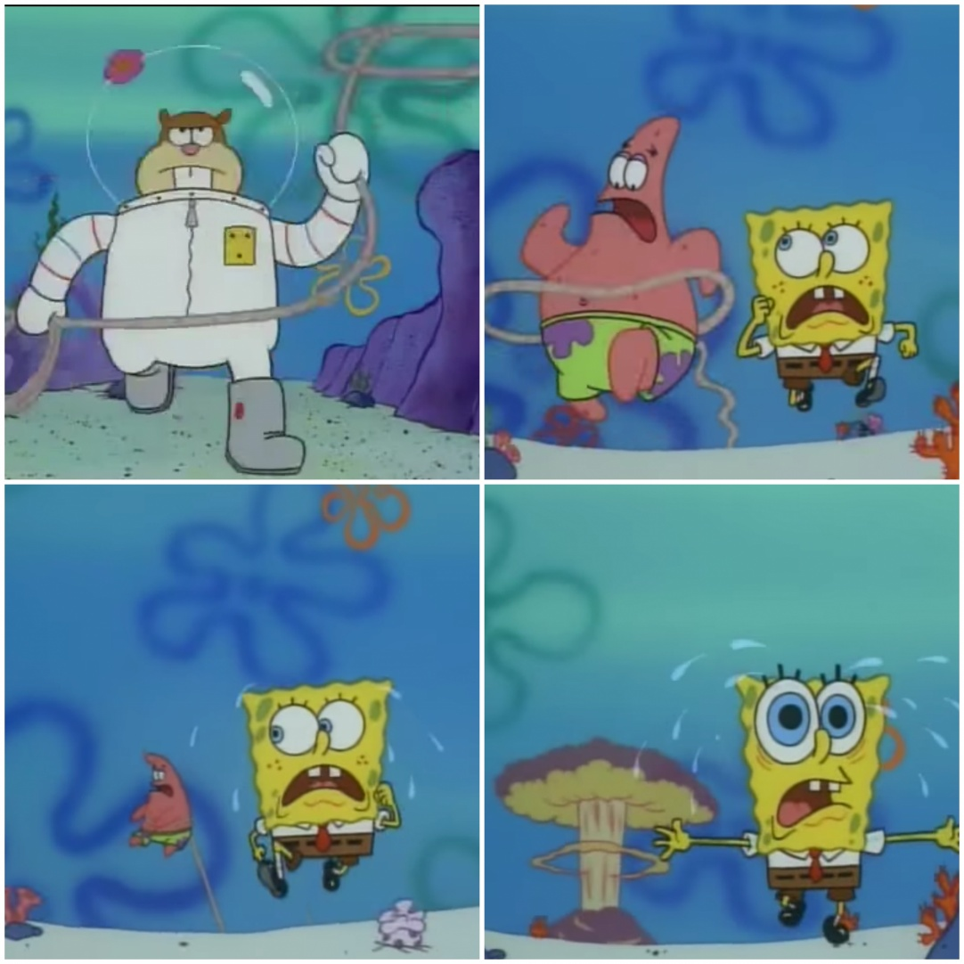
Announcements
poll()
Lab 6 due Friday at 11:59 PM
Program 2 due Sunday at 11:59 PM
heap
smallest node
other nodes
other nodes
other nodes

Slide 3

Strings are encoded using a specific format
Convert characters to zeros and ones (binary)
Example: UTF
Character | UTF Encoding
a | 01100001
b | 01100010
c | 01100011
d | 01100100
e | 01100101
… | ….
String: “hello”
UTF Encoding:
01101000 01100101 01101100 01101100 01101111
Each character has an 8-bit binary representation

Slide 4

Strings are encoded using a specific format
Convert characters to zeros and ones (binary)
Example: UTF
Character | UTF Encoding
a | 01100001
b | 01100010
c | 01100011
d | 01100100
e | 01100101
… | ….
String: “hello”
UTF Encoding:
01101000 01100101 01101100 01101100 01101111
Each character has an 8-bit binary representation

Slide 5
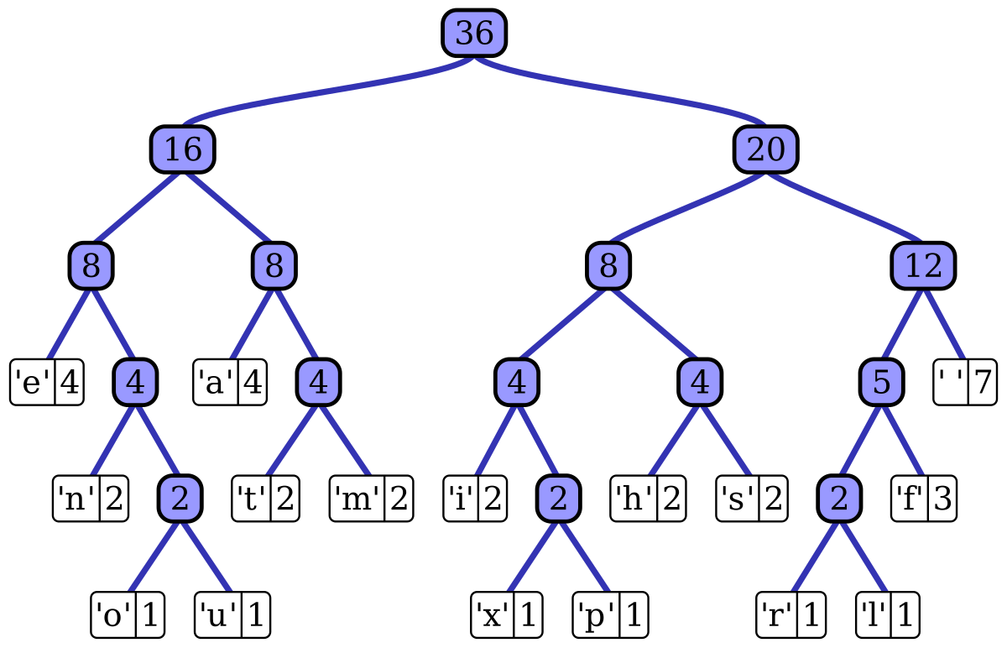
Huffman Coding is a way to encode a string using a binary tree
Internal Nodes are the sum of the children’s frequencies
Leaf nodes are characters with their frequency
When the Huffman tree is built, we can extract a binary encoding for each character

Slide 6
Huffman Coding
Step 1: Generate the frequencies of each character, and sort them from least to greatest

Slide 7
Huffman Coding
Step 1: Generate the frequencies of each character, and sort them from least to greatest
“hello world!”
Step 2: Insert them into a PriorityQueue
char
freq
 | 1
! | 1
d | 1
e | 1
h | 1
r | 1
w | 1
o | 2
l | 3

Slide 8
Huffman Coding
Step 3. Build subtrees, and merge trees into Huffman Tree
Create an internal node with the two nodes at front of queue,
Place new internal node in queue
PriorityQueue<HuffmanNode>
1
!
1
d
1
e
1
h
1
r
1
w
1
o
2
l
3

Slide 9
Huffman Coding
Step 3. Build subtrees, and merge trees into Huffman Tree
Create an internal node with the two nodes at front of queue,
Place new internal node in queue
2
1
!
1
PriorityQueue<HuffmanNode>
d
1
e
1
h
1
r
1
w
1
o
2
l
3

Slide 10
Huffman Coding
Step 3. Build subtrees, and merge trees into Huffman Tree
Create an internal node with the two nodes at front of queue,
Place new internal node in queue
2
1
!
1
PriorityQueue<HuffmanNode>
d
1
e
1
h
1
r
1
w
1
2
o
2
l
3

Slide 11
Huffman Coding
Step 3. Build subtrees, and merge trees into Huffman Tree
Create an internal node with the two nodes at front of queue,
Place new internal node in queue
Repeat until all nodes are inserted!
2
1
!
1
PriorityQueue<HuffmanNode>
d
1
e
1
h
1
r
1
w
1
2
o
2
l
3

Slide 12
Huffman Coding
Step 3. Build subtrees, and merge trees into Huffman Tree
Create an internal node with the two nodes at front of queue,
Place new internal node in queue
2
2
d
1
e
1
1
!
1
PriorityQueue<HuffmanNode>
h
1
r
1
w
1
2
o
2
l
3

Slide 13
Huffman Coding
Step 3. Build subtrees, and merge trees into Huffman Tree
Create an internal node with the two nodes at front of queue,
Place new internal node in queue
2
2
d
1
e
1
1
!
1
PriorityQueue<HuffmanNode>
h
1
r
1
w
1
o
2
2
l
3

Slide 14


Huffman Coding
Step 3. Build subtrees, and merge trees into Huffman Tree
Create an internal node with the two nodes at front of queue,
Place new internal node in queue
These nodes have frequencies of two, but I am adding a way to distinguish them in the queue (.1, .2, .3)
2.2
2.1
d
1
e
1
1
!
1
PriorityQueue<HuffmanNode>
h
1
r
1
w
1
o
2
2.1
2.2
l
3

Slide 15
Huffman Coding
Step 3. Build subtrees, and merge trees into Huffman Tree
Create an internal node with the two nodes at front of queue,
Place new internal node in queue
2.2
2.1
d
1
e
1
1
!
1
PriorityQueue<HuffmanNode>
h
1
r
1
w
1
o
2
2.1
2.2
l
3

Slide 16
Huffman Coding
Step 3. Build subtrees, and merge trees into Huffman Tree
Create an internal node with the two nodes at front of queue,
Place new internal node in queue
2.2
2.3
2.1
d
1
e
1
h
1
r
1
1
!
1
PriorityQueue<HuffmanNode>
w
1
o
2
2.1
2.2
l
3

Slide 17
Huffman Coding
Step 3. Build subtrees, and merge trees into Huffman Tree
Create an internal node with the two nodes at front of queue,
Place new internal node in queue
2.2
2.3
2.1
d
1
e
1
h
1
r
1
1
!
1
PriorityQueue<HuffmanNode>
w
1
o
2
2.1
2.2
l
3

Slide 18
Huffman Coding
Step 3. Build subtrees, and merge trees into Huffman Tree
Create an internal node with the two nodes at front of queue,
Place new internal node in queue
Because it is a priority queue, it is not necessary FIFO…
2.2
2.3
2.1
d
1
e
1
h
1
r
1
1
!
1
PriorityQueue<HuffmanNode>
w
1
2.3
o
2
2.1
2.2
l
3

Slide 19
Huffman Coding
Step 3. Build subtrees, and merge trees into Huffman Tree
Create an internal node with the two nodes at front of queue,
Place new internal node in queue
2.2
2.3
2.1
d
1
e
1
h
1
r
1
1
!
1
PriorityQueue<HuffmanNode>
w
1
2.3
o
2
2.1
2.2
l
3

Slide 20
Huffman Coding
Step 3. Build subtrees, and merge trees into Huffman Tree
Create an internal node with the two nodes at front of queue,
Place new internal node in queue
3
2.2
w
1
2.3
2.1
d
1
e
1
h
1
r
1
1
!
1
PriorityQueue<HuffmanNode>
o
2
2.1
2.2
l
3

Slide 21
Huffman Coding
Step 3. Build subtrees, and merge trees into Huffman Tree
Create an internal node with the two nodes at front of queue,
Place new internal node in queue
3
The frequencies of the internal node is the sum of the frequencies of its children
2.2
w
1
2
2.1
d
1
e
1
h
1
r
1
1
!
1
PriorityQueue<HuffmanNode>
o
2
2.1
2.2
l
3

Slide 22
Huffman Coding
Step 3. Build subtrees, and merge trees into Huffman Tree
Create an internal node with the two nodes at front of queue,
Place new internal node in queue
3
2.2
w
1
2
2.1
d
1
e
1
h
1
r
1
1
!
1
PriorityQueue<HuffmanNode>
2.1
o
2
2.2
3
l
3

Slide 23
Huffman Coding
Step 3. Build subtrees, and merge trees into Huffman Tree
Create an internal node with the two nodes at front of queue,
Place new internal node in queue
2.2
3
4
d
1
e
1
w
1
2
2
o
2
h
1
r
1
1
!
1
PriorityQueue<HuffmanNode>
2.2
3
l
3

Slide 24
Huffman Coding
Step 3. Build subtrees, and merge trees into Huffman Tree
Create an internal node with the two nodes at front of queue,
Place new internal node in queue
2.2
3
4
d
1
e
1
w
1
2
2
o
2
h
1
r
1
1
!
1
PriorityQueue<HuffmanNode>
2.2
3
l
3
4

Slide 25
Huffman Coding
Step 3. Build subtrees, and merge trees into Huffman Tree
5
Create an internal node with the two nodes at front of queue,
Place new internal node in queue
2
3
4
d
1
e
1
w
1
2
2
o
2
h
1
r
1
1
!
1
PriorityQueue<HuffmanNode>
l
3
4

Slide 26
Huffman Coding
Step 3. Build subtrees, and merge trees into Huffman Tree
5
Create an internal node with the two nodes at front of queue,
Place new internal node in queue
2
3
4
d
1
e
1
w
1
2
2
o
2
h
1
r
1
1
!
1
PriorityQueue<HuffmanNode>
l
3
4
5

Slide 27
Huffman Coding
Step 3. Build subtrees, and merge trees into Huffman Tree
5
7
2
3
l
3
4
d
1
e
1
w
1
2
2
o
2
h
1
r
1
1
!
1
PriorityQueue<HuffmanNode>
5

Slide 28
Huffman Coding
Step 3. Build subtrees, and merge trees into Huffman Tree
5
7
2
3
l
3
4
d
1
e
1
w
1
2
2
o
2
h
1
r
1
1
!
1
PriorityQueue<HuffmanNode>
5
7

Slide 29
Huffman Coding
12
5
7
2
3
l
3
4
12 is still added to the queue, but when there is only one node left, we know there is no more merging to be done!
d
1
e
1
w
1
2
2
o
2
PriorityQueue<HuffmanNode>
h
1
r
1
1
!
1
12

Slide 30

Huffman Coding
12
5
7
2
3
l
3
4
d
1
e
1
w
1
2
2
o
2
h
1
r
1
1
!
1

Slide 31
Huffman Coding
12
Final Step: Generate codes
Visit all leaf nodes and keep track of path
If we ever go left, add 0 to the code
If we ever go right, add 1 to the code
0
1
5
7
0
1
0
1
2
3
l
4
0
1
0
1
0
1
d
e
w
2
2
o
0
1
0
1
h
r
!

Slide 32
Huffman Coding
12
Final Step: Generate codes
Visit all leaf nodes and keep track of path
If we ever go left, add 0 to the code
If we ever go right, add 1 to the code
0
1
5
7
0
1
0
1
Character | Code
d | 000
2
3
l
4
0
1
0
1
0
1
d
e
w
2
2
o
0
1
0
1
h
r
!

Slide 33
Huffman Coding
12
Final Step: Generate codes
Visit all leaf nodes and keep track of path
If we ever go left, add 0 to the code
If we ever go right, add 1 to the code
0
1
5
7
0
1
0
1
Character | Code
d | 000
e | 001
2
3
l
4
0
1
0
1
0
1
d
e
w
2
2
o
0
1
0
1
h
r
!

Slide 34
Huffman Coding
12
Final Step: Generate codes
Visit all leaf nodes and keep track of path
If we ever go left, add 0 to the code
If we ever go right, add 1 to the code
0
1
5
7
0
1
0
1
Character | Code
d | 000
e | 001
w | 010
2
3
l
4
0
1
0
1
0
1
d
e
w
2
2
o
0
1
0
1
h
r
!

Slide 35
Huffman Coding
12
Final Step: Generate codes
Visit all leaf nodes and keep track of path
If we ever go left, add 0 to the code
If we ever go right, add 1 to the code
0
1
5
7
0
1
0
1
Character | Code
d | 000
e | 001
w | 010
h | 0110
2
3
l
4
0
1
0
1
0
1
d
e
w
2
2
o
0
1
0
1
h
r
!

Slide 36
Huffman Coding
12
Final Step: Generate codes
Visit all leaf nodes and keep track of path
If we ever go left, add 0 to the code
If we ever go right, add 1 to the code
0
1
5
7
0
1
0
1
Character | Code
d | 000
e | 001
w | 010
h | 0110
r | 0111
2
3
l
4
0
1
0
1
0
1
d
e
w
2
2
o
0
1
0
1
h
r
!

Slide 37
Huffman Coding
12
Final Step: Generate codes
Visit all leaf nodes and keep track of path
If we ever go left, add 0 to the code
If we ever go right, add 1 to the code
0
1
5
7
0
1
0
1
Character | Code
d | 000
e | 001
w | 010
h | 0110
r | 0111
l | 10
2
3
l
4
0
1
0
1
0
1
d
e
w
2
2
o
0
1
0
1
h
r
!

Slide 38
Huffman Coding
12
Final Step: Generate codes
Visit all leaf nodes and keep track of path
If we ever go left, add 0 to the code
If we ever go right, add 1 to the code
0
1
5
7
0
1
0
1
Character | Code
d | 000
e | 001
w | 010
h | 0110
r | 0111
l | 10
(space character) | 1100
2
3
l
4
0
1
0
1
0
1
d
e
w
2
2
o
0
1
0
1
h
r
!

Slide 39
Huffman Coding
12
Final Step: Generate codes
Visit all leaf nodes and keep track of path
If we ever go left, add 0 to the code
If we ever go right, add 1 to the code
0
1
5
7
0
1
0
1
Character | Code
d | 000
e | 001
w | 010
h | 0110
r | 0111
l | 10
(space character) | 1100
! | 1101
2
3
l
4
0
1
0
1
0
1
d
e
w
2
2
o
0
1
0
1
h
r
!

Slide 40
Huffman Coding
12
Final Step: Generate codes
Visit all leaf nodes and keep track of path
If we ever go left, add 0 to the code
If we ever go right, add 1 to the code
0
1
5
7
0
1
0
1
Character | Code
d | 000
e | 001
w | 010
h | 0110
r | 0111
l | 10
(space character) | 1100
! | 1101
o | 111
2
3
l
4
0
1
0
1
0
1
d
e
w
2
2
o
0
1
0
1
h
r
!

Slide 41
Huffman Coding
12
0
1
We now have encodings for each character!
5
7
Character | Code
d | 000
e | 001
w | 010
h | 0110
r | 0111
l | 10
(space character) | 1100
! | 1101
o | 111
0
1
0
1
2
3
l
4
0
1
0
1
0
1
d
e
w
2
2
o
0
1
0
1
h
r
!

Slide 42
Huffman Coding
We now have encodings for each character!
Character | Code
d | 000
e | 001
w | 010
h | 0110
r | 0111
l | 10
(space character) | 1100
! | 1101
o | 111

Slide 43
Huffman Coding
We now have encodings for each character!
Character | Code
d | 000
e | 001
w | 010
h | 0110
r | 0111
l | 10
(space character) | 1100
! | 1101
o | 111
String: “hello world!”
Encoding w/ Huffman codes:
0110 001 10 10 111 1100 010 111 0111 10 000 1101

Slide 44
Huffman Coding
We now have encodings for each character!
Character | Code
d | 000
e | 001
w | 010
h | 0110
r | 0111
l | 10
(space character) | 1100
! | 1101
o | 111
String: “hello world!”
Encoding w/ Huffman codes:
0110 001 10 10 111 1100 010 111 0111 10 000 1101

Slide 45
Huffman Coding
We now have encodings for each character!
Character | Code
d | 000
e | 001
w | 010
h | 0110
r | 0111
l | 10
(space character) | 1100
! | 1101
o | 111
String: “hello world!”
Encoding w/ Huffman codes:
0110 001 10 10 111 1100 010 111 0111 10 000 1101
Let’s code !!

Slide 46
Huffman Coding
We now have encodings for each character!
Character | Code
d | 000
e | 001
w | 010
h | 0110
r | 0111
l | 10
(space character) | 1100
! | 1101
o | 111
String: “hello world!”
Encoding w/ Huffman codes:
0110 001 10 10 111 1100 010 111 0111 10 000 1101
Message size: 37 bits

Slide 47
Huffman Coding
We now have encodings for each character!
Character | Code
d | 000
e | 001
w | 010
h | 0110
r | 0111
l | 10
(space character) | 1100
! | 1101
o | 111
String: “hello world!”
Encoding w/ Huffman codes:
0110 001 10 10 111 1100 010 111 0111 10 000 1101
Message size: 37 bits
Encoding w/ UTF:
01101000 01100101 01101100 01101100 01101111 00100000 01110111 01101111 01110010 01101100 01100100
Message size: 88 bits

Slide 48
Huffman Coding
We now have encodings for each character!
Huffman Coding is a compression algorithm
Character | Code
d | 000
e | 001
w | 010
h | 0111
r | 0111
l | 10
(space character) | 1100
! | 1101
o | 111
String: “hello world!”
Encoding w/ Huffman codes:
0110 001 10 10 111 1100 010 111 0111 10 000 1101
Message size: 37 bits
Encoding w/ UTF:
01101000 01100101 01101100 01101100 01101111 00100000 01110111 01101111 01110010 01101100 01100100
Message size: 88 bits

Slide 49

Huffman Coding is a way to encode a string using a binary tree
It also acts as a lossless compression algorithm for data, by creating smaller encodings for frequently used characters
When we compress files with formats such as .zip, .7z, .rar , Huffman Coding is used to compress the data!
It is also used for image, video, audio file compression, and even fax machines !
Huffman Coding Algorithm
Put nodes in PQ O(n)
Extract two smallest nodes and merge
(repeated n times)
3. Iterate through to all leaf nodes and get encoding
O(nlogn)
O(n)
Total Running time: O(nlogn) where n = # of characters

Slide 50
Huffman Coding Visualization
https://cmps-people.ok.ubc.ca/ylucet/DS/Huffman.html

