Slide 1

CSCI 232: Data Structures and Algorithms
Graphs (Representation)
Reese Pearsall
Spring 2025
https://www.cs.montana.edu/pearsall/classes/spring2025/232/main.html

Slide 2
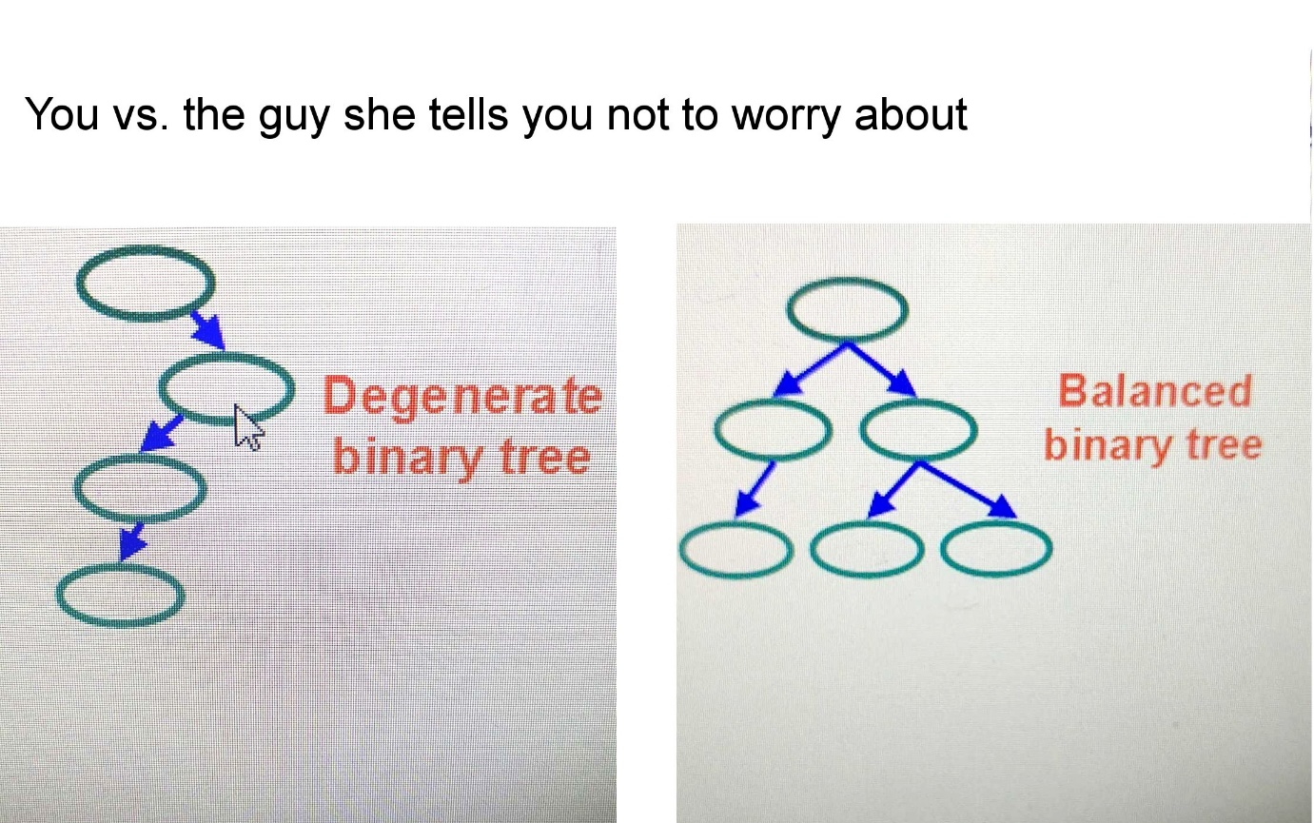
Announcements
Lab 7 due on Friday
→ Really easy

Slide 3
Registration

Slide 4

If you have not already:
CSCI 246 – Discrete Structures
CSCI 112- Programming in C
MART 145- Web Design
Next Classes (You can register for these anytime in the next couple years):
CSCI 366- Computer Systems
ESOF 322 – Software Engineering
CSCI 305 – Concepts of Programming Languages
CSCI 338 – Computer Science Theory
Other Classes that may be of interest
CSCI 252- Intro to Data Science
CSCI 331- Web Development
CSCI 351 – System Administration
CSCI 440 – Database Systems
CSCI 443 – User Interface Design
CSCI 451 – Computational Biology
CSCI 446 – Artificial Intelligence*
CSCI 460 – Operating Systems
CSCI 466 – Networks
CSCI 476 – Computer Security

Slide 5
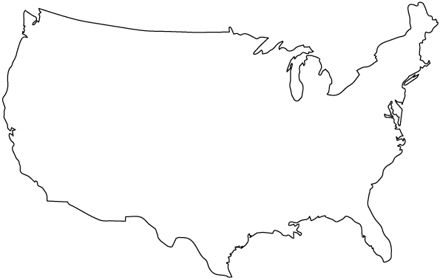
How could we visualize: The US Road Network?

Slide 6
How could we visualize: The US Road Network?
Bozeman
Pittsburgh
San Francisco
St. Louis
Dallas
How to represent cities?

Slide 7
How could we visualize: The US Road Network?
Bozeman
Pittsburgh
San Francisco
St. Louis
Dallas
How to represent cities?

Slide 8
How could we visualize: The US Road Network?
Bozeman
Pittsburgh
San Francisco
St. Louis
Dallas
How to represent roads?

Slide 9
How could we visualize: The US Road Network?
Bozeman
Pittsburgh
San Francisco
St. Louis
Dallas
How to represent roads?

Slide 10
How could we visualize: The US Road Network?
Bozeman
1846 miles
Pittsburgh
San Francisco
St. Louis
Dallas
How to represent roads?

Slide 11







How could we visualize: Connections in a Social Media Network?

Slide 12
How could we visualize: Connections in a Social Media Network?

Slide 13
How could we visualize: Connections in a Social Media Network?
Red Lines = “Friends with”

Slide 14


How could we visualize: Restaurants and Potential Customers?

Slide 15
How could we visualize: Restaurants and Potential Customers?

Slide 16
How could we visualize: Restaurants and Potential Customers?
Red Lines = “Would dine at”

Slide 17
Graphs
Vertices (or Nodes)

Slide 18
Graphs
Vertices (or Nodes)
Edges

Slide 19

Graphs
Vertices (or Nodes)
Edges
$$G=(V,E)$$

Slide 20
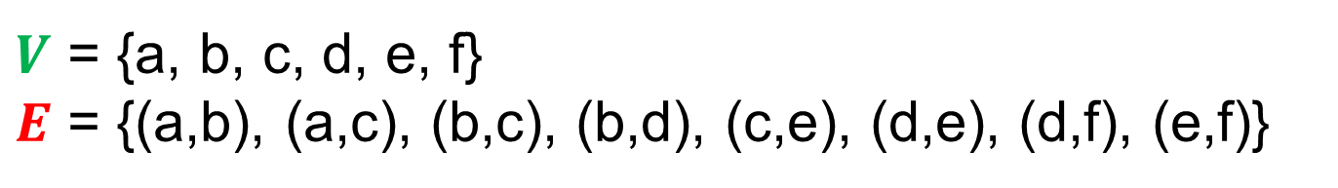
Graphs
b
d
a
Vertices (or Nodes)
Edges
f
$$G=(V,E)$$
c
e
$V$ = {a, b, c, d, e, f}
$E$ = {(a,b), (a,c), (b,c), (b,d), (c,e), (d,e), (d,f), (e,f)}

Slide 21
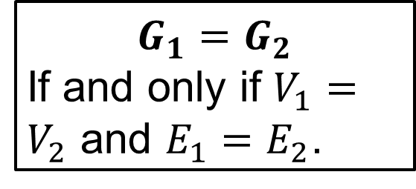
Graphs
b
d
a
Vertices (or Nodes)
Edges
f
$$G=(V,E)$$
c
e
$$G_{1}=G_{2}$$
If and only if $V_{1}=V_{2}$ and $E_{1}=E_{2}$.
$V$ = {a, b, c, d, e, f}
$E$ = {(a,b), (a,c), (b,c), (b,d), (c,e), (d,e), (d,f), (e,f)}

Slide 22
Graphs
b
d
a
Vertices (or Nodes)
Edges
f
$$G=(V,E)$$
c
e
$$G_{1}=G_{2}$$
If and only if $V_{1}=V_{2}$ and $E_{1}=E_{2}$.
$V$ = {a, b, c, d, e, f}
$E$ = {(a,b), (a,c), (b,c), (b,d), (c,e), (d,e), (d,f), (e,f)}
d
b
f
a
✓
Same graph?
e
c

Slide 23
Graphs
b
d
a
Vertices (or Nodes)
Edges
f
$$G=(V,E)$$
c
e
$$G_{1}=G_{2}$$
If and only if $V_{1}=V_{2}$ and $E_{1}=E_{2}$.
$V$ = {a, b, c, d, e, f}
$E$ = {(a,b), (a,c), (b,c), (b,d), (c,e), (d,e), (d,f), (e,f)}
d
b
f
a
✓
Same graph?
e
c

Slide 24
Graphs
b
d
a
Vertices (or Nodes)
Edges
f
$$G=(V,E)$$
c
e
$$G_{1}=G_{2}$$
If and only if $V_{1}=V_{2}$ and $E_{1}=E_{2}$.
$V$ = {a, b, c, d, e, f}
$E$ = {(a,b), (a,c), (b,c), (b,d), (c,e), (d,e), (d,f), (e,f)}
d
b
a
f
Same graph?
e
c

Slide 25
Graphs
b
d
a
Vertices (or Nodes)
Edges
f
$$G=(V,E)$$
c
e
$$G_{1}=G_{2}$$
If and only if $V_{1}=V_{2}$ and $E_{1}=E_{2}$.
$V$ = {a, b, c, d, e, f}
$E$ = {(a,b), (a,c), (b,c), (b,d), (c,e), (d,e), (d,f), (e,f)}
d
b
a
f
✓
Same graph?
e
c

Slide 26
Graphs
b
d
a
Vertices (or Nodes)
Edges
f
$$G=(V,E)$$
c
e
$$G_{1}=G_{2}$$
If and only if $V_{1}=V_{2}$ and $E_{1}=E_{2}$.
$V$ = {a, b, c, d, e, f}
$E$ = {(a,b), (a,c), (b,c), (b,d), (c,e), (d,e), (d,f), (e,f)}
b
d
a
f
Same graph?
e
c

Slide 27
Graphs
b
d
a
Vertices (or Nodes)
Edges
f
$$G=(V,E)$$
c
e
$$G_{1}=G_{2}$$
If and only if $V_{1}=V_{2}$ and $E_{1}=E_{2}$.
$V$ = {a, b, c, d, e, f}
$E$ = {(a,b), (a,c), (b,c), (b,d), (c,e), (d,e), (d,f), (e,f)}
b
d
a
✗
f
Same graph?
e
c

Slide 28
Graphs
Vertices (or Nodes)
Edges
$$G=(V,E)$$
Edges can be directed…

Slide 29
Graphs
Vertices (or Nodes)
Edges
$$G=(V,E)$$
Edges can be directed or undirected.

Slide 30
Graphs
5
10
1
Vertices (or Nodes)
Edges
$$G=(V,E)$$
7
14
3
8
6
Edges can be directed or undirected.
Edges can have weights

Slide 31
Graphs
5
10
1
Vertices (or Nodes)
Edges
$$G=(V,E)$$
7
14
3
8
6
Edges can be directed or undirected.
Edges can have weights
Simple graph = At most one edge between pair of vertices and no edges that start and end at same vertex.

Slide 32
Graphs
X
5
10
1
Vertices (or Nodes)
Edges
$$G=(V,E)$$
7
14
3
8
6
Edges can be directed or undirected.
Edges can have weights
Simple graph = At most one edge between pair of vertices and no edges that start and end at same vertex.

Slide 33
Graphs
5
X
10
1
Vertices (or Nodes)
Edges
$$G=(V,E)$$
7
14
3
8
6
Edges can be directed or undirected.
Edges can have weights
Simple graph = At most one edge between pair of vertices and no edges that start and end at same vertex.

Slide 34
Graphs
b
5
d
10
1
a
Vertices (or Nodes)
Edges
f
$$G=(V,E)$$
7
14
3
c
8
e
6
Edges can be directed or undirected.
Edges can have weights
Simple graph = At most one edge between pair of vertices and no edges that start and end at same vertex.
Path = Sequence of vertices connected by edges without loops.

Slide 35


Graphs
b
5
d
10
1
a
Vertices (or Nodes)
Edges
f
$$G=(V,E)$$
7
14
3
c
8
e
6
Edges can be directed or undirected.
Edges can have weights
Simple graph = At most one edge between pair of vertices and no edges that start and end at same vertex.
Path = Sequence of vertices connected by edges without loops.
✓
a,c,e,f
“cost” of path = 17

Slide 36
Graphs
b
5
d
10
1
a
Vertices (or Nodes)
Edges
f
$$G=(V,E)$$
7
14
3
c
8
e
6
Edges can be directed or undirected.
Edges can have weights
Simple graph = At most one edge between pair of vertices and no edges that start and end at same vertex.
Path = Sequence of vertices connected by edges without loops.
✓
b,d

Slide 37
Graphs
b
5
d
10
1
a
Vertices (or Nodes)
Edges
f
$$G=(V,E)$$
7
14
3
c
8
e
6
Edges can be directed or undirected.
Edges can have weights
Simple graph = At most one edge between pair of vertices and no edges that start and end at same vertex.
Path = Sequence of vertices connected by edges without loops.
a,c,d,f

Slide 38





Graphs
b
5
d
10
1
a
Vertices (or Nodes)
Edges
f
$$G=(V,E)$$
7
14
3
c
8
e
6
Edges can be directed or undirected.
Edges can have weights
Simple graph = At most one edge between pair of vertices and no edges that start and end at same vertex.
Path = Sequence of vertices connected by edges without loops.
a,c,d,f

Slide 39
Graphs
b
5
d
10
1
a
Vertices (or Nodes)
Edges
f
$$G=(V,E)$$
7
14
3
c
8
e
6
Edges can be directed or undirected.
Edges can have weights
Simple graph = At most one edge between pair of vertices and no edges that start and end at same vertex.
Path = Sequence of vertices connected by edges without loops.
c,e,d,f,e

Slide 40




Graphs
b
5
d
10
1
a
Vertices (or Nodes)
Edges
f
$$G=(V,E)$$
7
14
3
c
8
e
6
Edges can be directed or undirected.
Edges can have weights
Simple graph = At most one edge between pair of vertices and no edges that start and end at same vertex.
Path = Sequence of vertices connected by edges without loops.
c,e,d,f,e

Slide 41
Graphs
b
5
d
10
1
a
Vertices (or Nodes)
Edges
f
$$G=(V,E)$$
7
14
3
c
8
e
6
Edges can be directed or undirected.
Edges can have weights
Simple graph = At most one edge between pair of vertices and no edges that start and end at same vertex.
Path = Sequence of vertices connected by edges without loops.
Cycle = Sequence of vertices connected by edge with loop(s).

Slide 42
Graphs
b
5
d
10
1
a
Vertices (or Nodes)
Edges
f
$$G=(V,E)$$
7
14
3
c
8
e
6
Edges can be directed or undirected.
Edges can have weights
Simple graph = At most one edge between pair of vertices and no edges that start and end at same vertex.
Path = Sequence of vertices connected by edges without loops.
Cycle = Sequence of vertices connected by edge with loop(s).
Connected Graph = Graph that has a path between every vertex pair.

Slide 43
Graphs
Two Connected Components
Vertices (or Nodes)
Edges
$$G=(V,E)$$
Edges can be directed or undirected.
Edges can have weights
Simple graph = At most one edge between pair of vertices and no edges that start and end at same vertex.
Path = Sequence of vertices connected by edges without loops.
Cycle = Sequence of vertices connected by edge with loop(s).
Connected Graph = Graph that has a path between every vertex pair.

Slide 44
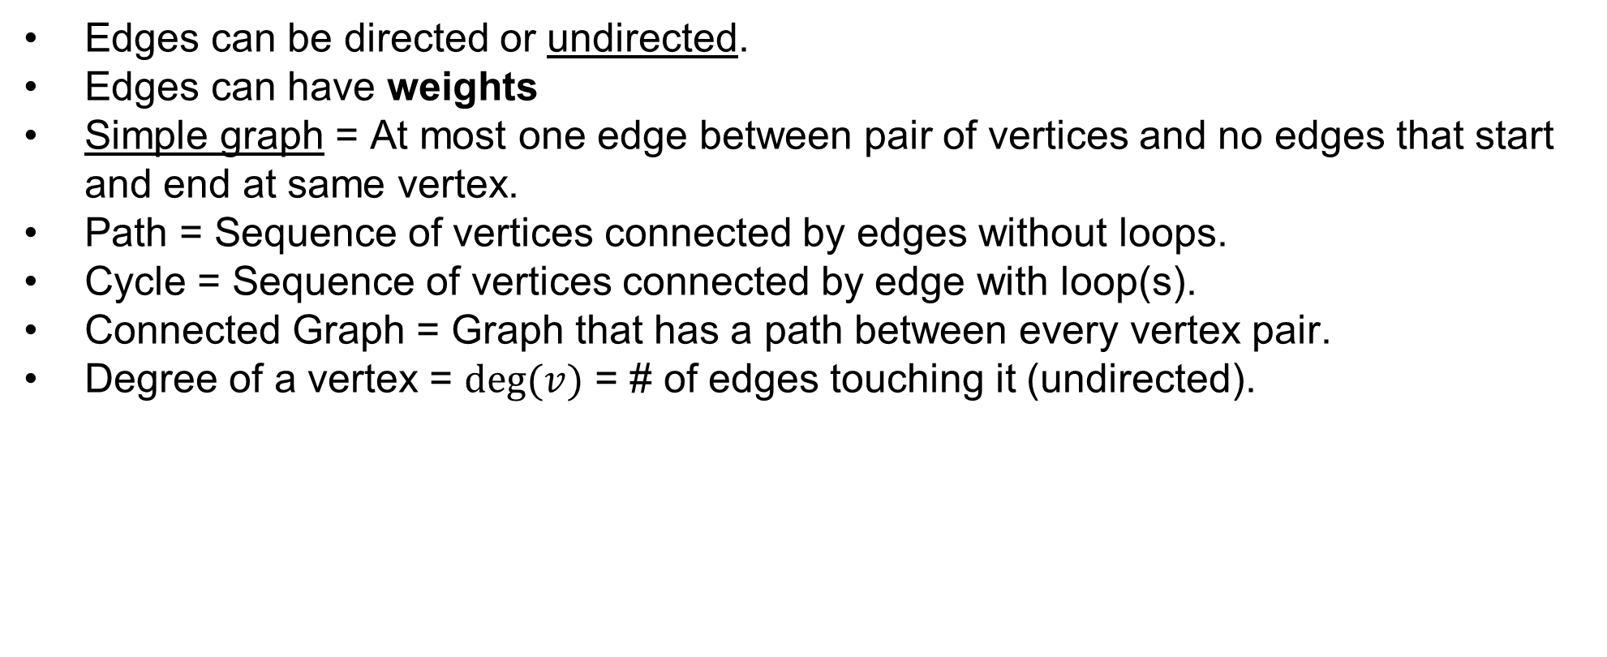
Graphs
Vertices (or Nodes)
Edges
$$G=(V,E)$$
Edges can be directed or undirected.
Edges can have weights
Simple graph = At most one edge between pair of vertices and no edges that start and end at same vertex.
Path = Sequence of vertices connected by edges without loops.
Cycle = Sequence of vertices connected by edge with loop(s).
Connected Graph = Graph that has a path between every vertex pair.
Degree of a vertex = $deg⁡(v)$ = # of edges touching it (undirected).

Slide 45
Graphs
Vertices (or Nodes)
Edges
$$G=(V,E)$$
What are some operations we may want to perform on a graph?
Add vertices/edges.
Find path between vertex pair.
Is graph connected?
Find degree of vertex.
Is the graph simple?
Get number of vertices/edges.
Get neighbors of vertex.
Is there a cycle?
Find max degree of graph.

Slide 46
1
3
How can we represent a graph in a computer?
0
5
2
4

Slide 47
1
3
How can we represent a graph in a computer?
0
5
2
4
Adjacency List
0
1
2
3
4
5
{1,2}
{0,2,3}
{0,1,4}
{1,4,5}
{2,3,5}
{3,4}

Slide 48
1
3
How can we represent a graph in a computer?
0
5
2
4
Adjacency List
Adjacency Matrix
0
1
2
3
4
5
{1,2}
 | 0 | 1 | 2 | 3 | 4 | 5
0 | F | T | T | F | F | F
1 | T | F | T | T | F | F
2 | T | T | F | F | T | F
3 | F | T | F | F | T | T
4 | F | F | T | T | F | T
5 | F | F | F | T | T | F
{0,2,3}
{0,1,4}
{1,4,5}
{2,3,5}
{3,4}

Slide 49
1
3
How can we represent a graph in a computer?
0
5
2
4
Adjacency List
Adjacency Matrix
Objects
0
1
2
3
4
5
{1,2}
 | 0 | 1 | 2 | 3 | 4 | 5
0 | F | T | T | F | F | F
1 | T | F | T | T | F | F
2 | T | T | F | F | T | F
3 | F | T | F | F | T | T
4 | F | F | T | T | F | T
5 | F | F | F | T | T | F
{0,2,3}
public class Node {
private Set<Node> neighbors;
…
}
{0,1,4}
{1,4,5}
{2,3,5}
{3,4}

Slide 50

1
3
How can we represent a graph in a computer?
0
5
2
4
Adjacency List
Adjacency Matrix
Objects
0
1
2
3
4
5
{1,2}
 | 0 | 1 | 2 | 3 | 4 | 5
0 | F | T | T | F | F | F
1 | T | F | T | T | F | F
2 | T | T | F | F | T | F
3 | F | T | F | F | T | T
4 | F | F | T | T | F | T
5 | F | F | F | T | T | F
{0,2,3}
public class Node {
private Set<Node> neighbors;
…
}
{0,1,4}
{1,4,5}
{2,3,5}
{3,4}

Slide 51



Adjacency Lists
1
3
Montana
North Dakota
0
5
Idaho
South Dakota
2
4
Wyoming
0
1
2
3
4
5
{1,2}
Montana: [ North Dakota, South Dakota, Wyoming, Idaho ]
Idaho: [ Montana, Wyoming]
Wyoming: [ Idaho, Montana, South Dakota ]
North Dakota: [ Montana, South Dakota ]
South Dakota: [ Wyoming, Montana, North Dakota ]
{0,2,3}
{0,1,4}
{1,4,5}
{2,3,5}
?
{3,4}

Slide 52



Adjacency Lists
1
3
Montana
North Dakota
0
5
Idaho
South Dakota
2
4
Wyoming
0
1
2
3
4
5
{1,2}
Montana: [ North Dakota, South Dakota, Wyoming, Idaho ]
Idaho: [ Montana, Wyoming]
Wyoming: [ Idaho, Montana, South Dakota ]
North Dakota: [ Montana, South Dakota ]
South Dakota: [ Wyoming, Montana, North Dakota ]
{0,2,3}
{0,1,4}
{1,4,5}
{2,3,5}
HashMap<String, LinkedList<String>>
HashMap<String, LinkedList<Edge>>
{3,4}

Slide 53
Adjacency Lists
1
3
Montana
North Dakota
0
5
Idaho
South Dakota
2
4
Wyoming
0
1
2
3
4
5
{1,2}
?
Montana: [ North Dakota, South Dakota, Wyoming, Idaho ]
Idaho: [ Montana, Wyoming]
Wyoming: [ Idaho, Montana, South Dakota ]
North Dakota: [ Montana, South Dakota ]
South Dakota: [ Wyoming, Montana, North Dakota ]
{0,2,3}
{0,1,4}
{1,4,5}
{2,3,5}
HashMap<String, LinkedList<String>>
HashMap<String, LinkedList<Edge>>
{3,4}

Slide 54
Adjacency Lists
1
3
Montana
North Dakota
0
5
Idaho
South Dakota
2
4
Wyoming
0
1
2
3
4
5
{1,2}
Array of Linked Lists
Montana: [ North Dakota, South Dakota, Wyoming, Idaho ]
Idaho: [ Montana, Wyoming]
Wyoming: [ Idaho, Montana, South Dakota ]
North Dakota: [ Montana, South Dakota ]
South Dakota: [ Wyoming, Montana, North Dakota ]
{0,2,3}
{0,1,4}
{1,4,5}
{2,3,5}
HashMap<String, LinkedList<String>>
HashMap<String, LinkedList<Edge>>
{3,4}

