Slide 1

CSCI 232: Data Structures and Algorithms
Graphs (Traversal and Searching)
Reese Pearsall
Spring 2025
https://www.cs.montana.edu/pearsall/classes/spring2025/232/main.html

Slide 2
Announcements
Lab 7 due tomorrow
No class next week (spring break)

Slide 3
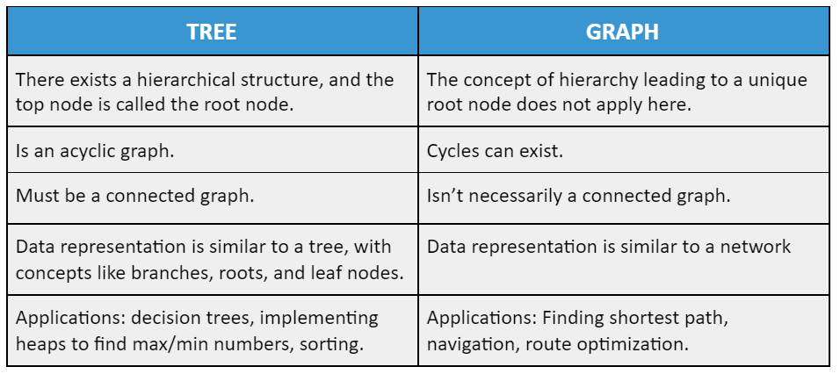
Graphs
G = (V, E)
1
3
0
5
2
4
3
3

Slide 4
Graphs
Adjacency List
1
3
0
1
2
3
4
5
{1,2}
{0,2,3}
0
5
{0,1,4}
{1,4,5}
2
4
{2,3,5}
{3,4}
4
4

Slide 5
Graphs - Paths
1
3
0
5
2
4
Is there a path from node 0 to node 5?
5

Slide 6
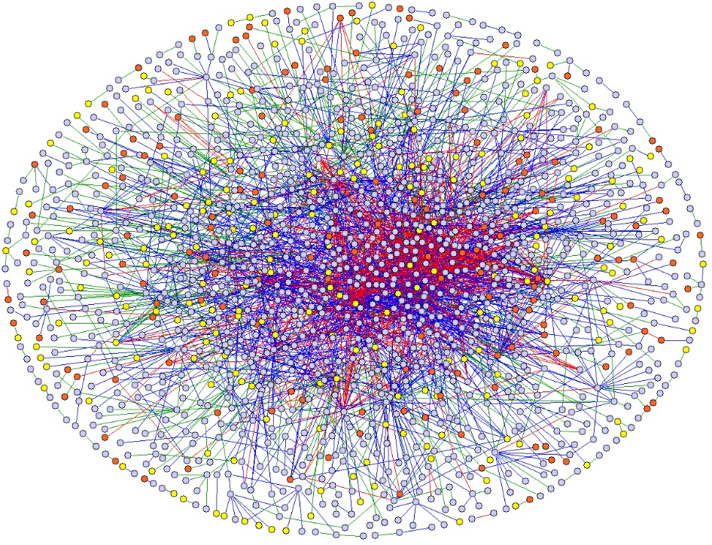
Graphs - Paths
node 5
node 0
Is there a path from node 0 to node 5?
6

Slide 7
Graphs - Paths
0
1
2
3
4
5
{1,2}
{0,2,3}
{0,1,4}
{1,4,5}
{2,3,5}
{3,4}
Is there a path from node 0 to node 5?
7

Slide 8
Graphs - Paths
0
1
2
3
4
5
{1,2}
{0,2,3}
{0,1,4}
{1,4,5}
{2,3,5}
We need a better process than “eyeballing it” for finding paths.
{3,4}
Is there a path from node 0 to node 5?
8

Slide 9
Graphs - Paths
1
3
0
5
2
4
What is a generalizable process to see if there is a path from node 0 to node 5?
9

Slide 10
Graphs - Paths
1
3
0
5
2
4
What is a generalizable process to see if there is a path from node 0 to node 5?
Start at node 0.
Go to each neighbor.
Check each neighbor’s neighbor.
Check each neighbor’s neighbor’s neighbor….
10

Slide 11
Binary Search Tree - Traversal
public void depthFirst(Node n) {
if (n != null) {
System.out.println(n.getValue());
depthFirst(n.getLeft());
depthFirst(n.getRight());
}
}
44
17
88
Recursion:
Calling a method from inside itself.
Solve the problem by solving identical smaller problems.
What is the “smaller problem”?
Process the left side, then process the right side.
8
32
65
97
27
54
82
93
21
29
76
95
30
68
80
11

Slide 12
Binary Search Tree - Traversal
public void depthFirst(44) {
if (n != null) {
System.out.println(n.getValue());
depthFirst(n.getLeft());
depthFirst(n.getRight());
}
}
44
17
88
8
32
65
97
27
54
82
93
21
29
76
95
30
68
80
12

Slide 13
Binary Search Tree - Traversal
public void depthFirst(44) {
if (n != null) {
System.out.println(n.getValue());
depthFirst(n.getLeft());
depthFirst(n.getRight());
}
}
44
17
88
8
32
65
97
27
54
82
93
21
29
76
95
30
68
80
13

Slide 14
Binary Search Tree - Traversal
public void depthFirst(44) {
if (n != null) {
System.out.println(n.getValue());
depthFirst(n.getLeft());
depthFirst(n.getRight());
}
}
44
17
88
public void depthFirst(17) {
if (n != null) {
System.out.println(n.getValue());
depthFirst(n.getLeft());
depthFirst(n.getRight());
}
}
8
32
65
97
27
54
82
93
21
29
76
95
30
68
80
14

Slide 15
Binary Search Tree - Traversal
public void depthFirst(44) {
if (n != null) {
System.out.println(n.getValue());
depthFirst(n.getLeft());
depthFirst(n.getRight());
}
}
44
17
88
public void depthFirst(17) {
if (n != null) {
System.out.println(n.getValue());
depthFirst(n.getLeft());
depthFirst(n.getRight());
}
}
8
32
65
97
27
54
82
93
21
29
76
95
30
68
80
15

Slide 16
Binary Search Tree - Traversal
public void depthFirst(44) {
if (n != null) {
System.out.println(n.getValue());
depthFirst(n.getLeft());
depthFirst(n.getRight());
}
}
44
17
88
public void depthFirst(17) {
if (n != null) {
System.out.println(n.getValue());
depthFirst(n.getLeft());
depthFirst(n.getRight());
}
}
8
32
65
97
27
54
82
93
21
29
76
95
30
68
80
16

Slide 17
Binary Search Tree - Traversal
public void depthFirst(44) {
if (n != null) {
System.out.println(n.getValue());
depthFirst(n.getLeft());
depthFirst(n.getRight());
}
}
44
17
88
public void depthFirst(17) {
if (n != null) {
System.out.println(n.getValue());
depthFirst(n.getLeft());
depthFirst(n.getRight());
}
}
8
32
65
97
27
54
82
93
21
29
76
95
public void depthFirst(8) {
if (n != null) {
System.out.println(n.getValue());
depthFirst(n.getLeft());
depthFirst(n.getRight());
}
}
30
68
80
17

Slide 18
Binary Search Tree - Traversal
public void depthFirst(44) {
if (n != null) {
System.out.println(n.getValue());
depthFirst(n.getLeft());
depthFirst(n.getRight());
}
}
44
17
88
public void depthFirst(17) {
if (n != null) {
System.out.println(n.getValue());
depthFirst(n.getLeft());
depthFirst(n.getRight());
}
}
8
32
65
97
27
54
82
93
21
29
76
95
public void depthFirst(8) {
if (n != null) {
System.out.println(n.getValue());
depthFirst(n.getLeft());
depthFirst(n.getRight());
}
}
30
68
80
18

Slide 19
Graphs - Traversal
public void depthFirst(Node n) {
if (n != null) {
System.out.println(n.getValue());
depthFirst(n.getLeft());
depthFirst(n.getRight());
}
}
1
3
0
5
2
4
19

Slide 20
Graphs - Traversal
public void depthFirst(Node n) {
if (n != null) {
System.out.println(n.getValue());
depthFirst(n.getLeft());
depthFirst(n.getRight());
}
}
1
3
0
5
2
4
20

Slide 21
Graphs - Traversal
int
public void depthFirst(Node n) {
if (n != null) {
System.out.println(n.getValue());
depthFirst(n.getLeft());
depthFirst(n.getRight());
}
}
1
3
0
5
2
4
21

Slide 22
Graphs - Traversal
int
public void depthFirst(Node n) {
if (n != null) {
System.out.println(n.getValue());
depthFirst(n.getLeft());
depthFirst(n.getRight());
}
}
1
3
0
5
2
4
22

Slide 23
Graphs - Traversal
int
public void depthFirst(Node n) {
if (n != null) {
System.out.println(n.getValue());
depthFirst(n.getLeft());
depthFirst(n.getRight());
}
}
1
3
0
5
2
4
23

Slide 24
Graphs - Traversal
int
public void depthFirst(Node n) {
if (n != null) {
System.out.println(n.getValue());
depthFirst(n.getLeft());
depthFirst(n.getRight());
}
}
1
3
0
5
2
4
24

Slide 25
Graphs - Traversal
int
public void depthFirst(Node n) {
if (n != null) {
System.out.println(n.getValue());
depthFirst(n.getLeft());
depthFirst(n.getRight());
}
}
1
3
0
for (int neighbor : getNeighbors(n)) {
depthFirst(neighbor);
}
5
2
4
25

Slide 26
Graphs - Traversal
public void depthFirst(int n) {
System.out.println(n);
for (int neighbor : getNeighbors(n)) {
depthFirst(neighbor);
}
}
1
3
0
5
2
4
26

Slide 27
Graphs - Traversal
public void depthFirst(int n) {
System.out.println(n);
for (int neighbor : getNeighbors(n)) {
depthFirst(neighbor);
}
}
1
3
CODE
0
5
2
4
27

Slide 28
Graphs - Traversal
public void depthFirst(int n) {
System.out.println(n);
for (int neighbor : getNeighbors(n)) {
depthFirst(neighbor);
}
}
1
3
Output
0
5
2
4
Run-time Stack
28

Slide 29
Graphs - Traversal
public void depthFirst(int n) {
System.out.println(n);
for (int neighbor : getNeighbors(n)) {
depthFirst(neighbor);
}
}
1
3
depthFirst(0)
Output
0
5
2
4
Run-time Stack
29

Slide 30
Graphs - Traversal
public void depthFirst(int n) {
System.out.println(n);
for (int neighbor : getNeighbors(n)) {
depthFirst(neighbor);
}
}
1
3
depthFirst(0)
Output
0
5
0
2
4
Run-time Stack
30

Slide 31
Graphs - Traversal
public void depthFirst(int n) {
System.out.println(n);
for (int neighbor : getNeighbors(n)) {
depthFirst(neighbor);
}
}
1
3
depthFirst(1)
depthFirst(0)
Output
0
5
0
2
4
Run-time Stack
31

Slide 32
Graphs - Traversal
public void depthFirst(int n) {
System.out.println(n);
for (int neighbor : getNeighbors(n)) {
depthFirst(neighbor);
}
}
1
3
depthFirst(1)
depthFirst(0)
Output
0
5
0
1
2
4
Run-time Stack
32

Slide 33
Graphs - Traversal
public void depthFirst(int n) {
System.out.println(n);
for (int neighbor : getNeighbors(n)) {
depthFirst(neighbor);
}
}
1
3
depthFirst(0)
depthFirst(1)
depthFirst(0)
Output
0
5
0
1
2
4
Run-time Stack
33

Slide 34
Graphs - Traversal
public void depthFirst(int n) {
System.out.println(n);
for (int neighbor : getNeighbors(n)) {
depthFirst(neighbor);
}
}
1
3
depthFirst(0)
depthFirst(1)
depthFirst(0)
Output
0
5
0
1
0
2
4
Run-time Stack
34

Slide 35
Graphs - Traversal
public void depthFirst(int n) {
System.out.println(n);
for (int neighbor : getNeighbors(n)) {
depthFirst(neighbor);
}
}
1
3
depthFirst(1)
depthFirst(0)
depthFirst(1)
depthFirst(0)
Output
0
5
0
1
0
2
4
Run-time Stack
35

Slide 36
Graphs - Traversal
public void depthFirst(int n) {
System.out.println(n);
for (int neighbor : getNeighbors(n)) {
depthFirst(neighbor);
}
}
1
3
depthFirst(1)
depthFirst(0)
depthFirst(1)
depthFirst(0)
Output
0
5
0
1
0
1
2
4
Run-time Stack
36

Slide 37
Graphs - Traversal
public void depthFirst(int n) {
System.out.println(n);
for (int neighbor : getNeighbors(n)) {
depthFirst(neighbor);
}
}
1
3
depthFirst(0)
depthFirst(1)
depthFirst(0)
depthFirst(1)
depthFirst(0)
Output
0
5
0
1
0
1
0
2
4
Run-time Stack
37

Slide 38
Graphs - Traversal
public void depthFirst(int n) {
System.out.println(n);
for (int neighbor : getNeighbors(n)) {
depthFirst(neighbor);
}
}
1
3
depthFirst(1)
depthFirst(0)
depthFirst(1)
depthFirst(0)
depthFirst(1)
depthFirst(0)
Output
0
5
0
1
0
1
0
1
2
4
Run-time Stack
38

Slide 39
Graphs - Traversal
public void depthFirst(int n) {
System.out.println(n);
for (int neighbor : getNeighbors(n)) {
depthFirst(neighbor);
}
}
1
3
depthFirst(0)
depthFirst(1)
depthFirst(0)
depthFirst(1)
depthFirst(0)
depthFirst(1)
depthFirst(0)
Output
0
5
0
1
0
1
0
1
0
2
4
Run-time Stack
39

Slide 40
Graphs - Traversal
public void depthFirst(int n) {
System.out.println(n);
for (int neighbor : getNeighbors(n)) {
depthFirst(neighbor);
}
}
1
3
depthFirst(1)
depthFirst(0)
depthFirst(1)
depthFirst(0)
depthFirst(1)
depthFirst(0)
depthFirst(1)
depthFirst(0)
Output
0
5
0
1
0
1
0
1
0
1
2
4
Run-time Stack
40

Slide 41
Graphs - Traversal
public void depthFirst(int n) {
System.out.println(n);
for (int neighbor : getNeighbors(n)) {
depthFirst(neighbor);
}
}
1
3
depthFirst(0)
depthFirst(1)
depthFirst(0)
depthFirst(1)
depthFirst(0)
depthFirst(1)
depthFirst(0)
depthFirst(1)
depthFirst(0)
Output
0
5
0
1
0
1
0
1
0
1
0
2
4
Run-time Stack
41

Slide 42

Graphs - Traversal
public void depthFirst(int n) {
System.out.println(n);
for (int neighbor : getNeighbors(n)) {
depthFirst(neighbor);
}
}
1
3
depthFirst(0)
depthFirst(1)
depthFirst(0)
depthFirst(1)
depthFirst(0)
depthFirst(1)
depthFirst(0)
depthFirst(1)
depthFirst(0)
Output
0
5
Stack Overflow
Error
0
1
0
1
0
1
0
2
4
Run-time Stack
42

Slide 43
Graphs - Traversal
Where is the problem?
public void depthFirst(int n) {
System.out.println(n);
for (int neighbor : getNeighbors(n)) {
depthFirst(neighbor);
}
}
1
3
depthFirst(1)
depthFirst(0)
Output
0
5
0
1
2
4
Run-time Stack
43

Slide 44
Graphs - Traversal
What neighbors should we call depthFirst() on?
public void depthFirst(int n) {
System.out.println(n);
for (int neighbor : getNeighbors(n)) {
depthFirst(neighbor);
}
}
1
3
depthFirst(1)
depthFirst(0)
Output
0
5
0
1
2
4
Run-time Stack
44

Slide 45
Graphs - Traversal
What neighbors should we call depthFirst() on?
Neighbors that have not already been visited.
public void depthFirst(int n) {
System.out.println(n);
for (int neighbor : getNeighbors(n)) {
depthFirst(neighbor);
}
}
1
3
depthFirst(1)
depthFirst(0)
Output
0
5
0
1
2
4
Run-time Stack
45

Slide 46
Graphs - Traversal
What neighbors should we call depthFirst() on?
Neighbors that have not already been visited.
How can we do that?
public void depthFirst(int n) {
System.out.println(n);
for (int neighbor : getNeighbors(n)) {
depthFirst(neighbor);
}
}
1
3
depthFirst(1)
depthFirst(0)
Output
0
5
0
1
2
4
Run-time Stack
46

Slide 47
Graphs - Traversal
public void depthFirst(int n) {
System.out.println(n);
for (int neighbor : getNeighbors(n)) {
depthFirst(neighbor);
}
}
1
3
0
5
2
4
47

Slide 48
Graphs - Traversal
private boolean visited[] = new boolean[getNumVertices()];
public void depthFirst(int n) {
System.out.println(n);
for (int neighbor : getNeighbors(n)) {
depthFirst(neighbor);
}
}
1
3
0
5
2
4
48

Slide 49
Graphs - Traversal
private boolean visited[] = new boolean[getNumVertices()];
public void depthFirst(int n) {
System.out.println(n);
for (int neighbor : getNeighbors(n)) {
if (!visited[neighbor]) {
depthFirst(neighbor);
}
}
}
1
3
0
5
2
4
49

Slide 50
Graphs - Traversal
private boolean visited[] = new boolean[getNumVertices()];
public void depthFirst(int n) {
System.out.println(n);
visited[n] = true;
for (int neighbor : getNeighbors(n)) {
if (!visited[neighbor]) {
depthFirst(neighbor);
}
}
}
1
3
0
5
2
4
50

Slide 51
Graphs - Traversal
private boolean visited[] = new boolean[getNumVertices()];
public void depthFirst(int n) {
System.out.println(n);
visited[n] = true;
for (int neighbor : getNeighbors(n)) {
if (!visited[neighbor]) {
depthFirst(neighbor);
}
}
}
1
3
0
5
depthFirst(1)
depthFirst(0)
Output
0
1
2
4
Run-time Stack
51

Slide 52
Graphs - Traversal
private boolean visited[] = new boolean[getNumVertices()];
public void depthFirst(int n) {
System.out.println(n);
visited[n] = true;
for (int neighbor : getNeighbors(n)) {
if (!visited[neighbor]) {
depthFirst(neighbor);
}
}
}
1
3
0
5
depthFirst(2)
depthFirst(1)
depthFirst(0)
Output
0
1
2
4
Run-time Stack
52

Slide 53
Graphs - Traversal
private boolean visited[] = new boolean[getNumVertices()];
public void depthFirst(int n) {
System.out.println(n);
visited[n] = true;
for (int neighbor : getNeighbors(n)) {
if (!visited[neighbor]) {
depthFirst(neighbor);
}
}
}
1
3
0
5
depthFirst(2)
depthFirst(1)
depthFirst(0)
Output
0
1
2
2
4
Run-time Stack
53

Slide 54
Graphs - Traversal
private boolean visited[] = new boolean[getNumVertices()];
public void depthFirst(int n) {
System.out.println(n);
visited[n] = true;
for (int neighbor : getNeighbors(n)) {
if (!visited[neighbor]) {
depthFirst(neighbor);
}
}
}
1
3
0
5
depthFirst(4)
depthFirst(2)
depthFirst(1)
depthFirst(0)
Output
0
1
2
2
4
Run-time Stack
54

Slide 55
Graphs - Traversal
private boolean visited[] = new boolean[getNumVertices()];
public void depthFirst(int n) {
System.out.println(n);
visited[n] = true;
for (int neighbor : getNeighbors(n)) {
if (!visited[neighbor]) {
depthFirst(neighbor);
}
}
}
1
3
0
5
depthFirst(4)
depthFirst(2)
depthFirst(1)
depthFirst(0)
Output
0
1
2
4
2
4
Run-time Stack
55

Slide 56
Graphs - Traversal
private boolean visited[] = new boolean[getNumVertices()];
public void depthFirst(int n) {
System.out.println(n);
visited[n] = true;
for (int neighbor : getNeighbors(n)) {
if (!visited[neighbor]) {
depthFirst(neighbor);
}
}
}
1
3
0
5
depthFirst(3)
depthFirst(4)
depthFirst(2)
depthFirst(1)
depthFirst(0)
Output
0
1
2
4
2
4
Run-time Stack
56

Slide 57
Graphs - Traversal
private boolean visited[] = new boolean[getNumVertices()];
public void depthFirst(int n) {
System.out.println(n);
visited[n] = true;
for (int neighbor : getNeighbors(n)) {
if (!visited[neighbor]) {
depthFirst(neighbor);
}
}
}
1
3
0
5
depthFirst(3)
depthFirst(4)
depthFirst(2)
depthFirst(1)
depthFirst(0)
Output
0
1
2
4
3
2
4
Run-time Stack
57

Slide 58
Graphs - Traversal
private boolean visited[] = new boolean[getNumVertices()];
public void depthFirst(int n) {
System.out.println(n);
visited[n] = true;
for (int neighbor : getNeighbors(n)) {
if (!visited[neighbor]) {
depthFirst(neighbor);
}
}
}
1
3
0
5
depthFirst(5)
depthFirst(3)
depthFirst(4)
depthFirst(2)
depthFirst(1)
depthFirst(0)
Output
0
1
2
4
3
2
4
Run-time Stack
58

Slide 59
Graphs - Traversal
private boolean visited[] = new boolean[getNumVertices()];
public void depthFirst(int n) {
System.out.println(n);
visited[n] = true;
for (int neighbor : getNeighbors(n)) {
if (!visited[neighbor]) {
depthFirst(neighbor);
}
}
}
1
3
0
5
depthFirst(5)
depthFirst(3)
depthFirst(4)
depthFirst(2)
depthFirst(1)
depthFirst(0)
Output
0
1
2
4
3
5
2
4
Run-time Stack
59

Slide 60
Graphs - Traversal
private boolean visited[] = new boolean[getNumVertices()];
public void depthFirst(int n) {
System.out.println(n);
visited[n] = true;
for (int neighbor : getNeighbors(n)) {
if (!visited[neighbor]) {
depthFirst(neighbor);
}
}
}
1
3
0
5
depthFirst(3)
depthFirst(4)
depthFirst(2)
depthFirst(1)
depthFirst(0)
Output
0
1
2
4
3
5
2
4
Run-time Stack
60

Slide 61
Graphs - Traversal
private boolean visited[] = new boolean[getNumVertices()];
public void depthFirst(int n) {
System.out.println(n);
visited[n] = true;
for (int neighbor : getNeighbors(n)) {
if (!visited[neighbor]) {
depthFirst(neighbor);
}
}
}
1
3
0
5
depthFirst(4)
depthFirst(2)
depthFirst(1)
depthFirst(0)
Output
0
1
2
4
3
5
2
4
Run-time Stack
61

Slide 62
Graphs - Traversal
private boolean visited[] = new boolean[getNumVertices()];
public void depthFirst(int n) {
System.out.println(n);
visited[n] = true;
for (int neighbor : getNeighbors(n)) {
if (!visited[neighbor]) {
depthFirst(neighbor);
}
}
}
1
3
0
5
depthFirst(2)
depthFirst(1)
depthFirst(0)
Output
0
1
2
4
3
5
2
4
Run-time Stack
62

Slide 63
Graphs - Traversal
private boolean visited[] = new boolean[getNumVertices()];
public void depthFirst(int n) {
System.out.println(n);
visited[n] = true;
for (int neighbor : getNeighbors(n)) {
if (!visited[neighbor]) {
depthFirst(neighbor);
}
}
}
1
3
0
5
depthFirst(1)
depthFirst(0)
Output
0
1
2
4
3
5
2
4
Run-time Stack
63

Slide 64
Graphs - Traversal
private boolean visited[] = new boolean[getNumVertices()];
public void depthFirst(int n) {
System.out.println(n);
visited[n] = true;
for (int neighbor : getNeighbors(n)) {
if (!visited[neighbor]) {
depthFirst(neighbor);
}
}
}
1
3
0
5
depthFirst(0)
Output
0
1
2
4
3
5
2
4
Run-time Stack
64

Slide 65
Graphs - Traversal
private boolean visited[] = new boolean[getNumVertices()];
public void depthFirst(int n) {
System.out.println(n);
visited[n] = true;
for (int neighbor : getNeighbors(n)) {
if (!visited[neighbor]) {
depthFirst(neighbor);
}
}
}
1
3
0
5
Output
0
1
2
4
3
5
2
4
Run-time Stack
65

Slide 66
Graphs - Traversal
private boolean visited[] = new boolean[getNumVertices()];
public void depthFirst(int n) {
System.out.println(n);
visited[n] = true;
for (int neighbor : getNeighbors(n)) {
if (!visited[neighbor]) {
depthFirst(neighbor);
}
}
}
1
3
CODE
0
5
Output
0
1
2
4
3
5
2
4
Run-time Stack
66

Slide 67
Graphs - Traversal
private boolean visited[] = new boolean[getNumVertices()];
public void depthFirst(int n) {
System.out.println(n);
visited[n] = true;
for (int neighbor : getNeighbors(n)) {
if (!visited[neighbor]) {
depthFirst(neighbor);
}
}
}
1
3
0
5
2
4
67

Slide 68
Graphs - Traversal
private boolean visited[] = new boolean[getNumVertices()];
public void depthFirst(int n) {
System.out.println(n);
visited[n] = true;
for (int neighbor : getNeighbors(n)) {
if (!visited[neighbor]) {
depthFirst(neighbor);
}
}
}
6
1
3
0
5
2
4
68

Slide 69
Graphs - Traversal
private boolean visited[] = new boolean[getNumVertices()];
public void depthFirst(int n) {
System.out.println(n);
visited[n] = true;
for (int neighbor : getNeighbors(n)) {
if (!visited[neighbor]) {
depthFirst(neighbor);
}
}
}
6
1
3
0
5
depthFirst(5)
depthFirst(3)
depthFirst(4)
depthFirst(2)
depthFirst(1)
depthFirst(0)
Output
0
1
2
4
3
5
2
4
Run-time Stack
69

Slide 70
Graphs - Traversal
private boolean visited[] = new boolean[getNumVertices()];
public void depthFirst(int n) {
System.out.println(n);
visited[n] = true;
for (int neighbor : getNeighbors(n)) {
if (!visited[neighbor]) {
depthFirst(neighbor);
}
}
}
6
1
3
0
5
depthFirst(3)
depthFirst(4)
depthFirst(2)
depthFirst(1)
depthFirst(0)
Output
0
1
2
4
3
5
2
4
Run-time Stack
70

Slide 71
Graphs - Traversal
private boolean visited[] = new boolean[getNumVertices()];
public void depthFirst(int n) {
System.out.println(n);
visited[n] = true;
for (int neighbor : getNeighbors(n)) {
if (!visited[neighbor]) {
depthFirst(neighbor);
}
}
}
6
1
3
0
5
depthFirst(4)
depthFirst(2)
depthFirst(1)
depthFirst(0)
Output
0
1
2
4
3
5
2
4
Run-time Stack
71

Slide 72
Graphs - Traversal
private boolean visited[] = new boolean[getNumVertices()];
public void depthFirst(int n) {
System.out.println(n);
visited[n] = true;
for (int neighbor : getNeighbors(n)) {
if (!visited[neighbor]) {
depthFirst(neighbor);
}
}
}
6
1
3
0
5
depthFirst(2)
depthFirst(1)
depthFirst(0)
Output
0
1
2
4
3
5
2
4
Run-time Stack
72

Slide 73
Graphs - Traversal
private boolean visited[] = new boolean[getNumVertices()];
public void depthFirst(int n) {
System.out.println(n);
visited[n] = true;
for (int neighbor : getNeighbors(n)) {
if (!visited[neighbor]) {
depthFirst(neighbor);
}
}
}
6
1
3
0
5
depthFirst(1)
depthFirst(0)
Output
0
1
2
4
3
5
2
4
Run-time Stack
73

Slide 74
Graphs - Traversal
private boolean visited[] = new boolean[getNumVertices()];
public void depthFirst(int n) {
System.out.println(n);
visited[n] = true;
for (int neighbor : getNeighbors(n)) {
if (!visited[neighbor]) {
depthFirst(neighbor);
}
}
}
6
1
3
0
5
depthFirst(6)
depthFirst(1)
depthFirst(0)
Output
0
1
2
4
3
5
2
4
Run-time Stack
74

Slide 75
Graphs - Traversal
private boolean visited[] = new boolean[getNumVertices()];
public void depthFirst(int n) {
System.out.println(n);
visited[n] = true;
for (int neighbor : getNeighbors(n)) {
if (!visited[neighbor]) {
depthFirst(neighbor);
}
}
}
6
1
3
0
5
depthFirst(6)
depthFirst(1)
depthFirst(0)
Output
0
1
2
4
3
5
6
2
4
Run-time Stack
75

Slide 76
Graphs - Traversal
private boolean visited[] = new boolean[getNumVertices()];
public void depthFirst(int n) {
System.out.println(n);
visited[n] = true;
for (int neighbor : getNeighbors(n)) {
if (!visited[neighbor]) {
depthFirst(neighbor);
}
}
}
6
1
3
0
5
depthFirst(1)
depthFirst(0)
Output
0
1
2
4
3
5
6
2
4
Run-time Stack
76

Slide 77
Graphs - Traversal
private boolean visited[] = new boolean[getNumVertices()];
public void depthFirst(int n) {
System.out.println(n);
visited[n] = true;
for (int neighbor : getNeighbors(n)) {
if (!visited[neighbor]) {
depthFirst(neighbor);
}
}
}
6
1
3
0
5
depthFirst(0)
Output
0
1
2
4
3
5
6
2
4
Run-time Stack
77

Slide 78
Graphs - Traversal
private boolean visited[] = new boolean[getNumVertices()];
public void depthFirst(int n) {
System.out.println(n);
visited[n] = true;
for (int neighbor : getNeighbors(n)) {
if (!visited[neighbor]) {
depthFirst(neighbor);
}
}
}
6
1
3
0
5
Output
0
1
2
4
3
5
6
2
4
Run-time Stack
78

Slide 79
Graphs - Paths
private boolean[] visited;
public DepthFirstSearch(Graph graph, int startVertex) {
visited = new boolean[graph.getNumVertices()];
dfs(graph, startVertex);
}
private void dfs(Graph graph, int vertex) {
visited[vertex] = true;
for (int neighbor : graph.getNeighbors(vertex)) {
if (!visited[neighbor]) {
dfs(graph, neighbor);
}
}
}
public boolean reachable(int endVertex) {
return visited[endVertex];
}
1
3
0
5
2
4
79

Slide 80
Graphs - Paths
private boolean[] visited;
public DepthFirstSearch(Graph graph, int startVertex) {
visited = new boolean[graph.getNumVertices()];
dfs(graph, startVertex);
}
private void dfs(Graph graph, int vertex) {
visited[vertex] = true;
for (int neighbor : graph.getNeighbors(vertex)) {
if (!visited[neighbor]) {
dfs(graph, neighbor);
}
}
}
public boolean reachable(int endVertex) {
return visited[endVertex];
}
1
3
0
5
2
4
How do we get actual paths between vertices?
80

Slide 81
Graphs - Paths
private boolean[] visited;
public DepthFirstSearch(Graph graph, int startVertex) {
visited = new boolean[graph.getNumVertices()];
dfs(graph, startVertex);
}
private void dfs(Graph graph, int vertex) {
visited[vertex] = true;
for (int neighbor : graph.getNeighbors(vertex)) {
if (!visited[neighbor]) {
dfs(graph, neighbor);
}
}
}
1
3
0
2
4
Run-time Stack
81

Slide 82
Graphs - Paths
private boolean[] visited;
public DepthFirstSearch(Graph graph, int startVertex) {
visited = new boolean[graph.getNumVertices()];
dfs(graph, startVertex);
}
private void dfs(Graph graph, int vertex) {
visited[vertex] = true;
for (int neighbor : graph.getNeighbors(vertex)) {
if (!visited[neighbor]) {
dfs(graph, neighbor);
}
}
}
1
3
0
2
4
depthFirst(0)
Run-time Stack
82

Slide 83
Graphs - Paths
private boolean[] visited;
public DepthFirstSearch(Graph graph, int startVertex) {
visited = new boolean[graph.getNumVertices()];
dfs(graph, startVertex);
}
private void dfs(Graph graph, int vertex) {
visited[vertex] = true;
for (int neighbor : graph.getNeighbors(vertex)) {
if (!visited[neighbor]) {
dfs(graph, neighbor);
}
}
}
1
3
0
2
4
depthFirst(1)
depthFirst(0)
Run-time Stack
83

Slide 84
Graphs - Paths
private boolean[] visited;
public DepthFirstSearch(Graph graph, int startVertex) {
visited = new boolean[graph.getNumVertices()];
dfs(graph, startVertex);
}
private void dfs(Graph graph, int vertex) {
visited[vertex] = true;
for (int neighbor : graph.getNeighbors(vertex)) {
if (!visited[neighbor]) {
dfs(graph, neighbor);
}
}
}
1
3
0
2
4
depthFirst(2)
depthFirst(1)
depthFirst(0)
Run-time Stack
84

Slide 85
Graphs - Paths
private boolean[] visited;
public DepthFirstSearch(Graph graph, int startVertex) {
visited = new boolean[graph.getNumVertices()];
dfs(graph, startVertex);
}
private void dfs(Graph graph, int vertex) {
visited[vertex] = true;
for (int neighbor : graph.getNeighbors(vertex)) {
if (!visited[neighbor]) {
dfs(graph, neighbor);
}
}
}
1
3
0
2
4
depthFirst(4)
depthFirst(2)
depthFirst(1)
depthFirst(0)
Run-time Stack
85

Slide 86
Graphs - Paths
private boolean[] visited;
public DepthFirstSearch(Graph graph, int startVertex) {
visited = new boolean[graph.getNumVertices()];
dfs(graph, startVertex);
}
private void dfs(Graph graph, int vertex) {
visited[vertex] = true;
for (int neighbor : graph.getNeighbors(vertex)) {
if (!visited[neighbor]) {
dfs(graph, neighbor);
}
}
}
1
3
0
2
4
depthFirst(3)
depthFirst(4)
depthFirst(2)
depthFirst(1)
depthFirst(0)
Was a path identified when determining that 0 and 3 are connected?
Run-time Stack
86

Slide 87
Graphs - Paths
private boolean[] visited;
public DepthFirstSearch(Graph graph, int startVertex) {
visited = new boolean[graph.getNumVertices()];
dfs(graph, startVertex);
}
private void dfs(Graph graph, int vertex) {
visited[vertex] = true;
for (int neighbor : graph.getNeighbors(vertex)) {
if (!visited[neighbor]) {
dfs(graph, neighbor);
}
}
}
1
3
0
2
4
depthFirst(3)
depthFirst(4)
depthFirst(2)
depthFirst(1)
depthFirst(0)
Was a path identified when determining that 0 and 3 are connected?
YES!
Run-time Stack
87

Slide 88
Graphs - Paths
private boolean[] visited;
public DepthFirstSearch(Graph graph, int startVertex) {
visited = new boolean[graph.getNumVertices()];
dfs(graph, startVertex);
}
private void dfs(Graph graph, int vertex) {
visited[vertex] = true;
for (int neighbor : graph.getNeighbors(vertex)) {
if (!visited[neighbor]) {
dfs(graph, neighbor);
}
}
}
1
3
0
2
4
depthFirst(0)
Was a path identified when determining that 0 and 3 are connected?
YES!
Run-time Stack
88

Slide 89
Graphs - Paths
private boolean[] visited;
public DepthFirstSearch(Graph graph, int startVertex) {
visited = new boolean[graph.getNumVertices()];
dfs(graph, startVertex);
}
private void dfs(Graph graph, int vertex) {
visited[vertex] = true;
for (int neighbor : graph.getNeighbors(vertex)) {
if (!visited[neighbor]) {
dfs(graph, neighbor);
}
}
}
1
3
0
2
4
depthFirst(1)
depthFirst(0)
Was a path identified when determining that 0 and 3 are connected?
YES!
Run-time Stack
89

Slide 90
Graphs - Paths
private boolean[] visited;
public DepthFirstSearch(Graph graph, int startVertex) {
visited = new boolean[graph.getNumVertices()];
dfs(graph, startVertex);
}
private void dfs(Graph graph, int vertex) {
visited[vertex] = true;
for (int neighbor : graph.getNeighbors(vertex)) {
if (!visited[neighbor]) {
dfs(graph, neighbor);
}
}
}
1
3
0
2
4
depthFirst(2)
depthFirst(1)
depthFirst(0)
Was a path identified when determining that 0 and 3 are connected?
YES!
Run-time Stack
90

Slide 91
Graphs - Paths
private boolean[] visited;
public DepthFirstSearch(Graph graph, int startVertex) {
visited = new boolean[graph.getNumVertices()];
dfs(graph, startVertex);
}
private void dfs(Graph graph, int vertex) {
visited[vertex] = true;
for (int neighbor : graph.getNeighbors(vertex)) {
if (!visited[neighbor]) {
dfs(graph, neighbor);
}
}
}
1
3
0
2
4
depthFirst(4)
depthFirst(2)
depthFirst(1)
depthFirst(0)
Was a path identified when determining that 0 and 3 are connected?
YES!
Run-time Stack
91

Slide 92
Graphs - Paths
private boolean[] visited;
public DepthFirstSearch(Graph graph, int startVertex) {
visited = new boolean[graph.getNumVertices()];
dfs(graph, startVertex);
}
private void dfs(Graph graph, int vertex) {
visited[vertex] = true;
for (int neighbor : graph.getNeighbors(vertex)) {
if (!visited[neighbor]) {
dfs(graph, neighbor);
}
}
}
1
3
0
2
4
depthFirst(3)
depthFirst(4)
depthFirst(2)
depthFirst(1)
depthFirst(0)
Was a path identified when determining that 0 and 3 are connected?
YES!
Run-time Stack
92

Slide 93
Graphs - Paths
private boolean[] visited;
public DepthFirstSearch(Graph graph, int startVertex) {
visited = new boolean[graph.getNumVertices()];
dfs(graph, startVertex);
}
private void dfs(Graph graph, int vertex) {
visited[vertex] = true;
for (int neighbor : graph.getNeighbors(vertex)) {
if (!visited[neighbor]) {
dfs(graph, neighbor);
}
}
}
1
3
0
2
4
depthFirst(3)
depthFirst(4)
depthFirst(2)
depthFirst(1)
depthFirst(0)
Was a path identified when determining that 0 and 3 are connected?
YES!
Run-time Stack
93

Slide 94
Graphs - Paths
private boolean[] visited;
public DepthFirstSearch(Graph graph, int startVertex) {
visited = new boolean[graph.getNumVertices()];
dfs(graph, startVertex);
}
private void dfs(Graph graph, int vertex) {
visited[vertex] = true;
for (int neighbor : graph.getNeighbors(vertex)) {
if (!visited[neighbor]) {
dfs(graph, neighbor);
}
}
}
1
3
0
2
4
depthFirst(3)
depthFirst(4)
depthFirst(2)
depthFirst(1)
depthFirst(0)
What else was identified?
Run-time Stack
94

Slide 95
Graphs - Paths
private boolean[] visited;
public DepthFirstSearch(Graph graph, int startVertex) {
visited = new boolean[graph.getNumVertices()];
dfs(graph, startVertex);
}
private void dfs(Graph graph, int vertex) {
visited[vertex] = true;
for (int neighbor : graph.getNeighbors(vertex)) {
if (!visited[neighbor]) {
dfs(graph, neighbor);
}
}
}
1
3
0
2
4
depthFirst(3)
depthFirst(4)
depthFirst(2)
depthFirst(1)
depthFirst(0)
What else was identified?
A path from 0 to everything connected to 0!
Run-time Stack
95

Slide 96
Graphs - Paths
6
5
7
private boolean[] visited;
public DepthFirstSearch(Graph graph, int startVertex) {
visited = new boolean[graph.getNumVertices()];
dfs(graph, startVertex);
}
private void dfs(Graph graph, int vertex) {
visited[vertex] = true;
for (int neighbor : graph.getNeighbors(vertex)) {
if (!visited[neighbor]) {
dfs(graph, neighbor);
}
}
}
1
3
0
2
4
What else was identified?
A path from 0 to everything connected to 0!
96

Slide 97
Graphs - Paths
6
5
7
private boolean[] visited;
public DepthFirstSearch(Graph graph, int startVertex) {
visited = new boolean[graph.getNumVertices()];
dfs(graph, startVertex);
}
private void dfs(Graph graph, int vertex) {
visited[vertex] = true;
for (int neighbor : graph.getNeighbors(vertex)) {
if (!visited[neighbor]) {
dfs(graph, neighbor);
}
}
}
1
3
0
2
4
What else was identified?
A path from 0 to everything connected to 0!
97

Slide 98
Graphs - Paths
6
5
7
private boolean[] visited;
public DepthFirstSearch(Graph graph, int startVertex) {
visited = new boolean[graph.getNumVertices()];
dfs(graph, startVertex);
}
private void dfs(Graph graph, int vertex) {
visited[vertex] = true;
for (int neighbor : graph.getNeighbors(vertex)) {
if (!visited[neighbor]) {
dfs(graph, neighbor);
}
}
}
1
3
0
2
4
How can we store/compute these paths?
98

Slide 99
Graphs - Paths
6
5
7
private boolean[] visited;
public DepthFirstSearch(Graph graph, int startVertex) {
visited = new boolean[graph.getNumVertices()];
dfs(graph, startVertex);
}
private void dfs(Graph graph, int vertex) {
visited[vertex] = true;
for (int neighbor : graph.getNeighbors(vertex)) {
if (!visited[neighbor]) {
dfs(graph, neighbor);
}
}
}
1
3
0
2
4
How can we store/compute these paths?
What if, for each vertex, we stored the previous vertex?
99

Slide 100
Graphs - Paths
6
5
7
int[] previousVertex
0 | -
1
2
3
4
5
6
7
1
3
0
2
4
How can we store/compute these paths?
What if, for each vertex, we stored the previous vertex?
100

Slide 101
Graphs - Paths
6
5
7
int[] previousVertex
0 | -
1 | 0
2
3
4
5
6
7
1
3
0
2
4
How can we store/compute these paths?
What if, for each vertex, we stored the previous vertex?
101

Slide 102
Graphs - Paths
6
5
7
int[] previousVertex
0 | -
1 | 0
2 | 1
3
4
5
6
7
1
3
0
2
4
How can we store/compute these paths?
What if, for each vertex, we stored the previous vertex?
102

Slide 103
Graphs - Paths
6
5
7
int[] previousVertex
0 | -
1 | 0
2 | 1
3 | 4
4
5
6
7
1
3
0
2
4
How can we store/compute these paths?
What if, for each vertex, we stored the previous vertex?
103

Slide 104
Graphs - Paths
6
5
7
int[] previousVertex
0 | -
1 | 0
2 | 1
3 | 4
4 | 2
5
6
7
1
3
0
2
4
How can we store/compute these paths?
What if, for each vertex, we stored the previous vertex?
104

Slide 105
Graphs - Paths
6
5
7
int[] previousVertex
0 | -
1 | 0
2 | 1
3 | 4
4 | 2
5 | 1
6
7
1
3
0
2
4
How can we store/compute these paths?
What if, for each vertex, we stored the previous vertex?
105

Slide 106
Graphs - Paths
6
5
7
int[] previousVertex
0 | -
1 | 0
2 | 1
3 | 4
4 | 2
5 | 1
6 | 5
7
1
3
0
2
4
How can we store/compute these paths?
What if, for each vertex, we stored the previous vertex?
106

Slide 107
Graphs - Paths
6
5
7
int[] previousVertex
0 | -
1 | 0
2 | 1
3 | 4
4 | 2
5 | 1
6 | 5
7 | 6
1
3
0
2
4
How can we store/compute these paths?
What if, for each vertex, we stored the previous vertex?
107

Slide 108
Graphs - Paths
6
5
7
int[] previousVertex
0 | -
1 | 0
2 | 1
3 | 4
4 | 2
5 | 1
6 | 5
7 | 6
1
3
0
2
4
How do we determine the path from 0 to 6?
108

Slide 109
Graphs - Paths
6
5
7
int[] previousVertex
0 | -
1 | 0
2 | 1
3 | 4
4 | 2
5 | 1
6 | 5
7 | 6
1
3
0
2
4
How do we determine the path from 0 to 6?
Start at vertex 6.
109

Slide 110
Graphs - Paths
6
5
7
int[] previousVertex
0 | -
1 | 0
2 | 1
3 | 4
4 | 2
5 | 1
6 | 5
7 | 6
1
3
0
2
4
How do we determine the path from 0 to 6?
Start at vertex 6. Find its previous vertex.
110

Slide 111
Graphs - Paths
6
5
7
int[] previousVertex
0 | -
1 | 0
2 | 1
3 | 4
4 | 2
5 | 1
6 | 5
7 | 6
1
3
0
2
4
How do we determine the path from 0 to 6?
Start at vertex 6. Find its previous vertex. Find its previous vertex
111

Slide 112
Graphs - Paths
6
5
7
int[] previousVertex
0 | -
1 | 0
2 | 1
3 | 4
4 | 2
5 | 1
6 | 5
7 | 6
1
3
0
2
4
How do we determine the path from 0 to 6?
Start at vertex 6. Find its previous vertex. Find its previous vertex…
until we get back to the start (0).
112

Slide 113
Graphs - Paths
6
5
7
int[] previousVertex
0 | -
1 | 0
2 | 1
3 | 4
4 | 2
5 | 1
6 | 5
7 | 6
1
3
0
2
4
How do we determine the path from 0 to 3?
113

Slide 114
Graphs - Paths
6
5
7
int[] previousVertex
0 | -
1 | 0
2 | 1
3 | 4
4 | 2
5 | 1
6 | 5
7 | 6
1
3
0
2
4
How do we determine the path from 0 to 3?
114

Slide 115
Graphs - Paths
6
5
7
int[] previousVertex
0 | -
1 | 0
2 | 1
3 | 4
4 | 2
5 | 1
6 | 5
7 | 6
1
3
0
2
4
How do we determine the path from 0 to 3?
115

Slide 116
Graphs - Paths
6
5
7
int[] previousVertex
0 | -
1 | 0
2 | 1
3 | 4
4 | 2
5 | 1
6 | 5
7 | 6
1
3
0
2
4
How do we determine the path from 0 to 3?
116

Slide 117
Graphs - Paths
6
5
7
int[] previousVertex
0 | -
1 | 0
2 | 1
3 | 4
4 | 2
5 | 1
6 | 5
7 | 6
1
3
0
2
4
How do we determine the path from 0 to 3?
117

Slide 118
Graphs - Paths
6
5
7
int[] previousVertex
0 | -
1 | 0
2 | 1
3 | 4
4 | 2
5 | 1
6 | 5
7 | 6
1
3
0
2
4
How do we determine the path from 0 to 3?
118

Slide 119
Graphs - Paths
6
5
7
private boolean[] visited;
public DepthFirstSearch(Graph graph, int startVertex) {
visited = new boolean[graph.getNumVertices()];
dfs(graph, startVertex);
}
private void dfs(Graph graph, int vertex) {
visited[vertex] = true;
for (int neighbor : graph.getNeighbors(vertex)) {
if (!visited[neighbor]) {
dfs(graph, neighbor);
}
}
}
1
3
0
2
4
What do we need to do in the code?
119

Slide 120
Graphs - Paths
6
5
7
private boolean[] visited;
public DepthFirstSearch(Graph graph, int startVertex) {
visited = new boolean[graph.getNumVertices()];
dfs(graph, startVertex);
}
private void dfs(Graph graph, int vertex) {
visited[vertex] = true;
for (int neighbor : graph.getNeighbors(vertex)) {
if (!visited[neighbor]) {
dfs(graph, neighbor);
}
}
}
1
3
0
2
4
What do we need to do in the code?
1 – Create/Initialize previousVertex
2 – Populate previousVertex
3 – getPathTo(int endVertex)
120

Slide 121
Graphs - Paths
6
5
7
private boolean[] visited;
private int[] previousVertex;
public DepthFirstSearch(Graph graph, int startVertex) {
visited = new boolean[graph.getNumVertices()];
previousVertex = new int[graph.getNumVertices()];
dfs(graph, startVertex);
}
private void dfs(Graph graph, int vertex) {
visited[vertex] = true;
for (int neighbor : graph.getNeighbors(vertex)) {
if (!visited[neighbor]) {
dfs(graph, neighbor);
}
}
}
1
3
0
2
4
What do we need to do in the code?
1 – Create/Initialize previousVertex
2 – Populate previousVertex
3 – getPathTo(int endVertex)
121

Slide 122
Graphs - Paths
6
5
7
private boolean[] visited;
private int[] previousVertex;
public DepthFirstSearch(Graph graph, int startVertex) {
visited = new boolean[graph.getNumVertices()];
previousVertex = new int[graph.getNumVertices()];
dfs(graph, startVertex);
}
private void dfs(Graph graph, int vertex) {
visited[vertex] = true;
for (int neighbor : graph.getNeighbors(vertex)) {
if (!visited[neighbor]) {
previousVertex[?????] = ?????;
dfs(graph, neighbor);
}
}
}
1
3
0
2
4
What do we need to do in the code?
1 – Create/Initialize previousVertex
2 – Populate previousVertex
3 – getPathTo(int endVertex)
122

Slide 123
Graphs - Paths
6
5
7
private boolean[] visited;
private int[] previousVertex;
public DepthFirstSearch(Graph graph, int startVertex) {
visited = new boolean[graph.getNumVertices()];
previousVertex = new int[graph.getNumVertices()];
dfs(graph, startVertex);
}
private void dfs(Graph graph, int vertex) {
visited[vertex] = true;
for (int neighbor : graph.getNeighbors(vertex)) {
if (!visited[neighbor]) {
previousVertex[vertex] = neighbor;
dfs(graph, neighbor);
}
}
}
1
3
0
2
4
What do we need to do in the code?
1 – Create/Initialize previousVertex
2 – Populate previousVertex
3 – getPathTo(int endVertex)
123

Slide 124
Graphs - Paths
6
5
7
private boolean[] visited;
private int[] previousVertex;
public DepthFirstSearch(Graph graph, int startVertex) {
visited = new boolean[graph.getNumVertices()];
previousVertex = new int[graph.getNumVertices()];
dfs(graph, startVertex);
}
private void dfs(Graph graph, int vertex) {
visited[vertex] = true;
for (int neighbor : graph.getNeighbors(vertex)) {
if (!visited[neighbor]) {
previousVertex[neighbor] = vertex;
dfs(graph, neighbor);
}
}
}
1
3
0
2
4
What do we need to do in the code?
1 – Create/Initialize previousVertex
2 – Populate previousVertex
3 – getPathTo(int endVertex)
124

Slide 125
Graphs - Paths
6
5
7
1
3
0
public ??? getPathTo(int endVertex) {
}
2
4
What do we need to do in the code?
1 – Create/Initialize previousVertex
2 – Populate previousVertex
3 – getPathTo(int endVertex)
125

Slide 126
Graphs - Paths
6
5
7
1
3
0
public ??? getPathTo(int endVertex) {
if (!reachable(endVertex)) {
} else {
}
}
2
4
What do we need to do in the code?
1 – Create/Initialize previousVertex
2 – Populate previousVertex
3 – getPathTo(int endVertex)
126

Slide 127
Graphs - Paths
6
5
7
1
3
0
public ??? getPathTo(int endVertex) {
if (!reachable(endVertex)) {
return null;
} else {
}
}
2
4
What do we need to do in the code?
1 – Create/Initialize previousVertex
2 – Populate previousVertex
3 – getPathTo(int endVertex)
127

Slide 128
Graphs - Paths
6
5
7
1
3
0
public ??? getPathTo(int endVertex) {
if (!reachable(endVertex)) {
return null;
} else {
?? path = ??
}
}
2
4
What do we need to do in the code?
1 – Create/Initialize previousVertex
2 – Populate previousVertex
3 – getPathTo(int endVertex)
128

Slide 129
Graphs - Paths
6
5
7
1
3
0
public ??? getPathTo(int endVertex) {
if (!reachable(endVertex)) {
return null;
} else {
LinkedList<Integer> path = new LinkedList<>();
}
}
2
4
What do we need to do in the code?
1 – Create/Initialize previousVertex
2 – Populate previousVertex
3 – getPathTo(int endVertex)
129

Slide 130
Graphs - Paths
6
5
7
1
3
0
public LinkedList<Integer> getPathTo(int endVertex) {
if (!reachable(endVertex)) {
return null;
} else {
LinkedList<Integer> path = new LinkedList<>();
}
}
2
4
What do we need to do in the code?
1 – Create/Initialize previousVertex
2 – Populate previousVertex
3 – getPathTo(int endVertex)
130

Slide 131
Graphs - Paths
6
5
7
1
3
0
public LinkedList<Integer> getPathTo(int endVertex) {
if (!reachable(endVertex)) {
return null;
} else {
LinkedList<Integer> path = new LinkedList<>();
for (int v = ?? ; ; ) {
}
}
}
2
4
What do we need to do in the code?
1 – Create/Initialize previousVertex
2 – Populate previousVertex
3 – getPathTo(int endVertex)
131

Slide 132
Graphs - Paths
6
5
7
1
3
0
public LinkedList<Integer> getPathTo(int endVertex) {
if (!reachable(endVertex)) {
return null;
} else {
LinkedList<Integer> path = new LinkedList<>();
for (int v = endVertex; v ?? ; ) {
}
}
}
2
4
What do we need to do in the code?
1 – Create/Initialize previousVertex
2 – Populate previousVertex
3 – getPathTo(int endVertex)
132

Slide 133
Graphs - Paths
6
5
7
1
3
0
public LinkedList<Integer> getPathTo(int endVertex) {
if (!reachable(endVertex)) {
return null;
} else {
LinkedList<Integer> path = new LinkedList<>();
for (int v = endVertex; v != startVertex; ) {
}
}
}
2
4
What do we need to do in the code?
1 – Create/Initialize previousVertex
2 – Populate previousVertex
3 – getPathTo(int endVertex)
133

Slide 134
Graphs - Paths
6
5
7
private boolean[] visited;
private int[] previousVertex;
public DepthFirstSearch(Graph graph, int startVertex) {
visited = new boolean[graph.getNumVertices()];
previousVertex = new int[graph.getNumVertices()];
dfs(graph, startVertex);
}
private void dfs(Graph graph, int vertex) {
visited[vertex] = true;
for (int neighbor : graph.getNeighbors(vertex)) {
if (!visited[neighbor]) {
previousVertex[neighbor] = vertex;
dfs(graph, neighbor);
}
}
}
1
3
0
2
4
What do we need to do in the code?
1 – Create/Initialize previousVertex
2 – Populate previousVertex
3 – getPathTo(int endVertex)
134

Slide 135
Graphs - Paths
6
5
7
private boolean[] visited;
private int[] previousVertex;
private int startVertex;
public DepthFirstSearch(Graph graph, int startVertex) {
visited = new boolean[graph.getNumVertices()];
previousVertex = new int[graph.getNumVertices()];
this.startVertex = startVertex;
dfs(graph, startVertex);
}
private void dfs(Graph graph, int vertex) {
visited[vertex] = true;
for (int neighbor : graph.getNeighbors(vertex)) {
if (!visited[neighbor]) {
previousVertex[neighbor] = vertex;
dfs(graph, neighbor);
}
} }
1
3
0
2
4
What do we need to do in the code?
1 – Create/Initialize previousVertex
2 – Populate previousVertex
3 – getPathTo(int endVertex)
135

Slide 136
Graphs - Paths
6
5
7
1
3
0
public LinkedList<Integer> getPathTo(int endVertex) {
if (!reachable(endVertex)) {
return null;
} else {
LinkedList<Integer> path = new LinkedList<>();
for (int v = endVertex; v != startVertex; ) {
}
}
}
2
4
What do we need to do in the code?
1 – Create/Initialize previousVertex
2 – Populate previousVertex
3 – getPathTo(int endVertex)
136

Slide 137
Graphs - Paths
6
5
7
private int[] previousVertex;
1
3
0
public LinkedList<Integer> getPathTo(int endVertex) {
if (!reachable(endVertex)) {
return null;
} else {
LinkedList<Integer> path = new LinkedList<>();
for (int v = endVertex; v != startVertex; v ?? ) {
}
}
}
2
4
What do we need to do in the code?
1 – Create/Initialize previousVertex
2 – Populate previousVertex
3 – getPathTo(int endVertex)
137

Slide 138
Graphs - Paths
6
5
7
private int[] previousVertex;
1
3
0
public LinkedList<Integer> getPathTo(int endVertex) {
if (!reachable(endVertex)) {
return null;
} else {
LinkedList<Integer> path = new LinkedList<>();
for (int v = endVertex; v != startVertex; v = previousVertex[v]) {
}
}
}
2
4
What do we need to do in the code?
1 – Create/Initialize previousVertex
2 – Populate previousVertex
3 – getPathTo(int endVertex)
138

Slide 139
Graphs - Paths
6
5
7
1
3
0
public LinkedList<Integer> getPathTo(int endVertex) {
if (!reachable(endVertex)) {
return null;
} else {
LinkedList<Integer> path = new LinkedList<>();
for (int v = endVertex; v != startVertex; v = previousVertex[v]) {
path.add(v);
}
}
}
2
4
What do we need to do in the code?
1 – Create/Initialize previousVertex
2 – Populate previousVertex
3 – getPathTo(int endVertex)
139

Slide 140
Graphs - Paths
6
5
7
1
3
0
public LinkedList<Integer> getPathTo(int endVertex) {
if (!reachable(endVertex)) {
return null;
} else {
LinkedList<Integer> path = new LinkedList<>();
for (int v = endVertex; v != startVertex; v = previousVertex[v]) {
path.addFirst(v);
}
}
}
2
4
What do we need to do in the code?
1 – Create/Initialize previousVertex
2 – Populate previousVertex
3 – getPathTo(int endVertex)
140

Slide 141
Graphs - Paths
6
5
7
1
3
0
public LinkedList<Integer> getPathTo(int endVertex) {
if (!reachable(endVertex)) {
return null;
} else {
LinkedList<Integer> path = new LinkedList<>();
for (int v = endVertex; v != startVertex; v = previousVertex[v]) {
path.addFirst(v);
}
path.addFirst(startVertex);
return path;
}
}
2
4
What do we need to do in the code?
1 – Create/Initialize previousVertex
2 – Populate previousVertex
3 – getPathTo(int endVertex)
141

Slide 142
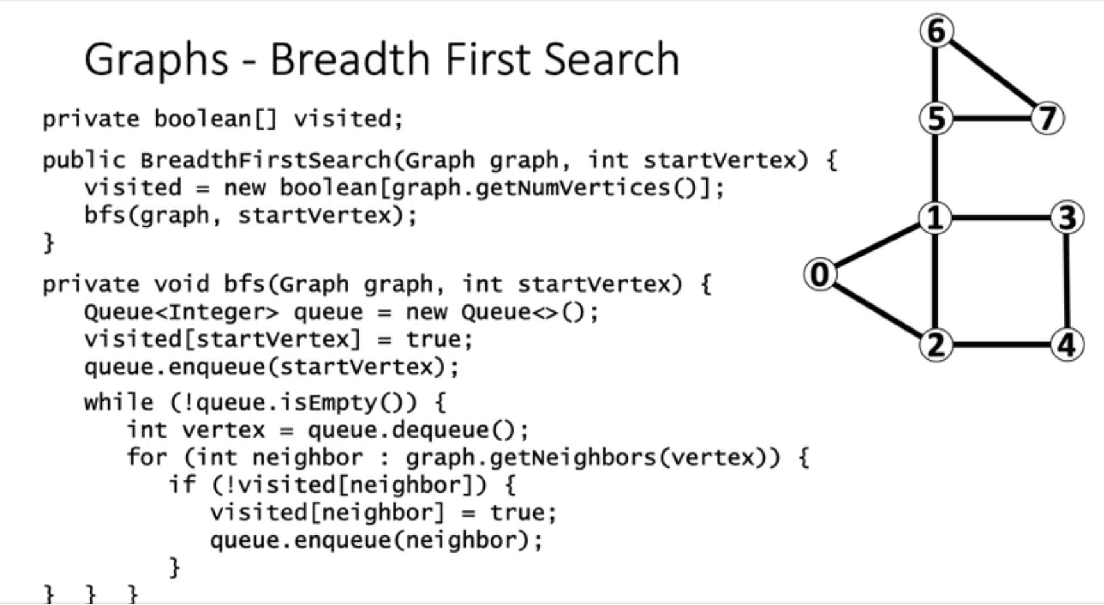
142

Slide 143
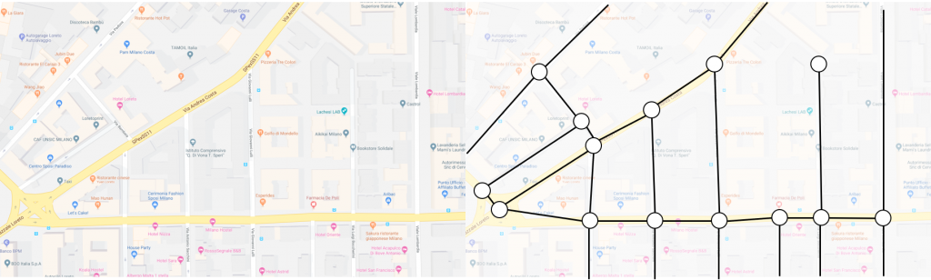
Graphs – More Applications
143

Slide 144
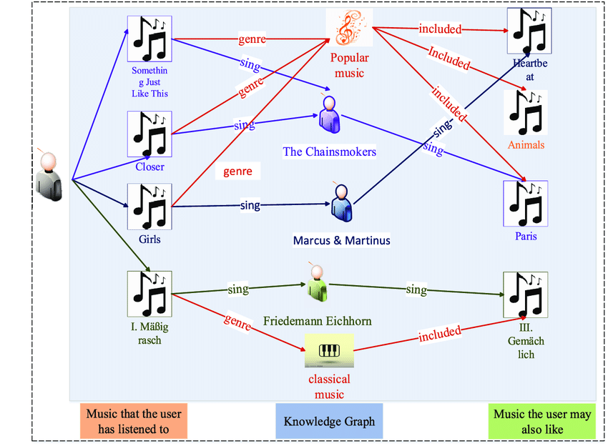
Graphs – More Applications
144

Slide 145

Graphs – More Applications
145

Slide 146
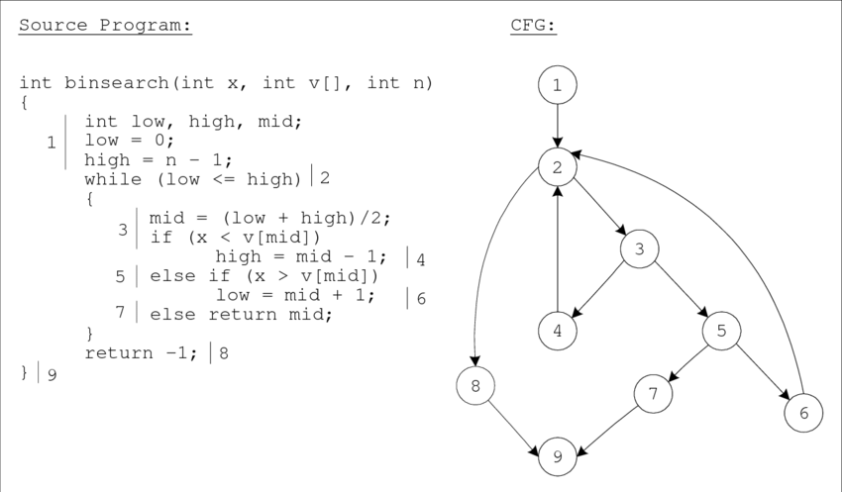
Graphs – More Applications
146

Slide 147
Graphs – More Applications
1
147

Slide 148
Graphs – More Applications
1
2
148

Slide 149

Graphs – More Applications
1
2
3
149

Slide 150


Graphs – More Applications
1
2
3
4
150

Slide 151


Graphs – More Applications
1
2
3
4
5
151

Slide 152



Graphs – More Applications
1
2
3
4
5
6
152

Slide 153


Graphs – More Applications
1
2
3
4
5
6
7
153

Slide 154




Graphs – More Applications
1
2
3
4
5
8
6
7
9
154

Slide 155
Control Flow Graph (CFG)
155

Slide 156
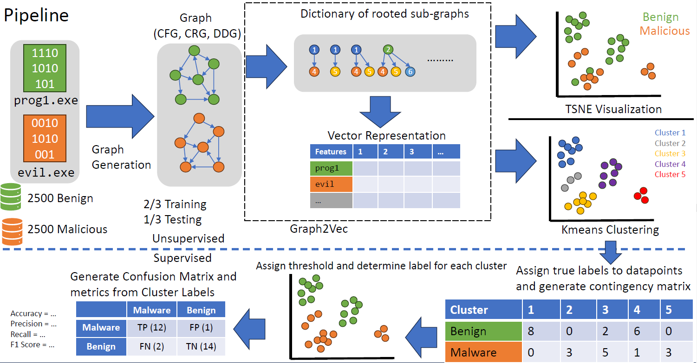
Identifying malware
156

