Slide 1

CSCI 232: Data Structures and Algorithms
Shortest Path (Part 2)
Reese Pearsall
Spring 2025
https://www.cs.montana.edu/pearsall/classes/spring2025/232/main.html

Slide 2
Quiz 2 is tomorrow
→ It may be helpful to bring something you can write on

Slide 3
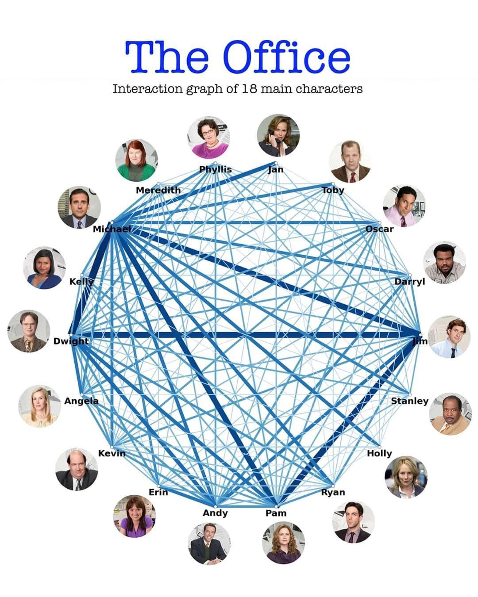
3

Slide 4
https://youtu.be/EFg3u_E6eHU
4

Slide 5
Dijkstra’s Algorithm
Distance from 0
Previous vertex
Priority queue
0.22
1
0.29
0 | 0
1 | 0.92
2 | 0.26
3 | 0.99
4 | 0.38
5 | 0.70
6 | 1.51
7 | 0.60
0 | -
1 | 5
2 | 0
3 | 7
4 | 0
5 | 7
6 | 3
7 | 2
5
3
0.1
0.39
0.28
7
0.34
0.35
2
0.52
0.37
0.26
0.35
0
0.4
0.38
0.58
4
6
0.93
Rule: When processing vertex v, only add/modify queue for neighbor u if and only if: distance[v] + weight(v, u) < distance[u]
vertex (distance)
5

Slide 6
u₁
0.22
1
0.29
u₂
Distance from 0
Previous vertex
Priority queue
5
3
0.1
v
0.39
0.28
7
0 | 0
1 | ∞
2 | 0.26
3 | 0.99
4 | 0.38
5 | 0.73
6 | ∞
7 | 0.60
0 | -
1
2 | 0
3 | 7
4 | 0
5 | 4
6
7 | 2
5 (0.73)
0.34
0.35
2
0.52
0.37
0.26
3 (0.99)
0.35
0
0.4
0.38
0.58
4
6
0.93
Rule: When processing vertex v, only add/modify queue for neighbor u if and only if: distance[v] + weight(v, u) < distance[u]
vertex (distance)
PriortityVertex
Objects
0.60 + 0.1 < 0.73
6

Slide 7


u₁
0.22
1
0.29
u₂
Distance from 0
Previous vertex
Priority queue
5
3
0.1
v
0.39
0.28
7
0 | 0
1 | ∞
2 | 0.26
3 | 0.99
4 | 0.38
5 | 0.73
6 | ∞
7 | 0.60
0 | -
1
2 | 0
3 | 7
4 | 0
5 | 4
6
7 | 2
5 (0.73)
0.34
0.35
2
0.52
0.37
0.26
3 (0.99)
0.35
0
0.4
0.38
0.58
5 (0.70)
4
6
0.93
0.70
7
Rule: When processing vertex v, only add/modify queue for neighbor u if and only if: distance[v] + weight(v, u) < distance[u]
vertex (distance)
PriortityVertex
Objects
7

Slide 8
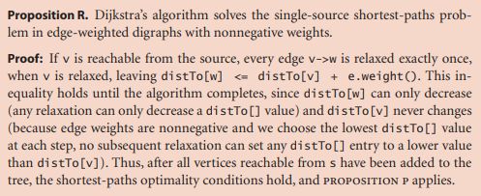
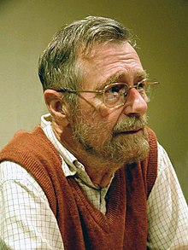

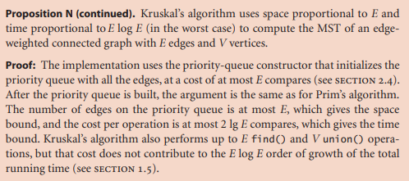
Dijkstra’s Algorithm
Running Time: O(E ⋅ log(V))*
E = # of edges
V = # of vertices
* Varies depending on implementation and representation
Edsger Wybe Dijkstra
11 May 1930 – 6 August 2002
8

Slide 9
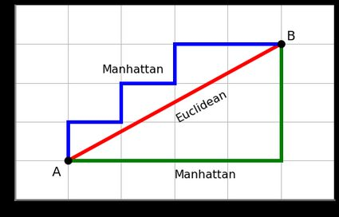

A Star
A Star or A* is another algorithm that will compute the shortest path in a graph
In Dijkstra’s Algorithm we select the least-cost unvisited node, and we compute the shortest path to all other nodes
In A*, we select the node that is the shortest distance away from the target, and does not compute the shortest path to all other nodes
In A* we use a heuristic to make decisions
Euclidean Distance heuristic
(No difference in running time)
9

Slide 10
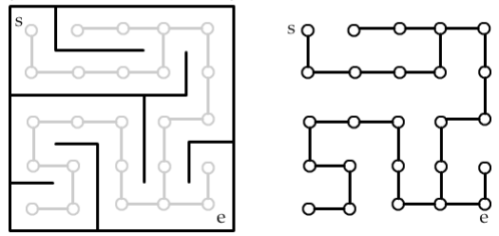
We can represent a maze using graphs!
10

Slide 11
Creating Mazes with Depth First
https://www.youtube.com/watch?v=e5zDG4JIsyg
11

Slide 12
Shortest Path Algorithms on Maze
https://clementmihailescu.github.io/Pathfinding-Visualizer/
12

Slide 13
Applications of Shortest Path?
13

Slide 14
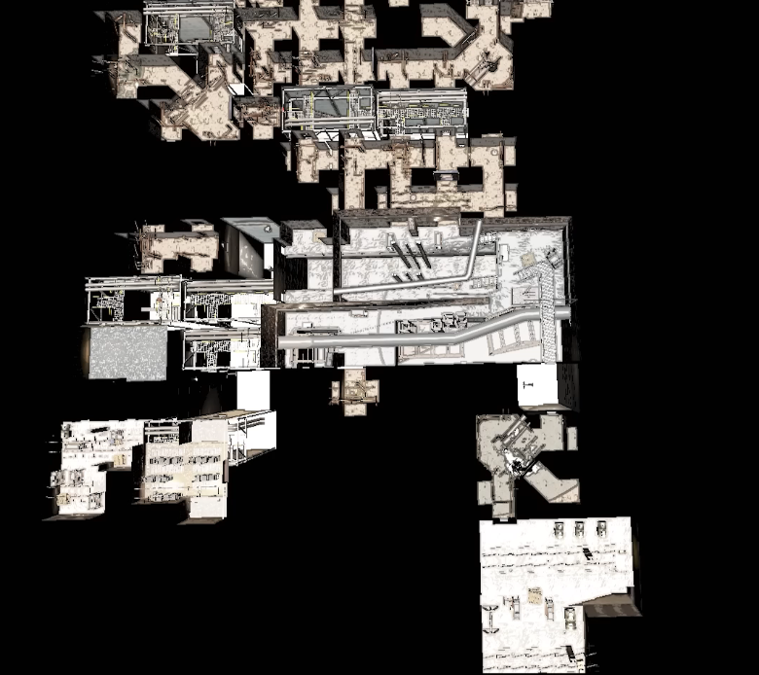
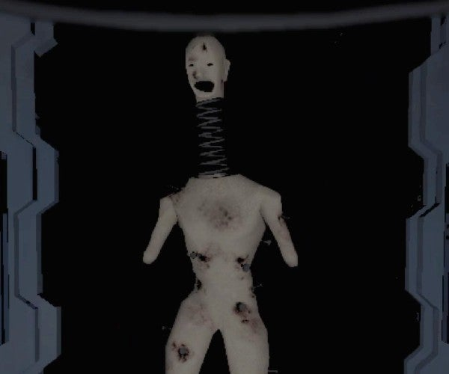

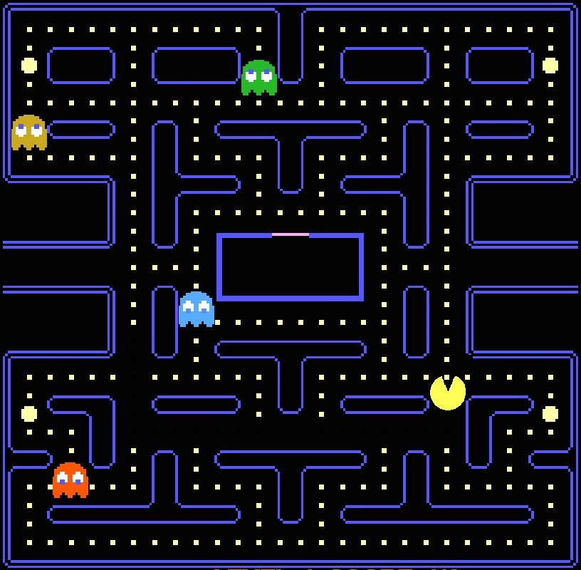
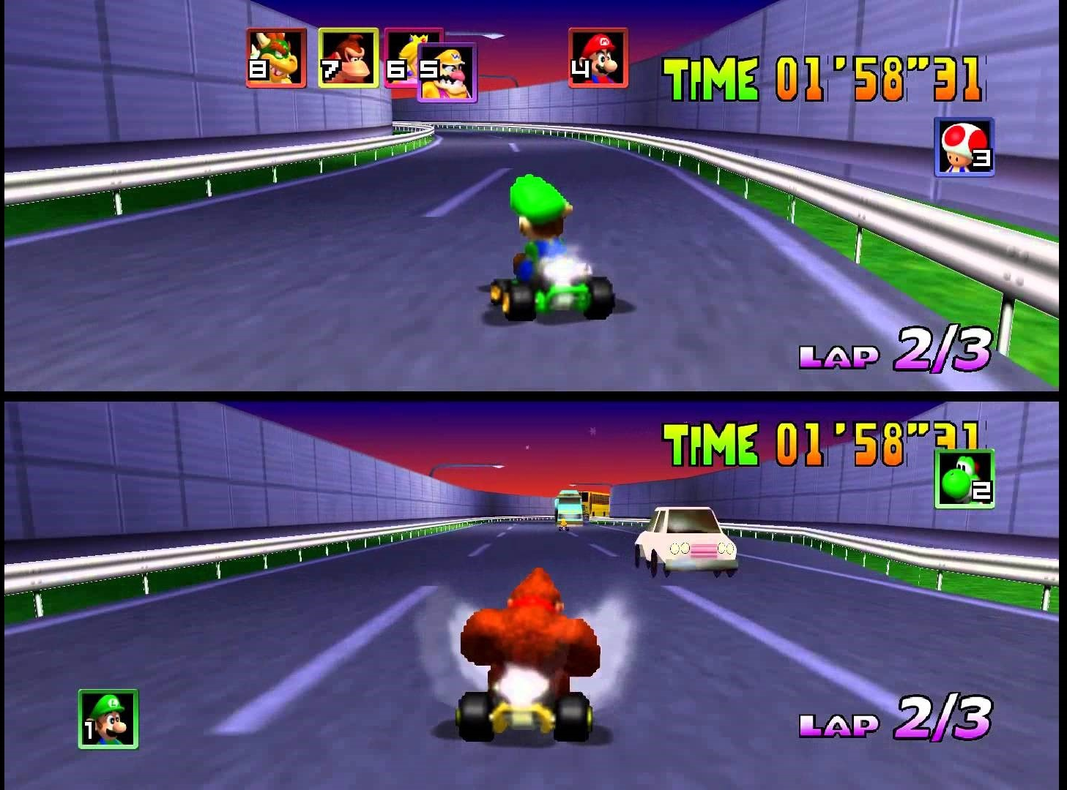
14

Slide 15

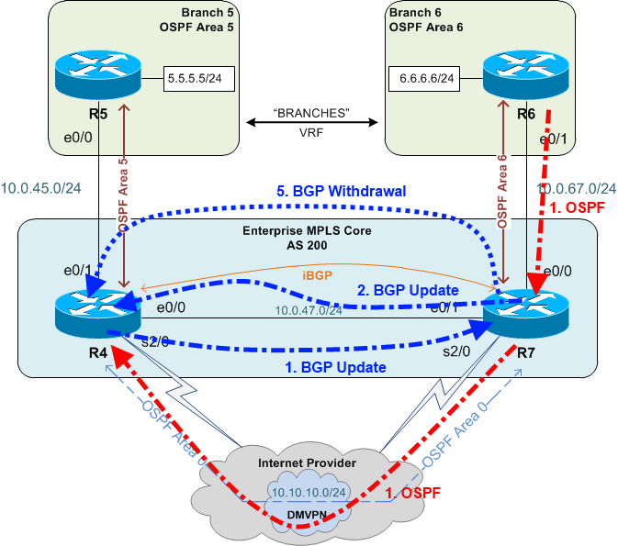
Dijkstra’s Algorithm is used for network routing
The OSPF Protocol
15

Slide 16
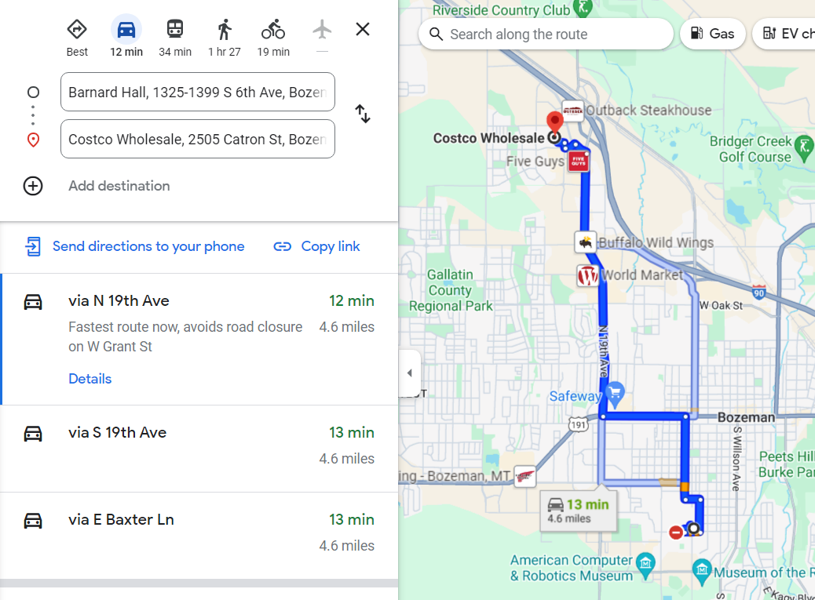
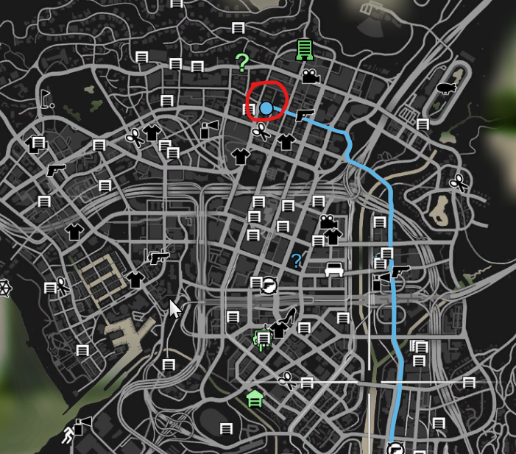
Finding shortest path on a map
16

Slide 17


Sending drones or robots on the shortest path
17

Slide 18
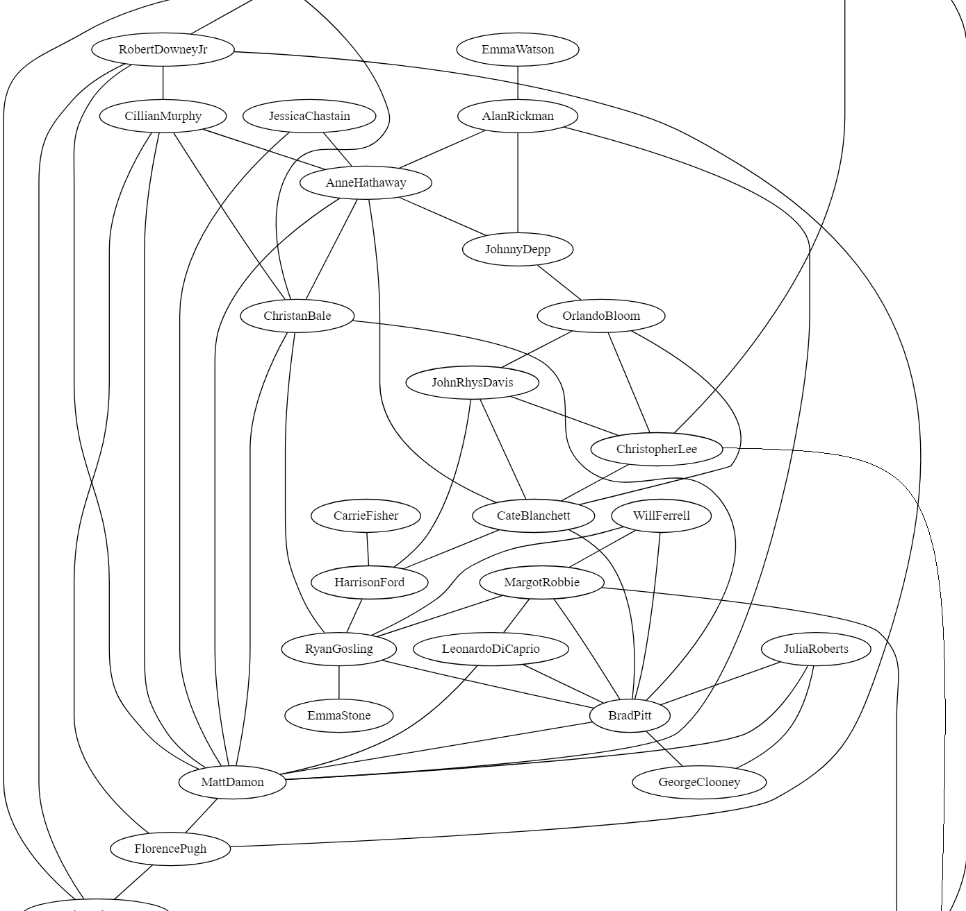
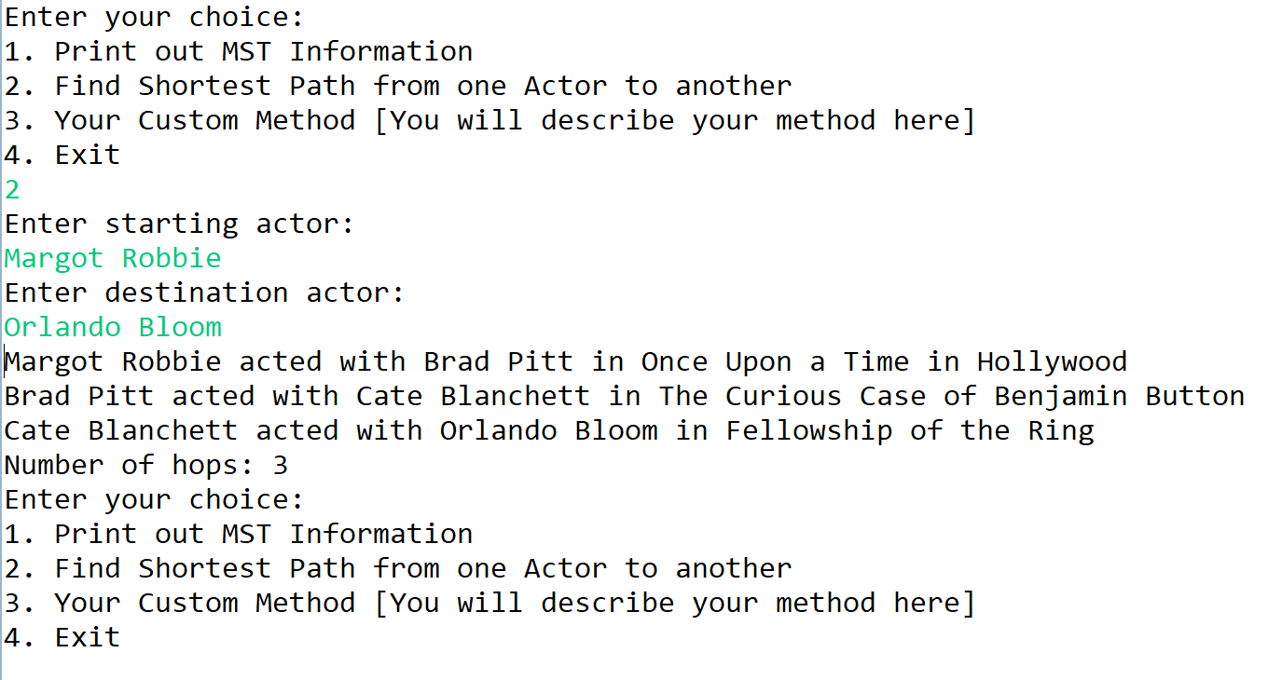
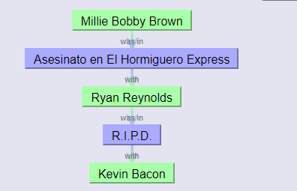



Finding Shortest Path between actors
Oracle of Bacon
18

Slide 19
Program 3
* And MST tree
19

