Slide 1

CSCI 232: Data Structures and Algorithms
Course Conclusion, Review
Reese Pearsall
Spring 2025
https://www.cs.montana.edu/pearsall/classes/spring2025/232/main.html

Slide 2
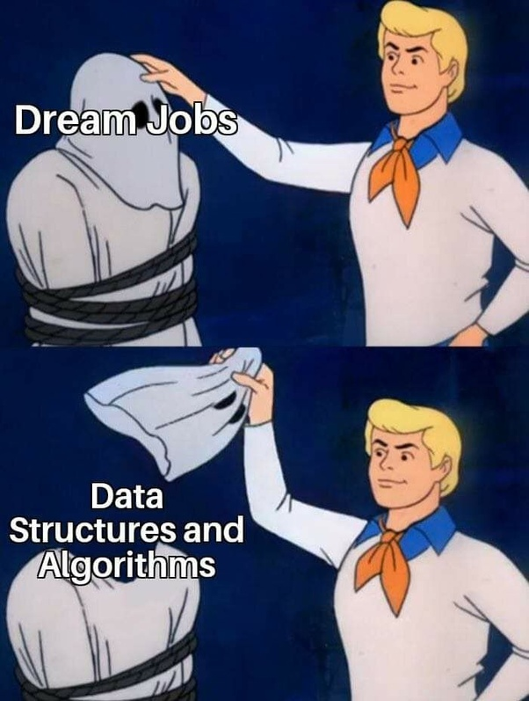
Announcements
Lab 11- Course Evaluation due tomorrow
Still need to submit a screenshot to D2L
LeetCode XC due tomorrow
Program 4 due Sunday @ 11:59 PM
Check your grades this week. Make sure nothing seems wack

Slide 3
Final Quiz
Quiz Contents
Linked Lists
Trees
BST
Heaps
Hash Tables
Graphs
Graph Algorithms
Minimum Spanning Tree
Shortest Path
Greedy Algorithms
Divide and Conquer
Dynamic Programming
Tuesday, May 6th @ 10:00 AM – 11:50 AM
Barnard Hall 103
Bring your laptop
Will be a D2L quiz just like the other quizzes, but
Cumulative
A little bit longer than the other quizzes
You can use any notes, assignments, slides, lecture recordings, documentation, but just no accessing external resources or AI tools
I’d recommend bringing a scratch piece of paper, notebook, or something you can write on
3

Slide 4
Final Quiz Review
4

Slide 5

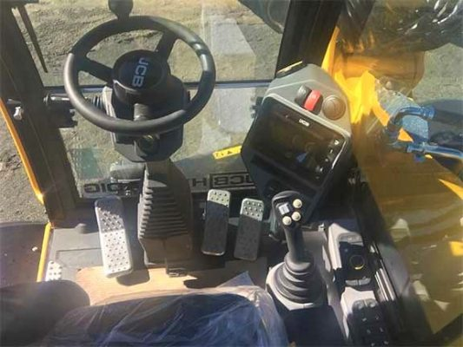


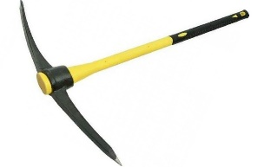


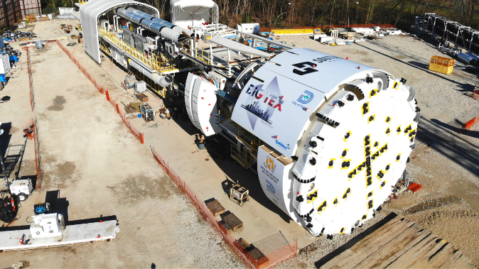


CSCI 232- Data Structures and Algorithms
“Tools”
Arrays
Linked Lists
Stacks/Queues
Hash Tables
Trees
Graphs
“Use of tools”
Sorting
Searching
Routing
Optimization
A data structure is a mechanism for storing and organizing data
An algorithm is a series of instructions to be followed to solve some problem

Slide 6
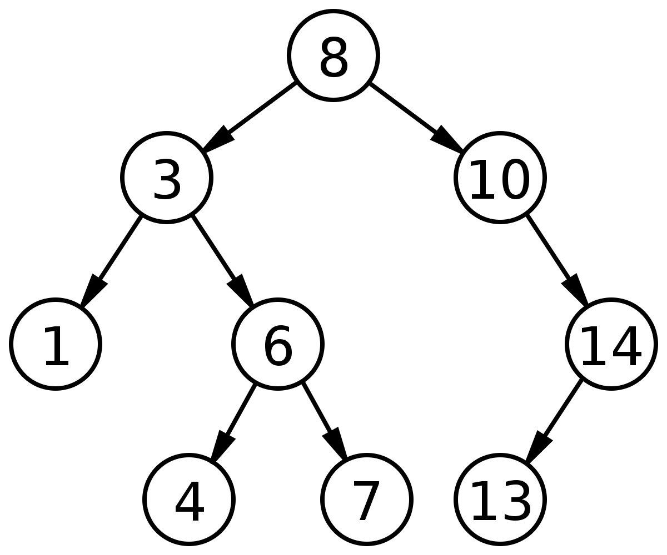


(Balanced) Binary Search Trees
O(logn) Addition Time
O(logn) Removal Time
O(logn) Search Time
Not as efficient for adding/removing, but much more efficient to search through
How to guarantee balance?
→ Red/Black Trees!
More complex operations, especially in a self-balancing tree (rotations, replacements, etc)
6

Slide 7
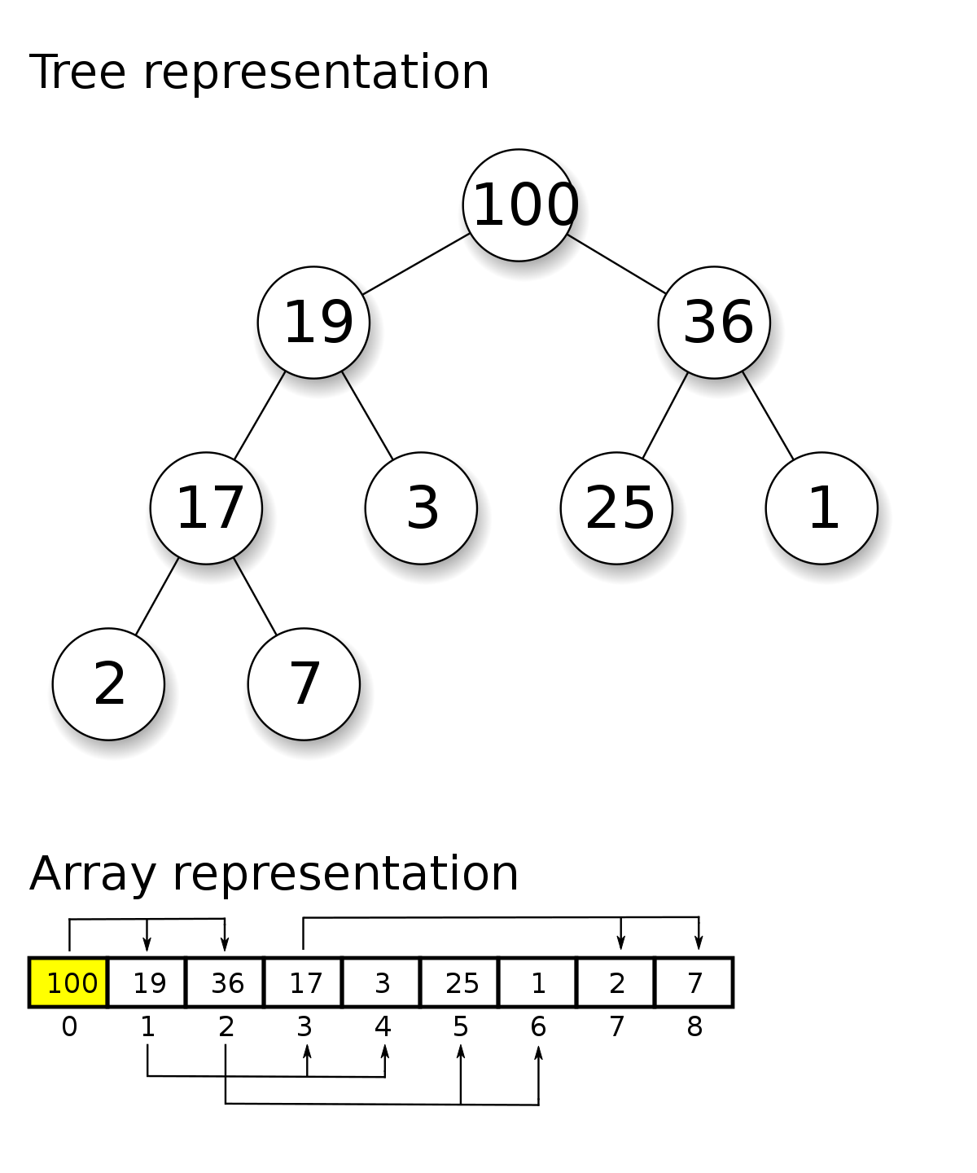
Heap
O(logn) Addition Time
O(logn) Removal Time
O(n) Search Time
O(1) Retrieving Highest Priority Element
A priority queue!!
Efficient at retrieving the highest priority element
General searches are not as efficient
Creating a heap from an (unsorted) array is also efficient
7

Slide 8

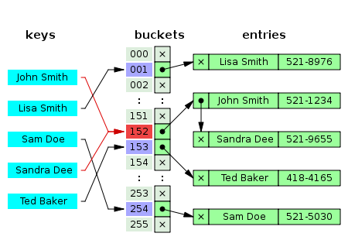


Hash Tables
O(1) Addition
O(1) Removal
O(1) Retrieval/Contains
O(n) searching if you don’t have key
(n = # of keys)
Hashing Function
Downsides
No Duplicate Keys
Unordered
Difficult to Sort
Collisions can be spooky
(These libraries are very optimized to avoid collisions ☺ )
8

Slide 9
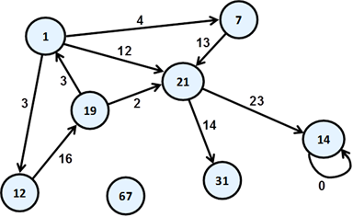
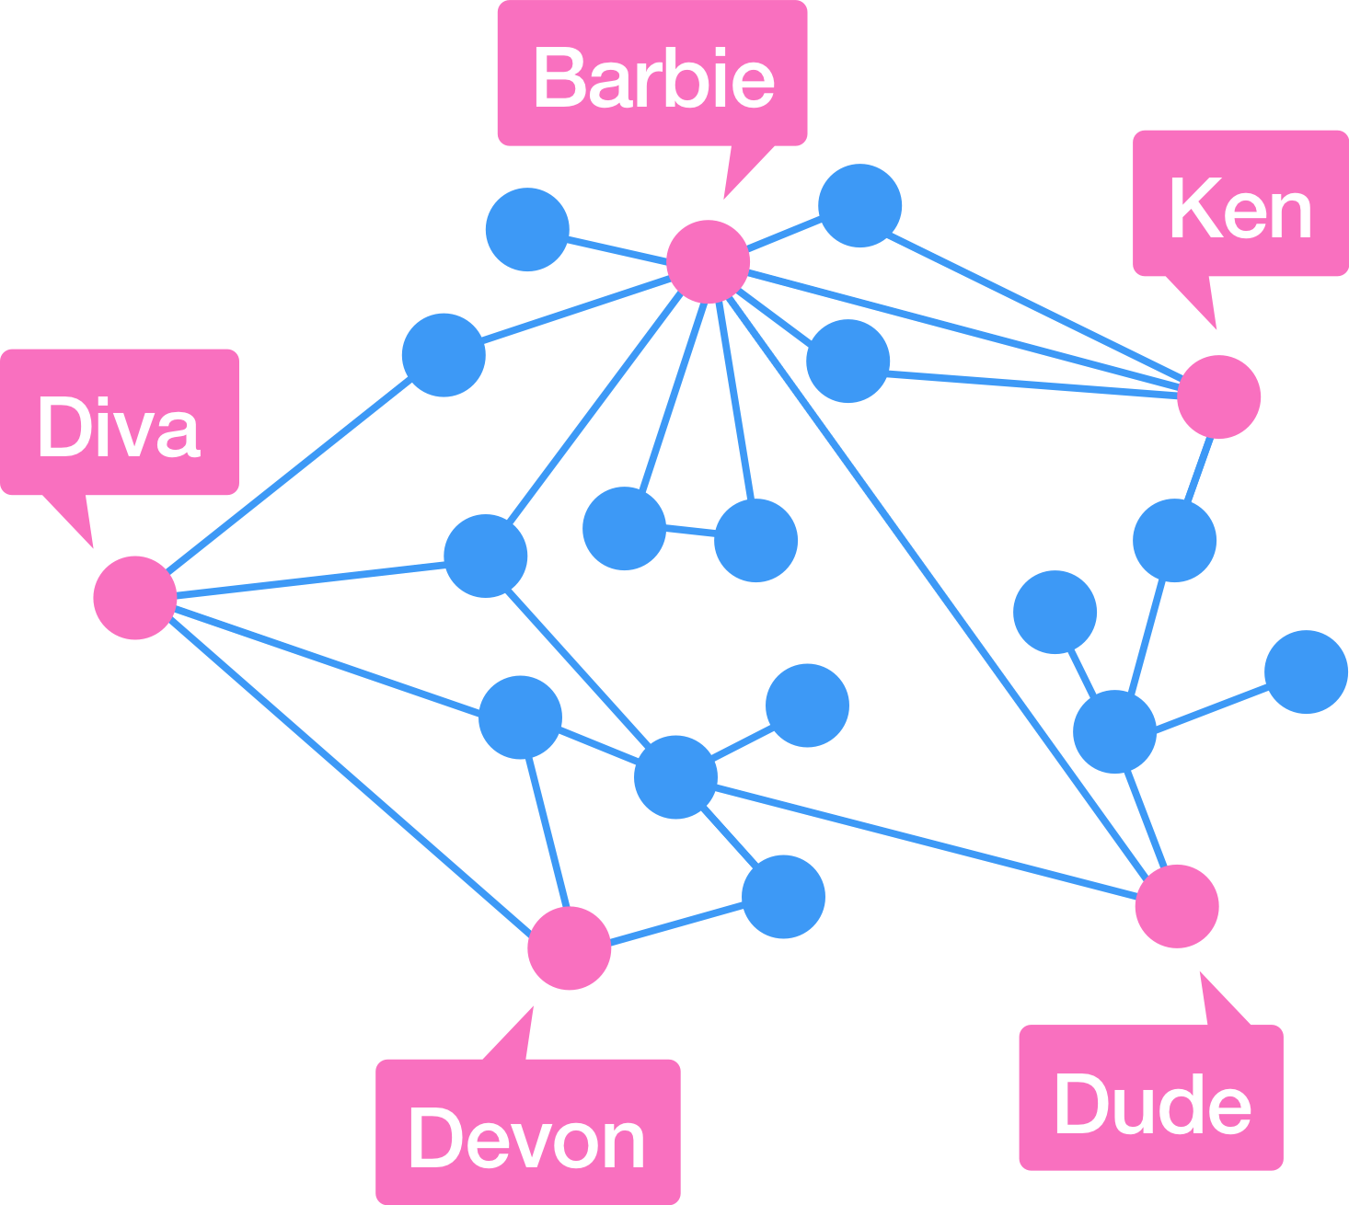
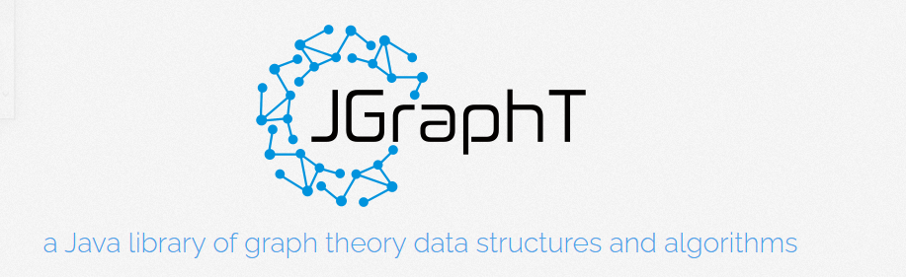
Graphs
A fundamental data structure that can be applied to many problems
Many problems that don’t seem like a graph problem can be restructured to a graph problem
Many graph algorithms can be done in polynomial time (shortest path, searching, MST)
9

Slide 10
Algorithms
Dijkstra’s Algorithm (Shortest Path)
A* (Shortest Path)
Greedy Algorithms
Knapsack Problem
Traveling Salesman
Dynamic Programming
Change Making
Rod Cutting
Edit Distance
Divide and Conquer
Closest Pair
Breadth-First
Depth-First
Heap Sort
Hashing Function
Collision Resolution
Kruskal’s Algorithm (MST)
Primm’s Algorithm (MST)
There are some problems that we don’t have an efficient algorithm for!
10

Slide 11
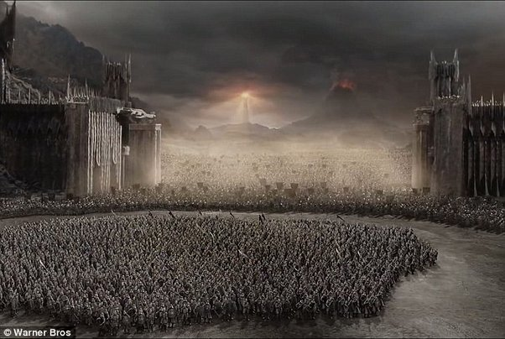
Literally every upper division CS class
CSCI 232
CS students
11

Slide 12
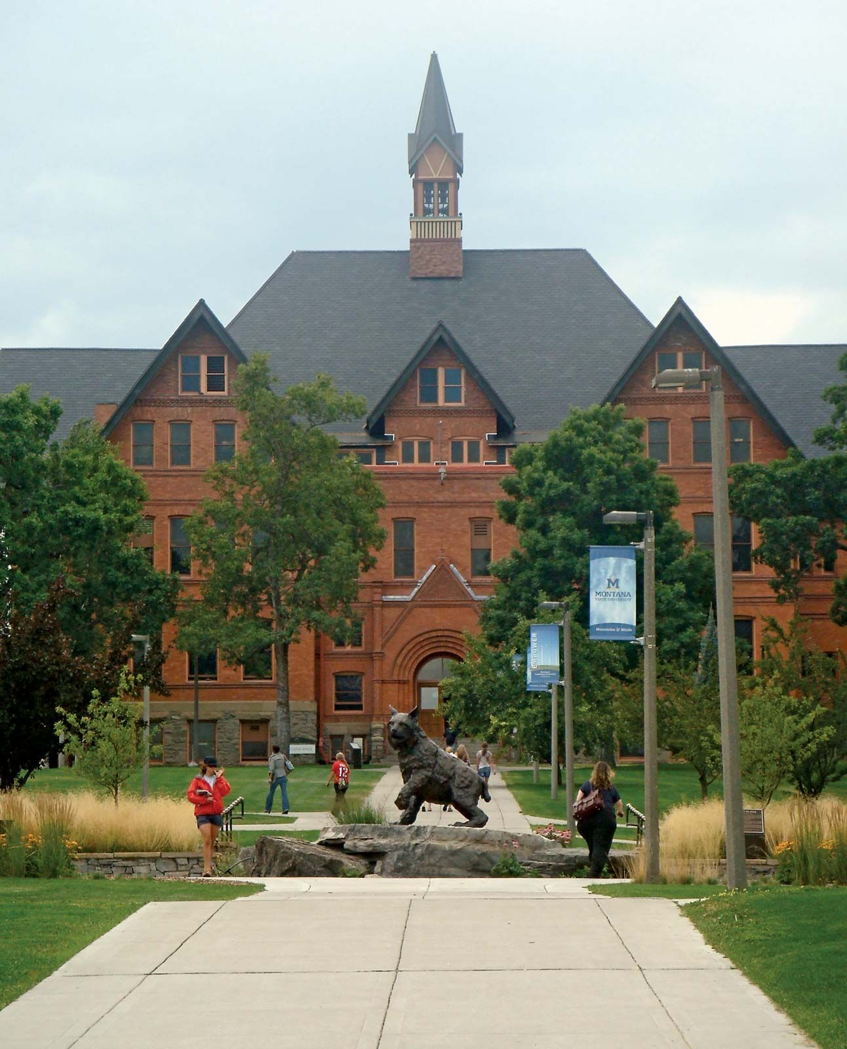


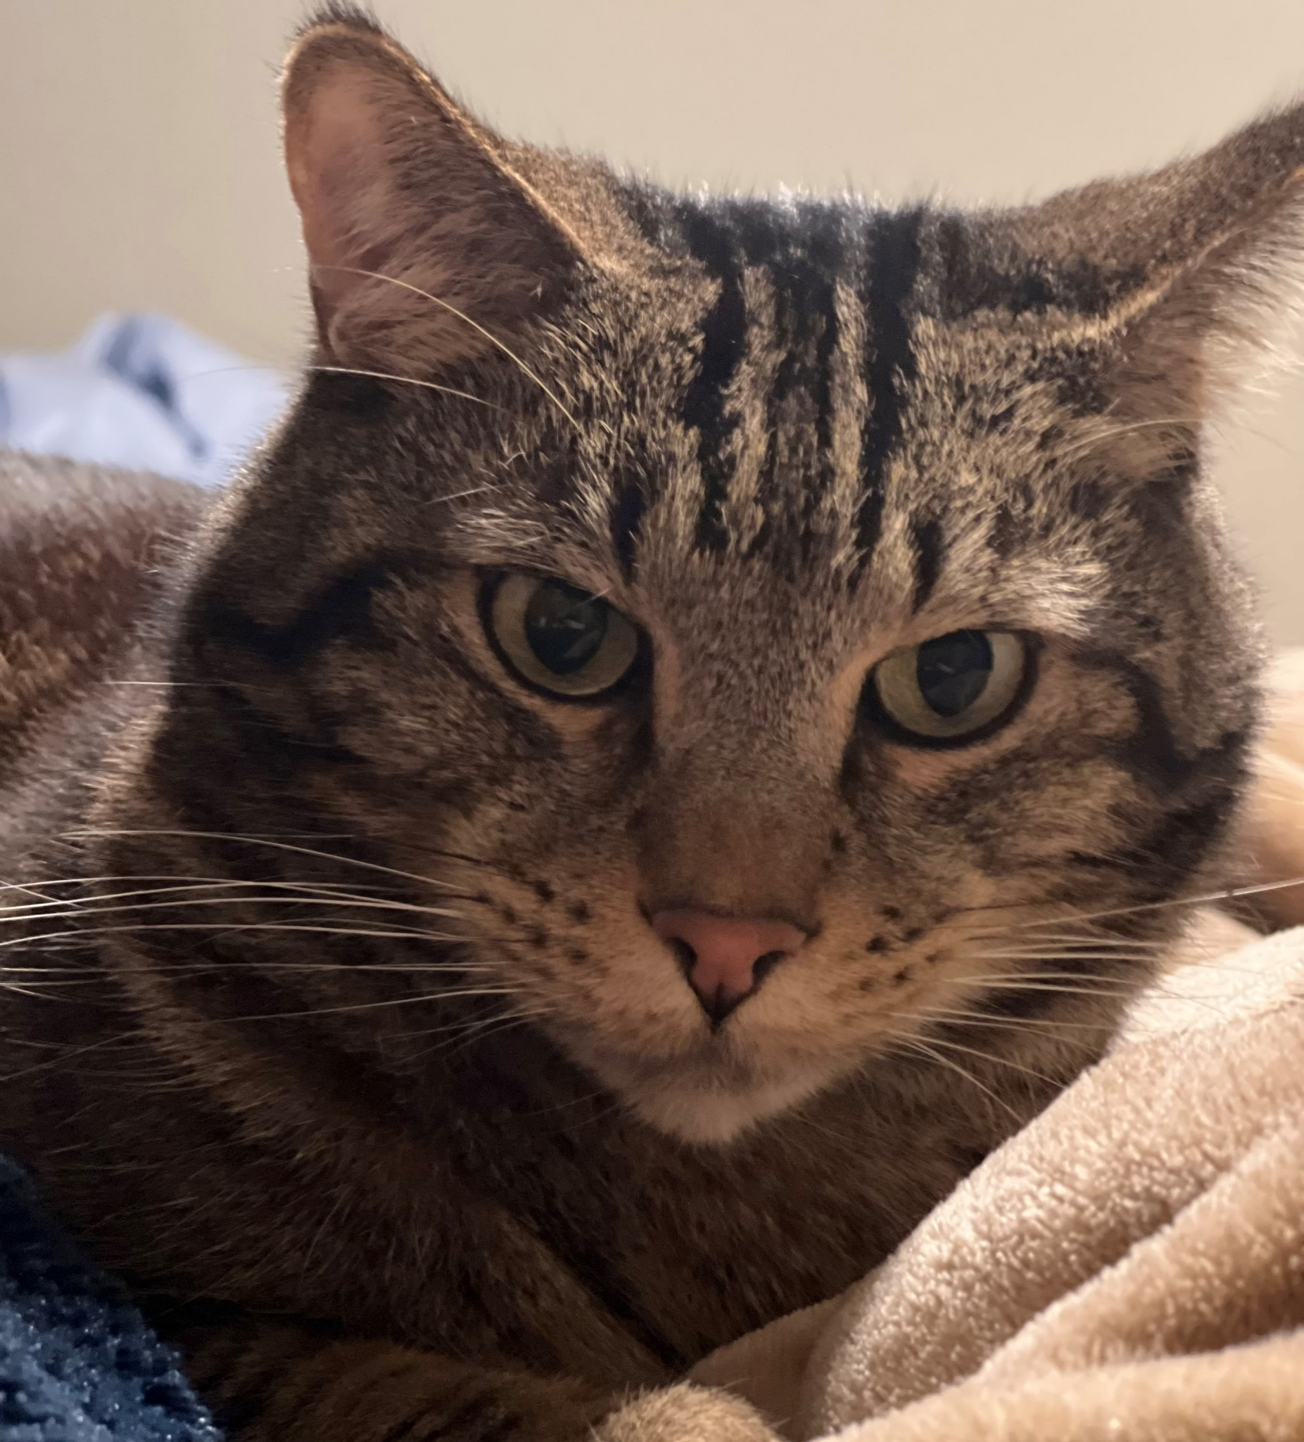
Thank You!
This class has been fun to teach. I think this class is much more enjoyable and interesting than CSCI 132.
I really enjoyed being able to have you for both CSCI 132 and CSCI 232
I hope you enjoyed this class, and I hope the stuff you learned will be helpful in your career/future classes (this is one of the most important classes you take!)
If I can be of assistance to you for anything in the future (reference, advising, support), please let me know!
(you built some pretty cool things in this class!)
I will be teaching CSCI 466, CSCI 476, and CSCI 232 next semester
Meatball wishes you good luck for finals week
Congrats to those that are graduating next weekend! I hope you find a job that you love!
Connect with me on LinkedIn!
12

