Slide 1

ESOF 422: Advanced Software Engineering: Cyber Practices
Secure by Design (Part 2)
Benefits of DDD, Immutability, Input Validation
Reese Pearsall
Spring 2025

Slide 2
Exam
If you want a third exam (finals week)
It would be optional
If you don’t take it, the average of your first two exams will be used
https://etc.ch/FTqK

Slide 3




Domain Expert
Doesn’t know how to code
Expert in the field
Not concerned about business logic
Stakeholder
Programmer
Doesn’t know how to code
Might not know details of the field
Knows business logic
Knows how to code
Might not know details of the field
Knows how to implement business logic
Domain-Driven Design: focus of modeling software to match a domain according to input from domain experts. Divide system into bounded contexts (domain primitives), each having their own model with strict contraints

Slide 4
public class Quantity {
private final int value;
public Quantity(final int value) throws Exception {
if(!inclusiveBetween(1,99)){
throw new Exception("Invalid Quantity");
}
this.value = value;
}
}
Domain primitive enforce domain rule validation at creation time
Tightens our design by explicitly stating requirements and assumptions
Deeper modeling
Another important question:
Is the object mutable or immutable ?
Mutable: allows an object to change (setters are used)
Immutable: object is not allowed to change

Slide 5

Immutability
Mutable: allows an object to change
Immutable: object is not allowed to change
If an object is mutable, then thread contention is a problem (threads will have to wait until the previous thread is done with it)
Immutable objects are safe to share between threads
Thread 1
Thread 2
Thread 3
Thread 4
Thread 5
Thread 6
Thread 1
Thread 2
Thread 3
Thread 4
Thread 5
Thread 6
val
val
val
val
wait
wait
wait
wait
wait
val
val
val

Slide 6
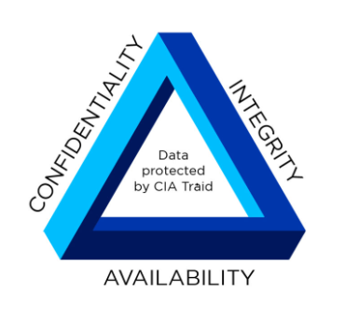
Immutability
Mutable: allows an object to change
Immutable: object is not allowed to change
If an object is mutable, then thread contention is a problem (threads will have to wait until the previous thread is done with it)
Immutable objects are safe to share between threads
Thread 1
Thread 2
Thread 3
Thread 4
Thread 5
Thread 6
Thread 1
Thread 2
Thread 3
Thread 4
Thread 5
Thread 6
val
val
val
val
wait
wait
wait
wait
wait
val
val
This is an Availability concern
val

Slide 7

public class Customer {
private static final int MIN_INVOICE_SCORE = 500;
private Id id;
private Name name;
private Order order;
private CreditScore creditScore;
Customers with at least 500 credit score can pay by invoice (good thing). Customers with a credit score less than 500 must pay by credit card (bad thing?)
Credit score is based on payment history, and is a dynamic value

Slide 8

public class Customer {
private static final int MIN_INVOICE_SCORE = 500;
…
private CreditScore creditScore;
public synchronized void setCreditScore(CreditScore creditScore) {
this.creditScore = creditScore;
}
public synchronized boolean isAcceptedForInvoicePayment() {
return creditScore.compute() > MIN_INVOICE_SCORE;
}
}
This takes some time to compute…
Synchronized = only one thread is allowed to use method at a time
Many users = threads have to wait

Slide 9
public class Customer {
private static final int MIN_INVOICE_SCORE = 500;
…
private CreditScore creditScore;
public synchronized void setCreditScore(CreditScore creditScore) {
this.creditScore = creditScore;
}
public synchronized boolean isAcceptedForInvoicePayment() {
return creditScore.compute() > MIN_INVOICE_SCORE;
}
}
Problem | Category | Probable cause
Long waits and poor performance | Availability | System fails to access customer data in a reliable way and times out
Orders timing out at checkout | Availability | The system fails to retrieve necessary data to process the order in a timely fashion

Slide 10
public class Customer {
private static final int MIN_INVOICE_SCORE = 500;
…
private CreditScore creditScore;
public synchronized CreditScore getCreditScore() {
return creditScore;
}
public synchronized void setCreditScore(CreditScore creditScore) {
this.creditScore = creditScore;
}
public synchronized boolean isAcceptedForInvoicePayment() {
return creditScore.compute() > MIN_INVOICE_SCORE;
}
Let’s look at another issue with mutable design

Slide 11
public class Customer {
private static final int MIN_INVOICE_SCORE = 500;
…
private CreditScore creditScore;
public synchronized CreditScore getCreditScore() {
return creditScore;
}
public synchronized void setCreditScore(CreditScore creditScore) {
this.creditScore = creditScore;
}
public synchronized boolean isAcceptedForInvoicePayment() {
return creditScore.compute() > MIN_INVOICE_SCORE;
}
We expect credit score to only be modified with the setter or the compute() method (synchronized)

Slide 12
public class Customer {
private static final int MIN_INVOICE_SCORE = 500;
…
private CreditScore creditScore;
public synchronized CreditScore getCreditScore() {
return creditScore;
}
public synchronized void setCreditScore(CreditScore creditScore) {
this.creditScore = creditScore;
}
public synchronized boolean isAcceptedForInvoicePayment() {
return creditScore.compute() > MIN_INVOICE_SCORE;
}
However, the getCreditScore() method returns a pointer to a mutable object!

Slide 13
public class Customer {
private static final int MIN_INVOICE_SCORE = 500;
…
private CreditScore creditScore;
public synchronized CreditScore getCreditScore() {
return creditScore;
}
public synchronized void setCreditScore(CreditScore creditScore) {
this.creditScore = creditScore;
}
public synchronized boolean isAcceptedForInvoicePayment() {
return creditScore.compute() > MIN_INVOICE_SCORE;
}
However, the getCreditScore() method returns a pointer to a mutable object!
This value can be modified outside of the class without requiring a lock! (scary)

Slide 14
public class Customer {
private static final int MIN_INVOICE_SCORE = 500;
…
private CreditScore creditScore;
public synchronized CreditScore getCreditScore() {
return creditScore;
}
Lessons Learned:
The mutability of an object can impact the availability and integrity of your system
Problem | Category | Probable cause
Long waits and poor performance | Availability | System fails to access customer data in a reliable way and times out
Orders timing out at checkout | Availability | The system fails to retrieve necessary data to process the order in a timely fashion
Inconsistent payment options | Integrity | Credit score can be changed in an illegal way

Slide 15
public class Customer {
private static final int MIN_INVOICE_SCORE = 500;
…
private final CreditScore creditScore;
public boolean isAcceptedForInvoicePayment() {
return creditScore.check();
}
public class CreditScore {
private static final int MIN_INVOICE_SCORE = 500;
…
private final int score;
public CreditScore(final int computedCreditScore){
//validation checks
this.score = computedCreditScore;
}
public boolean check() {
return score > MIN_INVOICE_SCORE;
}
}
The final keyword in Java makes an object immutable
Choosing a design that favors immutability, the need for locks and protections against illegal change disappear
How to change Customer Data if its Immutable?
→ See “Entity Snapshot pattern”

Slide 16

External vs Internal Primitive
Defined by RFC
Defined by You
-
-
email
email
External Context
Your context

Slide 17
External vs Internal Primitive
Our “library” of domain primitives that don’t rely on external definitions
-
-
email
ISBN
-
-
ISBN
quantity
External Context
Your context

Slide 18
Passing Primitives
public void sendAuditLogsToServerAt(java.net.InetAddress serverAddress) {
}
By accepting a domain primitive (InternalAddress), it ensures the logs will be sent to a valid IP address
Refactor
Remember, the existence of a domain primitive means that is has to be valid!
public void sendAuditLogsToServerAt(InternalAddress serverAddress) {
notNull(serverAddress)
}
If you are building a public API, you should not reveal domain information

Slide 19
class Order {
private BookRepository bookCatalog;
private ArrayList<Object> items;
private boolean paid = false;
Inventory inventory;
public void addItem(String isbn, int qty) {
if (this.paid == false) {
notNull(isbn);
isTrue(isbn.length() == 10);
isTrue(isbn.matches("[0-9X]+"));
isTrue(isbn.matches("[0-9]{9}[0-9X]"));
Book book = bookCatalog.findByISBN(isbn);
if (inventory.availableBooks(isbn) >= qty) {
items.add(new OrderLine(book, qty));
}
}
}
...
}

Slide 20
class Order {
private BookRepository bookCatalog;
private ArrayList<Object> items;
private boolean paid = false;
Inventory inventory;
public void addItem(String isbn, int qty) {
if (this.paid == false) {
notNull(isbn);
isTrue(isbn.length() == 10);
isTrue(isbn.matches("[0-9X]+"));
isTrue(isbn.matches("[0-9]{9}[0-9X]"));
Book book = bookCatalog.findByISBN(isbn);
if (inventory.availableBooks(isbn) >= qty) {
items.add(new OrderLine(book, qty));
}
}
}
...
}
This method does not treat ISBN and Quantity as domain primitives
It does validation checking on a few different things
It is missing checks for negative values!

Slide 21
class Order {
private BookRepository bookCatalog;
private ArrayList<Object> items;
private boolean paid = false;
Inventory inventory;
public void addItem(String isbn, int qty) {
if (this.paid == false) {
notNull(isbn);
isTrue(isbn.length() == 10);
isTrue(isbn.matches("[0-9X]+"));
isTrue(isbn.matches("[0-9]{9}[0-9X]"));
Book book = bookCatalog.findByISBN(isbn);
if (inventory.availableBooks(isbn) >= qty) {
items.add(new OrderLine(book, qty));
}
}
}
...
}
If a method does validation checks on several different arguments, this method can become cluttered, which increases the chances of missing something
Tip: Leave domain validation to domain primitives
isNotNegative(qty)
isLessThan(99)

Slide 22
class Order {
private BookRepository bookCatalog;
private ArrayList<Object> items;
private boolean paid = false;
Inventory inventory;
public void addItem(ISBN isbn, Quantity qty) {
notNull(isbn);
notNull(qty);
if (this.paid == false) {
Book book = bookCatalog.findByISBN(isbn);
if (inventory.availableBooks(isbn) >= qty) {
items.add(new OrderLine(book, qty));
}
}
}
...
}
isbn and qty are already valid before entering method
Validation only needs to happen in the domain primitive class, resulting in less cluttering, and less chance of missing something
Class ISBN {
private final String value;
public ISBN(String isbn){
//validation checks here
value = isbn
}
}
Class Quantity {
private final int value;
public ISBN(int q){
//validation checks here
value = q
}
}

Slide 23
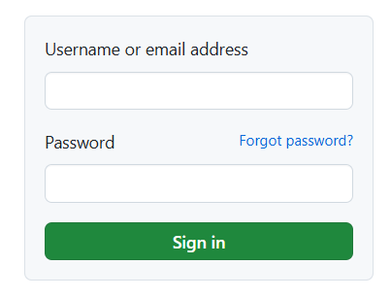
Input Checking
The attack surface of your system will usually always include areas of untrusted user input
The most severe vulnerabilities are usually due to lack of input checking or input validation
SQL Injections
XSS Attacks
Path Traversal
Availability Attacks
‘;DROP table Users where 0=0;--
<script> //steal cookies </script>
“;cat ../../../../etc/shadow
AAAAAAAAAAAAAAAAAAAA

Slide 24
Input Checking
Is this a “valid” input?
‘;DROP table Users where 0=0;--
99.9% of the time, this isn’t valid
Bad
Unexpected inputs → Unexpected Behaviors → Potential Vulnerabilities
Good
Unexpected inputs → Input Validation → Only expected behaviors → More secure

Slide 25
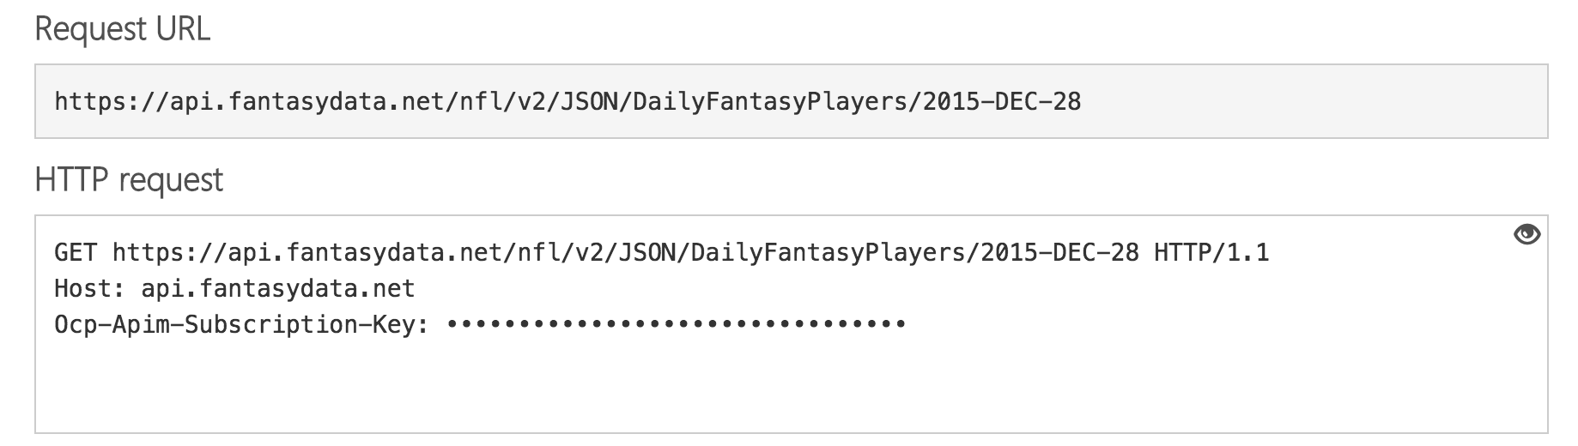
Steps of input validation
1. Origin – Is the data from a legitimate sender?
Check source IP address (Whitelists, Cloud configuration)
Require use of API key or Access Token

Slide 26
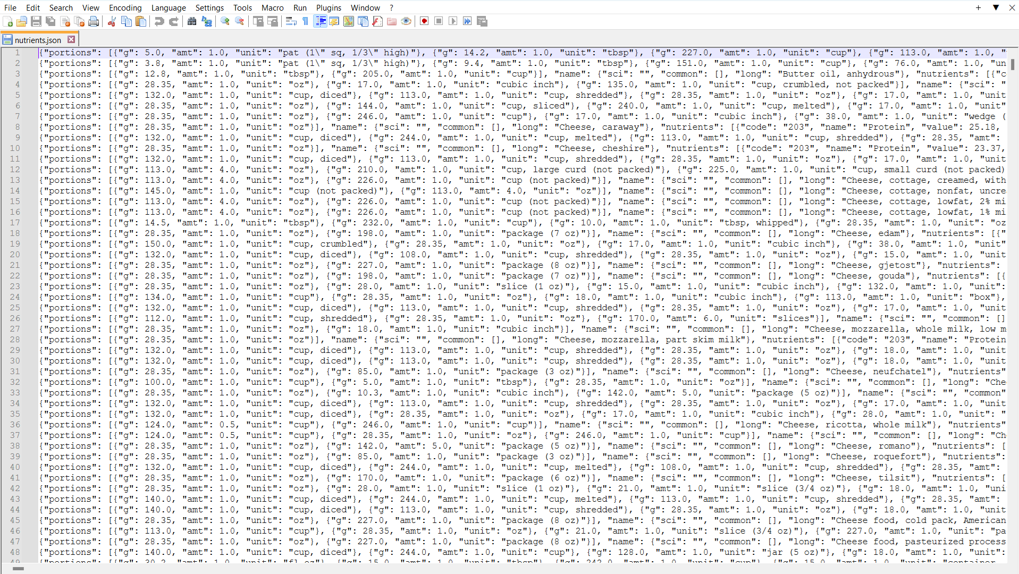
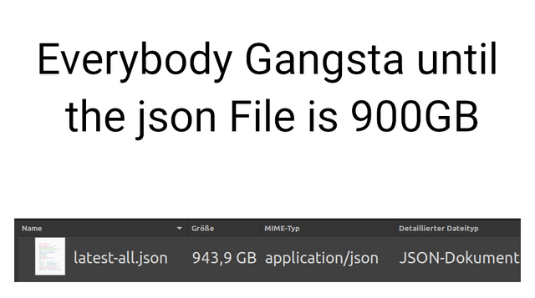
Steps of input validation
Origin – Is the data from a legitimate sender?
Size – Is the input reasonably large?
HTTP Content-Length header
Is 10 MB of JSON reasonable? What about 10 GB of JSON?

Slide 27
Steps of input validation
Origin – Is the data from a legitimate sender?
Size – Is the input reasonably large?
Lexical Content – Does it contain the right characters and encoding ?
; , < > -- Have special meanings in programming languages, which often makes them part of an attack. Do those characters make sense in an email address input box?
isTrue(isbn.matches(“[0-9x]*”));
Filter out or encode special characters
<script>
&lt;script&gt;

Slide 28
Steps of input validation
Origin – Is the data from a legitimate sender?
Size – Is the input reasonably large?
Lexical Content – Does it contain the right characters and encoding ?
Syntax– Is the format right?
XML – Do all opening tags have an ending tag?
JSON – Are key value pairs correctly defined and follow correct JSON syntax ?
HTTP – Does it contain the HTTP method? Does it have the necessary headers?

Slide 29
Steps of input validation
Origin – Is the data from a legitimate sender?
Size – Is the input reasonably large?
Lexical Content – Does it contain the right characters and encoding ?
Syntax– Is the format right?
Semantics– Does it make sense?
Are the actual input values valid for the domain ?
If input is selecting an item to add to cart, does the item actually exist?

Slide 30
Taint Analysis
Tainted code analysis looks at the flow of potentially tainted input and flags potentially malicious before it is used
Username: input1
Password: input2
Email: input3
Data is used in an SQL query
SELECT * WHERE Username==input1 and Password==input2 and Email == input3

Slide 31
Taint Analysis
Tainted code analysis looks at the flow of potentially tainted input and flags potentially malicious before it is used
These are the sources
Username: input1
Password: input2
Email: input3
Areas where malicious code may be introduced
Data is used in an SQL query
SELECT * WHERE Username==input1 and Password==input2 and Email == input3

Slide 32
Taint Analysis
Tainted code analysis looks at the flow of potentially tainted input and flags potentially malicious before it is used
These are the sources
Username: input1
Password: input2
Email: input3
Areas where malicious code may be introduced
Data is used in an SQL query
These is a sink
SELECT * WHERE Username==input1 and Password==input2 and Email == input3
Areas where input is used in application

Slide 33
Taint Analysis
Tainted code analysis looks at the flow of potentially tainted input and flags potentially malicious before it is used
These are the sources
Username: input1
Password: input2
Email: input3
Areas where malicious code may be introduced
Username input validation
Password input validation
Ideally, all user inputs should be sanitized
These is a sink
SELECT * WHERE Username==input1 and Password==input2 and Email == input3
Areas where input is used in application

Slide 34
Taint Analysis
Tainted code analysis looks at the flow of potentially tainted input and flags potentially malicious before it is used
These are the sources
Username: input1
Password: input2
Email: input3
Areas where malicious code may be introduced
Ideally, all user inputs should be sanitized
Username input validation
Password input validation
It’s possible an input could never be sanitized, which creates security concern
These is a sink
SELECT * WHERE Username==input1 and Password==input2 and Email == input3
Areas where input is used in application

Slide 35

Taint Analysis
Tainted code analysis looks at the flow of potentially tainted input and flags potentially malicious before it is used
Taint analysis keeps track of the flow of user input data, and makes sure all sources are sanitized
These are the sources
Username: input1
Password: input2
Email: input3
tainted: true
tainted: true
tainted: true
Ideally, all user inputs should be sanitized
Username input validation
Password input validation
tainted: false
tainted: false
These is a sink
SELECT * WHERE Username==input1 and Password==input2 and Email == input3
Areas where input is used in application

