Slide 1

ESOF 422: Advanced Software Engineering: Cyber Practices
Secure by Design (Part 3)
Software Development Lifecycle, Testing
Reese Pearsall
Spring 2025

Slide 2
Announcements
Third exam will take place during finals week
This exam is optional
If you don’t take it, the average of your first two exam scores will be used instead
The exam will largely cover the second half of the semester, but there may be material from earlier this semester
Next homework posted. Due Friday April 4th
→ Coding-based project

Slide 3
HW 4

Slide 4
Software Development Lifecycle
Plan
Develop
Test
Deploy
Operate

Slide 5

Software Development Lifecycle
“Continuous Delivery Pipeline”
CI/CD
Plan
Develop
Test
Deploy
Operate

Slide 6
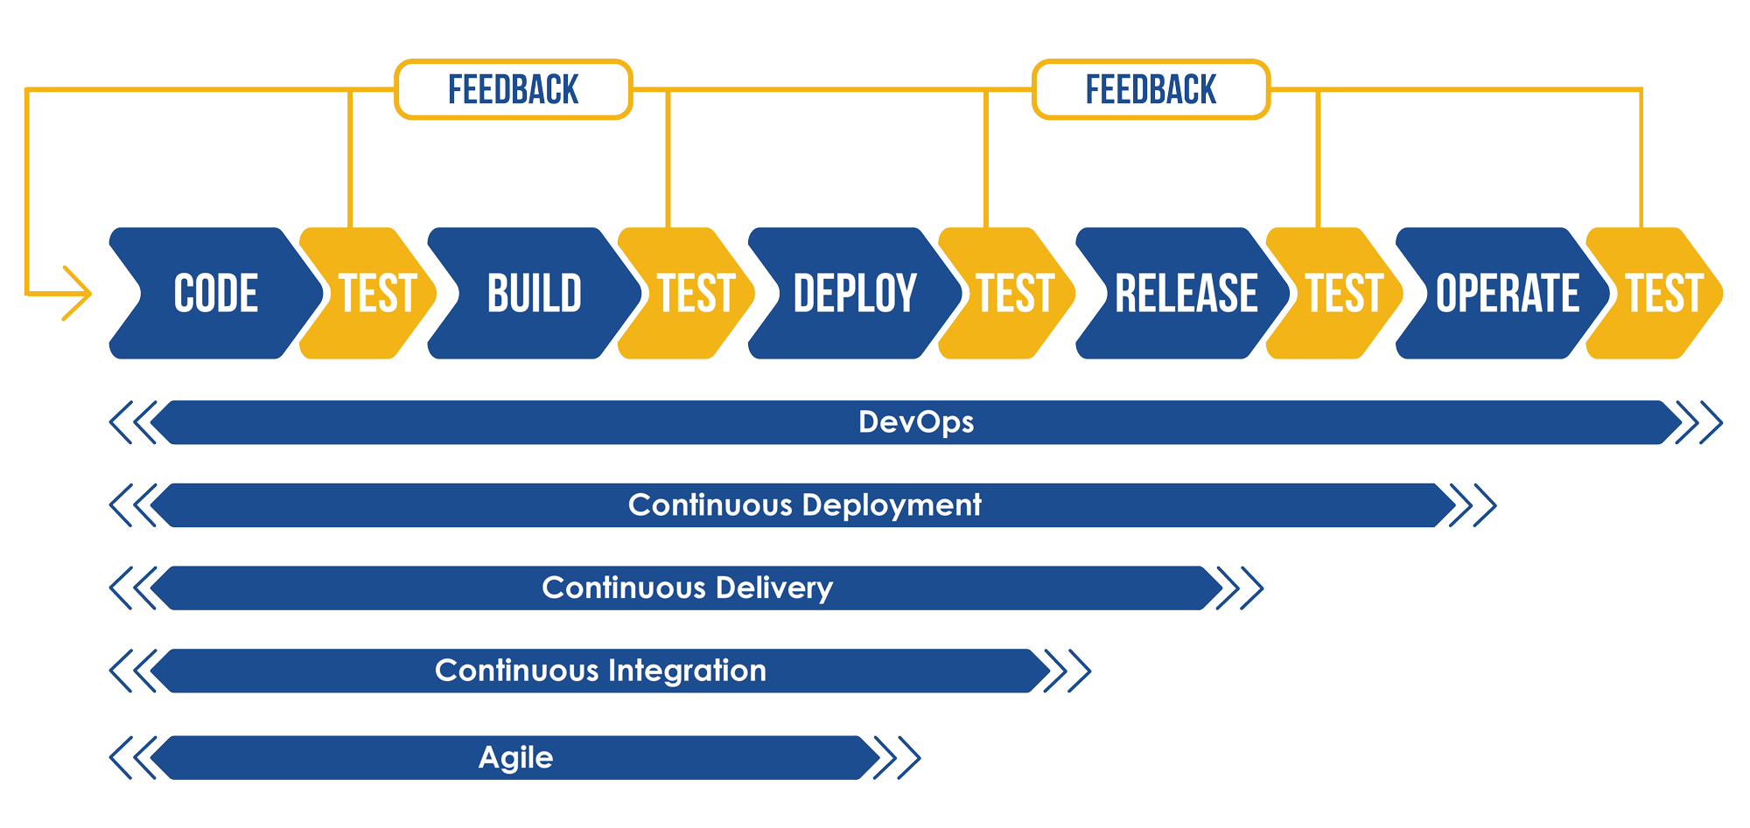

Slide 7
Software Development Lifecycle
Plan
Develop
Test
Deploy
Operate

Slide 8
Secure Development Lifecycle (SDL)
Plan
Consider Security
Develop
Consider security
Test
Consider Security
Deploy
Consider Security
Operate
Consider Security

Slide 9
Secure Development Lifecycle (SDL)
Plan
Consider Security
Develop
Consider security
Test
Consider Security
Deploy
Consider Security
Operate
Consider Security
Clearly Define the requirements
Compliance- requirement to adhere to specific standards and regulations to ensure CIA
Many software issues and vulnerabilities can be linked to poor requirement gathering
Gaps in security
How should encryption and authentication be handled?
Performance Issues
Estimated user load?
Physical servers and database requirements?
Compliance Regulations
Healthcare data must be HIPPA compliant
Credit card data must be PCI compliant

Slide 10
Secure Development Lifecycle (SDL)
Plan
Consider Security
Develop
Consider security
Test
Consider Security
Deploy
Consider Security
Operate
Consider Security
“How?”
Generate UML Class Diagrams, Sequence Diagrams
Are there any design patterns?
What external components are there?
Secure Architecture- Apply security principles when designing the system
Principle of least privilege: Giver users the minimum level of access necessary to perform their tasks.

Slide 11
Secure Development Lifecycle (SDL)
Plan
Consider Security
Develop
Consider security
Test
Consider Security
Deploy
Consider Security
Operate
Consider Security
“How?”
Generate UML Class Diagrams, Sequence Diagrams
Are there any design patterns?
What external components are there?
Secure Architecture- Apply security principles when designing the system
Principle of secure defaults: The default configurations should favor security rather than convenience

Slide 12
Secure Development Lifecycle (SDL)
Plan
Consider Security
Develop
Consider security
Test
Consider Security
Deploy
Consider Security
Operate
Consider Security
Code Responsibly
Try to step in the shoes of an attacker
Bug vs vulnerability ?

Slide 13
Secure Development Lifecycle (SDL)
Plan
Consider Security
Develop
Consider security
Test
Consider Security
Deploy
Consider Security
Operate
Consider Security
Code Responsibly
Try to step in the shoes of an attacker
Bug- an unintended flaw in code that cause incorrect or unexpected behavior
Vulnerability- a bug that creates some weakness that can be exploited

Slide 14
Secure Development Lifecycle (SDL)
Plan
Consider Security
Develop
Consider security
Test
Consider Security
Deploy
Consider Security
Operate
Consider Security
Code Responsibly
Try to step in the shoes of an attacker
Secure coding practices (NIST, OWASP)
Static code analysis tools

Slide 15
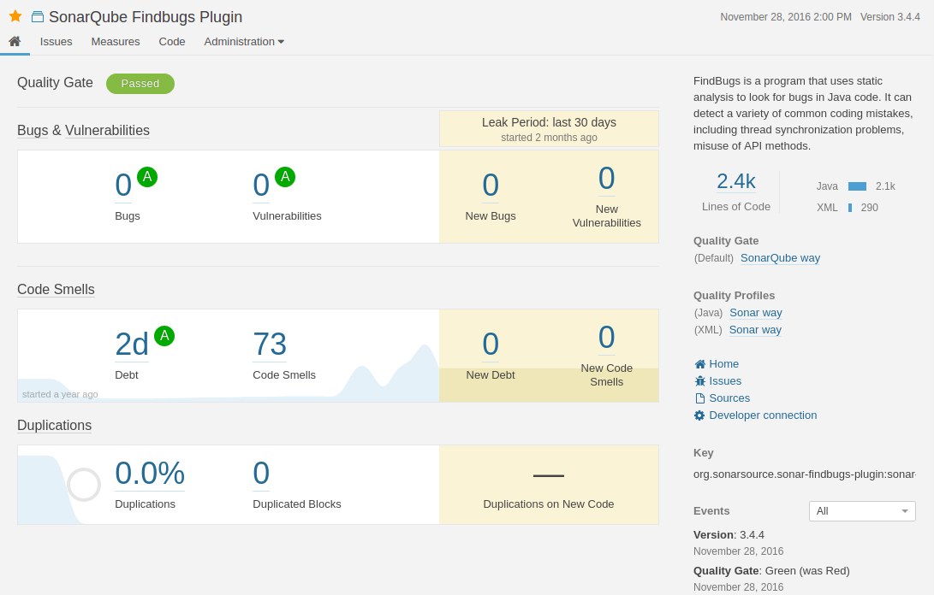
Secure Development Lifecycle (SDL)
Plan
Consider Security
Develop
Consider security
Test
Consider Security
Deploy
Consider Security
Operate
Consider Security
Sonar Qube is an excellent static analysis tools that can automatically scan for bugs and vulnerabilities in source code,
Code Smells- poor coding practices that don’t necessarily cause errors
Technical Debt- the cost of taking shortcuts during the software development process

Slide 16
Secure Development Lifecycle (SDL)
Plan
Consider Security
Develop
Consider security
Test
Consider Security
Deploy
Consider Security
Operate
Consider Security
Software tests and security tests are not the same thing
Software tests focus on software failure and intended design
Software security tests adds a focused adversary
Security flaws are more difficult and more expensive to six later in the development lifecycle

Slide 17
Secure Development Lifecycle (SDL)
Plan
Consider Security
Develop
Consider security
Test
Consider Security
Deploy
Consider Security
Operate
Consider Security
White Box
Tester knows all information about system.
Including source code, design, requirements.
Most efficient technique.
Black Box
Examines system as an outsider world
Tester builds understanding of attack surface and system internals during test process
Can use to evaluate effort required to attack system

Slide 18
Secure Development Lifecycle (SDL)
Plan
Consider Security
Develop
Consider security
Test
Consider Security
Deploy
Consider Security
Operate
Consider Security
Normal Input Testing
Verifies that the design accepts input that clearly passes the domain rules, ensuring that the code handles vanilla input correctly
Boundary Input Testing
Verifies that only structurally correct input is accepted. Examples of boundary checks include length, size, and quantity.
Invalid Input Testing
Verifies that the design doesn’t break when invalid input is handled. Empty data structures, null, and strange characters are often considered invalid input.
Extreme Input Testing
Verifies that design doesn’t break when extreme inputs are handled. For example, such input may include a string of 40 million characters.

Slide 19
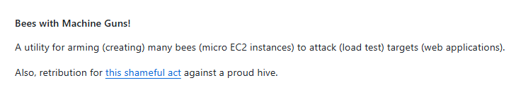
Secure Development Lifecycle (SDL)
Plan
Consider Security
Develop
Consider security
Test
Consider Security
Deploy
Consider Security
Operate
Consider Security
Bees with machine guns is a command line utility
Availability of system is important. However, unit tests cannot really be written to taest for availability
For load testing web applications for scenarios such as DDOS attacks

Slide 20
Secure Development Lifecycle (SDL)
Plan
Consider Security
Develop
Consider security
Test
Consider Security
Deploy
Consider Security
Operate
Consider Security
Ensure cloud instance is configured correctly
Enable all necessary services, disable all unnecessary services
Accumulate all third-party security components in the supply chain
Libraries
API
Package Managers

Slide 21

Secure Development Lifecycle (SDL)
Plan
Consider Security
Develop
Consider security
Test
Consider Security
Deploy
Consider Security
Operate
Consider Security
Log and monitor traffic to detect anomalies and potential threats
A security operations center (SOC) is an team that monitors, detects, analyzes, and respond to cyberthreats to protect an organization’s system

Slide 22
Secure Development Lifecycle (SDL)
Plan
Consider Security
Develop
Consider security
Test
Consider Security
Deploy
Consider Security
Operate
Consider Security
Log and monitor traffic to detect anomalies and potential threats
Incidence Response Plan
Application maintenance and patching

Slide 23

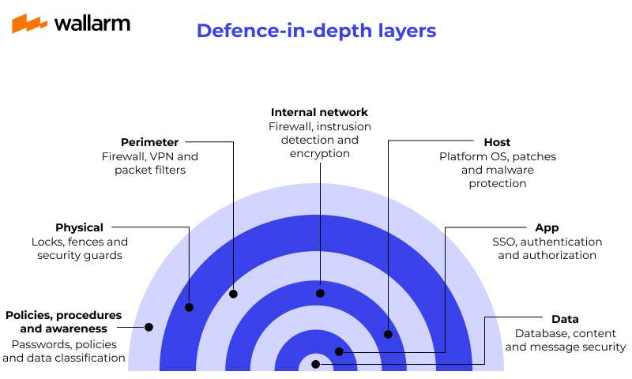



Defense-in-Depth is a principle that states multiple layers of security should be implemented in case one layer fails

Slide 24



Security flaws can often come from configuration-related issues
Misunderstood
Unintentional
Unintuitive API
Bad Merge
Poor Documentation
Typo
Missing Test
Missing Test
Security Flaw by Configuration
New Feature
Upgrade Dependency
Missing Test
Intentional

Slide 25





Software Development Lifecycle
Plan
Develop
Test
Deploy
Operate

