Slide 1

ESOF 422: Advanced Software Engineering: Cyber Practices
Threat Modeling, Mitigating Threats, Security Reviews
Reese Pearsall
Spring 2025

Slide 2

During the secure software development lifecycle, we consider security at each step of the development process
Plan
Consider Security
Develop
Consider security
Test
Consider Security
Deploy
Consider Security
Operate
Consider Security
During the Planning/Design face, we need to consider design flaws and potential vulnerabilities of the system

Slide 3
Threat Modeling is a formal approach for analyzing the security and potential risks of some system
Risk- The potential for loss and damage when the threat occurs
Vulnerability- a weaknesses that exposes an organization to a threat
Exploit- some type of attack/approach to take advantage of a vulnerability
Must think from the perspective of an attacker, and identify potential vulnerabilities
Threat modeling allows you to identify and (hopefully) eliminate design issues in your system prior to implementation
It is an industry best practice to validate and implement the defenses that were derived from the threat model
Threat modeling isn’t a super complex process, but it is an incredibly valuable skill in the cyber world

Slide 4
How do we actually “do” threat modeling?
Threat modeling boils down to answer four essential questions:
What are we building? (Provides scope and assets of threat modeling)
What can go wrong? (Identify potential vulnerabilities)
What are we going to do about it? (Provide countermeasure for Q2)
Did we do a good job? (Reflect on answers, and go back to Q1 if needed)
Other interesting questions worth answering:
Who are the adversaries?
What is their motive?

Slide 5

Optional steps of Threat Modeling
It is helpful to define the trust boundaries of the system
Trust Boundary- a point where a system’s level of trust changes from untrusted to trusted
Attacks and vulnerabilities typically occur at the trust boundary
Most web applications are exposed to the public internet, which is an untrusted zone
Trusted zones
Internal networks
Authenticated information
Input sanitized
Public Internet
API
Internal Database

Slide 6
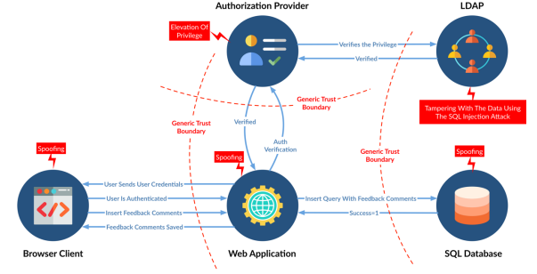
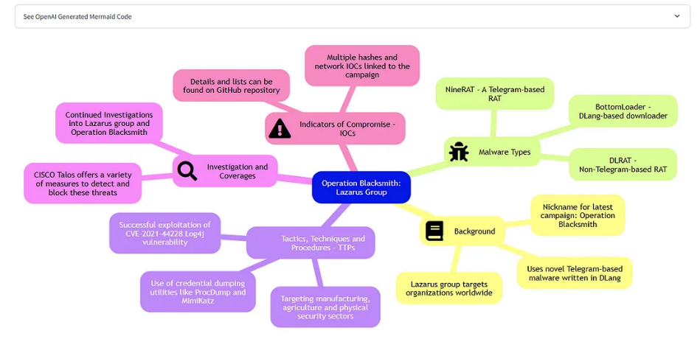
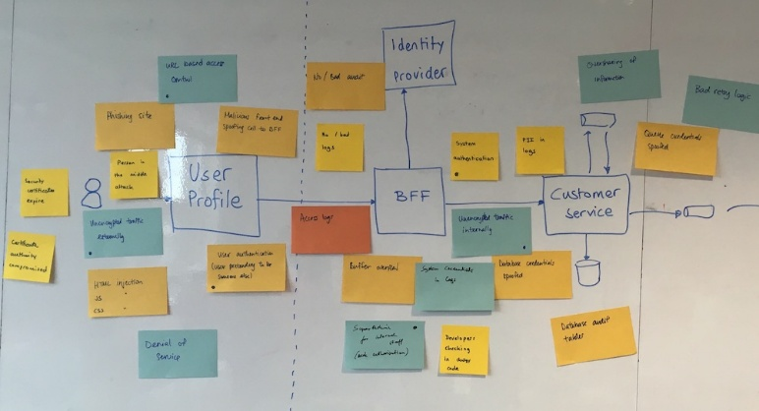
What are we building?
What can go wrong?
What are we going to do about it?
Did we do a good job?
Answering Questions
We answering questions, we typically start with a high-level diagram of the system and list of requirements
Mind Map
Brainstorm, Answer in Writing, Whiteboard
Mind map or Diagram
Research similar systems
Generate scenarios
Use a structured threat modeling approach
Whiteboard w/ Sticky Notes

Slide 7
What are we building?
What can go wrong?
What are we going to do about it?
Did we do a good job?
STRIDE
STRIDE is a model made by Microsoft for identifying security threats during threat modeling
Widely-used in industry
Classifies attacks under 6 different categories
Spoofing – illegally accessing and then using another user’s authentication information or pretending to be someone else
Ex. Identify theft, spoofing packets to do something malicious

Slide 8
What are we building?
What can go wrong?
What are we going to do about it?
Did we do a good job?
STRIDE
STRIDE is a model made by Microsoft for identifying security threats during threat modeling
Widely-used in industry
Classifies attacks under 6 different categories
Tampering – malicious modification of data (Data integrity violation)
Ex. Database modifications, packet tampering

Slide 9
What are we building?
What can go wrong?
What are we going to do about it?
Did we do a good job?
STRIDE
STRIDE is a model made by Microsoft for identifying security threats during threat modeling
Widely-used in industry
Classifies attacks under 6 different categories
Repudiation – users deny performing a malicious action without parties having any way to prove otherwise
Ex. No logging or auditing done on system

Slide 10
What are we building?
What can go wrong?
What are we going to do about it?
Did we do a good job?
STRIDE
STRIDE is a model made by Microsoft for identifying security threats during threat modeling
Widely-used in industry
Classifies attacks under 6 different categories
Information Disclosure – Exposing data to unauthorized users
Ex. password leaks, API key hardcoded, error message leaking

Slide 11
What are we building?
What can go wrong?
What are we going to do about it?
Did we do a good job?
STRIDE
STRIDE is a model made by Microsoft for identifying security threats during threat modeling
Widely-used in industry
Classifies attacks under 6 different categories
Denial of service– Denying service to a user (Availability violation)
Ex. DDOS attacks

Slide 12
What are we building?
What can go wrong?
What are we going to do about it?
Did we do a good job?
STRIDE
STRIDE is a model made by Microsoft for identifying security threats during threat modeling
Widely-used in industry
Classifies attacks under 6 different categories
Elevation of Privilege– An unprivileged user gains access and does an action they should not be able to do
Ex. SET-UID program exploit to gain root access

Slide 13

Spoofing
Tampering
Repudiation
Information Disclosure
Denies of Service
Elevation of Privilege
STRIDE
Let’s apply STRIDE threats to the famous heist movie Ocean’s Eleven (2001)
The story follows friends Danny Ocean (Clooney) and Rusty Ryan (Pitt), who plan a heist of $160 million from casino owner Terry Benedict (García), the lover of Ocean's ex-wife Tess (Roberts).

Slide 14
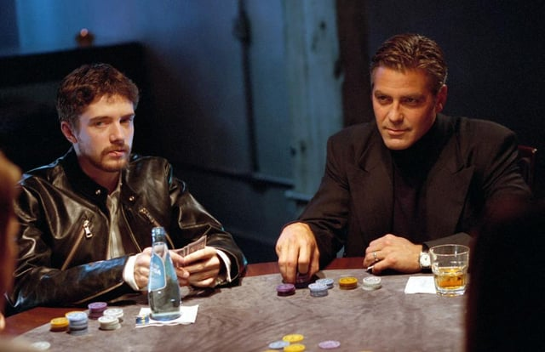
Spoofing
Tampering
Repudiation
Information Disclosure
Denial of Service
Elevation of Privilege
STRIDE
Danny violates his parole and flies out to meet his partner in crime, Rusty
With low permissions (parole) he is able to escape and fly across the country → Elevation of Privilege

Slide 15
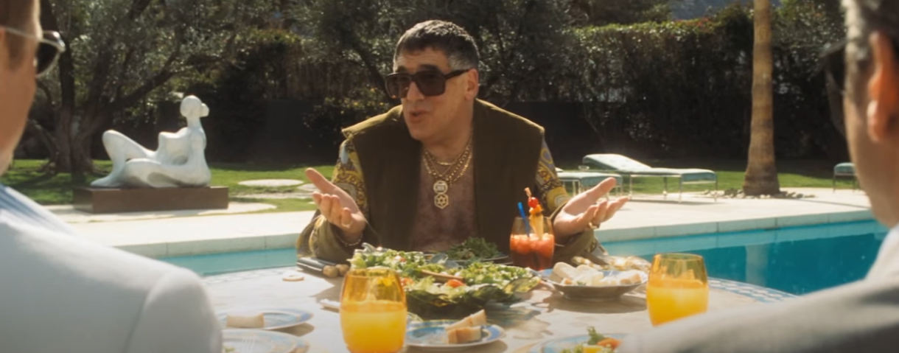
Spoofing
Tampering
Repudiation
Information Disclosure
Denial of Service
Elevation of Privilege
STRIDE
Danny and Rusty meet with a casino insider, who provides them with sensitive operational details of the victim casino → Information Disclosure

Slide 16
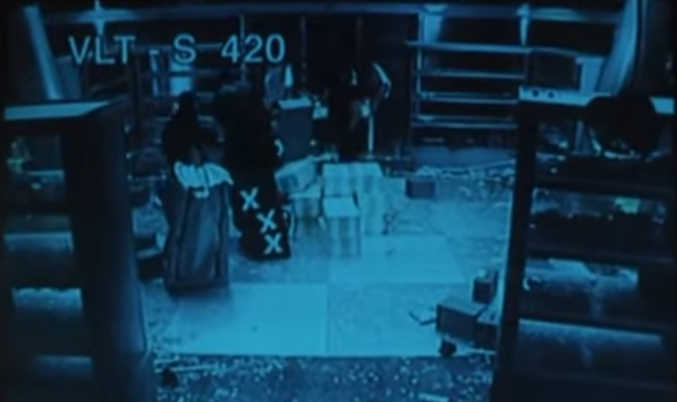
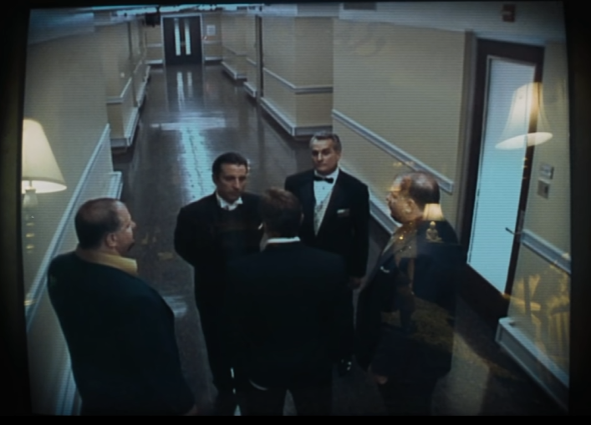
Spoofing
Tampering
Repudiation
Information Disclosure
Denial of Service
Elevation of Privilege
STRIDE
Before the heist, Danny is apprehended by security, which gives him a perfect alibi → Repudiation of guilt

Slide 17
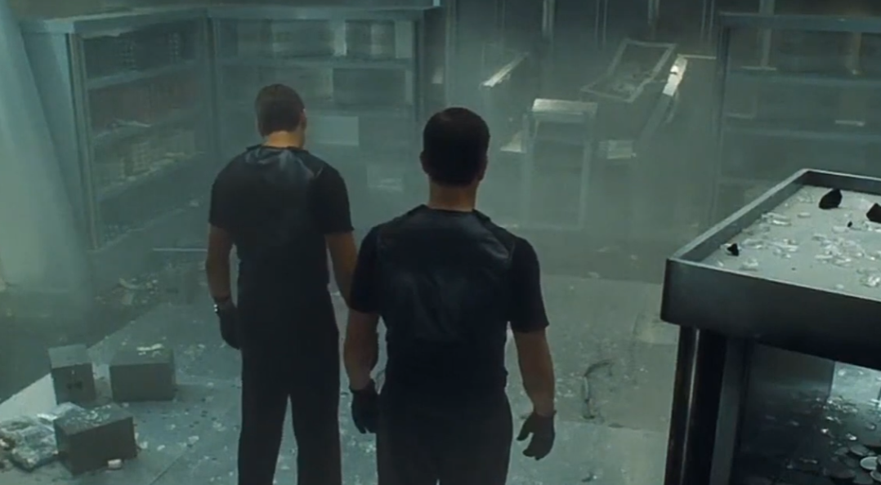
Spoofing
Tampering
Repudiation
Information Disclosure
Denial of Service
Elevation of Privilege
STRIDE
Danny and his team end up stealing half of money from the vault later that night (Tampering of integrity of vault)

Slide 18
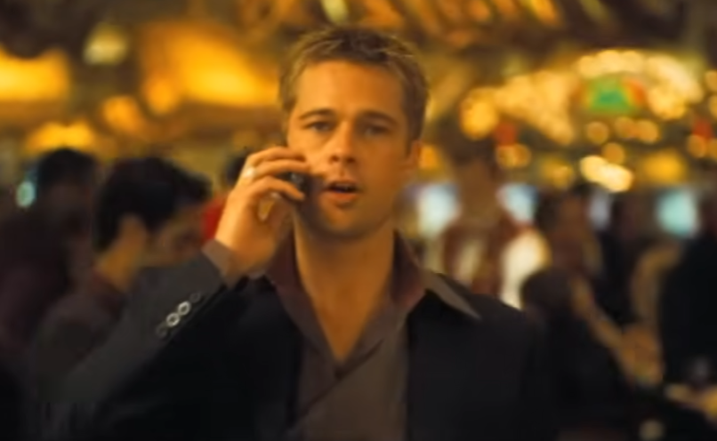
Spoofing
Tampering
Repudiation
Information Disclosure
Denial of Service
Elevation of Privilege
STRIDE
Rusty threatens to blow up the entire vault if the casino doesn’t allow them to steal half of the money (a very expensive Denial of Service)

Slide 19
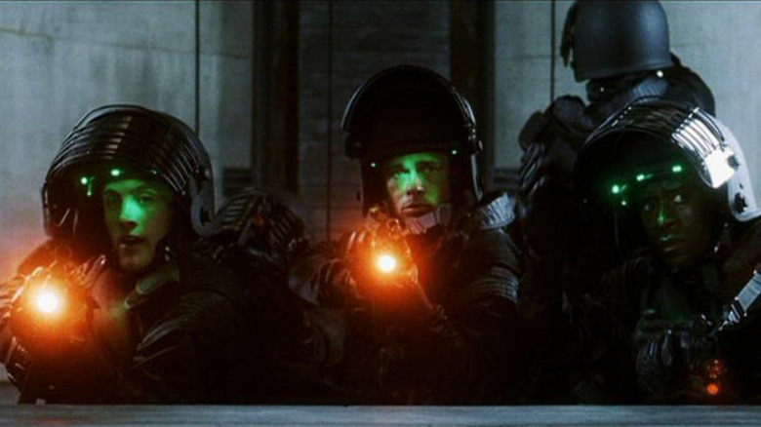
Spoofing
Tampering
Repudiation
Information Disclosure
Denial of Service
Elevation of Privilege
STRIDE
The team impersonates as the Las Vegas SWAT to extract the money → Spoofing and Elevation of Privilege

Slide 20
Mitigating Risks for Threat Modeling
What are we building?
What can go wrong?
What are we going to do about it?
Mitigate the risk by either redesigning or add defense (most common)
Remove the threatened asset entirely, or reduce exposure
Transfer the risk to a third party, usually in exchange for compensation
Accept the risk and accept consequences
4. Did we do a good job?

Slide 21
Let’s get some hands-on practice

Slide 22
CatCloud if a file-sharing web application that allows users to upload and share files that are stored on some remote server

Slide 23
CatCloud if a file-sharing web application that allows users to upload and share files that are stored on some remote server
- Users log in to website with a username and password
catcloud.com
Browser Client

Slide 24
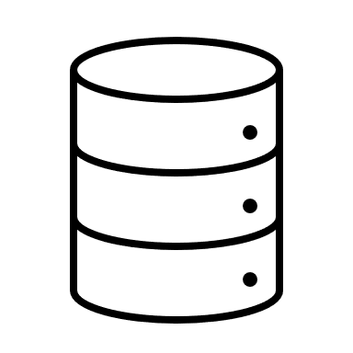
CatCloud if a file-sharing web application that allows users to upload and share files that are stored on some remote server
Users log in to website with a username and password
Login request is sent to a CatCloud API (via HTTP) and then queries an internal SQL database to check for correct login
catcloud.com
Check login request
Browser Client
Log in
CatCloud API
Allow/Reject
Authenticated
Update Account Info
Operation Complete
SQL Database
User Information
HTTP

Slide 25
File Storage Server
CatCloud if a file-sharing web application that allows users to upload and share files that are stored on some remote server
Users log in to website with a username and password
Login request is sent to a CatCloud API (via HTTP) and then queries an internal SQL database to check for correct login
Users can upload files to the file server (POST), delete a file (DELETE), or view a file (GET) by sending a request to the API
FTP
Fetch File/Delete File/Upload File
File returned
catcloud.com
Check login request
Browser Client
Log in
CatCloud API
Allow/Reject
Authenticated
Request File
Update Account Info
Return File
Operation Complete
SQL Database
User Information
HTTP
GET catcloudapi.com/retrieve?filename=meatball&userid=12053754
DELETE catcloudapi.com/delete?filename=embarrassingpicture&userid=12053754

Slide 26
Group Activity Time !
Go to a whiteboard with a group of (2-4) students (or you can work alone) and threat model this system!
What are the assets of CatCloud ?
What can go wrong?
There are many answers here. Step into the shoes of an evil hacker
This could be generally risk, or a specific type of attack
Think about common weaknesses, lack of requirements, and stuff from CSCI 476, 466, 460, 440
For each weakness state what kind of CIA violation it is
You can just do bullet points, mind maps, or STRIDE
3. What can we do about it?
For each item from Q2, propose a countermeasure that would mitigate or remove the threat
Please write your name(s) next to your threat model ☺

