Slide 1

ESOF 422: Advanced Software Engineering: Cyber Practices
Penetration Testing (Introduction, Reconnaissance)
Reese Pearsall
Spring 2025

Slide 2


Announcements
HW4 due Friday at 11:59 PM
Zip up your Java workspace and submit to Brightspace
No hardcopy needed
Fridays will be “lab days”
We will work through some in-class examples or
You will work through parts of the homework
Attendance is still encouraged unless I tell you otherwise
Even when vulnerabilities are fixed with a patch, those same patches can introduce new vulnerabilities ☺

Slide 3
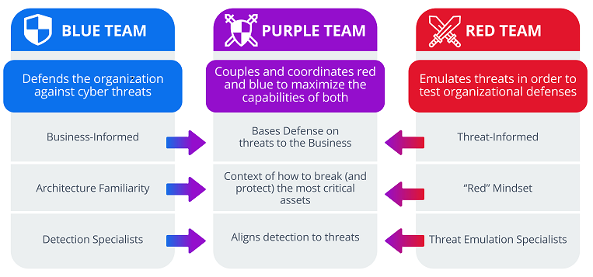
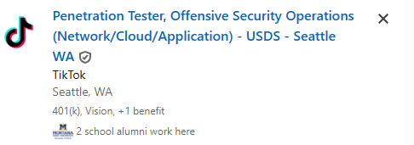

Penetration Testing (pen testing) is an authorized simulated cyber attack launched against a system to evaluate its security
Another instance of ethical hacking
These tests are done by a security expert of a group of experts
Helps identify vulnerabilities before attackers can exploit them
authorized- an organization allows them to “hack” them (no legal consequences)
These vulnerabilities range from simple social engineering attacks to fully-fledged RCE exploits
The process of penetration testing includes several steps, but the main parts are finding vulnerabilities and exploiting them (with permission)
“Red Teamers” are often the integral part of penetration tests

Slide 4
Types of Penetration Testing
Overt- Pen Testers work with the organization and IT team and are have full knowledge of the system and network
Requires less time and skill
Can uncover many more vulnerabilities
Covert- Pen testers have no knowledge of the system and organization’s IT are not aware that they are pen testers
Requires more time and skill.
More closely simulates a real cyber attack
May find less vulnerabilities

Slide 5

Penetration Testing Phases
Preengagement Interaction- Meet with client, and discuss scope of penetration test

Slide 6
Penetration Testing Phases
Preengagement Interaction- Meet with client, and discuss scope of penetration test
Intelligence Gathering- Find information about client (legally)
Who they are
How it operates
What mechanism are in place
What services are open
Openings

Slide 7
Penetration Testing Phases
Preengagement Interaction- Meet with client, and discuss scope of penetration test
Intelligence Gathering- Find information about client (legally)
Who they are
How it operates
What mechanism are in place
What services are open
Openings
Threat Modeling- Identify potential vulnerabilities

Slide 8
Penetration Testing Phases
Preengagement Interaction- Meet with client, and discuss scope of penetration test
Intelligence Gathering- Find information about client (legally)
Who they are
How it operates
What mechanism are in place
What services are open
Openings
Threat Modeling- Identify potential weaknesses
Vulnerability Analysis- Determine if the vulnerability exists and is viable to exploit

Slide 9
Penetration Testing Phases
Preengagement Interaction- Meet with client, and discuss scope of penetration test
Intelligence Gathering- Find information about client (legally)
Who they are
How it operates
What mechanism are in place
What services are open
Openings
Threat Modeling- Identify potential weaknesses
Vulnerability Analysis- Determine if the vulnerability exists and is viable to exploit
Exploitation- Send target malicious payload to exploit vulnerability

Slide 10
Penetration Testing Phases
Preengagement Interaction- Meet with client, and discuss scope of penetration test
Intelligence Gathering- Find information about client (legally)
Who they are
How it operates
What mechanism are in place
What services are open
Openings
Threat Modeling- Identify potential weaknesses
Vulnerability Analysis- Determine if the vulnerability exists and is viable to exploit
Exploitation- Send target malicious payload to exploit vulnerability
Post Exploitation- What sensitive data can be found, and how much damage can be caused.

Slide 11
Penetration Testing Phases
Preengagement Interaction- Meet with client, and discuss scope of penetration test
Intelligence Gathering- Find information about client (legally)
Who they are
How it operates
What mechanism are in place
What services are open
Openings
Threat Modeling- Identify potential weaknesses
Vulnerability Analysis- Determine if the vulnerability exists and is viable to exploit
Exploitation- Send target malicious payload to exploit vulnerability
Post Exploitation- What sensitive data can be found, and how much damage can be caused.
Reporting- Provide an executive summary about weaknesses found and suggest countermeasures

Slide 12
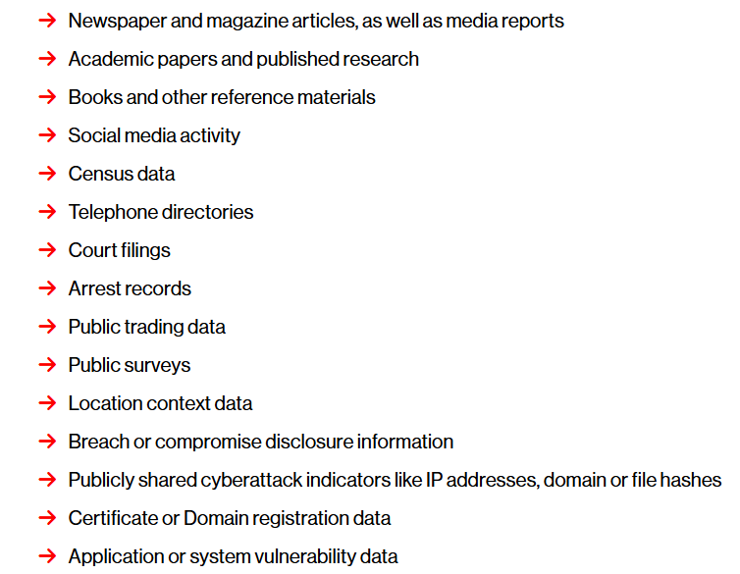
Intelligence Gathering
OSINT (Open-Source Intelligence) is the process of collecting and analyzing publicly available information
Very helpful for the penetration testing process
Target Profiling
Leaked Credentials
Social Engineering
Physical Access
Identifying threat surfaces

Slide 13
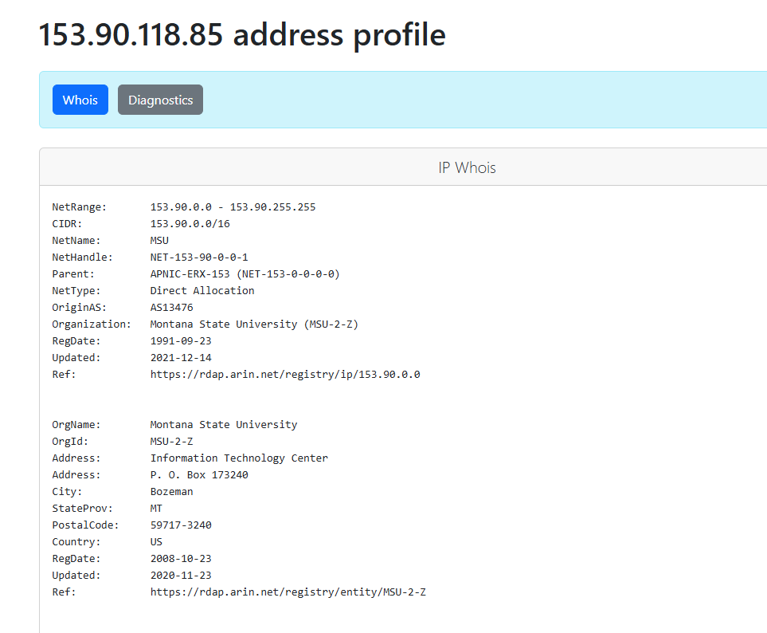
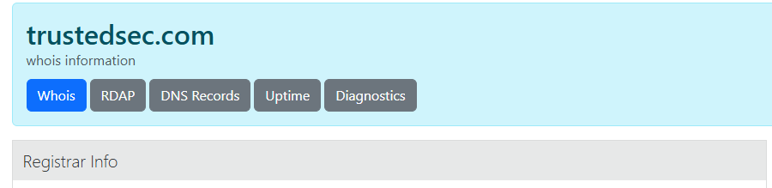
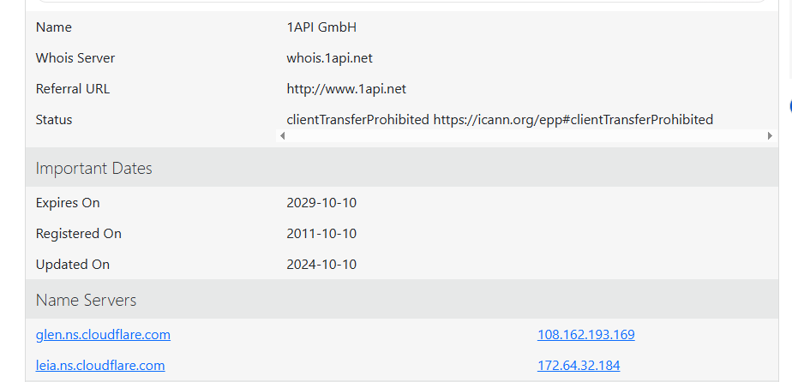
Intelligence Gathering
Whois is a public database that stores information about registration and ownership of a particular domain and IP address
https://who.is/

Slide 14
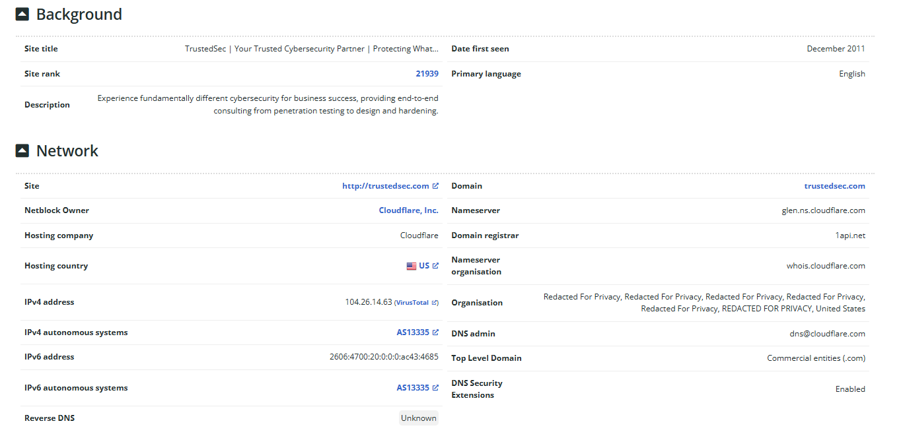
Intelligence Gathering
Netcraft is a web-based tool that can be used to find an IP address of a server hosting a particular website
https://searchdns.netcraft.com/

Slide 15
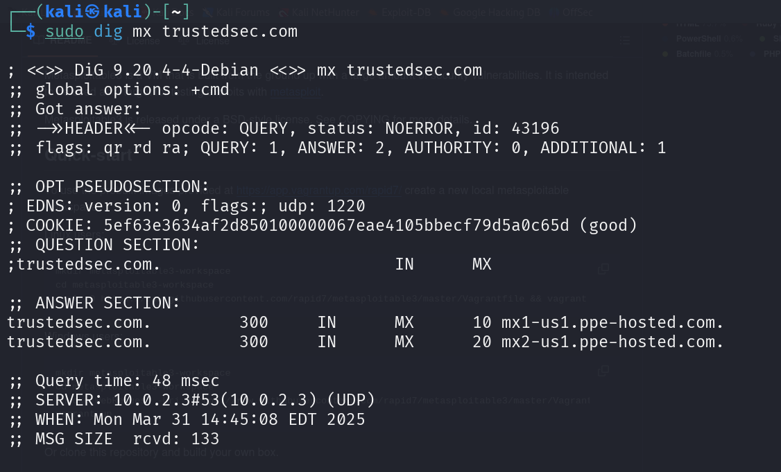

Intelligence Gathering
dig or nslookup can be used to find domain information
mx = “mail server”
Mail servers can be found under these domains

Slide 16

Don’t be malicious
Don’t be stupid
Your actions have consequences, and hacking can put you in prison

Slide 17

Kali Linux
Kali Linux is a Linux distro that comes with many offensive security tools and is designed for security testing
Commonly used for penetration testing

Slide 18

Metasploit
Metasploit is the go-to framework for penetration testing
Free and open-source
Provides endless functionality for automating routine and complex pen testing procedures

Slide 19
Metasploit Terminology
Exploit- how a pen tester takes advantage of a flaw
Payload- malicious code or request that we send to victim server
Shellcode- binary instructions of malicious code
Module- a built-in function that Metasploit uses for some task
Listener- a component on the pen tester’s machine that waits for a connection from the victim machine

Slide 20
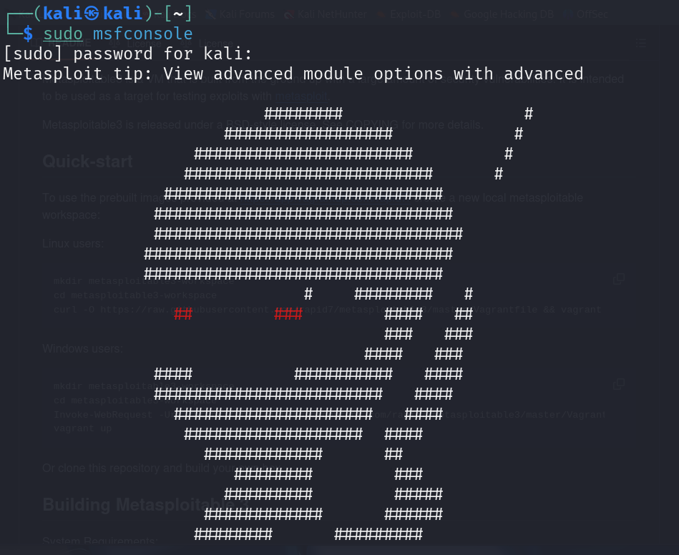
Starting Metasploit
sudo msfconsole will summon a Metasploit console, which understands Metasploit “commands”

Slide 21

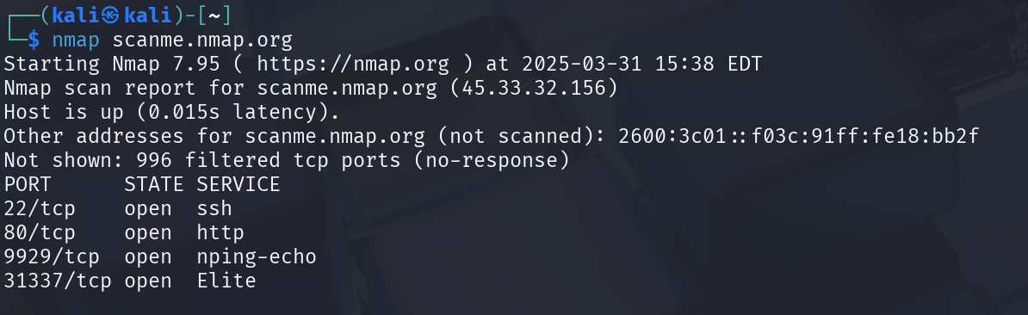
Port scanning is a common first step in pen testing. nmap is the most popular port scanning tool
You should not nmap an address unless you have permission

Slide 22

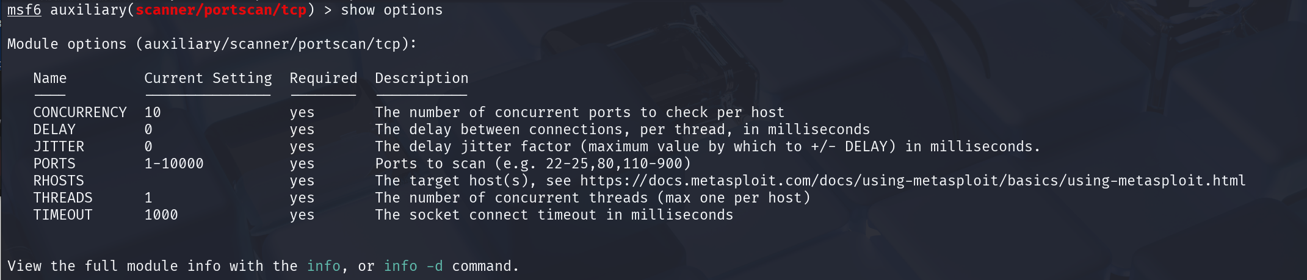
Port scanning is a common first step in pen testing. nmap is the most popular port scanning tool
Metaploit has a module for nmapping a remote host!
You should not nmap an address unless you have permission
We need to set the IP address of the remote host !

Slide 23
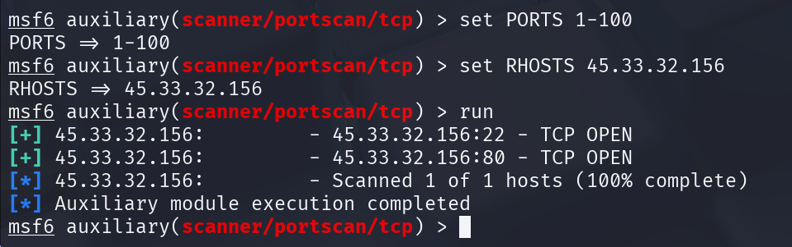
Port scanning is a common first step in pen testing. nmap is the most popular port scanning tool
Metaploit has a module for nmapping a remote host!
You should not nmap an address unless you have permission
(TCP port scanning is slightly different than nmap)
TCP ports 22 and 88 are open

