Slide 1

ESOF 422: Advanced Software Engineering: Cyber Practices
Metasploit, Exploitation, Causing some damage
Reese Pearsall
Spring 2025

Slide 2
Announcements
Friday will be a workday for HW4 and HW5

Slide 3
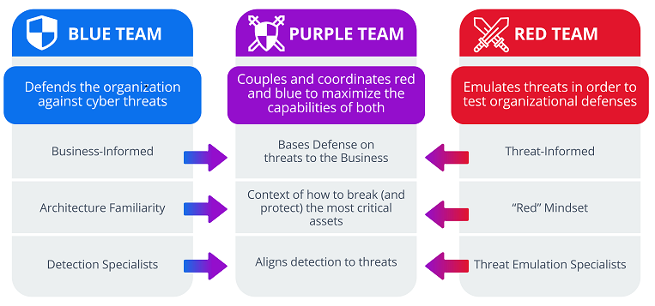
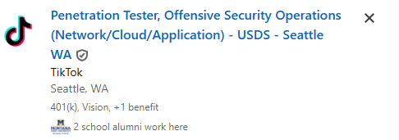

Penetration Testing (pen testing) is an authorized simulated cyber attack launched against a system to evaluate its security
Another instance of ethical hacking
These tests are done by a security expert of a group of experts
Helps identify vulnerabilities before attackers can exploit them
authorized- an organization allows them to “hack” them (no legal consequences)
These vulnerabilities range from simple social engineering attacks to fully-fledged RCE exploits
The process of penetration testing includes several steps, but the main parts are finding vulnerabilities and exploiting them (with permission)
“Red Teamers” are often the integral part of penetration tests

Slide 4

Metasploit
Metasploit is the go-to framework for penetration testing
Free and open-source
Provides endless functionality for automating routine and complex pen testing procedures

Slide 5
Metasploit Modules
Metasploit Framework consists of modules which are programs/functionality to do something handy in the world of ethical hacking. There are six types of modules
Auxiliary- do not exploit a target, but contain helpful tasks for analyzing, gathering, scanning, etc.
NOP- generate a sequence of “No operations” instructions, typically used if buffer overflow exploits
Encoder- Techniques for encoding payloads to deal with bad characters, such as null bytes
Exploit- used to leverage vulnerabilities that allow the framework to execute arbitrary code
Evasion- Techniques for creating evasive payloads to avoid antivirus and windows defender
Payloads- Provide the shellcode of the arbitrary code
Post- Techniques that are useful for post exploitation tasks

Slide 6



The slides and lecture have the following setup:
You won’t be able to run the commands with the same IP addresses that I do
192.168.1.0/24
192.168.1.4
192.168.1.5
Windows 2008 Server
Kali Linux
“Target Machine”
“The pen tester”
Our goal will be to do some reconnaissance on the target machine, and exploit a vulnerability

Slide 7
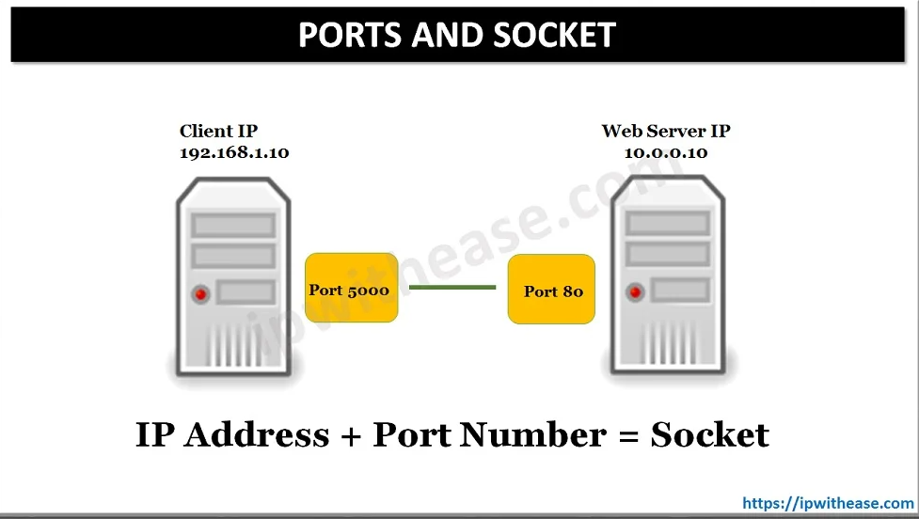
How to find vulnerabilities?
Ports are logical endpoints for communication between devices over a network. All network communication goes through a port of some kind
80 → HTTP
443 → HTTPS
22 → SSH
53 → DNS
Ports 1024 – 49151 are used by software vendors, and their applications are typically binded to a specific port
https://en.wikipedia.org/wiki/List_of_TCP_and_UDP_port_numbers

Slide 8

How to find vulnerabilities?
You should not nmap a machine unless you have permission
nmap is usually a good starting point
The –A flag will try to identify services and their versions
Warning: nmap can take a long time to run
You can then research known vulnerabilities and exploits for those services
sudo nmap –A 192.168.1.4 <additional-flags>
-script specifies a specific nmap script to run
-sT TCP connection scan
-sS stealthy TCP connection
-pN skip ping tests
-p specify port ranges (ex –p1-1000, -p 22, 80, 443)
-script=http-enum.nse will scan for popular web applications and servers
-script=http-cors.nse will a test an http server for its CORS policy
-script=http-vuln-cve2011-3192 will test for a specific apache CVE
https://nmap.org/nsedoc/scripts/

Slide 9
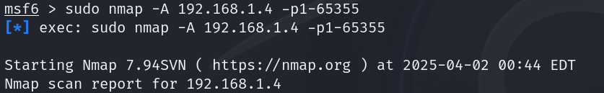

Slide 10
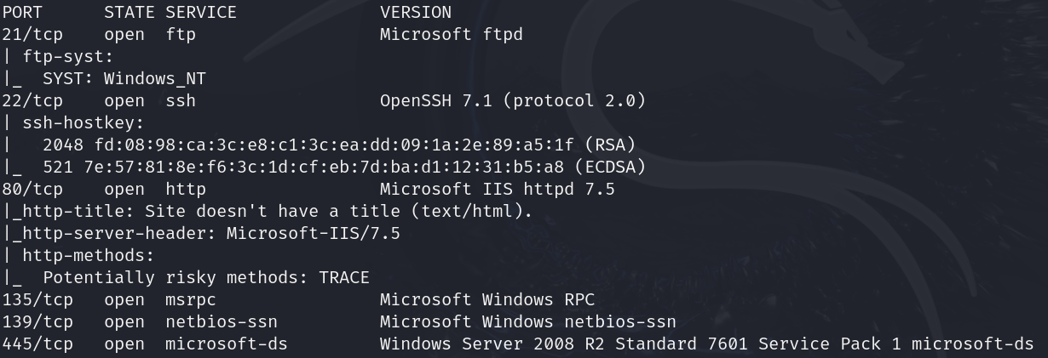











Slide 11
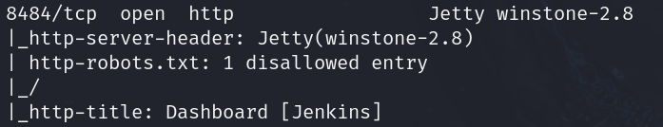












There is a Jenkins server running on port 8484

Slide 12
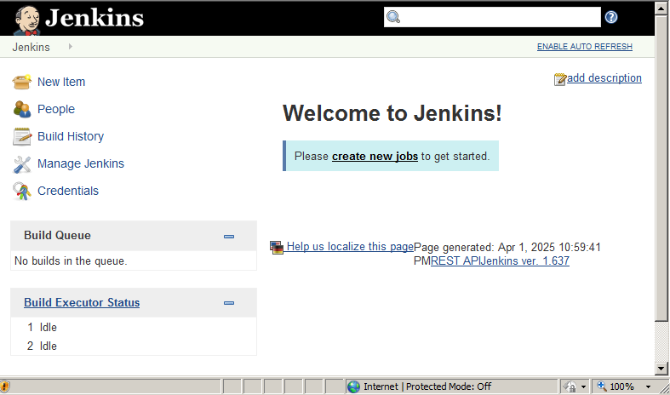


Jenkins is a popular tool used in a CI/CD pipeline.
When new code is pushed, it kicks off an automated process of building, running tests, and deploying
localhost:8484
https://www.jenkins.io/security/advisories/
There have been many CVEs linked to Jenkins in the past 20 years…
Let’s see what Metasploit has about Jenkins…

Slide 13
Searching for stuff in Metasploit
You can think of Metasploit as a large catalog of different modules. Now you need to search for a specific exploit in the msfconsole
search log4j
search <keyword:value> type:exploit
Some of the keywords
cve- a specific CVE ID (ex. cve:2024)
platform- victim operating system (ex. platform:-windows)
rank- how “effective” of an exploit it is (ex. rank:good)
port- exploits that target a specific port (ex. port:22)

Slide 14
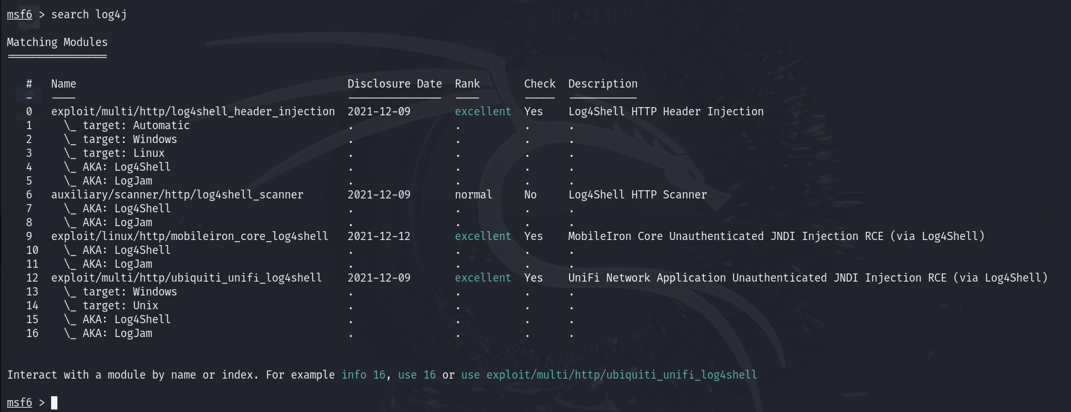
Let’s search for modules that have to do with log4j
There are 16 different modules we can use

Slide 15
Let’s search for modules that have to do with log4j
When we decide which module to use, we can use the #
There are 16 different modules we can use

Slide 16
Let’s search for modules that have to do with log4j
Module name and keywords
There are 16 different modules we can use

Slide 17
Let’s search for modules that have to do with log4j
When the vulnerability was disclosed
There are 16 different modules we can use

Slide 18
Let’s search for modules that have to do with log4j
The rank is how likely it is to disrupt or crash the service
There are 16 different modules we can use

Slide 19
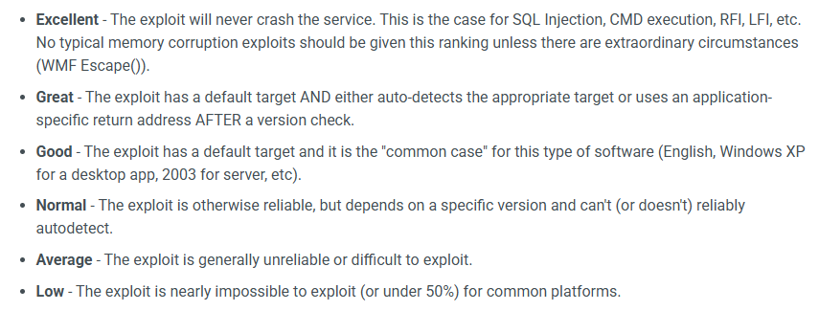
Let’s search for modules that have to do with log4j
The rank is how likely it is to disrupt or crash the service
There are 16 different modules we can use

Slide 20
Let’s search for modules that have to do with log4j
This is an exploit module for Log4J that will inject the payload in an HTTP header

Slide 21

Let’s search for modules that have to do with log4j
This is an auxiliary module that will scan a remote host to look for the Log4J vulnerability

Slide 22
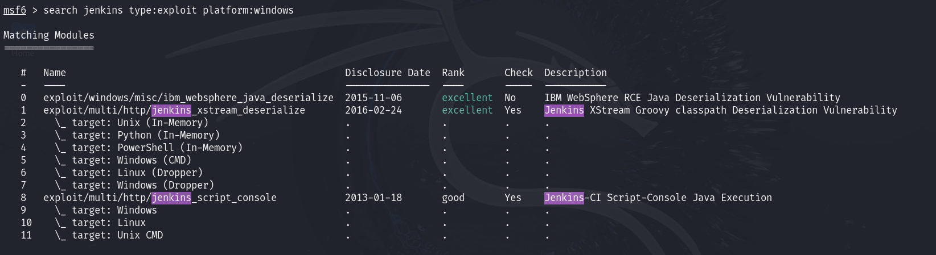
Back to Jenkins.
We know the target is a windows machine using a Jenkins server on port 8484

Slide 23
Back to Jenkins.
We know the target is a windows machine using a Jenkins server on port 8484
Let’s look at this exploit
This will give us a detailed description of the exploit

Slide 24
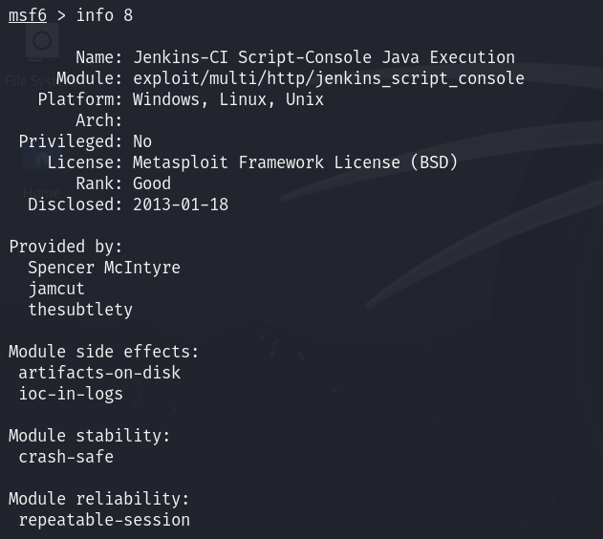
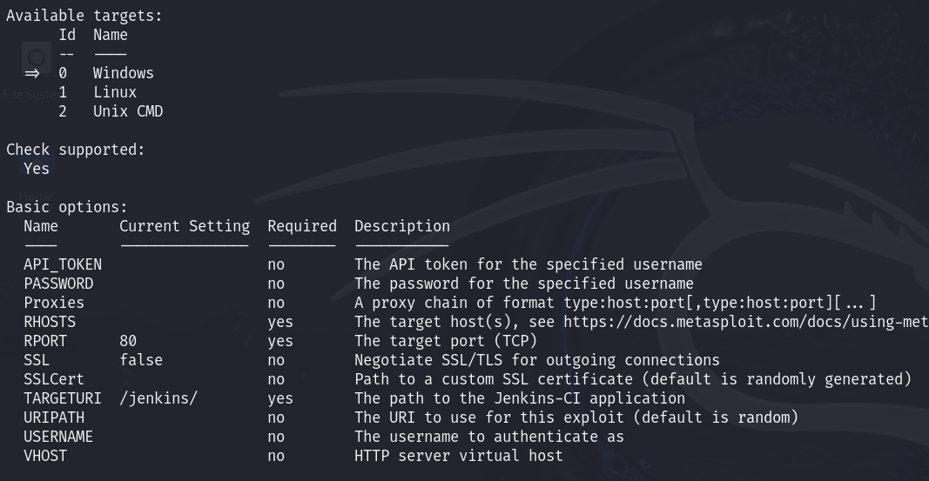

Ok… so this seems to be a RCE exploit where we can execute arbitrary OS commands

Slide 25
Ok… so this seems to be a RCE exploit where we can execute arbitrary OS commands
We must provide the remote IP address, remote port, and URL path to the Jenkins application

Slide 26


The “use” keyword is used to load the exploit and prepare for execution
We can provide a specific payload (which OS command we want to run). By default, the payload will be to summon a reverse shell on the target machine
A reverse shell is a shell that is created on a victim’s remote machine, and the input, output, and standard error come from the attacker
Send payload to create a special shell
192.168.1.5
192.168.1.4
Listener
Port 8080
Special Shell:
Input comes from 192.168.1.5:8080
Output goes to 192.168.1.5:8080
Windows 2008 Server
Kali Linux
“Target Machine”
“The pen tester”

Slide 27
The “use” keyword is used to load the exploit and prepare for execution
We can provide a specific payload (which OS command we want to run). By default, the payload will be to summon a reverse shell on the target machine
A reverse shell is a shell that is created on a victim’s remote machine, and the input, output, and standard error come from the attacker
It’s the most common way to get control (an interactiable OS shell) on a remote machine
192.168.1.4
192.168.1.5
Listener
Port 8080
OS shell
TCP
Windows 2008 Server
Kali Linux
“Target Machine”
“The pen tester”

Slide 28
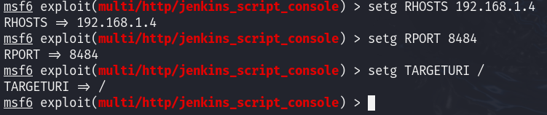
The “use” keyword is used to load the exploit and prepare for execution
Set the required fields
(information about the victim machine)

Slide 29
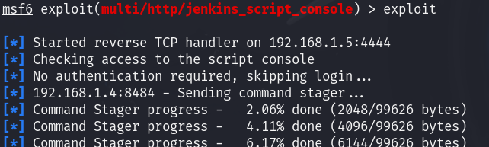
The “use” keyword is used to load the exploit and prepare for execution
Set the required fields
(information about the victim machine)
exploit is used to run our exploit and send the payload

Slide 30
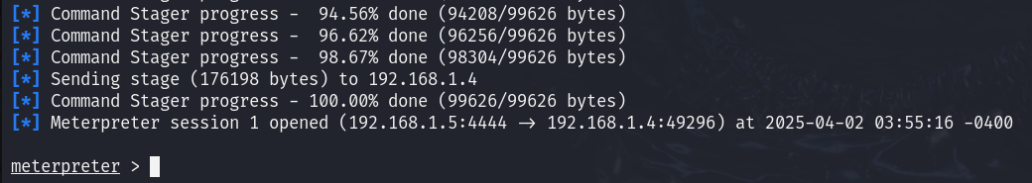
If our attack works, we are met with a meterpreter shell
meterpreter is our reverse shell, but it can also recognize a variety of different Metaploit commands and modules for post-exploitation tools

Slide 31
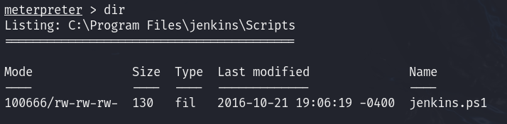
If our attack works, we are met with a meterpreter shell
We can now run commands in the reverse shell, and those commands are being executed on the victim machine
We now enter the post-exploitation stage. What damage can we do? Can we move around? Can we exfiltrate information?

Slide 32
If our attack works, we are met with a meterpreter shell
We can now run commands in the reverse shell, and those commands are being executed on the victim machine
We now enter the post-exploitation stage. What damage can we do? Can we move around? Can we exfiltrate information?

Slide 33

Common Post-Exploitation Tactics
Privilege Escalation
→ Try to get admin permissions
Persistence
Create a backdoor for access into the system later on
Credential Harvesting
Steal information, credentials, passwords, browser history
Lateral Movement
Move from the compromised machine to another machine on the network
Data Exfiltration
→ Steal information. Send information back to attacker’s machine via HTTP, DNS tunneling, Dropbox
Covering Tracks
Erase logs, disable antivirus
Break the system
→ Encrypt all the files, install a cryptominer, turn it into part of a botnet

Slide 34
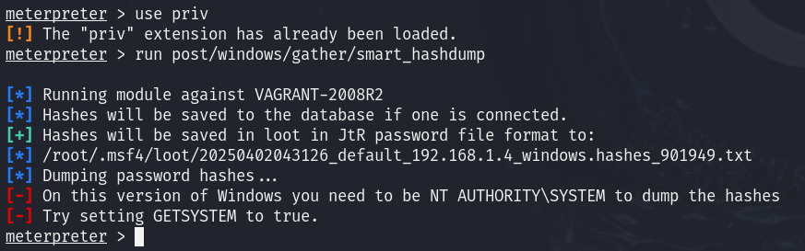
Let’s steal some password hashes!
Metasploit has plenty of modules for post-exploitation, including a module for dumping the password hashes and sending them back to the attacker machine

Slide 35


Let’s steal some password hashes!
Metasploit has plenty of modules for post-exploitation, including a module for dumping the password hashes and sending them back to the attacker machine
This fails! Because our shell does not have Admin level permissions

Slide 36


Let’s steal some password hashes!
Metasploit has plenty of modules for post-exploitation, including a module for dumping the password hashes and sending them back to the attacker machine
There are exploit modules for privilege escalations on Windows… but Reese couldn’t find any that works

Slide 37
Let’s suppose we were able to get an exploit working, and we were able to get the hashed passwords of five different users
user1:8846f7eaee8fb117ad06bdd830b7586c
user2:e10adc3949ba59abbe56e057f20f883e
user3:b1b3773a05c0ed0176787a4f1574ff007
admin:5f4dcc3b5aa765d61d8327deb882cf99
user5:c8e792b64cc27cb40d29018f6da0973a
These are NTLM Hashes, a password hashing algorithm used on Windows 2000, XP, Vista, 7 and 8!
This a weak hashing algorithm, because it uses MD4 (broken) (no salt)

Slide 38

user1:8846f7eaee8fb117ad06bdd830b7586c
user2:e10adc3949ba59abbe56e057f20f883e
user3:b1b3773a05c0ed0176787a4f1574ff007
admin:5f4dcc3b5aa765d61d8327deb882cf99
user5:c8e792b64cc27cb40d29018f6da0973a
passwords.txt
We can use some Kali Linux tools to crack these passwords!
John the Ripper is an open-source password cracking tool that uses several different approaches to crack a variety of different hashed passwords

Slide 39
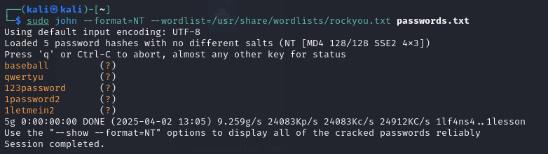
We find the plaintext passwords!

Slide 40
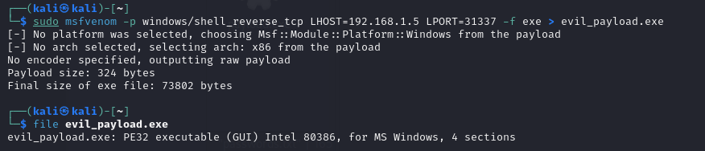
msfvenom is a Metasploit tool that allows you to create shellcode and binaries from common payloads
issues?

