Slide 1

ESOF 422: Advanced Software Engineering: Cyber Practices
Introduction to Digital Forensics
Reese Pearsall
Spring 2025

Slide 2
Announcements

Slide 3
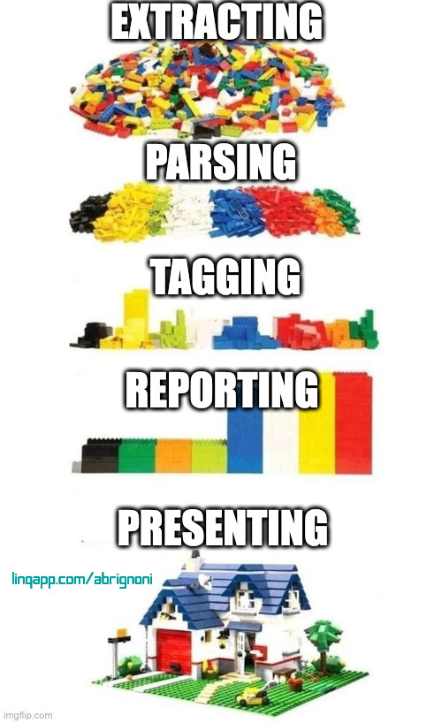

Digital Forensics
Digital Forensics is the collection, analysis, and interpretation of digital evidence
Can help support or refute a theory of how an offense occurred or that critical address critical elements of the offense such as intent or an alibi
Digital Evidence plays a crucial part in many modern-day investigations
In our scope of digital forensics, we are focusing on incident response.
System has been compromised, now must analyze, recover, and report on the threat
Crucial for understanding threats and hardening security
Import legal implications

Slide 4

Goals
When responding to an incident, we want to answer important questions such as
When did the incident happen? What is the timeline?
What is the root cause of the incident?
Who attacked us?
Why did they attack us?
What is the scope of the damage?
Reflection
Did staff and organizations perform as expected?
What will our organization do next time?
What corrective actions need to happen?

Slide 5
Important Difference
Cybersecurity | Digital Forensics
Prevents attacks, Securing devices, CIA | Investigates after an attack
Real-time response | Post-incident analysis
Proactive | Reactive
Building | Investigating and Analyzing

Slide 6
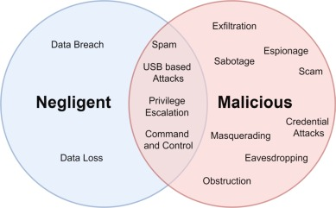
Common Use Cases
Data Breaches
Insider threats
Malware infections
Intellectual property theft
Employee Misconduct

Slide 7
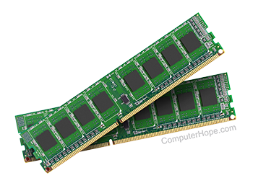
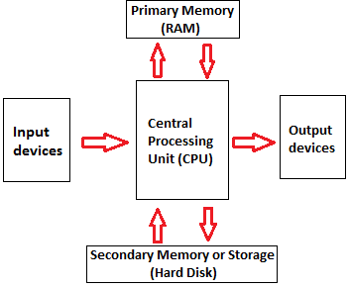

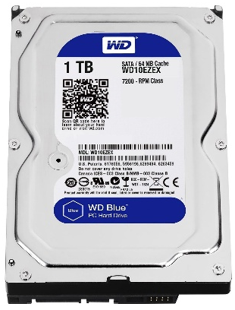


Types of Forensics

Slide 8



Types of Forensics
Memory forensics focuses on analyzing volatile data in RAM

Slide 9

Types of Forensics
Disk forensics focuses on analyzing non-volatile data in persistent memory

Slide 10



Types of Forensics
Network forensics focuses on analyzing digital evidence from network traffic

Slide 11
Digital Evidence Processing
It is critical to follow appropriate processes and procedures when collecting and processing digital evidence
Not following processes could put an investigator at legal risk
Improperly collected or tracked evidence could be inadmissible in court
NIST 800-61r2 and NIST IR 8387 provides guidelines and best practices for incident response and digital evidence preservation

Slide 12
Context
Context is critical
Always important to understand the “why” of the case that you’re working on
Timelines can be critical
Will directly influence what data you collect, how you process it
Technical vs. Corporate vs Legal vs Law Enforcement

Slide 13
Digital Evidence Collection
Digital evidence is typically collected through software or hardware tools
Hardware tools are used when the device is physically in the possession of the investigator and provide power and an interface to access on the target device
Implicants of these choices on the principles of computer-based evidence exchange
We collect artifacts on the system
Volatile Artifacts
Does not persistent across power cycles
RAM contents, fileless malware
Faster
Non-volatile Artifacts
Does persistent across power cycles
Hard drive contents, malware
Slower

Slide 14
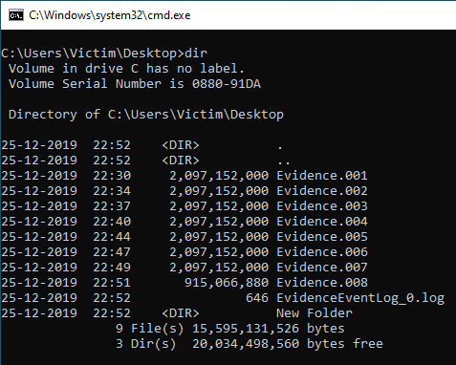
Disk Capture (Non-volatile artifacts)
Creating a copy of the contents of a hard drive to a file for analysis
Must have a way to:
Access data (physically and virtually)
Power on the device
Pros:
May get deleted files
Will be able to parse the entire “raw” disk and data structures
Cons:
Capture used and “unused” disk space
Time consuming
Very large output file

Slide 15

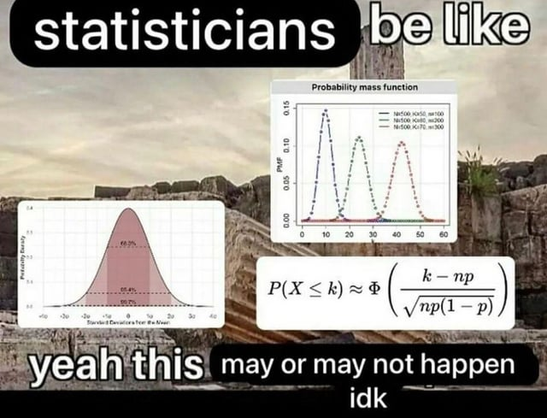
Principle of Digital Forensics
Certainty
We’re almost never “certain”. This is a protected term that must be used with extreme care
We cannot be certain of what occurred at a crime scene or other situation when we have only a limited amount of information
We present possibilities and hypotheses and the evidence and information that support or refute these hypotheses
forensics
have
happened idk

Slide 16
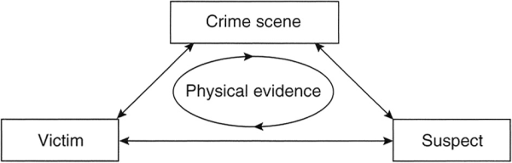
Principle of Digital Forensics
Locard’s Exchange Principle: every contact leaves a trace
Data Exchange: Every interaction with digital devices involves data exchange. Actions leave behind traces in the form of data packets, logs, or artefacts.
Digital Evidence: When a hacker gains unauthorized access to a system, they may leave behind login records, IP addresses, or malware signatures.
Anyone, or anything, entering a crime scene
takes something of the scene with them
leaves something of themselves behind when they leave.

Slide 17
Principle of Digital Forensics
Authentication
Integrity of data/records being analyzed
Must be able to show:
→ Contents of record are unchanged
→ Information in record originates from purported source
→ Extraneous information such as data of collection/record is accurate
Integrity
Showing that evidence has not been modified since time of collection
Use message digest (hash) functions to perform this work for us
Hash functions always produce the same output for a given input
SHA256/SHA512 is ideal

Slide 18
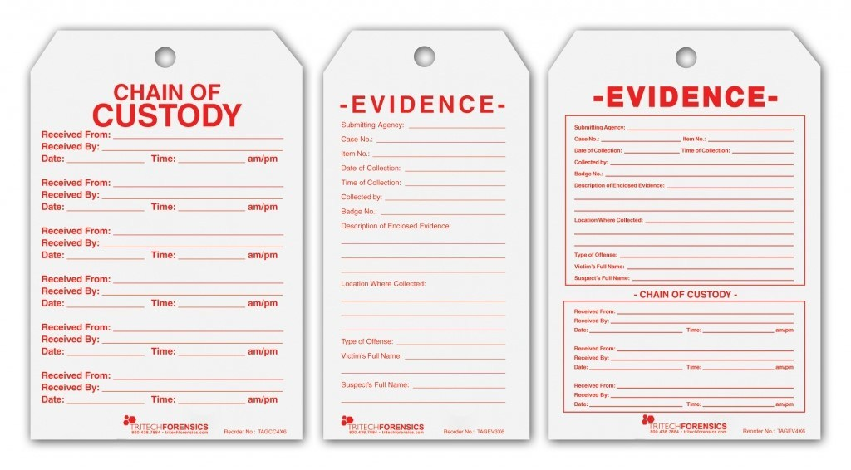
Principle of Digital Forensics
Soundness
How the evidence was handled (preserved and examined)
Consists of two key concepts
→ Non-modification of evidence
→ Documentation (tools, time, methods, hashes)
Chain of Custody
Documentation that proves continuity of possession of evidence

Slide 19
Principle of Digital Forensics
Repeatability
For a given piece of evidence, the process by which it is analyzed and information that analysis is repeatable
Enables independent verification
Evidence Characteristics
-Class characteristics: similar between groups of items (ex. file formats, headers)
-Unique traits: can be tied to an individual (ex. MAC address, static IPs)

Slide 20
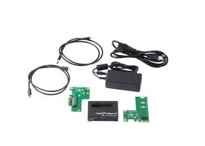
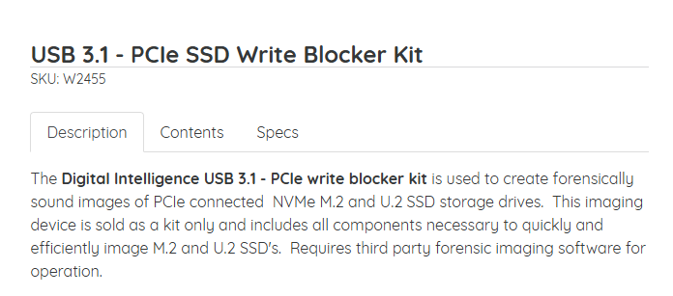
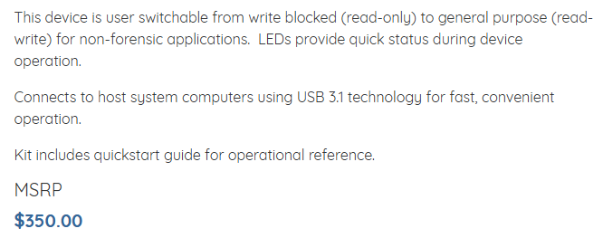
Disk Capture (Non-volatile artifacts)
Creating a copy of the contents of a hard drive to a file for analysis
Must have a way to:
Access data (physically and virtually)
Power on the device
A write blocker is a tool that permits read-only access to storage devices and copies hard disk contents
Read-only → evidence won’t change. Maintains integrity of machine

Slide 21

Capturing Volatile Evidence
Volatile evidence is non-persistent when power is lost to the device
Main component that affects us is any system with RAM
RAM loses all contents when system is powered off
Volatile evidence capture requires interacting with a running system
Typically done remotely over SSH using RAM capture tools (software)
Need to be careful to understand how you're capturing RAM
-You need administrative access
-You could be creating new files on disk
-You can trigger an antivirus

Slide 22
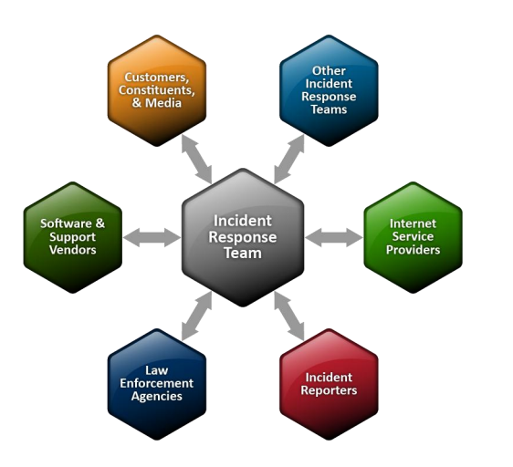
Communication

