Slide 1

ESOF 422: Advanced Software Engineering: Cyber Practices
Investigative models, Attacker Lifecycle
Reese Pearsall
Spring 2025

Slide 2
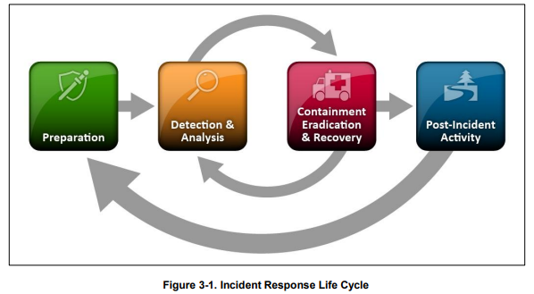
Investigation Models
NIST-800-61r2 provides guidelines and best practices for incident response

Slide 3
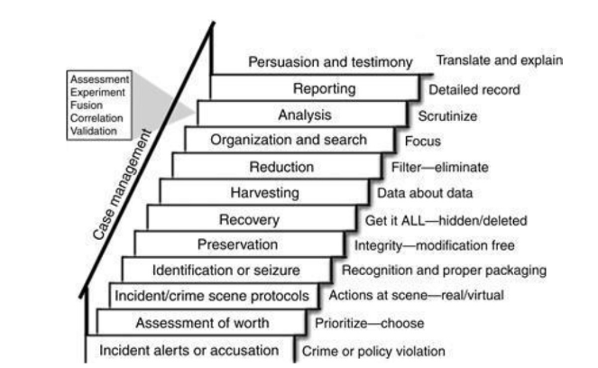
Other Investigation Models
Staircase Model

Slide 4
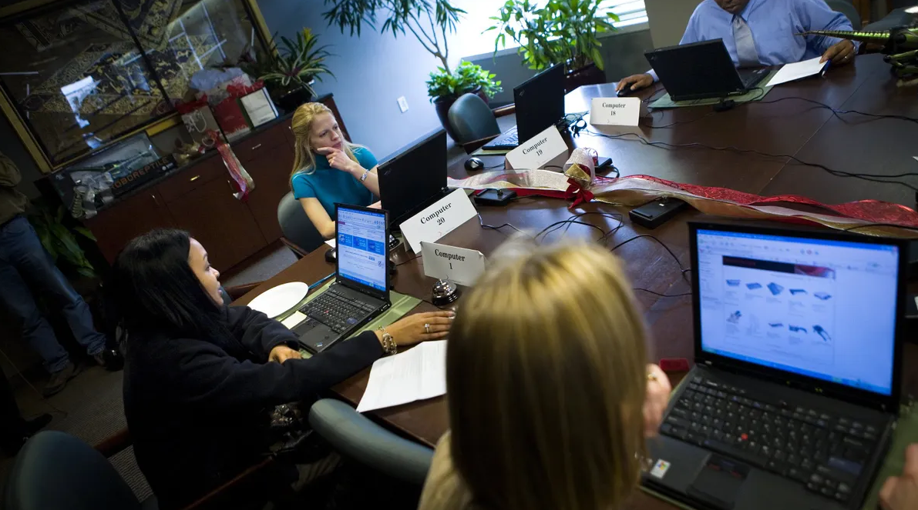
Preparation
Contact information for team members within and outside the organization, law enforcement agencies
Issue tracking system
Encryption software
Secure storage facility
Port lists
Documentation
Network diagrams and critical assets

Slide 5
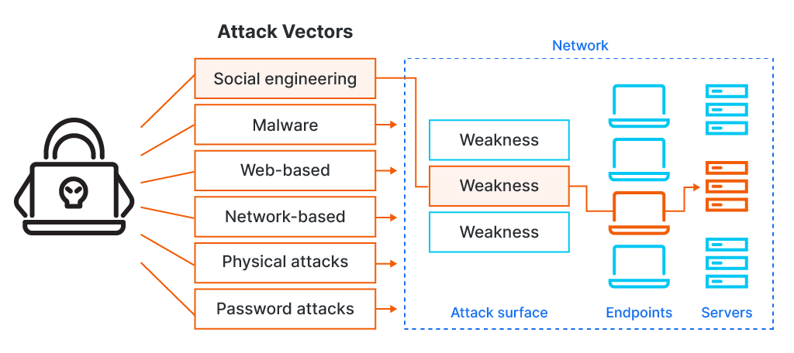
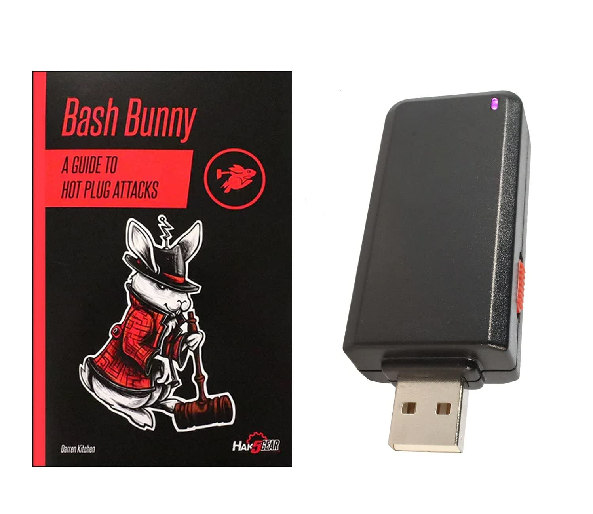
Detection and Analysis
An attack vector is a method an attacker may use to exploit a vulnerability and compromise a system
An attack surface are a list of potential entry points and vulnerabilities an attacker could interact with
Common attack vectors:
External/Removable Media- malicious USBs
Attrition- a brute force method to disrupt or degrade a system or service (DDos)
Web-based exploits- XSS, SSRF, etc
Impersonation- spoofing, MITM, rogue wireless points
Loss or theft of equipment

Slide 6
Detection and Analysis
A precursor is a sign that an incident may occur in the future.
An indicator of compromise is a sign that an incident may have occurred or may be occurring now.
Example precursors:
Web server log entries show usage of vulnerability scanner
An announcement of new exploit that targets a vulnerability on the organization’s mail server
A public threat from a hacker group
Example IOCs:
Alert from an IDS or antivirus
Unusual network traffic spike
Unfamiliar IP addresses
Multiple failed login attempts
Unusual configuration changes
Large number of bounced emails with suspicious content

Slide 7
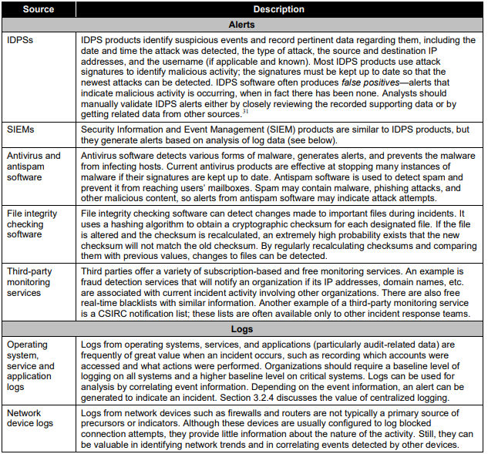
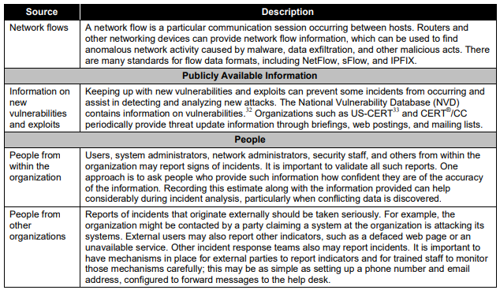
Detection and Analysis
We can gather precursor and indicator information from a wide variety of sources (defense in depth!)

Slide 8
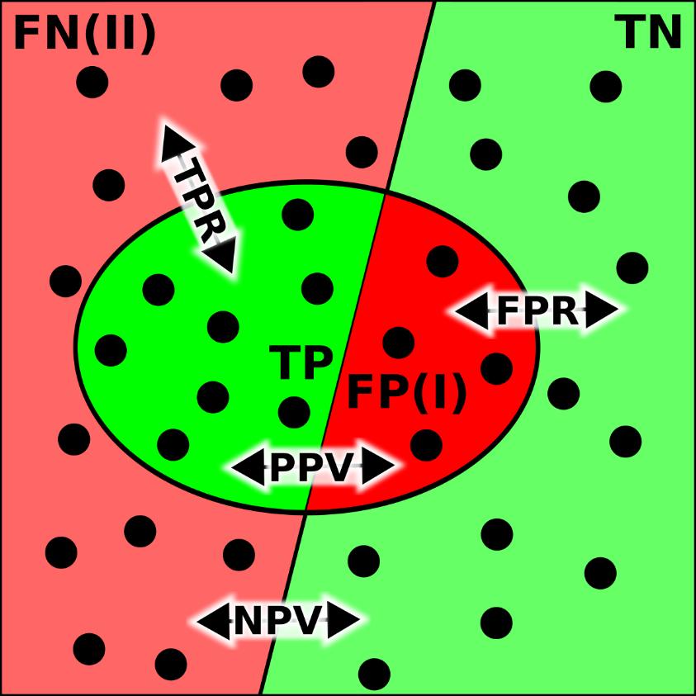
Detection and Analysis
True Positive – The detection system correctly identifies malicious activity
False Positive – The detection system incorrectly flags legitimate activity as a threat (false alarm)
True Negative – The detection system correctly identifies normal, benign traffic
False Negative – The detection system fails to detect actual malicious traffic, thinking it is just benign traffic
False Negatives are the scariest, and we want to minimize the number of false negatives for an IDS

Slide 9
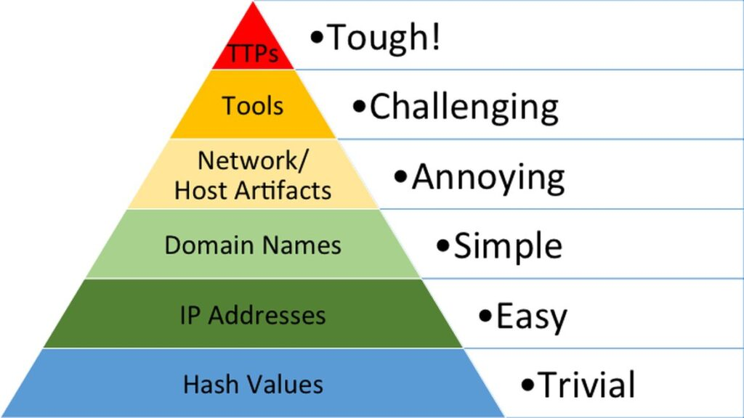
Detection and Analysis
Tactics, Techniques and Procedures (TTPs)
Pyramid of pain describes different indicators of compromise that can be found during investigation
How easy they are to find
How much pain they cause an attacker if we can implement appropriate countermeasures

Slide 10
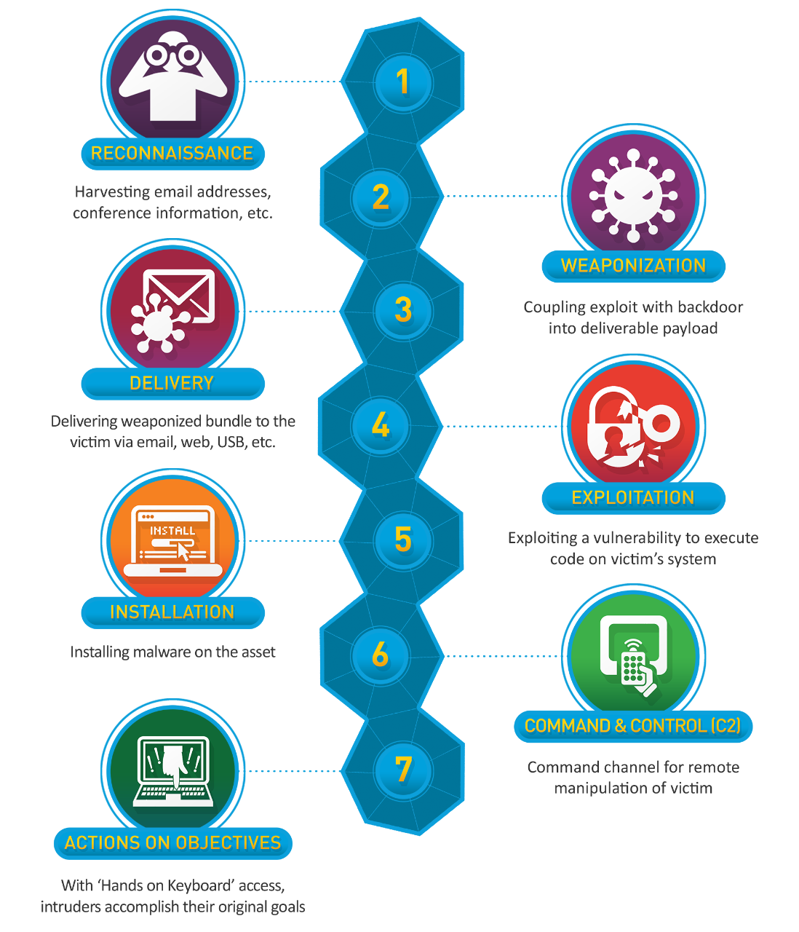
The Cyber Kill Chain describes the typical steps a malicious actor carries out to conduct a cyber attack
In network forensic investigations, we can see evidence of these steps occurring!
10

Slide 11
The Cyber Kill Chain describes the typical steps a malicious actor carries out to conduct a cyber attack
Step 1. Reconnaissance
Gather information about their target to understand potential vulnerabilities and points of entry
Open Source Intelligence (OSINT)
- look at public web pages, social media profiles, forums
Network Scanning
- Use nmap to discover open ports and/or services
Gather information for phishing
- Email lists, credentials, etc
Identify attack surface
11

Slide 12
The Cyber Kill Chain describes the typical steps a malicious actor carries out to conduct a cyber attack
Step 2. Weaponization
Create a tailored payload for your attack
Malicious Emails
- Phishing email, malicious macro file (.docx, .xlsx), zip file
Trojan Software
- Hide malicious payload in benign-looking software
Language-specific payload for targeted vulnerability
Malicious USB Drives
12

Slide 13
The Cyber Kill Chain describes the typical steps a malicious actor carries out to conduct a cyber attack
Step 3. Delivery
Transmit payload to target victim
Phishing Email(s)
Send data to open port(s)
Send malicious USB
13

Slide 14
The Cyber Kill Chain describes the typical steps a malicious actor carries out to conduct a cyber attack
Step 4. Exploitation
Payload is triggered, and vulnerability is exploited
Victim opens malicious files
Victim opens malicious ZIP
Server accepts attacker’s payload
Victim plugs in USB device
14

Slide 15
The Cyber Kill Chain describes the typical steps a malicious actor carries out to conduct a cyber attack
Step 5. Installation
Find way to install malware to cause damage or gain persistence
Remote Access Trojans (RATs)
- Allows attack remote control over victim’s system
Keyloggers
- Discover passwords or credentials
Backdoor
- Can be used to re-enter system later on
Lateral Movement
- Try to spread to other devices on a network
15

Slide 16
The Cyber Kill Chain describes the typical steps a malicious actor carries out to conduct a cyber attack
Step 6. Command and Control
It is very common for attackers to “phone home” to a command and control (C2) server to be able to compromise the system remotely
HTTPS/HTTP
DNS Tunneling
Peer-to-Peer for Botnets
16

Slide 17
The Cyber Kill Chain describes the typical steps a malicious actor carries out to conduct a cyber attack
Step 7. Actions on Objectives
Malware is installed, attacker can remotely access a system, now do something evil
Data exfiltration – unauthorized transfer of data from a device or network
Delete Information
Ransomware
Deface website
17

Slide 18
The Cyber Kill Chain describes the typical steps a malicious actor carries out to conduct a cyber attack
Step 7. Actions on Objectives
Malware is installed, attacker can remotely access a system, now do something evil
Data exfiltration – unauthorized transfer of data from a device or network
Delete Information
Ransomware
Deface website
18

Slide 19
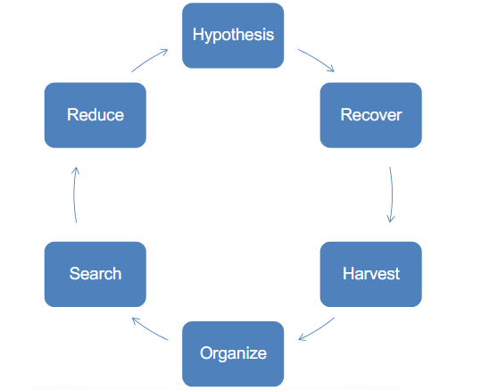
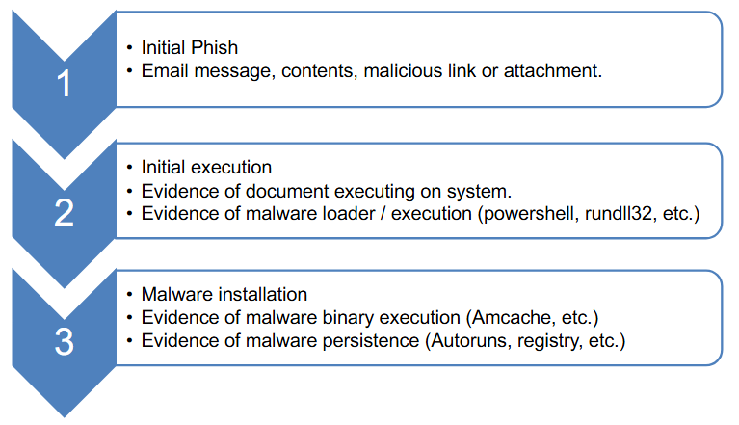
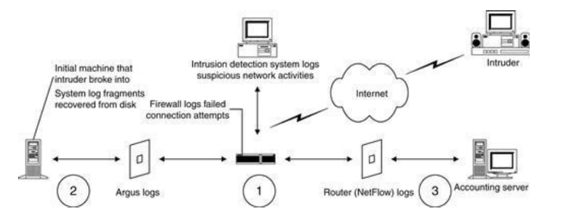
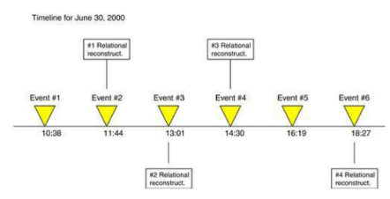
Detection and Analysis
Analysis by attack lifecycle
Scientific Method
Relational Analysis- Track objects, people, and relationships
Chronological event analysis

Slide 20
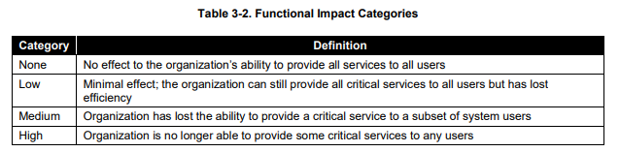
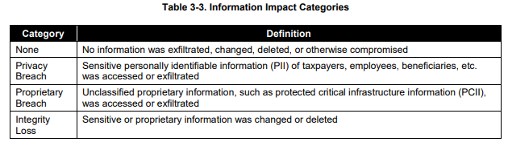
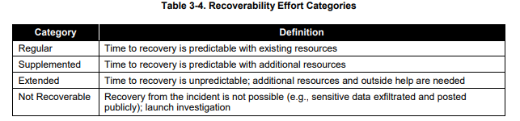
Detection and Analysis
It is important to prioritize handling of incidents based on the following factors:
Functional Impact of the Incident
Information Impact of the Incident
Recoverability from the incident
High functional impact and regular recoverability → good candidate for IT team to prioritize

Slide 21
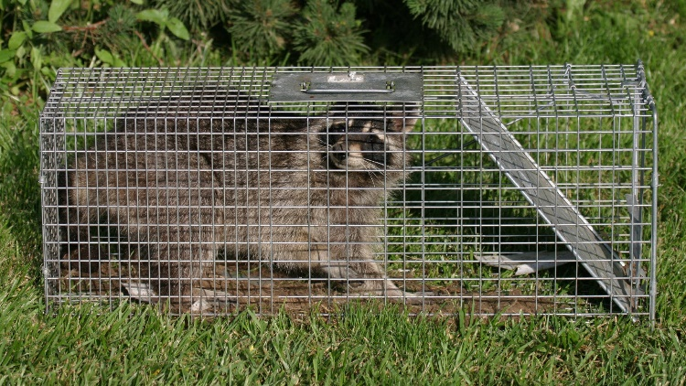

Eradication, Containment, and Recovery
Containment = limit spread of incident and damage
Containment strategies vary and they must balance the need to prevent additional damage or theft with a need to maintain and collect evidence.
Premature containment can lead to situations where an adversary is thought to be “evicted” but is not.
Containment cannot occur without root cause analysis.
Containment typically involves parallel network and identity efforts.

Slide 22
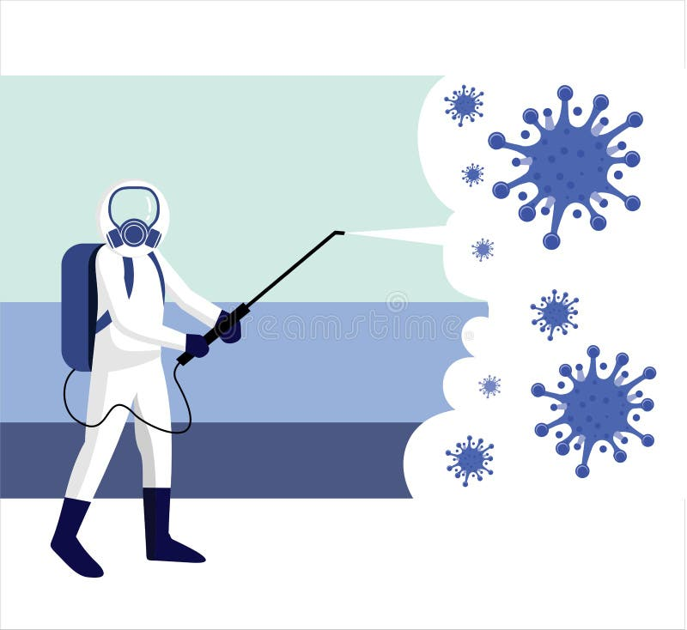
Eradication, Containment, and Recovery
Eradication- removing adversary access. Eliminate vulnerability
Good eradication and recovery strategies will take inputs from evidence collection and analysis and balance the business capabilities against attacker access.
Must identify all affected hosts
Phased approaches generally work better.
Recovery- ensuring systems are functional within expected parameters

Slide 23
Evidence Gathering and Handling
A detailed log should be kept for all evidence:
Identifying information
Name, title, and phone number of who has handled each piece of evidence
Time and data (and time zone) of each occurrence of evidence handling
Locations and where evidence was stored
Identifying Attacking Host:
Validate the Attacking Host’s IP address
Researching IP addresses (WHOIS)
Using Incident Databases
Monitoring known attacker communication channels

Slide 24
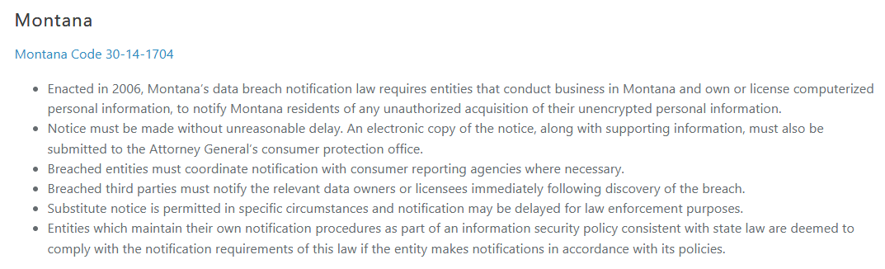

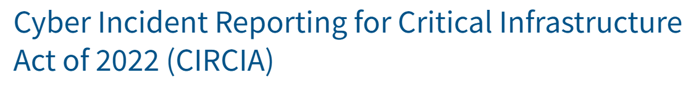
Incident Notification
Incident response policy typically involves notification to certain individuals or entities
CIO
Head of information security
Security officer
Legal department
Cybersecurity and Infrastructure Security Agency (CISA)
Cybersecurity Information Sharing Act of 2015 allows for government agencies to share cybersecurity threat data amongst federal and nonfederal entities, to help strengthen cybersecurity defenses
May expire in September. Congress currently debating renewal.

Slide 25
Post Incident Activity
Lessons learned
What happened, when?
Did staff and organization perform as expected
What would staff do differently next time?
What corrective actions should be taken?
Assess issues because on prioritization from the detection/analysis steps
Put together report, document the number of incidents, time per incident, objective assessment, and share with necessary parties
Retention- data and records may need to be kept for a certain amount of time, or until legal cases have resolved

Slide 26
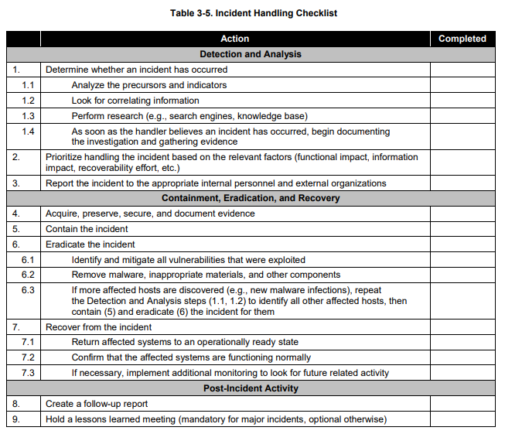
Incident response can be a daunting task at first, so it may be helpful to keep a checklist of necessary tasks

Slide 27
Critical Focus Areas
Despite each investigation being unique, there are core investigations focus area almost all investigation includes:
Core Areas
Customer Data
Intellectual Property
Financial and Payment system
Core Functions
Local Authentication
Remote Authentication
Data Access
Core Systems
Active Domain Controllers
Active Directory- (Microsoft) database of user accounts, groups, network resources, and security policies
Email server
Web application servers
Remote Access Servers

