Slide 1

ESOF 422: Advanced Software Engineering: Cyber Practices
Volatility
Reese Pearsall
Spring 2025

Slide 2
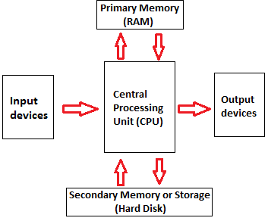

Memory Forensics
Analysis of data sources from a running system’s memory (RAM)
What does RAM contain?
Programs and files that have been executed
Running (and sometimes dead) processes
What programs accessed what files
Where opens files are/were location on disk
Information from keyboard (passwords, emails, chats)
Opened web pages
Decrypted content
Network connections
Content no longer on disk
Content that was never on disk

Slide 3
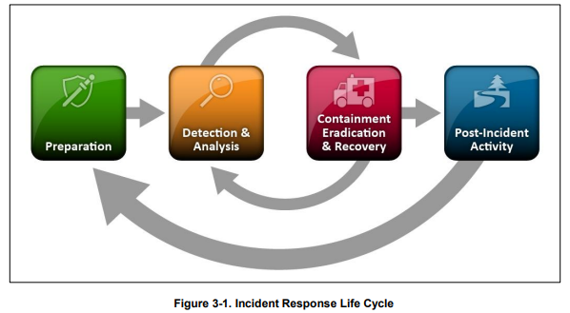

Memory Forensics
The stuff we are talking about for the remainder of the semester are parts of the analysis stage

Slide 4

Volatility
Volatility is a popular, modular framework used for memory forensics
Written in Python
Works on memory images from Windows, Mac, and Linux systems
Runs on Windows, Mac, and Linux
Open source
Extensible and scriptable API
Lots of plugins and community modules
Volatility is not:
A memory acquisition tool
Not a GUI
Bug-free
Supportive of every single OS version

Slide 5
Installation
You must have access to a Linux VM to install and run volatility.
Kali Linux is great, but it could be any Linux distro
There is volatility2 and volatility3. They are both memory forensics tools. Volatility3 is newer, and may have slightly different syntax
Kali Linux has many things already installed, but there are some dependencies that we may need to install
The source code for the volatility3 framework will come from a GitHub repo!

Slide 6
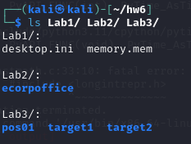
Memory Files
You will need to get a zip file of a few different memory files you will use for the homework
This is around 3GB in size. You will need to have some available space
There is nothing malicious about this file, and the commands that we are running with volatility are safe
.mem and .vmem files are contents of a (virtual) machine’s RAM contents
Can be analyzed using volatility

Slide 7
Getting Started

Slide 8

Getting Started
vol.py will always be the script we run for volatility commands

Slide 9


Getting Started
vol.py will always be the script we run for volatility commands
We provide the path to the .mem or .vmem files for analysis with the –f flag

Slide 10

Getting Started
vol.py will always be the script we run for volatility commands
We provide the path to the .mem or .vmem files for analysis with the –f flag
The name of the plugin to run

Slide 11
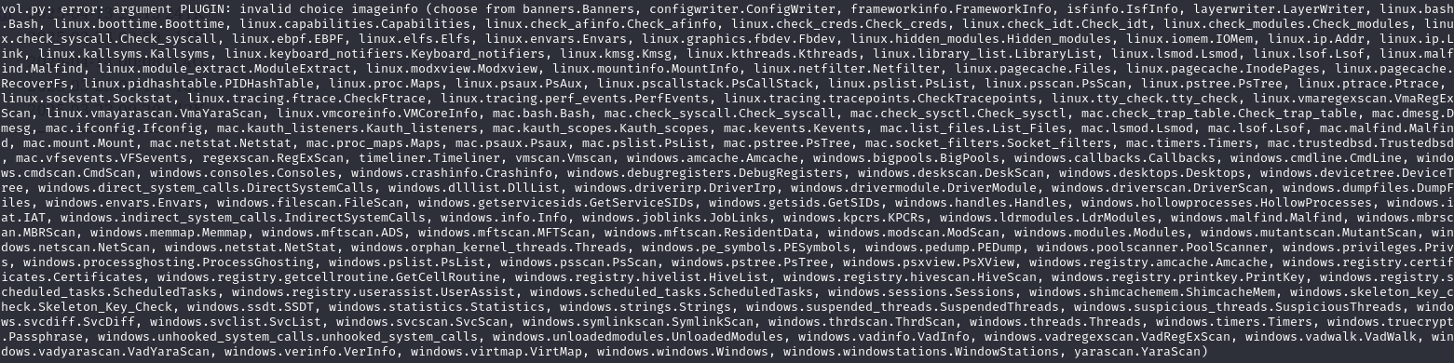
Plugins
Volatility plugins are a module or script provided by volatility to extract certain types of data from a memory file
There are over 200 different plugins, but we will use only a few of them
May need to provide the machine OS profile with –p flag to get results

Slide 12
Plugins
Volatility plugins are a module or script provided by volatility to extract certain types of data from a memory file
There are over 200 different plugins, but we will use only a few of them
For volatility2, you may need to provide the OS profile info w/ the command
Key plugins:
windows.netscan- lists network connections
windows.pslist- lists running processes
windows.filescan- finds file objects in memory
windows.pstree- shows a process tree
windows.psscan- finds hidden or terminated processes via memory scanning
windows.malfind- attempts to find malicious processes
windows.registry.printkey- prints the value of a registry key
windows.hashdump- dumps the NT hashes for logged in users
windows.cmdscan- extracts windows command prompt history

Slide 13
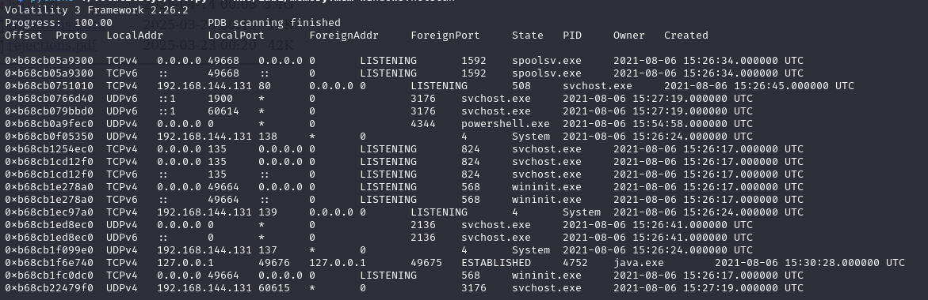
Netscan
Netscan will print out connection information, but also open ports

Slide 14
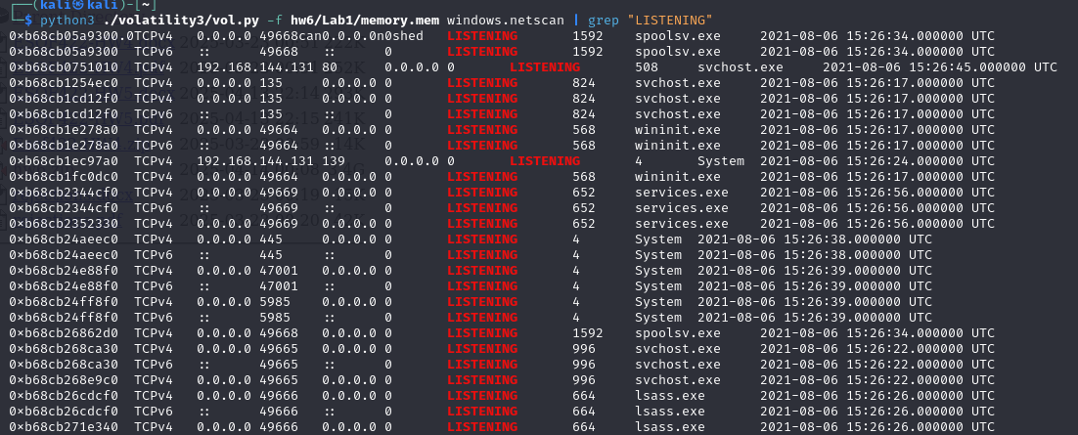
Netscan
We can use grep to scan for just the listening ports (open ports)

Slide 15
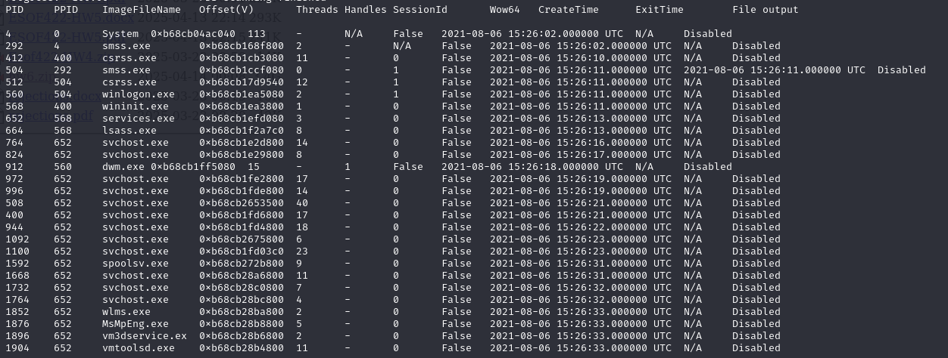




Processes
We can use pslist or pstree to see active processes
The process IDs

Slide 16
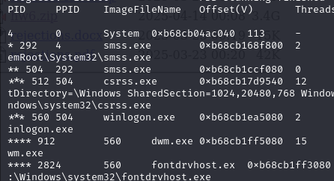

Processes
pstree will try to capture the relationships of process (who spawned who)
System
smss.exe
smss.exe
csrss.exe
winlogon.exe
If you detect a malicious process, this is very helpful to determine how that malicious process was created!

Slide 17
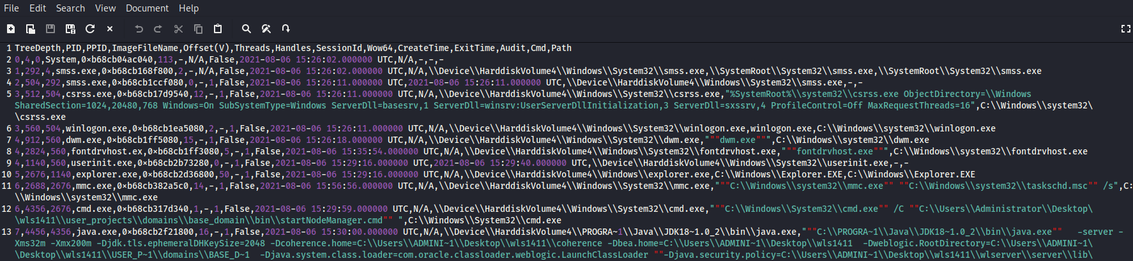
Processes
You can use the –r flag to render the output as csv, and save it to an output file (output.csv)
(It may be easier to sift through a CSV file than a terminal output)

Slide 18

Process Dumping
We can provide a process ID, and the memap plugin will dump the raw contents of the process space (this may take awhile)
There will be a lot of data (in hexadecimal) that is dumped. There are several different tools
The strings command can be used to identify possible strings that existed in the process space
90% of the strings generated will likely be irrelevant, but some might provide some insight!
If a malicious payload is executed, that string should be located somewhere as a String

Slide 19
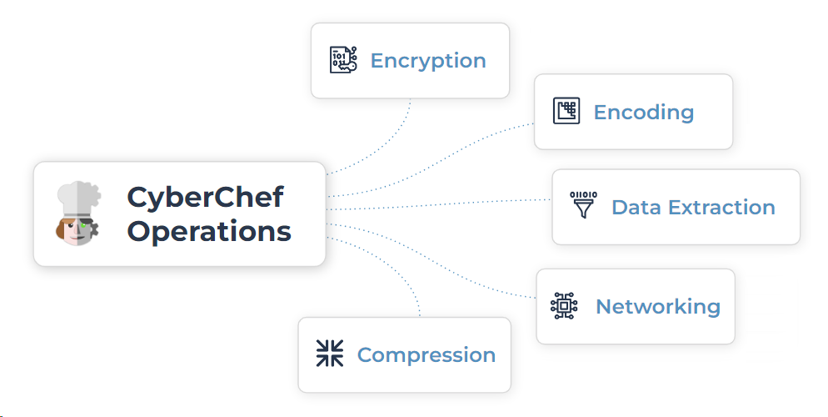
Code obfuscation
It is common behavior for a threat actor to obfuscate their payload by encoding it in a certain way
Cyberchef is a “cyber swiss army knife” web app for encryption, encoding, compression, and data analysis
We can plug Strings into cyberchef, apply some “recipes” and see if we can find the original payload

Slide 20
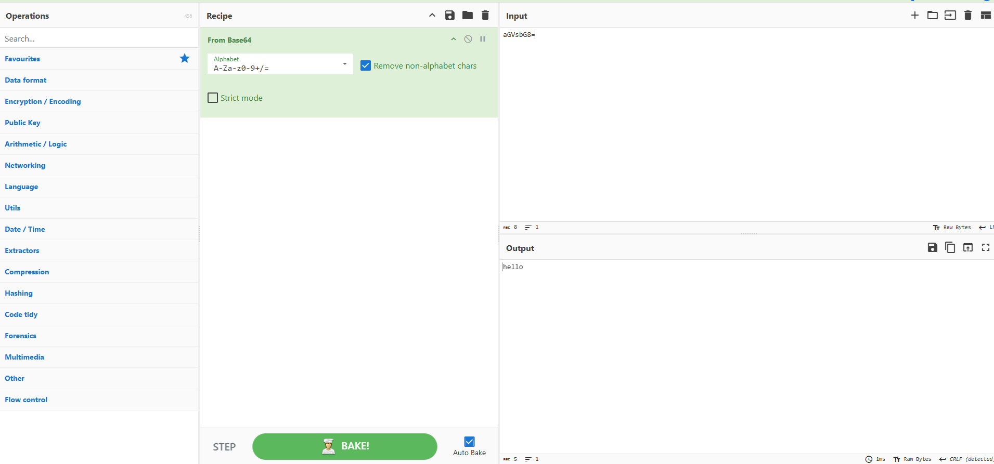
Cyberchef
Cyberchef is a “cyber swiss army knife” web app for encryption, encoding, compression, and data analysis
Input data
Our “Recipe” aka the operations to be done on input
This recipe decodes a base64 string
Output data

Slide 21
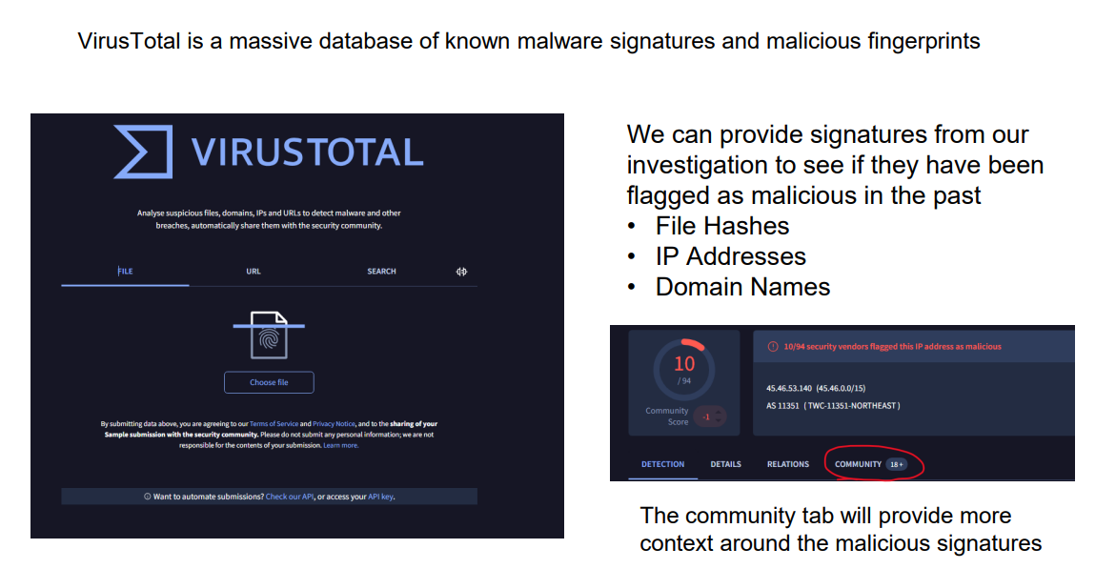
VirusTotal

Slide 22
Printing Windows Registry Values
Software\Microsoft\Windows\CurrentVersion\Run has items that execute when the user logs in
Software\Microsoft\Internet Explorer\TypedURLs has a list of typed URLs
Software\Microsoft\Windows\CurrentVersion\Explorer\RecentDocs shows recently opened documents per file extension
SYSTEM\CurrentControlSet\Control\DeviceClasses shows detailed USB device information
…and so much more. Some keys may not have a value yet

