Slide 1

ESOF 422: Advanced Software Engineering: Cyber Practices
More Volatility
Reese Pearsall
Spring 2025

Slide 2
Announcements
HW6 will be posted very soon (sorry)
We will try to work through some parts on Friday
You will need to have Kali Linux and Volatility installed before Friday’s classtime (I’ll post an installation video)
Final Exam: Wednesday May 7th 2:00 – 3:50 PM
Students with accommodations: Final Exam should be registered at the testing center

Slide 3
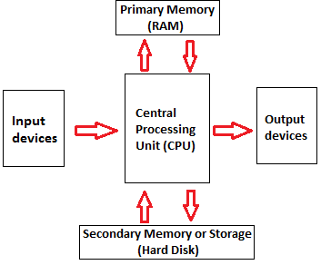

Memory Forensics
Analysis of data sources from a running system’s memory (RAM)
What does RAM contain?
Programs and files that have been executed
Running (and sometimes dead) processes
What programs accessed what files
Where opens files are/were location on disk
Information from keyboard (passwords, emails, chats)
Opened web pages
Decrypted content
Network connections
Content no longer on disk
Content that was never on disk

Slide 4
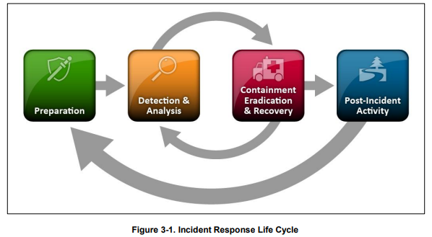

Memory Forensics
The stuff we are talking about for the remainder of the semester are parts of the analysis stage

Slide 5

Volatility
Volatility is a popular, modular framework used for memory forensics
Written in Python
Works on memory images from Windows, Mac, and Linux systems
Runs on Windows, Mac, and Linux
Open source
Extensible and scriptable API
Lots of plugins and community modules
Volatility is not:
A memory acquisition tool
Not a GUI
Bug-free
Supportive of every single OS version

Slide 6
Executed Code
Any program will typically be in the form of an .exe file or a .dll file
.exe file
.exe files run by itself, or can be ran by a user (double-click)
Starts its own process when launched
Every program has an .exe of some kind
.dll file (Dynamic Linked Library)
Cannot be ran by itself. Must be called by another process
Contains library code (reuseable code, classes, and objects)
Can be difficult to find usage in memory
Can be injected with malicious code (DLL Hijacking)

Slide 7


Getting Started
vol.py will always be the script we run for volatility commands
We provide the path to the .mem or .vmem files for analysis with the –f flag
The name of the plugin to run

Slide 8

Process Dumping
We can provide a process ID, and the memap plugin will dump the raw contents of the process space (this may take awhile)
There will be a lot of data (in hexadecimal) that is dumped. There are several different tools
The strings command can be used to identify possible strings that existed in the process space
90% of the strings generated will likely be irrelevant, but some might provide some insight!
If a malicious payload is executed, that string should be located somewhere as a String
Malware authors typically execute their code through some programming-level system call
.exec(), .execve(), .popen() .system()

Slide 9
Printing Windows Registry Values
Software\Microsoft\Windows\CurrentVersion\Run has items that execute when the user logs in
Software\Microsoft\Internet Explorer\TypedURLs has a list of typed URLs
Software\Microsoft\Windows\CurrentVersion\Explorer\RecentDocs shows recently opened documents per file extension
SYSTEM\CurrentControlSet\Control\DeviceClasses shows detailed USB device information
…and so much more. Some keys may not have a value yet

Slide 10
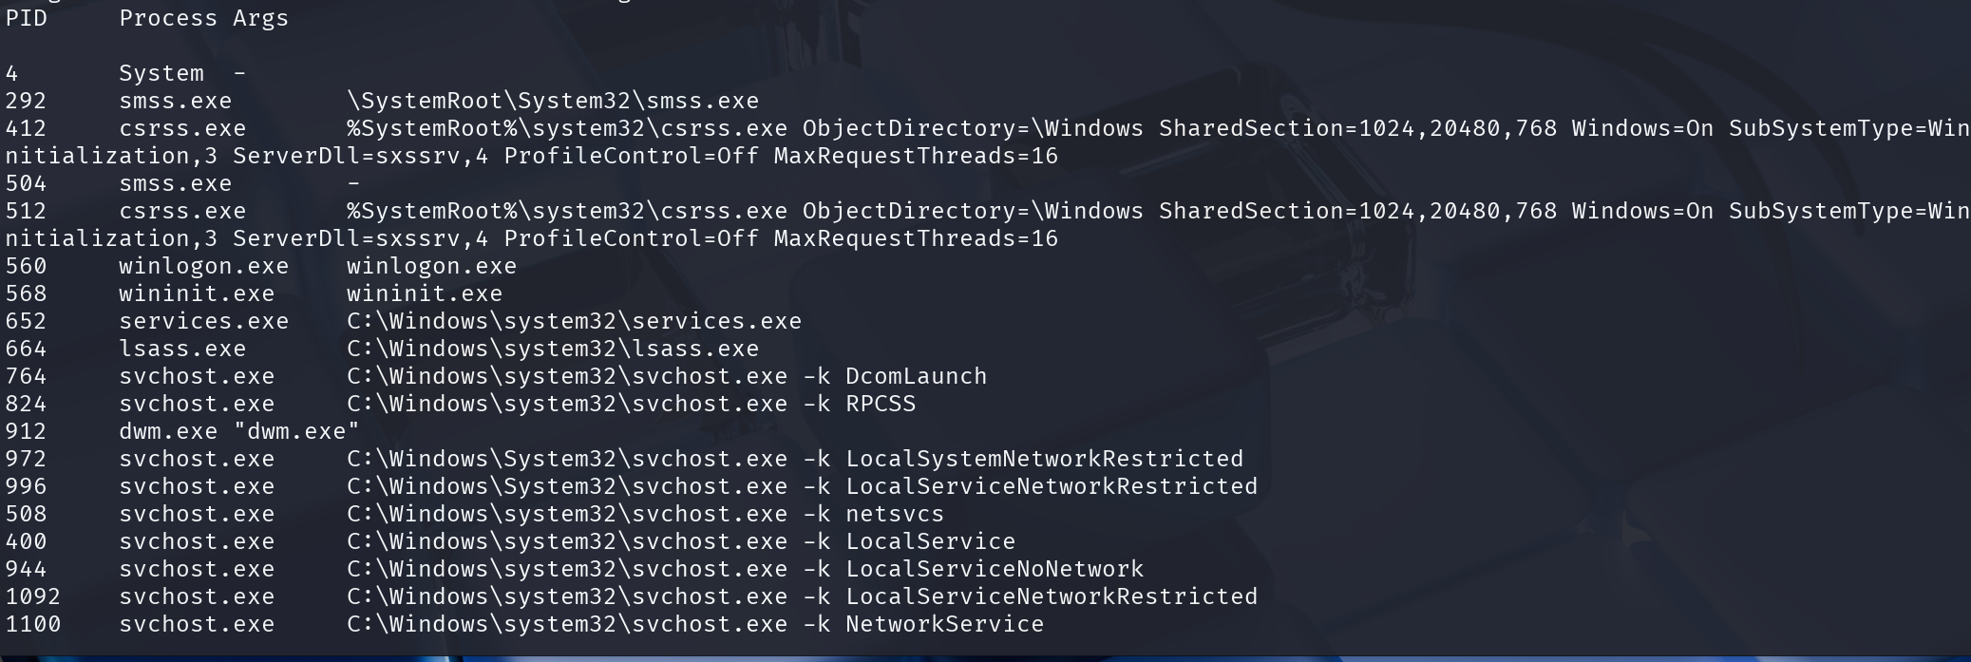
Command Line History
windows.cmdline is used to see how processes used the command line and arguments for commands
Many of it will be benign Windows services, but if a malicious process spawns a new process via command line, it will show up here

Slide 11
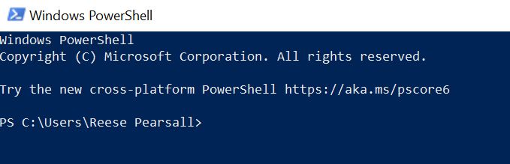
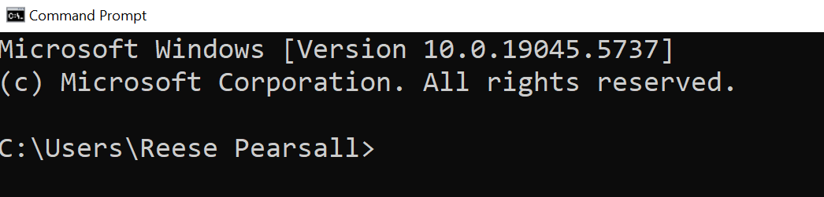
Powershell and Command Line (cmd)
On Windows, Powershell and Command Line are both command-line interfaces, but are much different in design and power
Command Line
Limited scripting capabilities
Very old
Cannot manage windows services/users
More challenging to communicate with other processes
Powershell
Robust scripting capabilities, access to .NET framework
Modern
Can manage windows services/users
Able to communicate with processes easier
For more complex tasks, malware authors will try to summon Powershell to execute their payload

Slide 12
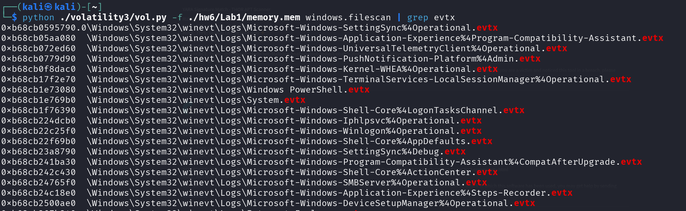
File Scanning
windows.filescan will scan for files that are found in the memory image
exe files
dll files
Documents
.evtx files (indows XML Event Log) – stores system log information

Slide 13
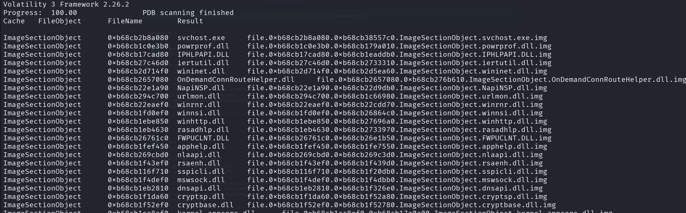
Process File Dumping
windows.dumpfile will scan and extract any files used by a certain process
exe files
dll files
documents

Slide 14
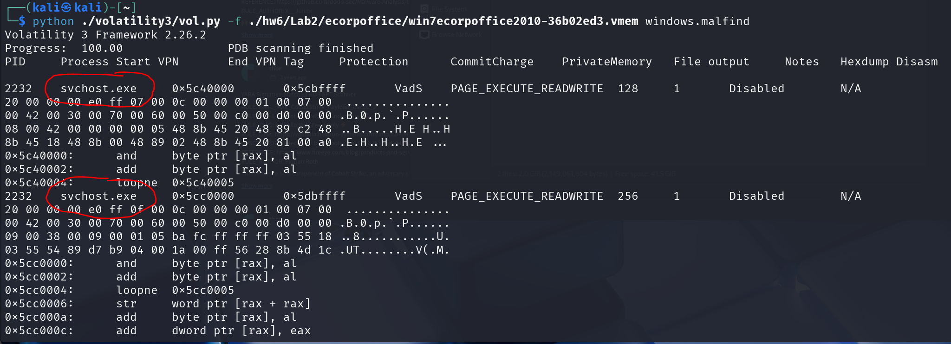
Malfind
windows.malfind will identify malicious process information
False positives are possible, but malfind can be a great place to start searching

Slide 15
Malfind
windows.malfind will identify malicious process information
False positives are possible, but malfind can be a great place to start searching

Slide 16
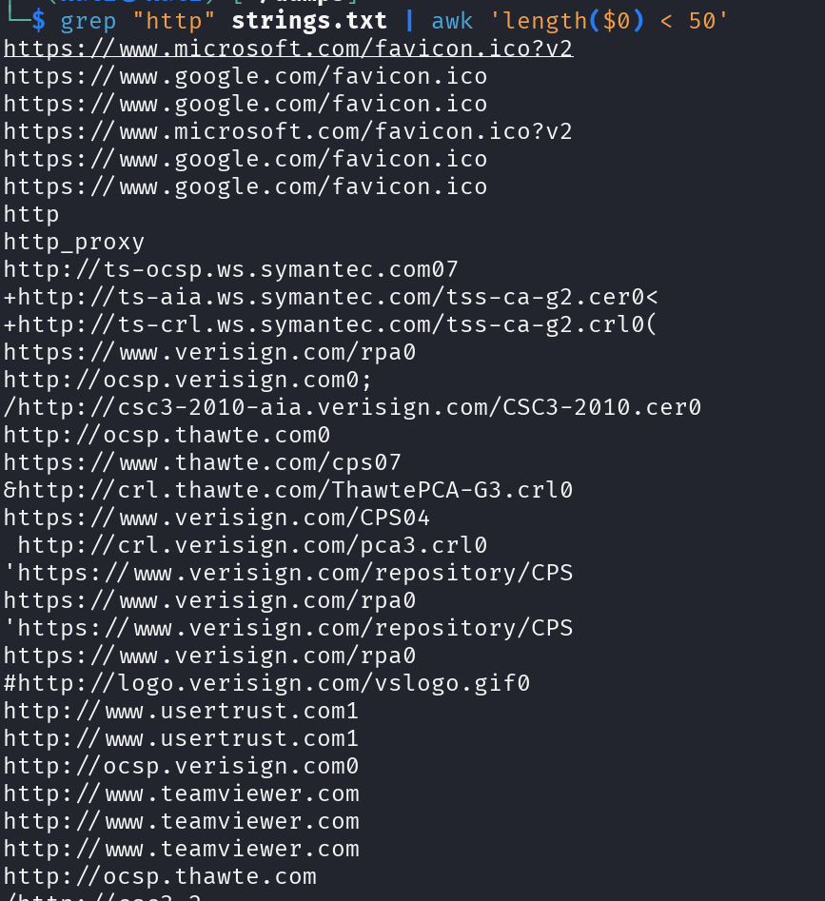
Identifying Suspicious Activity
windows.memmap to dump a process
VirusTotal?
Let’s check strings. http:// is a code string to search for finding what websites the user may have visited
awk is a command-line utility/scripting framework used to process and manipulate data

Slide 17
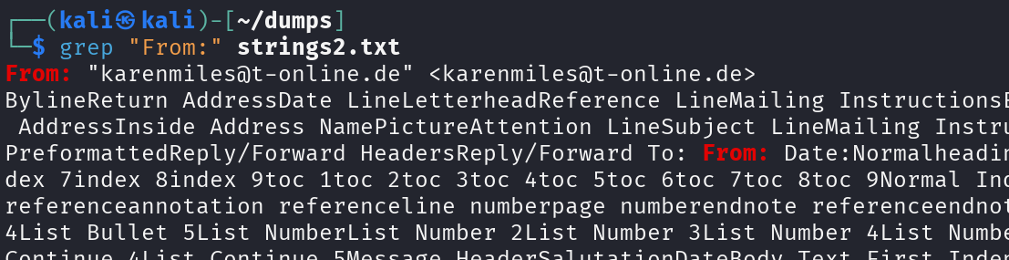
Email Activity
Outlook (email agent) is a process in memory, lets dump it with windows.memmap!
We can grep through it to see email messages that were in memory
If this was a phishing attack, knowing the email is came from is valuable information
Copies of emails are stored in a .PST file
GoldFynch has a great online tool for viewing PST files
(And will let you download email attachments)

