Slide 1

ESOF 422: Advanced Software Engineering: Cyber Practices
Memory Forensics Conclusion, Disk Forensics
Reese Pearsall
Spring 2025

Slide 2
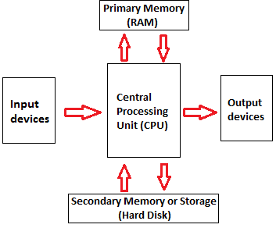

Memory Forensics
Analysis of data sources from a running system’s memory (RAM)
What does RAM contain?
Programs and files that have been executed
Running (and sometimes dead) processes
What programs accessed what files
Where opens files are/were location on disk
Information from keyboard (passwords, emails, chats)
Opened web pages
Decrypted content
Network connections
Content no longer on disk
Content that was never on disk

Slide 3
Malware Persistence
Malware will try to stay on the machine even after a reboot. One common approach for persistence is to add a new file to the list of programs to run on startup within the Windows Registry
“Microsoft\Windows\CurrentVersion\Run” controls programs that automatically start when the user logs into windows
You may find that an unusual program (.exe) is included in the list

Slide 4
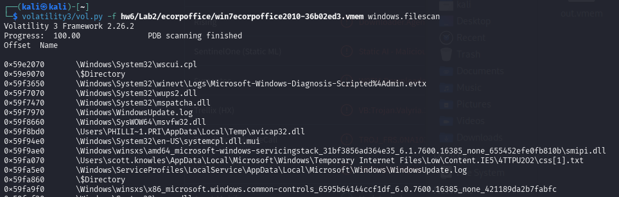

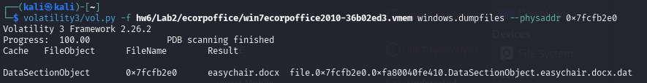


Extracting Specific File
windows.dumpfile may give you a lot of files that you may not want. If you do windows.filescan first, you can get the offset of the file you are looking for
This will only extract that file that you are looking for!

Slide 5
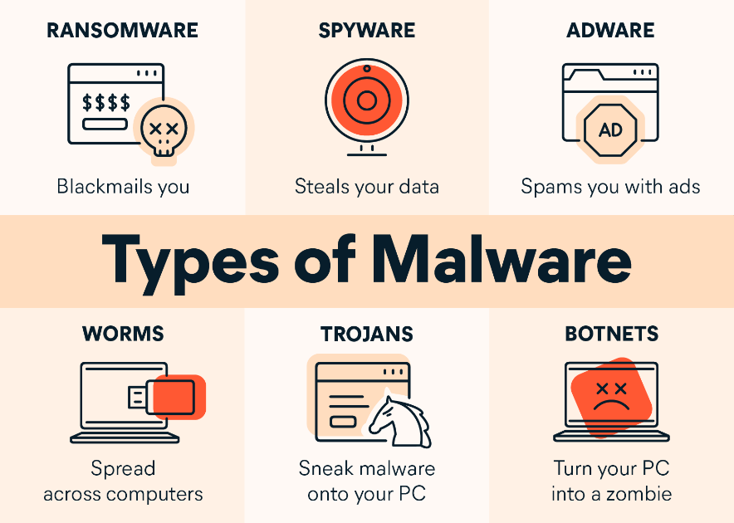
Malware Taxonomy
VirusTotal is very helpful for identifying the type of malware, which will help you analyze the threat
Trojan - disguises itself as legitimate program
Worm - self replicating malware and spreads over a network
Adware - displays and spams user with unwanted ads
Virus - attaches to legitimate program or file to spread itself
Dropper - attempts to deliver and install additional software
Ransomware - encrypts and locks files until a ransom is paid
RAT (Remote Access Trojan) – Malware designed to allow an attacker to remotely control an infected computer
Spyware- Secretly monitors user activity
Dr. Zhong offers a 500-level malware analysis course if you are interested

Slide 6
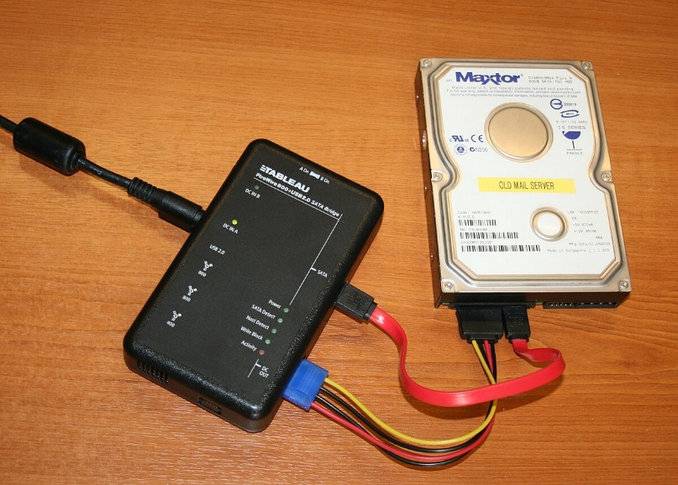
Disk Forensics
• Disk forensics is the study and analysis of storage volumes
• Disk forensics is typically used when you:
– Cannot access the running state of the system
– Are investigating historical activity
– Are working a Law Enforcement (LE) case

Slide 7
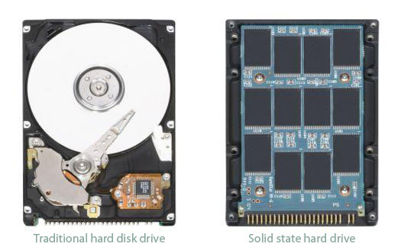
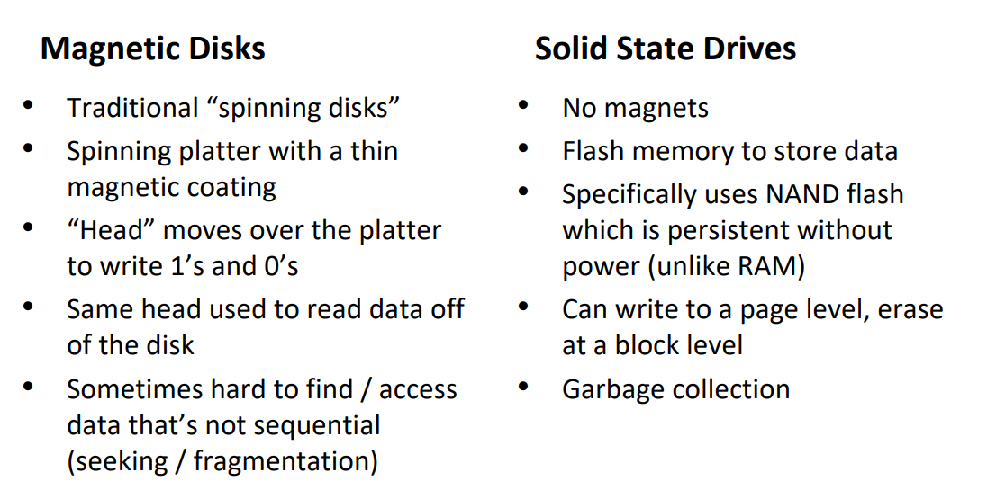
Types of Disks
Other types: VMWare volumes, AWS Volumes

Slide 8
Disk File System Formats
Format | Full Name | Creator | Released | Max File Size | Max Volume Size | Used for
NTFS | New Technology File System | Microsoft | 1993 | 16 TB | 256 TB | Windows systems, large disks
FAT | File Allocation Table | Microsoft | 1977 | 2 GB | 2 GB | Legacy files
FAT32 | File Allocation Table 32 bit | Microsoft | 1996 | 4 GB | 32 GB | USB Drives, SD Cards
APFS | Apple File System | Apple | 2017 | 8 EB | 8 EB | Modern macOS devices

Slide 9
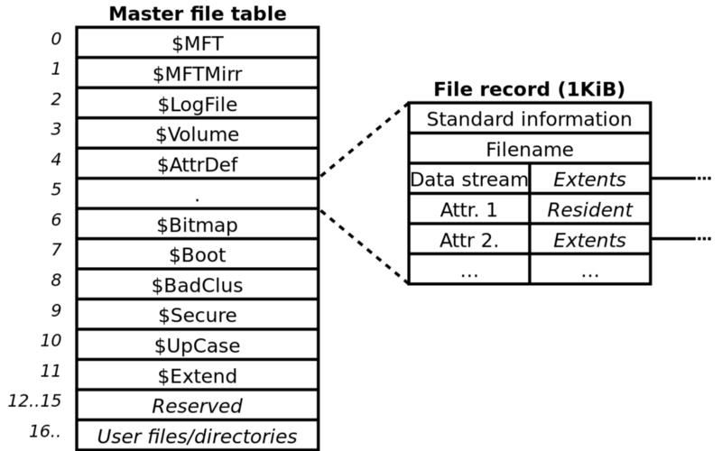

What is a file?
Short answer is that it depends on the file system.
• “indexed” file systems keep an index of every file on the disk
• On an indexed file system the file is a combination of:
– Index entry (record) on MFT (Master File Table) for NTFS (metadata)
– Points to a location(s) on disk where the actual bytes reside

Slide 10
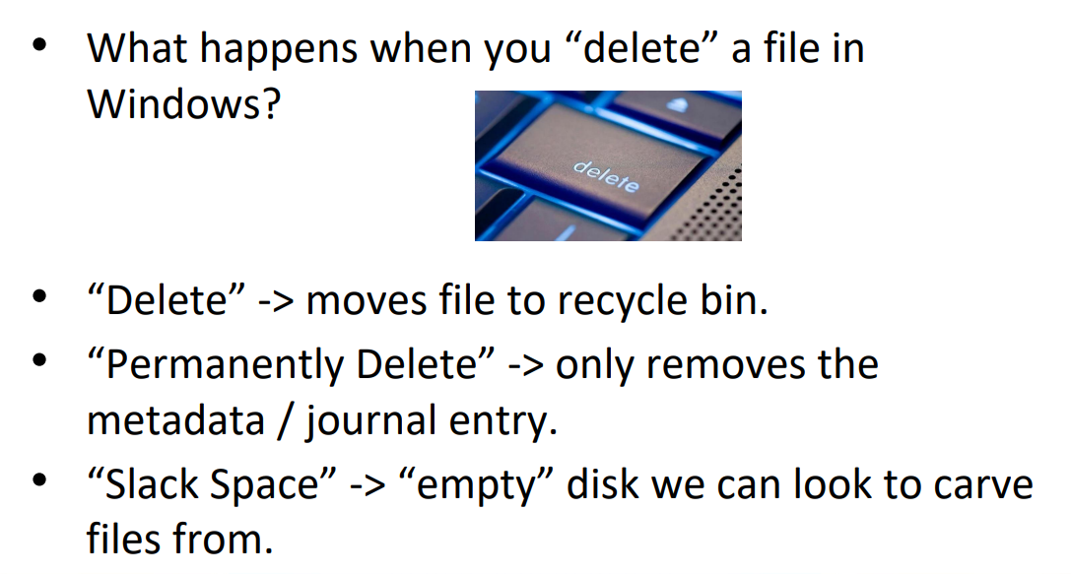
File Deletion

Slide 11
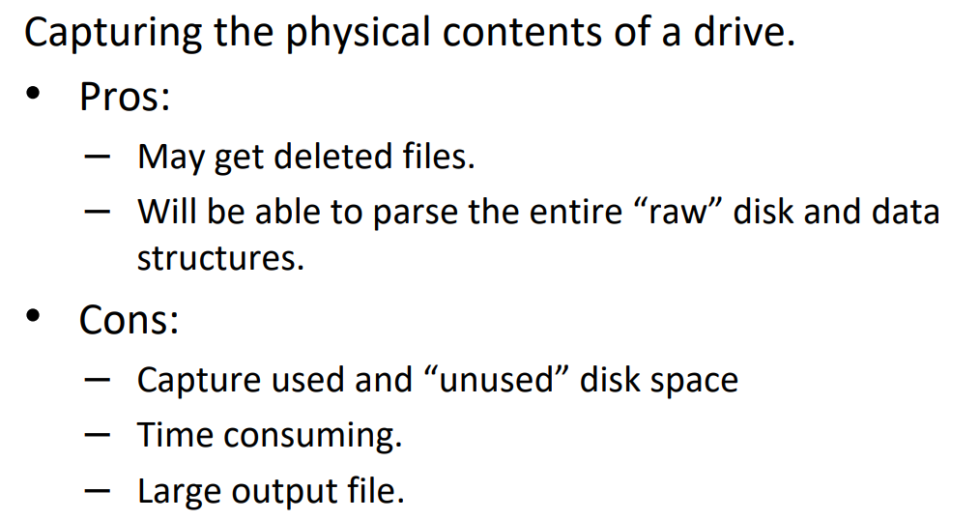
Physical Disk Capture

Slide 12
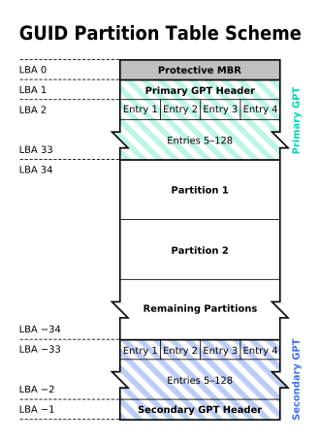
Important Disk Forensics Data Structures
MBR (Master Boot Record)
Stored in first sector of the hard disk
Contains the partition table
Partition Table
Table that describes the logical segmentation and portioning of the physical disk
GPT (GUID global unique identifier Partition Table)
Used in most modern (non-Windows) operating systems
Typically used today unless there are hardware or other backwards-compatibility concerns.

Slide 13
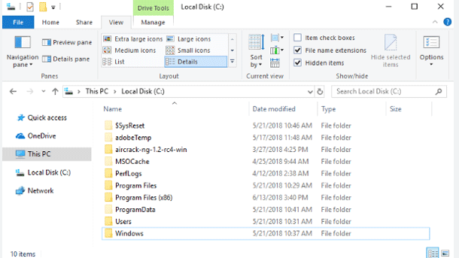
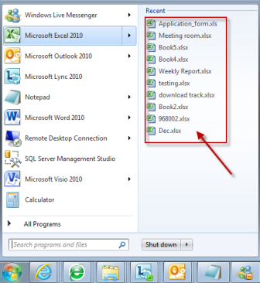
Key Filesystems
Documents/Desktop/Downloads
Temporary files
Browser temp / artifacts
Browser downloads cache
Email attachments
Prefetch
Windows registry
Jump lists
Common log directories

Slide 14
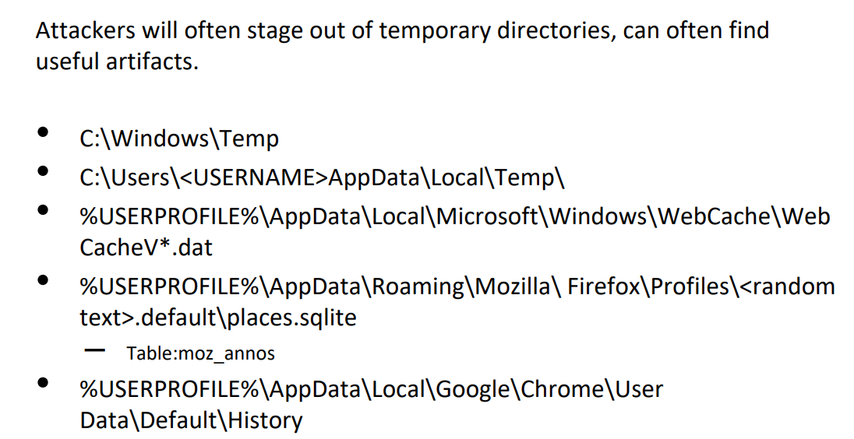
Temporary Files

Slide 15
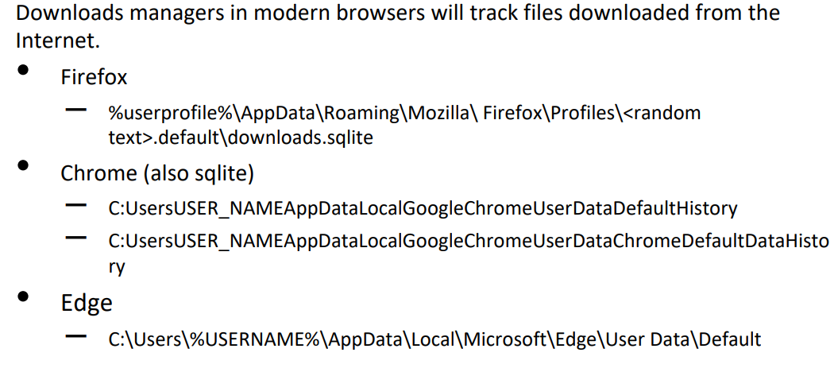
Browser Downloads Cache

Slide 16
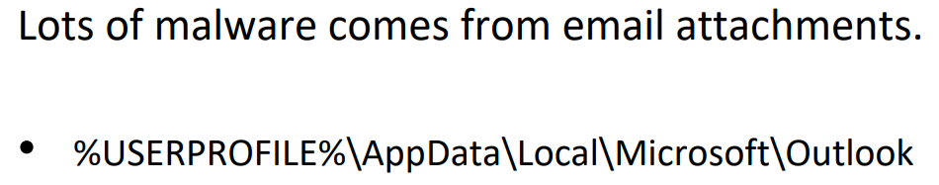
Email Attachments

Slide 17
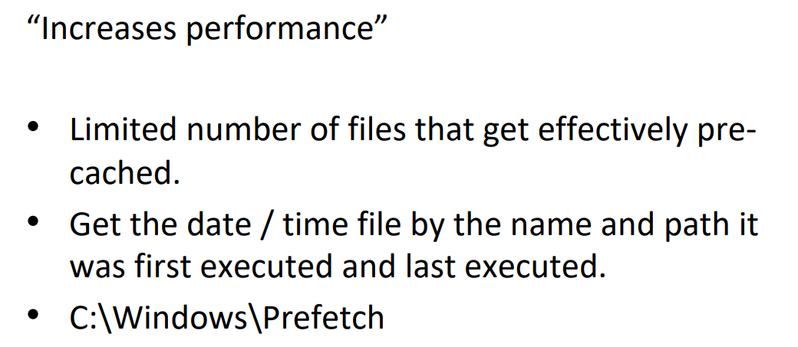
Prefetch

Slide 18
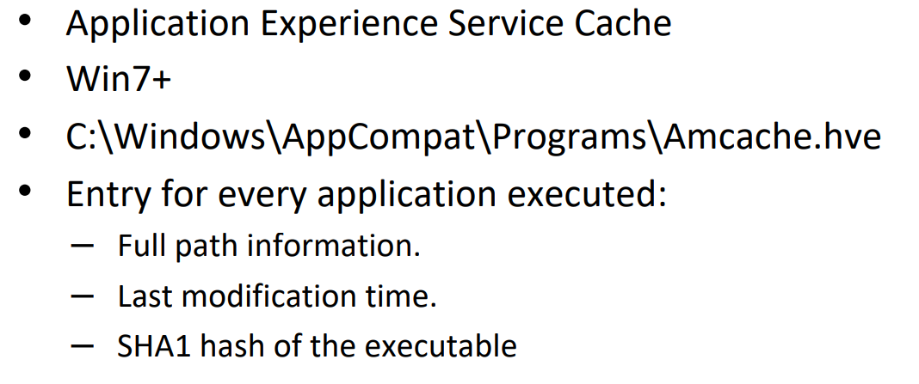
AMCACHE

Slide 19
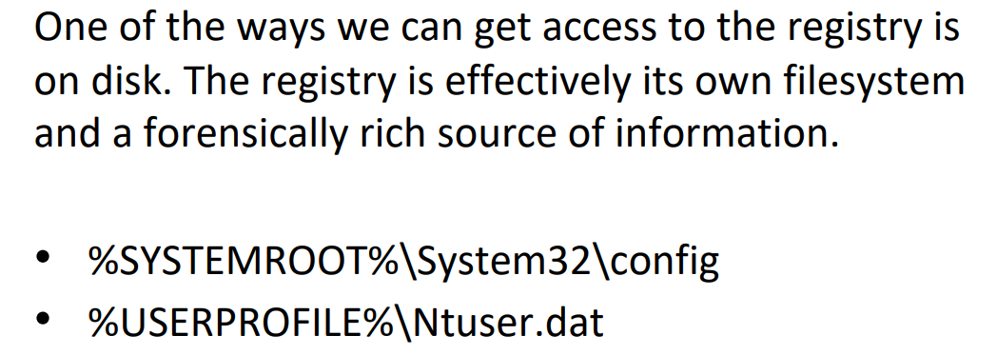
Windows Registry

Slide 20
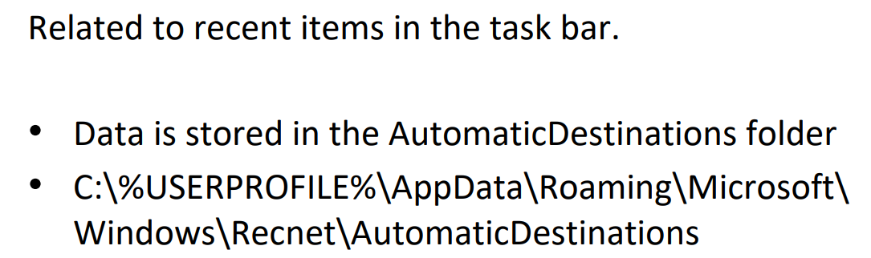
Jump Lists

Slide 21
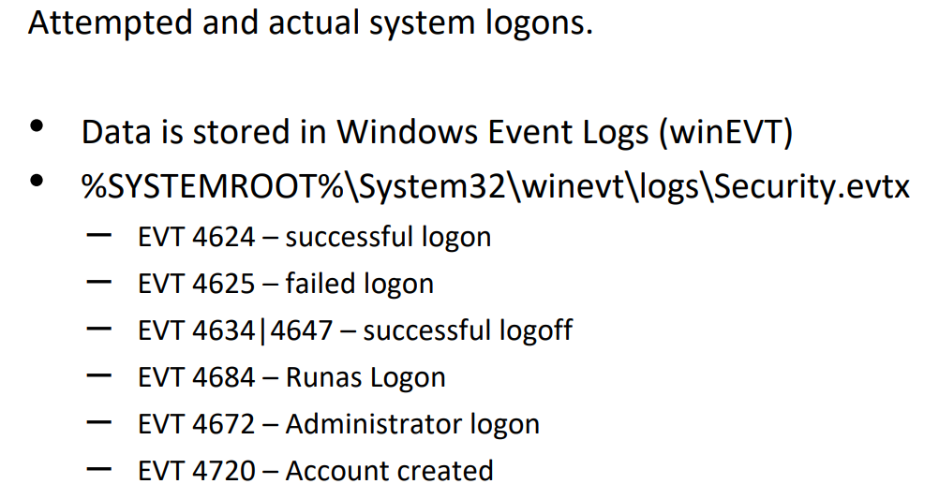
Logon Activity

Slide 22
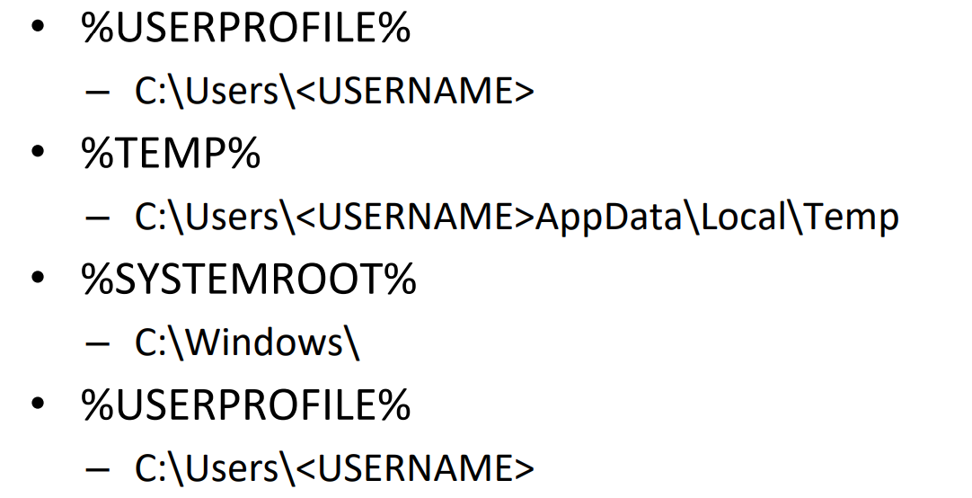
Environment Variables Shortcut

