Slide 1

CSCI 466: Networks
Network Layer – Routing (Control Plane)
Reese Pearsall Fall 2022
https://www.cs.montana.edu/pearsall/classes/fall2022/466/main.html
*All images are stolen from the internet
1

Slide 2
Announcements
NO CLASS on Monday (10/24)
Email/DM me if you need to chat or have questions
PA2 due tonight* at 11:59 PM
→ You can submit it any time this weekend without a late pass and you won’t lose points ☺
HW2 Released. Due one week from today (10/28)

Slide 3
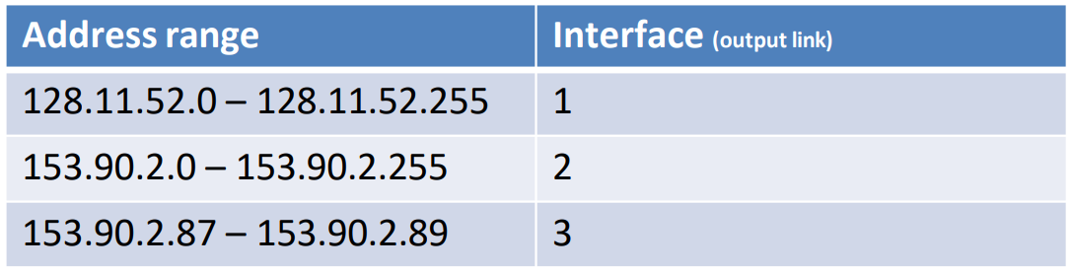
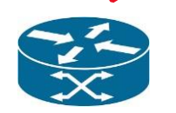
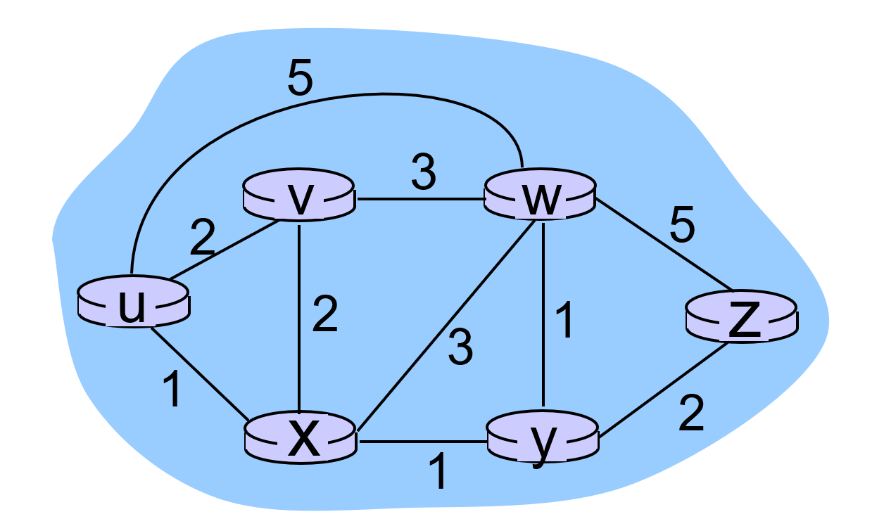
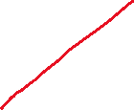
Forwarding refers to moving packets from a router’s input to appropriate router output, and is implemented in the data plane.
Ideally, this output links are the most optimal path to get to the destination
Routing refers to determining the route taken by packets from source to destination, and is implemented in the control plane.
What is the best way to get from u to z?

Slide 4
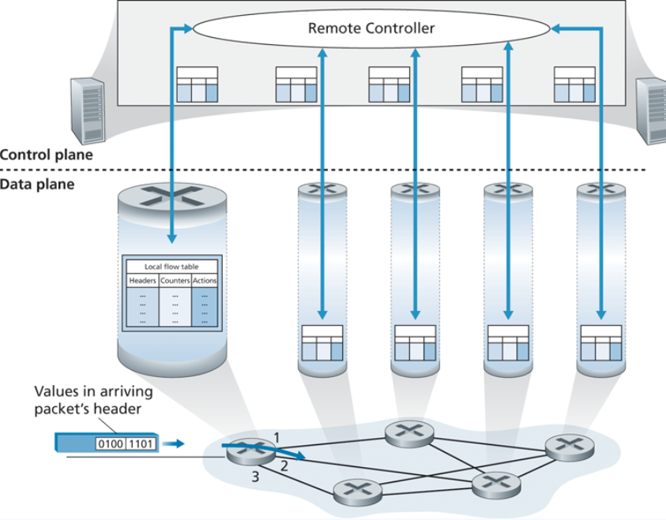
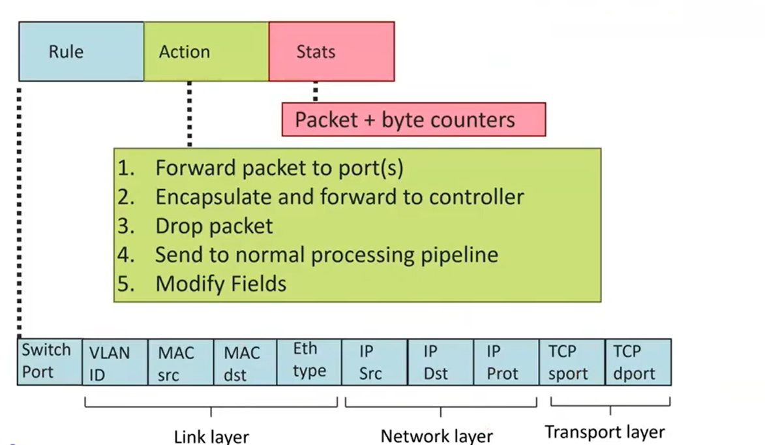
Generalized Forwarding and Software Defines Network (SDN)
Control Plane and Data Plane need to work together in order to create efficient routing tables

Slide 5

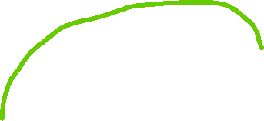
Network as a Graph
A graph G consists of N nodes
N = { u v x w y z }
A node could be a host, a router, or a smaller network!
A graph consists of edges E
E₁
(u,v) = 2
E₂
(u,w) = 5
E₆
(x,y) = 1
An example network with 6 hosts/routers
In most cases, edges will also have a cost
What do the costs represent??

Slide 6


Network as a Graph
A graph G consists of N nodes
N = { u v x w y z }
A node could be a host, a router, or a smaller network!
A graph consists of edges E
E₁
(u,v) = 2
E₂
(u,w) = 5
E₆
(x,y) = 1
An example network with 6 hosts/routers
In most cases, edges will also have a cost
What do the costs represent?? Physical distance, time needed, bandwidth, delay

Slide 7




Network as a Graph
The cost from A to B is the sum of the edge weights of the path taken
C(u,z) = 1 + 1 + 2 = 4
C(u,z) = 2 + 3 + 5 = 10
If a packet needs to go from U to Z, we want it to take the most optimal path!
Routing algorithm: algorithm that finds the least cost path
Do you know any?
👀

Slide 8
Link-state Algorithm (Dijkstra’s algorithm)
Dijkstra’s algorithm is a shortest path algorithm that is guaranteed to find a solution
step | N’ | D(v), p(v) | D(w), p(w) | D(x), p(x) | D(y), p(y) | D(z), p(z)
0 | u | 2, u | 5, u | 1, u | N/A | N/A
1
2
3
4
5
Goal: Find shortest path from u to z
N’ is our current optimal path. We must start at u obviously

Slide 9



Link-state Algorithm (Dijkstra’s algorithm)
Dijkstra’s algorithm is a shortest path algorithm that is guaranteed to find a solution
step | N’ | D(v), p(v) | D(w), p(w) | D(x), p(x) | D(y), p(y) | D(z), p(z)
0 | u | 2, u | 5, u | 1, u | N/A | N/A
1
2
3
4
5
Goal: Find shortest path from u to z
N’ is our current optimal path. We must start at u obviously

Slide 10



Link-state Algorithm (Dijkstra’s algorithm)
Dijkstra’s algorithm is a shortest path algorithm that is guaranteed to find a solution
step | N’ | D(v), p(v) | D(w), p(w) | D(x), p(x) | D(y), p(y) | D(z), p(z)
0 | u | 2, u | 5, u | 1, u | N/A | N/A
1
2
3
4
5
The path with the least cost is to X, so x will get added onto our path!
Goal: Find shortest path from u to z

Slide 11
Link-state Algorithm (Dijkstra’s algorithm)
Dijkstra’s algorithm is a shortest path algorithm that is guaranteed to find a solution
step | N’ | D(v), p(v) | D(w), p(w) | D(x), p(x) | D(y), p(y) | D(z), p(z)
0 | u | 2, u | 5, u | 1, u | N/A | N/A
1 | ux
2
3
4
5
Goal: Find shortest path from u to z

Slide 12



Link-state Algorithm (Dijkstra’s algorithm)
Dijkstra’s algorithm is a shortest path algorithm that is guaranteed to find a solution
step | N’ | D(v), p(v) | D(w), p(w) | D(x), p(x) | D(y), p(y) | D(z), p(z)
0 | u | 2, u | 5, u | 1, u | N/A | N/A
1 | ux | 2, u | 4, x |  | 2, x | N/A
2
3
4
5
The shortest path from u to w is now 4 (travel through x) instead of taking the 4 cost path
The shortest path from u to v is still the same
Goal: Find shortest path from u to z

Slide 13

Link-state Algorithm (Dijkstra’s algorithm)
Dijkstra’s algorithm is a shortest path algorithm that is guaranteed to find a solution
step | N’ | D(v), p(v) | D(w), p(w) | D(x), p(x) | D(y), p(y) | D(z), p(z)
0 | u | 2, u | 5, u | 1, u | N/A | N/A
1 | ux | 2, u | 4, x |  | 2, x | N/A
2 | uxy | 2, u | 3, y |  |  | 4,y
3
4
5
We also have a more optimal path to W now
Now that y is on our path, we can now reach z!
Goal: Find shortest path from u to z
Path(u,z) = uxyz
Cost = 1 +1 + 2 = 4

Slide 14
Link-state Algorithm (Dijkstra’s algorithm)
Dijkstra’s algorithm is a shortest path algorithm that is guaranteed to find a solution
step | N’ | D(v), p(v) | D(w), p(w) | D(x), p(x) | D(y), p(y) | D(z), p(z)
0 | u | 2, u | 5, u | 1, u | N/A | N/A
1 | ux | 2, u | 4, x |  | 2, x | N/A
2 | uxy | 2, u | 3, y |  |  | 4,y
3 | uxyv |  | 3,y |  |  | 4,y
4
5
NEW Goal: Find shortest path from u to any node

Slide 15
Link-state Algorithm (Dijkstra’s algorithm)
Dijkstra’s algorithm is a shortest path algorithm that is guaranteed to find a solution
step | N’ | D(v), p(v) | D(w), p(w) | D(x), p(x) | D(y), p(y) | D(z), p(z)
0 | u | 2, u | 5, u | 1, u | N/A | N/A
1 | ux | 2, u | 4, x |  | 2, x | N/A
2 | uxy | 2, u | 3, y |  |  | 4,y
3 | uxyv |  | 3,y |  |  | 4,y
4 | uxyvw |  |  |  |  | 4,y
5 | uxyvwz
NEW Goal: Find shortest path from u to any node

Slide 16
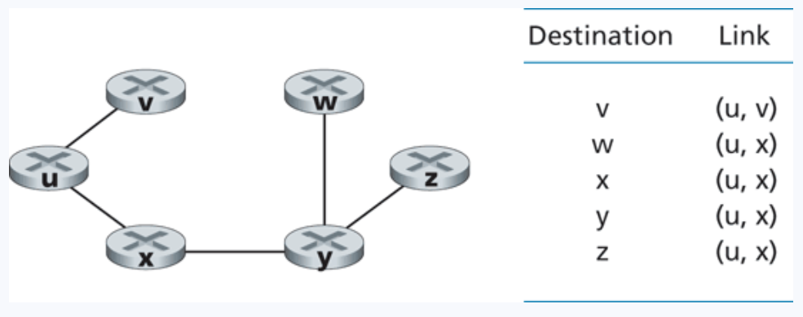
Link-state Algorithm (Dijkstra’s algorithm)
LS complexity = O(N^2)
Issues? Concerns?
Routing table for node u
We will then run the same algorithm on each node to create its forwarding table!

Slide 17
Link-state Algorithm (Dijkstra’s algorithm)
LS is a centralized routing algorithm, which means it has global knowledge about all the edge of the network!
However, it is very likely we will not know information about the network beforehand!
?
?
?
?
Additionally, path costs can frequently change based on network congestion
?
?
?

Slide 18
Distance Vector Algorithm
D_{x}(y) = estimate of least cost from x to y
x maintains distance vector D_{x} = [D_{x}(y): y є N ]
node x:
knows cost to each neighbor v: c(x,v)
maintains its neighbors’ distance vectors. For each neighbor v, x maintains D_{v} = [D_{v}(y): y є N ]
DV is not a centralized algorithm, which means that it does not require global knowledge about network edge costs
key idea:
from time-to-time, each node sends its own distance vector estimate to neighbors
when x receives new DV estimate from neighbor, it updates its own DV using B-F equation:
D_{x}(y) ← min_{v}{c(x,v) + D_{v}(y)} for each node y ∊ N

Slide 19
Distance vector algorithm
iterative, asynchronous: each local iteration caused by:
local link cost change
DV update message from neighbor
distributed:
each node notifies neighbors only when its DV changes
neighbors then notify their neighbors if necessary
each node:
wait for (change in local link cost or msg from neighbor)
recompute estimates
if DV to any dest has changed, notify neighbors

Slide 20
Comparison of LS and DV algorithms
message complexity
LS: with n nodes, E links, O(nE) msgs sent
DV: exchange between neighbors only
convergence time varies
speed of convergence
LS: O(n²) algorithm requires O(nE) msgs
may have oscillations
DV: convergence time varies
may be routing loops
count-to-infinity problem
robustness: what happens if router malfunctions?
LS:
node can advertise incorrect link cost
each node computes only its own table
DV:
DV node can advertise incorrect path cost
each node’s table used by others
error propagate thru network

Slide 21









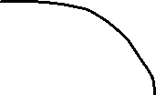
Intra-AS Routing: OSPF
An autonomous system is a group of routers that are under the same administrative control
AS 3
AS 1
AS 2

Slide 22


Intra-AS Routing: OSPF
Open Shortest Path First
OSPF is a link-state protocol that uses flooding of link-state information and Dijkstra’s least-cost algorithm
An autonomous system is a group of routers that are under the same administrative control
AS 1

Slide 23


Intra-AS Routing: OSPF
Open Shortest Path First
OSPF is a link-state protocol that uses flooding of link-state information and Dijkstra’s least-cost algorithm
An autonomous system is a group of routers that are under the same administrative control
1. Each router constructors a topological map of the AS
AS 1

Slide 24


Intra-AS Routing: OSPF
Open Shortest Path First
OSPF is a link-state protocol that uses flooding of link-state information and Dijkstra’s least-cost algorithm
An autonomous system is a group of routers that are under the same administrative control
1. Each router constructors a topological map of the AS
2. Run Dijikstra’s to determine shortest path to each subnet
(Edge costs will be set by a network administrator)
(could set all edges to be a cost of 1)
AS 1

Slide 25
Intra-AS Routing: OSPF
Open Shortest Path First
OSPF is a link-state protocol that uses flooding of link-state information and Dijkstra’s least-cost algorithm
An autonomous system is a group of routers that are under the same administrative control
1. Each router constructors a topological map of the AS
2. Run Dijikstra’s to determine shortest path to each subnet
(Edge costs will be set by a network administrator)
(could set all edges to be a cost of 1)
A | 1
B | 2
C | 3
… | …
AS 1
3. Fill in routing table

Slide 26

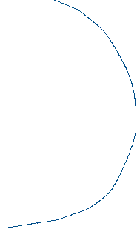
Routing Among the ISPs: BGP
Inter-AS routing protocol involves coordination amongst multiple AS’s, a common protocol needs to be used
AS 1
Border Gateway Protocol (BGP) is used for exchanging routing information between AS

Slide 27

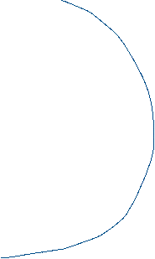
Routing Among the ISPs: BGP
Inter-AS routing protocol involves coordination amongst multiple AS’s, a common protocol needs to be used
AS 1
Border Gateway Protocol (BGP) is used for exchanging routing information between AS
BGP allows a router to tell other AS’s that it exists and needs to be connected

Slide 28
Routing Among the ISPs: BGP
AS consists of gateway routers and internal routers
Inter-AS routing protocol involves coordination amongst multiple AS’s, a common protocol needs to be used
AS6
AS3
AS2
AS4
AS5
AS6
AS 1
Border Gateway Protocol (BGP) is used for exchanging routing information between AS
BGP allows a router to tell other AS’s that it exists and needs to be connected

Slide 29
Routing Among the ISPs: BGP
AS consists of gateway routers and internal routers
Inter-AS routing protocol involves coordination amongst multiple AS’s, a common protocol needs to be used
AS6
AS3
AS2
AS4
AS5
AS6
AS 1
Border Gateway Protocol (BGP) is used for exchanging routing information between AS
BGP allows a router to tell other AS’s that it exists and needs to be connected

Slide 30
Routing Among the ISPs: BGP
AS consists of gateway routers and internal routers
Inter-AS routing protocol involves coordination amongst multiple AS’s, a common protocol needs to be used
AS6
“I am AS1 AND I EXIST!”
AS3
AS2
AS4
AS5
AS6
AS 1

Slide 31
Routing Among the ISPs: BGP
AS consists of gateway routers and internal routers
Inter-AS routing protocol involves coordination amongst multiple AS’s, a common protocol needs to be used
AS6
“I am AS1 AND I EXIST!”
AS3
AS2
AS4
AS5
AS6
AS 1
“A1 EXISTS AND FOUND THROUGH AS2”

Slide 32
Announcements
HW2 due tonight
PA3 due Monday November 14th

Slide 33
Routing Among the ISPs: BGP
BGP is the routing protocol used for routing amongst different ISPs + AS
Two important functions
Obtain prefix reachability information from neighboring ASs
→ Determine the “best” routes to the prefixes
2b
2a
2c
1b
3b
2d
∂
1a
1c
3a
3c
AS 2
1d
3d
AS 1
eBGP connectivity
AS 3
iBGP connectivity
1c
gateway routers run both eBGP and iBGP protools

Slide 34
Routing Among the ISPs: BGP
BGP is the routing protocol used for routing amongst different ISPs + AS
Two important functions
Obtain prefix reachability information from neighboring ASs
→ Determine the “best” routes to the prefixes
2b
2a
2c
1b
3b
Prefix X connect
2d
1a
1c
3a
3c
External BGP (eBGP)
AS 2
3a → 2c “Hey I have X”
2a → 1c “Hey AS 3 has X and I have AS3”
1d
3d
X
AS 1
eBGP connectivity
AS 3
iBGP connectivity
Internal BGP (iBGP)
2c → 2b
2c → 2d
2c → 2a
1c
gateway routers run both eBGP and iBGP protools

Slide 35
BGP basics
BGP session: two BGP routers (“peers”) exchange BGP messages over semi-permanent TCP connection:
advertising paths to different destination network prefixes (BGP is a “path vector” protocol)
when AS3 gateway router 3a advertises path AS3,X to AS2 gateway router 2c:
AS3 promises to AS2 it will forward datagrams towards X
AS 3
3b
AS 1
1b
3a
3c
1a
1c
AS 2
2b
3d
X
1d
2a
2c
BGP advertisement:
AS3, X
2d

Slide 36
BGP basics
Advertisements with BGP also include “BGP attributes”
Prefix (ip address or subnet) + attributes = “route”
Two important attributes:
AS-PATH: list of ASes through which prefix advertisement has passed
NEXT-HOP: indicates specific internal-AS router to next-hop AS

Slide 37
Hot Potato Routing
AS3
3b
AS1
1b
3a
3c
1a
1c
AS2
2b
3d
X
1d
112
152
AS3,X
AS1,AS3,X
2a
263
2c
201
OSPF link weights
2d
2d learns (via iBGP) it can route to X via 2a or 2c
hot potato routing: choose local gateway that has least intra-domain cost (e.g., 2d chooses 2a, even though more AS hops to X): don’t worry about inter-domain cost!
Network Layer: Control Plane
5-37

Slide 38
ICMP (Internet Control Message Protocol)
used by hosts & routers to communicate network-level information
error reporting: unreachable host, network, port, protocol
echo request/reply (used by ping)
network-layer “above” IP:
ICMP msgs carried in IP datagrams
ICMP message: type, code plus first 8 bytes of IP datagram causing error
Type Code description
0 0 echo reply (ping)
3 0 dest. network unreachable
3 1 dest host unreachable
3 2 dest protocol unreachable
3 3 dest port unreachable
3 6 dest network unknown
3 7 dest host unknown
4 0 source quench (congestion
control - not used)
8 0 echo request (ping)
9 0 route advertisement
10 0 router discovery
11 0 TTL expired
12 0 bad IP header

Slide 39

Control Plane Wrap up
Routing
Algorithm
approaches to network control plane
- per-router control (traditional)
- logically centralized control (software defined networking)
traditional routing algorithms
- routing: link state, distance vectors
- implementation in Internet: OSPF, BGP
Internet Control Message Protocol
control
plane
data
plane
Next:
Link Layer
Security
Random Topics in session, presentation, and physical layers

