Slide 1




CSCI 466: Networks
Halloween Special – TOR, Dark Net, Anonymity
Trigger warning: We will briefly be mentioning sexual abuse and exploitation via the internet
Reese Pearsall Fall 2022
https://www.cs.montana.edu/pearsall/classes/fall2022/466/main.html
*All images are stolen from the internet
1

Slide 2
Announcements
Announcements
NO CLASS on Monday (10/24)
Email/DM me if you need to chat or have questions
PA3 due Nov 14th @ 11:59 PM
I might be on a watch list
PA2 due tonight* at 11:59 PM
→ You can submit it any time this weekend without a late pass and you won’t lose points ☺
HW2 Released. Due one week from today (10/28)

Slide 3















Announcements
The Public Internet
HW2 Released. Due one week from today (10/28)
We’ve seen that our data can pass through many routers and servers to get to their destination
Generally, If we use HTTPS, our traffic will be encrypted

Slide 4












Announcements
The Public Internet
HW2 Released. Due one week from today (10/28)
We’ve seen that our data can pass through many routers and servers to get to their destination
Generally, If we use HTTPS, our traffic will be encrypted
However, routing is a black box

Slide 5





Announcements
The Public Internet
HW2 Released. Due one week from today (10/28)
We’ve seen that our data can pass through many routers and servers to get to their destination
Generally, If we use HTTPS, our traffic will be encrypted
However, routing is a black box
The router, server, and web browser we are passing through can track our data! (ISP, server host, etc)
→ IP address, Cookies, physical location

Slide 6
Announcements
The Public Internet
Your activity on the internet is not totally anonymous (even in incognito mode)
HW2 Released. Due one week from today (10/28)
We’ve seen that our data can pass through many routers and servers to get to their destination
Generally, If we use HTTPS, our traffic will be encrypted
However, routing is a black box
The router, server, and web browser we are passing through can track our data! (ISP, server host, etc)
→ IP address, Cookies, physical location

Slide 7

TOR (The Onion Router)
Developed by US Naval Research Laboratory to protect American Intelligence Communications online. Released publicly in 2004

Slide 8
TOR (The Onion Router)
Developed by US Naval Research Laboratory to protect American Intelligence Communications online. Released publicly in 2004
Built on P2P architecture,
→ Messages are passed through a network of Tor nodes.

Slide 9
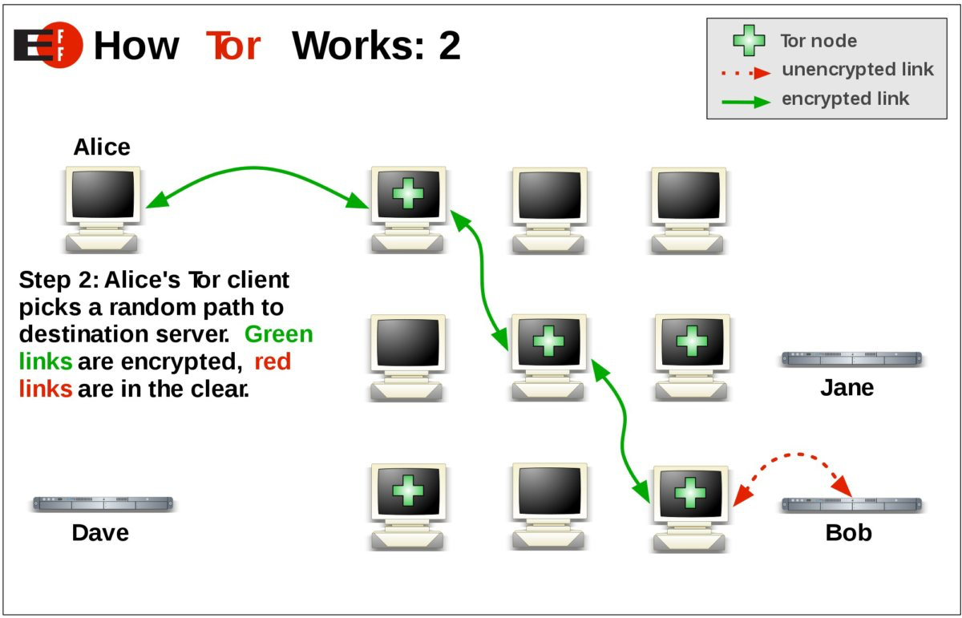
TOR (The Onion Router)
Developed by US Naval Research Laboratory to protect American Intelligence Communications online. Released publicly in 2004
Built on P2P architecture,
→ Messages are passed through a network of Tor nodes.

Slide 10


TOR (The Onion Router)
Developed by US Naval Research Laboratory to protect American Intelligence Communications online. Released publicly in 2004
Built on P2P architecture,
→ Messages are passed through a network of Tor nodes.
From this Node’s perspective it only can see the previous node and the next node
It has no idea who the original sender was

Slide 11



TOR (The Onion Router)
Developed by US Naval Research Laboratory to protect American Intelligence Communications online. Released publicly in 2004
Built on P2P architecture,
→ Messages are passed through a network of Tor nodes.
Not totally safe. Messages leaving an “exit node” will be in cleartext
Random path each time!

Slide 12
TOR (The Onion Router)
Developed by US Naval Research Laboratory to protect American Intelligence Communications online. Released publicly in 2004
Built on P2P architecture,
→ Messages are passed through a network of Tor nodes.
→ Encrypted throughout the entire process. Cant tell who sent what
Browser can be found online as a modified version of Firefox (Slow)
→ You can visit .onion links

Slide 13
TOR (The Onion Router)
Onion Links websites that are not accessible by normal web browser
→ .onion instead of .com, .net, etc

Slide 14
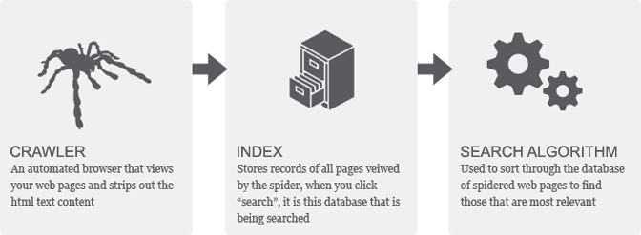
TOR (The Onion Router)
Onion Links websites that are not accessible by normal web browser
→ .onion instead of .com, .net, etc
We next need to understand how search engines store, or index webpages
Web browsers will utilize a web crawler that automatically scans the internet and pulls the static content
This content is put into a database (the same database we use when we search for stuff)
A special algorithm is used to rank indexed content based on relevancy

Slide 15
TOR (The Onion Router)
Developed by US Naval Research Laboratory to protect American Intelligence Communications online. Released publicly in 2004
Built on P2P architecture,
→ Messages are passed through a network of Tor nodes.
→ Encrypted throughout the entire process. Cant tell who sent what
Browser can be found online as a modified version of Firefox (Slow)
→ You can visit .onion links

Slide 16
TOR (The Onion Router)
Developed by US Naval Research Laboratory to protect American Intelligence Communications online. Released publicly in 2004
Built on P2P architecture,
→ Messages are passed through a network of Tor nodes.
→ Encrypted throughout the entire process. Cant tell who sent what
Browser can be found online as a modified version of Firefox (Slow)
→ You can visit .onion links
“Good” uses for TOR browser:

Slide 17
TOR (The Onion Router)
Developed by US Naval Research Laboratory to protect American Intelligence Communications online. Released publicly in 2004
Built on P2P architecture,
→ Messages are passed through a network of Tor nodes.
→ Encrypted throughout the entire process. Cant tell who sent what
Browser can be found online as a modified version of Firefox (Slow)
→ You can visit .onion links
“Good” uses for TOR browser:
→ Online privacy, Governments that censor and heavily monitor the internet

Slide 18
TOR (The Onion Router)
Developed by US Naval Research Laboratory to protect American Intelligence Communications online. Released publicly in 2004
Built on P2P architecture,
→ Messages are passed through a network of Tor nodes.
→ Encrypted throughout the entire process. Cant tell who sent what
Browser can be found online as a modified version of Firefox (Slow)
→ You can visit .onion links
“Good” uses for TOR browser:
→ Online privacy, Governments that censor and heavily monitor the internet
“Bad” uses for TOR browser:
→

Slide 19
TOR (The Onion Router)
Developed by US Naval Research Laboratory to protect American Intelligence Communications online. Released publicly in 2004
Built on P2P architecture,
→ Messages are passed through a network of Tor nodes.
→ Encrypted throughout the entire process. Cant tell who sent what
Browser can be found online as a modified version of Firefox (Slow)
→ You can visit .onion links
“Good” uses for TOR browser:
→ Online privacy, Governments that censor and heavily monitor the internet
“Bad” uses for TOR browser:
→ Criminal Activity that is difficult to track
Practically impossible to conduct mass surveillance

Slide 20
The Depth of the Internet
Onion Links websites that are not accessible by normal web browser
→ .onion instead of .com, .net, etc
What sort of things will not be indexed by our web browser?

Slide 21
The Depth of the Internet
Onion Links websites that are not accessible by normal web browser
→ .onion instead of .com, .net, etc
What sort of things will not be indexed by our web browser?
→ Dynamic content, content that requires authentication, passwords, etc

Slide 22
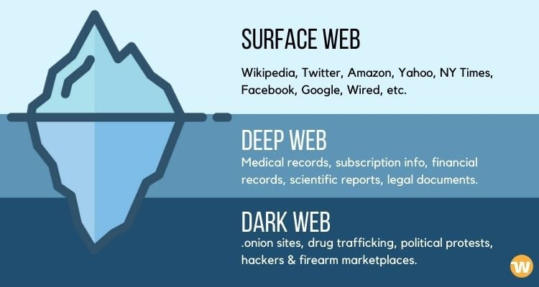
The Depth of the Internet
Onion Links websites that are not accessible by normal web browser
→ .onion instead of .com, .net, etc
The deep web is the area of the internet that is not accessible by normal browsers (90%)
This includes information such as emails, financial information, records, private social media content, personal data
Pretty benign stuff, but remember that this data requires authentication to access

Slide 23
The Depth of the Internet
Onion Links websites that are not accessible by normal web browser
→ .onion instead of .com, .net, etc
The deep web is the area of the internet that is not accessible by normal browsers (90%)
The dark web is the area of the internet the is hidden and requires a Tor browser
Hosts web services for both legal/illegal activities

Slide 24

The Dark Net
The “Good”
Anonymous political discussion
Selling of legal goods
Whistleblowers
*subjective (this also does not reflect my personal opinion)

Slide 25

The Dark Net
The “Good”
Anonymous political discussion
Selling of legal goods
Whistleblowers
The Really Bad
Selling of (illegal) firearms
Selling of Fake Identification
Selling of stolen passwords/credential
Crypto shenanigans + Malware
*subjective (this also does not reflect my personal opinion)

Slide 26

The Dark Net
The “Good”
Anonymous political discussion
Selling of legal goods
Whistleblowers
The Really Bad
Selling of (illegal) firearms
Selling of Fake Identification
Selling of stolen passwords/credential
Crypto shenanigans + Malware
Purchased with bitcoins
The Really Ugly (unfortunately the most common uses)
Selling of drugs
Human Trafficking + Illegal Pornography
Hitman Services
*subjective (this also does not reflect my personal opinion)

Slide 27
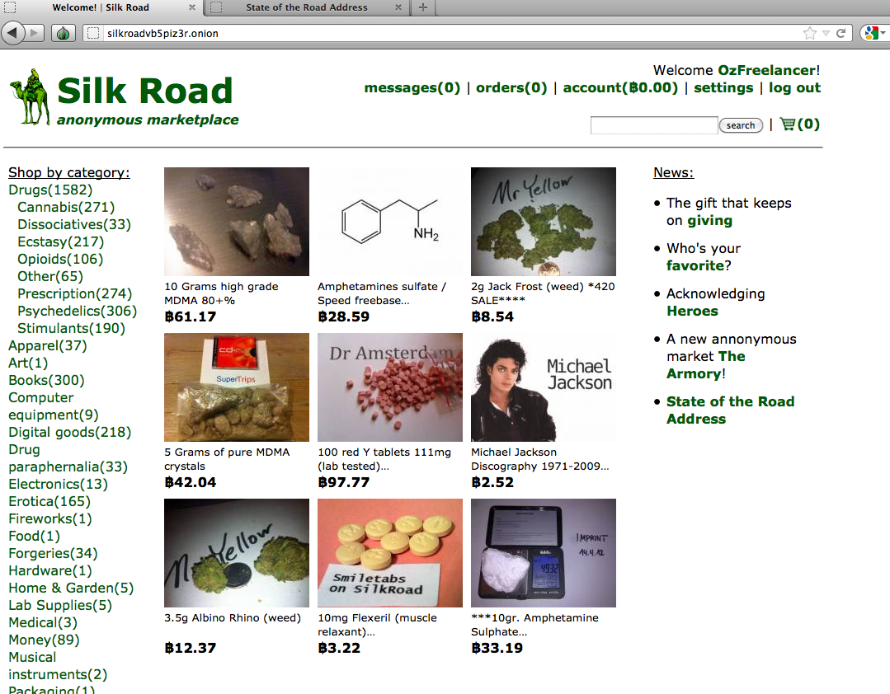

The Silk Road
Famous dark net marketplace for selling drugs, fake identities, and some legal goods
Accumulated $15 million in sales
Started by Ross Ubricht in 2011
→ Advocate for free market, Libertarian politics
→ Wanted a place “where you could buy anything anonymously with no trail whatsoever”
Arrested in 2013 after DEA+FBI tracked him to a San Francisco library
Ross Urbricht
Aka “Dread Pirate Roberts”
→ How? He posted on stack overflow with his real name (lmao)
Serving double life sentence in jail (rip bozo) … also allegedly hired several hitman

Slide 28
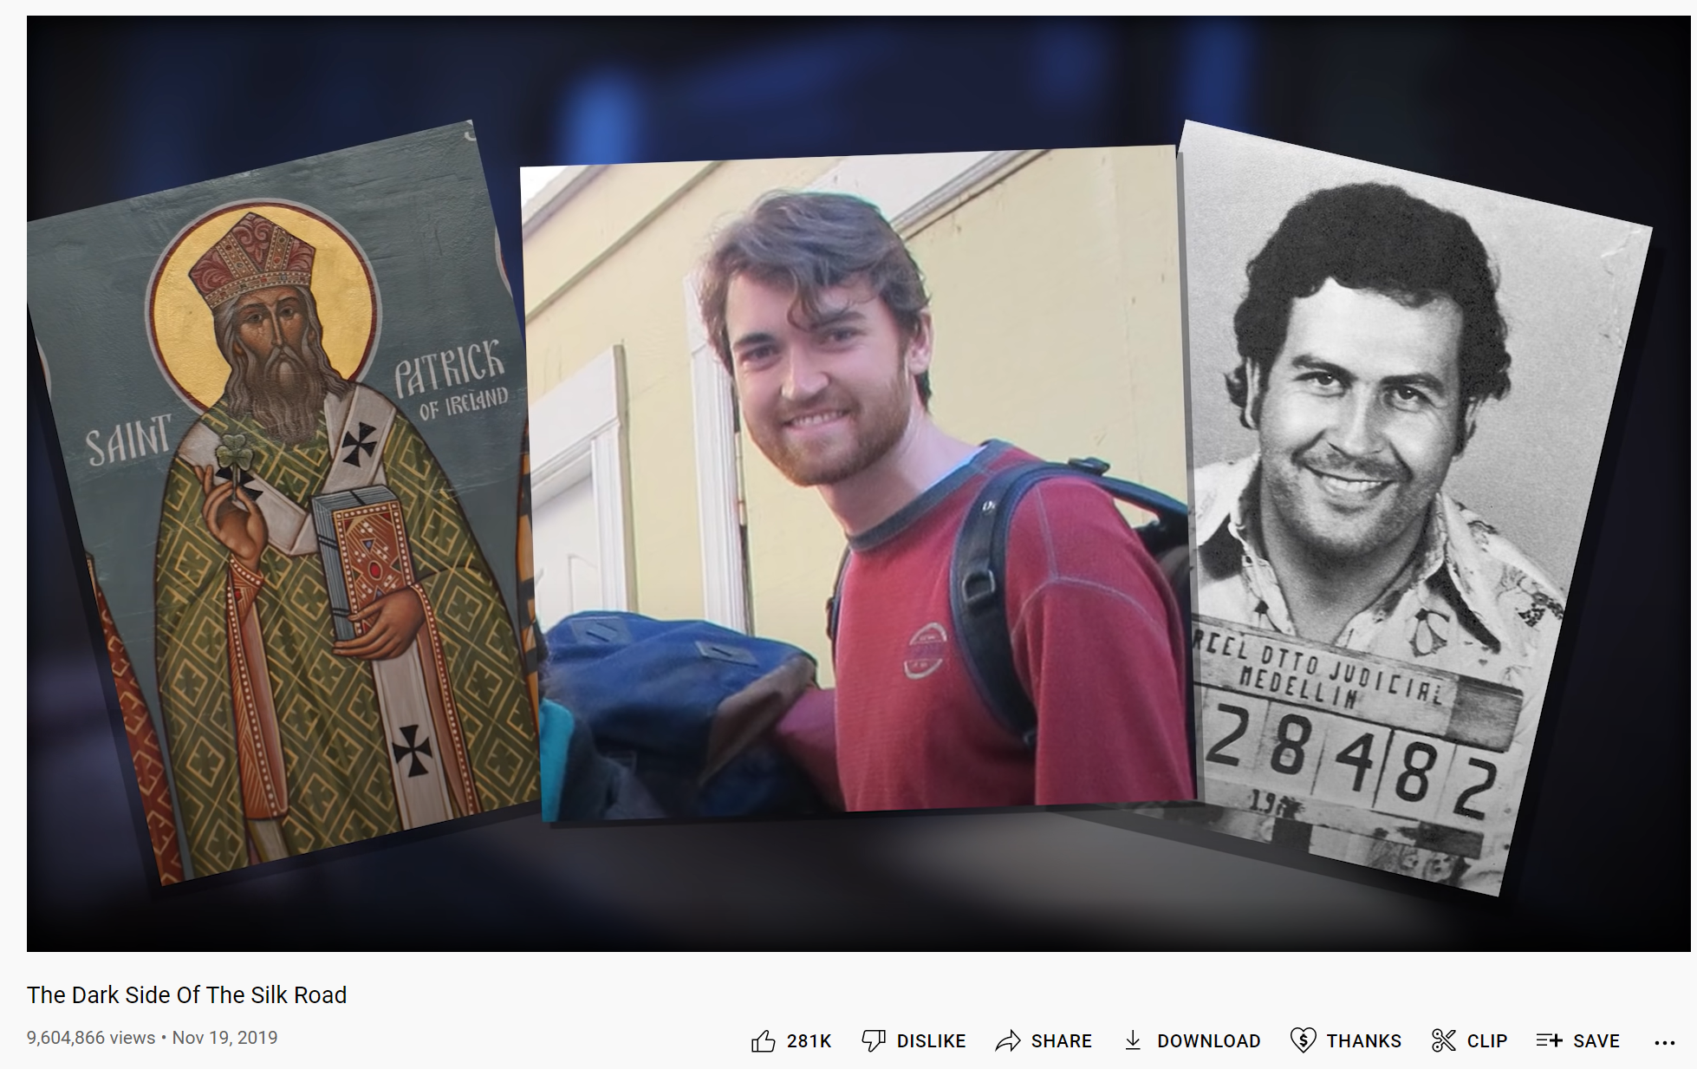
More…
https://www.youtube.com/watch?v=GpMP6Nh3FvU&ab_channel=BarelySociable

Slide 29
Legality and Policing the Darknet
Is it illegal to browse the dark net?

Slide 30

Legality and Policing the Darknet
Is it illegal to browse the dark net?

Slide 31
Legality and Policing the Darknet
Is it illegal to browse the dark net?
Downloading TOR is not illegal, and accessing the dark web is not illegal
BUT, when you start engaging in illegal activities, then you have broken the law
this is not legal advice + I am not your lawyer…i did pass criminal law my junior year with an A tho..

Slide 32
Legality and Policing the Darknet
Is it illegal to browse the dark net?
Downloading TOR is not illegal, and accessing the dark web is not illegal
BUT, when you start engaging in illegal activities, then you have broken the law
Because the dark web is being used more as a criminal platform, law enforcement presence has also increased
How to find and arrest criminals?
Going undercover
Seizure of illegal websites + data
(Legal*) malware installation
this is not legal advice + I am not your lawyer…i did pass criminal law my junior year with an A tho..

Slide 33

Conclusion
There are parts on the internet we cannot normally access
Unfortunately, these parts host some very evil content
You should be aware that these places exist, but I recommend not visiting them
Anonymity and privacy on the internet can be a sensitive subject, but there are tools (TOR) that can be used to boost your privacy
We will talk more about security and privacy on the internet in the coming weeks

