Slide 1

CSCI 466: Networks
Link Layer
Reese Pearsall Fall 2022
https://www.cs.montana.edu/pearsall/classes/fall2022/466/main.html
*All images are stolen from the internet
1

Slide 2
Announcements
NO CLASS next Friday 11/11
Might have to also cancel next Monday (11/7)*

Slide 3

Application Layer
OSI Model
Presentation Layer
*
Application Layer
Session Layer
*
Messages from Network Applications
Transport Layer
Network Layer
Physical Layer
Data Link Layer
Bits being transmitted over a copper wire
Physical Layer
*In the textbook, they condense it to a 5-layer model, but 7 layers is what is most used

Slide 4


















Data Link Layer
The link layer is responsible for the actual node-to-node delivery of data and ensure error-free transmission of information
We have not addressed how we will overcome various transmission mediums!
terminology:
hosts and routers: nodes
communication channels that connect adjacent nodes along communication path: links
wired links
wireless links
LANs
layer-2 packet: frame, encapsulates datagram
data-link layer has responsibility of
transferring datagram from one node
to physically adjacent node over a link

Slide 5
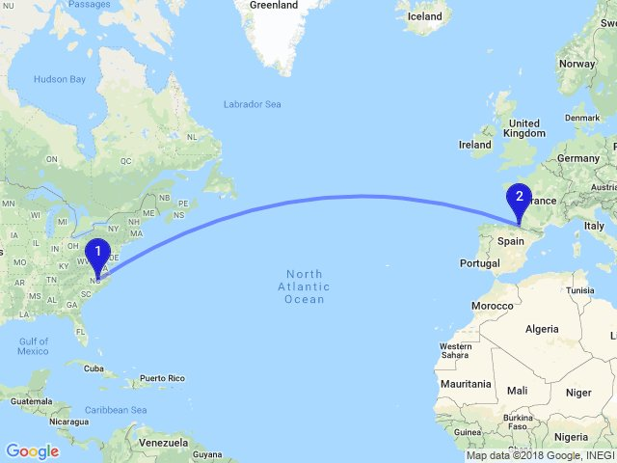
Data Link Layer
Ways to get form US to Paris?
We can visit a travel agent that will give us a travel plan
Take a car to the airport
Take a plane to France
Take a train from Airport to Paris
Take a bus from the train stop to the Eifel tower

Slide 6
Data Link Layer
Ways to get form US to Paris?
We can visit a travel agent that will give us a travel plan
Take a car to the airport
Take a plane to France
Take a train from Airport to Paris
Take a bus from the train stop to the Eifel tower
Tourist = Datagram
Transportation Segment = Link
Airport, Bus Stop, Train Stop = Node
Transport Mode = Link Layer Protocol
Travel Agent = Routing Protocol (Network Layer)

Slide 7
Data Link Layer
Services offered by the Link Layer
Framing
→ Encapsulate a network layer Datagram in another header
Link access
→ LL dictate the rules and process of transmitting a frame over a link
Reliable Delivery
→ For unreliable link, some reliable delivery mechanisms may need to be used
Error Detection and Correction
→ Bits can get messed up as the are transmitted through a medium
Why do we need RDT and error detection in the link layer when it is also offered in the transport layer?

Slide 8
Data Link Layer
Services offered by the Link Layer
Framing
→ Encapsulate a network layer Datagram in another header
Link access
→ LL dictate the rules and process of transmitting a frame over a link
Reliable Delivery
→ For unreliable link, some reliable delivery mechanisms may need to be used
Error Detection and Correction
→ Bits can get messed up as the are transmitted through a medium
Why do we need RDT and error detection in the link layer when it is also offered in the transport layer?
Some packets of data don’t even travel through the transport layer…

Slide 9
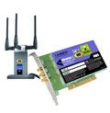
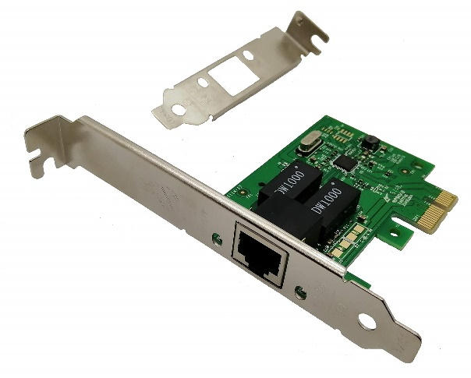

Data Link Layer
Implementation of Link Layer
Implemented within the hardware of your computer
NIC (Network Interface Controller)- Integrated into the motherboard and allows the machine to use LL services such as ethernet (combination of hardware, software, and some firmware)
application
transport
network
link
cpu
memory
link
physical
host
bus
(e.g., PCI)
controller
Wireshark uses your NIC to determine which packets should be sniffed!
physical
transmission
network adapter
card

Slide 10
Data Link Layer
datagram
datagram
controller
controller
sending host
receiving host
datagram
frame
receiving side
looks for errors, rdt, flow control, etc.
extracts datagram, passes to upper layer at receiving side
sending side:
encapsulates datagram in frame
adds error checking bits, rdt, flow control, etc.
Link Layer and LANs
6-10

Slide 11
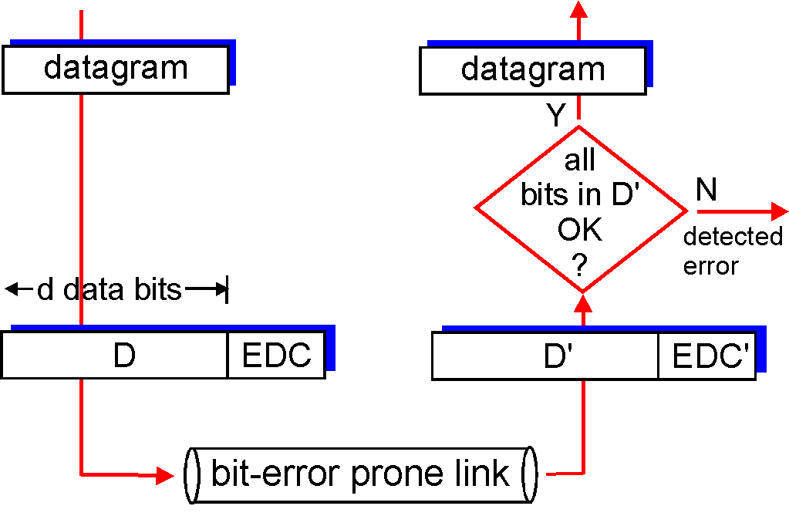
Data Link Layer
Bits can get messed during the physical layer and link layer
Faulty wires
NIC issues
Unreliable mediums
The Data Link Layer implements services for detecting and correcting errors
EDC= Error Detection and Correction bits D = Data protected by error checking, may include header fields
Error detection not 100% reliable!
protocol may miss some errors, but rarely
larger EDC field yields better detection and correction
otherwise
Link Layer and LANs
6-11

Slide 12
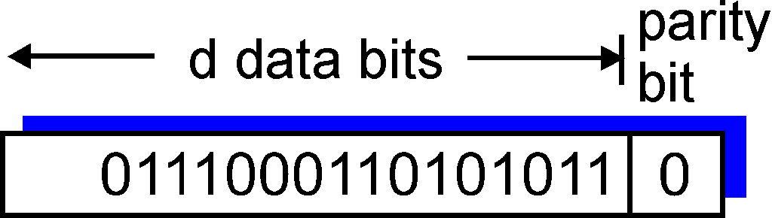
Data Link Layer
Single bit parity:
Detect single bit errors
Is the number of 1s odd (0) or even (1) ? (Including the parity bit)
Data
01110001001010110
The receiver counts eight 1s, but the parity bit tells us it should be an odd number of 1s → ERROR DETECTED
Link Layer and LANs
6-12

Slide 13
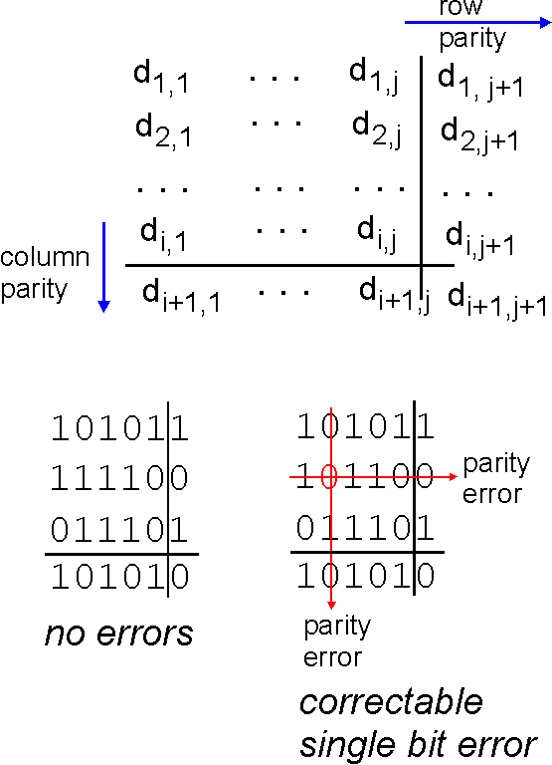
Data Link Layer
Two-dimensional bit parity:
Detect and correct single bit errors
Single bit parity:
Detect single bit errors
Is the number of 1s odd (0) or even (1) ? (Including the parity bit)
Data
01110001001010110
The receiver counts eight 1s, but the parity bit tells us it should be an odd number of 1s → ERROR DETECTED
Link Layer and LANs
6-13

Slide 14
Data Link Layer
Checksum
(Sender)
(Receiver)
0110011001100000
0101010101010101
1000111100001100
0100101011000010
0110011001100000
0101010101010101
1000111100001100
Binary sum of words
0100101011000010
(Binary Sum → One’s Complement)
(one’s complement)
1011010100111101
= 1111111111111111
Checksum!
All 1s = No error!

Slide 15
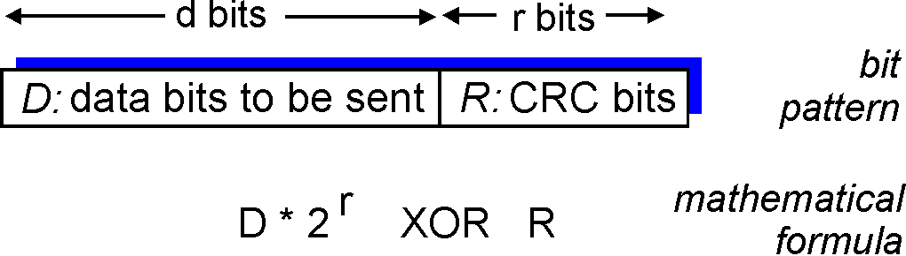
Data Link Layer
more powerful error-detection coding
view data bits, D, as a binary number
choose r+1 bit pattern (generator), G
goal: choose r CRC bits, R, such that
<D,R> exactly divisible by G (modulo 2)
receiver knows G, divides <D,R> by G. If non-zero remainder: error detected!
can detect all burst errors less than r+1 bits
widely used in practice (Ethernet, 802.11 WiFi, ATM)
Sender/Receiver has D and G. Need to compute R
6-15

Slide 16
Data Link Layer
more powerful error-detection coding
view data bits, D, as a binary number
choose r+1 bit pattern (generator), G
goal: choose r CRC bits, R, such that
<D,R> exactly divisible by G (modulo 2)
receiver knows G, divides <D,R> by G. If non-zero remainder: error detected!
can detect all burst errors less than r+1 bits
widely used in practice (Ethernet, 802.11 WiFi, ATM)
Sender/Receiver has D and G. Need to compute R
6-16

Slide 17
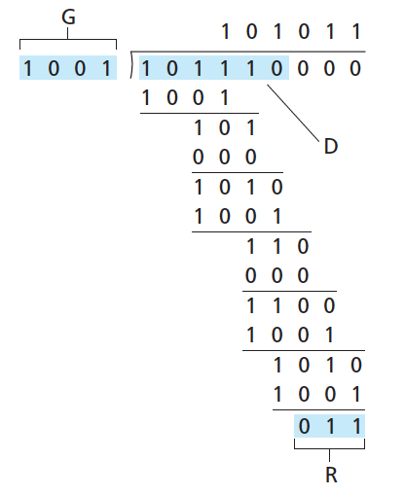

Data Link Layer
(Do some algebra to find R)
D.2^{r}
G
R = remainder[ ]
Sender sends D + R bits.
Receiver divides D + R bits by G. Result should always be Zero if no errors occured
6-17

Slide 18

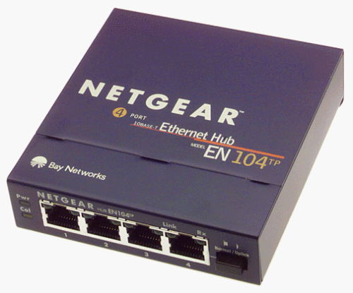




Data Link Layer
Access links
Point to Point – Single sender, Single Receiver at each end of link
Broadcast – shared medium
shared wire (e.g.,
cabled Ethernet)
shared RF
(e.g., 802.11 WiFi)
shared RF
(satellite)
humans at a
cocktail party
(shared air, acoustical)
6-18

Slide 19
Data Link Layer
MAC (Media Access Control) Addresses
32-bit IP address:
network-layer address for interface
used for layer 3 (network layer) forwarding
MAC (or LAN or physical or Ethernet) address:
function: used ‘locally” to get frame from one interface to another physically-connected interface (same network, in IP-addressing sense)
48 bit MAC address (for most LANs) burned in NIC ROM, also sometimes software settable
e.g.: 1A-2F-BB-76-09-AD
hexadecimal (base 16) notation
(each “numeral” represents 4 bits)
How do we know two NICs wont have the same MAC address?
MAC Address is your SSN, IP address is your Postal code ☺
6-19

Slide 20
Data Link Layer
1A-2F-BB-76-09-AD
LAN
(wired or
wireless)
adapter
71-65-F7-2B-08-53
58-23-D7-FA-20-B0
0C-C4-11-6F-E3-98
6-20

