Slide 1

CSCI 132: Basic Data Structures and Algorithms
Lecture 6: More Java (while loops, practice)
Reese Pearsall
Fall 2023
https://www.cs.montana.edu/pearsall/classes/fall2023/132/main.html
*All images are stolen from the internet

Slide 2
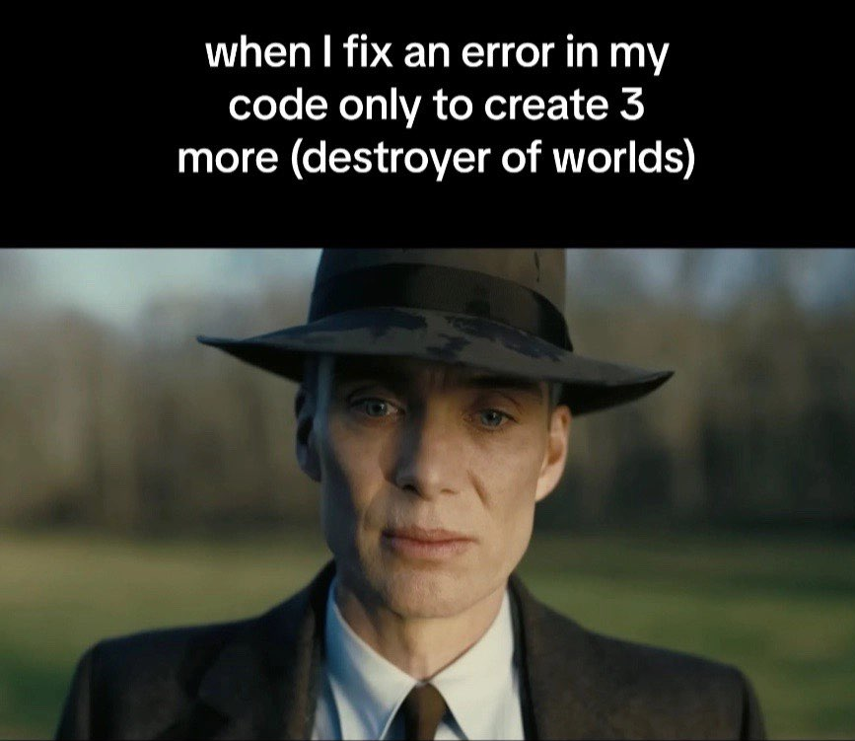
Announcements
Lab 2 due tomorrow @ 11:59 PM
Program 1 is posted, due on September 18th
I will talk about it and give some hints on Friday

Slide 3
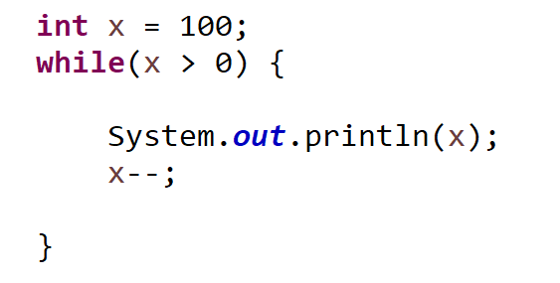
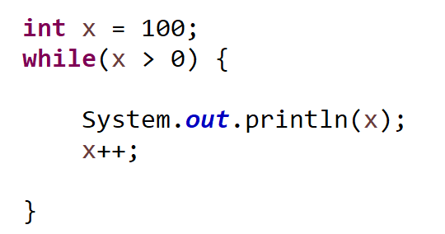
While loops can be used to iterate if a condition is true.
Check Condition
If condition is true, execute body of loop
Repeat
You do have to worry about the possibility of infinite loops….

Slide 4
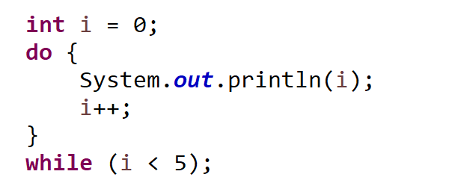
The do/while loop will always execute the body of the loop once, and then check the condition
New
Execute body of loop
Check condition
Repeat
!!! You are guaranteed at least one execution of the loop body

Slide 5
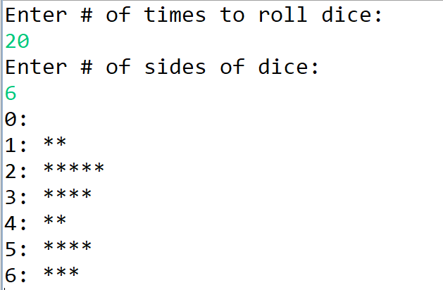
Practice
Write a Java program that will simulate dice being rolled. The Java program should keep track of the frequencies of how much each dice number was rolled (# of 1s rolled, # of 2s rolled, etc) and print it out to the screen like a Histogram

