Slide 1

CSCI 132: Basic Data Structures and Algorithms
OOP Conclusion, UML, Java file I/O
Reese Pearsall
Fall 2023
https://www.cs.montana.edu/pearsall/classes/fall2023/132/main.html
*All images are stolen from the internet

Slide 2
Announcements
Program 1 due MONDAY at 11:59 PM
If you worked with a partner, make sure you clearly indicate that in your submission

Slide 3
Inheritance is a mechanism in Java that allows for a class to acquire instance fields and methods from another class
public class Programmer extends Employee {
}
Inheritance is great when you have shared attributes and methods across different classes

Slide 4
Inheritance is a mechanism in Java that allows for a class to acquire instance fields and methods from another class
public class Programmer extends Employee {
}
Inheritance is great when you have shared attributes and methods across different classes
public Abstract class Employee {
}
We can inherit from Abstract classes, but we can’t create instances of Abstract classes (can’t use new keyword)

Slide 5
Interfaces are abstract classes that only contain methods with no body
public class Ferrari implements Vehicle {
}
Interfaces are great when you need shared functionality with different implementations
When a class implements an interface, that class MUST define and write the bodies of the interface methods
public interface Vehicle {
void accelerate(int a);
void slowdown(int a);
void refuel(int a);
}

Slide 6
Inheriting from a class
Implementing an Interface
Class inherits instance fields and methods
Class inherits methods with no bodies
Can only inherit from one class
Can implement multiple interfaces
Sub class is not required to override methods
Sub class is required to override methods

Slide 7
Polymorphism is the ability of a class to provide different implementations of a method, depending on the type of object that is passed to the method.
Bird a2 = new Bird("Puffin",27.0, "North America",7400000,21.5);
Wolf b2 = new Wolf("Arctic Wolf",120.0, "North America",200000, 16);
a2.makeSound();
b2.makeSound();
The makeSound()method does something different for each object

Slide 8


We could have many classes with many kinds of relationships
Many levels of inheritance
Multiple interfaces
Some abstract classes, some not
Method overloading
Reading Java Code
It would be nice to have a way to visualize the architecture of Java classes without needing to dive into complex source code

Slide 9
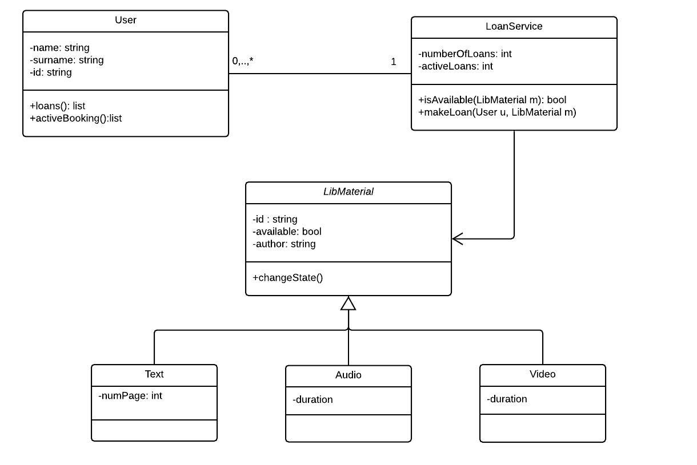
UML (Unified Modeling Language) is a standard language for specifying, visualizing, constructing, and documenting the artifacts of software systems.
We can use a UML Class Diagram to visualize the architecture of our Java classes

Slide 10
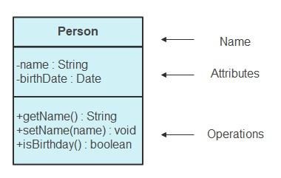

We can use a UML Class Diagram to visualize the architecture of our Java classes
Each Java class is a box.
Each box has the
name of the class
Attributes
operations/methods of the class
+ = public
= private
# = protected
Public Method (+), One argument, Returns nothing

Slide 11
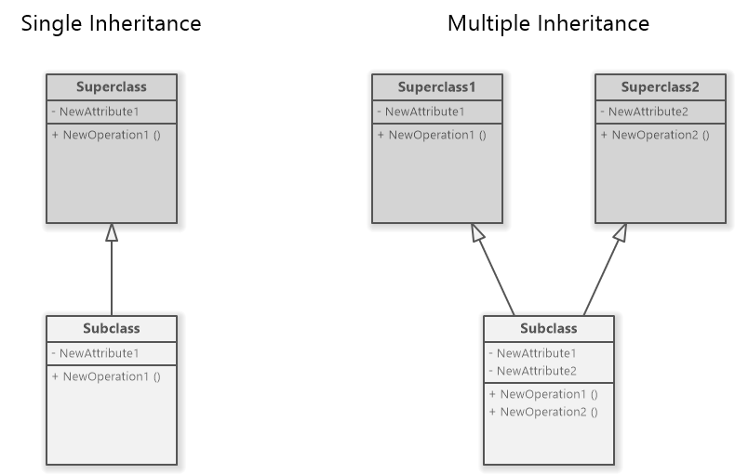

Inheritance is indicated by an open arrow

Slide 12

Card
PokerHand
Indicated by a normal line
Or by a normal arrow
An association is created when a class is referenced from another

Slide 13
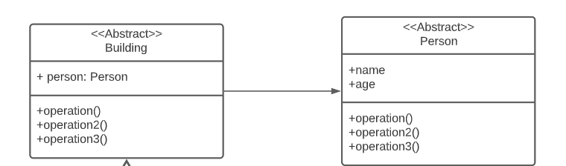
Abstract classes are indicated by
<< Abstract >>

Slide 14
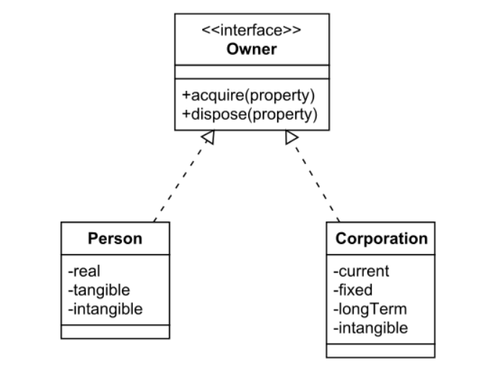

Interfaces are indicated by
<<interface>>
Implementing an interface is a realization relationship

Slide 15





Employee
Basic UML Example
#name (String)
#emp_id (int)
#salary (int)
+getName()
+getID()
+getSalary()
Programmer
-language (String)
+getLanguage()
Salesperson
Accountant
- commission (int)
-cpa_grade (char)
+getCommission()
+getCpaGrade()
ProgrammerIntern
-school (String)
+getSchool()

Slide 16
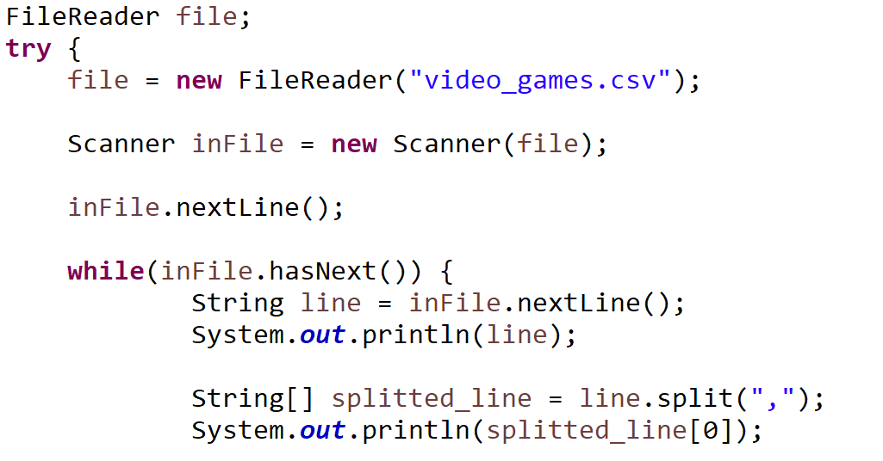
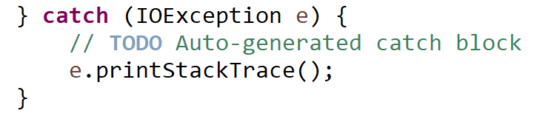
Reading in a file in Java
Opening a reading a file must be done inside of a try/catch statement

Slide 17

Reading in a file in Java
Open a file with the FileReader library

Slide 18
Reading in a file in Java
Open a file with the FileReader library
Read contents of file with Scanner

Slide 19

Reading in a file in Java
Open a file with the FileReader library
Read contents of file with Scanner
Read headers of csv file (discard them)

Slide 20

Reading in a file in Java
Open a file with the FileReader library
Read contents of file with Scanner
Read headers of csv file (discard them)
Iterate through each line of file

Slide 21



Reading in a file in Java
Open a file with the FileReader library
Read contents of file with Scanner
Read headers of csv file (discard them)
Iterate through each line of file
Get each line and print it out

Slide 22
Reading in a file in Java
Open a file with the FileReader library
Read contents of file with Scanner
Read headers of csv file (discard them)
Iterate through each line of file
Get each line and print it out
“Reese,Susan,Spencer”
One long String
To print out the first column of the file, we can split each line, and print out the first column
.split(“,”)
[ “Reese”, “Susan”, “Spencer” ]
Array of Strings

Slide 23
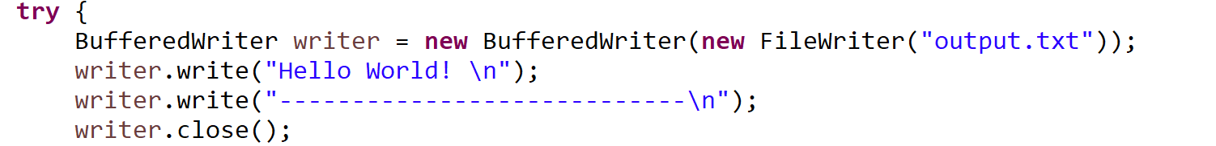
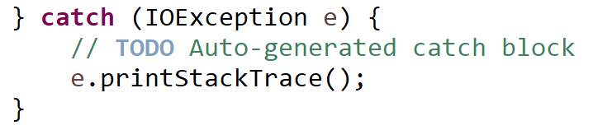
Writing to a file in Java

Slide 24



Writing to a file in Java
Name of output file

Slide 25

Writing to a file in Java
We write out contents to file using the write() method

Slide 26
Writing to a file in Java
When writing to a file, it is very important to close the file when you are finished

