Slide 1

CSCI 132: Basic Data Structures and Algorithms
Linked Lists (Part 2)
Doubly Linked List
Reese Pearsall
Fall 2023
https://www.cs.montana.edu/pearsall/classes/fall2023/132/main.html
*All images are stolen from the internet

Slide 2


Announcements
Lab 5 due Thursday @ 11:59 PM (Singly Linked Lists)
Program 2 (Circular Linked Lists)
We will try to talk about it on Friday
Next week we are covering some important stuff ☺
(Not a good week to ignore the class)

Slide 3
Lab 5

Slide 4
insert(Node newMovie, int N)
ll.insert(new Node("Ratatouille",2007), 2 );
Titanic
1997
Titanic
1997

Slide 5
insert(Node newMovie, int N)
ll.insert(new Node("Ratatouille",2007), 2 );
Titanic
1997
Titanic
1997
Ratatouille
2007
newNode

Slide 6
insert(Node newMovie, int N)
1. Get to node N-1
ll.insert(new Node("Ratatouille",2007), 2 );
current
Titanic
1997
Titanic
1997
Ratatouille
2007
newNode

Slide 7
insert(Node newMovie, int N)
Get to node N-1
Get the next node after current
ll.insert(new Node("Ratatouille",2007), 2 );
current
nextNode
Titanic
1997
Titanic
1997
Ratatouille
2007
newNode

Slide 8
insert(Node newMovie, int N)
Get to node N-1
Get the next node after current
Update pointers
ll.insert(new Node("Ratatouille",2007), 2 );
current
nextNode
Titanic
1997
Titanic
1997
Ratatouille
2007
newNode

Slide 9
insert(Node newMovie, int N)
Get to node N-1
Get the next node after current
Update pointers
ll.insert(new Node("Ratatouille",2007), 2 );
current
nextNode
Titanic
1997
Titanic
1997
(You only need to worry about inserting something into the middle)
Ratatouille
2007
newNode

Slide 10


Linked Lists
A Linked List is a data structure that consists of a collection of connected nodes
Susan
Reese
Spencer
Nodes consists of data (String, int, array, etc) and a pointer to the next node

Slide 11

Linked Lists
A Linked List is a data structure that consists of a collection of connected nodes
head
Susan
Reese
Spencer
Nodes consists of data (String, int, array, etc) and a pointer to the next node
A Linked List also has a pointer to the start of the Linked List (head)

Slide 12
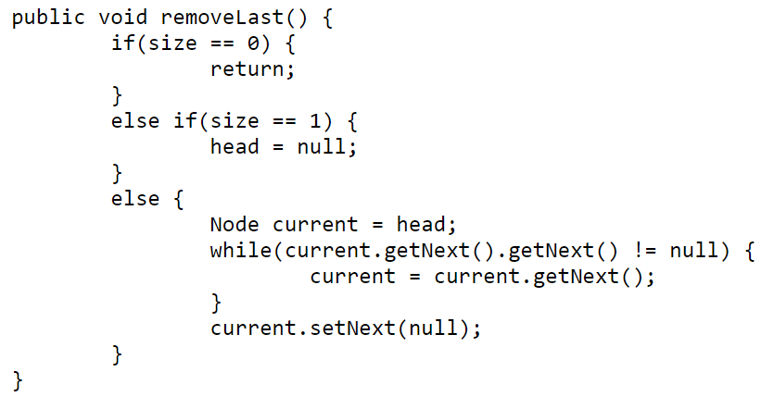





Linked List Methods
removeLast() – removes last node of LL
Find the second to last node
Set that node’s next value to null
head
Spencer
null
Susan
Reese
null

Slide 13
Linked Lists
A Singly Linked List only keeps track of the next node
head
Susan
Reese
Spencer

Slide 14
Linked Lists
A Singly Linked List only keeps track of the next node
head
tail
Susan
Reese
Spencer
The tail of a linked list is a pointer to the last node

Slide 15
Linked Lists
A Singly Linked List only keeps track of the next node
head
tail
Susan
Reese
Spencer
The tail of a linked list is a pointer to the last node
This makes adding to/removing from the end of a linked list easier

Slide 16







Linked Lists
A Doubly Linked List keeps track of the next node and the previous node
head
tail
Susan
Reese
prev
next
null
null
Spencer
prev
next
prev
next
next
prev

Slide 17
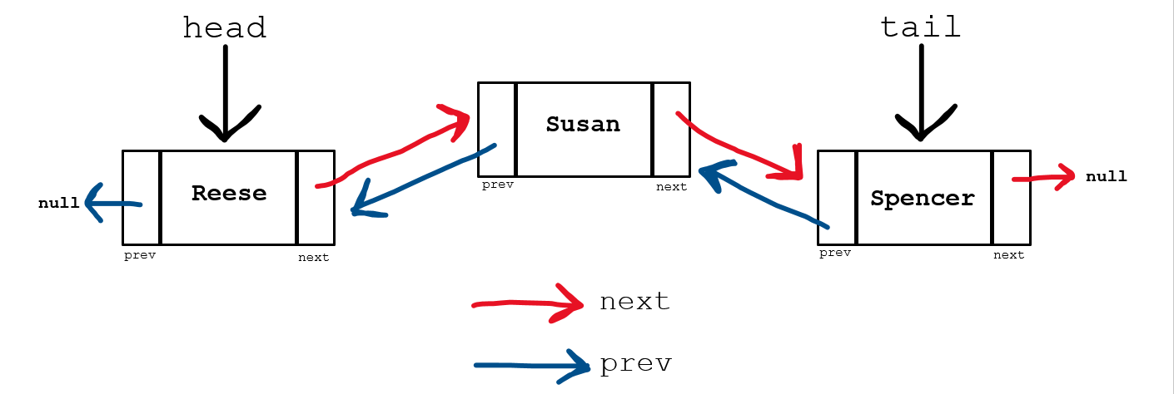
Linked Lists
A Doubly Linked List keeps track of the next node and the previous node
Doubly Linked List Methods
insert(newNode, N) – Insert new node at spot N
remove(name) – Remove node by name
remove(N) – Remove node by Spot #
printReverse() – Prints LL in reverse order

Slide 18
Java File I/O
Let’s read in node information from a file
There are tons of way to read from a file in Java. We will use the BufferedReader library
airports.txt
LAX,Los Angeles
SEA,Seattle
BZN,Bozeman
ORD,Chicago
BOS,Boston

Slide 19




Java File I/O
Let’s read in node information from a file
There are tons of way to read from a file in Java. We will use the BufferedReader library
(We can also do it with the Scanner)
BZN
Bozeman
airports.txt
LAX,Los Angeles
SEA,Seattle
BZN,Bozeman
ORD,Chicago
BOS,Boston
ORD
Chicago
SEA
Seattle
LAX
Los Angeles
BOS
Boston
head

Slide 20
Java File I/O
Let’s read in node information from a file
There are tons of way to read from a file in Java. We will use the BufferedReader library
airports.txt
1. Iterate through each line of the file
LAX,Los Angeles
SEA,Seattle
BZN,Bozeman
ORD,Chicago
BOS,Boston
BufferedReader br = new BufferedReader(new FileReader(filename));
String line = "";
while( (line=br.readLine()) != null){
}

Slide 21
Java File I/O
Let’s read in node information from a file
There are tons of way to read from a file in Java. We will use the BufferedReader library
airports.txt
1. Iterate through each line of the file
LAX,Los Angeles
SEA,Seattle
BZN,Bozeman
ORD,Chicago
BOS,Boston
BufferedReader br = new BufferedReader(new FileReader(filename));
String line = "";
while( (line=br.readLine()) != null){
}
“Iterate through each line in the file until we reach the end”

Slide 22
Java File I/O
Let’s read in node information from a file
There are tons of way to read from a file in Java. We will use the BufferedReader library
airports.txt
Iterate through each line of the file
Parse each line using .split()
LAX,Los Angeles
SEA,Seattle
BZN,Bozeman
ORD,Chicago
BOS,Boston
while( (line=br.readLine()) != null){
String[] vals = line.split(",");
0
1
“LAX,Los Angeles” →
vals =
LAX | Los Angeles
.split(“,”) will “split” the string everything it sees a comma, returns an array of the splitted string

Slide 23
Java File I/O
Let’s read in node information from a file
There are tons of way to read from a file in Java. We will use the BufferedReader library
airports.txt
Iterate through each line of the file
Parse each line using .split()
LAX,Los Angeles
SEA,Seattle
BZN,Bozeman
ORD,Chicago
BOS,Boston
while( (line=br.readLine()) != null){
String[] vals = line.split(",");
0
1
“LAX,Los Angeles” →
vals =
LAX | Los Angeles
0
1
“SEA,Seattle” →
vals =
SEA | Seattle

Slide 24

Java File I/O
Let’s read in node information from a file
There are tons of way to read from a file in Java. We will use the BufferedReader library
Iterate through each line of the file
Parse each line using .split()
Create Node object using information from file
airports.txt
LAX,Los Angeles
SEA,Seattle
BZN,Bozeman
ORD,Chicago
BOS,Boston
1
while( (line=br.readLine()) != null){
String[] vals = line.split(",");
String code = vals[0];
String location = vals[1];
Node n = new Node(code, location);
insert(n,size+1);
}
2
3

Slide 25

Java File I/O
Let’s read in node information from a file
There are tons of way to read from a file in Java. We will use the BufferedReader library
Iterate through each line of the file
Parse each line using .split()
Create Node object using information from file
Insert new node at the end of the linked list
airports.txt
LAX,Los Angeles
SEA,Seattle
BZN,Bozeman
ORD,Chicago
BOS,Boston
1
while( (line=br.readLine()) != null){
String[] vals = line.split(",");
String code = vals[0];
String location = vals[1];
Node n = new Node(code, location);
insert(n,size+1);
}
2
3
4

Slide 26
Java File I/O
while( (line=br.readLine()) != null){
String[] vals = line.split(",");
String code = vals[0];
String location = vals[1];
Node n = new Node(code, location);
insert(n,size+1);
}
airports.txt
LAX,Los Angeles
SEA,Seattle
BZN,Bozeman
ORD,Chicago
BOS,Boston

Slide 27
Java File I/O
while( (line=br.readLine()) != null){
String[] vals = line.split(",");
String code = vals[0];
String location = vals[1];
Node n = new Node(code, location);
insert(n,size+1);
}
airports.txt
LAX,Los Angeles
SEA,Seattle
BZN,Bozeman
ORD,Chicago
BOS,Boston
line = ”LAX,Los Angeles”

Slide 28
Java File I/O
while( (line=br.readLine()) != null){
String[] vals = line.split(",");
String code = vals[0];
String location = vals[1];
Node n = new Node(code, location);
insert(n,size+1);
}
airports.txt
LAX,Los Angeles
SEA,Seattle
BZN,Bozeman
ORD,Chicago
BOS,Boston
line = ”LAX,Los Angeles”
0
1
vals[] =
LAX | Los Angeles

Slide 29
Java File I/O
while( (line=br.readLine()) != null){
String[] vals = line.split(",");
String code = vals[0];
String location = vals[1];
Node n = new Node(code, location);
insert(n,size+1);
}
airports.txt
LAX,Los Angeles
SEA,Seattle
BZN,Bozeman
ORD,Chicago
BOS,Boston
line = ”LAX,Los Angeles”
0
1
vals[] =
LAX | Los Angeles
code = “LAX”
location = “Los Angeles”

Slide 30
Java File I/O
while( (line=br.readLine()) != null){
String[] vals = line.split(",");
String code = vals[0];
String location = vals[1];
Node n = new Node(code, location);
insert(n,size+1);
}
airports.txt
LAX,Los Angeles
SEA,Seattle
BZN,Bozeman
ORD,Chicago
BOS,Boston
line = ”LAX,Los Angeles”
0
1
vals[] =
LAX | Los Angeles
code = “LAX”
location = “Los Angeles”

Slide 31
Java File I/O
while( (line=br.readLine()) != null){
String[] vals = line.split(",");
String code = vals[0];
String location = vals[1];
Node n = new Node(code, location);
insert(n,size+1);
}
airports.txt
LAX,Los Angeles
SEA,Seattle
BZN,Bozeman
ORD,Chicago
BOS,Boston
line = ”LAX,Los Angeles”
0
1
vals[] =
LAX | Los Angeles
code = “LAX”
location = “Los Angeles”
LAX
Los Angeles
n =

Slide 32
BufferedReader br = new BufferedReader(new FileReader(filename));
String line = "";
while( (line=br.readLine()) != null){
String[] vals = line.split(",");
String code = vals[0];
String location = vals[1];
Node n = new Node(code, location);
insert(n,size+1);
}

Slide 33
insert(newNode, N) – Insert new node (newNode) at spot N

Slide 34
insert(newNode, N) – Insert new node (newNode) at spot N
Case 1: The Linked List is Empty

Slide 35
insert(newNode, N) – Insert new node (newNode) at spot N
Case 1: The Linked List is Empty
Case 2: The user is inserting a node at the very beginning (N = 1)

Slide 36
insert(newNode, N) – Insert new node (newNode) at spot N
Case 1: The Linked List is Empty
Case 2: The user is inserting a node at the very beginning (N = 1)
Case 3: The user is inserting a node at the very end (N = getSize() + 1)

Slide 37
insert(newNode, N) – Insert new node (newNode) at spot N
Case 1: The Linked List is Empty
Case 2: The user is inserting a node at the very beginning (N = 1)
Case 3: The user is inserting a node at the very end (N = getSize() + 1)
Case 4: The user is inserting a node somewhere in the middle of the LL

Slide 38
insert(newNode, N) – Insert new node (newNode) at spot N
Case 1: The Linked List is Empty
How do we know if the linked list is empty?

Slide 39
insert(newNode, N) – Insert new node (newNode) at spot N
Case 1: The Linked List is Empty
How do we know if the linked list is empty?
If the head and tail are null
If the size is 0

Slide 40
insert(newNode, N) – Insert new node (newNode) at spot N
Case 1: The Linked List is Empty
???

Slide 41
insert(newNode, N) – Insert new node (newNode) at spot N
Case 1: The Linked List is Empty
head
tail
LAX
Los Angeles
null
null
prev
next
Set the tail and head to be the newNode

Slide 42



insert(newNode, N) – Insert new node (newNode) at spot N
Case 2: The user is inserting a node at the very beginning (N = 1)
head
newNode
tail
BZN
Bozeman
SEA
Seattle
LAX
Los Angeles
null
null
null
prev
next
prev
next
prev
next
???

Slide 43




insert(newNode, N) – Insert new node (newNode) at spot N
Case 2: The user is inserting a node at the very beginning (N = 1)
head
newNode
tail
BZN
Bozeman
SEA
Seattle
LAX
Los Angeles
null
null
prev
next
prev
next
prev
next
Update the head node prev value to newNode

Slide 44


insert(newNode, N) – Insert new node (newNode) at spot N
Case 2: The user is inserting a node at the very beginning (N = 1)
head
newNode
tail
BZN
Bozeman
SEA
Seattle
LAX
Los Angeles
null
null
prev
next
prev
next
prev
next
Update the head node prev value to newNode
Update the newNode’s next value to be the current head node

Slide 45


insert(newNode, N) – Insert new node (newNode) at spot N
Case 2: The user is inserting a node at the very beginning (N = 1)
newNode
head
tail
BZN
Bozeman
SEA
Seattle
LAX
Los Angeles
null
null
prev
next
prev
next
prev
next
Update the head node to be the newNode
Update the head node prev value to newNode
Update the newNode’s next value to be the current head node

Slide 46

insert(newNode, N) – Insert new node (newNode) at spot N
Case 3: The user is inserting a node at the very end (N = getSize() + 1)
head
tail
newNode
SEA
Seattle
LAX
Los Angeles
BZN
Bozeman
null
null
null
null
prev
next
prev
next
prev
next
insert(newNode, 3)

Slide 47


insert(newNode, N) – Insert new node (newNode) at spot N
Case 3: The user is inserting a node at the very end (N = getSize() + 1)
head
tail
newNode
SEA
Seattle
LAX
Los Angeles
BZN
Bozeman
null
null
null
prev
next
prev
next
prev
next
Update the tail node next value to newNode

Slide 48


insert(newNode, N) – Insert new node (newNode) at spot N
Case 3: The user is inserting a node at the very end (N = getSize() + 1)
head
tail
newNode
SEA
Seattle
LAX
Los Angeles
BZN
Bozeman
null
null
prev
next
prev
next
prev
next
Update the tail node next value to newNode
Update the newNode’s prev value to be the current tail node

Slide 49


insert(newNode, N) – Insert new node (newNode) at spot N
Case 3: The user is inserting a node at the very end (N = getSize() + 1)
head
tail
newNode
SEA
Seattle
LAX
Los Angeles
BZN
Bozeman
null
null
prev
next
prev
next
prev
next
Update the tail node to be the newNode
Update the tail node next value to newNode
Update the newNode’s prev value to be the current tail node

Slide 50





insert(newNode, N) – Insert new node (newNode) at spot N
Case 4: The user is inserting a node somewhere in the middle of the LL
head
tail
LAX
Los Angeles
ORD
Chicago
null
null
prev
next
prev
next
SEA
Seattle
BZN
Bozeman
prev
next
prev
next
insert(newNode, 3)

Slide 51


insert(newNode, N) – Insert new node (newNode) at spot N
Case 4: The user is inserting a node somewhere in the middle of the LL
SEA
Seattle
BZN
Bozeman
newNode
prev
next
prev
next
BOS
Boston
prev
next

Slide 52



insert(newNode, N) – Insert new node (newNode) at spot N
Case 4: The user is inserting a node somewhere in the middle of the LL
current
SEA
Seattle
BZN
Bozeman
newNode
prev
next
prev
next
BOS
Boston
1. Reach the Nth node (current)
prev
next

Slide 53

insert(newNode, N) – Insert new node (newNode) at spot N
Case 4: The user is inserting a node somewhere in the middle of the LL
prevNode
current
SEA
Seattle
BZN
Bozeman
newNode
prev
next
prev
next
BOS
Boston
Reach the Nth node (current)
Get the N-1 node (prevNode)
(current.getPrev())
prev
next

Slide 54

insert(newNode, N) – Insert new node (newNode) at spot N
Case 4: The user is inserting a node somewhere in the middle of the LL
prevNode
current
SEA
Seattle
BZN
Bozeman
newNode
prev
next
prev
next
BOS
Boston
Reach the Nth node (current)
Get the N-1 node (prevNode)
Update prevNode’s next pointer
(current.getPrev())
prev
next

Slide 55


insert(newNode, N) – Insert new node (newNode) at spot N
Case 4: The user is inserting a node somewhere in the middle of the LL
prevNode
current
SEA
Seattle
BZN
Bozeman
newNode
prev
next
prev
next
BOS
Boston
Reach the Nth node (current)
Get the N-1 node (prevNode)
Update prevNode’s next pointer
Update newNode’s prev pointer
(current.getPrev())
prev
next

Slide 56


insert(newNode, N) – Insert new node (newNode) at spot N
Case 4: The user is inserting a node somewhere in the middle of the LL
prevNode
current
SEA
Seattle
BZN
Bozeman
newNode
prev
next
prev
next
BOS
Boston
Reach the Nth node (current)
Get the N-1 node (prevNode)
Update prevNode’s next pointer
Update newNode’s prev pointer
5. Update newNode’s next pointer
(current.getPrev())
prev
next

Slide 57


insert(newNode, N) – Insert new node (newNode) at spot N
Case 4: The user is inserting a node somewhere in the middle of the LL
prevNode
current
SEA
Seattle
BZN
Bozeman
newNode
prev
next
prev
next
BOS
Boston
Reach the Nth node (current)
Get the N-1 node (prevNode)
Update prevNode’s next pointer
Update newNode’s prev pointer
5. Update newNode’s next pointer
6. Update current’s prev pointer
(current.getPrev())
prev
next

Slide 58
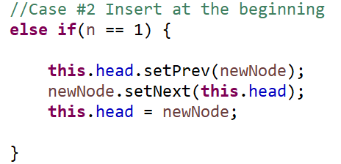
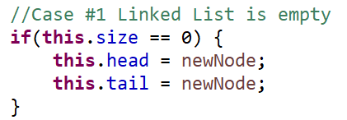
insert(newNode, N) – Insert new node (newNode) at spot N
Case 1: The Linked List is Empty
Case 2: The user is inserting a node at the very beginning (N = 1)

Slide 59
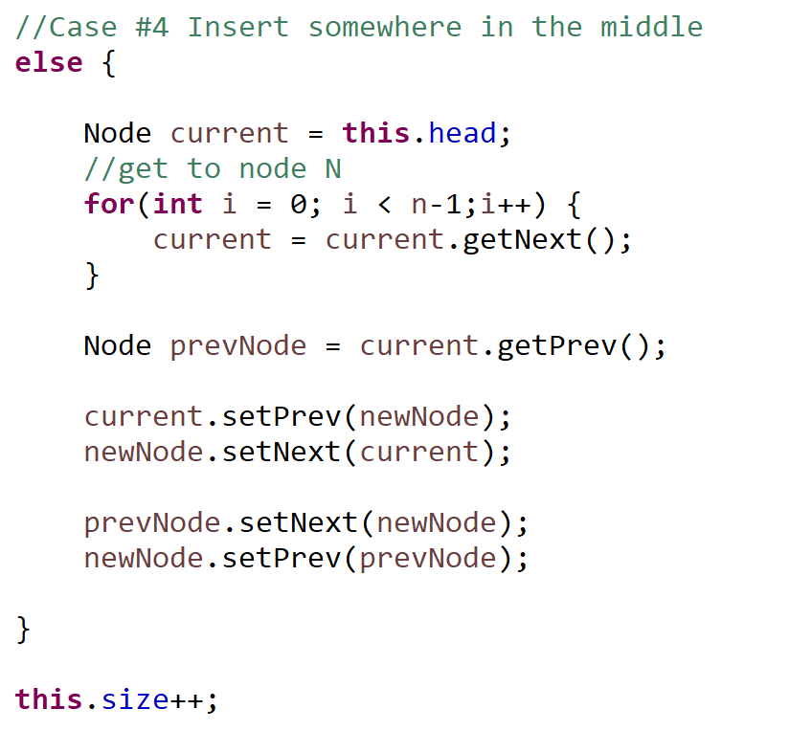
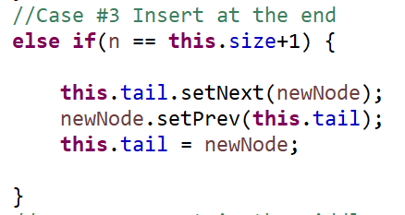
insert(newNode, N) – Insert new node (newNode) at spot N
Case 3: The user is inserting a node at the very end (N = getSize() + 1)
Case 4: The user is inserting a node somewhere in the middle of the LL

Slide 60






A Circular Linked List is a linked list where the first and last node are connected, which creates a circle
BZN
Bozeman
ORD
Chicago
SEA
Seattle
LAX
Los Angeles
BOS
Boston
head
tail

Slide 61




remove(name) – Remove node by name
head
tail
SEA
Seattle
BOS
Boston
BZN
Bozeman
null
null
prev
next
prev
next
prev
next

Slide 62




remove(name) – Remove node by name
head
tail
SEA
Seattle
BOS
Boston
BZN
Bozeman
null
null
prev
next
prev
next
prev
next
1. Traverse the Linked List and look for a match

Slide 63
remove(name) – Remove node by name
head
tail
SEA
Seattle
BOS
Boston
BZN
Bozeman
null
null
prev
next
prev
next
prev
next
1. Traverse the Linked List and look for a match
remove(“SEA”)
What if the removed node is the head?

Slide 64
remove(name) – Remove node by name
head
tail
SEA
Seattle
BOS
Boston
BZN
Bozeman
null
null
prev
next
prev
next
prev
next
1. Traverse the Linked List and look for a match
remove(“SEA”)
What if the removed node is the head?
2. Update the head to be the next node

Slide 65
remove(name) – Remove node by name
head
tail
SEA
Seattle
BOS
Boston
BZN
Bozeman
null
null
null
prev
next
prev
next
prev
next
1. Traverse the Linked List and look for a match
remove(“SEA”)
We can longer reach the SEA node from the head node, so it is effectively removed
What if the removed node is the head?
2. Update the head to be the next node
3. Update the new head’s prev value to be null

Slide 66
remove(name) – Remove node by name
head
tail
SEA
Seattle
BOS
Boston
BZN
Bozeman
null
null
prev
next
prev
next
prev
next
1. Traverse the Linked List and look for a match
remove(“BZN”)
What if the removed node is the tail?

Slide 67
remove(name) – Remove node by name
head
tail
SEA
Seattle
BOS
Boston
BZN
Bozeman
null
null
prev
next
prev
next
prev
next
1. Traverse the Linked List and look for a match
remove(“BZN”)
What if the removed node is the tail?
2. Update the tail to be the previous node

Slide 68
remove(name) – Remove node by name
head
tail
SEA
Seattle
BOS
Boston
BZN
Bozeman
null
null
null
prev
next
prev
next
prev
next
1. Traverse the Linked List and look for a match
remove(“BZN”)
We can longer reach the BZN node from the head node, so it is effectively removed
What if the removed node is the tail?
2. Update the tail to be the previous node
3. Update the new tail’s next value to be null

Slide 69
remove(name) – Remove node by name
head
tail
SEA
Seattle
BOS
Boston
BZN
Bozeman
null
null
prev
next
prev
next
prev
next
1. Traverse the Linked List and look for a match
remove(“BOS”)
What if the removed node is somewhere in the middle?

Slide 70


remove(name) – Remove node by name
head
prevNode
nextNode
tail
SEA
Seattle
BOS
Boston
BZN
Bozeman
null
null
prev
next
prev
next
prev
next
1. Traverse the Linked List and look for a match
remove(“BOS”)
What if the removed node is somewhere in the middle?
2. Retrieve the previous node and next node of the to-be-removed node

Slide 71



remove(name) – Remove node by name
head
prevNode
nextNode
tail
SEA
Seattle
BOS
Boston
BZN
Bozeman
null
null
prev
next
prev
next
prev
next
1. Traverse the Linked List and look for a match
remove(“BOS”)
What if the removed node is somewhere in the middle?
2. Retrieve the previous node and next node of the to-be-removed node
3. Update prevNode’s next value to be the nextNode

Slide 72


remove(name) – Remove node by name
head
prevNode
nextNode
tail
SEA
Seattle
BOS
Boston
BZN
Bozeman
null
null
prev
next
prev
next
prev
next
1. Traverse the Linked List and look for a match
remove(“BOS”)
What if the removed node is somewhere in the middle?
2. Retrieve the previous node and next node of the to-be-removed node
3. Update prevNode’s next value to be the nextNode
4. Update nextNode’s prev value to be prevNode

