Slide 1

CSCI 132: Basic Data Structures and Algorithms
Circular Linked Lists
Reese Pearsall
Fall 2023
https://www.cs.montana.edu/pearsall/classes/fall2023/132/main.html
*All images are stolen from the internet

Slide 2
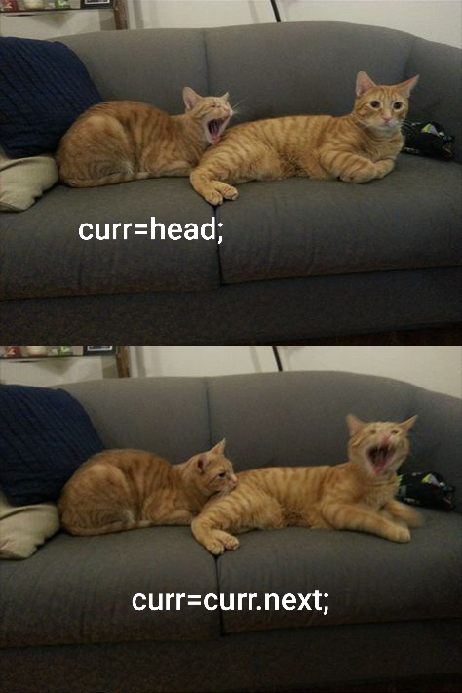

Announcements
Program 2 due Friday October 13th @ 11:59 PM (spooky)
After today, you should be able to complete it.
→ Get started on it early ☺

Slide 3
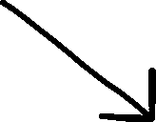
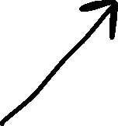
Linked Lists
A Linked List is a data structure that consists of a collection of connected nodes
Susan
Reese
Sarah
Nodes consists of data (String, int, array, etc) and a pointer to the next node

Slide 4








Linked Lists
A Doubly Linked List keeps track of the next node and the previous node
head
tail
Susan
Reese
prev
next
null
null
Sarah
prev
next
prev
next
next
prev

Slide 5






A Circular Linked List is a linked list where the first and last node are connected, which creates a circle
BZN
Bozeman
ORD
Chicago
SEA
Seattle
LAX
Los Angeles
BOS
Boston
head
tail

Slide 6
We will take our Doubly Linked List Implementation, and convert it into a Circular Doubly Linked List

Slide 7





Case 2: The user is inserting a node at the very beginning (N = 1)
newNode
head
tail
BZN
Bozeman
SEA
Seattle
LAX
Los Angeles
null
prev
next
prev
next
prev
next
???

Slide 8





Case 2: The user is inserting a node at the very beginning (N = 1)
newNode
head
tail
BZN
Bozeman
SEA
Seattle
LAX
Los Angeles
null
prev
next
prev
next
prev
next
Update the head node prev value to newNode
Update the head node to be the newNode
Update the newNode’s next value to be the current head node
NEW: Because this is a circular linked list, we need to make sure our tail and head are connected

Slide 9


Case 2: The user is inserting a node at the very beginning (N = 1)
newNode
head
tail
BZN
Bozeman
SEA
Seattle
LAX
Los Angeles
prev
next
prev
next
prev
next
Update the head node prev value to newNode
Update the head node to be the newNode
Update the newNode’s next value to be the current head node
NEW: Reconnect the head and tail node

Slide 10



Case 2: The user is inserting a node at the very beginning (N = 1)
newNode
head
tail
BZN
Bozeman
SEA
Seattle
LAX
Los Angeles
prev
next
prev
next
prev
next
Update the head node prev value to newNode
Update the head node to be the newNode
Update the newNode’s next value to be the current head node
NEW: Reconnect the head and tail node

Slide 11

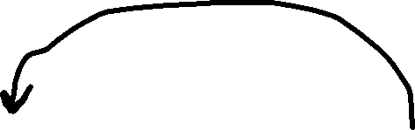

insert(newNode, N) – Insert new node (newNode) at spot N
Case 3: The user is inserting a node at the very end (N = getSize() + 1)
newNode
head
tail
SEA
Seattle
LAX
Los Angeles
BZN
Bozeman
null
null
prev
next
prev
next
prev
next

Slide 12




insert(newNode, N) – Insert new node (newNode) at spot N
Case 3: The user is inserting a node at the very end (N = getSize() + 1)
tail
newNode
head
SEA
Seattle
LAX
Los Angeles
BZN
Bozeman
null
prev
next
prev
next
prev
next
Update the tail node next value to newNode
Update the tail node to be the newNode
Update the newNode’s prev value to be the current tail node
NEW: Reconnect the head and tail node

Slide 13



insert(newNode, N) – Insert new node (newNode) at spot N
Case 3: The user is inserting a node at the very end (N = getSize() + 1)
tail
newNode
head
SEA
Seattle
LAX
Los Angeles
BZN
Bozeman
null
prev
next
prev
next
prev
next
Update the tail node next value to newNode
Update the tail node to be the newNode
Update the newNode’s prev value to be the current tail node
NEW: Reconnect the head and tail node

Slide 14

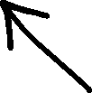
insert(newNode, N) – Insert new node (newNode) at spot N
Case 4: The user is inserting a node somewhere in the middle of the LL
SEA
Seattle
BZN
Bozeman
newNode
prev
next
prev
next
BOS
Boston
prev
next

Slide 15

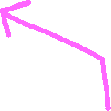





insert(newNode, N) – Insert new node (newNode) at spot N
Case 4: The user is inserting a node somewhere in the middle of the LL
current
nextNode
SEA
Seattle
BZN
Bozeman
newNode
prev
next
prev
next
BOS
Boston
4. Update nextNode’s prev value to be the newNode
5. Update the newNode’s next value to be the nextNode
6. Update the newNode’s prev value to be the current
Find the second-to-last node (current)
Get the nextNode (current.getNext())
Update current’s next value to the newNode
prev
next

Slide 16
insert(newNode, N) – Insert new node (newNode) at spot N
Case 4: The user is inserting a node somewhere in the middle of the LL
current
nextNode
We don’t need to change anything for case #4 and case #1
SEA
Seattle
BZN
Bozeman
newNode
prev
next
prev
next
BOS
Boston
4. Update nextNode’s prev value to be the newNode
5. Update the newNode’s next value to be the nextNode
6. Update the newNode’s prev value to be the current
Find the second-to-last node (current)
Get the nextNode (current.getNext())
Update current’s next value to the newNode
prev
next

Slide 17
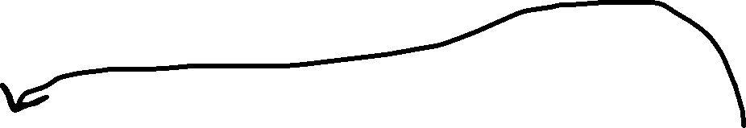




remove(name) – Remove node by name
head
tail
SEA
Seattle
BOS
Boston
BZN
Bozeman
prev
next
prev
next
prev
next
1. Traverse the Linked List and look for a match
remove(“SEA”)
What if the removed node is the head?

Slide 18
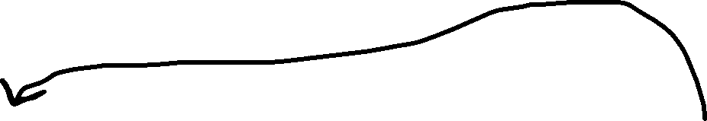
remove(name) – Remove node by name
tail
head
SEA
Seattle
BOS
Boston
BZN
Bozeman
prev
next
prev
next
prev
next
1. Traverse the Linked List and look for a match
remove(“SEA”)
What if the removed node is the head?
2. Update the head to be the next node
3. Update the new head’s prev value to be null

Slide 19


remove(name) – Remove node by name
tail
head
SEA
Seattle
BOS
Boston
BZN
Bozeman
prev
next
prev
next
prev
next
1. Traverse the Linked List and look for a match
remove(“SEA”)
What if the removed node is the head?
2. Update the head to be the next node
3. Update the new head’s prev value to be null
4. NEW: Reconnect the head and tail nodes

Slide 20

remove(name) – Remove node by name
head
tail
SEA
Seattle
BOS
Boston
BZN
Bozeman
prev
next
prev
next
prev
next
1. Traverse the Linked List and look for a match
remove(“BZN”)
What if the removed node is the tail?

Slide 21


remove(name) – Remove node by name
head
tail
SEA
Seattle
BOS
Boston
BZN
Bozeman
null
prev
next
prev
next
prev
next
1. Traverse the Linked List and look for a match
remove(“BZN”)
What if the removed node is the tail?
2. Update the tail to be the previous node
3. Update the new tail’s next value to be null
4. NEW: Reconnect the head and tail nodes

Slide 22

Traversing a Circular Linked List
public void printList() {
Node current = this.head;
while(current != null) {
current.printNode();
current = current.getNext();
}
}
BZN
Bozeman
This was our previous code for traversing and printing out nodes in a linked list
ORD
Chicago
SEA
Seattle
This will no longer work because…
LAX
Los Angeles
BOS
Boston
head
tail

Slide 23

Traversing a Circular Linked List
public void printList() {
Node current = this.head;
while(current != null) {
current.printNode();
current = current.getNext();
}
}
BZN
Bozeman
This was our previous code for traversing and printing out nodes in a linked list
ORD
Chicago
SEA
Seattle
This will no longer work because…
LAX
Los Angeles
BOS
Boston
We will never reach null
head
tail

Slide 24
Traversing a Circular Linked List
Suppose our goal is to print out each node only once
BZN
Bozeman
ORD
Chicago
SEA
Seattle
LAX
Los Angeles
BOS
Boston
head
tail

Slide 25
Traversing a Circular Linked List
Suppose our goal is to print out each node only once
BZN
Bozeman
ORD
Chicago
SEA
Seattle
How do we know that we’ve reached the “end” of the CLL ?
LAX
Los Angeles
BOS
Boston
head
tail

Slide 26
Traversing a Circular Linked List
Suppose our goal is to print out each node only once
BZN
Bozeman
ORD
Chicago
SEA
Seattle
How do we know that we’ve reached the “end” of the CLL ?
LAX
Los Angeles
BOS
Boston
head
tail
If we start from the head, we should stop looping once we reach the head again

Slide 27






Traversing a Circular Linked List
If we start from the head, we should stop looping once we reach the head again
BZN
Bozeman
ORD
Chicago
SEA
Seattle
public void printLinkedList() {
Node current = this.head.getNext();
while(current != this.head) {
current.printNode();
current = current.getNext();
}
}
LAX
Los Angeles
BOS
Boston
head
tail

Slide 28






Traversing a Circular Linked List
If we start from the head, we should stop looping once we reach the head again
BZN
Bozeman
ORD
Chicago
SEA
Seattle
public void printLinkedList() {
Node current = this.head.getNext();
while(current != this.head) {
current.printNode();
current = current.getNext();
}
}
LAX
Los Angeles
BOS
Boston
head
tail
This won’t work because…

Slide 29
Traversing a Circular Linked List
If we start from the head, we should stop looping once we reach the head again
BZN
Bozeman
ORD
Chicago
SEA
Seattle
public void printLinkedList() {
Node current = this.head.getNext();
while(current != this.head) {
current.printNode();
current = current.getNext();
}
}
LAX
Los Angeles
BOS
Boston
head
tail
This won’t work because…
The head node will never be printed out

Slide 30
Traversing a Circular Linked List
If we start from the head, we should stop looping once we reach the head again
BZN
Bozeman
ORD
Chicago
SEA
Seattle
public void printLinkedList() {
Node current = this.head;
do {
current.printNode();
current = current.getNext();
}
while(current != this.head);
}
LAX
Los Angeles
BOS
Boston
head
tail
A do/while loop executed the body of the loop, and then checks the looping condition

