Slide 1

CSCI 132: Basic Data Structures and Algorithms
Lessons Learned so far + Intro to Stacks
Reese Pearsall
Fall 2023
https://www.cs.montana.edu/pearsall/classes/fall2023/132/main.html
*All images are stolen from the internet

Slide 2

Announcements
Come get your midterm exam
Exam average was in the 80s
Don’t stress if you didn’t do well
Make sure I calculated your score correctly
Lab 7 and Program 3 will be posted very soon
Class Registration
CSCI 232
CS 145
CSCI 215
CSCI 246

Slide 3
Big-O
Big-O notation is a way to describe the running-time/time complexity of an algorithm regarding the number of operations that are executed in the algorithm (in relation to some input n)
Focus on worst-case scenario, and how the algorithm scales as n gets really big

Slide 4
Big-O
Big-O notation is a way to describe the running-time/time complexity of an algorithm regarding the number of operations that are executed in the algorithm (in relation to some input n)
Focus on worst-case scenario, and how the algorithm scales as n gets really big
A very powerful computer and a very weak computer running the same algorithm will both execute the same number of operations (the speed at which they execute these operations will be different)
Takeaway: the asymptotic running time (the big-o running time) will be the same for each computer

Slide 5
Big-O
Big-O notation is a way to describe the running-time/time complexity of an algorithm regarding the number of operations that are executed in the algorithm (in relation to some input n)
Focus on worst-case scenario, and how the algorithm scales as n gets really big
To find the total running time of an algorithm, we calculate the running-time of each operation in the algorithm and then add everything together
In Big-O, we can drop non-dominant factors and multiplicative constants (coefficients)
O(n) + O(n) + O(n): Total running time = O(3n) O(n)
∈

Slide 6
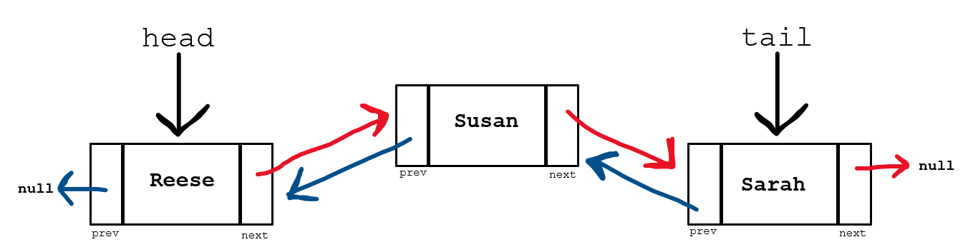
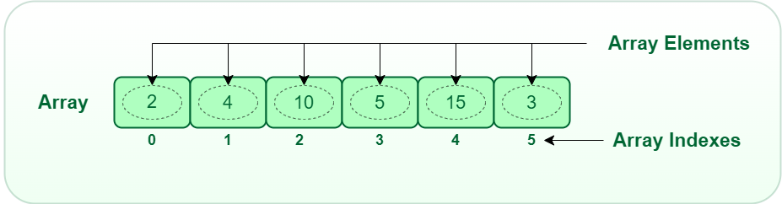
Data Structures so far:
ArrayLists (Arrays)
Linked Lists

Slide 7
Data Structures so far:
ArrayLists (Arrays)
Linked Lists
Can hold one data type
Can hold multiple data types

Slide 8
Data Structures so far:
ArrayLists (Arrays)
Linked Lists
Can hold one data type
Can also store objects, which allow for multiple data types
Nodes in the linked list can hold multiple data types

Slide 9
Data Structures so far:
ArrayLists (Arrays)
Linked Lists
Can hold one data type
Can also store objects, which allow for multiple data types
Nodes in the linked list can hold multiple data types
Entire array is stored at a contiguous spot in memory
Linked list nodes are stored at non-contiguous spots in memory

Slide 10






Can hold one data type
Can also store objects, which allow for multiple data types
Nodes in the linked list can hold multiple data types
Entire array is stored at a contiguous spot in memory
Linked list nodes are stored at non-contiguous spots in memory

Slide 11
Data Structures so far:
ArrayLists (Arrays)
Linked Lists
Can hold one data type
Can also store objects, which allow for multiple data types
Nodes in the linked list can hold multiple data types
Entire array is stored at a contiguous spot in memory
Linked list nodes are stored at non-contiguous spots in memory
Traversing a linked list requires more work than traversing an array

Slide 12
Data Structures so far:
ArrayLists (Arrays)
Linked Lists
Can add new elements to data structure (resizable)
Can add new elements to data structure (resizable)
Both data structures can grow dynamically, and new elements can be added, but they way they add new elements is drastically different

Slide 13
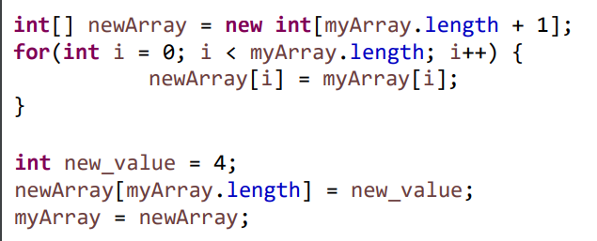
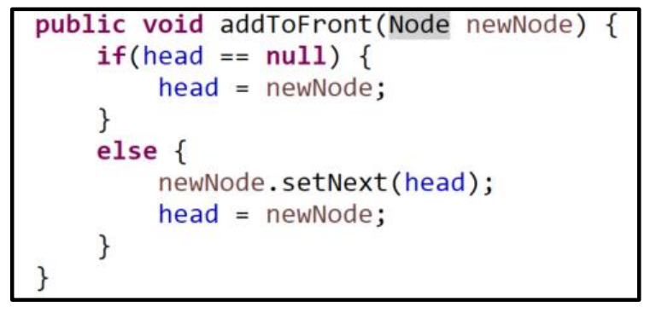
Data Structures so far:
ArrayLists (Arrays)
Linked Lists
Create a brand-new array, copy everything over from old array
Update pointers

Slide 14
Data Structures so far:
ArrayLists (Arrays)
Linked Lists
Create a brand-new array, copy everything over from old array
Update pointers
O(1)
O(n)

Slide 15
Data Structures so far:
ArrayLists (Arrays)
Linked Lists
Takeaway: Adding a new element to an ArrayList requires much more work than adding a new element to a Linked List

Slide 16
Data Structures so far:
ArrayLists (Arrays)
Linked Lists
Arrays are generally much easier to sort than Nodes in a Linked List
If you are constantly needing to add new elements to the data structure, using a Linked List requires much less work in the long run
Arrays are more memory efficient (adding is not very memory efficient though)

Slide 17
Data Structures so far:
ArrayLists (Arrays)
Linked Lists
When to use each data structure?
It depends on how you are using your data and if you know how much data you have
If you don’t know how much data you need to store, or if you are constantly needing to add new elements to the data structure → Linked Lists
If you know how much data you need to store, and if you can add all your data at once → Arrays/ArrayLists

Slide 18
Data Structures so far:
ArrayLists (Arrays)
Linked Lists
These two data structures are implementations of a List Abstract Data Type (ADT)
ADT is a class whose behavior is defined by a set of operations and how a user interacts with it.
A list data type must be able to get an element, add an element, remove an element, etc
→ How they do these operations is up to the subclass (LL and AL)
As programmers, we use handy methods that were written by other people that allows us to use these data structures

Slide 19
The Linked List Class
We will no longer be writing our own Linked List class, instead we will now import the Java-provided Linked List Class
import java.util.LinkedList;

Slide 20
The Linked List Class
We will no longer be writing our own Linked List class, instead we will now import the Java-provided Linked List Class
import java.util.LinkedList;
LinkedList<String> names = new LinkedList<String>();
The data type the linked list will be holding
Reference variable for LL

Slide 21

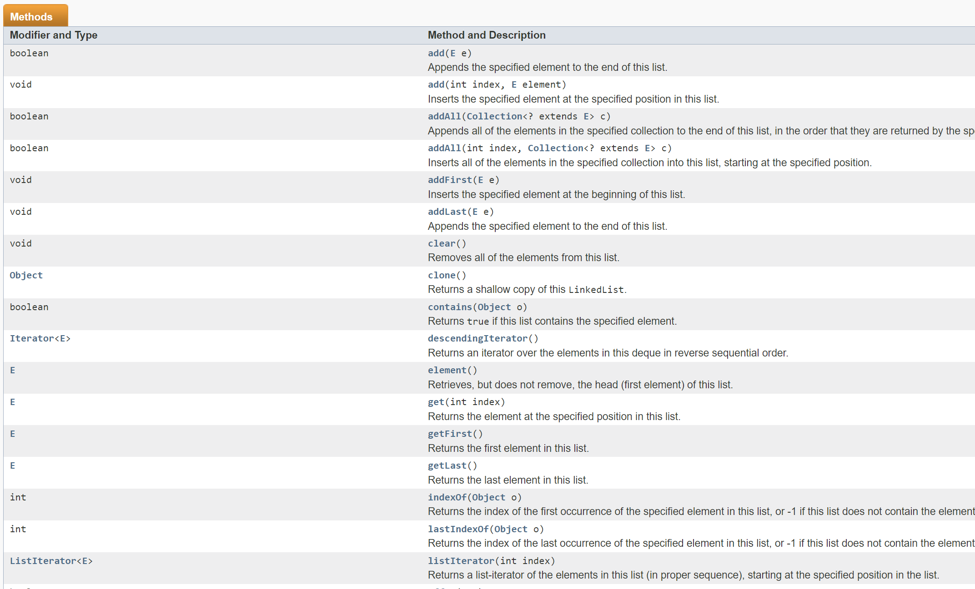
The Linked List Class
https://docs.oracle.com/javase/7/docs/api/java/util/LinkedList.html
The documentation describe how the LinkedList class was implemented, and all the methods/operations we can do with the Linked List class

Slide 22
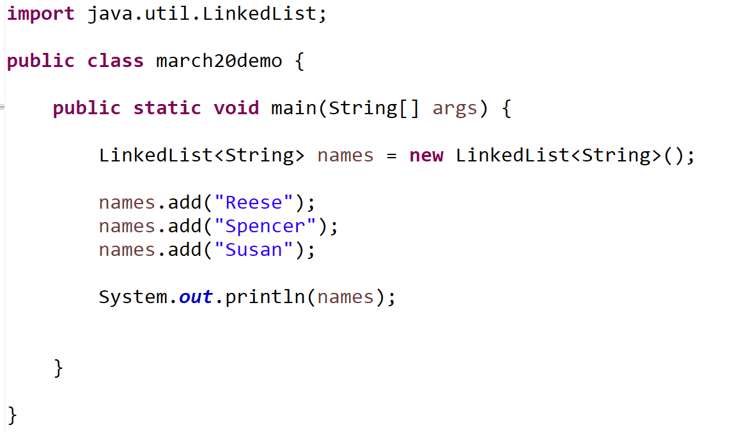
The Linked List Class

Slide 23
A stack is a data structure that can hold data, however the way we interact with a stack is a little bit different
Top of Stack
Cosmo
Elements of Data Structure
Susan
Reese

Slide 24
A stack is a data structure that can hold data, however the way we interact with a stack is a little bit different
Spencer
When only interact with the top of the stack.
If we want to add a new element, we must put it on the top of the stack
Top of Stack
Cosmo
Elements of Data Structure
Susan
Reese

Slide 25
A stack is a data structure that can hold data, however the way we interact with a stack is a little bit different
Top of Stack
Spencer
Cosmo
Adding something to a stack is known as the push operation
Elements of Data Structure
Susan
Reese

Slide 26
A stack is a data structure that can hold data, however the way we interact with a stack is a little bit different
If we want to remove something, we must always remove the element on the top of the stack
Top of Stack
Spencer
Cosmo
Elements of Data Structure
Susan
Reese

Slide 27
A stack is a data structure that can hold data, however the way we interact with a stack is a little bit different
Spencer
Removing an element is known as the pop operation
Top of Stack
Cosmo
Elements of Data Structure
Susan
Reese
stack.pop() → Top node (spencer) is removed

Slide 28
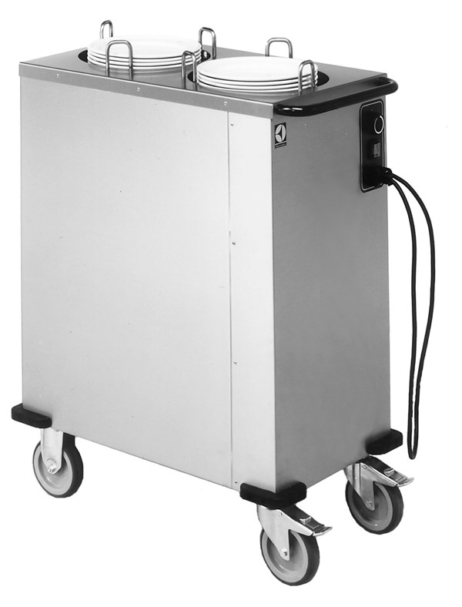
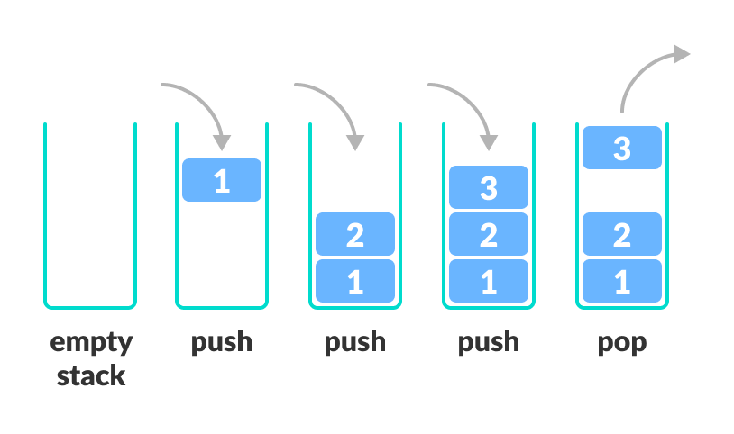
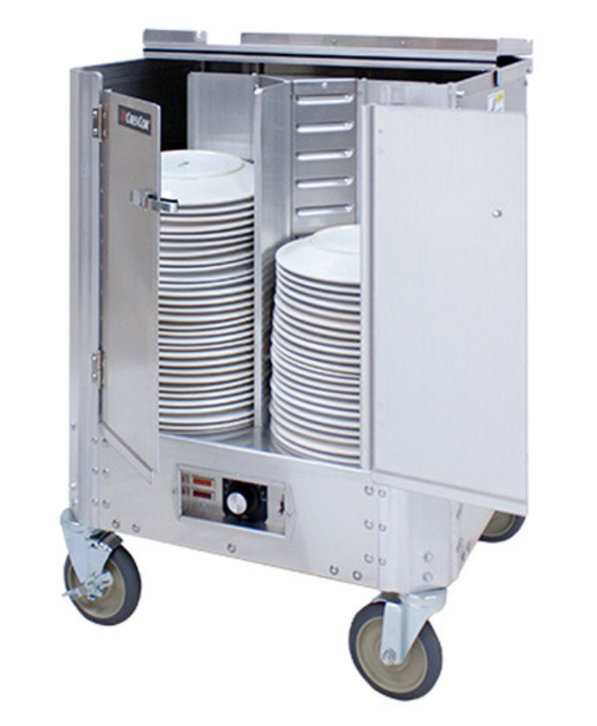
A stack is a data structure that can hold data, and follows the last in first out (LIFO) principle
We can:
Add an element to the top of the stack (push)
Remove the top element (pop)

Slide 29
A stack is a data structure that can hold data, and follows the last in first out (LIFO) principle
Top of Stack
Our stack data structure needs to keep track of a few things
1. Something to hold our stack elements
Spencer
Cosmo
Elements of Data Structure
Susan
Reese

Slide 30
A stack is a data structure that can hold data, and follows the last in first out (LIFO) principle
Top of Stack
Our stack data structure needs to keep track of a few things
1. Something to hold our stack elements
Spencer
Cosmo
Elements of Data Structure
Susan
We have a few options:
Reese
1. Array
Spencer
Cosmo
Susan
Reese

Slide 31
A stack is a data structure that can hold data, and follows the last in first out (LIFO) principle
Top of Stack
Our stack data structure needs to keep track of a few things
1. Something to hold our stack elements
Spencer
Cosmo
Elements of Data Structure
Susan
We have a few options:
Reese
Array
ArrayList
Spencer
Cosmo
Susan
Reese

Slide 32
A stack is a data structure that can hold data, and follows the last in first out (LIFO) principle
Top of Stack
Our stack data structure needs to keep track of a few things
1. Something to hold our stack elements
Spencer
Cosmo
Elements of Data Structure
Susan
We have a few options:
Reese
Spencer
Array
ArrayList
3. Linked List
Spencer
Cosmo
Susan
Reese
Cosmo
Susan
Reese

Slide 33
A stack is a data structure that can hold data, and follows the last in first out (LIFO) principle
Top of Stack
Our stack data structure needs to keep track of a few things
1. Something to hold our stack elements
Spencer
Cosmo
Elements of Data Structure
Susan
We have a few options:
Reese
Spencer
Array
ArrayList
3. Linked List
Which should you pick?
Spencer
Cosmo
Susan
Reese
Cosmo
Susan
Reese

Slide 34
A stack is a data structure that can hold data, and follows the last in first out (LIFO) principle
Top of Stack
Our stack data structure needs to keep track of a few things
1. Something to hold our stack elements
Spencer
Cosmo
Elements of Data Structure
Susan
We have a few options:
Reese
Spencer
Array
ArrayList
3. Linked List
Which should you pick?
Depends on how you are using the stack
Spencer
Cosmo
Susan
Reese
Cosmo
Susan
Reese

Slide 35
A stack is a data structure that can hold data, and follows the last in first out (LIFO) principle
Top of Stack
Our stack data structure needs to keep track of a few things
1. Something to hold our stack elements
Spencer
Cosmo
Elements of Data Structure
Susan
We have a few options:
Reese
Spencer
Array
ArrayList
3. Linked List
Which should you pick?
If you know how big the stack needs to be
→ Array
If you don’t know how big the stack needs to be
→ Linked List
Spencer
Cosmo
Susan
Reese
Cosmo
Susan
Reese

Slide 36
A stack is a data structure that can hold data, and follows the last in first out (LIFO) principle
Top of Stack
Our stack data structure needs to keep track of a few things
Something to hold our stack elements (Array/LinkedList)
Something that points the current top element of the stack
The size of the stack
Spencer
Cosmo
Elements of Data Structure
Susan
Reese

Slide 37
Stack Implementation (Array)
To Do List:
Push()
Pop()
Peek()
IsEmpty()
Here, we’ve created an array of size 8 to hold our stack data
7
6
5
4
3
2
1
0

Slide 38
Stack Implementation (Array)
To Do List:
Push()
Pop()
Peek()
IsEmpty()
Here, we’ve created an array of size 8 to hold our stack data
The bottom of the stack will always be at index 0, and grows towards the higher indices
7
String[] data = new String[8]
6
5
When the stack is empty, the index of the bottom of the stack, and the index of the top of the stack will be the same
top_of_stack = 0
4
3
2
1
The size of the stack will start at 0
size = 0
Top of Stack
0

Slide 39
Stack Implementation (Array)
To Do List:
Push()
Pop()
Peek()
IsEmpty()
Here, we’ve created an array of size 8 to hold our stack data
public void push(newElement){
}
Stack Instance Fields
7
String[] data = new String[8]
6
top_of_stack = 0
5
size = 0
4
3
2
1
Top of Stack
0

Slide 40
Stack Implementation (Array)
To Do List:
Push()
Pop()
Peek()
IsEmpty()
Here, we’ve created an array of size 8 to hold our stack data
public void push(newElement){
}
Stack Instance Fields
Reese
7
if stack is empty:
place newElement at current top_of_stack
size++
if stack if full:
return
String[] data = new String[8]
6
top_of_stack = 0
5
size = 1
4
3
2
1
Top of Stack
0

Slide 41
Stack Implementation (Array)
To Do List:
Push()
Pop()
Peek()
IsEmpty()
Here, we’ve created an array of size 8 to hold our stack data
public void push(newElement){
}
Stack Instance Fields
Reese
7
if stack is empty:
place newElement at current top_of_stack
size++
if stack if full:
return
else:
top_of_stack++;
place newElement at index top_of_stack
size++
String[] data = new String[8]
6
top_of_stack = 0
5
size = 1
4
3
2
1
Top of Stack
0

Slide 42
Stack Implementation (Array)
To Do List:
Push()
Pop()
Peek()
IsEmpty()
Here, we’ve created an array of size 8 to hold our stack data
Susan
public void push(newElement){
}
Stack Instance Fields
Reese
7
if stack is empty:
place newElement at current top_of_stack
size++
if stack if full:
return
else:
top_of_stack++;
place newElement at index top_of_stack
size++
String[] data = new String[8]
6
top_of_stack = 0
5
size = 1
4
3
2
1
Top of Stack
0
stack.push(“Susan”)

Slide 43
Stack Implementation (Array)
To Do List:
Push()
Pop()
Peek()
IsEmpty()
Here, we’ve created an array of size 8 to hold our stack data
Susan
public void push(newElement){
}
Stack Instance Fields
Reese
7
if stack is empty:
place newElement at current top_of_stack
size++
if stack if full:
return
else:
top_of_stack++;
place newElement at index top_of_stack
size++
String[] data = new String[8]
6
top_of_stack = 1
5
size = 1
4
3
2
Top of Stack
1
0
stack.push(“Susan”)

Slide 44
Stack Implementation (Array)
To Do List:
Push()
Pop()
Peek()
IsEmpty()
Here, we’ve created an array of size 8 to hold our stack data
public void push(newElement){
}
Stack Instance Fields
Susan
Reese
7
if stack is empty:
place newElement at current top_of_stack
size++
if stack if full:
return
else:
top_of_stack++;
place newElement at index top_of_stack
size++
String[] data = new String[8]
6
top_of_stack = 1
5
size = 1
4
3
2
Top of Stack
1
0
stack.push(“Susan”)

Slide 45
Stack Implementation (Array)
To Do List:
Push()
Pop()
Peek()
IsEmpty()
Here, we’ve created an array of size 8 to hold our stack data
public void push(newElement){
}
Stack Instance Fields
Susan
Reese
7
if stack is empty:
place newElement at current top_of_stack
size++
if stack if full:
return
else:
top_of_stack++;
place newElement at index top_of_stack
size++
String[] data = new String[8]
6
top_of_stack = 1
5
size = 2
4
3
2
Top of Stack
1
0
stack.push(“Susan”)

Slide 46
Stack Implementation (Array)
To Do List:
Push()
Pop()
Peek()
IsEmpty()
Here, we’ve created an array of size 8 to hold our stack data
Cosmo
public void push(newElement){
}
Stack Instance Fields
Susan
Reese
7
if stack is empty:
place newElement at current top_of_stack
size++
if stack if full:
return
else:
top_of_stack++;
place newElement at index top_of_stack
size++
String[] data = new String[8]
6
top_of_stack = 1
5
size = 2
4
3
2
Top of Stack
1
0
stack.push(“Cosmo”)

Slide 47
Stack Implementation (Array)
To Do List:
Push()
Pop()
Peek()
IsEmpty()
Here, we’ve created an array of size 8 to hold our stack data
Cosmo
public void push(newElement){
}
Stack Instance Fields
Susan
Reese
7
if stack is empty:
place newElement at current top_of_stack
size++
if stack if full:
return
else:
top_of_stack++;
place newElement at index top_of_stack
size++
String[] data = new String[8]
6
top_of_stack = 2
5
size = 2
4
3
Top of Stack
2
1
0
stack.push(“Cosmo”)

Slide 48
Stack Implementation (Array)
To Do List:
Push()
Pop()
Peek()
IsEmpty()
Here, we’ve created an array of size 8 to hold our stack data
public void push(newElement){
}
Stack Instance Fields
Cosmo
Susan
Reese
7
if stack is empty:
place newElement at current top_of_stack
size++
if stack if full:
return
else:
top_of_stack++;
place newElement at index top_of_stack
size++
String[] data = new String[8]
6
top_of_stack = 2
5
size = 3
4
3
Top of Stack
2
1
0
stack.push(“Cosmo”)

Slide 49
Stack Implementation (Array)
To Do List:
Push()
Pop()
Peek()
IsEmpty()
Here, we’ve created an array of size 8 to hold our stack data
public void pop(){
}
Stack Instance Fields
Cosmo
Susan
Reese
7
String[] data = new String[8]
6
top_of_stack = 2
5
size = 3
4
3
Top of Stack
2
The pop method will always remove the element on the top of the stack
1
0

Slide 50
Stack Implementation (Array)
To Do List:
Push()
Pop()
Peek()
IsEmpty()
Here, we’ve created an array of size 8 to hold our stack data
public void pop(){
}
Stack Instance Fields
Cosmo
Susan
Reese
7
if stack is empty:
return
Set index top_of_stack to be null
top_of_stack--
size--
String[] data = new String[8]
6
top_of_stack = 2
5
size = 3
4
3
Top of Stack
2
1
0
stack.pop()

Slide 51
Stack Implementation (Array)
To Do List:
Push()
Pop()
Peek()
IsEmpty()
Here, we’ve created an array of size 8 to hold our stack data
public void pop(){
}
Stack Instance Fields
null
Susan
Reese
7
if stack is empty:
return
Set index top_of_stack to be null
top_of_stack--
size--
String[] data = new String[8]
6
top_of_stack = 2
5
size = 3
4
3
Top of Stack
2
1
0
stack.pop()

Slide 52
Stack Implementation (Array)
To Do List:
Push()
Pop()
Peek()
IsEmpty()
Here, we’ve created an array of size 8 to hold our stack data
public void pop(){
}
Stack Instance Fields
null
Susan
Reese
7
if stack is empty:
return
Set index top_of_stack to be null
top_of_stack--
size--
String[] data = new String[8]
6
top_of_stack = 1
5
size = 3
4
3
2
Top of Stack
1
0
stack.pop()

Slide 53
Stack Implementation (Array)
To Do List:
Push()
Pop()
Peek()
IsEmpty()
Here, we’ve created an array of size 8 to hold our stack data
public void pop(){
}
Stack Instance Fields
null
Susan
Reese
7
if stack is empty:
return
Set index top_of_stack to be null
top_of_stack--
size--
String[] data = new String[8]
6
top_of_stack = 1
5
size = 2
4
3
2
Top of Stack
1
0
stack.pop()

Slide 54
Stack Implementation (Array)
To Do List:
Push()
Pop()
Peek()
IsEmpty()
Here, we’ve created an array of size 8 to hold our stack data
public void pop(){
}
Stack Instance Fields
null
Susan
Reese
7
if stack is empty:
return
Set index top_of_stack to be null
top_of_stack--
size--
String[] data = new String[8]
6
top_of_stack = 1
5
size = 2
4
3
2
Top of Stack
1
0
Note: This method does not return the element that was removed, however there may be times where the pop() method returns the element that got removed

Slide 55
Stack Implementation (Array)
To Do List:
Push()
Pop()
Peek()
IsEmpty()
Here, we’ve created an array of size 8 to hold our stack data
public String peek(){
}
Stack Instance Fields
null
Susan
Reese
7
String[] data = new String[8]
6
top_of_stack = 1
5
size = 2
4
3
2
Top of Stack
1
0
The peek()method returns the element that is currently on the top of the stack

Slide 56
Stack Implementation (Array)
To Do List:
Push()
Pop()
Peek()
IsEmpty()
Here, we’ve created an array of size 8 to hold our stack data
public String peek(){
}
Stack Instance Fields
null
Susan
Reese
7
String[] data = new String[8]
6
top_of_stack = 1
5
If stack is not empty:
return data[top_of_stack]
size = 2
4
3
2
Top of Stack
1
0
The peek()method returns the element that is currently on the top of the stack

Slide 57
Stack Implementation (Array)
To Do List:
Push()
Pop()
Peek()
IsEmpty()
Here, we’ve created an array of size 8 to hold our stack data
public boolean isEmpty(){
}
Stack Instance Fields
null
Susan
Reese
7
String[] data = new String[8]
6
top_of_stack = 1
5
if size == 0:
return true
else:
return false
size = 2
4
3
2
Top of Stack
1
0
The isEmpty()method returns a boolean: true if the stack is empty, false if the stack is not empty

