Slide 1

CSCI 132: Basic Data Structures and Algorithms
Stacks (Linked List implementation)
Reese Pearsall
Fall 2023
https://www.cs.montana.edu/pearsall/classes/fall2023/132/main.html
*All images are stolen from the internet

Slide 2

Announcements
Lab 7 due tomorrow
Program 3 will be posted very soon ™

Slide 3
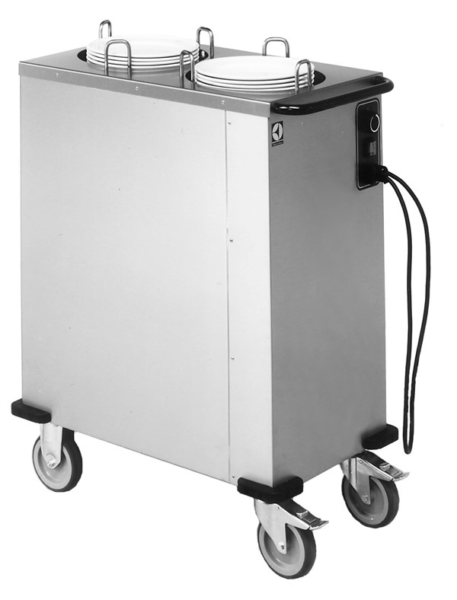
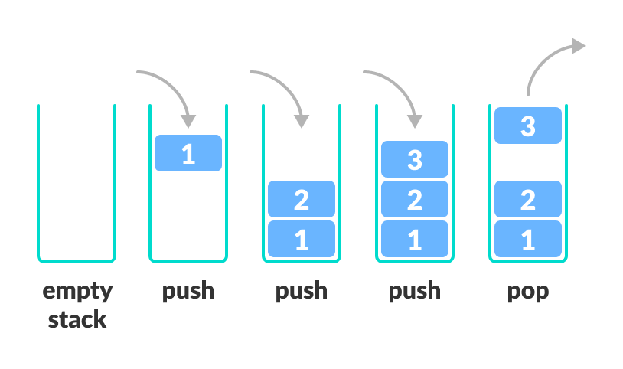
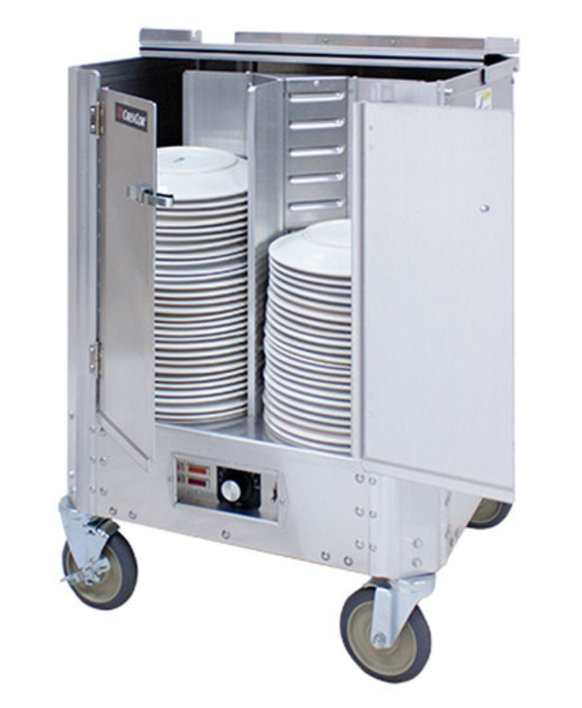
A stack is a data structure that can hold data, and follows the last in first out (LIFO) principle
We can:
Add an element to the top of the stack (push)
Remove the top element (pop)
We can implement a Stack using an Array, or a linked List

Slide 4
Stack Implementation (Linked List)
To Do List:
Push()
Pop()
Peek()
IsEmpty()
We will import the Linked List Library (we will not write our own linked list class)
Head
Spencer
If we don’t know how big out stack needs to be ahead of time, then using a linked list will be a better choice than an array/arraylist
Susan
Cosmo
Reese
The top of the stack will be the head of the linked list

Slide 5
Stack Implementation (Linked List)
To Do List:
Push()
Pop()
Peek()
IsEmpty()
We will import the Linked List Library (we will not write our own linked list class)
Head
Jeff
stack.add(“Jeff”)
Spencer
Whenever we add something to the stack, we add the element to the front of the linked list
Susan
Cosmo
Reese
The top of the stack will be the head of the linked list

Slide 6
Stack Implementation (Linked List)
To Do List:
Push()
Pop()
Peek()
IsEmpty()
We will import the Linked List Library (we will not write our own linked list class)
stack.pop()
Head
Spencer
Whenever we remove an element from the stack ( pop() ), we always remove the head node of the linked list
Susan
Cosmo
Reese
The top of the stack will be the head of the linked list

Slide 7
Stack Implementation (Linked List)
To Do List:
Push()
Pop()
Peek()
IsEmpty()
We will import the Linked List Library (we will not write our own linked list class)
public void push(newElement){
}
Head
addToFront(newElement);
size++
Spencer
Susan
When we use a linked list, we are no longer restricted by a fixed size
Cosmo
Reese

Slide 8
Stack Implementation (Linked List)
To Do List:
Push()
Pop()
Peek()
IsEmpty()
We will import the Linked List Library (we will not write our own linked list class)
public void push(newElement){
}
Head
addToFront(newElement);
size++
top_of_stack = head
Spencer
Susan
When we use a linked list, we are no longer restricted by a fixed size
public void pop(){
}
Cosmo
If size == 0:
return
Else:
removeFront()
size--
top_of_stack = head
Reese

Slide 9
Stack Runtime Analysis
(Array Implementation)
Algorithm | w/ Array | w/ Linked List
Creation
Push()
Pop()
peek()
Print()
public StackArray() {
data = new VideoGame[8];
top_of_stack = -1;
size = 0;
}
(Linked List Implementation)
public StackLinkedList() {
data = new LinkedList<VideoGame>();
top_of_stack = null;
this.size = 0;
}

Slide 10
Stack Runtime Analysis
(Array Implementation)
Algorithm | w/ Array | w/ Linked List
Creation | O(n) | O(1)
Push()
Pop()
peek()
Print()
public StackArray() {
data = new VideoGame[8];
top_of_stack = -1;
size = 0;
}
O(n)
O(1)
O(1)
Total Running time: O(n)
n = | array |
(Linked List Implementation)
public StackLinkedList() {
data = new LinkedList<VideoGame>();
top_of_stack = null;
this.size = 0;
}
O(1)
O(1)
O(1)
Total Running time: O(1)

Slide 11
Stack Runtime Analysis
(Array Implementation)
Algorithm | w/ Array | w/ Linked List
Creation | O(n) | O(1)
Push()
Pop()
peek()
Print()
public StackArray() {
data = new VideoGame[8];
top_of_stack = -1;
size = 0;
}
O(n)
O(1)
O(1)
Total Running time: O(n)
n = | array |
(Linked List Implementation)
public StackLinkedList() {
data = new LinkedList<VideoGame>();
top_of_stack = null;
this.size = 0;
}
O(1)
O(1)
O(1)
Total Running time: O(1)

Slide 12
Stack Runtime Analysis
Algorithm | w/ Array | w/ Linked List
Creation | O(n) | O(1)
Push()
Pop()
peek()
Print()
(Array Implementation)
public void push(VideoGame newVideoGame) {
if(this.size == this.data.length) {
return;
}
else {
This.top_of_stack++;
data[this.top_of_stack] = newVideoGame;
this.size++;
}
}

Slide 13
Stack Runtime Analysis
Algorithm | w/ Array | w/ Linked List
Creation | O(n) | O(1)
Push() | O(1)
Pop()
peek()
Print()
(Array Implementation)
public void push(VideoGame newVideoGame) {
if(this.size == this.data.length) {
return;
}
else {
This.top_of_stack++;
data[this.top_of_stack] = newVideoGame;
this.size++;
}
}
O(1)
O(1)
O(1)
O(1)
O(1)
Total Running Time: O(1)

Slide 14
Stack Runtime Analysis
Algorithm | w/ Array | w/ Linked List
Creation | O(n) | O(1)
Push() | O(1)
Pop()
peek()
Print()
(Linked List Implementation)
public void push(VideoGame newVideoGame) {
data.addFirst(newVideoGame);
this.top_of_stack = this.data.getFirst();
this.size++;
}

Slide 15
Stack Runtime Analysis
Algorithm | w/ Array | w/ Linked List
Creation | O(n) | O(1)
Push() | O(1) | O(1)
Pop()
peek()
Print()
(Linked List Implementation)
public void push(VideoGame newVideoGame) {
data.addFirst(newVideoGame);
this.top_of_stack = this.data.getFirst();
this.size++;
}
O(1)
O(1)
O(1)
Total Running Time: O(1)

Slide 16
Stack Runtime Analysis
Algorithm | w/ Array | w/ Linked List
Creation | O(n) | O(1)
Push() | O(1) | O(1)
Pop()
peek()
Print()
(Array)
public void pop() {
if(this.size == 0) {
return;
}
else {
this.data[this.top_of_stack] = null;
this.top_of_stack--;
this.size--;
}
}
public void pop() {
if(this.size == 0) {
return;
}
else {
this.data.removeFirst();
this.top_of_stack = this.data.getFirst();
this.size--;
}
}
(Linked List)

Slide 17
Stack Runtime Analysis
Algorithm | w/ Array | w/ Linked List
Creation | O(n) | O(1)
Push() | O(1) | O(1)
Pop() | O(1) | O(1)
peek()
Print()
(Array)
public void pop() {
if(this.size == 0) {
return;
}
else {
this.data[this.top_of_stack] = null;
this.top_of_stack--;
this.size--;
}
}
O(1)
O(1)
O(1)
O(1)
O(1)
Total Running Time: O(1)
public void pop() {
if(this.size == 0) {
return;
}
else {
this.data.removeFirst();
this.top_of_stack = this.data.getFirst();
this.size--;
}
}
(Linked List)
O(1)
O(1)
O(1)
O(1)
O(1)
O(1)
Total Running Time: O(1)

Slide 18
Stack Runtime Analysis
Algorithm | w/ Array | w/ Linked List
Creation | O(n) | O(1)
Push() | O(1) | O(1)
Pop() | O(1) | O(1)
peek()
Print()
(Array)
public VideoGame peek() {
if(this.size != 0) {
return this.data[this.top_of_stack];
}
else {
return null;
}
}
(Linked List)
public VideoGame peek() {
if(this.size != 0) {
return this.top_of_stack;
}
else {
return null;
}
}

Slide 19
Stack Runtime Analysis
Algorithm | w/ Array | w/ Linked List
Creation | O(n) | O(1)
Push() | O(1) | O(1)
Pop() | O(1) | O(1)
peek() | O(1) | O(1)
Print()
(Array)
public VideoGame peek() {
if(this.size != 0) {
return this.data[this.top_of_stack];
}
else {
return null;
}
}
O(1)
O(1)
O(1)
Total Running Time: O(1)
(Linked List)
public VideoGame peek() {
if(this.size != 0) {
return this.top_of_stack;
}
else {
return null;
}
}
O(1)
O(1)
O(1)
O(1)
Total Running Time: O(1)

Slide 20
Stack Runtime Analysis
Algorithm | w/ Array | w/ Linked List
Creation | O(n) | O(1)
Push() | O(1) | O(1)
Pop() | O(1) | O(1)
peek() | O(1) | O(1)
Print()
(Array)
public void printStack() {
for(int i = this.size-1; i >= 0; i--) {
this.data[i].printInfo();
}
}
(Linked List)
public void printStack() {
for(int i = 0; i < this.data.size(); i++) {
this.data.get(i).printInfo();
}
}

Slide 21
Stack Runtime Analysis
Algorithm | w/ Array | w/ Linked List
Creation | O(n) | O(1)
Push() | O(1) | O(1)
Pop() | O(1) | O(1)
peek() | O(1) | O(1)
Print()
(Array)
public void printStack() {
for(int i = this.size-1; i >= 0; i--) {
this.data[i].printInfo();
}
}
Both of these for loops go through the stack and print out all N elements → O(n) where n = # of elements in the stack
(Linked List)
public void printStack() {
for(int i = 0; i < this.data.size(); i++) {
this.data.get(i).printInfo();
}
}

Slide 22
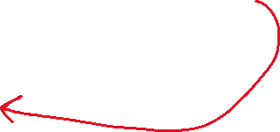
Stack Runtime Analysis
Algorithm | w/ Array | w/ Linked List
Creation | O(n) | O(1)
Push() | O(1) | O(1)
Pop() | O(1) | O(1)
peek() | O(1) | O(1)
Print() | O(n) | O(n)
(Array)
public void printStack() {
for(int i = this.size-1; i >= 0; i--) {
this.data[i].printInfo();
}
}
O(n)
O(1)
Total Running Time: O(n)
The .get() method actually runs in linear time (O(n))
(Linked List)
public void printStack() {
for(int i = 0; i < this.data.size(); i++) {
this.data.get(i).printInfo();
}
}
O(n)
O(n)
Total Running Time: O(n^2)
n = # of elements in the stack

Slide 23
Stack Runtime Analysis
Algorithm | w/ Array | w/ Linked List
Creation | O(n) | O(1)
Push() | O(1) | O(1)
Pop() | O(1) | O(1)
peek() | O(1) | O(1)
Print() | O(n) | O(n)
(Array)
public void printStack() {
for(int i = this.size-1; i >= 0; i--) {
this.data[i].printInfo();
}
}
O(n)
O(1)
Total Running Time: O(n)
(Linked List)
public void printStack() {
for(VideoGame each : this.data) {
each.printInfo();
}
}
O(n)
O(1)
Total Running Time: O(n)
n = # of elements in the stack

Slide 24
Stack Runtime Analysis
Algorithm | w/ Array | w/ Linked List
Creation | O(n) | O(1)
Push() | O(1) | O(1)
Pop() | O(1) | O(1)
peek() | O(1) | O(1)
Print() | O(n) | O(n)
Takeaways: Adding and removing elements from a stack runs in constant time ( O(1) )
(we like algorithms that run in constant time!!)

Slide 25
Stack Runtime Analysis
Algorithm | w/ Array | w/ Linked List
Creation | O(n) | O(1)
Push() | O(1) | O(1)
Pop() | O(1) | O(1)
peek() | O(1) | O(1)
Print() | O(n) | O(n)
Takeaways: Adding and removing elements from a stack runs in constant time ( O(1) )
(we like algorithms that run in constant time!!)
Downside: Stacks operate in a LIFO structure, which might not be ideal for some data

Slide 26
Stack Runtime Analysis
Algorithm | w/ Array | w/ Linked List
Creation | O(n) | O(1)
Push() | O(1) | O(1)
Pop() | O(1) | O(1)
peek() | O(1) | O(1)
Print() | O(n) | O(n)
With an array, our stack size is limited by the size of the array
With a linked list, our stack can grow infinitely*

Slide 27
Stack Runtime Analysis
Algorithm | w/ Array | w/ Linked List
Creation | O(n) | O(1)
Push() | O(1) | O(1)
Pop() | O(1) | O(1)
peek() | O(1) | O(1)
Print() | O(n) | O(n)
Arrays are more memory efficient (contiguous memory), but there might be a lot of unused space in an array (not ideal)

Slide 28
Stack Runtime Analysis
Algorithm | w/ Array | w/ Linked List
Creation | O(n) | O(1)
Push() | O(1) | O(1)
Pop() | O(1) | O(1)
peek() | O(1) | O(1)
Print() | O(n) | O(n)
Do you know how big the stack needs to be?
Yes→ Array
No → Linked List

